Slide 1
Satellite data assimilation of dust aerosol observations for the MONARCH forecasting system
Enza Di Tomaso, Jerónimo Escribano, Nick Schutgens,
Oriol Jorba, Carlos Pérez García-Pando, Francesca Macchia
17/05/2019
Living Planet Symposium 2019, Milano, Italy

Slide 2
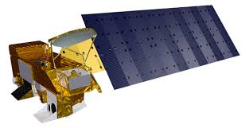
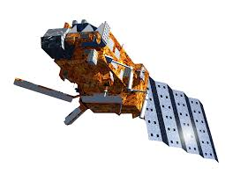
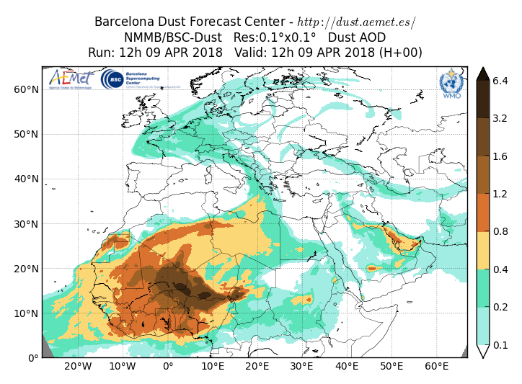
Constrainting Mineral Dust Simulations with Observations
Model simulations and observations are combined to obtain the ‘best’ estimate of current atmospheric conditions (dust analysis)

Slide 3
Motivation
Assess the potential benefit of dedicated dust observation products in dust data assimilation

Slide 4
Motivation
Assess the potential benefit of dedicated dust observation products in dust data assimilation
Operational dust forecast and dust reanalyses are produced in the framework of aerosol data assimilation, where total AOD is used to constrain all the main aerosol species

Slide 5
Experiment design
control simulation
Dust component of the NMMB-MONARCH chemical weather system (Pérez et al., 2011)

Slide 6
Experiment design
control simulation
Dust component of the NMMB-MONARCH chemical weather system (Pérez et al., 2011)
NMMB-MONARCH ensemble members are obtained taking into account model and IC/BC uncertainty
ensemble forecast

Slide 7
Experiment design
control simulation
Dust component of the NMMB-MONARCH chemical weather system (Pérez et al., 2011)
NMMB-MONARCH ensemble members are obtained taking into account model and IC/BC uncertainty
ensemble forecast
Role of the ensemble (B matrix):
spatial spreading of information from observations
statistically consistent increments between neighbouring grid points
multivariate analysis

Slide 8
Experiment design
data assimilation
An ensemble-based DA scheme: LETKF
- usage of a flow-dependent background error covariance
- performing the analysis locally

Slide 9
Experiment design
data assimilation
An ensemble-based DA scheme: LETKF
- usage of a flow-dependent background error covariance
- performing the analysis locally
Dedicated dust observations:
MODIS Dark Target AOD in dust-dominated conditions
MODIS Deep Blue AOD in dust-dominated conditions
IASI dust AOD
- ACTRIS lidar dust exinction coefficient profiles
observations

Slide 10
MODIS Dark Target and Deep Blue, Level3

Slide 11
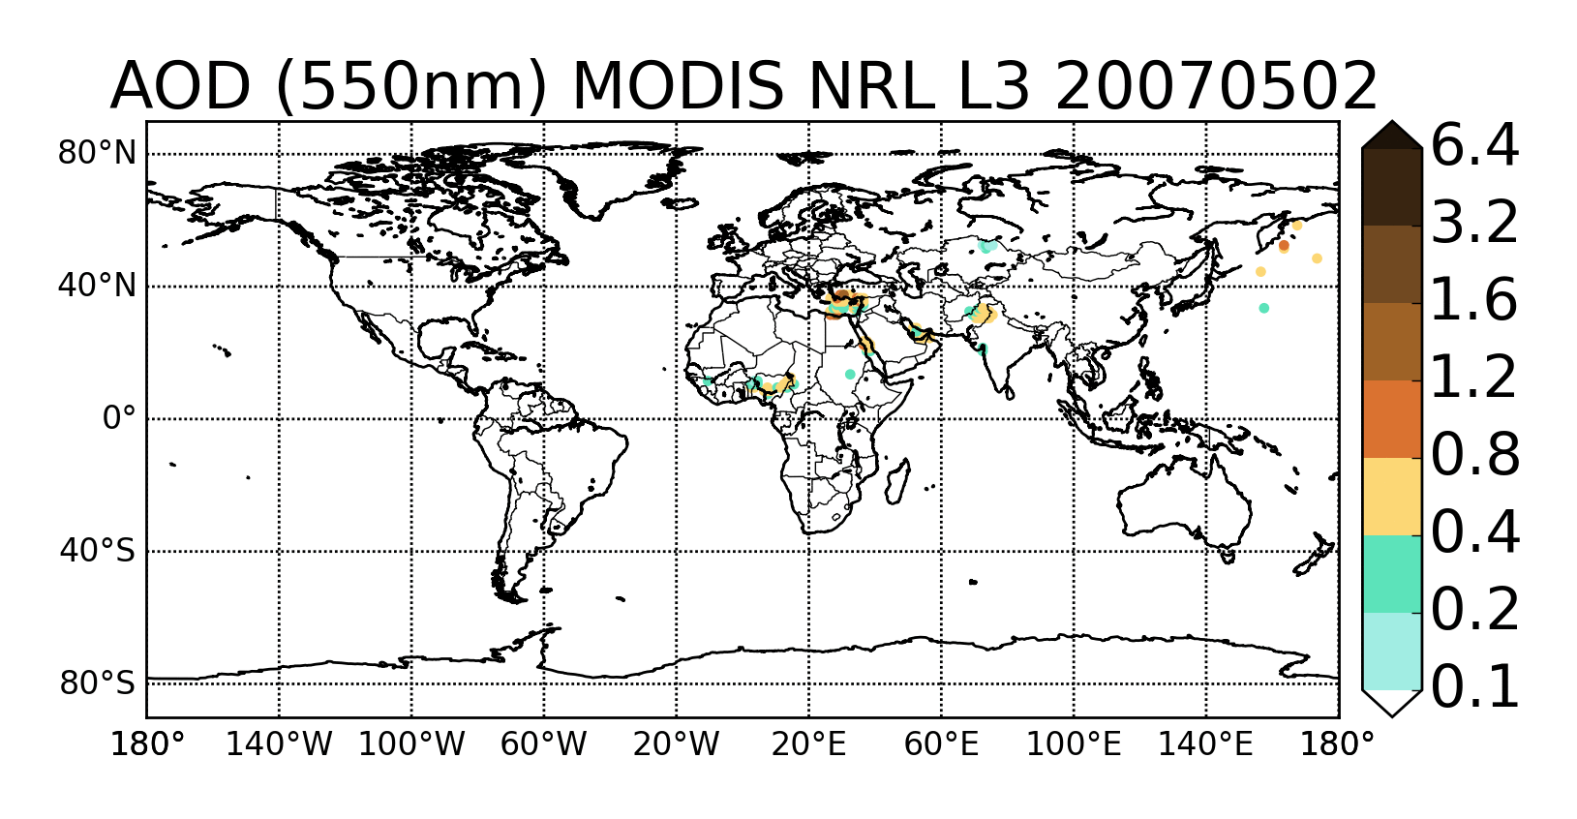
Assimilated observations
NRL MODIS Dark Target, L3 C5
- filtered and corrected,
- spatially aggregated,
- uncertainty estimation
(Zhang and Reid, 2006; Hyer et al., 2010; Shi et al., 2011)
- AE, AI filter for dust

Slide 12
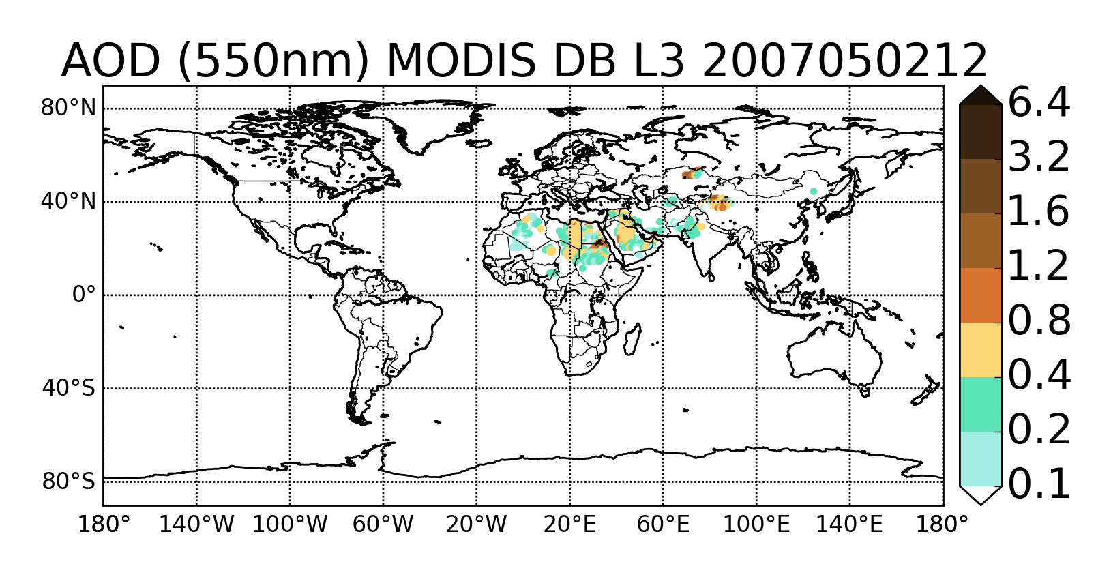
Assimilated observations
NRL MODIS Dark Target, L3 C5
- filtered and corrected,
- spatially aggregated,
- uncertainty estimation
(Zhang and Reid, 2006; Hyer et al., 2010; Shi et al., 2011)
- AE, AI filter for dust
MODIS Deep Blue, L3 C6
- aggregation of highest quality L2
- uncertainty model for L2
(Sayer et al., 2014)
- AE, AI, counts filter
- uncertainty model for L3:

Slide 13
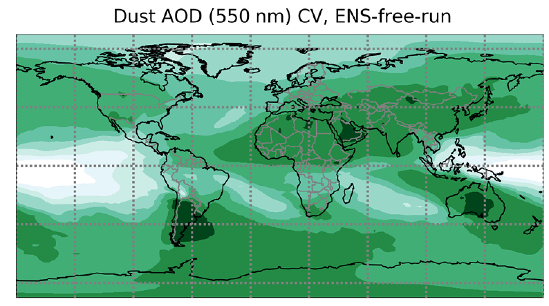
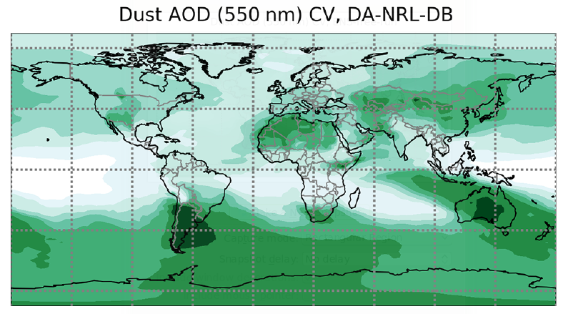
Ensemble Spread Reduction
Ensemble free run
Data assimilation run
Data assimilation lowers the values of the coefficient of variation in the regions where observations are present, which indicates a reduction of the ensemble spread due to the assimilated observations
.

Slide 14
Analysis increments
MODIS NRL
MODIS NRL +DB
- Non-zero systematic increments are to be interpreted as systematic corrections that these sets of observations are making, in particular removing mass close to sources and, to a lesser extent, adding mass in the outflow.
- The spatial distribution of the increments highlights the role that MODIS Deep Blue observations play in particular over the Sahara dust sources

Slide 15
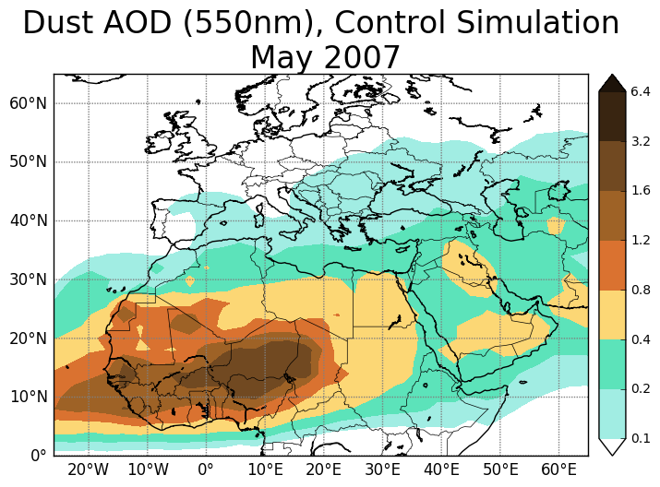
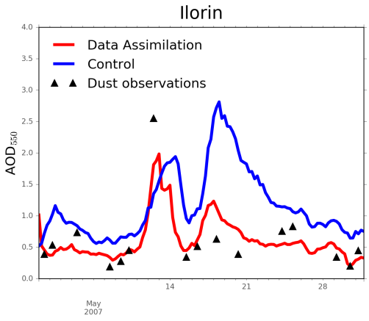
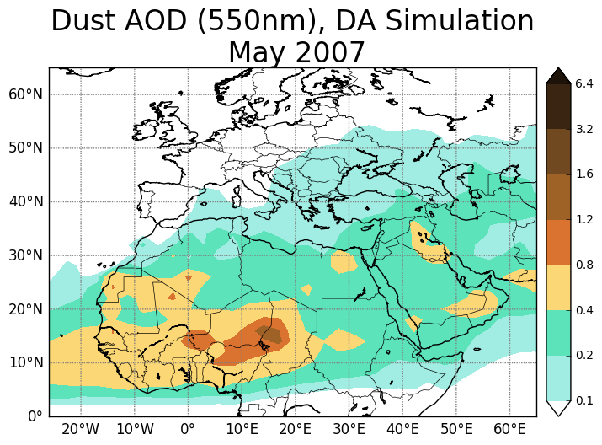
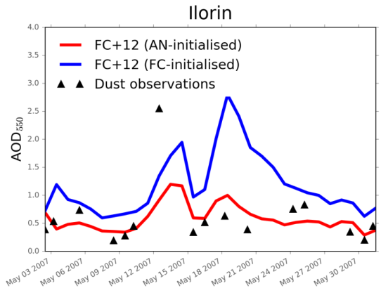
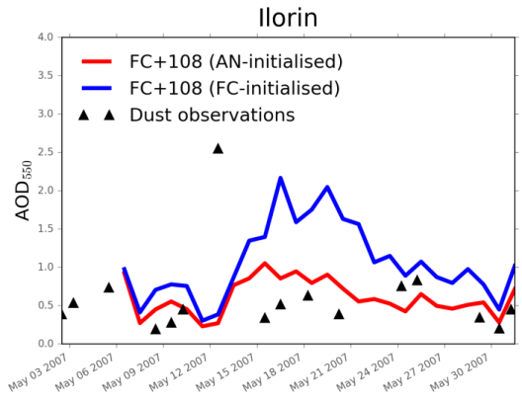
Validation of the forecast
Validation
Better description of current and forecast conditions for dust with data assimilation
AERONET site of independent sun photometer observations

Slide 16
MODIS Deep Blue, Level 2

Slide 17
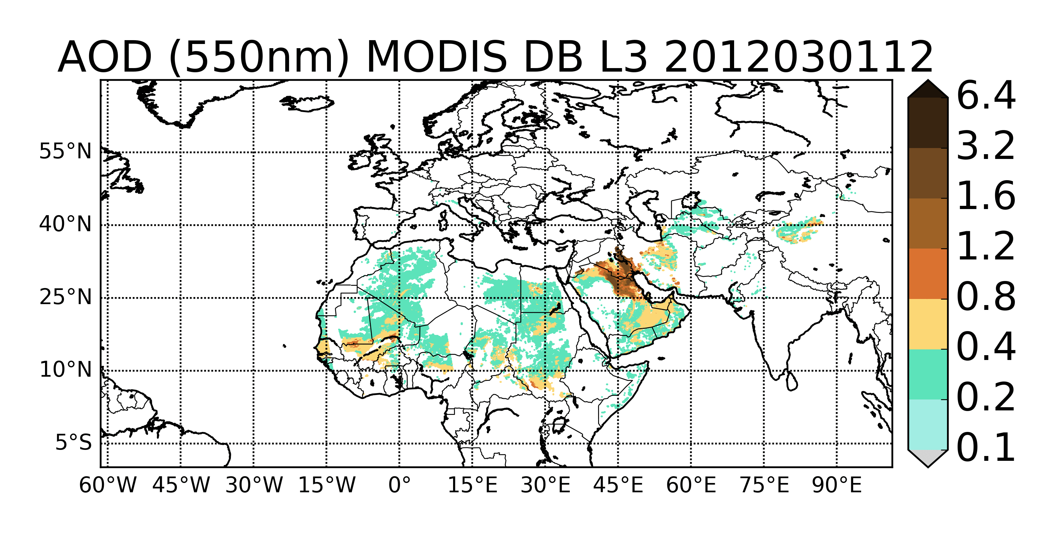
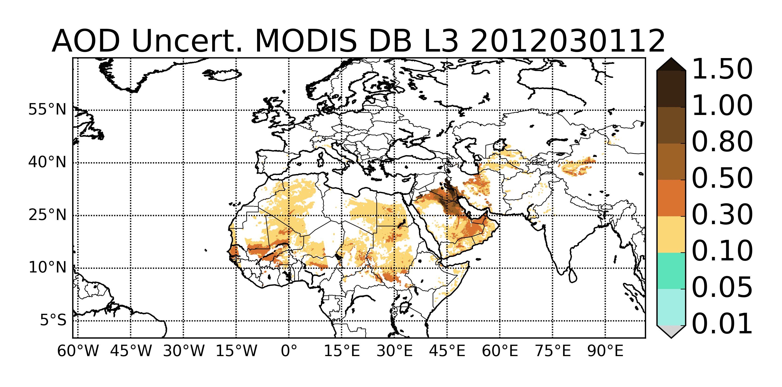
Assimilated observations
MODIS Deep Blue, L2 C6
- AE, ω filter
- highest quality flag
(Ginoux et al., 2012)
- uncertainty model based on Sayer et al., 2014

Slide 18
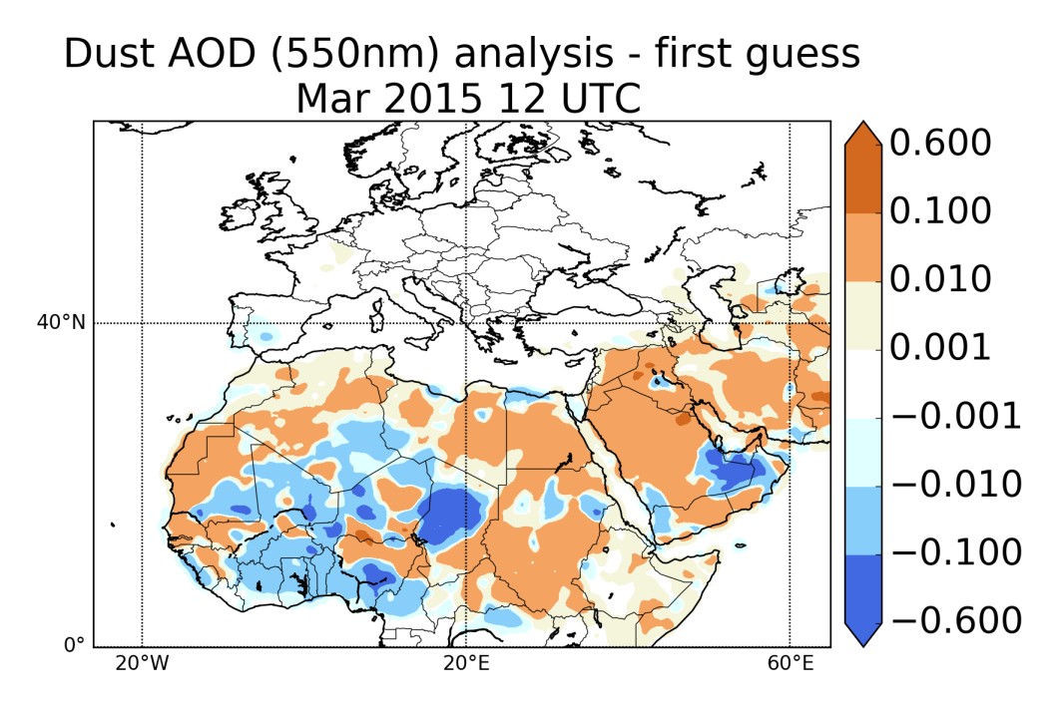
Analysis increments
Feedback from assimilation increments

Slide 19
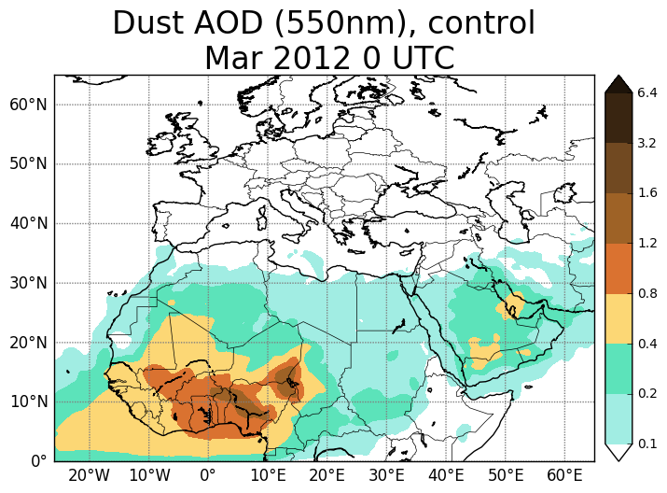
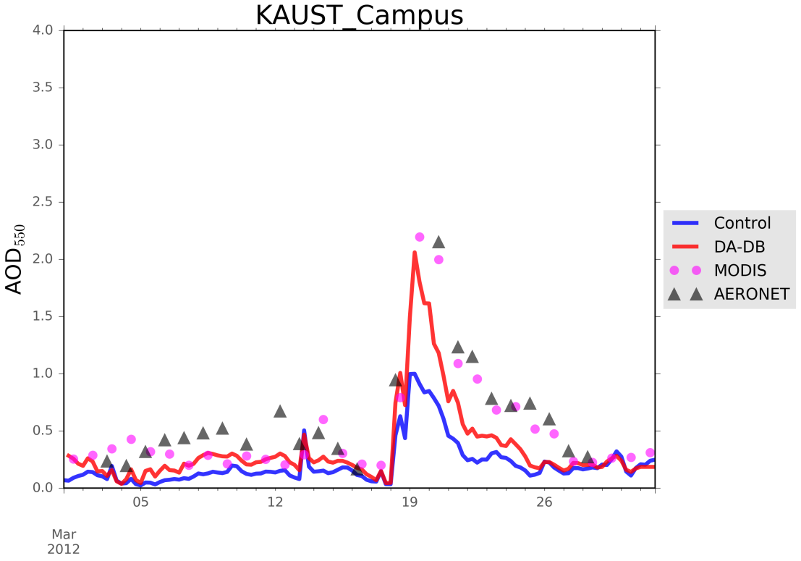
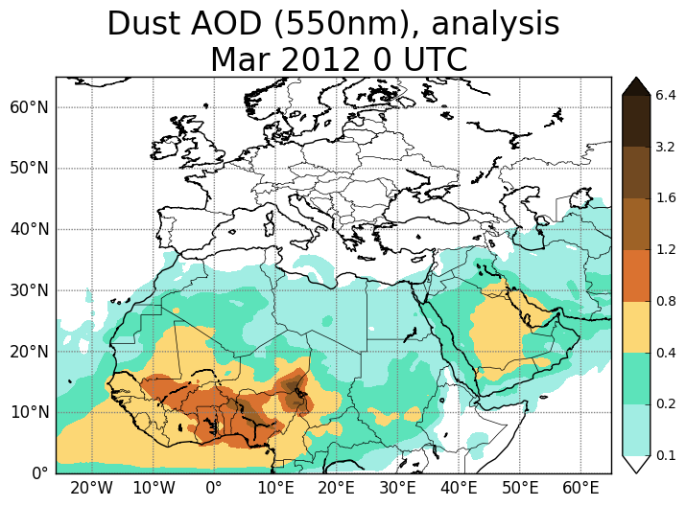
Indipendent validation
0.33ºx0.33º model resolution

Slide 20
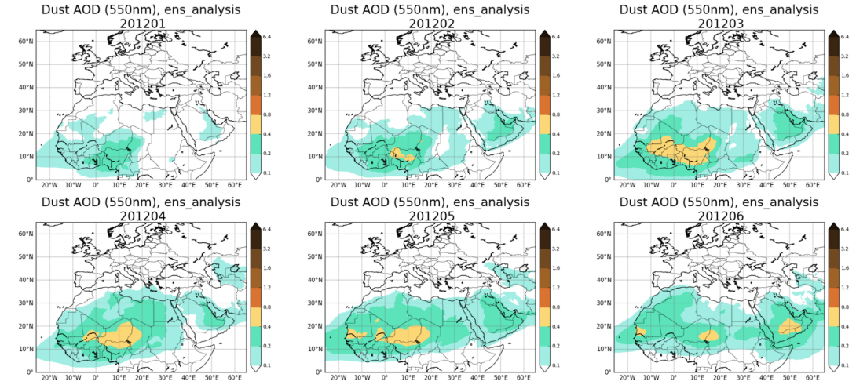
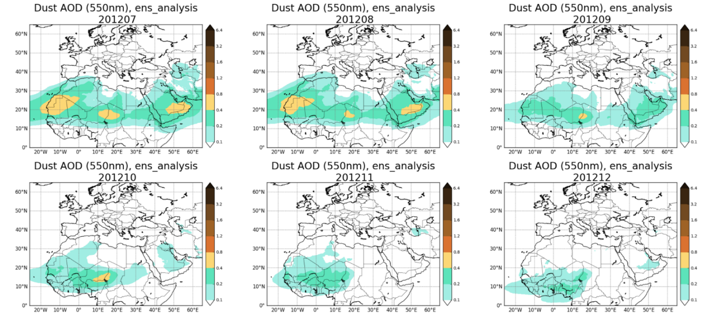
DustClim Project (2017-2020)
Produce a high resolution dust reanalysis for Northern Africa, Middle East and Europe covering the satellite era of quantitative aerosol information, and develop dust-related services tailored to specific socio-economic sectors
Monthly dust analyses for 2012

Slide 21
IASI dust AOD, Level 3

Slide 22
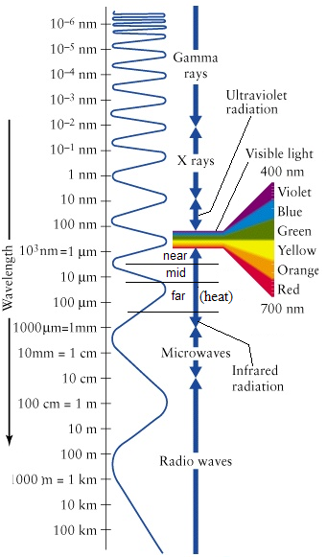
Aerosol_cci and CMUG projects
IASI dust AOD
- observations available day time and night time
- over ocean and over land (desert)
- 10 μm: detection of dust aerosol coarse mode (infrared wavelengths and ‘‘V’’ shaped depression of the Brightness Temperature)
- pixel level uncertainty
MODIS
IASI

Slide 23
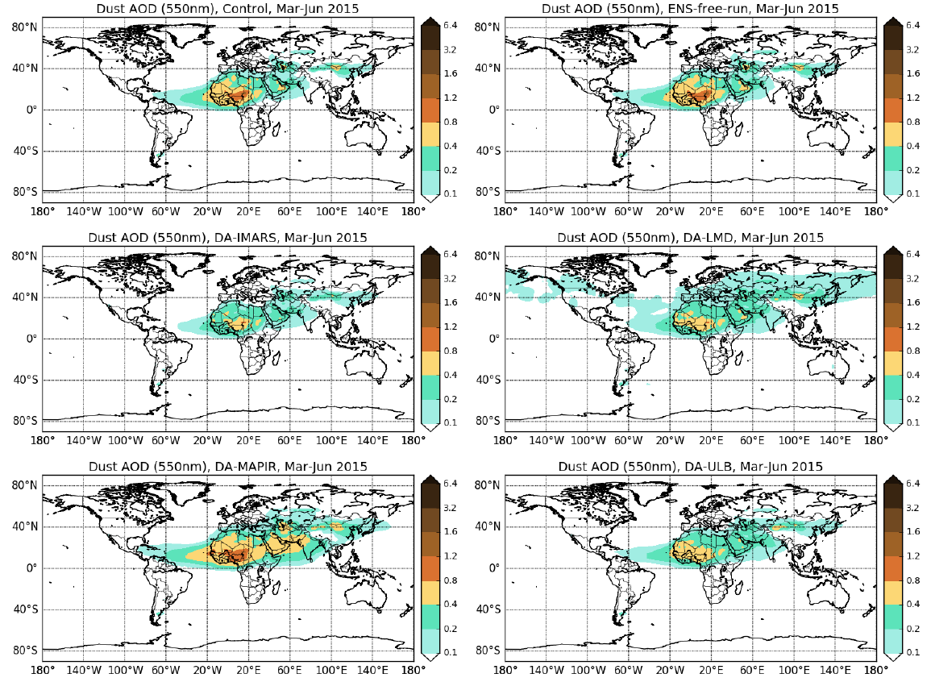
IASI analyses
CTL (det.)
Free-run
IMARS
LMD
MAPIR
ULB
The seasonal value of AOD is lowered by DA over the strong African sources in all the experiments, with the exception of the MAPIR analysis;
The LMD analysis stands out for higher AOD values at latitudes above 40 degree north.

Slide 24
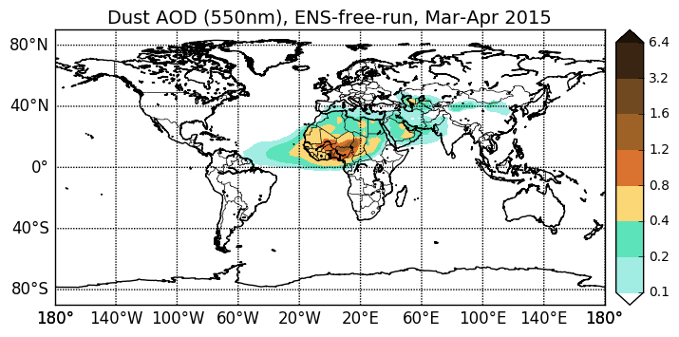
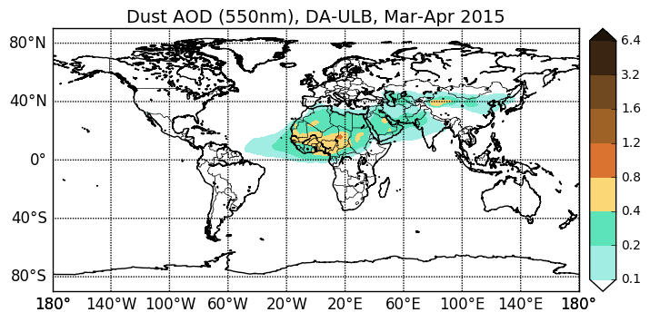
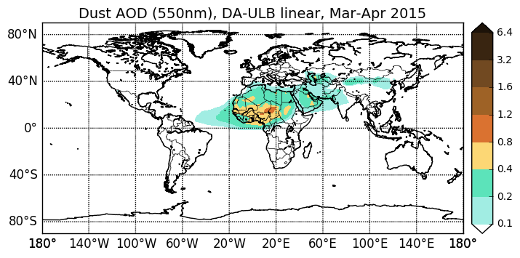
Exercise on observation uncertainty
Free-run
ULB AOD_unc
Linear: AOD_unc = 0.1 + 0.54 * AOD
Constant: AOD_unc = 0.35
Relevant impact of the observation error characterization
24

Slide 25
Aerosol, Clouds, and Trace gases (ACTRIS) lidar profiles

Slide 26
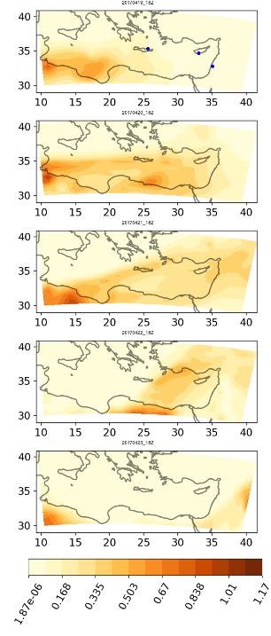
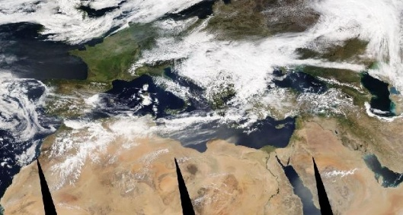
Evaluating the potential of ACTRIS‐2 profiles for DA
- Model simulations from the BSC model (NMMB-MONARCH)
- PollyNet lidar extinction profiles processed by TROPOS
19/04/2017
18Z
20/04/2017
18Z
21/04/2017
18Z
22/04/2017
18Z
23/04/2017
18Z
MODIS-Aqua 21/04/2017, NASA
Dust AOD

Slide 27
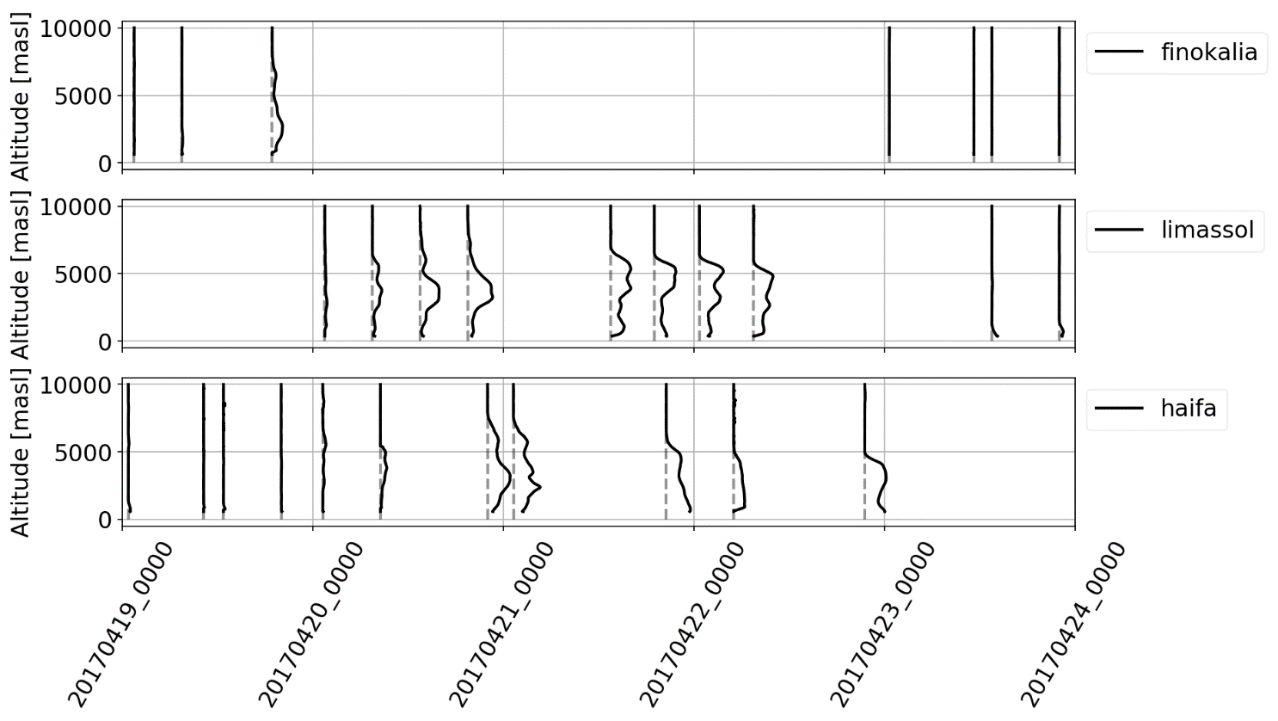
Evaluating the potential of ACTRIS‐2 profiles for DA
Event observed by 3 lidar sensors located in Finokalia (Crete), Limassol (Cyprus) and Haifa (Israel) part of the PollyNet (http://polly.tropos.de/) system. Data (with uncertainty estimation) processed by TROPOS.
19/04/2017
18Z
Dust extinction coefficient
20/04/2017
18Z
Finokalia (Crete)
21/04/2017
18Z
Limassol (Cyprus)
22/04/2017
18Z
Haifa (Israel)
23/04/2017
18Z
Dust AOD

Slide 28
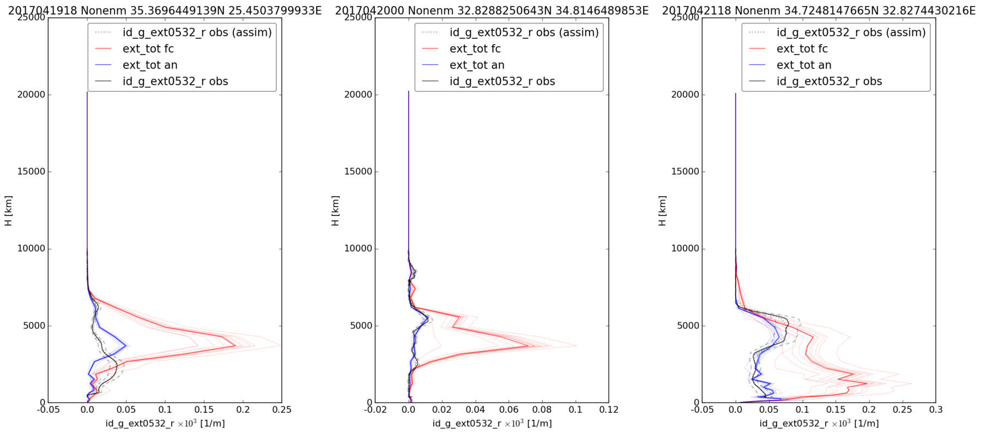
Evaluating the potential of ACTRIS‐2 profiles for DA
- Model simulations from the BSC model (NMMB-MONARCH)
- PollyNet lidar extinction profiles processed by TROPOS
Case study: 19-23 April 2017
Extinction profiles for
- ensemble forecast
- ensemble analysis
- observations
Finokalia (Crete) Haifa (Israel) Limassol (Cyprus)
correction of a model underestimation of the total column extinction
correction in most cases the plume height

Slide 29
Constrainting Mineral Dust Simulations with Observations
Model simulations and observations are combined to obtain the ‘best’ estimate of current atmospheric conditions (dust analysis)

Slide 30
Constrainting Mineral Dust Simulations with Observations
Model simulations and observations are combined to obtain the ‘best’ estimate of current atmospheric conditions (dust analysis)
useful to initialise models
and improve predictions
used to produce reanalysis
reanalyis
analysis
analysis-initialized prediction
monitoring
forecast

Slide 31
Thanks to the people taking measurements, maintaining sites, making retrievals and observation products
enza.ditomaso@bsc.es

Slide 32
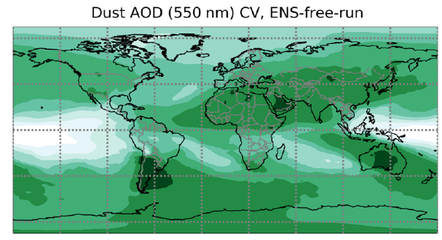
Ensemble-Based Data Assimilation (DA) at BSC
Dust ensemble forecasts are used at BSC to estimate flow-dependent forecast uncertainty, which is used by DA to optimally combine forecast with observations
The ensemble forecast has been designed considering model uncertainties with respect to:
surface winds
soil humidity
vertical flux distribution at sources
Ensemble free run
Data assimilation run
Currently working on enhancing the ensemble generation:
multi-parameters (emissions)
multi-physics (different emission schemes)
multi-model IC/BC (different meteo. analysis)

Slide 33
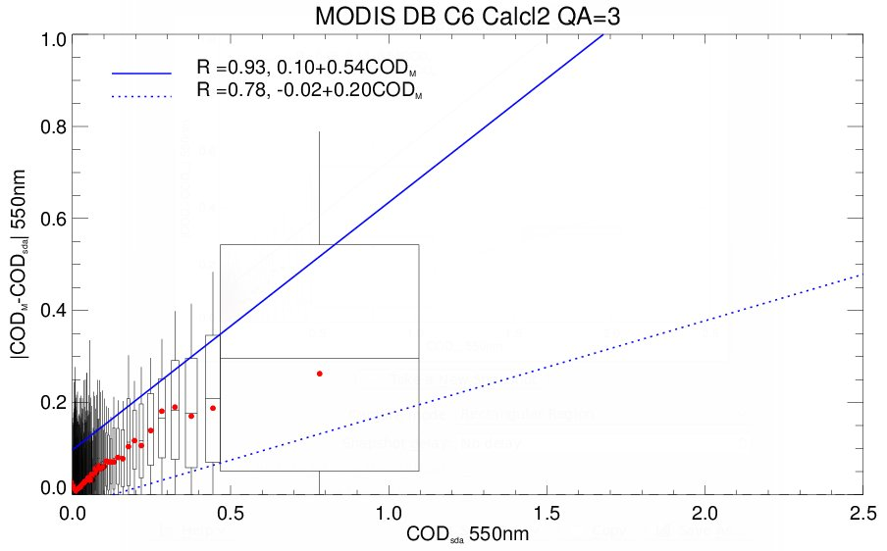
Characterization of observational uncertainty

Slide 34
Conclusions
The assimilation of dedicated dust observation products in dust data assimilation allows us to improve monitoring and forecast of mineral dust with the production of reanalyses and analyses (for past and current conditions of the atmosphere) and of prediction initialized with improved initial conditions.
This can potentially have a positive impact, through services, on key socio-economic sectors such as energy, transport and health.

