Slide 1
The NMMB-ASH model: description and implementation
Alex Martí, A. Folch, O. Jorba
Barcelona Supercomputing Center
Contributions: Z. Janjic (NCEP), C. Pérez (NASA-GISS)
Some slides from the 2nd NMMB Workshop, Maryland, March 2nd , 2016
Notes:
First of all, I would like to thank the EMC group to host me again. I am filling in for Oriol Jorba, who was going to give a presentation about the work being done at the BSC regarding Aerosol Prediction.
Unfortunately, Oriol could not be here today due to an injury, so I presenting a new model for forecasting the dispersal and deposition of volcanic ash: the NMMB-ASH model
We developed the model in collaboration with Arnau Folch and Oriol Jorba with the contributions of :

Slide 2
The BSC-CNS (www.bsc.es)
NMMB/BSC-CTM: New on-line chemistry transport model
NMMB- DUST: Provides operational Dust forecast:
Northern Africa, Middle East and Europe (http://dust.aemet.es)
NMMB-ASH: Volcanic ash and aerosols forecast
2
Notes:
2
2
The BSC is the national supercomputing centre of Spain.
Both, the Earth Sciences and the Computer Applications in Eng. Departments are involved in further developing the NMMB model through their different research lines.

Slide 3
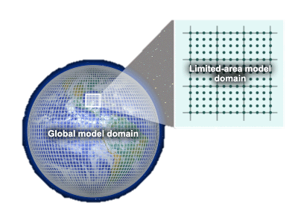
NMMB/BSC-Chemical Transport Model (Overview)
Nonhydrostatic Multiscale
Model on the B-grid (NMMB)
→ Janjic and Gall (NCAR/TN 2012)
→ Janjic and Vasic (EGU2012)
→ Janjic et al. (MWR 2011)
→ (...)
meteo variables/
parameters
Multiscale: Regional and global simulations..
Developed within the new NEMS framework
NMMB/
BSC-CTM
GAS-PHASE CHEM
(52 species)
→ Jorba et al. (JGR 2012)
→ Badia and Jorba (AE 2014)
→ Badia and Jorba (AE 2015)
(gas/aerosol variables:
mass mixing ratios)
On-line coupled aerosols and chemistry allowing consistency and feedbacks
DUST (8 bins)
→ Pérez et al. (ACP 2011)
→ Haustein et al. (ACP 2012)
SEA-SALT (8 bins)
BSC Chemical Transport Model
→ Spada et al. (ACP 2013)
→ Spada et al. (AE 2014)
ASH (n bins)
→ Martí et al. (in prep.)
→ Martí et al. -b (in prep.)
BC/OM/SO4
→ under dev.
Notes:
The BSC CTM model is fully coupled on-line with the NMMB meteorological core allowing consistency and feedbacks for 52 chemistry species, dust, sea-salt and volcanic ash. Modules for new aerosols particles are under development.

Slide 4
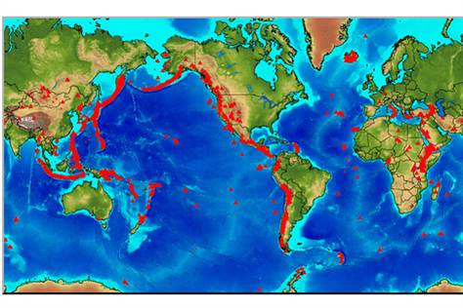
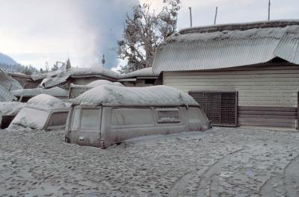
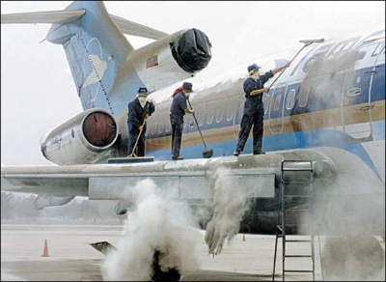
Motivation to forecast volcanic aerosols
1.500 active volcanoes worldwide
500 million people potentially exposed
160 active volcanoes in the US
Hazards
Direct
Ash fallout
Economic and heath
Indirect
Atmospheric and climate effects
Aircraft safety
https://volcanoes.usgs.gov/volcanic_ash/
Source: USGS
Notes:
There are roughtly 1500 active volcanoes h 500 million people exposed to a volcanic eruption. Out of those, 160 active volcanoes are in the US.
Forecasting the dispersal and sedimentation of volcanic aerosols is relevant due to the direct hazard due to the hazards associated to volcanic ash. You can find a descriptive list of these hazards in the USGS website.
Active volcano is one that has erupted since the last ice age
But it also have impacts on Buildings, Transportation, Power and water supply, Agriculture and animals, Communications, etc.
Active volcano is one that has erupted since the last ice age
But it also have impacts on Buildings, Transportation, Power and water supply, Agriculture and animals, Communications, etc.

Slide 5
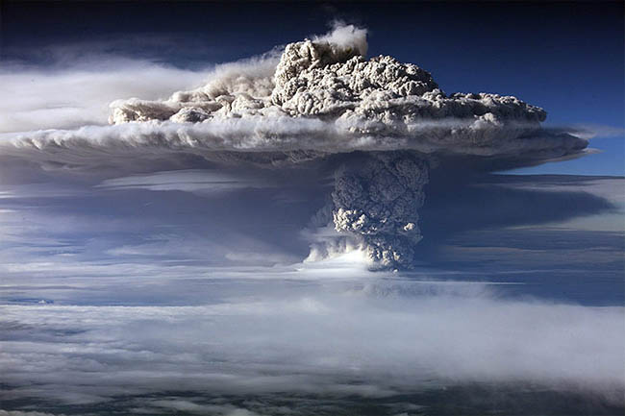
NMMB-ASH: MODEL description

Slide 6
OVERVIEW
NMMB-ASH solves the mass balance equation for ash taking into account the following processes:
EMISSIONS : 4 emissions schemes defined in the Source term
3 Mass Eruption Rate (MER) schemes
3 particle aggregation schemes
TRANSPORT : same horizontal and vertical advection than NMMB, with the inclusion of a gravity current model to account for the spreading of the umbrella cloud
SEDIMENTATION : with 3 particle settling velocity schemes
RRTM SW/LW ash radiative feedback (next)

Slide 7
Emissions: Volcanic Ash (tephra)
Fragments of rocks, minerals, and volcanic glass.
Total particle Grain
Size Distribution (TGSD)
Lapilli
10s Km
Coarse ash
100s Km
Fine ash
1000s Km
Dispersal distance
ASH
Residence time /
Sedimentation velocity
-
min
hours
days
months
+
Local / Regional
Global
Impact Scale
Ash particles range from 2 mm - 4 µm in diameter depending
on the eruption style (source)
Notes:
Tephra particles are a mixture of :
For the purpose of modeling it is important to mention that ash particles are those ranging from 2 mm - 4 µm in diameter

Slide 8
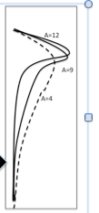
Emissions: Module BSC_Source (4 source types)
POINT: linear vertical distribution of mass
TOP-HAT(Morton et. al. 1956) 1D steady-state model with a constant eruption column using a top-hat profile
SUZUKI (Suzuki, 1983; Pfeiffer et al. 2005)) distributes mass vertically using a simple formula designed to concentrate mass near the plume top
FPLUME (Folch et. al. 2015) steady-state 1-D model with an averaged eruption column based on the Buoyant Plume Theory (BPT).
Notes:
Plume model accounts for plume bent over by wind, entrainment of ambient moisture, effects of water phase changes, particle fallout and re-entrainment, a new parameterization for the air entrainment coefficients and a model for wet aggregation of ash particles in presence of liquid water or ice. In the occurrence of wet aggregation
Possibilities are MFR or HEIGHT through an iterative procedure

Slide 9
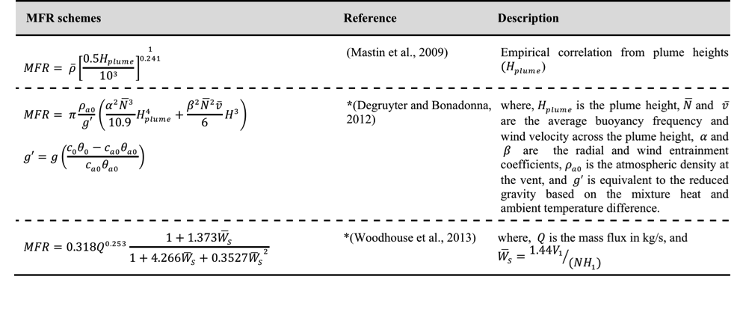
Emissions: Module BSC_Source (3 MER schemes)
MASS FLOW RATE
Define an array of values of the mass flow rate (in kg/s) for the nt eruptive phases, or automatically compute the MER from the column heights based on empirical fits.
Notes:
MFR from the column heights based on empirical fits. The last two options account for cross wind effects on plume height and MFR

Slide 10
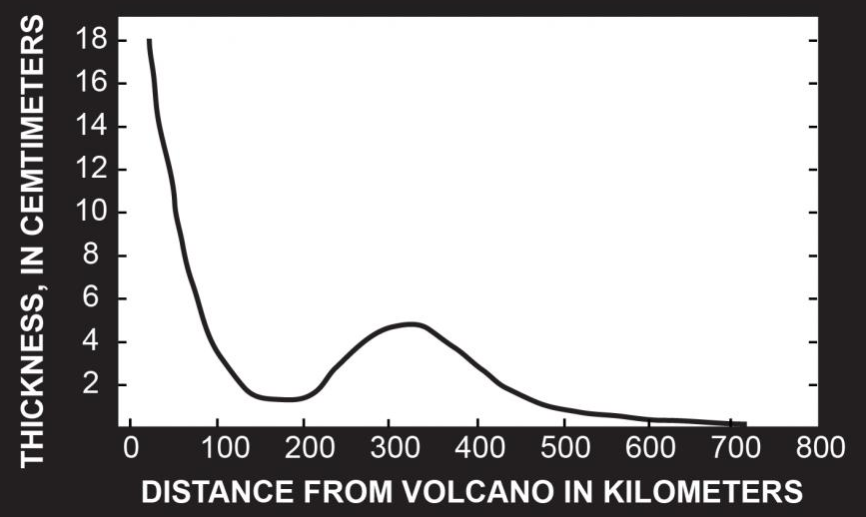
Emissions: Module BSC_Source (3 aggregation schemes)
AGGREGATION
Particle aggregation might have a dramatic effect on the transport and sedimentation of volcanic ash (eruption column)
NONE: No aggregation
PERCENTAGE (Sulpizio et al. 2012): assumes a given % of ash aggregating for classes
CORNELL (Cornell et al. 1983): assumption that a certain mass fraction of fine classes fall as a single aggregate class
COSTA (Costa et al. 2010): based on a fractal relationship to describe the rate particles are incorporated into ash aggregates – with FPLUME source only

Slide 11
Transport: Gravity current model
Add "effective" advection velocity resulting from:
adding the radial density-driven velocity
to the background wind velocity up to a certain distance
Costa et. al. 2013
Marti et. al. NSR 2016

Slide 12
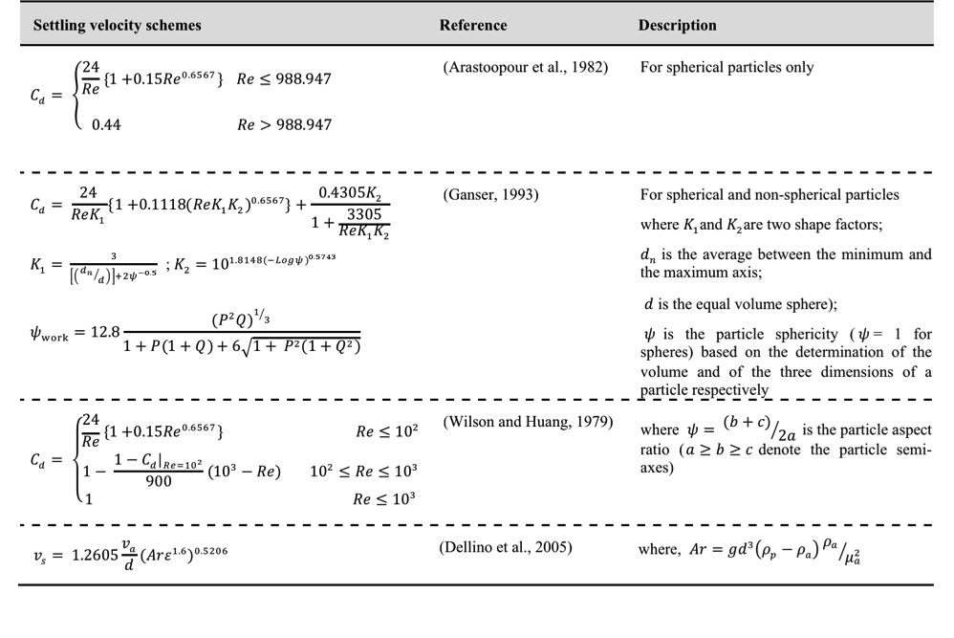
Sedimentation Module BSC_Sedimentation (4 schemes)
Semi-empirical parameterizations for particle settling velocity (assumes particles settle down at their terminal velocity):
Notes:
Based on their Drag coefficient (Cd) :)

Slide 13
NMMB-ASH: MODEL IMPLEMENTATION

Slide 14
NMMB integration
USE module_include
get_granulometry_nclass
get_granulometry_value
get_granulometry_name
get_input_int
get_input_rea
get_input_cha
get_input_npar
sdecode
upcase
decod1
addtime
julday
grday
grday
timeincr
setpsi
get_gama
get_aot_prop
get_distance
ash_source
solvepoint
solvesuzuki
solvetophat
Module_BSC_ASH_Kindtype
USE module_bsc_ash_kindtype
USE module_bsc_ash_kindtype
module_constants
Module_BSC_ASH_Source
ash_initialize
ash_couple
set_gravity_current
Module_BSC_ASH_Utilities
call ash_source
USE module_bsc_ash_source
module_bsc_ash_kindtype
module_bsc_ash_utilities
module_bsc_mass_balance
module_dm_parallel
module_my_domain_specs
module_exchage
module_constants
call addtime
get_granulometry_nclass
get_granulometry_value
get_granulometry_name
get_aot_prop
get_input_npar
get_input_cha
get_input_int
get_input_rea
setpsi
julday
get_distance
halo_exchange
set_gravity_current
New development
Module_BSC_ASH
Module_BSC_ASH
call mass_flux_boundary
mass_volume
mass_ground
mass_collect
mass_collect
mass_flux_boundary
mass_volume
mass_ground
call ash_initialize
ash_couple
sedimentation
vsettl
get_gama
* Only module updates shown
USE module_bsc_ash_kindtype
module_bsc_ash_utilities
module_dm_parallel
module_my_domain_specs
module_constants
module control
*Module_Solver_Grid_Comp
USE module_bsc_ash
module_include
module_my_domain_specs
module_mp_etanew
module_constants
Solver_initialize
call sedimentation
Module_mass_balance
USE module_bsc_ash
Module_Sedimentation
call ash_initialize
** Updates / new modules expected in 2015
Solver_run
Other modules updated:
Module_Turbulence
Module_BSC_Dynamics_routine_chem
Module_Initi_Read_Bin
** Module_BSC_CHEMISTRY_ EMISSIONS (v-SO₂)
Module_Depostion (v-aero)
Module_BSC_Radiative (v-aero)
USE module_bsc_ash
module_sedimentation
module bsc_dynamics_routine_chem
call ash_couple
sedimentation
turbl
adv2_chem
cucnv
gsmdrive
LEGEND
modified only
when:
Off-line and/or
Gravity current On
(Ueff,Veff)
Module_New
Module_Updated
call subroutine
USE module
Subroutine used by other modules
Subroutine used by same module
Notes:
Paper to Geoscientific Model Development (GMD) of the NMMB/BSC-ASH description, development and evaluation.

Slide 15
NMMB integration: Ash module input file
The ash input file in ASCII format consists of a set of blocks defining all the computational and physical parameters needed by the NMMB ASH Module
TIME_UTC
!
YEAR = FCST_YY
MONTH = FCST_MM
DAY = FCT_DD
ERUPTION_START_(HOURS_AFTER_00) = XXX
ERUPTION_END_(HOURS_AFTER_00) = XXX

Slide 16
Ash.inp (cont.)
SOURCE
!
SOURCE_TYPE = inp_SOURCE
LON_VENT = XXX
LAT_VENT = XXX
VENT_HEIGHT_(M) = XXX
!
POINT_SOURCE
!
HEIGHT_ABOVE_VENT_(M) = XXX
MASS_FLOW_RATE_(KGS) = inp_MFR
SUZUKI_SOURCE
!
HEIGHT_ABOVE_VENT_(M) = XXX
MASS_FLOW_RATE_(KGS) = inp_MFR
A = 4.
L = 5.
TOP_HAT_SOURCE
!
HEIGHT_ABOVE_VENT_(M) = XXX
PLUME_THICKNESS_(M) = XXX
MASS_FLOW_RATE_(KGS) = inp_MFR
GRAVITY_CURRENT
!
GRAVITY_CURRENT = inp_GC
C_FLOW_RATE = 1d4
LAMBDA_GRAV = 0.2
K_ENTRAIN = 0.1
BRUNT_VAISALA = 0.02
SETTLING_VELOCITY
!
MODEL_TYPE = Ganser
SOLVING_STRATEGY
!
ON_LINE = inp_STRATEGY
OFF_LINE_UPDATE_TIME_STEPS = inp_OFF_TS
Notes:
Falta Plume!

Slide 17
NMMB integration: Ash granulometry
The granulometry file is an ASCII file containing the characterization of the classes of particles.
nc: Total number of particle classes.
diam: Class diameter (in mm).
rho: Class density (in kg/m3).
sphe: Class sphericity.
fc: Class mass fraction (0-1). It must verify that fc = 1.
class: Label denoting class (particle/gas typology).
10
2.000000 1000.0 0.900 0.792081510E-03 class-01
1.000000 1133.3 0.900 0.816403783E-01 class-02
0.500000 1266.7 0.900 0.371653229E+00 class-03
...

Slide 18
Running NMMB-ASH (cont.)
NMMB configure file (not exhaustive)
#####################################################
##### Aerosol - chem species and number of bins #####
#####################################################
num_tracers_chem: 10 # Number of specified chem/aerosol "tracer" scalars
#AEROSOLS (true if >1, false if =0)
num_ash: 10 # Number of volcanic ash bins
num_dust: 0 # Number of dust transport bins (4 and 8 bins)
num_salt: 0 # Number of sea salt tranport bins (4 and 8 bins)
num_om: 0 # Number of organic matter transport bins
num_bc: 0 # Number of black carbon transport bins
num_so4: 0 # Number of sulphate transport
num_no3: 0 # Number of nitrate transport bins (only 3 works)
num_nh4: 0 # Number of ammonium transport bins (only 1 works)
num_aero_uci: 0 # Number of secondary aerosols bins

Slide 19
Running NMMB-ASH (cont.)
NMMB configure file (not exhaustive)
###################################################
##### Aerosol/chem species for model testing ###
##### true or false for the different processes ###
###################################################
diff_chem: true # Lateral diffusion for chem/aerosol species
adv_chem: true # Horizontal and vertical advection for chem/aerosol species
sedim: false # Aerosol sedimentation
incloud_conv: false # Aerosol In-cloud scavenging from convective clouds
bcloud_conv: false # Aerosol below-cloud scavenging from convective clouds
incloud_strt: false # Aerosol in-cloud scavenging from stratiform clouds
bcloud_strt: false # Aerosol below-cloud scavenging from stratiform clouds
conv_trans: false # Convective adjustment of aerosol/chem arrays
vdiff_chem: true # vertical diffusion
dry_dep: false # Aerosol dry deposition
newsedim: true # Use new sedimenation / settling velocitiy schemes
nsedim: 4 # Adjustment steps between new sedimentation calls

Slide 20
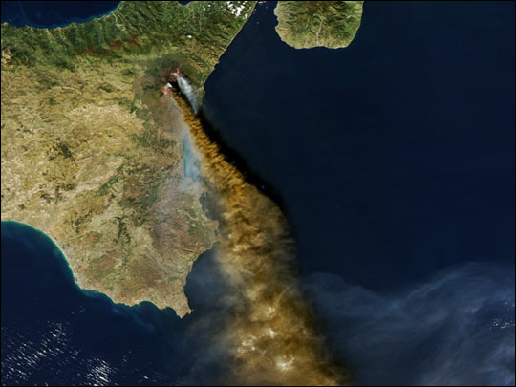
NMMB-ASH: PERFORMANCE ANALYSIS

Slide 21
Strong scalability GLOBAL RUN
Speed-up (p)
Parallel
Efficiency
Computation Nodes

Slide 22
RunTime/process GLOBAL RUN
Computational cost (%)
Ash module 10 – 50% time increase
Sedimentation term accounts for over 85% Ash module.
Additional Parallelization per ash bin – decreases dispersal time
CPU MNII

Slide 23
Domain decomposition – CPU cost (32 nodes)
Focus on reducing Meteo CPU time
Computational cost (%)
CPU MNII

Slide 24
Domain decomposition – Total RunTime (32 nodes)
20 days simulation
Horizontal Resolution: 1ºx1º
60 vertical layers ;
Pressure top 100HPa
X
+ 8%
+ 11%
+ 25%

Slide 25
RunTime REGIONAL RUN
1 ash bin
7 ash bins
RunTime (%)
CPU MNII

Slide 26
Strong scalability REGIONAL RUN
Speed-up (p)
Computation Nodes
Notes:
Fourier transformation

Slide 27
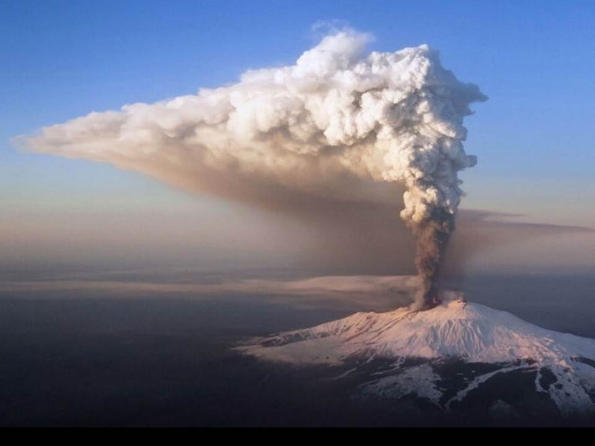
NMMB-ASH: RESULTS

Slide 28
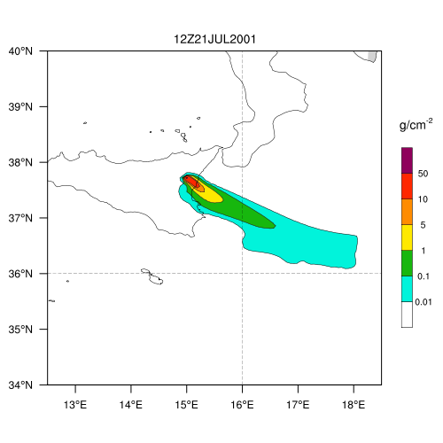
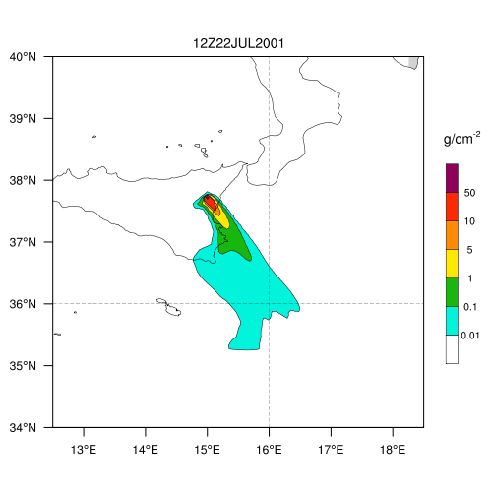
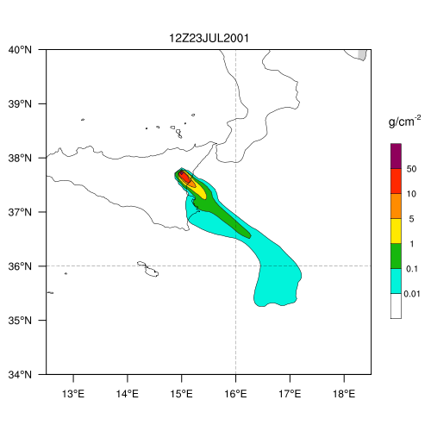
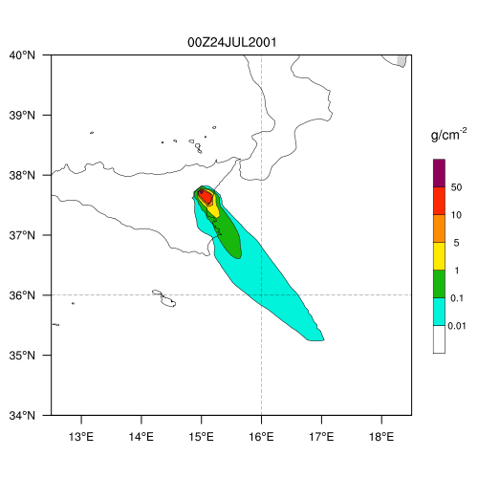
Ash dispersal (column mass) REGIONAL RUN
Mt. Etna eruption 2001 – Period 07/20/01 to 07/25/01
Horizontal resolution of 0.1ºx0.1º with 60 vertical layers
Meteorology: EraInterim at 0.75º
Schemes | Implemented | Tested
Emission | 4 | 3
MER | 3 | 3
Aggregation | 3 | 2
Set. Velocity | 4 | 2
Good agreement with time and direction of plume.
Marti et. al. GMD (in prep)

Slide 29
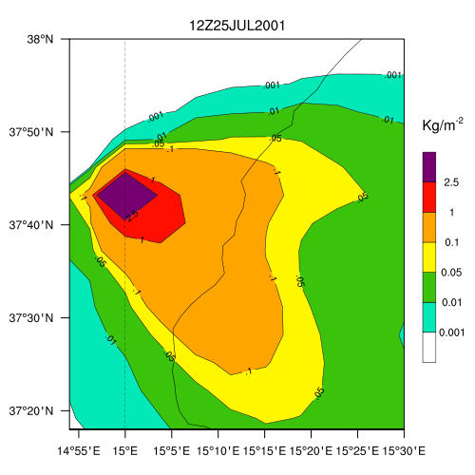
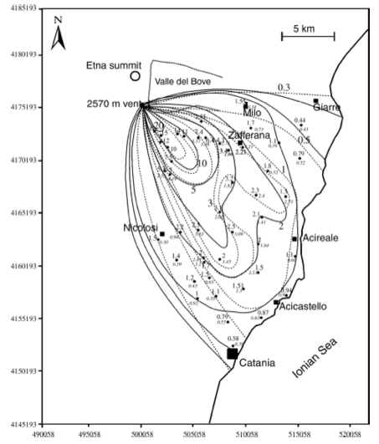
Ash deposition (load)
S. Scollo et al. JVGR 2007
Marti et. al. GMD (in prep)

Slide 30
Ash dispersal (column mass) GLOBAL RUN
Caulle eruption 2011 - Run 6/4/11 to 6/21/11 at 00:00 UTC
Horizontal resolution of 1ºx1º with 60 vertical layers ; Pressure top 100HPa (~12 km)
Wind profile from EraInterim at 0.75º with 24h restart

Slide 31
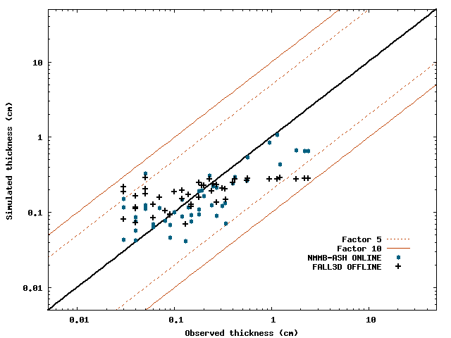
OFF vs. ONLINE
NMMB-ASH improves on traditional off-line Tephra dispersal models
LOAD (g/m²)
 | NMMB-ASH | FALL3D
R² | 0,80 | 0,64
RMSE | 0,014 | 0.24
BIAS | 0.02 | 0.6
Small overestimation proximal deposits
Marti et. al. GMD (in prep)

Slide 32
NMMB-ASH: Development notes

Slide 33
Future Development
NMMB Off vs. On-line comparison (Marti et. at. (b) in prep)
Development and implementation of a volcanic SO₂ module
Couple with Radiative budget
Quantify Two-way feedback effects
Explore implementation NMMB-ASH in a VAAC

Slide 34
Open questions
Model communications dependent on domain decomposition in X and Y for the same # of nodes
Source position is now determined using lon-lat at mass points (GLON/GLAT)
Source position detection can fail
Must be corrected (values at U and V points?).
Using U-V points for lon-lat the whole domain is covered. However, if source is at 2 processors’ boundary, two source are found…

Slide 35
Thank you!
Alejandro.Marti@bsc.es
Work funded by the People Programme (Marie Curie Actions) of the European Union’s Seventh Framework Programme (FP7/2007-2013) under the project NEMOH (REA grant agreement n° 289976), and Severo-Ochoa project of the Spanish Ministry of Economy and Competitiveness
Notes:
I would like to acknowledge all the people involved in the works done until now on the project, from BSC staff to external international research scientists.

Slide 36
Horizontal Operators Stencil
Advection, divergence operators, each point talks to 8 neighbors
Formal 4-th order accurate
NMMB
?
?
?
?

Slide 37
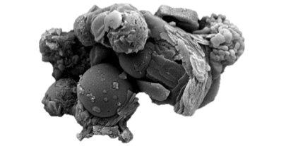
Distribution and Deposition
Mainly controlled by winds and eruption style
Source term
The initial particle-sizes of the ejecta
Height of the eruption column
Mass flow rate
Duration of the eruption
Particle transport is a f(size, density and shape)
The thickness of ash deposits decreases exponentially with increasing distance from a volcano
Secondary thickening may occur due to aggregation processes
Notes:
The transport and deposition of these particles are controlled by the wind profiles and the eruption style.
The type of eruption is described in the source term by defining the particle size of the ejecta, the column heigh and the MFR and duration of each eruptive phase.
Particle transport is a function their size, density and shape
Thickness deposits decrease exponentially with distances from the vent , however secondary maximums can occur due to aggregation processes as we see in this plot from an eruption in Mt St. Helens where secondary thickening occurs at 300km from the volcano.

Slide 38
Integration within NMMB
NEMS/NMMB
Chemistry implemented on-line within NMMB routines
Inline aerosol dynamic emissions and wet depositions
On-line with modular implementation of chemistry and gas depositions
Same advection, diffusion routines as NMMB
!*** AEROSOL - GAS TRACERS: LOCATIONS IN TRACER ARRAY
!*** [-----------------------------TRACERS-------------------------------------------------]
!
*** [------MET-----][--WATER---][-------------------CHEM------------------------------]
!
!*** [---------------------------CHEM---------------------------------------------------------]
!*** /ash bins/dust bins/salt bins/om bins/bc bins/so4 bins/no3 bins/nh4 bins/gas species/
!***
Module_Solver_Grid_Comp
Solver_initialize
USE module_bsc_initialize
call bsc_initialize
Solver_run
USE module_bsc_chemistry
module bsc_dynamics_routine_chem
module_bsc_deposition
module_bsc_sedimentation
call hdiff
adv2_chem
mono_chem
radiation
sedimentation
turblence
cucnv
gsmdrive
chem_driver
Module_BSC_Chemistry
USE module_bsc_...
call emissions
photolysis
gas_dry_deposition
gas_wet_deposition
chemistry_mechanism
aerosol_mechanism

Slide 39
The BSC-CNS (www.bsc.es)
Research lines
Ash dispersal Modeling
Computational Fluid Dynamics
Computational Solid Mechanics
Seismic Imaging
Social Simulations
Geophysical Flows
Visualization and post-process
Parallelization
Optimization
Air Quality
Mineral Dust
Aerosols
Atmospheric Modeling
Climate Modeling
39
Notes:
39
39
The BSC is the national supercomputing centre of Spain.
Both, the Earth Sciences and the Computer Applications in Eng. Departments are involved in further developing the NMMB model through their different research lines.

Slide 40
Running NMMB-ASH (cont.)
NMMB configure file (not exhaustive)
###################################################
##### Aerosol/chem species for model testing ###
##### true or false for the different processes ###
###################################################
diff_chem: true # Lateral diffusion for chem/aerosol species
adv_chem: true # Horizontal and vertical advection for chem/aerosol species
sedim: false # Aerosol sedimentation
incloud_conv: false # Aerosol In-cloud scavenging from convective clouds
bcloud_conv: false # Aerosol below-cloud scavenging from convective clouds
incloud_strt: false # Aerosol in-cloud scavenging from stratiform clouds
bcloud_strt: false # Aerosol below-cloud scavenging from stratiform clouds
conv_trans: false # Convective adjustment of aerosol/chem arrays
vdiff_chem: true # vertical diffusion
dry_dep: false # Aerosol dry deposition
newsedim: true # Number of specified chem/aerosol "tracer" scalars
nsedim: 4 # Adjustment steps between new sedimentation calls

Slide 41
Aerosols I
Mass-based approach. Dry sizes remain constant throughout the model simulation
The wet size of hygroscopic particles changes with relative humidity for radiation and sedimentation calculations
Dust: 8 size bins emitted as a function of friction velocity through a physically based dust emission scheme. Tested at global and regional scales (Northern Africa, Middle East and Europe)
Sea-salt: 8 size bins emitted as a function of 10-m wind speed. 5 emission schemes available and thoroughly evaluated
Black Carbon (BC): 2 tracers, one hydrophobic and one hydrophilic. Hydrophobic BC converted to hydrophilic with an e-folding time of 1.2 days (as in GOCART)
Organic Matter (OM):
Primary Organic Matter (POA): 2 tracers, one hydrophobic and one hydrophilic. Hydrophobic OM converted to hydrophilic with an e-folding time of 1.2 days (as in GOCART)
Secondary organic aerosols (SOA): 4 gaseous and 4 aerosol-phase tracers. SOA produced by the reversible partitioning of the semi-volatile gaseous O3 oxidation products of isoprene and terpenes (Tsigaridis and Kanakidou, 2003; 2007). Anthropogenic SOA produced from toluene and xylene is under development

Slide 42
Aerosols II
Sulfate (SO4): 1 hydrophilic tracer, 4 additional prognostic tracers (SO2, DMS, H2O2, H2SO4) and 3 online or climatological oxidants (OH, O3, HO2). Includes gas-phase oxidation of SO2, DMS and H202 by OH, and aqueous-phase oxidation by H202 and O3 (Sander et al., 2006, 2011)
Nitrate (NO3) and Ammonium (NH4): as calculated by EQSAM thermodynamic equilibrium model but not tested yet (Metztger et al. 2002)
Dry deposition from the bottom layer includes aerodynamic and surface resistance (Zhang et al., 2001)
Gravitational settling follows the Stokes approximation including the Cunningham correction factor accounting for reduced viscosity for small aerosols
In-cloud and below cloud scavenging from grid-scale (Ferrier) and sub-grid scale (BMJ) clouds
Below cloud scavenging follows Slinn (1984) (directional interception, inertial impaction and Brownian diffusion)
Vertical convective mixing follows the BMJ adjustment scheme (instead of a mass flux scheme)
Radiation: RRTM SW/LW aerosol radiative feedback
Optical properties: GADS refractive indexes (special for dust), Mie-scattering of spheres (Mischenko, 2000)

Slide 43
Configure file (not exhaustive)
For RRTM radiation
iaer: 22 # flag for aerosols scheme selection (all options work for N12B)
# - 3-digit aerosol flag (volc,lw,sw)
# = 0: turn all aeros effects off (sw,lw,volc)
# = 1: use clim tropspheric aerosol for sw only
# = 10: use clim tropspheric aerosol for lw only
# = 11: use clim tropspheric aerosol for both sw and lw (def. NCEP)
# =100: volc aerosol only for both sw and lw
# =101: volc and clim trops aerosol for sw only
# =110: volc and clim trops aerosol for lw only
# =111: volc and clim trops aerosol for both sw and lw
# = 2: gocart/BSC-Chem tropspheric aerosol for sw only
# = 20: gocart/BSC-Chem tropspheric aerosol for lw only
# = 22: gocart/BSC-Chem tropspheric aerosol for both sw and lw
# =102: volc and gocart/BSC-Chem trops aerosol for sw only
# =120: volc and gocart/BSC-Chem trops aerosol for lw only
# =122: volc and gocart/BSC-Chem trops aerosol for both sw and lw
fhdust: 100000. # = 0 dust determined from gocart clim
# > 0. and <99999. determined from nmmb fcst and gocart clim
# >99999. determined from fcst
fhsalt: 0.
fhom: 0.
fhbc: 0.
fhso4: 0.
fhash: 0.

Slide 44
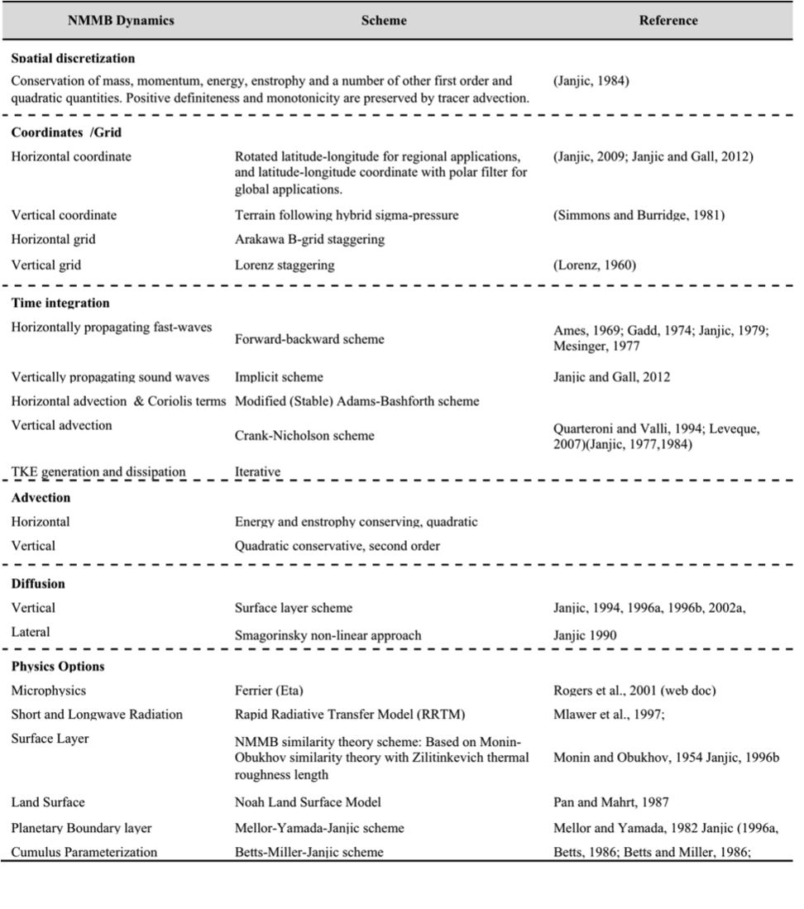
Dynamics

Slide 45
Running NMMB-ASH model
Input parameters required for the model include:
Source model
Mass Flow Rate / Total erupted mass
Eruption column height
Mass distribution along the column
Particle TGSD
Wind profile, and horizontal diffusion coefficient

Slide 46
RunTime GLOBAL RUN

Slide 47
Domain decomposition – best fit 512 CPUs (32 nodes)
Computation cost (%)
Nodes MNII

Slide 48
Source Model RunTime GLOBAL RUN

Slide 49
Source Model GLOBAL RUN

Slide 50
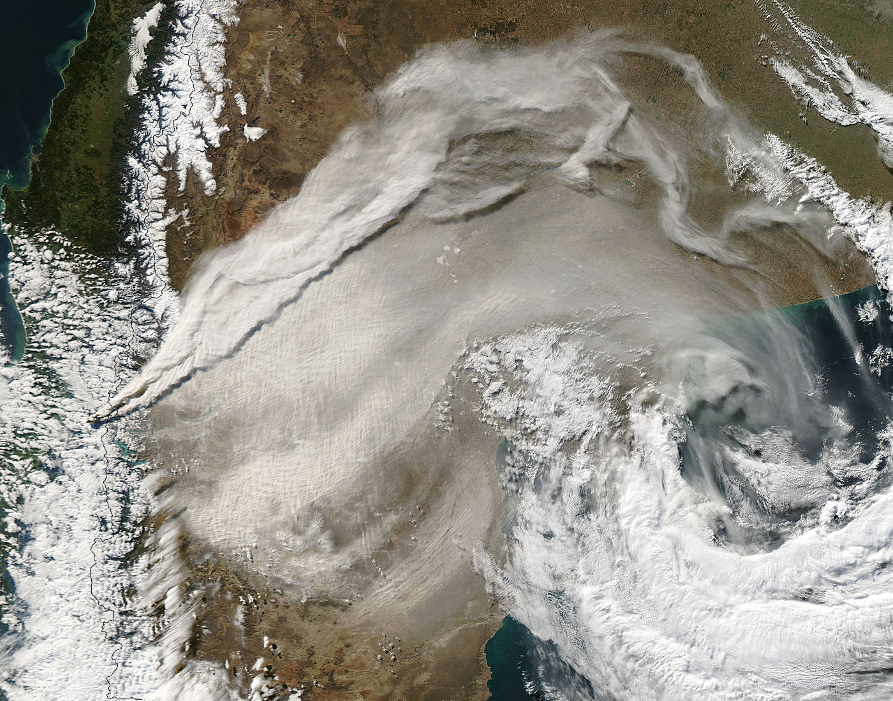
NMMB-ASH VS. OFF-LINE FALL3D

Slide 51
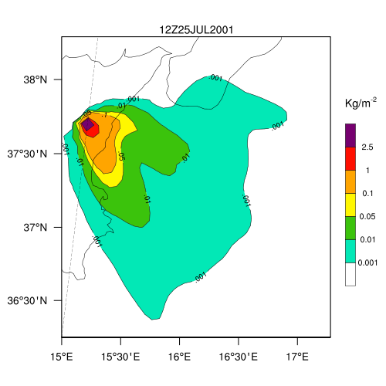
Settling velocity RunTime GLOBAL RUN

Slide 52
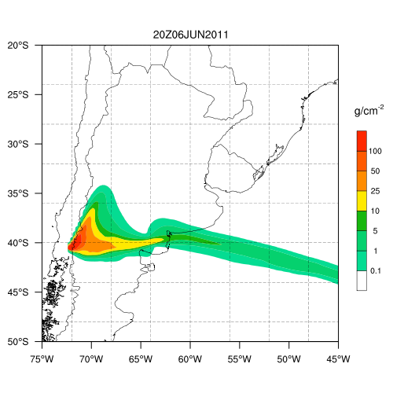
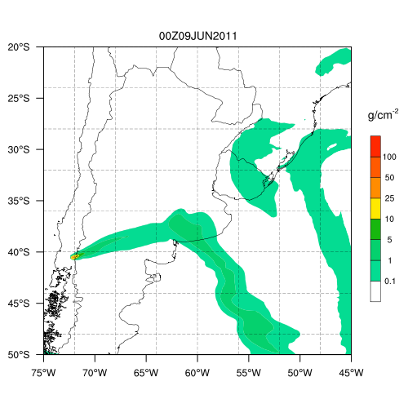
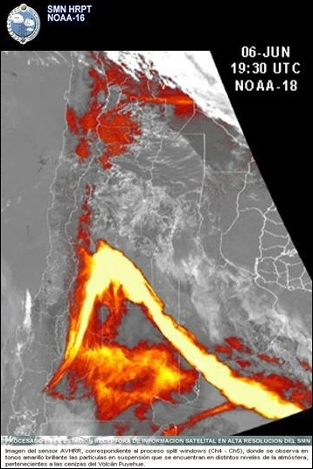
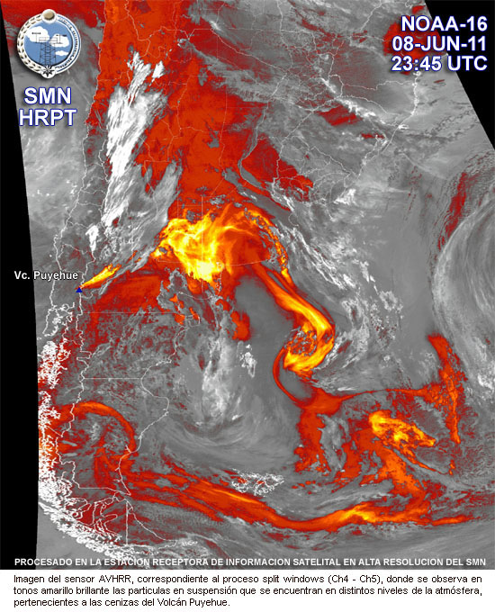
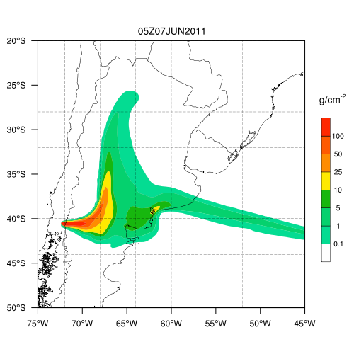
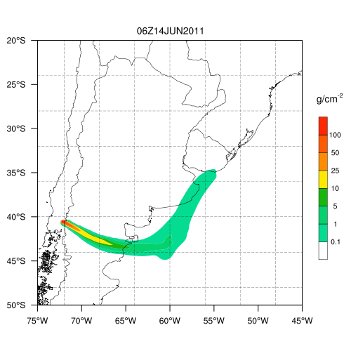
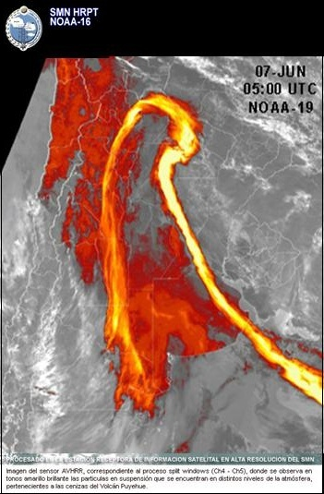
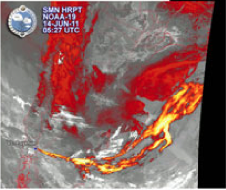
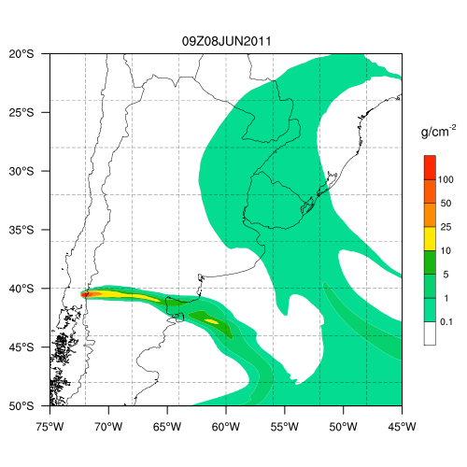
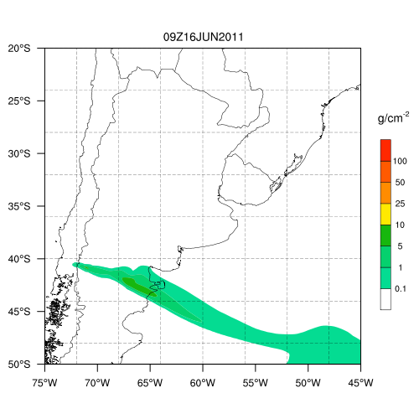
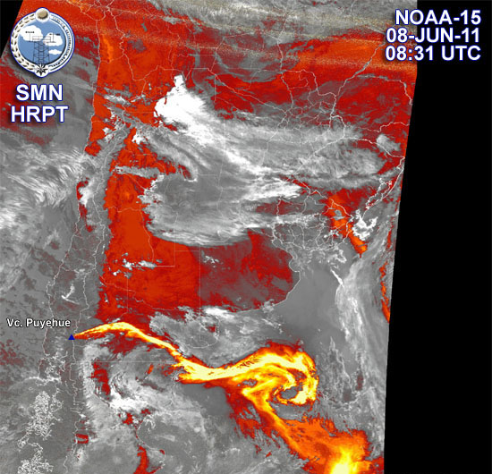
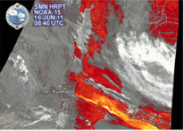
Ash deposition

