Slide 1
AGU21- 14/12/2021
Accelerating Earth System Predictability: Advances in High-Performance Computing, Numerical Modeling, Artificial Intelligence, and Machine Learning
Collecting and analysing computational performance metrics of ESMs in the CMIP6 experiment in the framework of IS-ENES3 project
Mario Acosta, Sergi Palomas, Kim Serradell
But also thanks to: BSC colleagues, IS-ENES3 partners, V. Balaji, Sadie Bartholomew, Niki Zadeh, HPC-TF Group, ...
IS-ENES3 has received funding from the European Union’s Horizon 2020 research and innovation programme under grant agreement No 824084

Slide 2
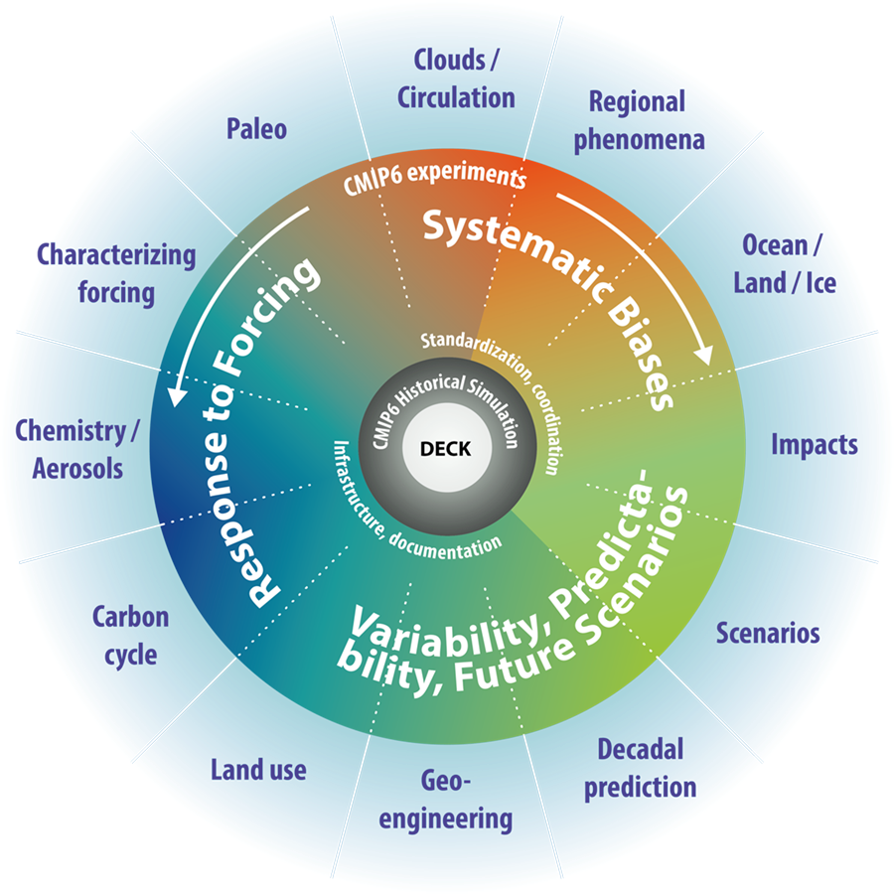
Motivation
CMIP6: Coordinated experiments designed to understand specific aspects of the model response.
Traditional metrics of computational efficiency such as performance counters and scaling curves do not provide us enough information about real sustained performance from climate models on different machines.
Traditional benchmarks (as LINPACK test) are not completely representative of a complete Earth System Model running an operational configuration as CMIP6.
CPMIP: a set of metrics that can be used for the study of computational performance of Earth System Models (ESMs)
Universally available from current ESMs
ESMs running as they are run for operational configurations
Measuring performance across the entire lifecycle of modeling, and cover both data and computational load;
Easy to collect, no requiring specialized instrumentation or software
The IS-ENES3 project has received funding from the European Union’s Horizon 2020
research and innovation programme under grant agreement No 824084

Slide 3
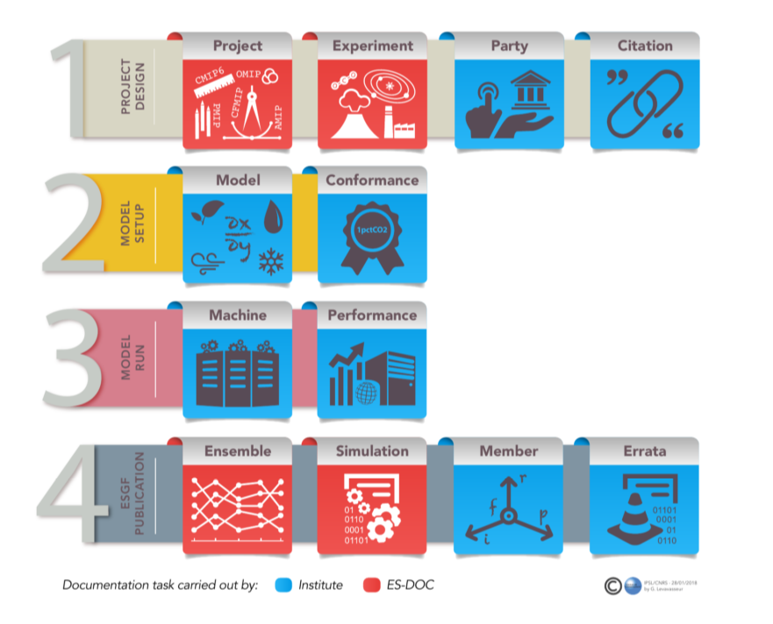
CPMIP: Community numbers
The CPMIP collection will be available through ES-DOC.
Analysis and general recommendations will be available in a IS-ENES3 deliverable in December.
Final results will be published as a paper at the beginning of next year.
Provided by Sadie Bartholomew
The IS-ENES3 project has received funding from the European Union’s Horizon 2020
research and innovation programme under grant agreement No 824084

Slide 4
CPMIP metrics
Simulation Year Per Day (SYPD): how efficient is your sim job per each year of the simulation
Core-hours Per Year (CHPY): how efficient is your sim job with respect to the number of parallel resources used
Complexity: the number of prognostic variables per component
Actual SYPD: how affect queue time and interruptions to the complete experiment
Parallelization: total number of cores allocated for the run
Energy Cost Per Year (JCPY): how much energy is needed per each year of simulation
Memory Bloat: the ratio between actual and ideal memory size
Data Output Cost: how much time and resources are used performing I/O
Data Intensity: the amount of data produced per compute-hour
Coupling Cost: how much time and resources are used in the cost of the coupling algorithm as well as load imbalance
Improve the computational performance evaluation of our ESMs
Compare the performance of models running similar CMIP6 experiments.
Evaluate the performance of a model compared to others with a similar complexity.
Evaluate the performance of one platform compared to others running the same model.
Evaluate the efficiency of a model when the complexity increase (more components, higher resolution…).
Evaluate the performance of a model from different points of view and find main bottlenecks.

Slide 5
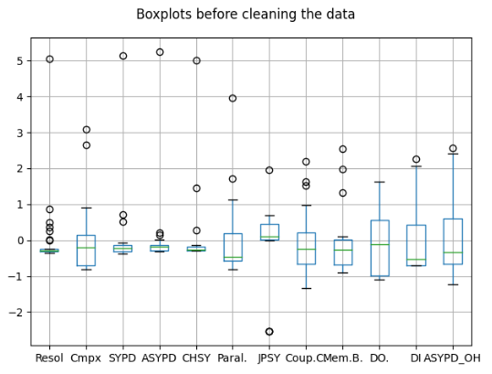
CPMIP Analysis
We gathered all the metrics to prove “statistically” the correlations between them
And we found that outliers were very common
Dropped values which were more than 2 standard deviations apart from the mean
We used the Pearson’s correlation coef. to get some insights on the relations between the metrics (>0.7)
Pearson’s corr. helps us to support our “theoretical” expectations (e.g. higher resolution ↔ higher CHPSY)
The IS-ENES3 project has received funding from the European Union’s Horizon 2020
research and innovation programme under grant agreement No 824084

Slide 6
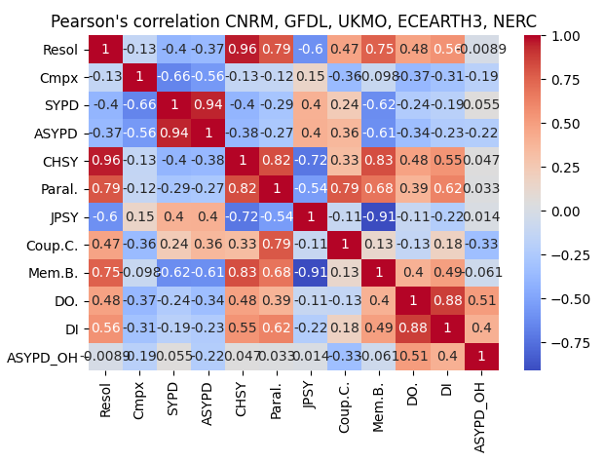
CPMIP Results
If we group these experiments per complexity
No model using the highest resolution is scaling ideally
These configurations are very demanding
This could be due to
to hardware restrictions,
the high cost of other phases
the overhead introduced for a higher number of parallel resources
the memory consumption
… or a combination of some of them
Resol
SYPD
CHSY
Paralel
The IS-ENES3 project has received funding from the European Union’s Horizon 2020
research and innovation programme under grant agreement No 824084

Slide 7
Lessons learned about the collection
CPMIP collection is not only a dissemination process. It is a very powerful tool to analyze the computational efficiency of a model across platforms, configurations; find bottlenecks…or even for the multi-model comparison.
Although the CPMIP collection is important, it is secondary during the CMIP execution.
Collect CPMIP metrics before or during the CMIP experiment.
Develop new approaches to analyze the results.
Inconsistencies in the way that some metrics are collected.
Create a finer granularity for some of the metrics.
The IS-ENES3 project has received funding from the European Union’s Horizon 2020
research and innovation programme under grant agreement No 824084

Slide 8
This project has received funding from the European Union’s Horizon 2020 research and innovation programme under grant agreement N°824084
Our website
https://is.enes.org/
Follow us on Twitter !
@ISENES_RI
Contact us at
is-enes@ipsl.fr
Follow our channel IS-ENES3 H2020

