Slide 1
Improving the throughput of Earth System Models using an asynchronous parallel I/O server
Xavier Yepes-Arbós
17/04/2018
8th JLESC Workshop, Barcelona

Slide 2
Index
Introduction
Motivation
I/O overview for Earth system models
Case study: IFS-XIOS
Evaluation
Conclusions

Slide 3
Introduction

Slide 4
Introduction
Scientific applications have benefited of the exponential growth of supercomputing power
This allows to use more complex computational models to find more accurate solutions
However, this implies to generate a huge amount of data to meticulously represent accurate solutions

Slide 5
Introduction
Earth system models are a particular case that solve complex models and generate a lot of data
More accurate forecasts, predictions and projections through higher grid resolutions
This implies to use efficient HPC techniques, such as optimized MPI communications
However, the I/O part has almost been forgotten, since it was not significant enough in the past

Slide 6
Introduction
Some Earth system models output data using inefficient sequential I/O schemes
This type of scheme requires a serial process:
Gather all data in the master process of the model
Then, the master process sequentially writes all data
This is not scalable for higher grid resolutions, and even less, for future exascale machines

Slide 7
Introduction
In addition, Earth system models run experiments that have other tasks in their workflow
Post-processing task can perform data format conversion, compression, diagnostics, etc.

Slide 8
Motivation

Slide 9
Motivation
In particular, we experience this problem with EC-Earth, a coupled climate model
EC-Earth has started to run ultra-high resolution experiments under the H2020 PRIMAVERA project
However, it suffers a considerable slowdown, where the I/O represents about 30% of the total execution time

Slide 10
Motivation
In order to address the I/O issue, we have to select a suitable tool that fulfills a series of needs:
It must be a parallel, efficient and scalable I/O tool
Data must be written using netCDF format and must follow the CMIP standard
It must perform online post-processing along with the simulation, such as interpolations or data compression
There is a tool designed to that end: XIOS
XIOS is an I/O server

Slide 11
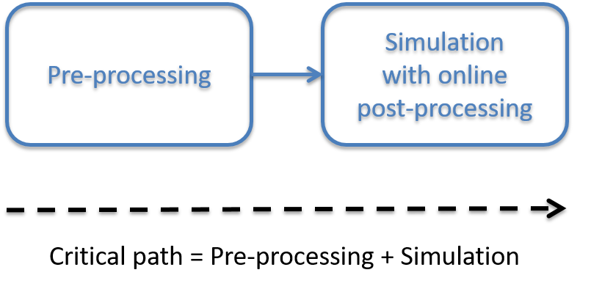
Motivation
Use a tool such as XIOS, has a twofold effect:
Improve the computational performance and efficiency of a model, and thus, reduce the execution time
Reduce the critical path of its workflow by avoiding the post-processing task

Slide 12
I/O overview for Earth system models

Slide 13
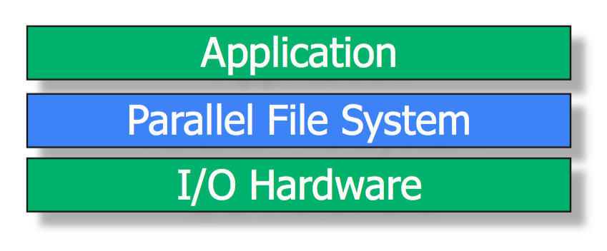
Sequential I/O
In parallel applications there are two approaches:
Each process outputs its own local data
Data is gathered by the master process, which sequentially writes the whole global data
It is typically done using the POSIX I/O API: open, write, close, etc.

Slide 14
Parallel I/O
In order to make the I/O scalable, it is typically used parallel I/O
Parallel I/O is the ability to perform multiple input/output operations at the same time, such as:
Simultaneously write several files
Concurrently write into different regions of the same file from different processes
Different writing modes: multiple file, one file and intermediate approach

Slide 15
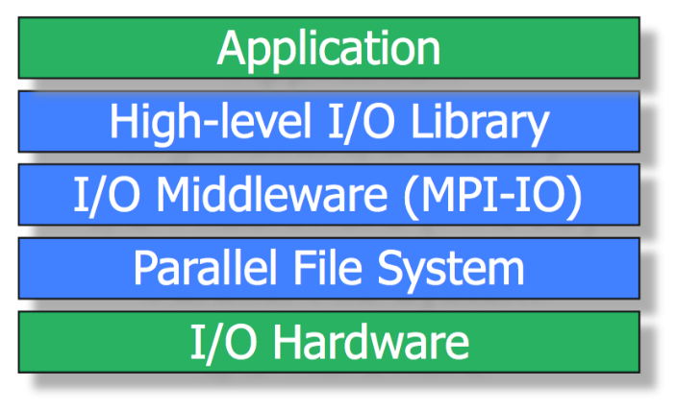
Parallel I/O
POSIX cannot offer the possibility to implement parallel I/O
Built upon MPI-IO for the I/O Middleware layer
Built upon netCDF or HDF5 for the High-level layer

Slide 16
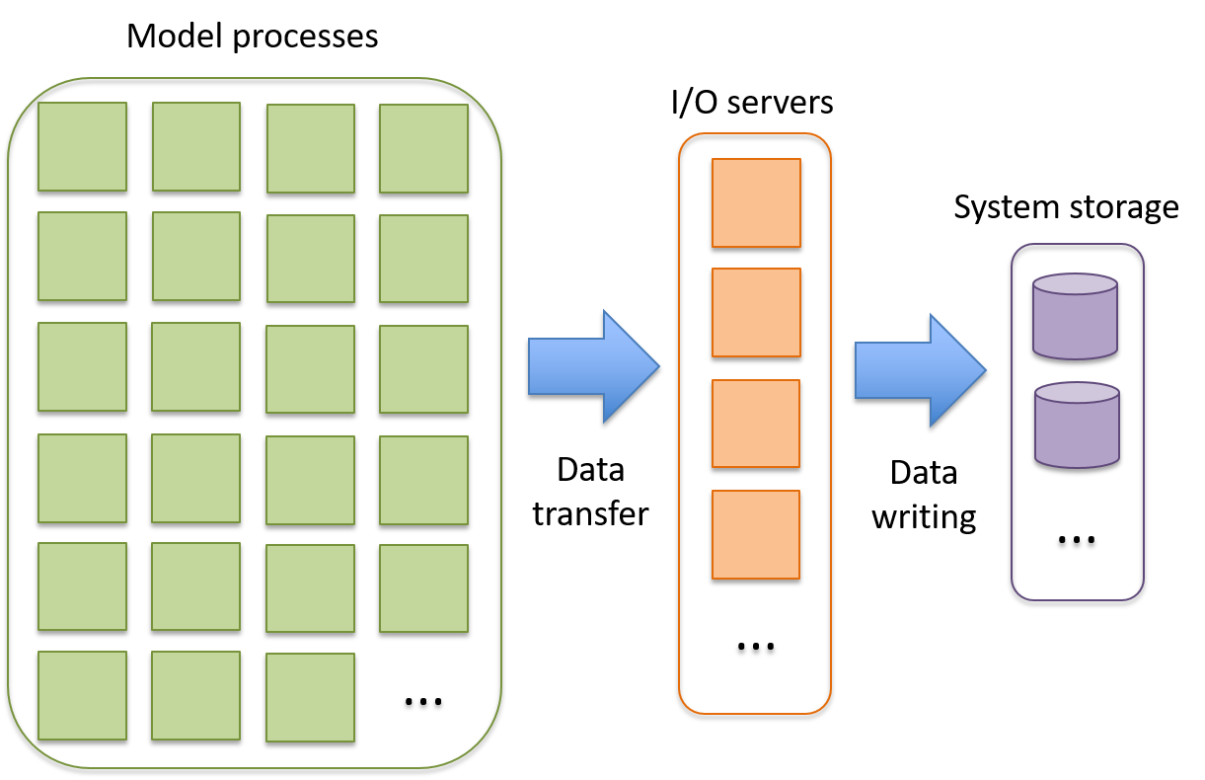
I/O servers
I/O servers are exclusively dedicated resources to perform input/output
Model processes do not deal with the I/O, so they can continue with the simulation
Disk latency is hidden

Slide 17
Case study: IFS-XIOS

Slide 18
IFS
The Integrated Forecast System (IFS) is a global data assimilation and forecasting system developed by ECMWF
It uses an inefficient sequential I/O scheme
It writes using the GRIB format (weather forecast)
When IFS is used for climate modeling, post-processing is needed to:
Convert GRIB to netCDF files
Transform data to be CMIP-compliant
Compute diagnostics

Slide 19
EC-Earth
EC-Earth is a global coupled climate model, which integrates a number of component models in order to simulate the Earth system
The two main components are IFS as the atmospheric model and NEMO as the ocean model

Slide 20
XIOS
The XML Input/Output Server (XIOS) is an asynchronous MPI parallel I/O server
It writes using the netCDF format
Written data is CMIP-compliant
It is able to post-process data online to generate diagnostics

Slide 21
IFS-XIOS integration
Integrate IFS with XIOS
Analyze and optimize the integration
The goal is to improve the IFS performance to get benefit of the XIOS features in EC-Earth:
Reduce the IFS execution time
Avoid the post-processing task

Slide 22
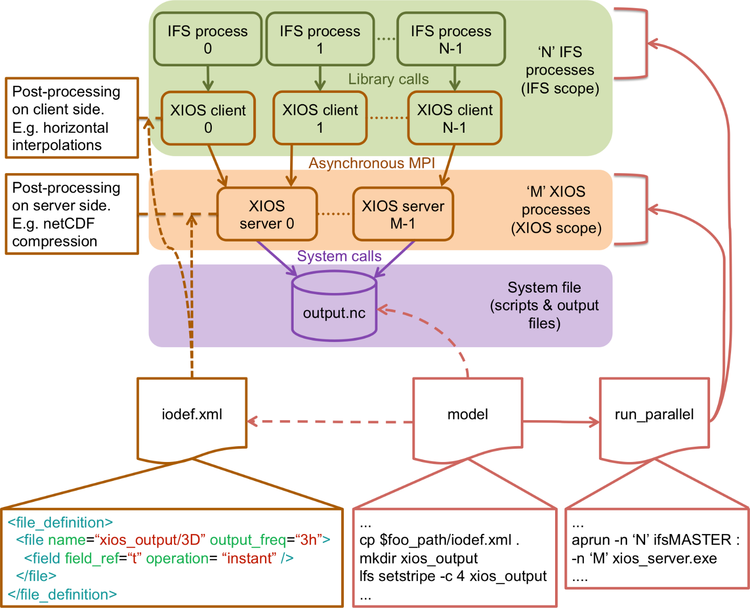
IFS-XIOS integration

Slide 23
Evaluation

Slide 24
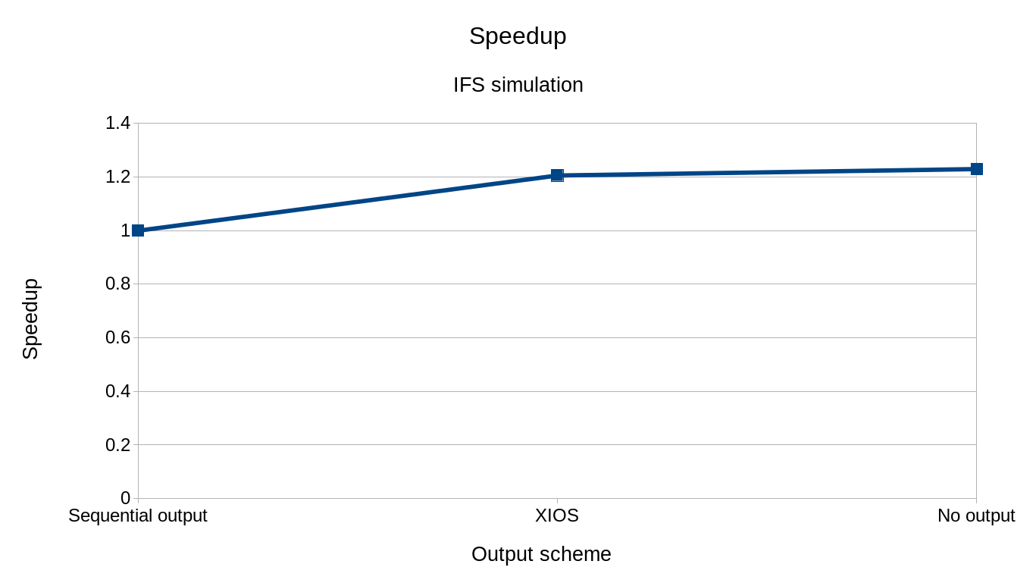
IFS simulation

Slide 25
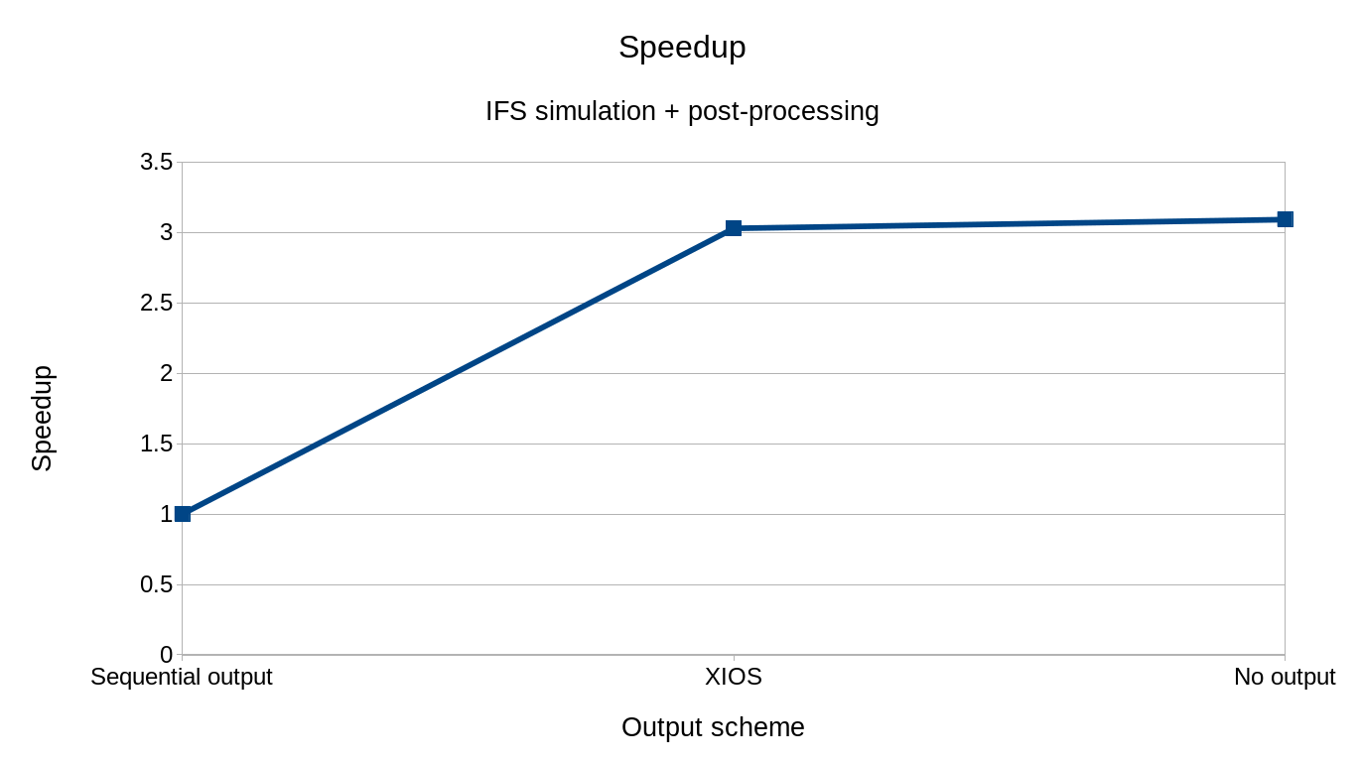
IFS simulation + post-processing

Slide 26
Discussion

Slide 27
Discussion
Is there any other tool similar to XIOS? If so, is it more efficient?
Do you think there are other parallel I/O techniques that are more suitable than XIOS?
Are I/O servers a good approach to address the I/O bottleneck for future exascale machines?

Slide 28
Thank you
xavier.yepes@bsc.es

