Slide 1
Destination Earth project: implementation of Earth Digital Twins at BSC
Kim Serradell, Paco Doblas-Reyes, Miguel Castrillo, Mario Acosta, Albert Soret, Jesús Labarta, Marta Garcia, David Vicente, Sergi Girona
15/09/2022
16th USERS CONFERENCE - RES

Slide 2
Outline
BSC Earth Sciences
Destination Earth program
Digital Twins
Implementation at BSC

Slide 3
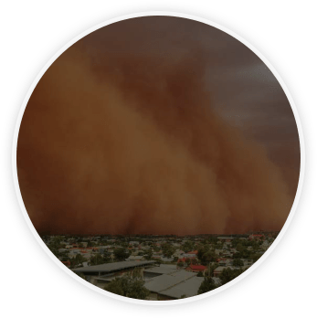
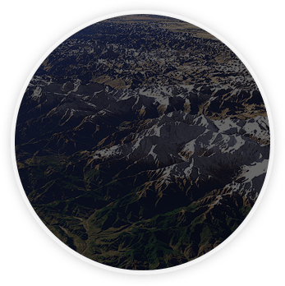
Earth Sciences
Environmental modelling and forecasting, with a particular focus on weather, climate and air quality
Modeling
air quality and
Sand and Dust Storms
Processes from urban to
Global and the impacts
on weather, health
and ecosystems
Climate
predictions
system from
subseasonal-to-decadal
forecasts
Research
and
Forecasts
Service Users Sectors
Infrastructures
Solar
Energy
Urban
development
Transport
Wind
Energy
Agriculture
Insurance

Slide 4
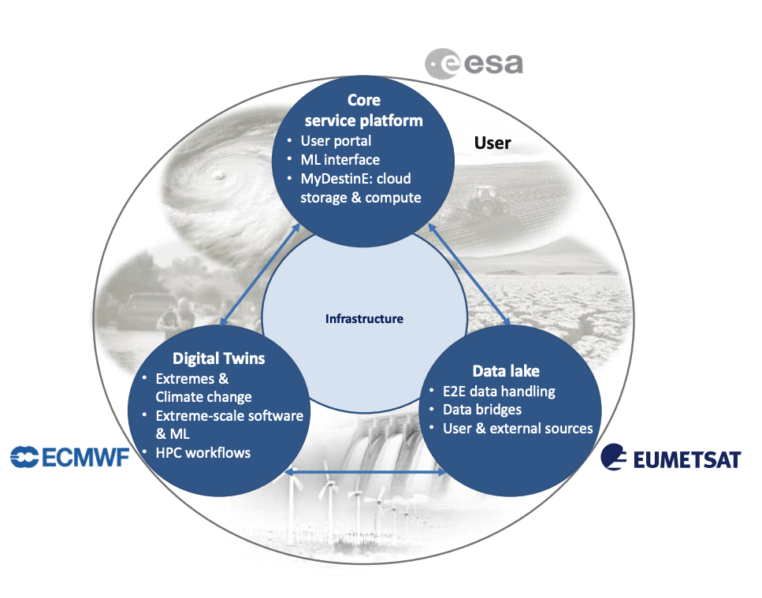
Destination Earth
Destination Earth is user-centred
Users of DestinE, including non-scientific experts, will be able to:
Perform highly accurate, interactive and dynamic simulations of the Earth system
Improve prediction capabilities to maximize impact
Support EU policy-making and implementation
Exploit the potential of distributed and high performance computing (HPC) and data handling at extreme scale
https://digital-strategy.ec.europa.eu/en/policies/destination-earth

Slide 5
Digital Twins
BSC is involved in two digital twins:
CATS: Climate Adaptation Digital Twins
DEODE: Destination Earth On-Demand Extremes
Schedule
Started 1st September
20 months

Slide 6
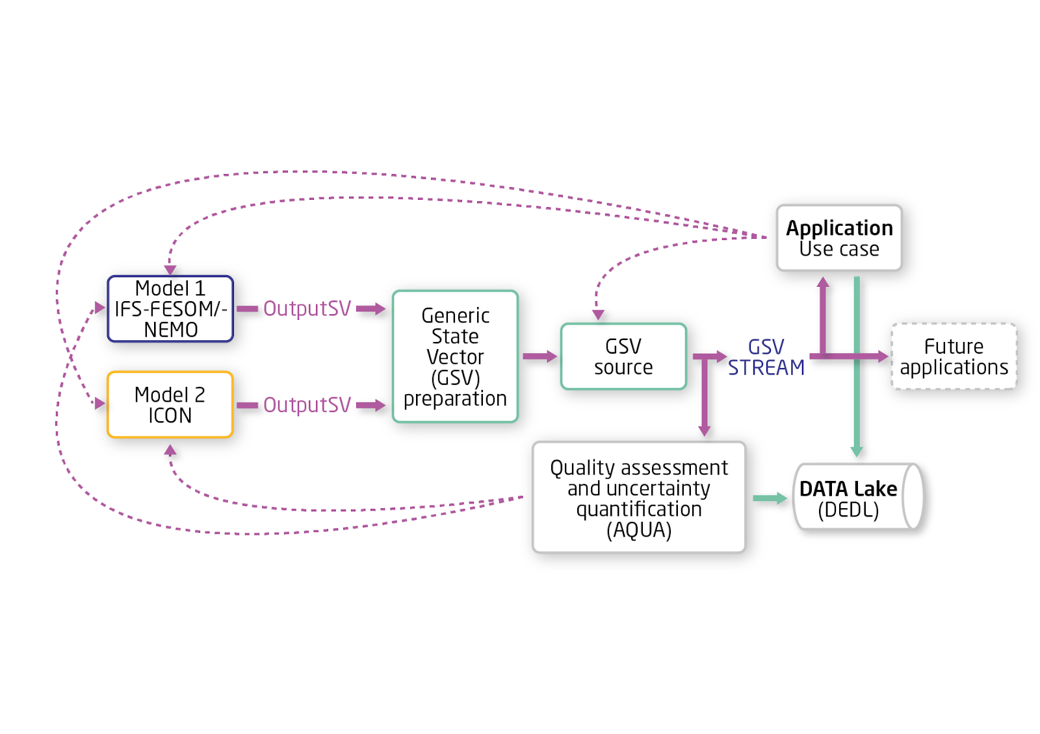
CATS (Climate DT)
Led by CSC (Finland) but strong BSC involvement
Create a climate information system that, enabling kilometre-scale models, effectively guides climate change adaptation measures
Models will run in EuroHPC machines
Focus on workflows → data streaming is central to the envisioned solution, delivering data needed by applications
DestinE CATs simplified concept

Slide 7
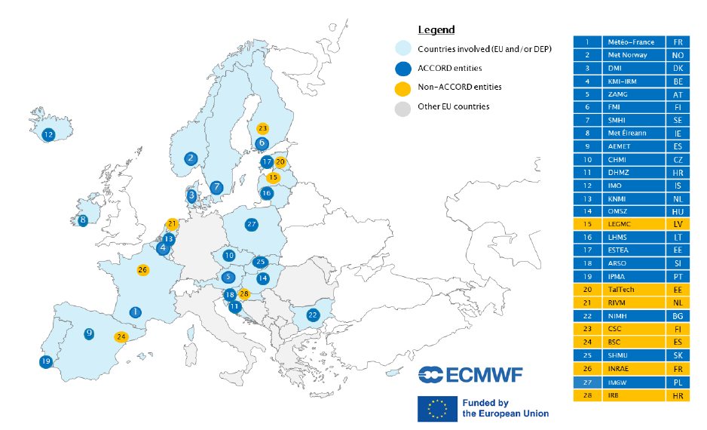
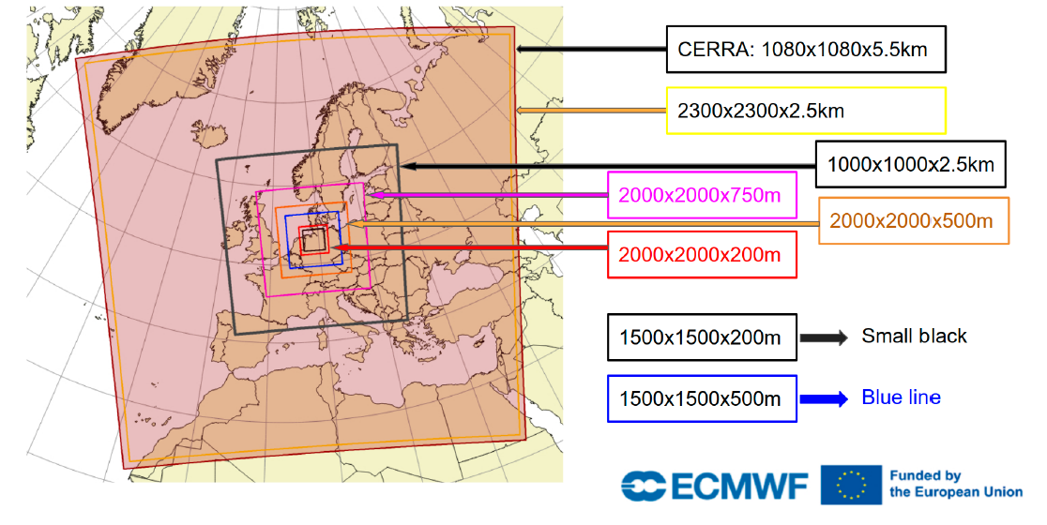
DEODE (Extremes DT)
Led by Meteo France with BSC technical involvement
Solution for making on-demand configurable digital twin engines for forecasting of environmental extremes at the sub-km scale
The model will run in LUMI
Based on the ACCORD existing consortium and meteorological model
Most of the meteorological services in Europe
Example of DEODE digital twin model domains
Map of entities involved in the DEODE project

Slide 8
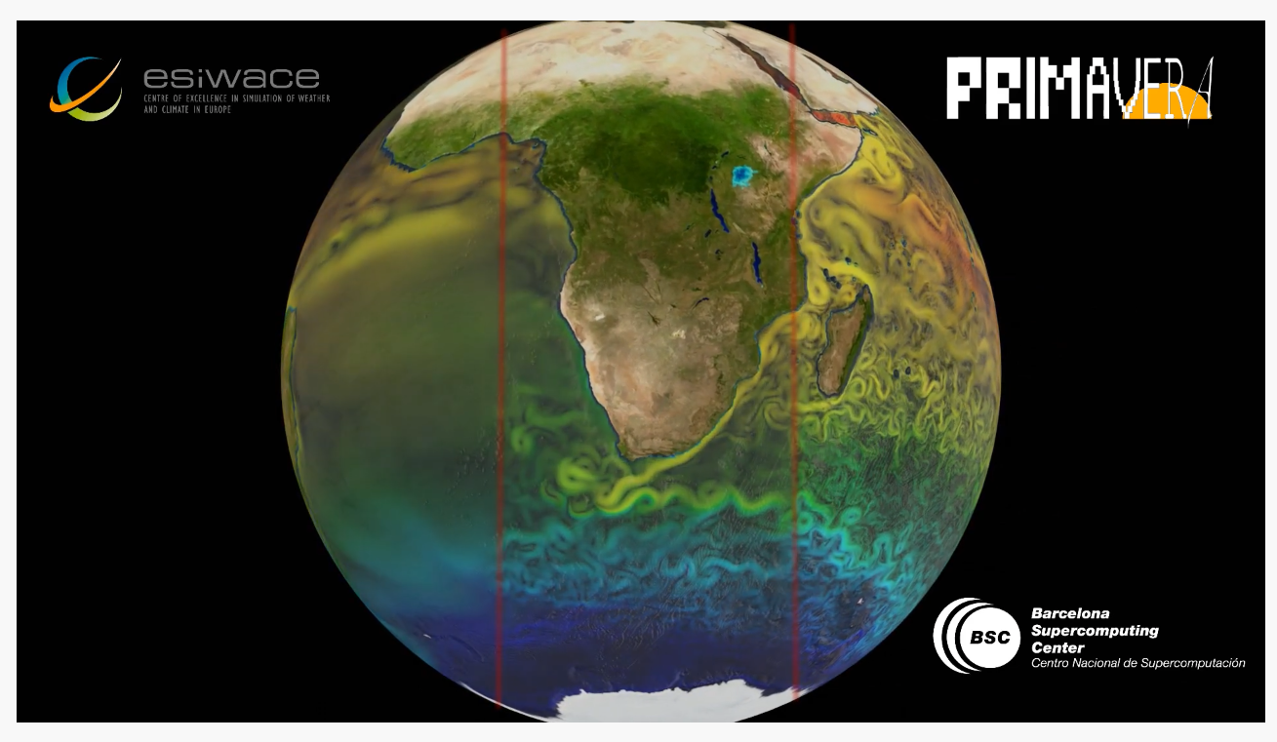
Unprecedented space and time resolution
and hourly resolution (at least).
Up to 2.5km of horizontal resolution in climate models
Comparison of sea-surface temperature and current speed from three different EC-Earth configurations
(ORCA1º, ORCA1/4º and ORCA1/12º).
https://www.youtube.com/watch?v=xmE9t0WYhsA

Slide 9
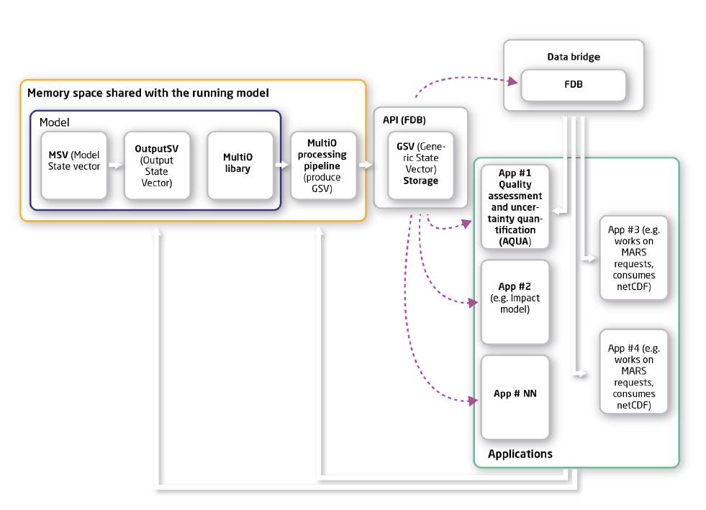
Output management
Digital Twins will produce unprecedented data volume → traditional approach based on files is no longer valid
DTs will store reduce and store data in Fields DataBase (FDB)
FDB is a domain-specific object store for meteorological objects (GRIB) developed by ECMWF (https://github.com/ecmwf/fdb)
DestinE climate DT simplified concept

Slide 10
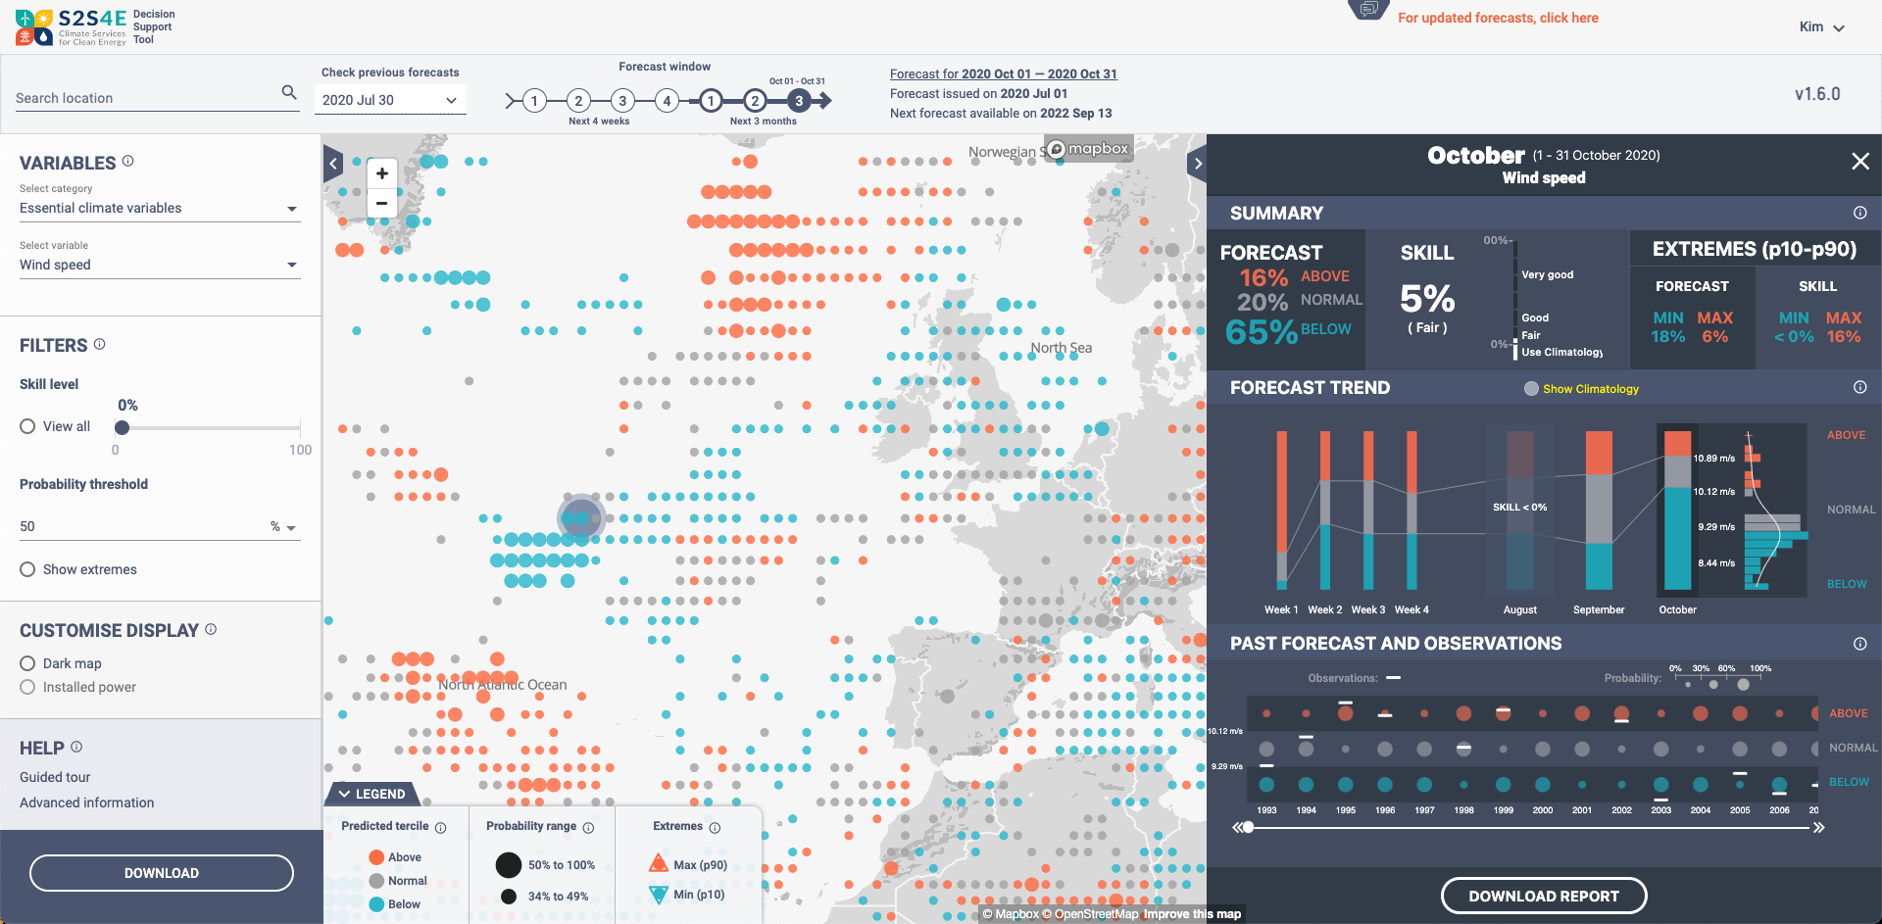
DE Uses Cases
Both DT will offer uses cases to show the potential application of the digital twins
Those uses cases should open the door to other applications (from end users)
Climate
Energy
Wildfires
Hydrology (river flows)
Hydro Meteorological Ind.
Urban Environments
Extremes
Hydrology
Air quality
Renewable energy
S2S4E Decision support tool

Slide 11
EuroHPC and pre-exascale machines
DTs will run in LUMI, Mare Nostrum 5 and Leonardo
Codes need to be modified to leverage the full potential of accelerators
With different models, different GPU porting strategies are considered
OpenACC
Source-to-source translators and DSLs (Loki, Psyclone, GPUFort, …)
CUDA
Strong involvement of model developers, performance engineers and system administrators to be successful
Further develop AI methods applied to Earth Sciences needs

Slide 12
Multidisciplinary and Interdepartamental
DestinE is an ambitious project and will requirement a wide range of expertise and knowledge to tackle the objectives
Within BSC
Earth Sciences
Computational Earth Sciences (performance analysis, porting, workflow design, post-processing tools, …)
Climate Variability and Change (model development, climate sciences, …)
Earth System Services (climate services, outreach, liason with users and stakeholders, …)
Computer Sciences (performance tools, co-design, …)
Operations (HPC operation, deployment of solutions, …)
Not many research institutions have this diverse knowledge in-house. The BSC role is key because few other institutions offer software engineers, natural scientists and social scientists under the same roof and sharing the same vision.
The technological solutions that will facilitate a new way of interacting with decision makers in DestinE require a significant investment in multidisciplinary groups such as those at BSC

Slide 13
Impact of DE in Spanish Ecosystem
Mare Nostrum 5 will run Destination Earth simulations
National expertise in models development and operation and data
Spanish meteorology and climate community (and HPC ecosystem associated) should take advantage of such a position
Stay tuned for the next dissemination activities (stakeholders meetings, data hackathons, …)

Slide 14
Destination Earth next phases
Phase 1 (2021-2024):
Delivery of 1st digital twin generation
Demonstration of new capabilities at scale
Phase 2+ (2024-):
Extend to new applications
Fully integrate components
Widen DTE scope (more DTs to come…)
By 2027
Further enhancement of the Destination Earth system and integration of additional digital twins and related services.
By 2030
A ‘full’ digital replica of the Earth

Slide 15
Destination Earth as a game changer
Long-term vision:
CATS: revolutionize climate adaptation putting user requirements at the centre and making the best use of the technology (models and machines)
DEODE: on-demand workflow of unprecedented, high-resolution forecasts extreme weather events combined with decision making support for impact sectors
DestinE will provide unprecedented environmental information in terms of quality, interactivity and relevance, ready to be consumed by applications through dedicated data lakes and a service platform

Slide 16
Thank you
kim.serradell@bsc.es

