Slide 1
A glimpse into the ongoing climate prediction activities with EC-Earth: going beyond CMIP6
Pablo Ortega (BSC)
On behalf of the Climate Prediction Working Group
EC-Earth meeting, Lund, 11-13 October 2022

Slide 2
A joint effort to expand the predictive capabilities of EC-Earth
Improving underlying models:
Corrected model biases
Optimised model tuning
Enhancing process representation:
More realistic forcings (vegetation, aerosol emissions)
Increased model resolution
Enhancing forecast initialization
Coupled nudging
EnKF assimilation
Going beyond climate prediction
Predicting the carbon cycle
Towards marine ecosystem prediction

Slide 3
Reducing sea surface biases via climatological flux adjustment
To what extent model biases degrade forecast system skill?
Development of a flux adjusted version EC-Earth3-CC with substantially reduced model biases ✓
t2m bias EC-Earth3-CC picontrol
t2m bias EC-Earth3-CC-FA 1990 control
Correction terms in:
SST, SSS, Wind Stress
Evaluation of EC-Earth3-CC-FA Ongoing
Production and evaluation of a decadal prediction system with EC-Earth3-CC-FA
Y. Ruprich-Robert

Slide 4
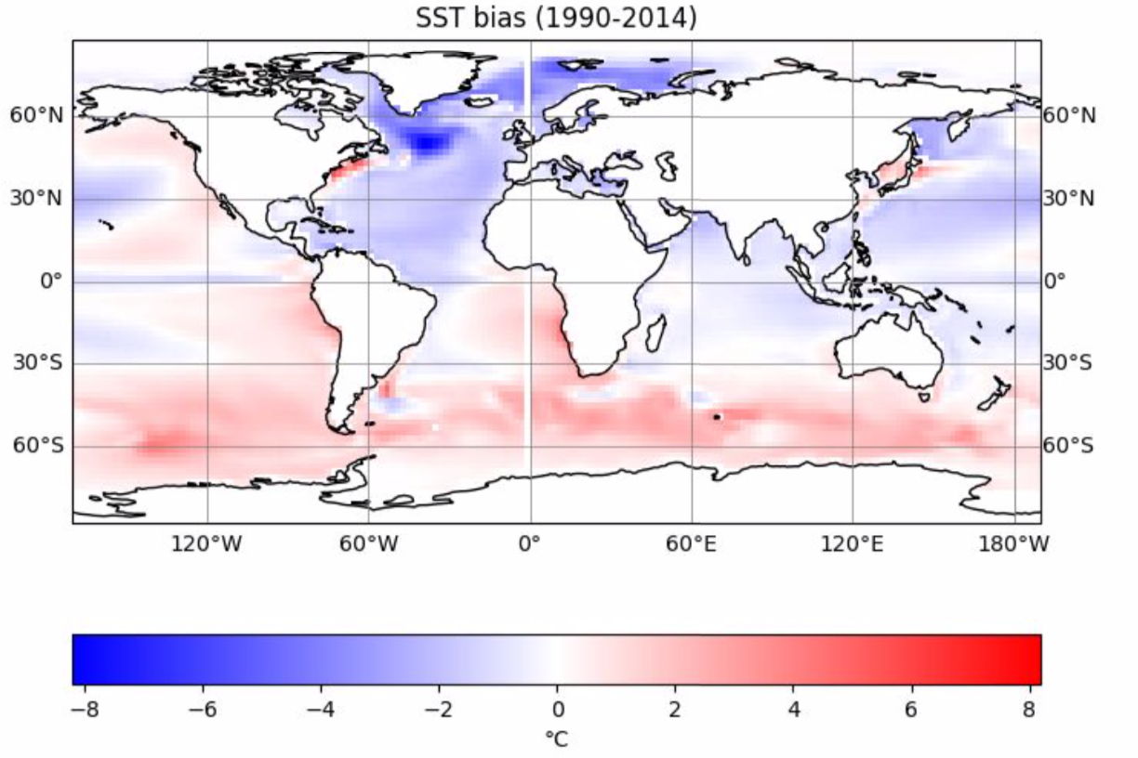
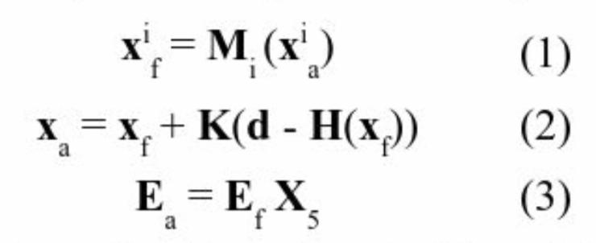
Parameter estimation using the EC-Earth model
Can we reduced key model biases via smart tuning approaches?
The main goal is to update the parameter distribution with new values from a data assimilation system based on an Ensemble Kalman Filter (EnKF)
SST biases in EC-Earth3 ensemble
Main EnKF Equations
North Atlantic Focus
But keeping an eye on the impact that the tuning will have elsewhere
Methodology used before the fine tune the sea ice (Massonnet et al 2014)
Helena Barbieri de Azevedo, François Massonnet and Xia Lin
Evaluation of EC-Earth3-CC-FA Ongoing
Production and evaluation of a decadal prediction system with EC-Earth3-CC-FA

Slide 5
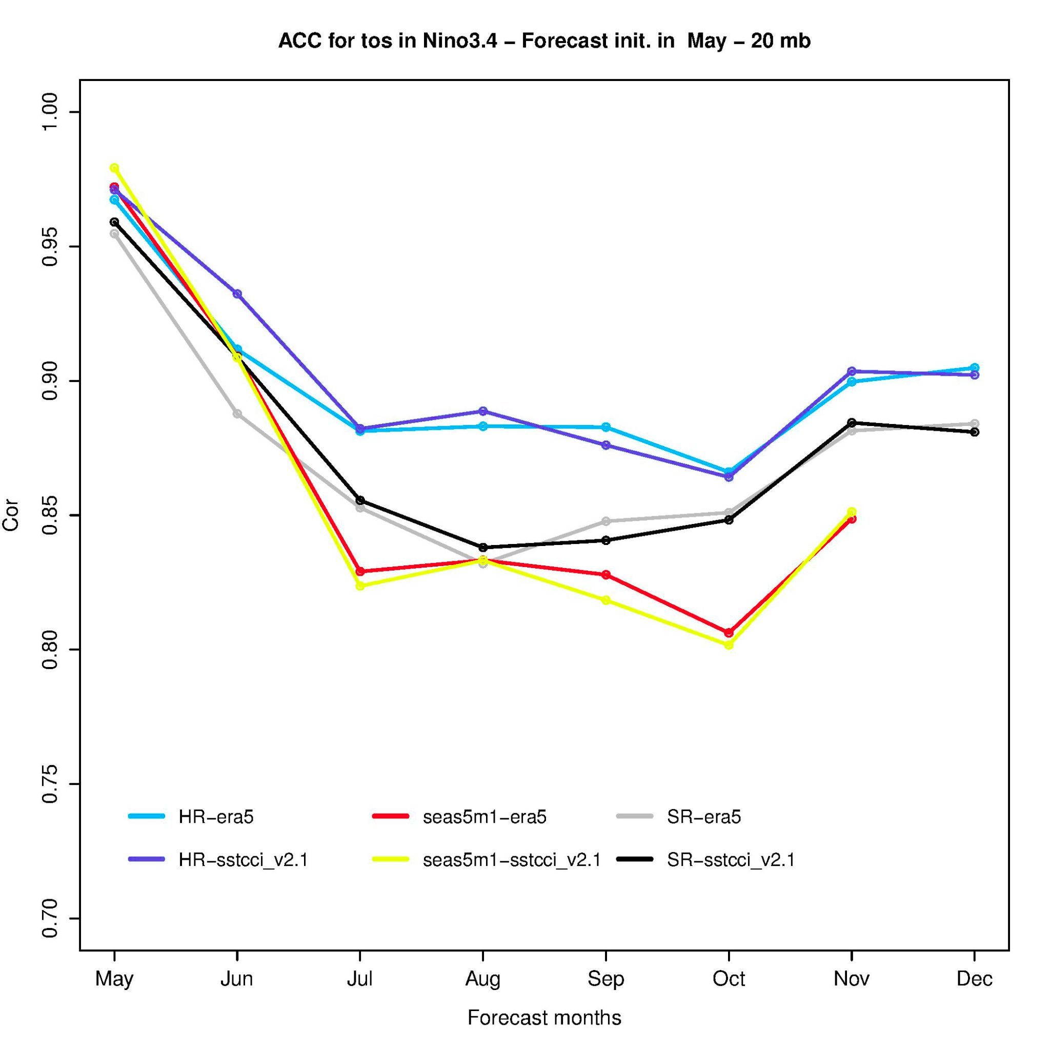
Seasonal and multi-annual predictions at eddy-permitting scales
Is there a tangible benefit of increasing the horizontal resolution?
HR ACC t2m MJJASO
LR ACC t2m MJJASO
LR - HR ACC t2m MJJASO
Seasonal forecast system
20 members
23 startdates (1993-2014)
8 forecast months
1st May/ Nov initial dates
Under analysis
Ref: ERA5 - TAS
Multi-annual forecast system
5 members
31 startdates (1960-2020)
24 forecast months
1st Nov initial dates
In Production
Some 1st May
Initialised Examples
ACC Niño3.4
HR
SR
SEAS5
Ref: ERA5 and SST-CCI
A. Carreric, M. Donat, F. Doblas-Reyes, P. Ortega
Evaluation of EC-Earth3-CC-FA Ongoing
Production and evaluation of a decadal prediction system with EC-Earth3-CC-FA

Slide 6
Effects of reduced anthropogenic emissions on the Asian summer monsoon prediction: the case of summer 2020
Can we better predict Asian summer 2020 monsoon with refined emissions?
Precipitation Anomaly JJA 2020
Changes in AOD @550nm
2020-2024
COVID-MIP is based on measures from LeQuere et al (2020)
A. Cherchi, A. Alessandri, E. Tourigny, J.C. Acosta Navarro, P. Ortega, P. Davini, D. Volpi, F. Catalano, T. van Noije, H. Annamalai

Slide 7
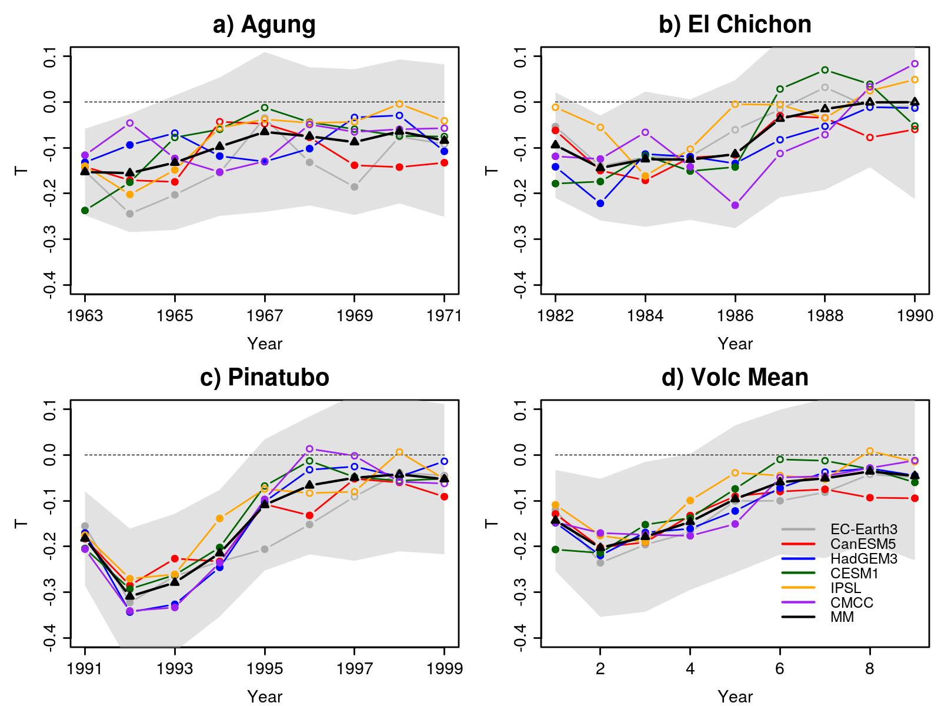
Including the predictive effect of past and new volcanic eruptions
Building and testing the necessary capabilities
DCPP-C: Climate impacts of major volcanic eruptions in CMIP6 decadal prediction systems (Bilbao et al., in prep.).
Validating the climate response to idealised volcanic forcings generated with EVA and EVA-H for past eruptions.
Decadal Prediction Volcanic Response Readiness Exercise (VolRes-RE): reapeting Nov 2021 prediction with a large volcanic eruption in April 2022.
Global SST response
Comparing real and idealized aerosol forcings and their responses
Global mean TOA
Pinatubo global AOD 530nm
R. Bilbao, E. Martín-Martinez, P. Ortega

Slide 8
Effect of improved vegetation-representation on decadal prediction
What are the benefits of considering realistic changes in vegetation?
DCPPctl bias lead 0
Experimental set-up
Effective vegetation estimated from satellite data of Fcover, LAI and the ESA-CCI land cover
Selection of start dates covers the period with available satellite vegetation data (1993-2014)
Comparison with DCPP r1-10i1f1p1 ensemble (DCPP-CTL)
DCPPveg - DCPPctl bias lead 0
Main results
Bias is largely reduced in tropical regions (South America and Africa) and Siberia.
Bias slightly reduced in Indian monsoon region & Australia.
Regions of boreal forests exhibit a bias increase
E. Di Carlo, A. Alessandri, A. Cherchi, E. Tourigny, R. Bilbao

Slide 9
Common plans for coupled assimilation at DMI & SMHI
Initial Considerations
Current initialization provides limited prediction skill above the uninitialized (historical) runs
Several studies showed the benefit of joint surface & atm. assimilation (e.g., Yang et al, 2021 with GFDL; SMHI experience)
A long continuous assimilation may lead to un-equally “spin-up” length of the ocean states on the course of assimilation
Short assimilation runs have the disadvantage of potential large drifts in the ocean.
Investigating the design of new assimilation approach
Restoring of SST anomalies (HadISST) and surface wind/pressure (ERA5).
Anomalies wrt a moving climatology (30-year before start year).
Test 5-10 yr assimilation runs starting every year vs a long continuous assimilation run.
Length of assimilation decided depending on how deep ocean converges
5-10 member ensemble depending on the resources
New hindcast/forecast experiments
Prediction runs with EC-Earth3 and initial states generated from new assimilation runs
Tests will be done to decide if short or long assimilation runs are finally used
Final details still to be discussed
T. Tian, A. Drews, M. Devilliers, S. Yang, T. Koenigk and P. Karami
Notes:
it is more effective to cold forcing: SIE/SIV reduced 11/27% all year round; to warm forcing SIE only improved in summer (JASO) along the ice edge in the CAO

Slide 10
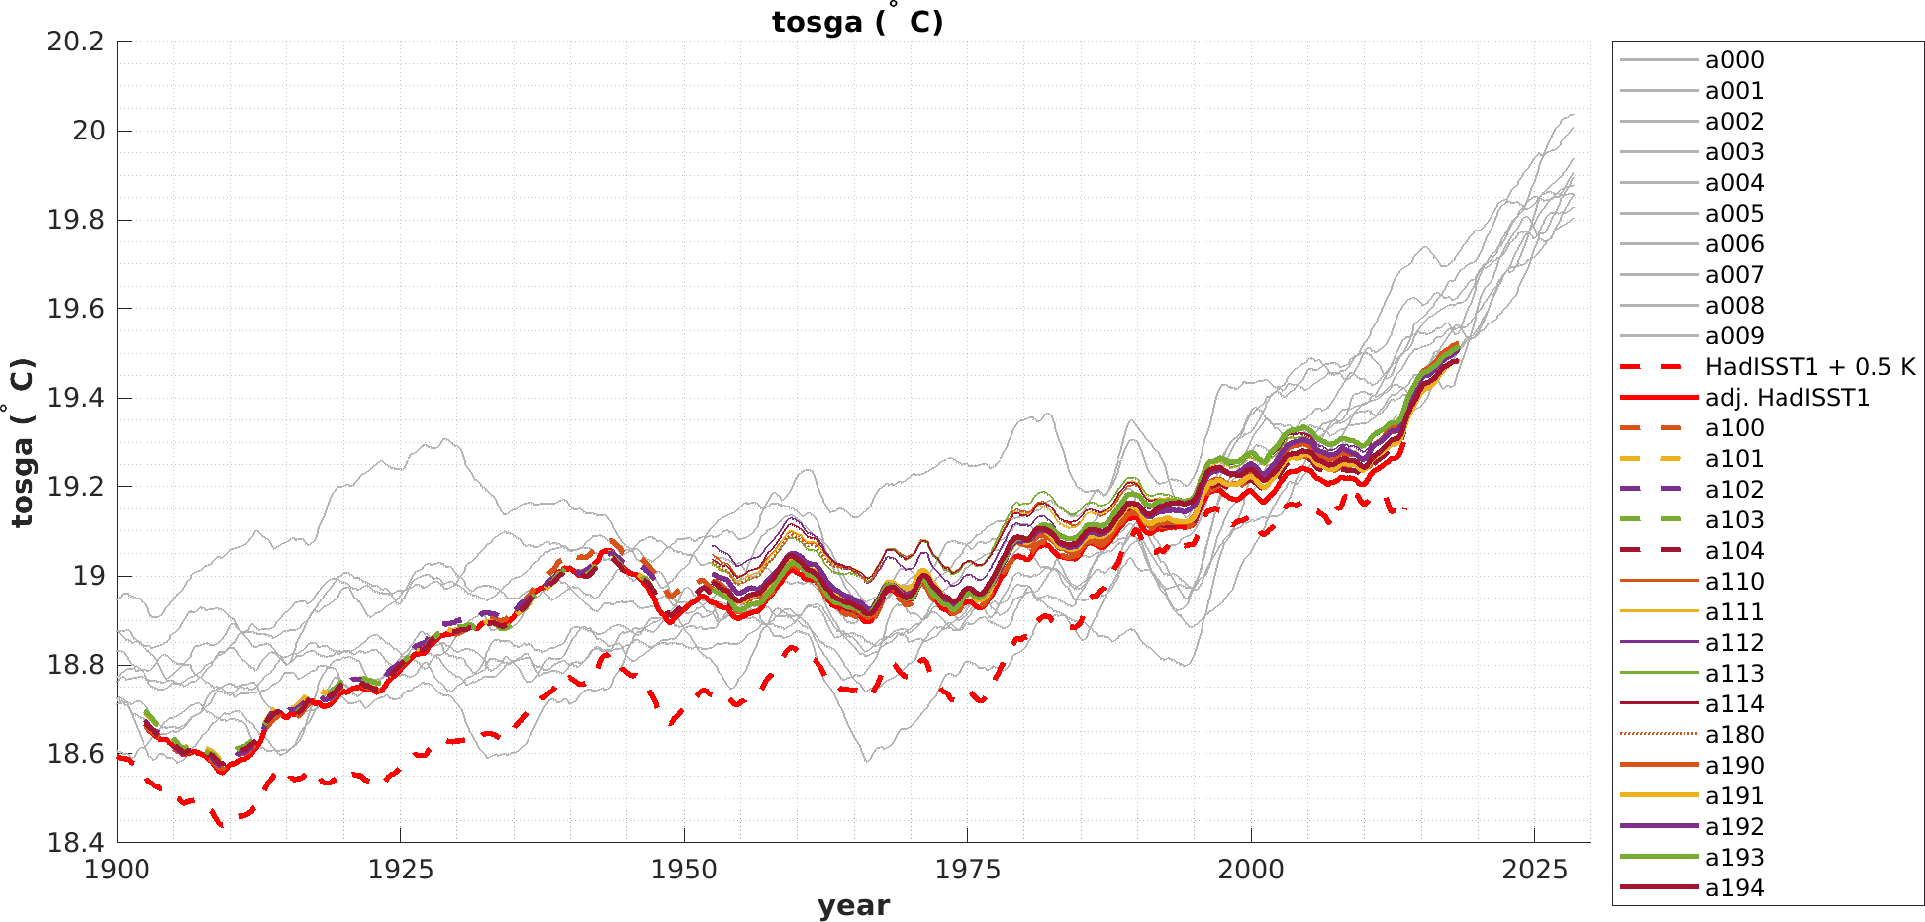
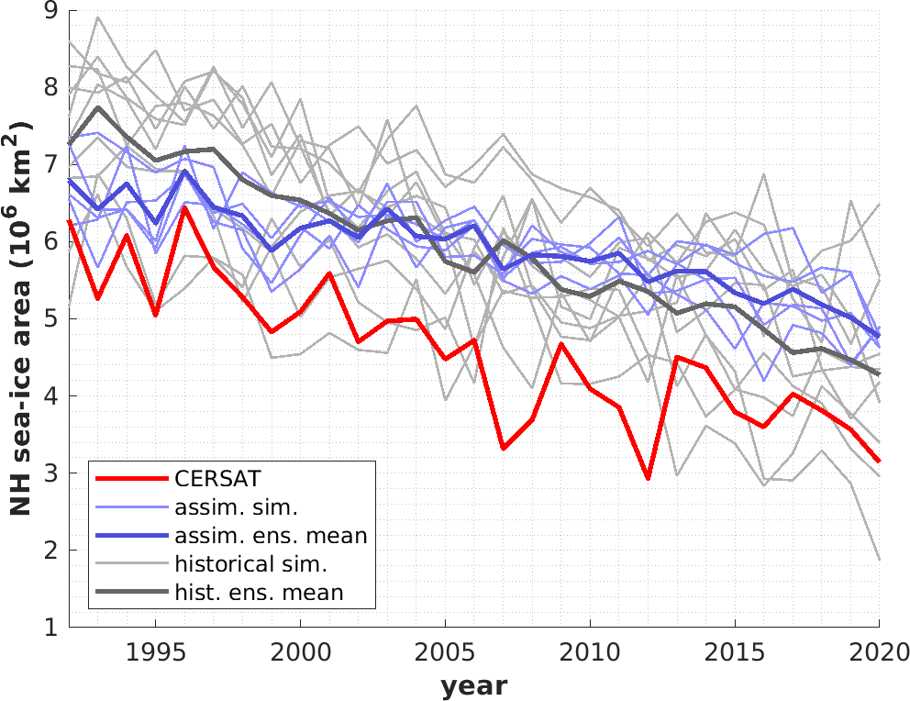
Towards a simple coupled assimilation approach for decadal prediction
Reconstructed global mean temperature
Experimental Protocol
Model version:
EC-Earth 3.3 TL255L91-ORCA1L75
Initialization:
Restarts froom 5 coupled assimilation runs
Data assimilation concept:
Assimilation of surface-near variables
Ocean:
SST-restored to monthly HadISST1 anomalies
Atmosphere:
Newtonian relaxation towards 6-hourly ERA5 anomalies of relative vorticity and divergence
Obs anomalies from running 31yr-climatologies
SST-restoring to HadISST1-anomalies since 1900
Nudging to ERA5-anomalies since 1950
Evaluated September NH SIA
Correlation of detrended timeseries: Assimilation runs: 0.64 Historicals runs: -0.08
T. Kruschke, P. Karami, K. Wyser, U. Fladrich, T. Koenigk

Slide 11
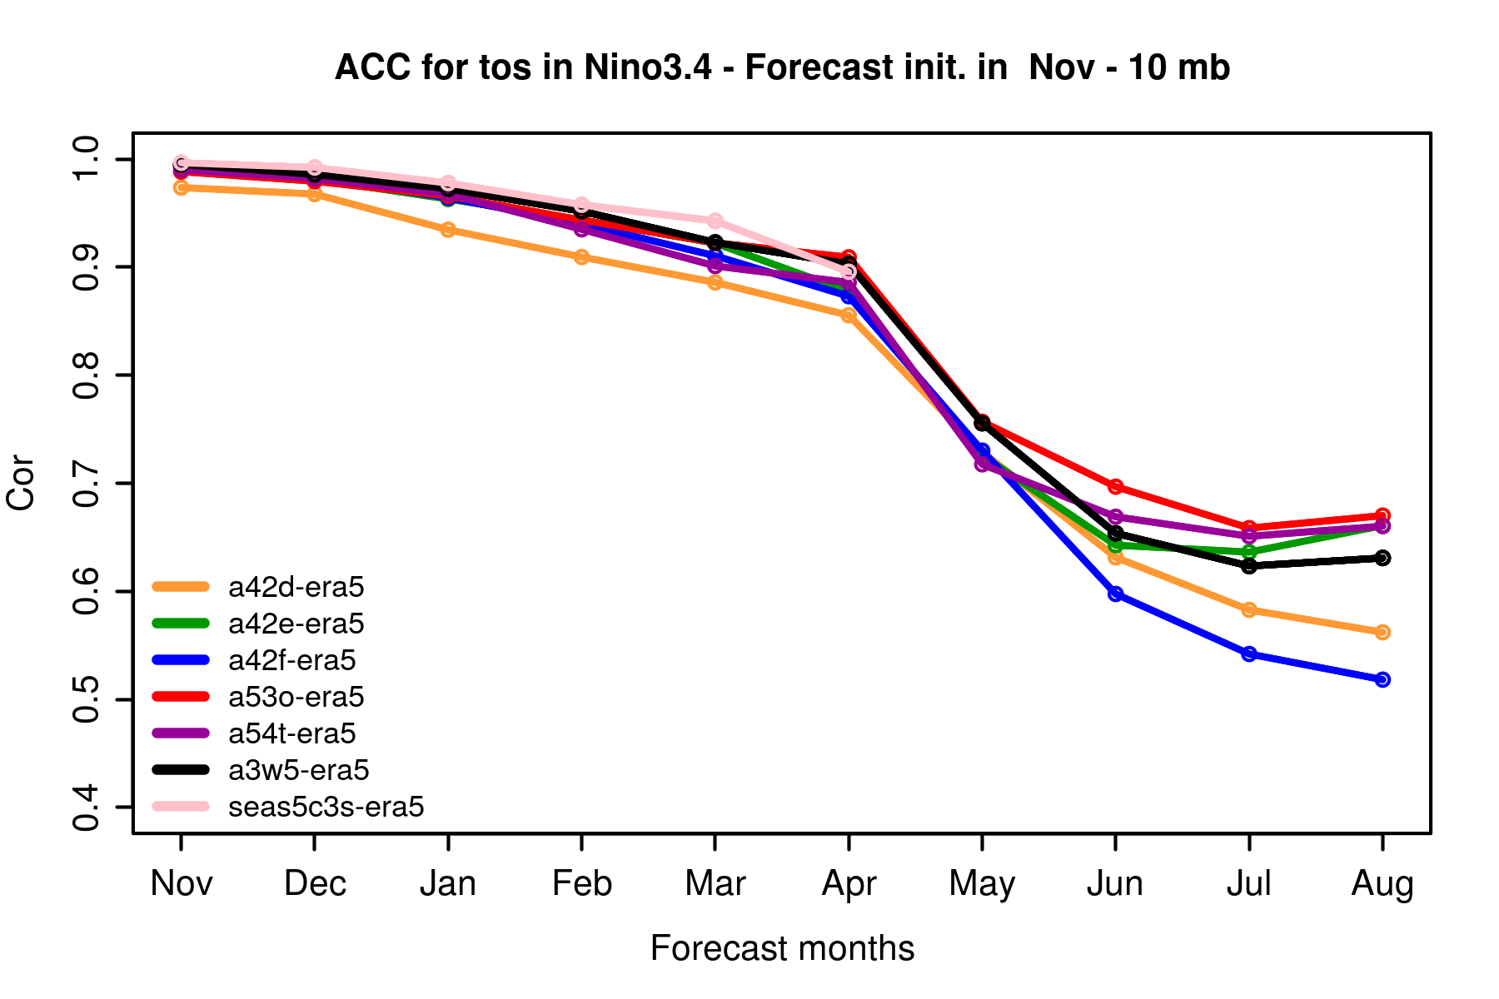
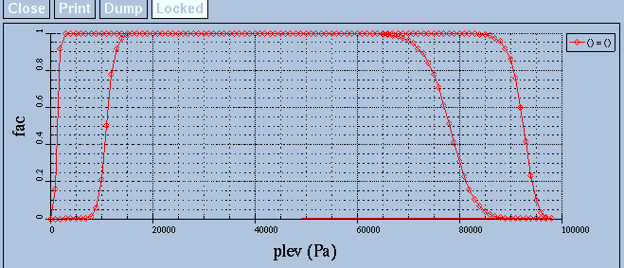
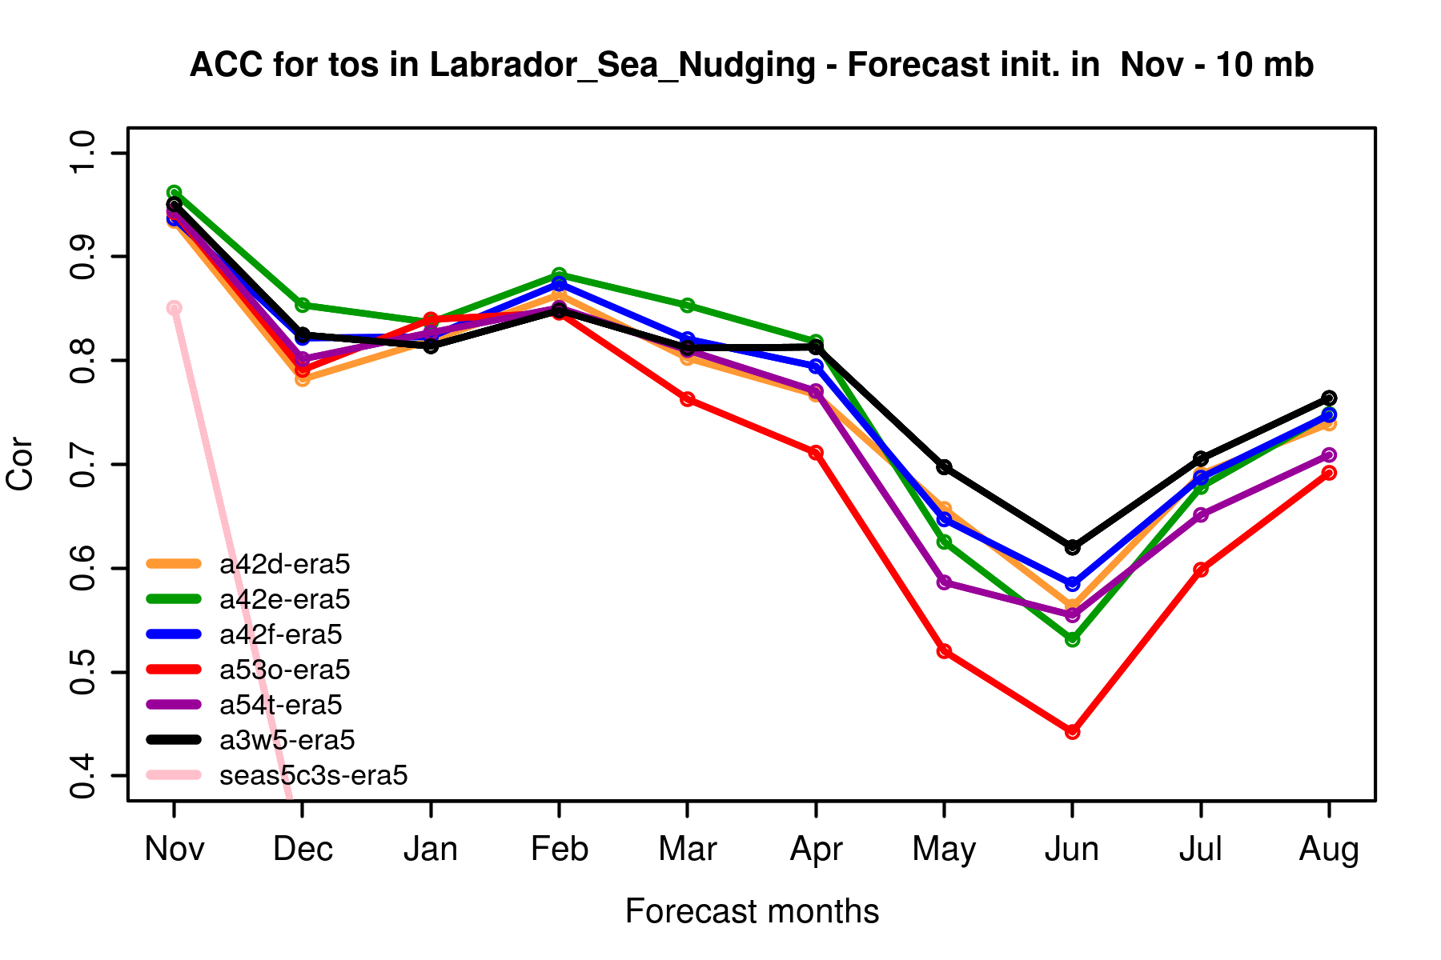
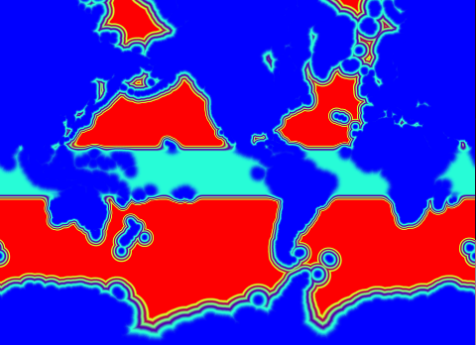
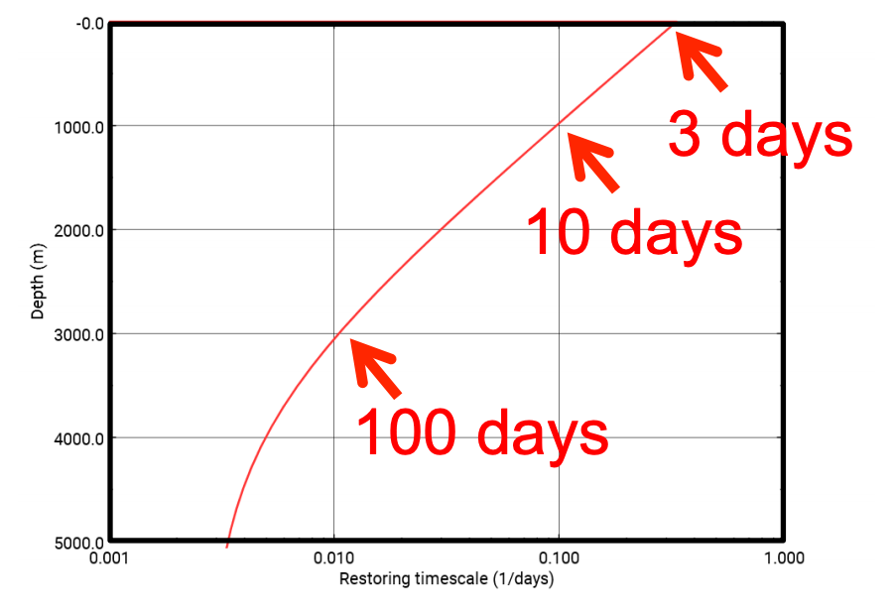
Testing coupled assimilation in a seasonal prediction framework
ACC Niño3.4 Index
Tested coupled nudging setups
Set up forecasts
Initial month: November
Startdates: 1985-2019
Length: 10 months
10 members
Atm: full column Oce: standard
Atm: free top-bottom Oce: standard
Atm: free narrow bottom Oce: standard
Atm: full column Oce: no surface
Atm: full column Oce: weak nudging
Atm: ERA5 Oce: forced recon
SEAS5
Atmosphere Nudging
ERA5, 12-hour restoring timescale
Variables: vorticity, divergence, temperature and log surf pressure)
ACC Labrador Sea SST Index
Ocean nudging
ORAS5, SST and SSS
EN4.2.2 3D T and S
A. Santos, V. Lapin, A. Carreric, P. Ortega, F. Doblas-Reyes

Slide 12
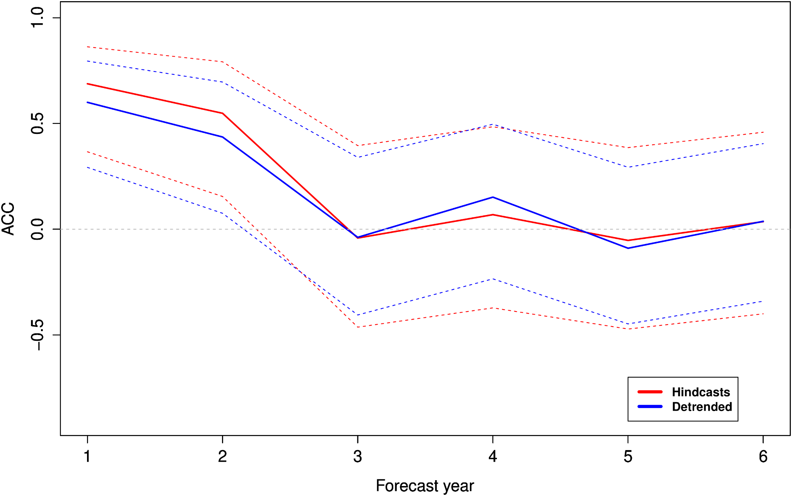
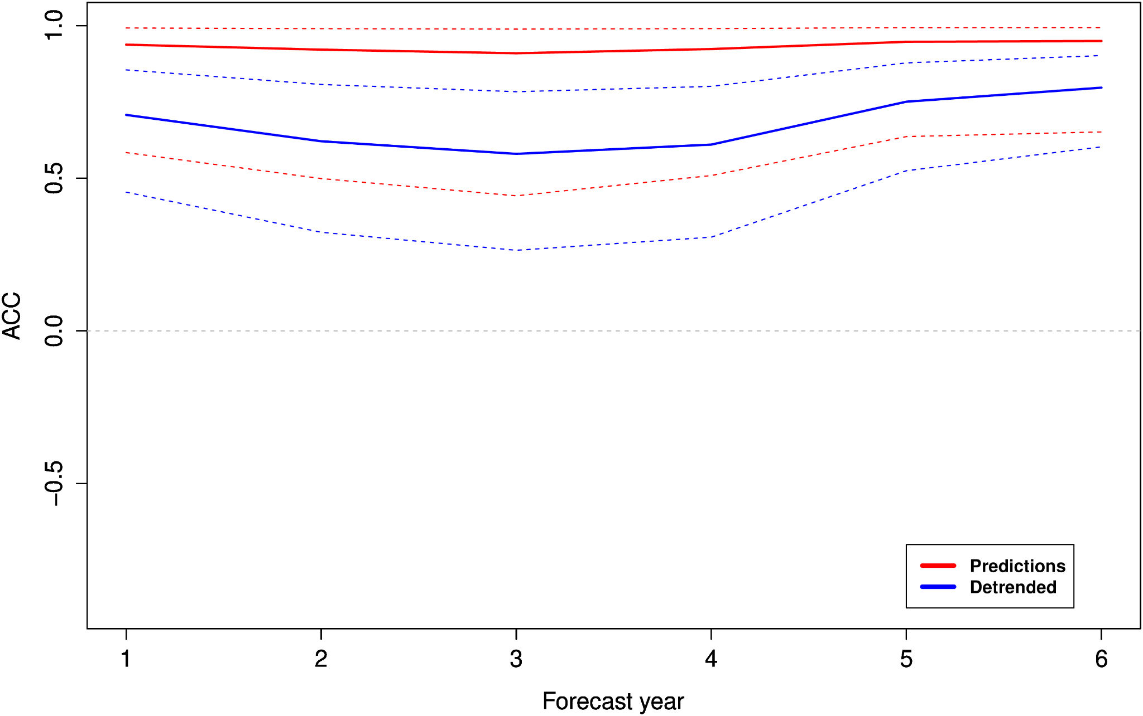
A first decadal hindcast of carbon cycle with EC-Earth-ESM
EC-Earth-3.3-CC (emission driven) Ensemble size: 10 members
Reforecast period: 1980-2020 Forecast length: 7 years
Ocean initialization: As in new EC-Earth3-GCM system (only physics assimilated) → 3 cycles to get present CO2 uptake
Land initialization: Offline land-surface reconstruction with LPJ-GUESS → forced with ERA20C/ERA5 (prior/after 1950)
Skill of global land CO2 flux anomalies
Skill of global ocean CO2 flux anomalies
Land C flux skill is limited to 2 years lead time
Ocean C flux skill is high and remains significant
E. Tourigny, J. Acosta Navarro, R. Bernardello, V. Sicardi, E. Exarchou, V. Lapin, M. Donat, P. Ortega
Notes:
Land BGC: cycled the first 20 years of era20c forcing with transient CO2 and other drivers
Ocean BGC: cycled 3 times over present period to get CO2 uptake levels expected at the current period.

