Slide 1
2024 OCEAN DECADE CONFERENCE
Ocean Decade
Marine Protected Areas Forum
8-9 APRIL 2024 BARCELONA, SPAIN
As part of the Ocean Decade Week (8-12 April 2024)
Digital Twins of the Ocean: Predicting Changes
Pablo Ortega (BSC)

Slide 2
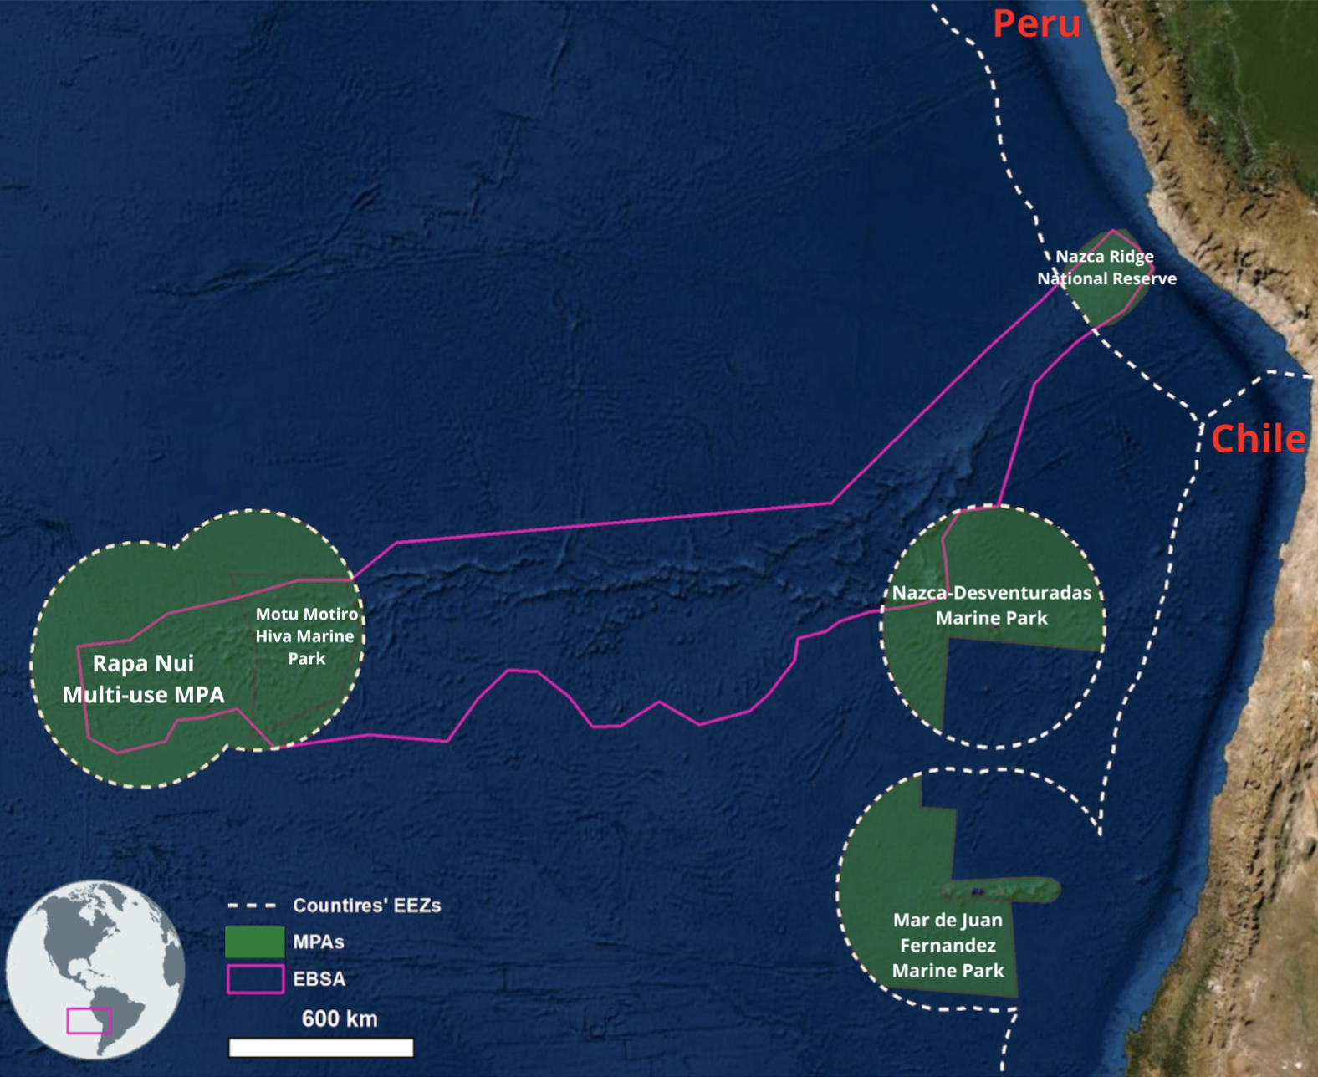
Salas y Gómez Ridge
Nazca Ridge
Nazca Ridge
Salas y Gómez Ridge
Salas y Gómez Ridge
A volcanic seamounts chain that extends 2,300 km between the Nazca Ridge and Rapa Nui.
Notes:
The Salas y Gómez Ridge extends across approximately 2,300 km between the Nazca Ridge and Rapa Nui
Its central portion is located in ABNJ, whereas both ends of this ridge fall within the Exclusive Economic Zone (EEZ) of Chile around the islands of Rapa Nui and San Ambrosio, respectively. The seamounts of the Salas y Gómez and Nazca ridges represent approximately 41% of all seamounts recorded throughout the southeastern Pacific and its shallow waters span across two unique ecoregions: Easter Island and Desventuradas Ecoregions. Oasis of productivity

Slide 3
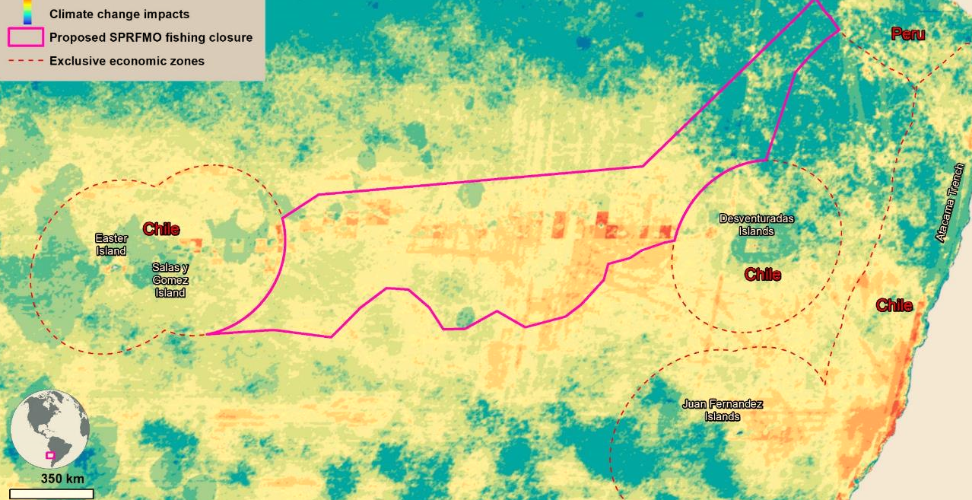
Salas y Gómez Ridge
Major Threats
Nazca Ridge
Salas y Gómez Ridge
Warming
Deoxygenation
Acidification
MPA survivability relies on the availability of reliable information on near-term environmental changes
Notes:
The Salas y Gómez Ridge extends across approximately 2,300 km between the Nazca Ridge and Rapa Nui
Its central portion is located in ABNJ, whereas both ends of this ridge fall within the Exclusive Economic Zone (EEZ) of Chile around the islands of Rapa Nui and San Ambrosio, respectively. The seamounts of the Salas y Gómez and Nazca ridges represent approximately 41% of all seamounts recorded throughout the southeastern Pacific and its shallow waters span across two unique ecoregions: Easter Island and Desventuradas Ecoregions. Oasis of productivity

Slide 4
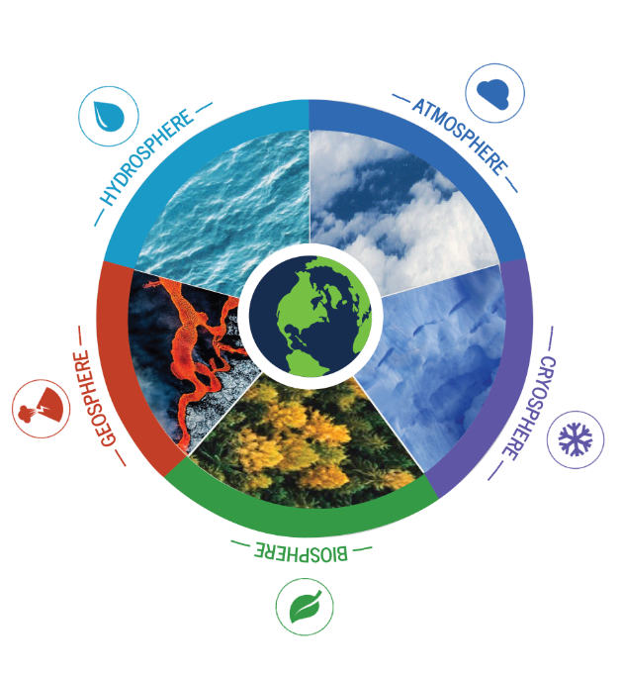
Earth System Models
(our research labs)
In essence
Mathematical representation of the Earth system through the fundamental laws governing the evolution within and interactions between the different Earth system components.

Slide 5
Earth System Models
(our research labs)
In essence
Mathematical representation of the Earth system through the fundamental laws governing the evolution within and interactions between the different Earth system components.
In Practice
ESMs are our key tool to generate scientific understanding via hypothesis testing on topics as diverse as:

Slide 6
Earth System Models
(our research labs)
In essence
Mathematical representation of the Earth system through the fundamental laws governing the evolution within and interactions between the different Earth system components.
In Practice
ESMs are our key tool to generate scientific understanding via hypothesis testing on topics as diverse as:
Attribution of past
climate changes
Risk of tipping (Irreversible Changes)
Adaptation/Mitigation
of future climate change
Near-term
climate prediction

Slide 7
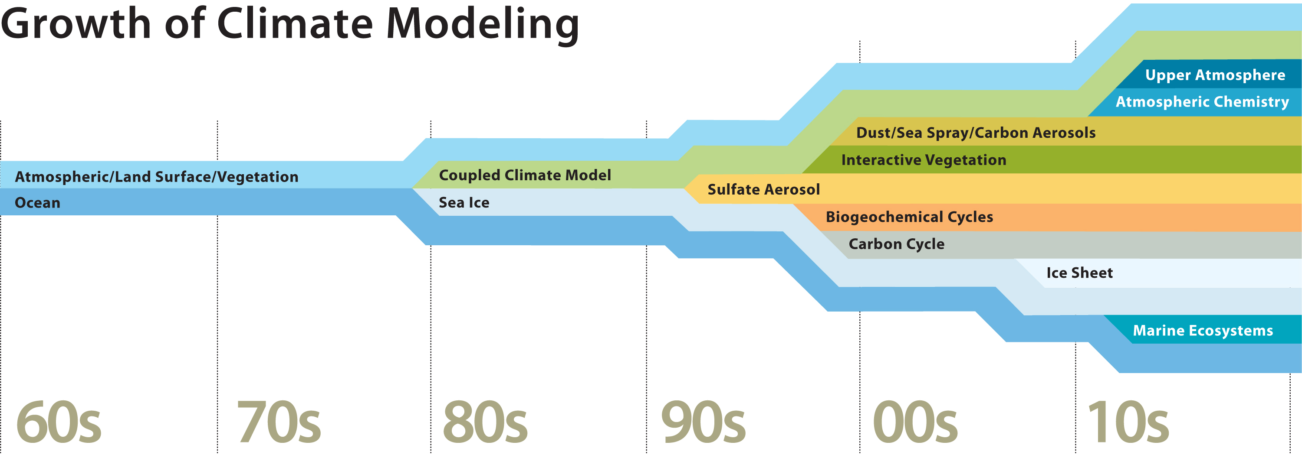
Model Complexity
(a timeline)
Growth in Modeling Capabilities
https://news.ucar.edu/sites/default/files/news/2011/predictFlow2.jpg
4th National Climate Assessment (US), Volume I

Slide 8
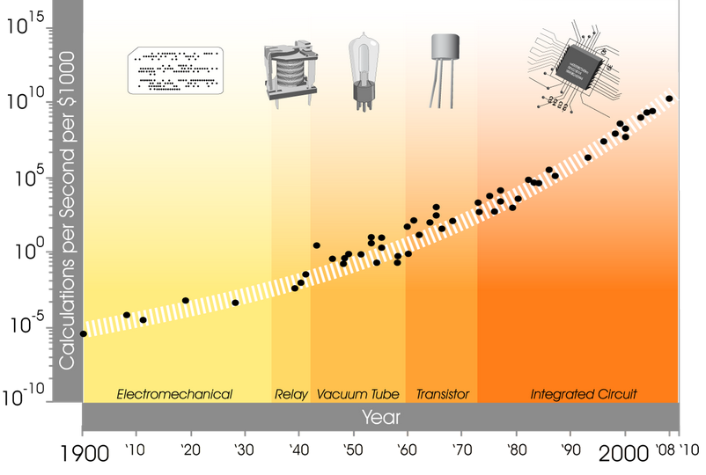
Model Complexity
(a timeline)
Growth in Modeling Capabilities
https://news.ucar.edu/sites/default/files/news/2011/predictFlow2.jpg
Growth in Supercomputing Power
4th National Climate Assessment (US), Volume I

Slide 9
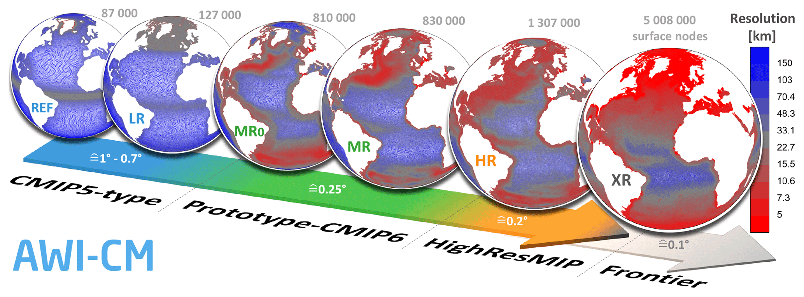
Model Resolution
(a timeline)
Rackow et al 2019

Slide 10
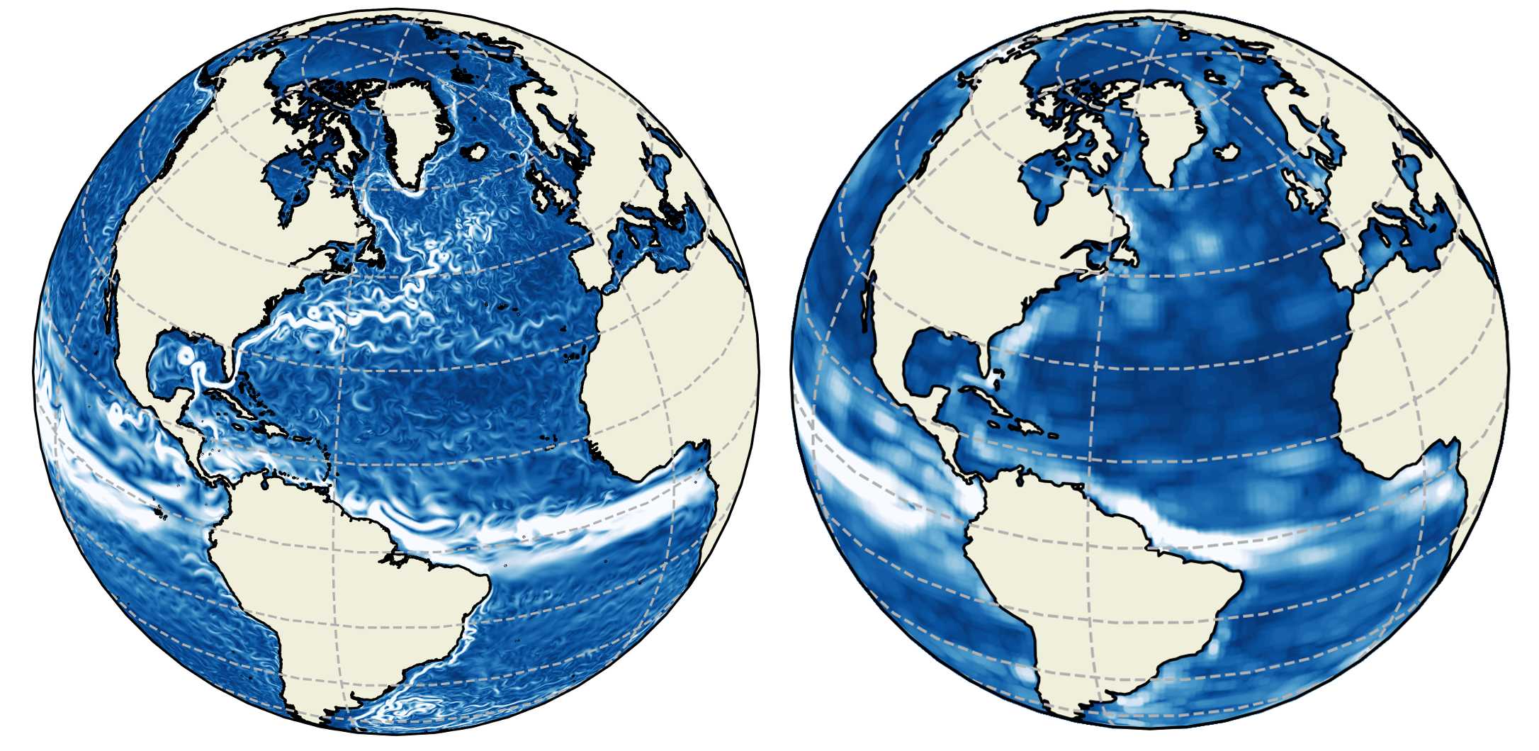
Model Resolution
(a timeline)
https://nemo-related.readthedocs.io/en/latest/nemo_notes/orca_config.htmlv
Rackow et al 2019

Slide 11
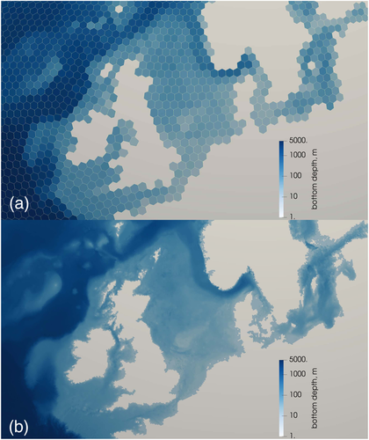
Model Resolution
(a timeline)
Petersen et al (2019)
https://nemo-related.readthedocs.io/en/latest/nemo_notes/orca_config.htmlv
Grid cell size > 50 km
Grid cell size < 10 km

Slide 12
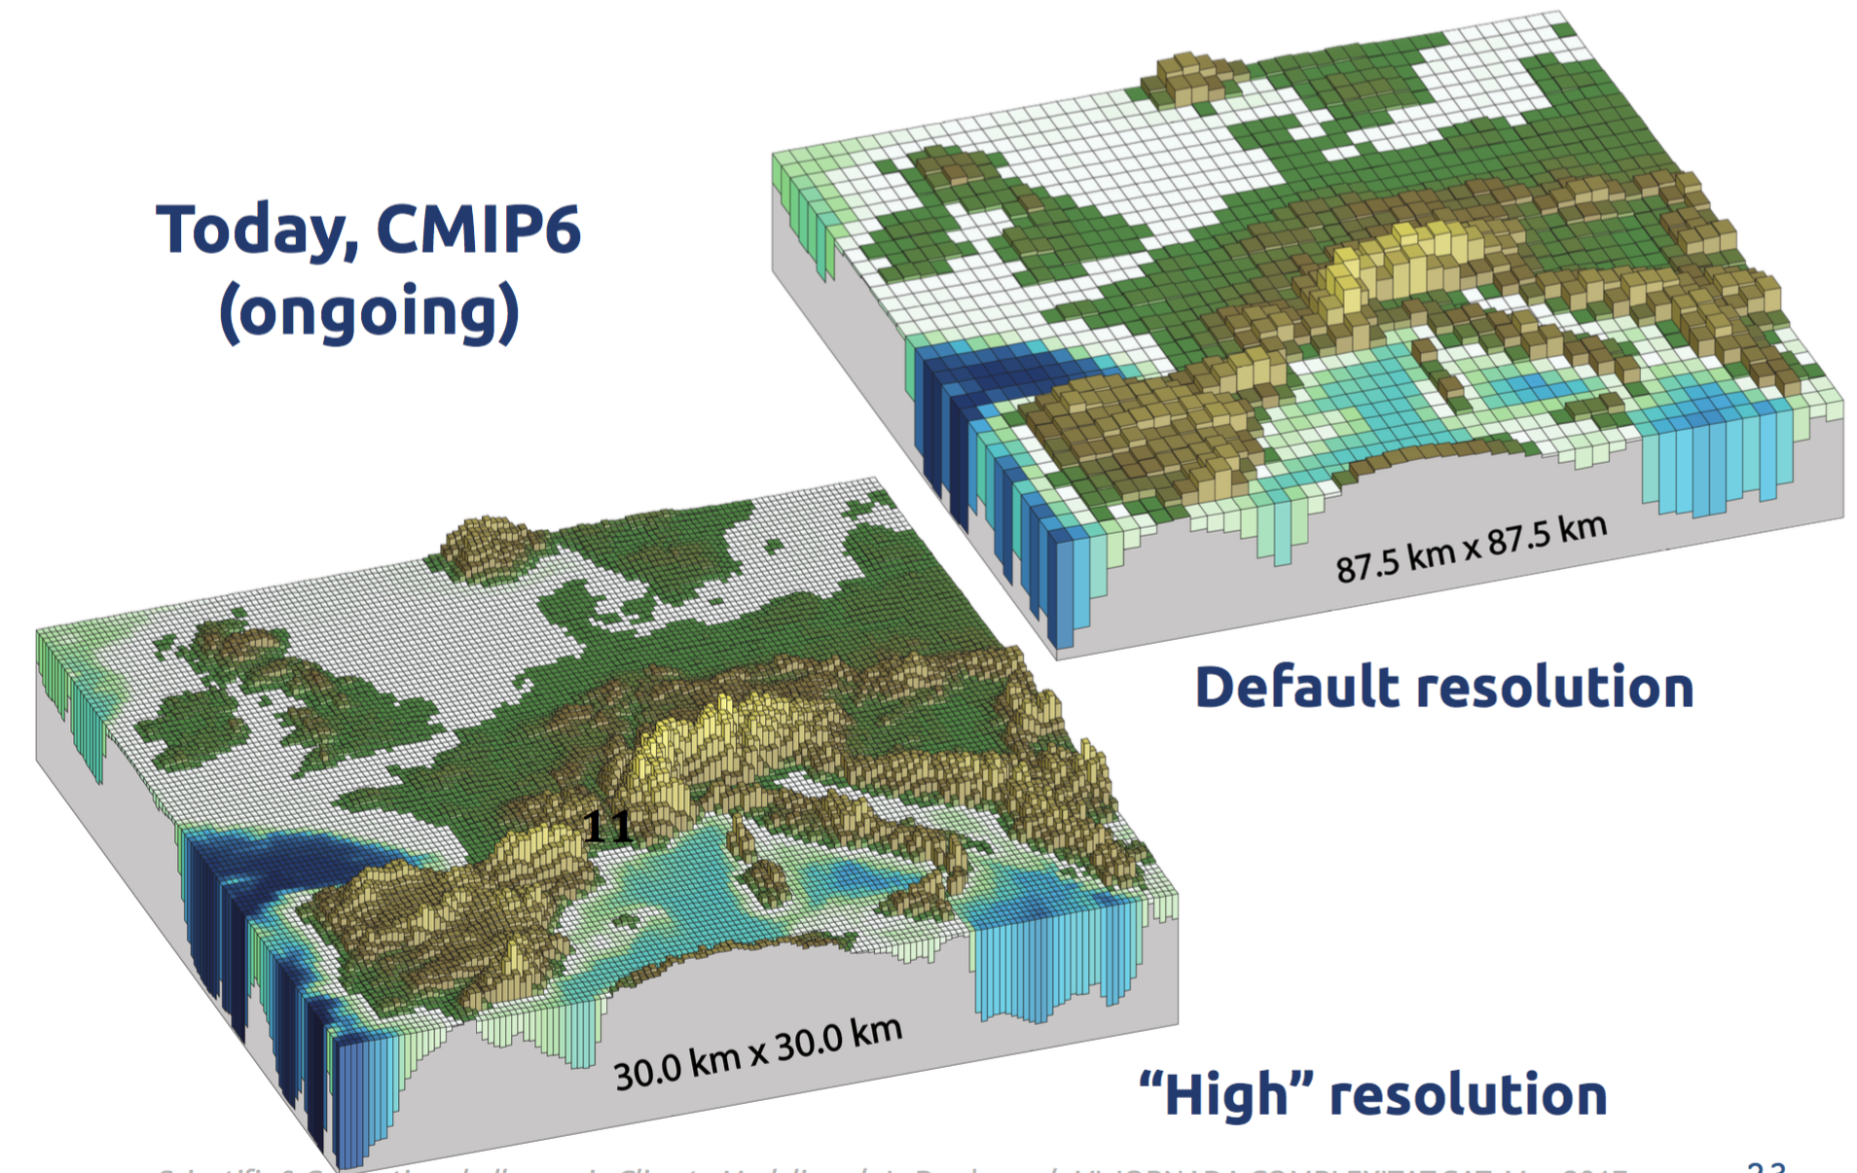
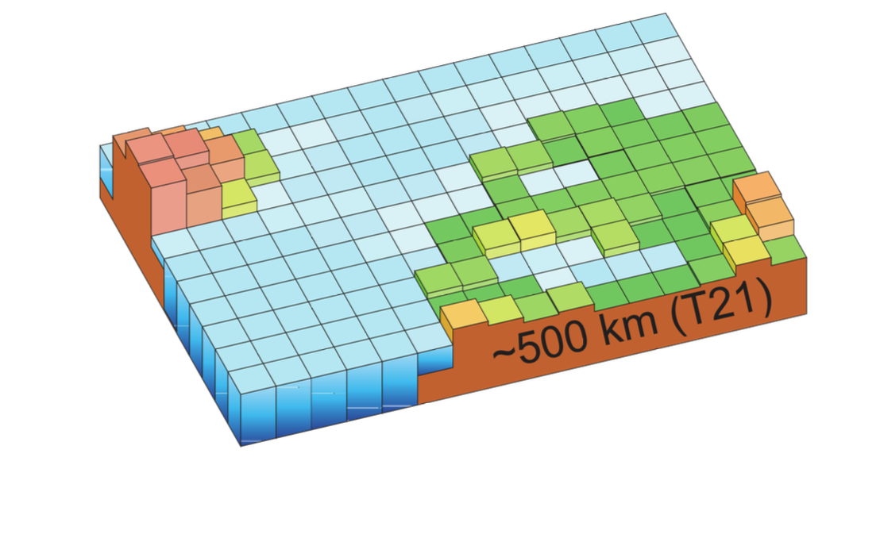
Model Resolution
(a timeline)
Petersen et al (2019)
https://nemo-related.readthedocs.io/en/latest/nemo_notes/orca_config.htmlv
Typical resolutions in the 90s
Today
Grid cell size > 50 km
Grid cell size < 10 km

Slide 13
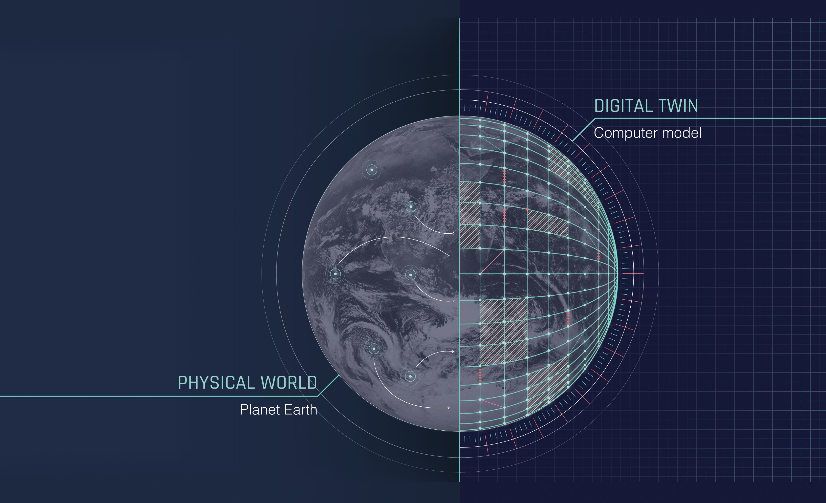
Digital Twins
(one step further)

Slide 14
Digital Twins
(one step further)
Destination Earth is developing a new type of climate information system tailored to assess the impacts of climate change and different adaptation strategies at local and regional levels over multiple decades using a strategy where user requests drive the whole production chain.

Slide 15
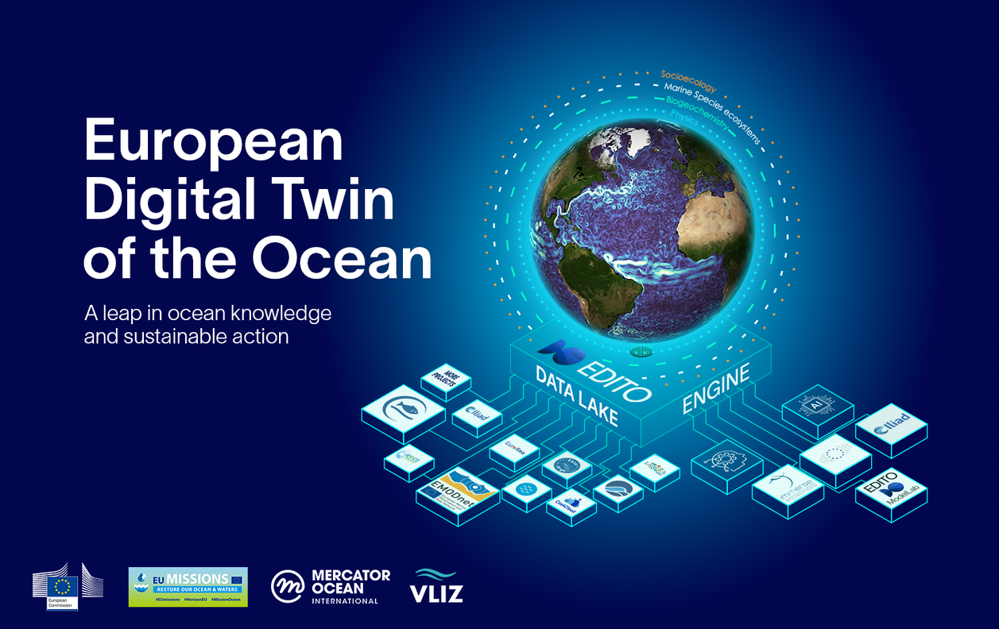
Digital Twins
(one step further)
EDITO-Model Lab will connect on a common platform, a large variety of ocean and coastal numerical models, allowing for global, regional-to-coastal model configuration and the co-development of new simulations and what-if scenarios for a more sustainable management of marine environments.

Slide 16
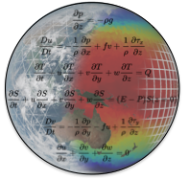
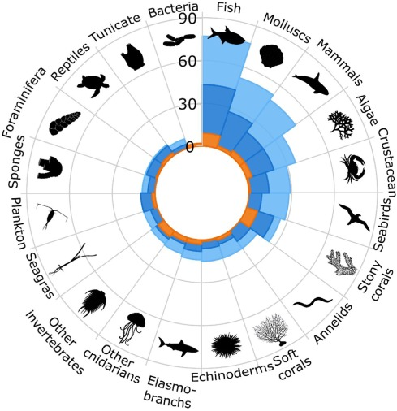
A Practical Example
(one step further)
MOANA | Marine climate change refugia for insular mesophotic ecosystems in the South Pacific ocean
Ariadna Mecho
101107435
Nazca Ridge
Salas y Gómez Ridge
Melo-Merino et al (2020)
Earth System Models
of different complexity
Species Distribution Models

Slide 17
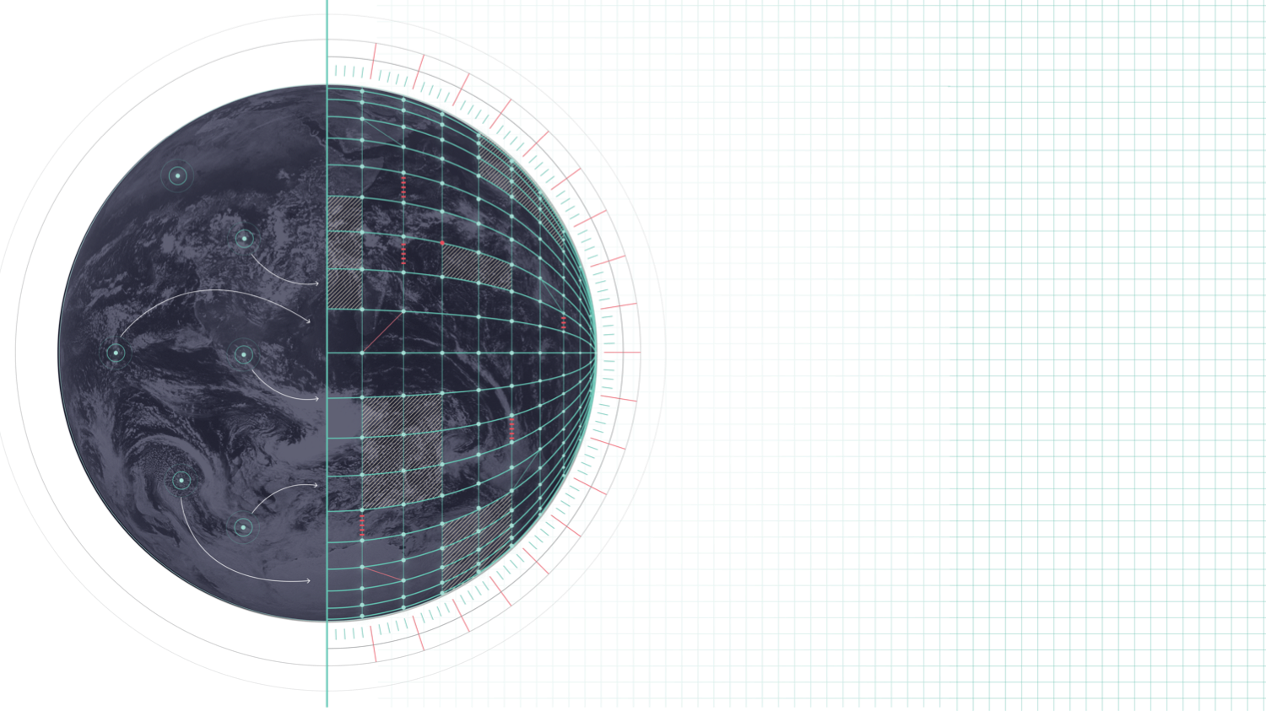
2024 OCEAN DECADE CONFERENCE
Acknowledgements
Ocean Decade
Marine Protected Areas Forum
8-9 APRIL 2024 BARCELONA, SPAIN
Destination Earth is a European Union funded initiative and is implemented by ECMWF, ESA, and EUMETSAT.
As part of the Ocean Decade Week (8-12 April 2024)
The research leading to these results has received funding from the EU HE Framework Programme under grant agreement n° 101093293 and 101081383

Slide 18
2024 OCEAN DECADE CONFERENCE
Ocean Decade
Marine Protected Areas Forum
8-9 APRIL 2024 BARCELONA, SPAIN
As part of the Ocean Decade Week (8-12 April 2024)
Booth 11 Host
JOIN US!!
Earth Sciences
Department

