Slide 1
Barcelona , 17 April 2018
Performance activities in Earth Science Department
Mario C. Acosta & Miguel Castrillo

Slide 2
Outline
Introduction
Next generation of HPC Challenges
Earth System Models: EC-Earth
Methodology
Some successful examples
Discussion

Slide 3
Introduction

Slide 4
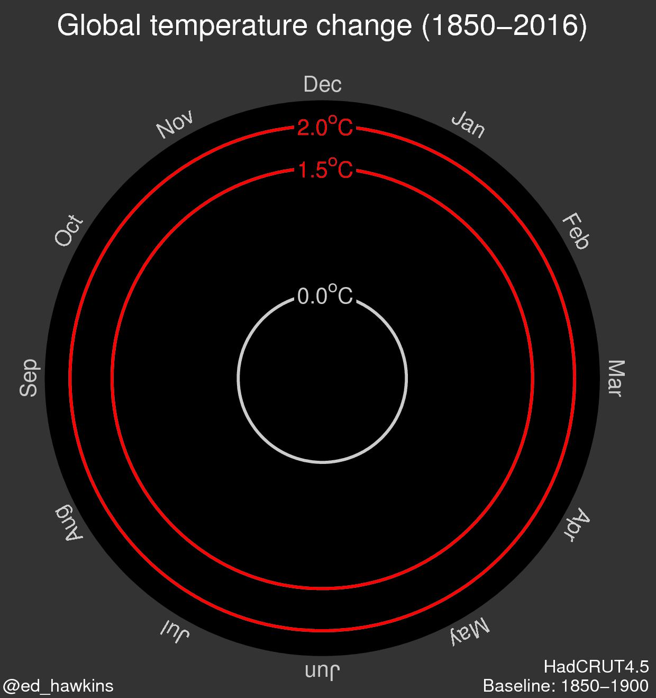
Introduction
Notes:
Escenario de cambio climático, aumento de temperaturas

Slide 5
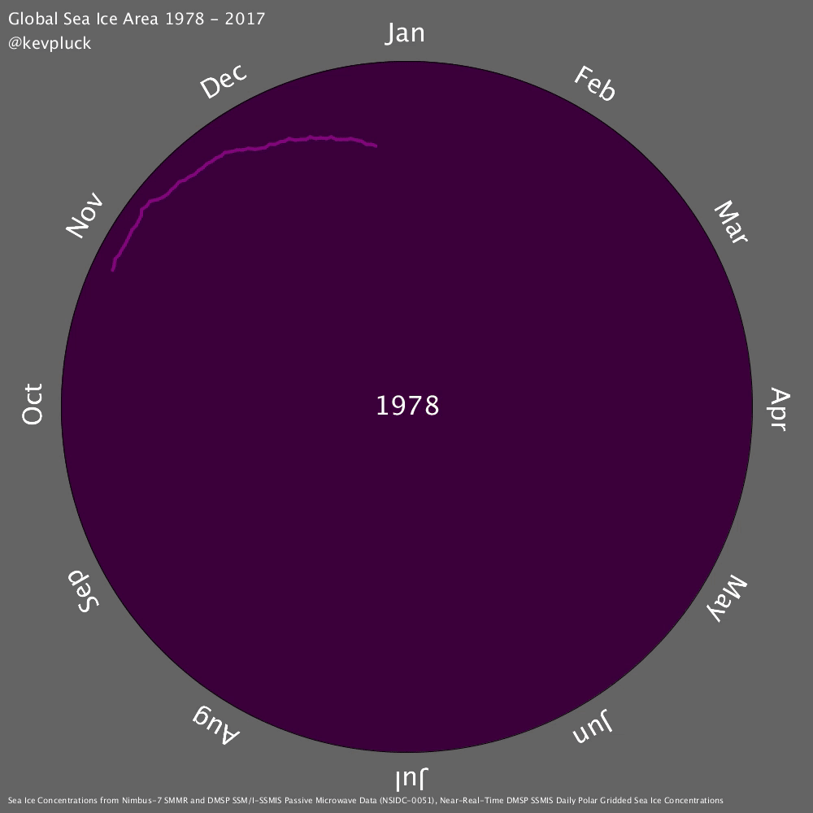
Introduction
Notes:
También se puede observar en la cantidad de hielo, el área total de hielo, visto mínimo en estos años

Slide 6
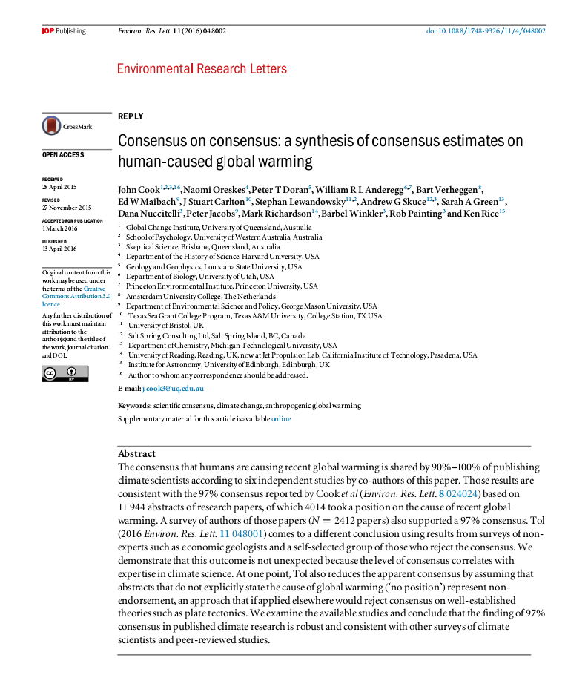
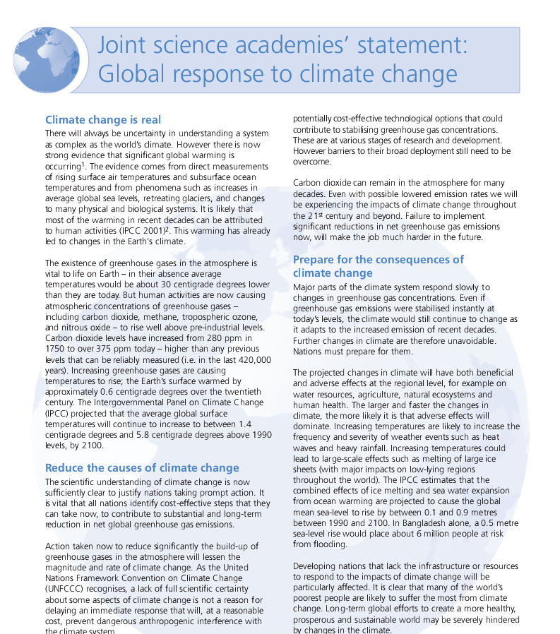
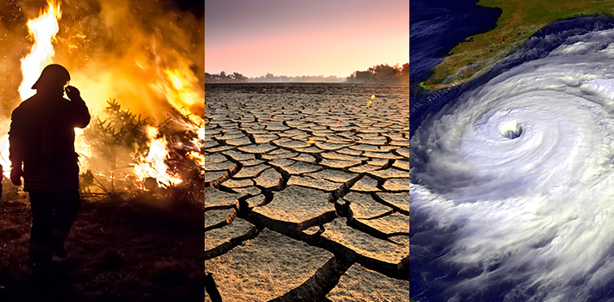
Next generation of HPC challenges
Climate is changing.
The potential impact of that change is huge.
The effects would be catastrophic for humankind.

Slide 7
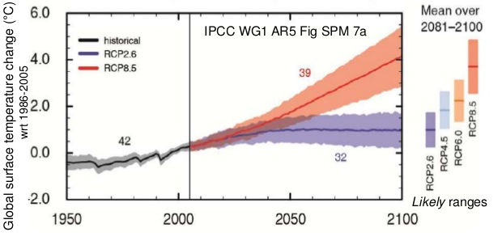
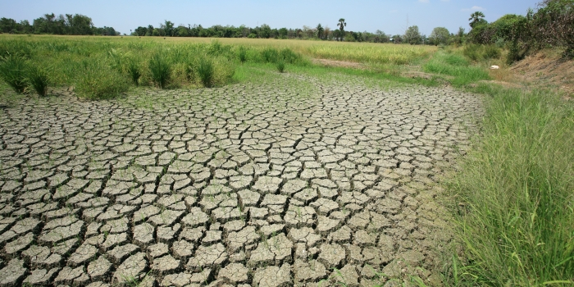
Next generation of HPC challenges
Projections
Impact analysis
Adaptation to climate change.
Currently, only computational models have the potential to provide geographically and physically consistent estimates.

Slide 8
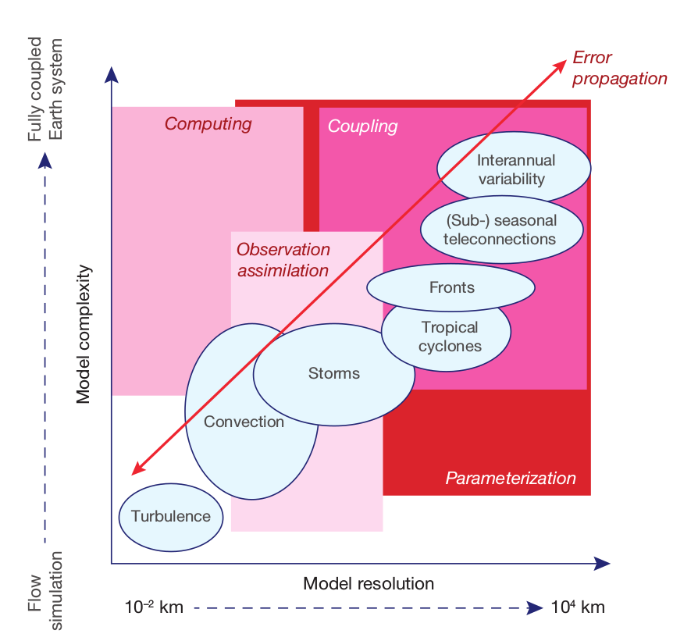
Next generation of HPC challenges

Slide 9
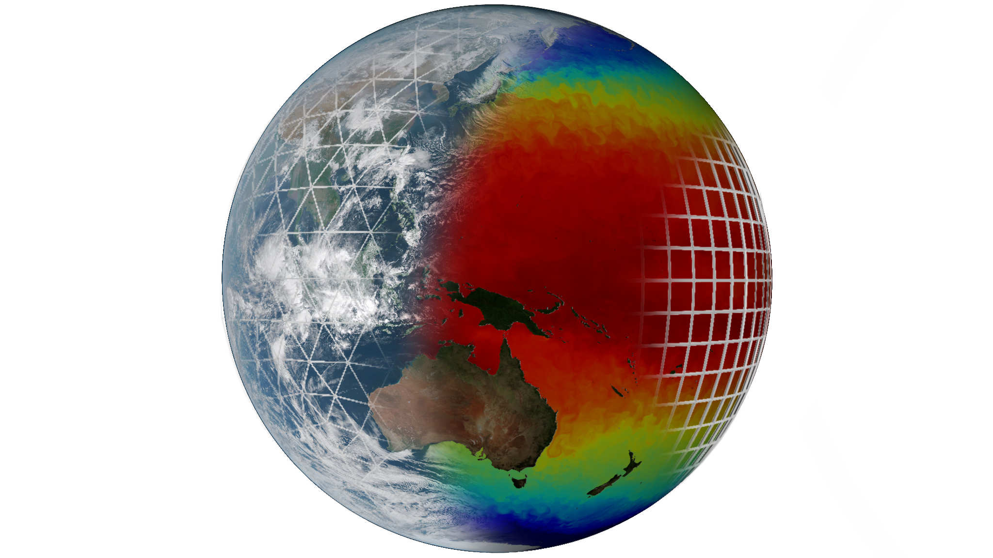
Earth System Models: EC-Earth
Atmosphere:
IFS
Ocean:
Coupler:

Slide 10
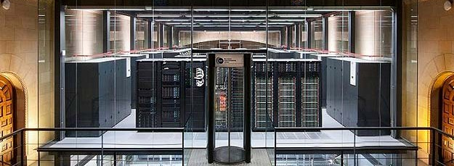
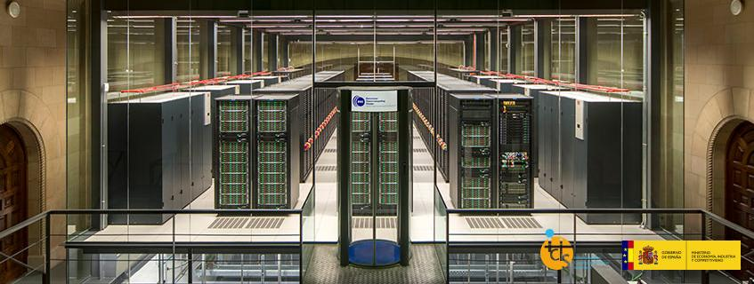
MareNostrum IV
MareNostrum IV in operation since July 2017
One of the first HPCs featuring new Intel Scalable Processors
 | MareNostrum III | MareNostrum IV
Processor | Intel Xeon E5-2670 2.6 GHz | Intel Xeon Platinum 8160 2.1 GHz
#Cores per socket | 8 | 24
#Sockets | 2 | 2
Memory | 32Gb DDR3-1600 2 GB/core | 96Gb DDR4-2667 2 GB/core
Interconnection | Infiniband FDR10 10Gb | Intel Omni-Path 100Gb
MareNostrum III - 11,15 petaFLOPS
MareNostrum IV - 11,15 petaFLOPS

Slide 11
Methodology

Slide 12
Methodology
To be able to use the computing power of modern supercomputers, applications must exploit parallelism.
Parallelism produce overhead (extra computation and communications)
We need to evaluate and optimize the parallelism efficiency of our computational models.
When the hardware change
When the number of resources change
When the model complexity increase
When the resolution increase
…

Slide 13
Methodology
Path to exascale is coming → But is not automatic, the free lunch is over
Processors can not be faster → But supercomputer parallel processing units can increase
Compilers work great at low level optimizations → But human decisions in the development will be more and more critical to achieve optimizations
Overhead does not look a problem in my model → But if the needs increase (i.e. higher resolutions), a bad implementation will be a problem in some point.
High Performance Computing is an essential part of Weather and Climate models nowadays
Although there are physical limitations, performance work help to achieve the modelization dreams of the community

Slide 14
Methodology

Slide 15
BSC Tools (Profiling Study)

Slide 16
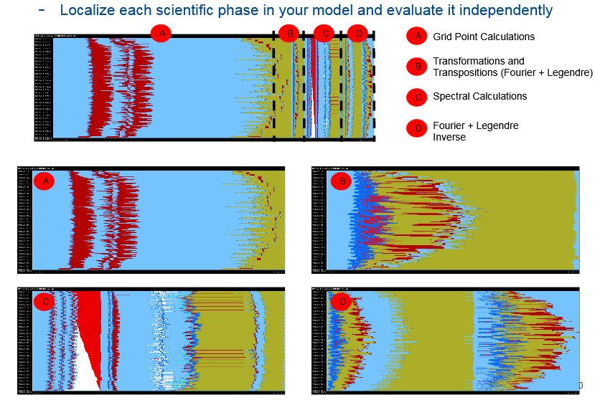
Computational Study (IFS example)

Slide 17
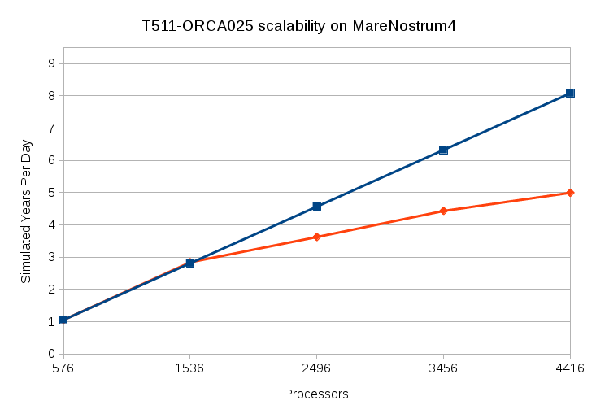
EC-Earth scalability on MN4
Scalability for EC-Earth trunk with default output configuration.

Slide 18
Some successful examples

Slide 19
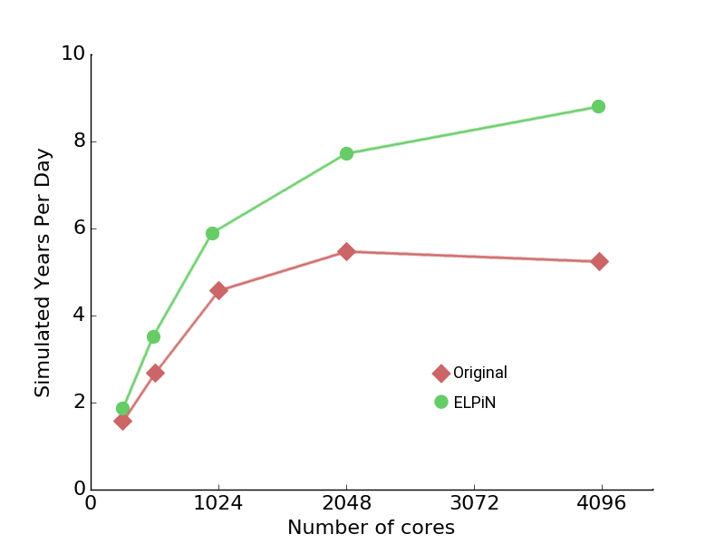
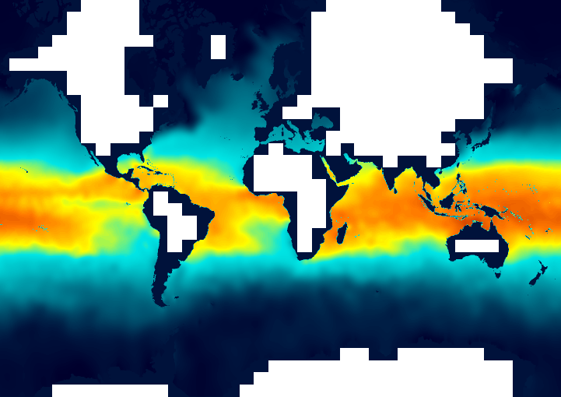
ELPiN (Exclude Land Processes in NEMO)
ELPiN allows to find proper namelist parameters to exclude land-only processes in NEMO simulations
Avoids NEMO to waste resources, speeds up simulations.
Included in EC-Earth production branches.
ORCA025 domain decomposed in 1287 sub-domains. 312 are land-only and therefore removed (24% of the total grid).
O. Tintó (BSC)
Impact of ELPiN on the NEMO model for an ORCA025-LIM3 simulation.
O. Tintó (BSC)

Slide 20
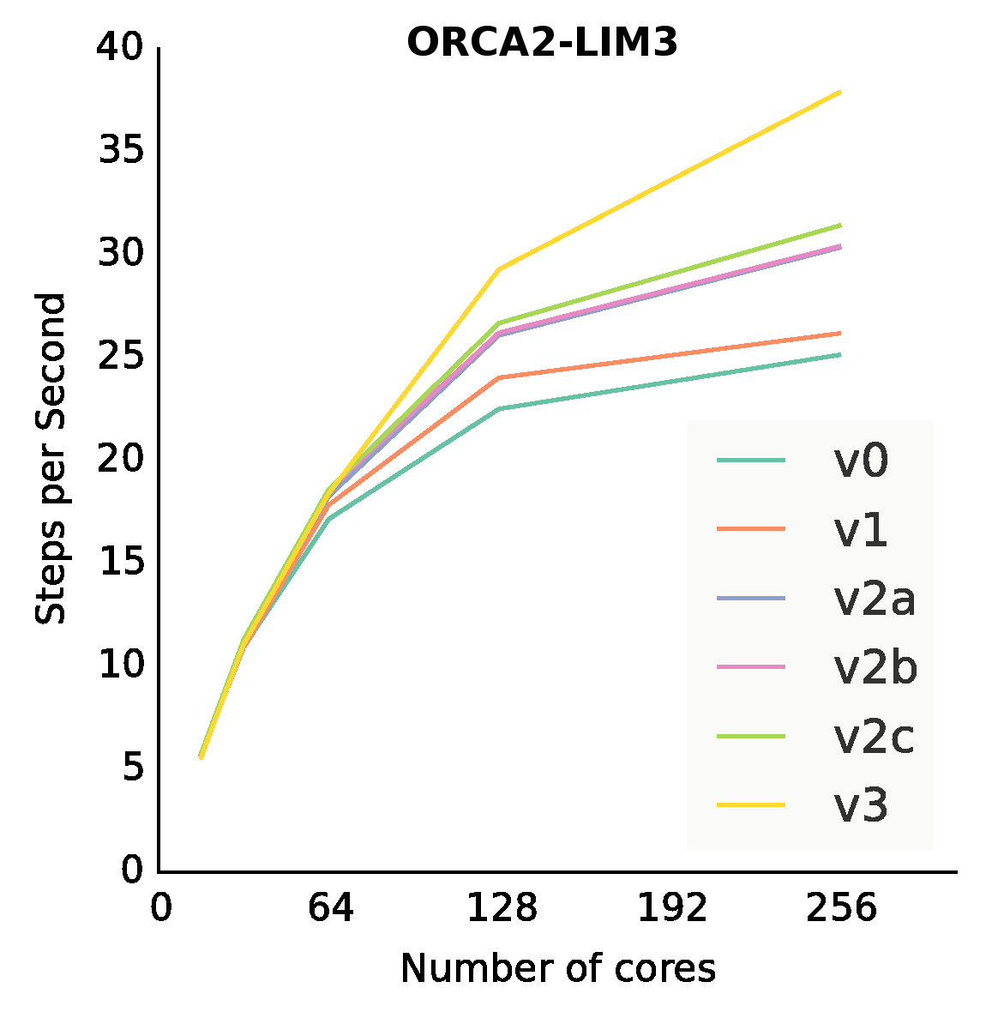
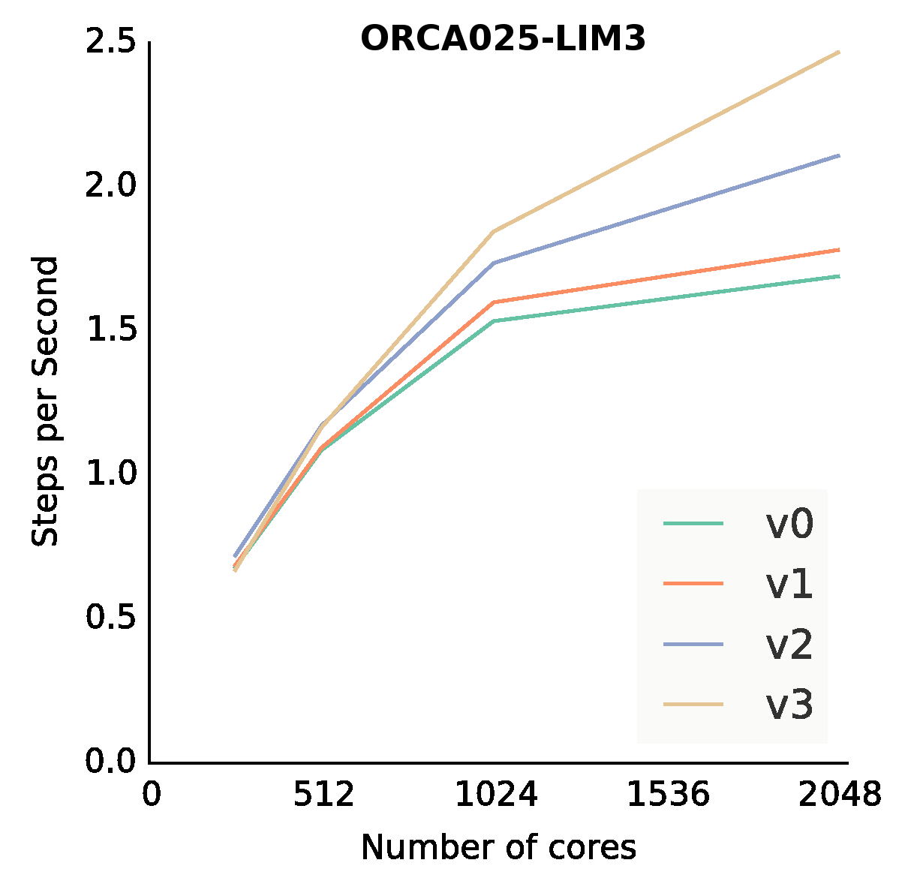
NEMO performance analysis
Original code
16
32
64
128
256
Optimized code
16
32
64
128
256
V0 → Original
V1 → Message packing
V2 → Conv. Check reduction
V3 → Reordering

Slide 21
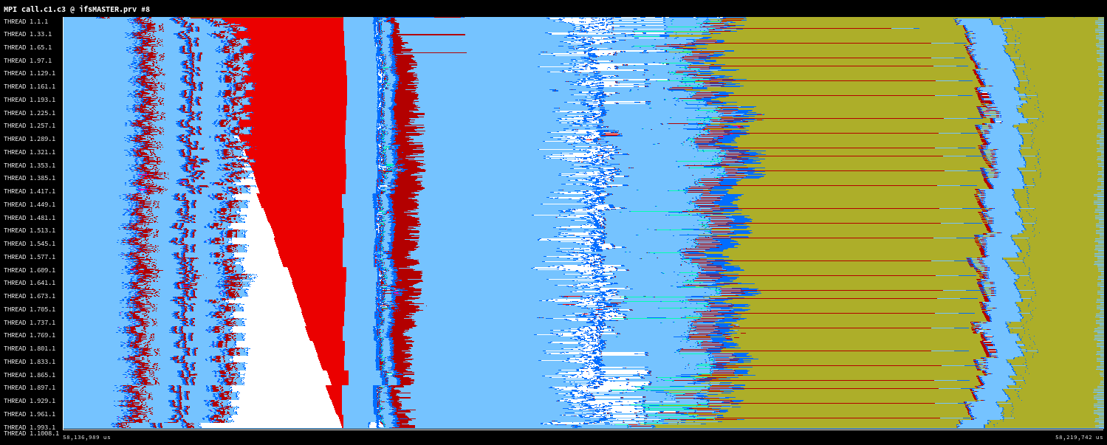
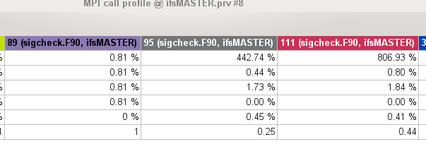
Check method for IFS
Synchronous point to point communication could be a bottleneck even for only one message from one master to hundreds of slaves
Sigcheck method
Using one asynchronous collective communication this time is reduced almost to 0

Slide 22
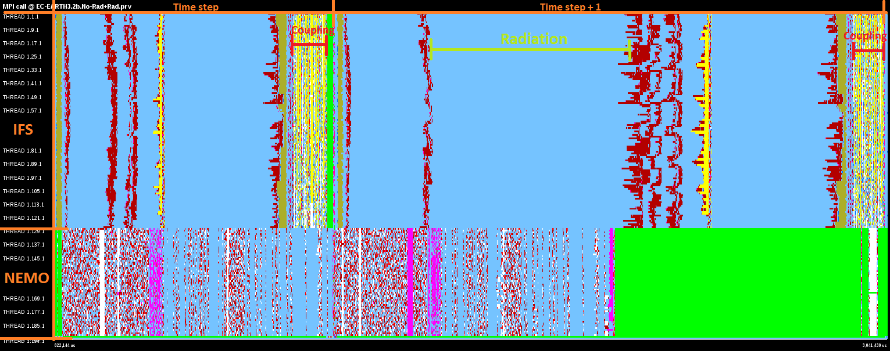
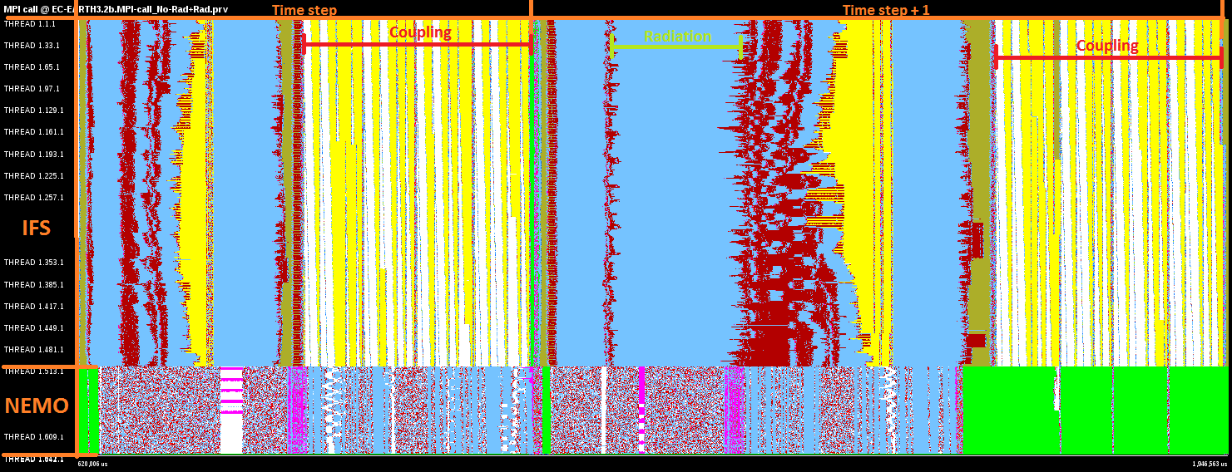
Bottleneck of the coupler OASIS
First studies showed that IFS-NEMO coupling was not a big issue
IFS: 128 cores
NEMO: 128 cores
Coupling time
is increased
TIME
But it seems that it is when increasing number of cores
IFS: 512 cores
NEMO: 128 cores

Slide 23
Discussion
There are some HPC challenges in the near future for Earth System Modelling
is it similar for other fields?
Is it important for you the optimization of the models or a machine with more computational power is enough?
There are several approaches to improve your application…
Optimization or revolution?
Optimizations → Are you interested in our work? Could be helpful for you?
Revolution → New approaches to solve the same problem (DSLs, Accelerators for heterogenous computation, new mathematical solutions...)
Which one is better? A combination of both?

Slide 24
Thank you!
For further information please contact to the Performance Team
Mario Acosta: mario.acosta@bsc.es
Miguel Castrillo: miguel.castrillo@bsc.es
Oriol Tintó: oriol.tinto@bsc.es
Xavier Yepes: xavier.yepes@bsc.es

