Slide 1
Co-production of multi-annual climate services to support food and wine production resilience
Carlos Delgado-Torres, Sara Octenjak, Raül Marcos, Francisco J. Doblas-Reyes, Markus G. Donat, Nadia Milders, Núria Pérez-Zanón, Albert Soret, Marta Terrado, Verónica Torralba and Dragana Bojovic
Bergen, May 2022
carlos.delgado@bsc.es

Slide 2
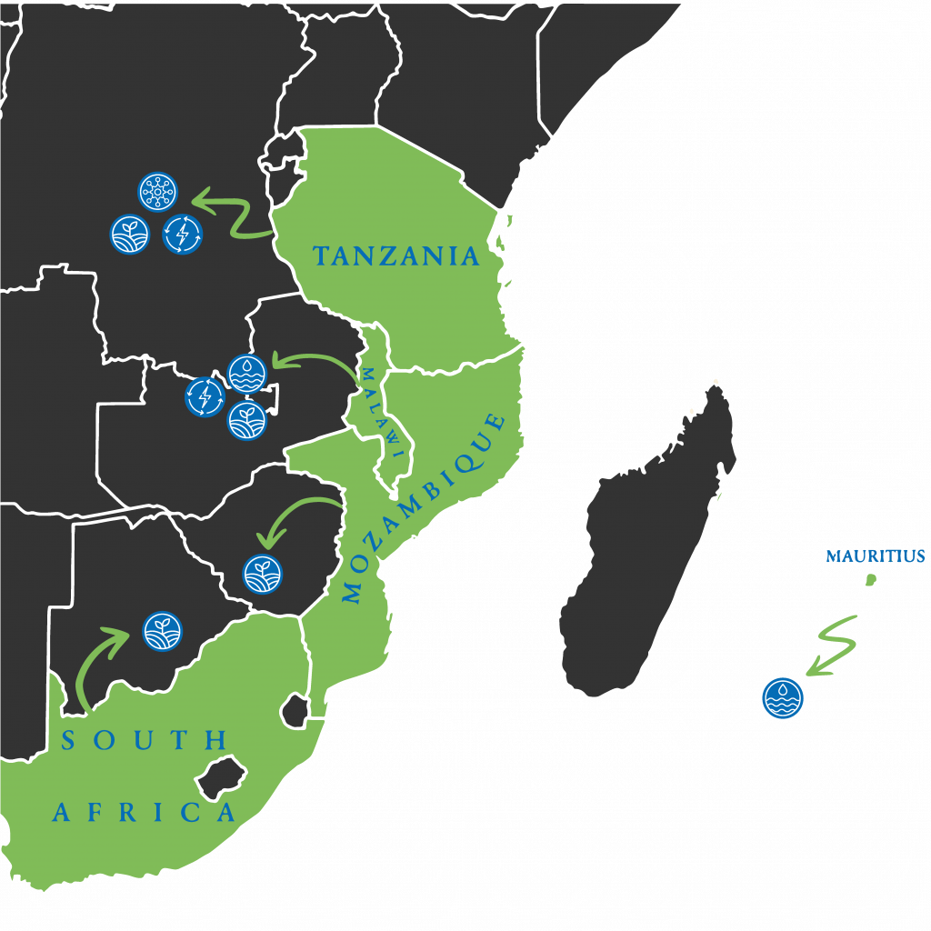
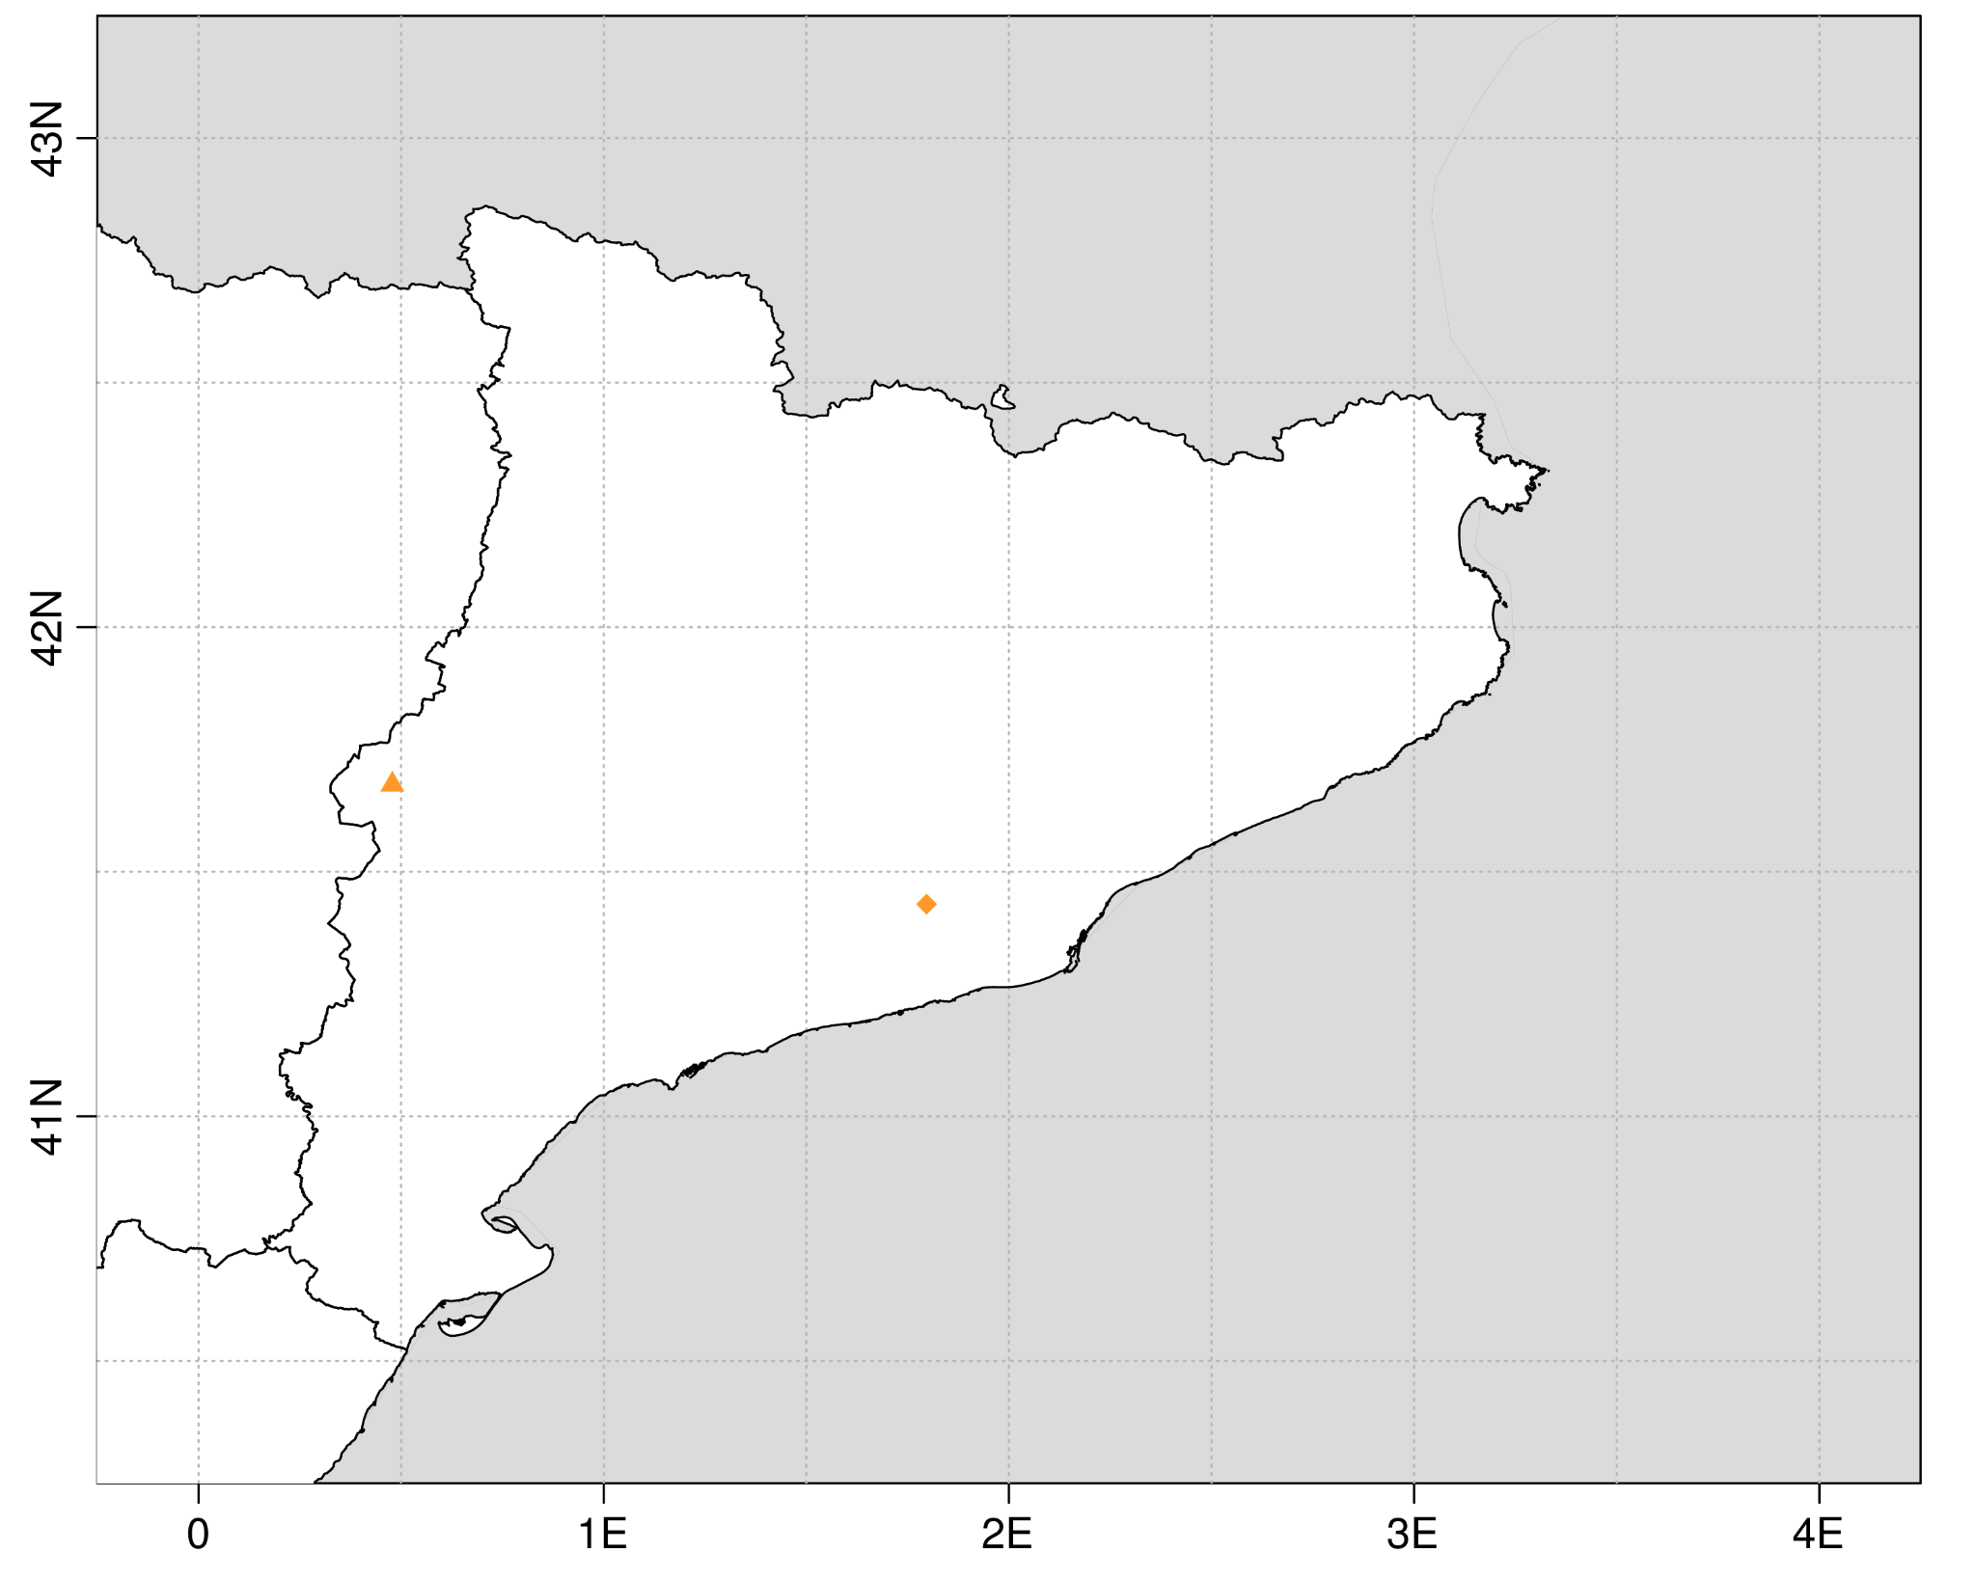
Motivation
Climate events affecting agricultural productivity
Shifts in rainy season
Intensity and frequency of temperature extremes
Prolonged droughts
Floods
Spring frosts
Adaptation policies to reduce risk and loses
Investment on new irrigation technologies
Water management
Delay bud-break
Invest in frost prevention systems
Selection of crop varieties
Agroforestry
Livelihood diversification
Post-harvest management planning
Raimat
Sant Sadurní d'Anoia

Slide 3
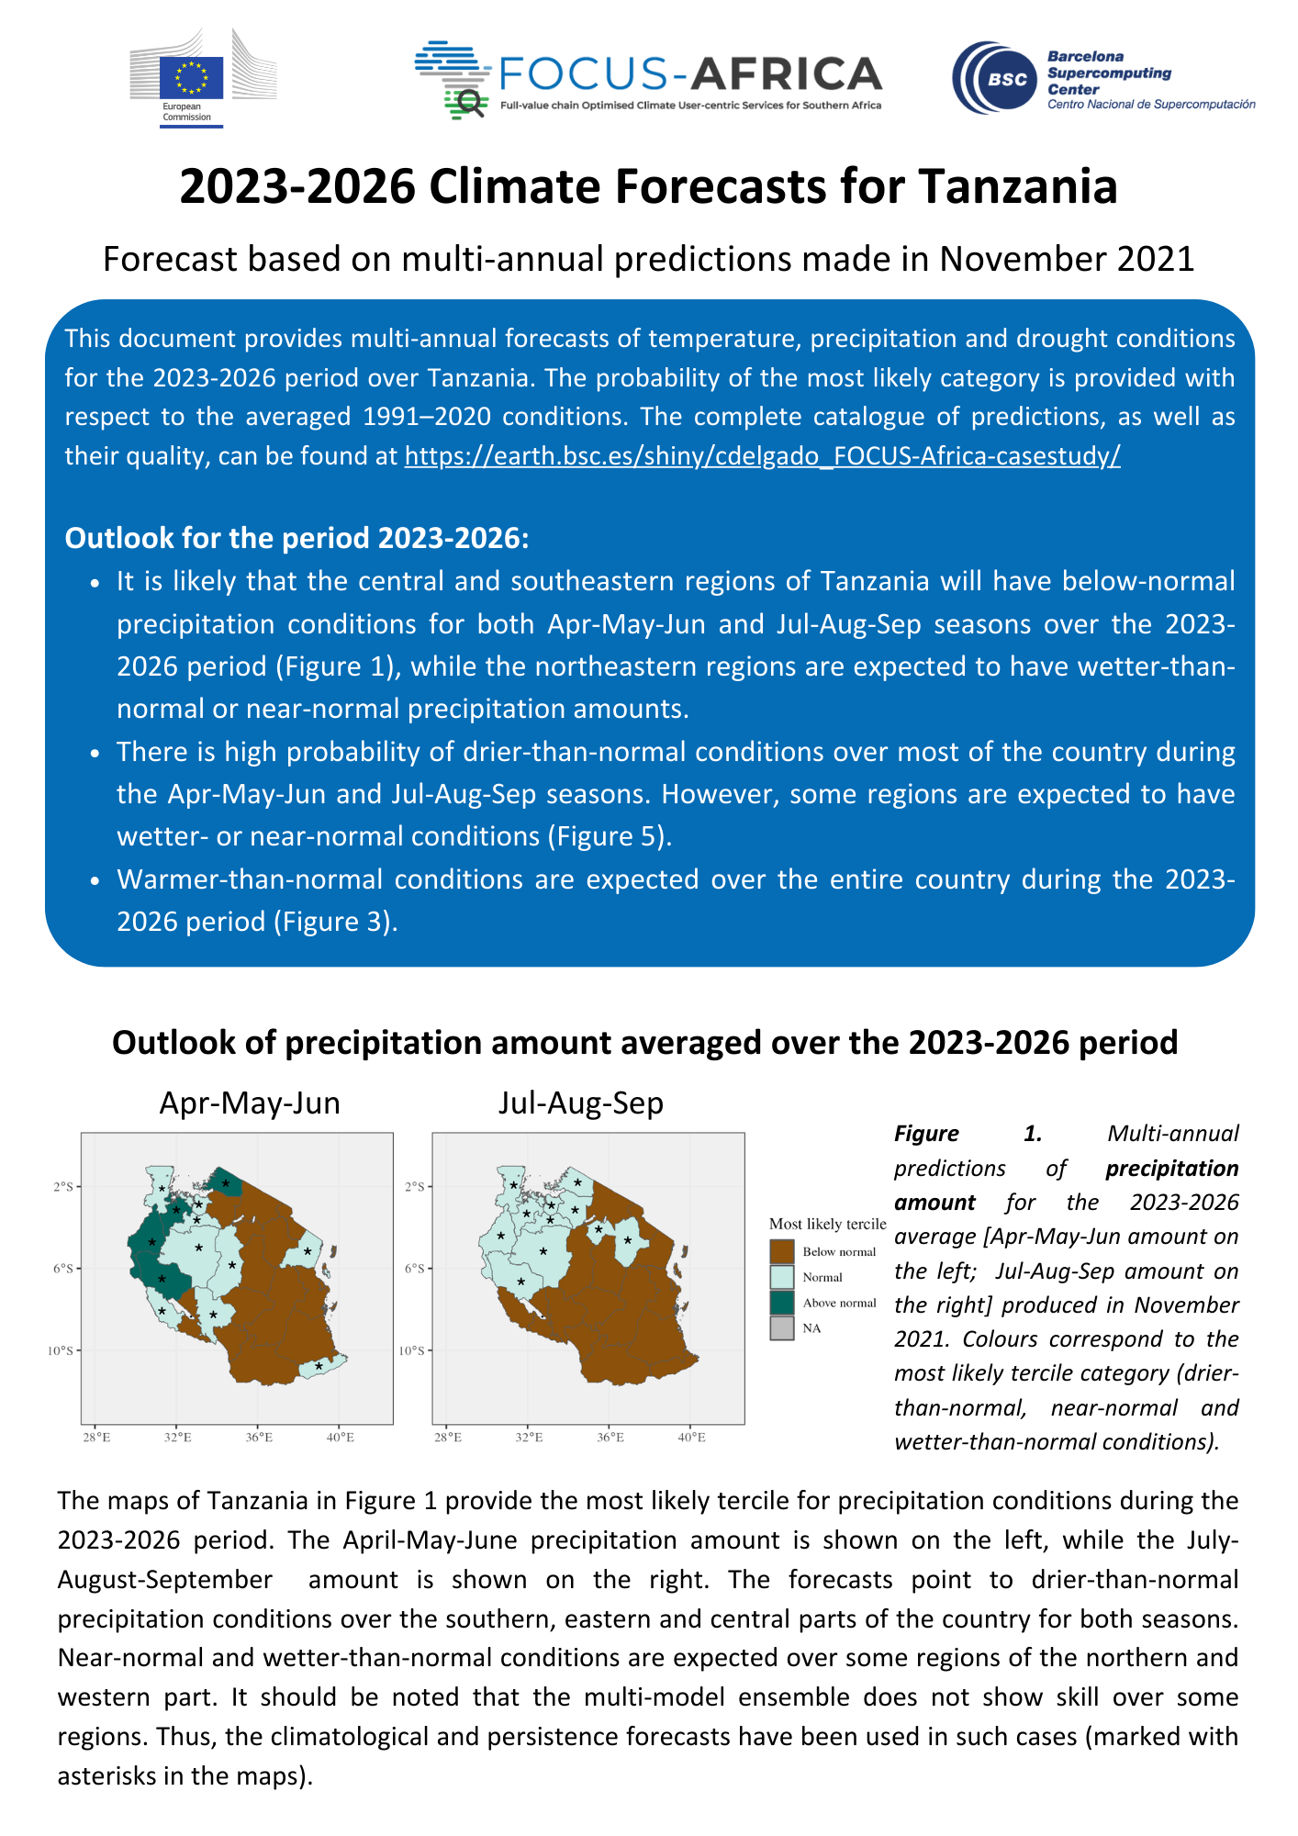
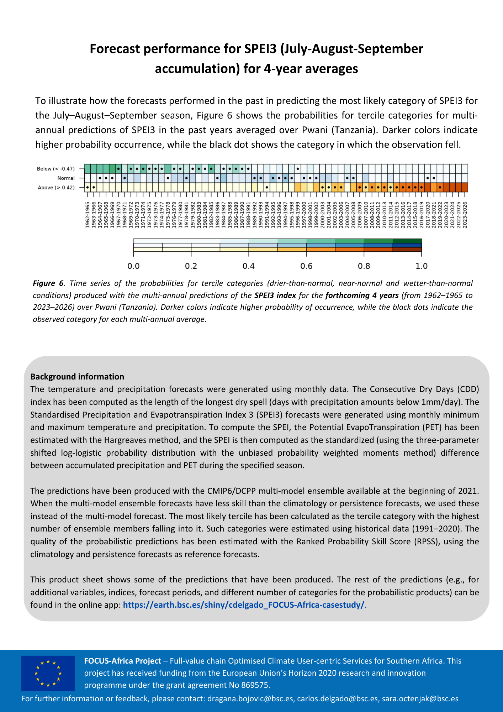
Printed bulletins
Document that provides multi-annual forecasts of temperature, precipitation and drought conditions for the next years over Tanzania and Malawi.
Used for in-person meetings with stakeholders to enhance the discussion and receive feedback to improve and tailor the climate information.

Slide 4
Multi-annual forecasts
Variables and indicators
Mean temperature and precipitation
Extreme maximum temperature: TX90p, TXx, HWMI
Extreme minimum temperature: FD, TN10p, TNn and CSDI
Extreme precipitation: CDD and CWD
Drought conditions: SPEI
Forecast systems
Individual models
Multi-model ensemble
Climatology
Persistence

Slide 5
Forecast quality

Slide 6
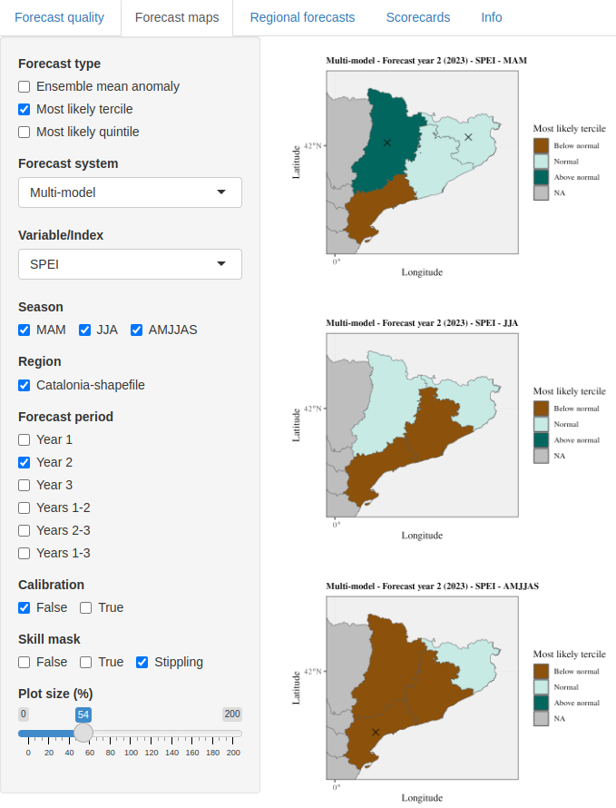
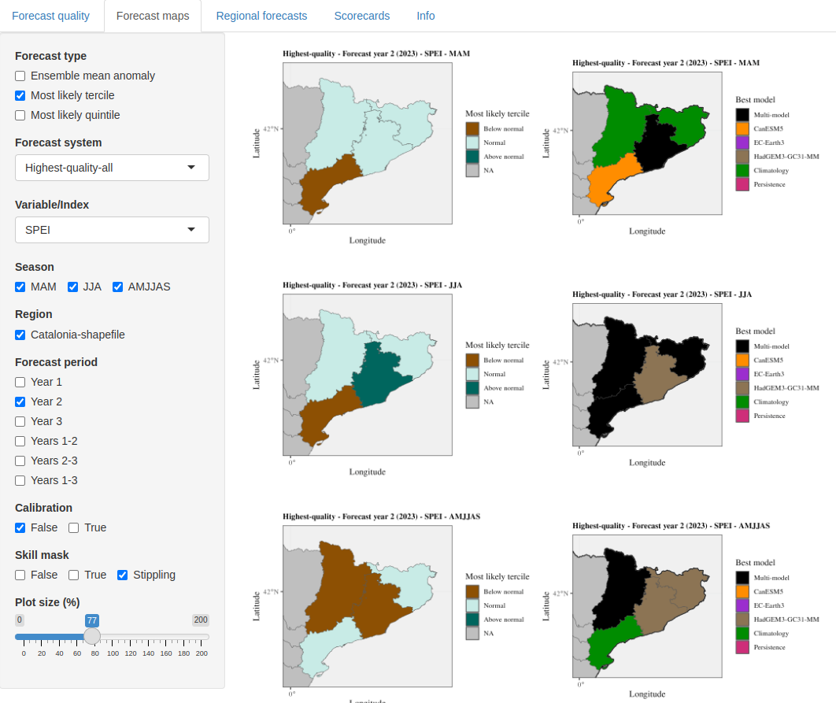
Forecast maps

Slide 7
Regional forecast

Slide 8
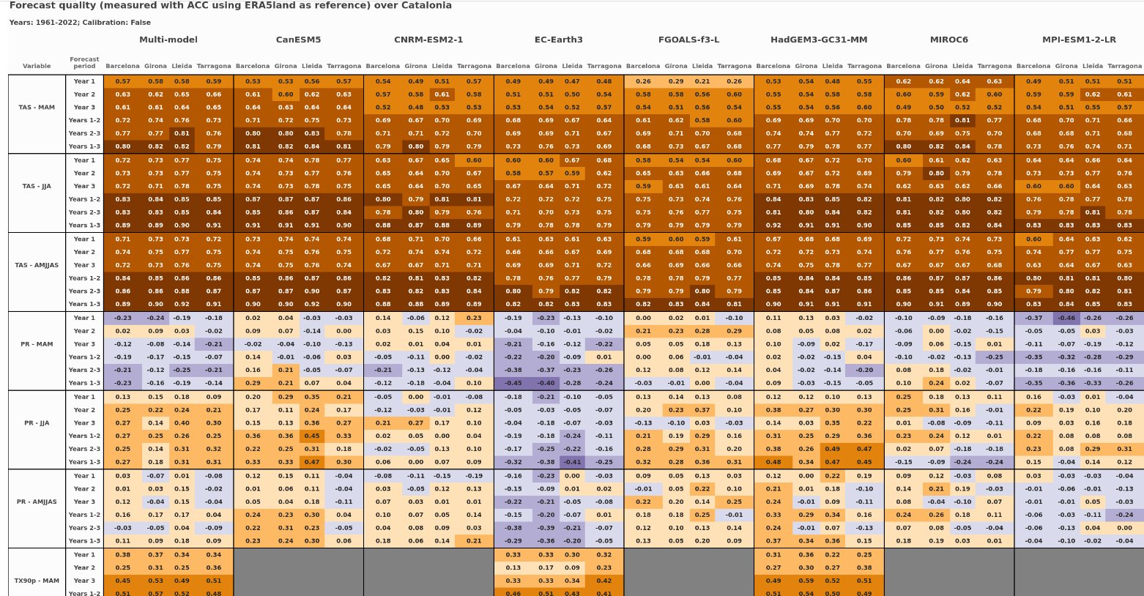
Scorecards

Slide 9
Key challenges
Identification of users’ needs
Communication of the forecast quality and uncertainty
Limited forecast quality → selecting the highest-quality source of information (individual forecast systems, multi-model ensemble, climatology, persistence)
Availability of the predictions → larger multi-model ensemble size for hindcasts than for forecasts
Timeliness of the predictions → low availability of start date 2023 on ESGF
Spatial resolution → statistical downscaling
Temporal resolution → sub-daily resolution is required for certain variables (e.g. wind speed)

Slide 10
Thank you!
Bergen, May 2022
carlos.delgado@bsc.es

