Slide 1
Implementation of EC-Earth 10km Global Coupled ESiWACE Demonstrator and Recent Computational Improvements
Mario Acosta, Miguel Castrillo, Kim Serradell
Computational Earth Sciences
13/06/2019
PASC19 – MS28: High-Resolution Weather and Climate Simulations
Notes:
In the framework of the Centre of Excellence in Simulation of Weather and Climate in Europe (ESiWACE), a ground-breaking configuration for EC-Earth - a European community Earth-System Model – has been developed. In the atmosphere, the horizontal domain is based on a spectral truncation of the atmospheric model (IFS) at T1279 together with 91 vertical levels. The ocean component (NEMO) is run on the so-called ORCA12 tripolar (cartesian) grid at a horizontal resolution of about 1/12°, with 75 vertical levels. In this talk, we will present the work done to develop this configuration, the computational challenges faced and the usage of the Barcelona Supercomputing Center (BSC) performance tools to analyse and profile the code. Finally, we will present some computational improvements regarding code execution and improved I/O management, currently developed in the Computational Earth Sciences team (CES) to increase the performance of this configuration.

Slide 2
Outline
Introduction
ESiWACE Center of Excellence
EC-Earth and demonstrator
Implementation and results
Future work and improvements

Slide 3
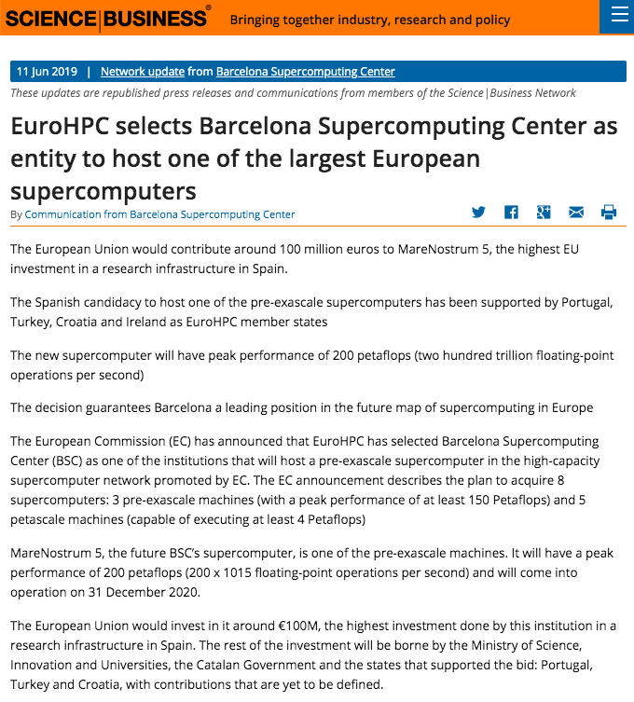
Barcelona Supercomputing Center Centro Nacional de Supercomputación
BSC-CNS objectives
Supercomputing services
to Spanish and
EU researchers
R&D in Computer,
Life, Earth and
Engineering Sciences
PhD programme,
technology transfer,
public engagement
Spanish Government 60%
Catalan Government 30%
Univ. Politècnica de Catalunya (UPC) 10%
BSC-CNS is
a consortium
that includes

Slide 4
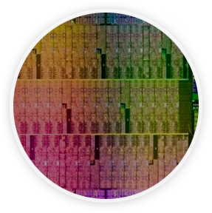
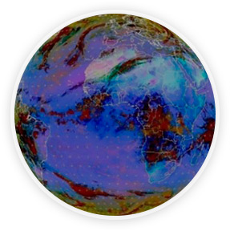
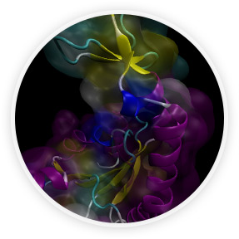
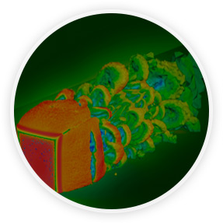
Mission of BSC Scientific Departments
Computer
Sciences
Earth Sciences
To influence the way machines are built, programmed and used: programming models, performance tools, Big Data, computer architecture, energy efficiency
To develop and implement global and regional state-of-the-art models for short-term air quality forecast and long-term climate applications
Life
Sciences
CASE
To understand living organisms by means of theoretical and computational methods (molecular modeling, genomics, proteomics)
To develop scientific and engineering software to efficiently exploit super-computing capabilities (biomedical, geophysics, atmospheric, energy, social and economic simulations)

Slide 5
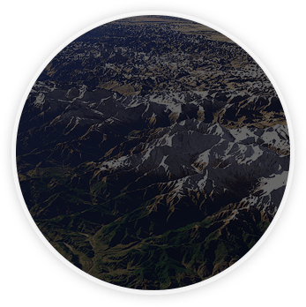
Earth Sciences
Environmental modelling and forecasting, with a particular focus on weather, climate and air quality
Modeling
air quality and
Sand and Dust Storms
Processes from urban to
Global and the impacts
on weather, health
and ecosystems
Climate
predictions
system from
subseasonal-to-decadal
forecasts
Research
and
Forecasts
Service Users Sectors
Infrastructures
Solar
Energy
Urban
development
Transport
Wind
Energy
Agriculture
Insurance

Slide 6
Computational Earth Sciences
Weather and Climate Science
Computational Earth Sciences
Computer Science
Knowledge about the mathematical and computational side of Earth System Applications
Knowledge about the specific needs in HPC of the Earth System Applications
Researching about HPC methods specifically used for Earth System Applications

Slide 7
Related talks
In session MS43, Computational Performance Evaluation for Hardware and Software Alternatives to Increase the HPC Efficiency of Earth System Models
When: 14 June 2019
Where: HG D 1.1
Mario Acosta: New Methodologies for Computational Performance Evaluation of Climate and Weather (10:30 - 11:00)
Oriol Tintó: Improving Ocean Model Computational Performance by using Mixed-Precision Approaches (11:00 – 11:30)

Slide 8
ESiWACE & EC-Earth

Slide 9
ESiWACE & ESiWACE2
Centre of Excellence in Simulation of Weather and Climate in Europe
Major benefit: create a framework where different institutions can work together to technically improve a community model as EC-Earth
First part of this talk is a summary from D2.11 deliverable: “Implementation of EC-Earth 10km global coupled demonstrator and performance analysis” - Zenodo

Slide 10
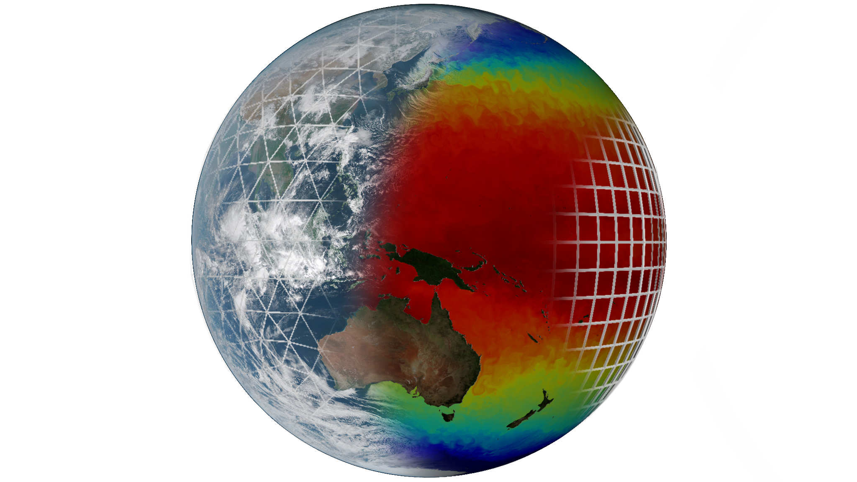
EC-Earth (I)
Ocean - ICE:
NEMO - LIM
Atmosphere:
IFS
Coupler:

Slide 11
EC-Earth (II)
29 partner institutes
8 core partners
KNMI, AEMET, DMI, Met Éireann, FMI, IPMA, CNR-DTA, SMHI
Workgroups
Technical
Tuning
Atmospheric Composition and Land
Ocean
Millennium scale studies
CMIP6

Slide 12
EC-Earth demonstrator

Slide 13
Demonstrators
EC-Earth 10km coupled demonstrator
IFS (atmosphere)
T1279L91: ~16km grid point distance, 2.1M grid points
NEMO-LIM (ocean – sea-ice)
ORCA12L75: ~9km grid point distance, 13.2M grid points

Slide 14
Role of demonstrators
COMPUTATIONAL CHALLENGE
Demonstrate the computability of atmosphere-only, ocean-only and coupled global models at the highest possible resolution that is configurable today. The task will quantify how far away current capabilities are from the long-term strategic target (global cloud resolving models).
SCIENCE ENABLER
PRIMAVERA is a Horizon 2020 project which aims to develop a new generation of advanced and well-evaluated high-resolution global climate models.
The High Resolution Model Intercomparison Project (HighResMIP) is a CMIP6 endorsed MIP that applies, for the first time, a multi-model approach to the systematic investigation of the impact of horizontal resolution.

Slide 15
H2020: European HPC & science integration
Research
infrastructure
HPC applications (CoEs)
Climate science and HPC
Community

Slide 16
Development of EC-Earth T1279-ORCA12
Develop initial data
Including OASIS interpolation weight files
Create namelists for IFS, NEMO-LIM (XIOS) and OASIS
Adapt source code and existing runscripts
Introduce required changes in the experiment workflow
Work done in collaboration between Research Engineers and Climate Scientists
Scalability tests / load balance studies / profiling

Slide 17
EC-Earth T1279-ORCA12: production runs
Courtesy of: Thomas Arsouze

Slide 18
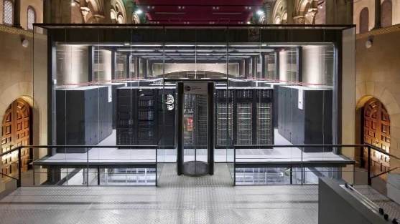
EC-Earth T1279-ORCA12 in MareNostrum3
First global, coupled ~10km simulations (T1279 - ORCA12):
EC-Earth 3.2 (IFS36r4 + NEMO 3.6 + OASIS3-MCT)
2,035 MPI tasks - 60 SDPD
1,170 NEMO
848 IFS
16 XIOS
1 runoff mapper
MareNostrum3 @ BSC

Slide 19
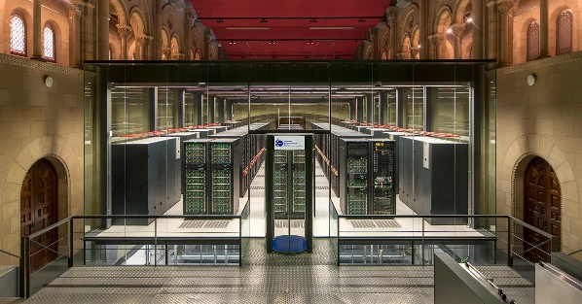
EC-Earth T1279-ORCA12 in MareNostrum4
Operational global, coupled ~10 km simulations (T1279 - ORCA12):
EC-Earth 3.2 (IFS36r4 + NEMO 3.6 + OASIS3-MCT)
5,040 MPI tasks - 0.44 SYPD, 160 SDPD
3,209 NEMO
1,584 IFS
69 XIOS
1 runoff mapper
MareNostrum4 @ BSC
100 year exp ~40M ch !!!

Slide 20
MareNostrum4: Tackled issues
I/O management
Use of MareNostrum4 data-transfer nodes
Optimal libraries and dependencies
Never forget Usability (software stack and workflows) and user support
Come up with a stable environment
OmniPath: numerous tests and collaboration with operations to find optimal configuration (tmi, PSM2)
XIOS update: decrease number of communications
Controlling process pinning: better memory management

Slide 21
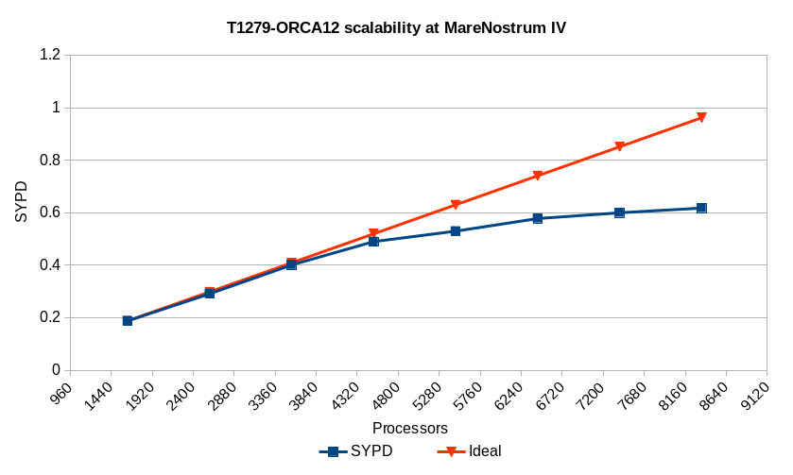
Scalability

Slide 22
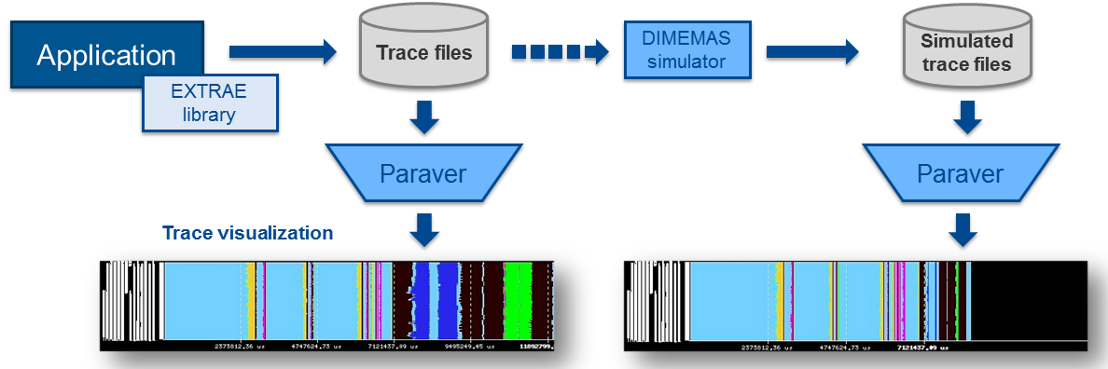
Performance analysis
Since 1991
Based on traces
Open Source: https://tools.bsc.es
Extrae: Package that generates Paraver trace-files for a post-mortem analysis
Paraver: Trace visualization and analysis browser
Dimemas: Message passing simulator

Slide 23
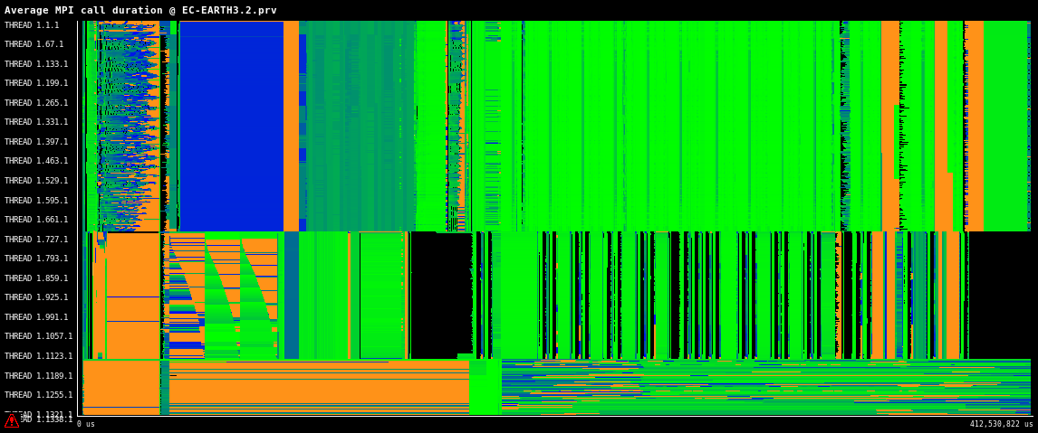
Tracing runs
Trace of 24h T1279‐ORCA12 execution representing the average MPI call duration

Slide 24
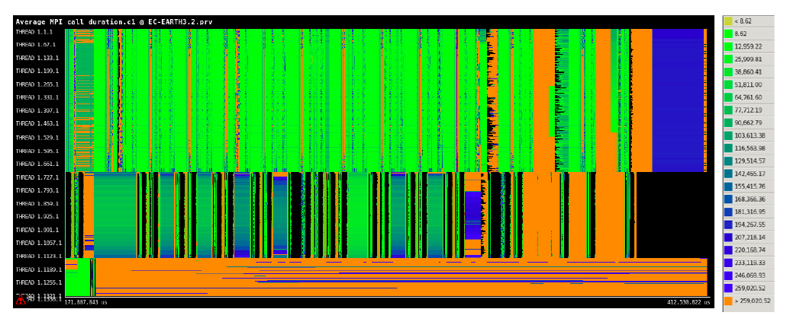
Tracing runs
Trace of 24h T1279‐ORCA12 execution representing the average MPI call duration with a zoom to catch more details in each time step.

Slide 25
Issues found
Reduce I/O overhead → Interface IFS with XIOS
I/O in IFS36r4 is sequential
NEMO-LIM (ORCA12): Up to 3 SYPD in MareNostrum4 (LIM -> 2OCE stp)
Sea-ice is slow and computationally demanding
Update IFS to newest cycle, using octahedral grid
Update NEMO to NEMO4 (and beyond)
Most of these improvements can be real in EC-Earth4

Slide 26
What next?

Slide 27
EC-Earth4
In parallel with EC-Earth3.X (CMIP6), we started the development of the next version
Still work to do in ESiWACE2 to reach “production mode”
EC-Earth TWG is currently working in a first release (end 2019)
Objective: more regular releases
But in this mixed approach “scientific-technical”, many other things need to be discussed

Slide 28
EC-Earth4 TODO list
Main components will be upgraded to last versions (OpenIFS, NEMO4, OASIS and XIOS)
XIOS as I/O server for Atmosphere and Ocean
Decouple sea-ice model from NEMO and use OASIS instead
Providing a ”mixed-precision” version
Improving workflow management, code modularity and CI/CD
Continue deploying the reproducibility protocol among partners/machines (paper under discussion in GMD)
Adapt post-processing tools to work with high-resolution configuration
Increase adoption and feedback from EC-Earth developers to model developers

Slide 29
Exploring new I/O methods
With this new configuration, I/O is a huge problem and should always be considered when doing projections
Sequential I/O in the Atmosphere
Issues to produce large coupler files
Different file formats, post-processing, big investment to have a curated and structured storage.
Starting from the same point, we decided to tackle the problem from two perspectives
Based on files, more operational
Removing files, totally experimental

Slide 30
OpenIFS - XIOS
One year ago, we started the project to integrate XIOS in IFS/OpenIFS
First version to validate the approach (only storing grid-point variables) has been completed
In April-May, thanks to ESiWACE2, a visit from BSC research engineer to NLeSC led to complete the work
OpenIFS can now output all variables using XIOS
ECMWF will integrate this developments in the next OpenIFS release (expected for the next OpenIFS workshop)

Slide 31
OpenIFS - XIOS
The current operations performed in the EC-Earth post-processing task are avoidable, since XIOS has these features:
Output files are in netCDF format
Written data is CMIP-compliant (CMORized)
It is able to post-process data online to generate diagnostics
The use of XIOS in EC-Earth has a twofold effect:
Improve the computational performance and efficiency of the model, and thus, reduce the execution time (previously mentioned)
Reduce the critical path of its workflow by avoiding the post-processing task

Slide 32
OpenIFS - Cassandra
In collaboration with Data Driven Group in Computer Sciences, we are running an experimental project to couple OpenIFS with Apache Cassandra (NoSQL DB).
OpenIFS
Run the atmospheric model
Cassandra
Store model output in Cassandra data model
Query
Run a query to store results in Cassandra
In execution time, fields from OpenIFS are send to Cassandra (distributed) and stored.
Different configurations: T255, T511 and T1279 and pushed to outputting each timestep.
Optimized queries (using PyCOMPSs) can be developed to retrieve data and generate files (if needed).

Slide 33
OpenIFS - Cassandra
OpenIFS
OpenIFS
OpenIFS
OpenIFS
OpenIFS
Cassandra
OpenIFS
Cassandra
OpenIFS
OpenIFS
OpenIFS
OpenIFS
OpenIFS
OpenIFS
MPI/OpenMP
MPI/OpenMP
LOCAL
REMOTE

Slide 34
Conclusions
Now the EC-Earth T1279-ORCA12 configuration is:
Developed and shared among EC-Earth consortium partners
Deployed and tested in MareNostrum3 and MareNostrum4 HPC systems
Used in production for H2020 projects such as PRIMAVERA using PRACE resources
Used to investigate the scalability of ultra-high resolution coupled models, enabling to push computational challenges of the current HPC generation
And led to build a roadmap to EC-Earth4

Slide 35
Thank you
The projects ESiWACE and ESiWACE2 have received funding from the European Union’s Horizon 2020 research and innovation programme under grant agreements No 675191 and 823988.
The content of this presentation reflects only the author’s view. The European Commission is not responsible for any use that may be made of the information it contains.
kim.serradell@bsc.es

