Slide 1
Vila Velha de Ródão/Perdigão,
May 10-13, 2016
First results on predictability assessment
A.Soret¹, V.Torralba¹, S. Lozano², N.Cortesi¹, J. Sanz², F. J.Doblas-Reyes^{1, 3}
¹Barcelona Supercomputing Center, Barcelona (BSC), Spain
²National Renewable Energy Centre
³Institució Catalana de Recerca i Estudis Avançats (ICREA), Spain
Notes:
To provide a full characterization of the wind speed predictability at different time scales based on seasonal climate predictions and assess the evolution of this predictability in different European regions
End-users requirements:
lenght of the mesoscale model (volen 30 anys de smulacio)
probabilitat
time series, not only statistics

Slide 2
Objective
Introduction to climate predictions
Sources of predictability
Methodology
Preliminary results
Conclusions and future work

Slide 3
Introduction
Introduction to climate predictions
Weather forecasting: Initial-value problems
Climate projections: forced boundary condition problem.
Climate predictions (sub-seasonal, seasonal and decadal) in the middle.
Weather forecasts
Climate predictions
Climate-change projections
Sub-seasonal
Seasonal
Decadal
1-15 days
10-32 days
1-15 months
2-30 years
20-100 years
Time
Initial-value
driven
Boundary-condition
driven
Adapted from: Meehl et al. (2009)
Notes:
Schematic illustrating progression from initial value problems with daily weather forecasts at one end, and multidecadal to century projections as a forced boundary condition problem at the other, with seasonal and decadal prediction in between.
Progression from initial-value problems with weather forecasting at one end and multi-decadal to century projections as a forced boundary condition problem at the other, with climate prediction (sub-seasonal, seasonal and decadal) in the middle. Prediction involves initialization and systematic comparison with a simultaneous reference

Slide 4
Introduction
Introduction to climate services
Wind energy sector routinely uses weather forecast up to 15 days. Beyond this time horizon, climatological data are used.
In other sectors, climate information on seasonal-to-interannual time scales have already been illustrated for management decisions.
Hydroelectric power management
Electricity demand
Notes:
While the energy sector has routinely been using weather forecast out up to 15 days (Dubus, 2010), beyond this time horizon, climatological data (typically 30-years averages) are used. A common assumption in this method is that future conditions will be similar to past conditions. This assumption entails two inherent shortcomings. The first one is that past conditions can be highly variable, which can make them of limited use when guessing the future. The second one is that climatology cannot predict events which have never happened before, i.e. extreme events, which can be particularly harmful and whose prediction is of special interest for stakeholders. Our knowledge of climatology is based on a finite sample of past events. This sample is limited in time, and doesn’t need to be fully representative of what can happen. Moreover, a climatological approach does not take into account changes in atmospheric dynamics, such as those caused by climate change. Climate change may render past conditions useless for predicting future events, as they may no longer hold true.

Slide 5
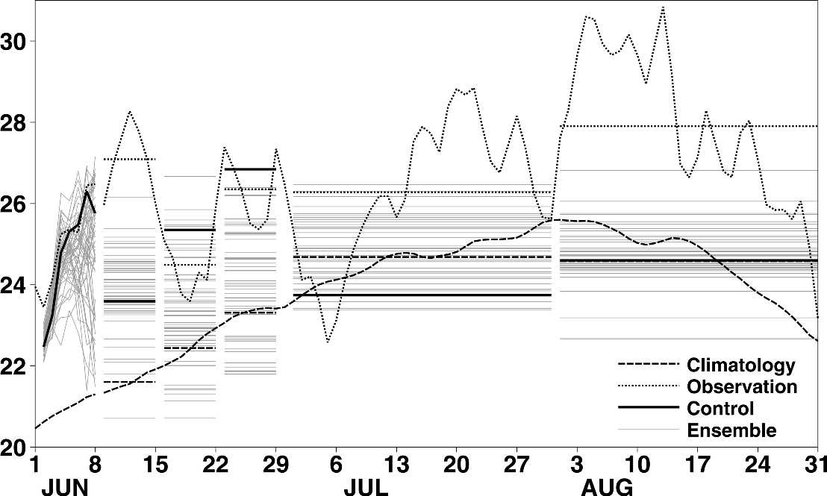
Introduction
Introduction to climate predictions
Heat wave 2003.Prediction of temperature produced by ECMWF
Fig. Observations (dotted) and forecasts (solid) made by ECMWF at the beginning of June of European 2-m land temperatures ( °C). (Source: Rodwell and Doblas-Reyes, 2006)
Notes:
During the summer of 2003, Europe experienced a
strong heat wave. June–August (JJA) temperature
anomalies peaked at over 4 K (and five standard deviations)
above the 30-yr mean over France and Switzerland
(Schär et al. 2004). European rainfall was also
reduced, particularly over southern France. The heat
wave was apparently responsible for (or at least accelerated)
the deaths of nearly 15 000 people in France
alone, caused billions of euros in damage to crops, and
had detrimental impacts on metropolitan pollution levels
and alpine glaciers.
Here, we will examine this particular
case study because it is of interest in itself and
because it provides a means of motivating the general
topic of predictability of European climate. For example,
we will use this case study to illustrate what we
mean by “predictability” and to highlight some salient
questions that need answering. Figure 1 shows (dashed
curve) the daily climatological average European 2-m
temperatures (T2m) based on the 40-yr European Centre
for Medium-Range Weather Forecasts (ECMWF)
Re-Analysis (ERA-40) record (Uppala et al. 2005). The
much higher daily observed values for summer 2003 are
shown by the dotted curve. Horizontal dashed and dotted
lines show the corresponding weekly mean and
monthly mean values. Important questions are how
well was this 2003 event “predicted,” and what impact
did the predictions have on decision making?
FIG. 1. Observations (dotted) and forecasts (solid) made by
ECMWF at the beginning of June of European 2-m land temperatures
(°C). Also shown (dashed) are the climatological mean
values based on ERA-40. (The mean annual cycle is calculated
from the daily ERA-40 data, 1 Sep 1957–31 Aug 2002, with a
5-day running-mean filter applied.) Horizontal lines show weekly
and monthly mean values. For the period 2–8 June the single
high-resolution “control” forecast (black solid) is made at a (triangular)
resolution of T511 and the ensemble forecasts (gray) are
made at a resolution of T255. The weekly mean forecasts 9–15
June, 16–22 June, and 23–29 June are based on T159 forecasts
started on 4 June (black solid again signifies the control forecast,
which is initiated with unperturbed initial conditions). The
monthly mean forecasts for July and August are based on T95
forecasts initiated on 1 June (black solid simply signifies the first
member of the ensemble). All results are spatially averaged over
the land points in the box (35°–55°N, 5°W–25°E).

Slide 6
Introduction. Decision-making
MONTHLY TO SEASONAL TIMESCALES
Energy producers: Resource management strategies
Energy traders: Resource effects on markets
Wind farm operators: Planning for maintenance works
Wind farm investors: Optimise return on investments
ANNUAL TO DECADAL TIMESCALES
Wind farm planners: Site selection
Wind farm investors: Evaluate return on investments
Policy makers: Understand changes to energy mix

Slide 7
Sources of predictability

Slide 8
Seasonal forecast predictability
How can we predict climate for the coming season if we cannot predict the weather next week?
Weather forecasts
The forecasts are based in the initial conditions of the atmosphere, which is highly variable and develops a chaotic behaviour after a few days
Climate predictions
The predictions are based in the initial conditions of the sea surface temperature, snow cover or sea ice, which have a slow evolution that can range from few months to years.
Notes:
Climate predictions don’t have usable skill in forecasting on which day a locality will have temperature extremes, etc.
However, climate predictions have nonetheless some skill in predicting anomalies in the seasonal average of the weather i.e., anomalies of the climate. This skill is present regardless of the daily timing of the major weather events within the period. This level of skill for seasonal averages or totals may be useful for sectors impacted by climate variability, such as viticulture.

Slide 9
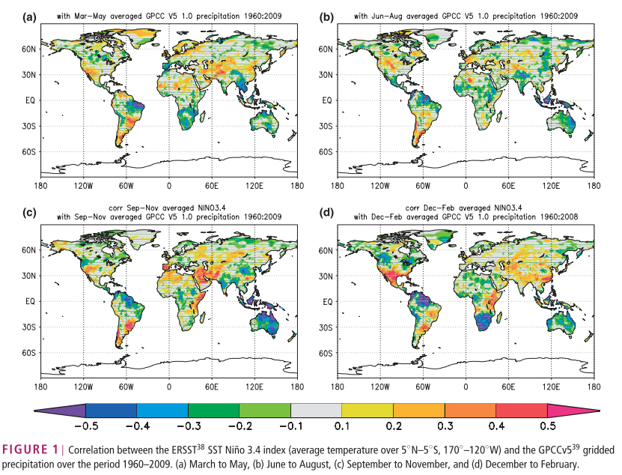
Sources of seasonal predictability
ENSO is the most important source of predictability at seasonal timescales (see e.g. Doblas-Reyes et al. 2013)
Notes:
The predictability of the Surface air temperatura and precipitation patterns, which are the varibles that play the most importatn role to agricluture is linked to our ability to predict the boundary conditions of the climate system such as the SST, especially in the tropics. ENSO is the most important source of predictability at seasonal time scales. The large spatial shifts in tropical Pacific rainfall associated with ENSO lead to large-scale changes in global circulation and precipitation, , which makes ENSO a primary source for predictabilty in remote regions. Figure shows that the linear association of an ENSO index with the local precipitation is high in many regions, even in the extratopics, although the relation has a strong seasonality.

Slide 10
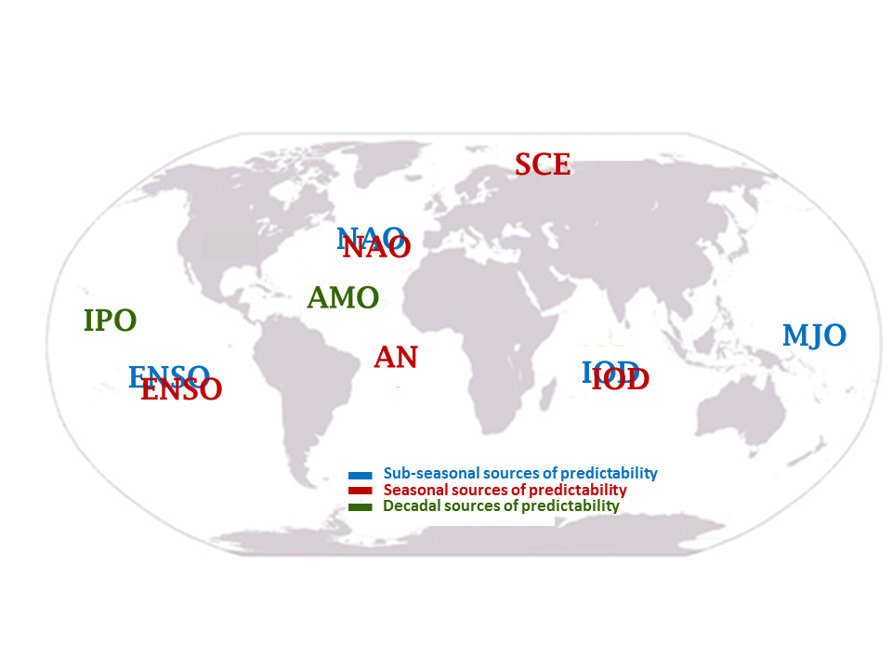
Sources of predictability of wind
Notes:
Main sources of predictability of wind speed. Each color corresponds to a different timescale: sub-seasonal (blue), seasonal (red) or decadal (green). The acronyms employed are: NAO (North Atlantic Oscillation), ENSO (El Niño Southern Oscillation), MJO (Madden-Julien Oscillation), IPO (Inter-decadal Pacific Oscillation), AMO (Atlantic Meridional Oscillation), AN (Atlantic Niño), IOD( Indian Ocean Dipole), SCE (Snow Cover Extent).

Slide 11
Methodology

Slide 12
Methodology
Download climate predictions:
Sub-seasonal
Seasonal
Decadal
Comparison with observations
Sources of predictability
Predictability assessment
Notes:
Comparison with observations, by means of different skill scores, each one developd to capture a particular aspect of the forecast system.

Slide 13
Preliminary results: Sub-seasonal predictions

Slide 14
Sub-seasonal prediction systems
http://s2sprediction.net
Comparison of the different subseasonal prediction systems.
Evolution of the skill with the lead time for the 10m wind speed predictions.

Slide 15
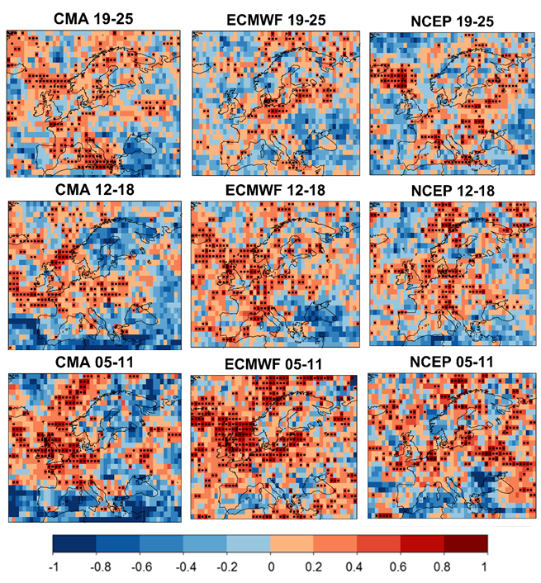
Sub-seasonal predictability in Europe
Correlation (January 1995-2014)
The CMA prediction system displays lower correlations than those from ECMWF and NCEP.
The considered S2S prediction systems show statistically significant levels of correlation for the three lead times.
The results enhance our confidence in the ability of the systems to forecast wind speed, however the sources of predictability need to be further explored.

Slide 16
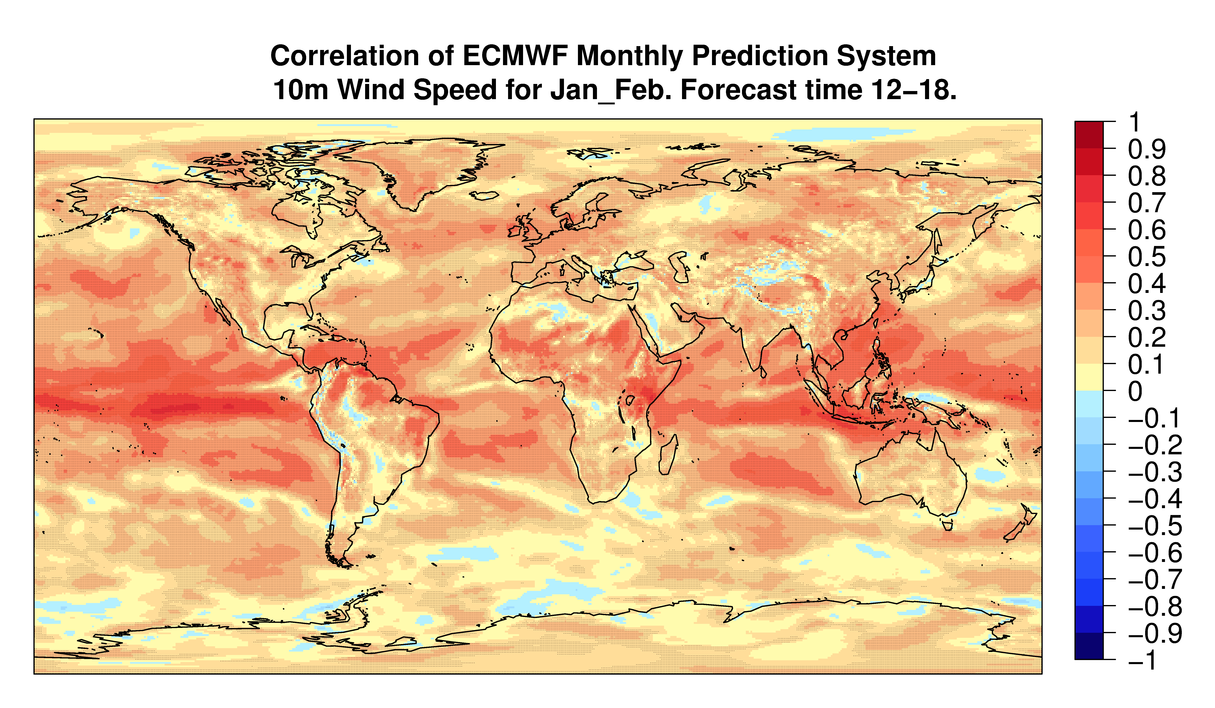
Sub-seasonal predictability

Slide 17
Preliminary results: Seasonal predictions

Slide 18
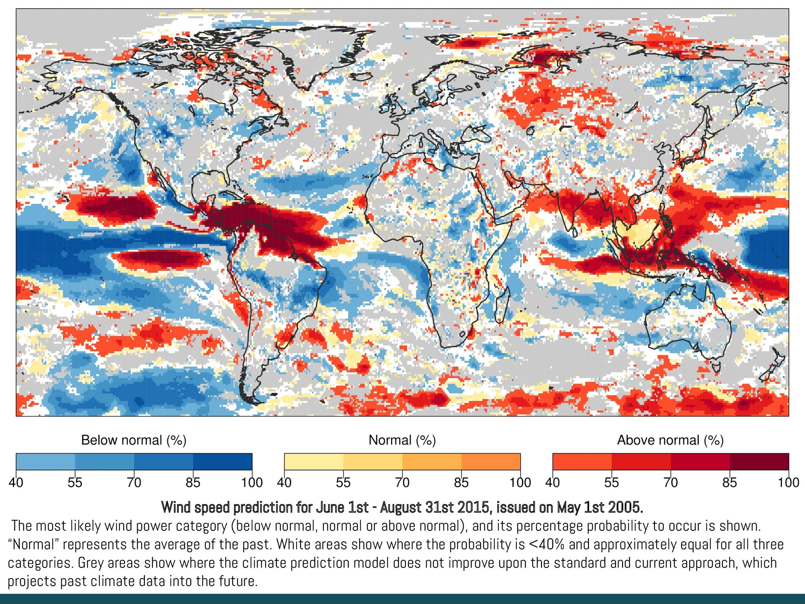
Seasonal prediction system
Data from ECMWF (European Centre for Medium-Range Weather Forecasts)
We assess the global behavior providing probabilistic predictions
Aggregated output in terciles:
Above normal
Normal
Below normal

Slide 19
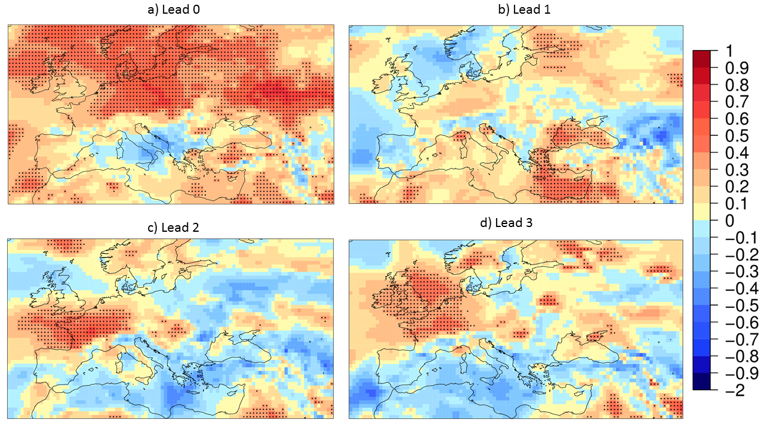
Seasonal predictability in Europe
Correlation Skill Score. 10-m wind speed. ECMWF S4 with starts dates once a year on first of December and ERA-Interim from 1981 to 2013. Raw data.
Lead 0. Average over months 1-3
Lead 1. Average over months 2-4
Lead 2. Average over months 3-5
Lead 3. Average over months 4-6

Slide 20
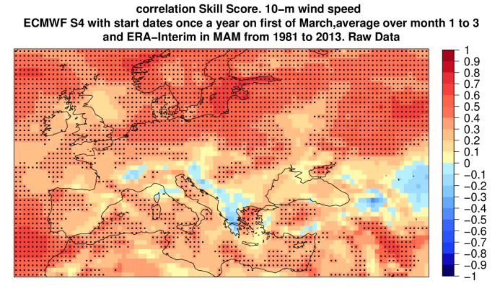
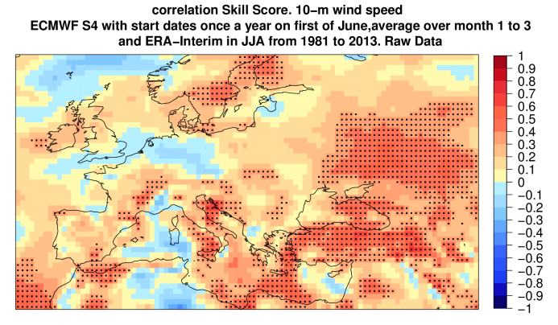
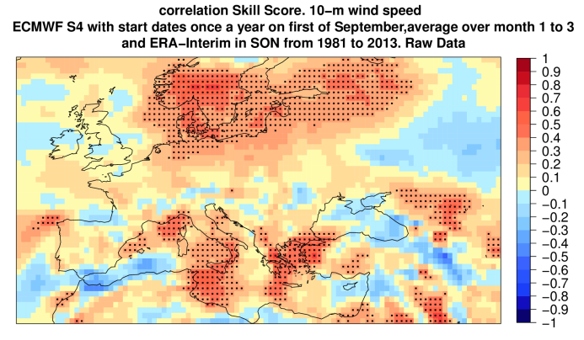
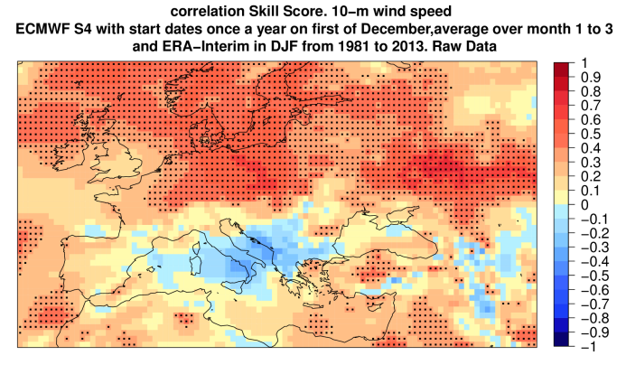
Seasonal predictability in Europe

Slide 21
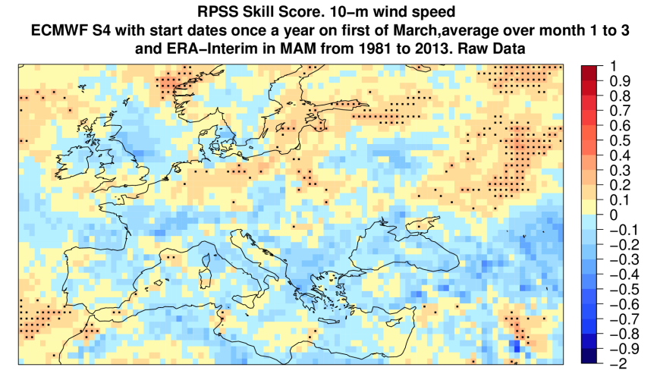
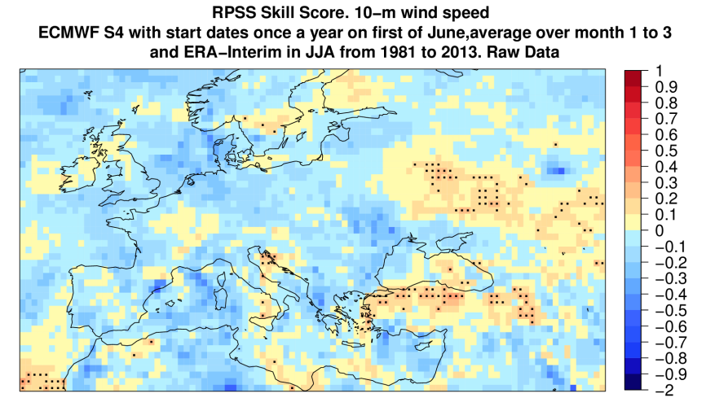
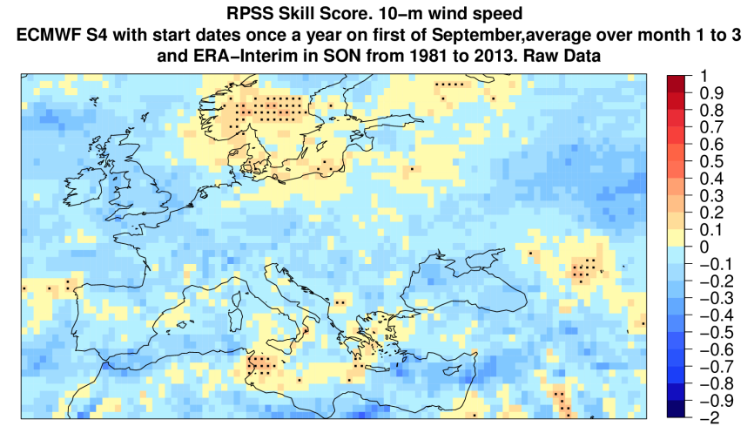
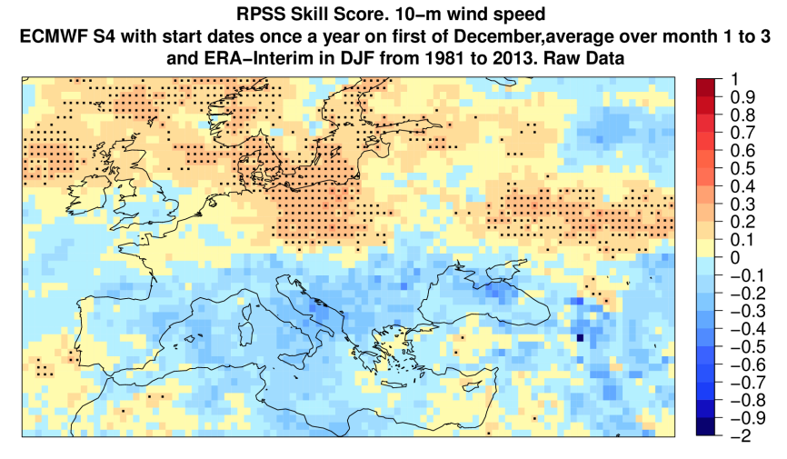
Seasonal predictability in Europe

Slide 22
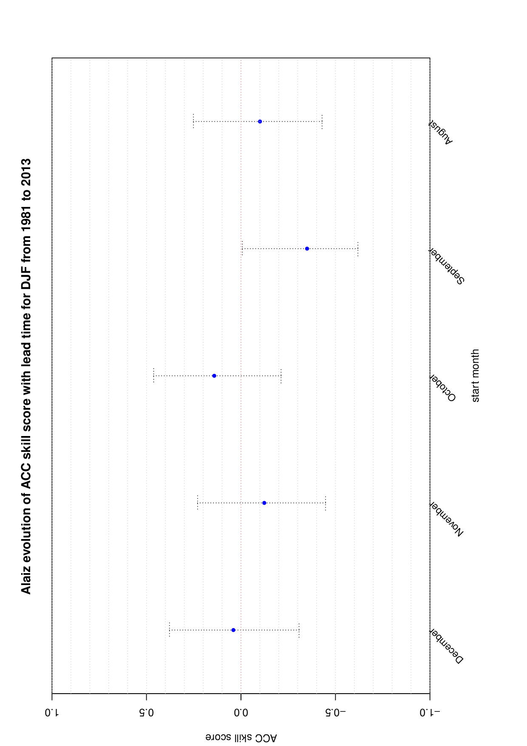
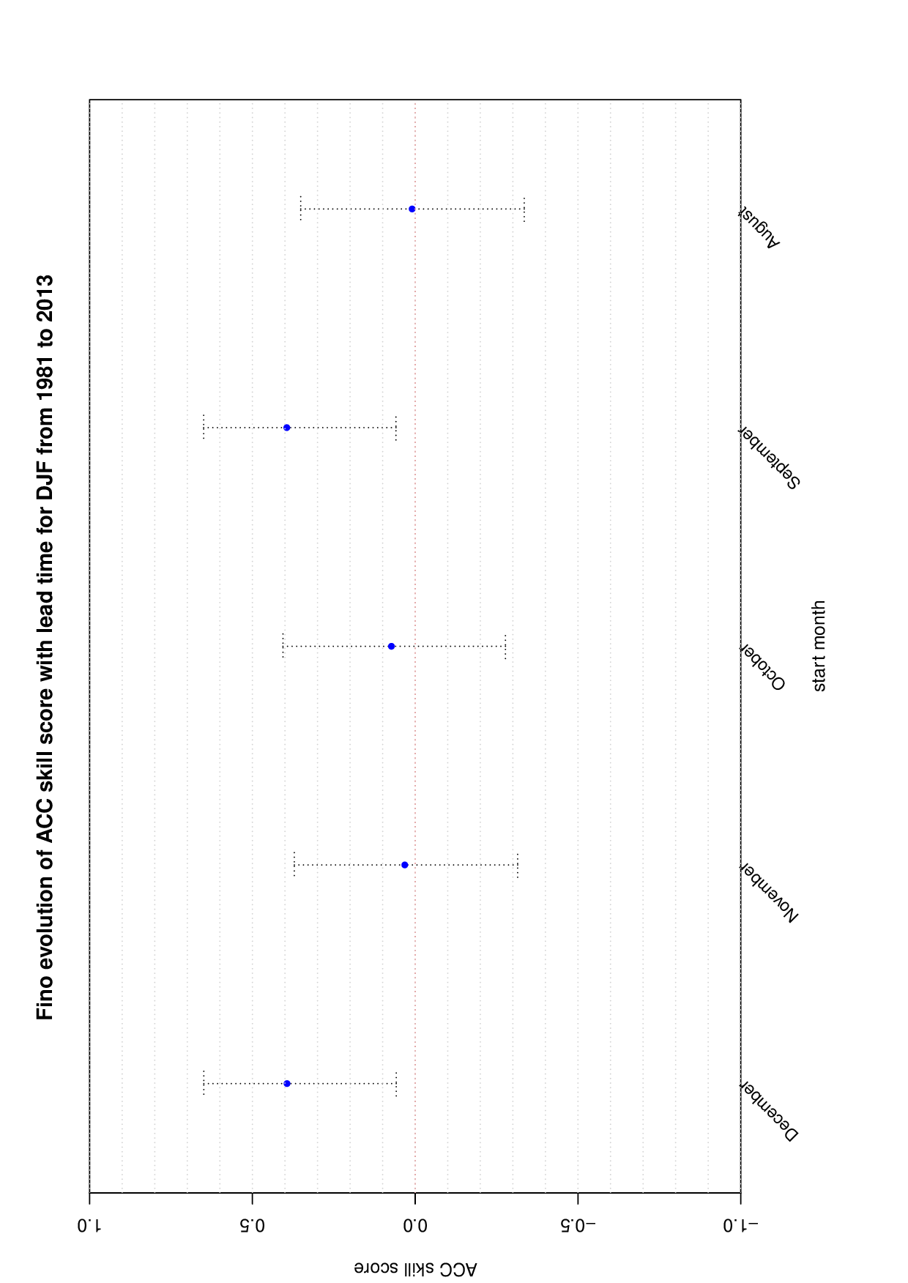
Seasonal predictability at specific sites
Alaiz experimental park (for DJF 1981-2013)
Fino met mast park (for DJF 1981-2013)

Slide 23
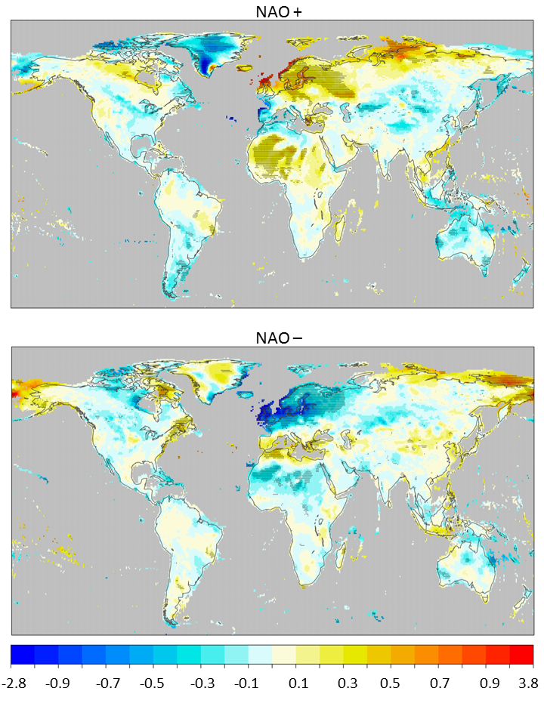
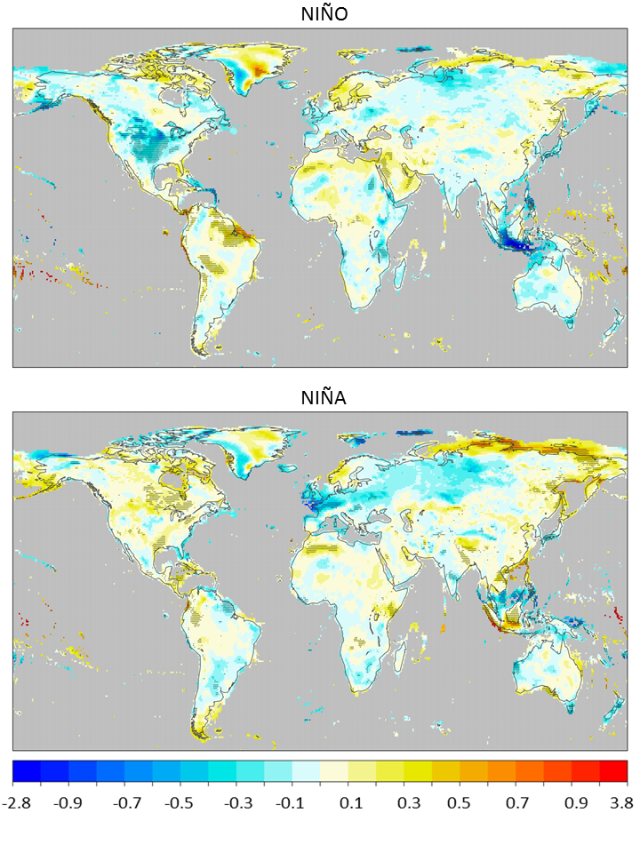
Wind speed drivers: ENSO and NAO
m/s
Notes:
Difference in wind speed between years with possittive NAO index and years with a negative NAO index for DJF.
Decadal predictions are a field of research that is on early stages, so we lack examples illustrating the methodology

Slide 24
Conclusions and future work

Slide 25
Conclusions
Preliminary results detected at least two windows of opportunity (potential forecast skill) over Europe:
Sub-seasonal; lead time of 12-18 days
Seasonal scale; lead time of one month.
Central and Northern Europe
Winter months of December-February.
For further information, see D3.2. Description of the predictability assessment methodology.

Slide 26
Future work
Next steps
Verification against other data bases: NCEP reanalysis, JRA, 10m measurements
Apply bias-correction techniques
Assessment of different forecast systems
Categorization of regions
Summarize all information in easy interpretable format

Slide 27
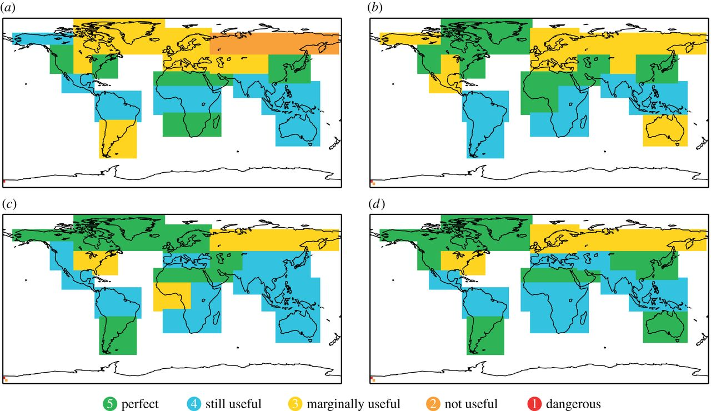
Future work
Notes:
At the end of the project our aim is to provide a clear description of the predictability of climate predictions at different time scales assessing the evolution of this predictability in different European regions. Rather than coming up with complex estimates of different characteristics of forecast skill and reliability whose relevance strongly depends on the specific application the preliminary results illustrated, in this deliverable we are going to be included in an easy interpretive and user-friendly example for an end user. This could be a similar tool to the information developed by Weisheimer and Palmer (2014) for precipitation and temperature seasonal forecasts (Figure 16), but for near-surface wind speed at sub-seasonal to decadal timescales and focusing in different European regions.

Slide 28
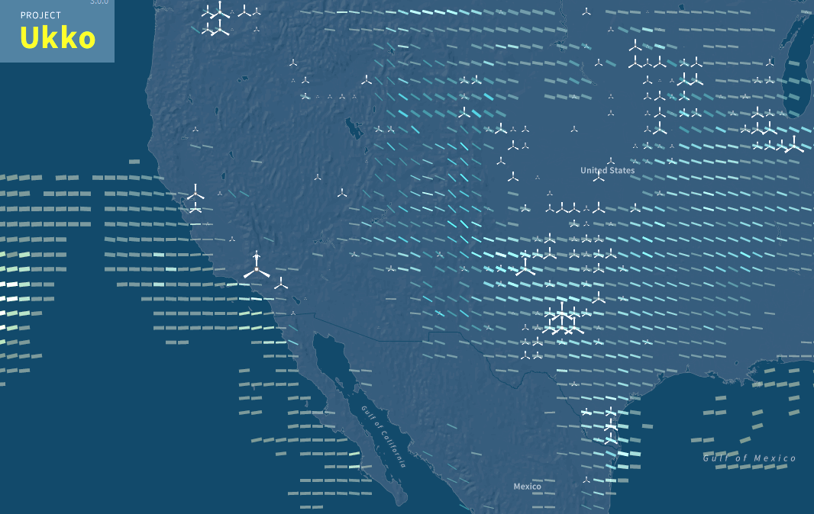
Further discussion:
1) Which format/kind of information will be uploaded to the GIS wind resources map? Rasters? Vectorial layers? Both? Could each geographical point have value tables or graphs associated?
2) When the 10m European data base will be available?
http://project-ukko.net/

Slide 29
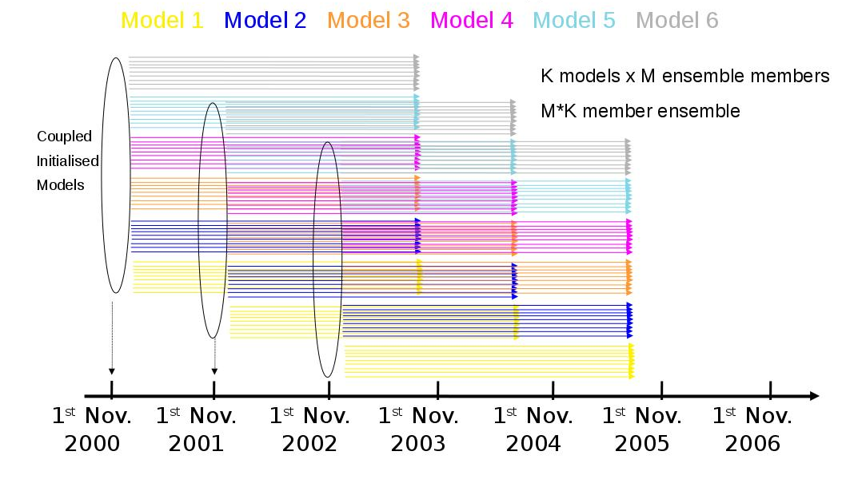
Methodology description
Decadal predictions are a field of research that is on early stages, so we lack examples illustrating the methodology
Multimodel approach:
CMIP5 decadal dataset
Planned analyses
Skill evaluation of individual models and comparison with the skill of the multi-model by means of a Taylor diagram.
The worst models are then discarded and the remaining models are used to generate the new, improved multi-model.
Assessment of the AMO and IPO roles in the wind speed variability at decadal time-scales.

Slide 30
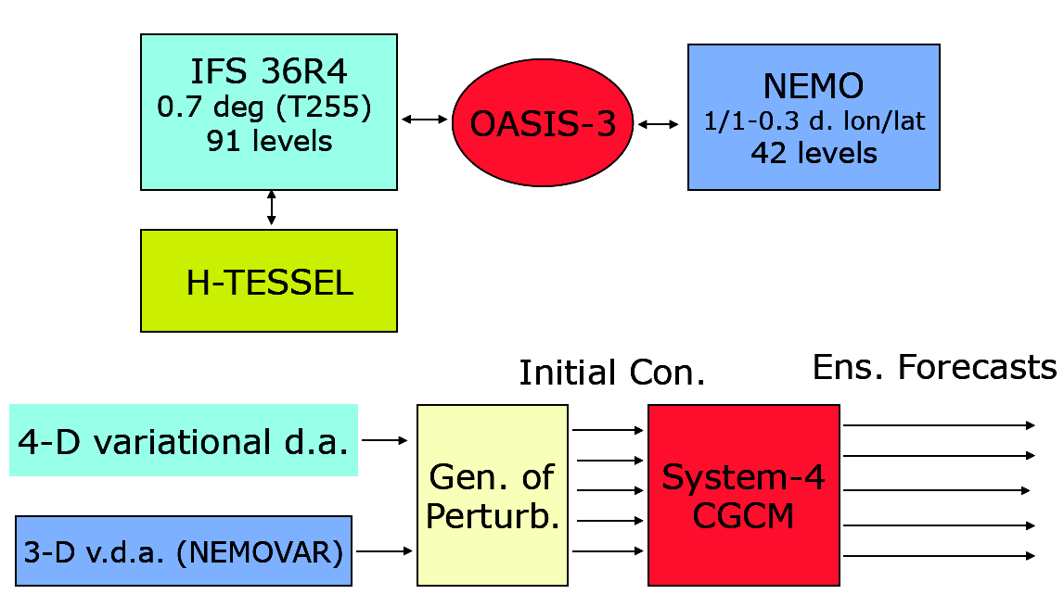
The new ECMWF Seasonal forecast system (Sys-4)

Slide 31
ECMWF System 4: main features (1)
• New ocean model : NEMO v. 3.0 + 3.1 coupling interface
ORCA-1 configuration (~1-deg. resol., ~0.3 lat. near the equator)
42 vertical levels, 20 levels with z < 300 m
• Variational ocean data assimilation (NEMOVAR)
3-D var with inner and outer loop
Collaboration with CERFACS, UK Met Office, INRIA
First re-analysis (1957-2009), no assim. of sea-level anomalies
Final re-analysis (ORA-S4) and real-time system including SLA
• IFS model cycle: 36r4 (op. Nov. 2010-May 2011), T255-L91
New physics package, including H-TESSEL land-surface scheme,
new snow model, new land surface initialization
• Prescribed sea-ice conc. with sampling from recent years

Slide 32
ECMWF System 4: main features (2)
• Operational forecasts
51-member ensemble from 1st day of the month
released on the 8th
7-month integration
• Experimental ENSO outlook
13-month extension from 1st Feb/May/Aug/Nov
15-member ensemble
• Re-forecast set
33years, start dates from 1 Jan 1981 to 1 Dec 2013
15-member ensembles, 7-month integrations
51-member ensembles from 1st Feb/May/Aug/Nov
13-month extension from 1st Feb/May/Aug/Nov

Slide 33
Ensemble predictions
Ensemble forecast system
Nov 2000 Nov 2001 Nov 2002 Nov 2003 Nov 2004 Nov 2005 Nov 2006
Notes:
Simple diagram illustrating the initialization and production of the multi-model hindcasts.

Slide 34
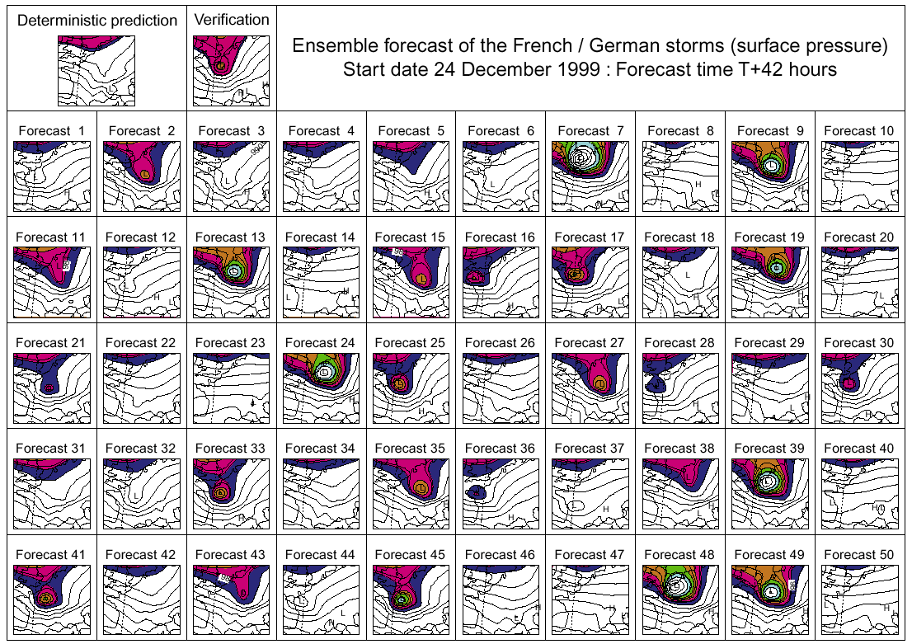
How many members: ensemble size
ECMWF forecasts (D+42) for the storm Lothar
Misses
Notes:
Simple diagram illustrating the initialization and production of the multi-model hindcasts.

Slide 35
How many members: ensemble size
ECMWF forecasts (D+42) for the storm Lothar
Misses
Notes:
Simple diagram illustrating the initialization and production of the multi-model hindcasts.

Slide 36
How many members: ensemble size
ECMWF forecasts (D+42) for the storm Lothar
With a large enough ensemble size, the very rare event can be forecast with a probability of 9/50, i.e. ~20%
Misses
Notes:
Simple diagram illustrating the initialization and production of the multi-model hindcasts.

Slide 37
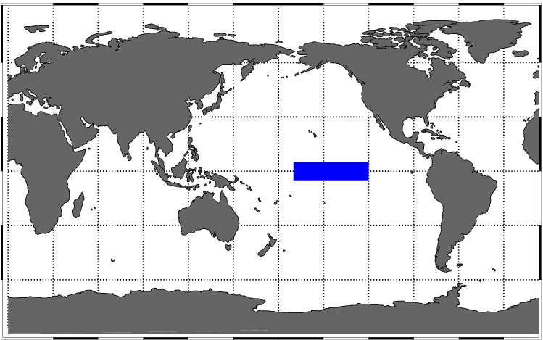
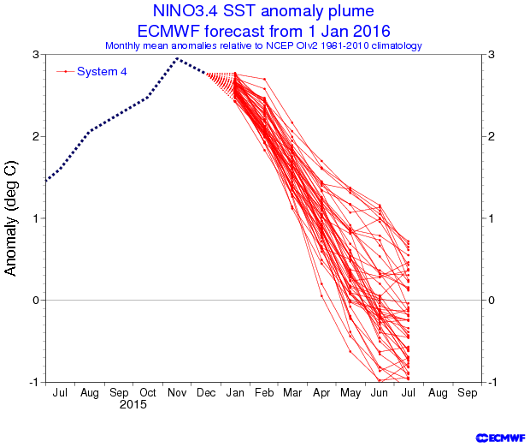
ENSO ensemble predictions

Slide 38
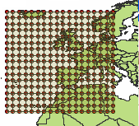
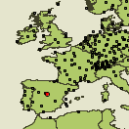
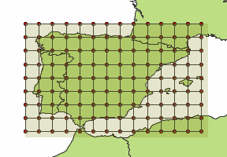
Bias correction/downscaling
Perfect prognosis approach:
In the training phase the statistical model is calibrated using observational data for both the predictands and predictors (e.g. reanalysis data)
Typical techniques: transfer functions, analogs, weather typing, weather generators, etc. (Maraun et al. 2010)
Predictors
Downscaling
Model
Predictands
(SLP, T(850 hPa);
T(700 hPa),..., Z(500 mb))
X_{n}
Precipitation Temperature
Regres, Analogs, …
Y_{n} = W^{T} X_{n}
Y_{n}
Global zone
Local zone
Source: José M. Gutiérrez, University of Cantabria

