Slide 2
Highlights [BSC]
Louis-Philippe Caron, Andrea Manrique, Niti Mishra, Chloé Prodhomme
Barcelona Supercomputing Center
Mini GA, De Bilt, 15-16 March 2018

Slide 3
Highlights
Skill of sub-seasonal systems over Europe
Skill of EUROSIP systems over Europe
Impact of increasing model resolution on seasonal skill of EC-Earth
Impact of land surface initialization on seasonal skill for EC-Earth
Impact of land surface initialization on agriculture relevant indices
Comparison of System4 and System5 skill

Slide 4
Meteorological predictions
Seasonal: EUROSIP (1992-2012)
ECMWF System4 (51 members)
GloSea5 (24 members)
NCEP System2 (28/24 members in winter/summer)
Météo-France System5 (15 members)

Slide 5
Seasonal verification: correlation 2m temperature
Mishra et al. (2018) Clim Dyn

Slide 6
Seasonal verification: correlation precipitation
Mishra et al. (2018) Clim Dyn

Slide 7
Seasonal verification: best performing model
Mishra et al. (2018) Clim Dyn

Slide 8
Seasonal verification: best performing model

Slide 9
Meteorological predictions
Subseasonal:
ECMWF monthly prediction system: 11 members, 20 yrs hincast (1996-2015)
NCEP (CFSv2): 4 members, 12 yrs hindcast (1999-2010)

Slide 10
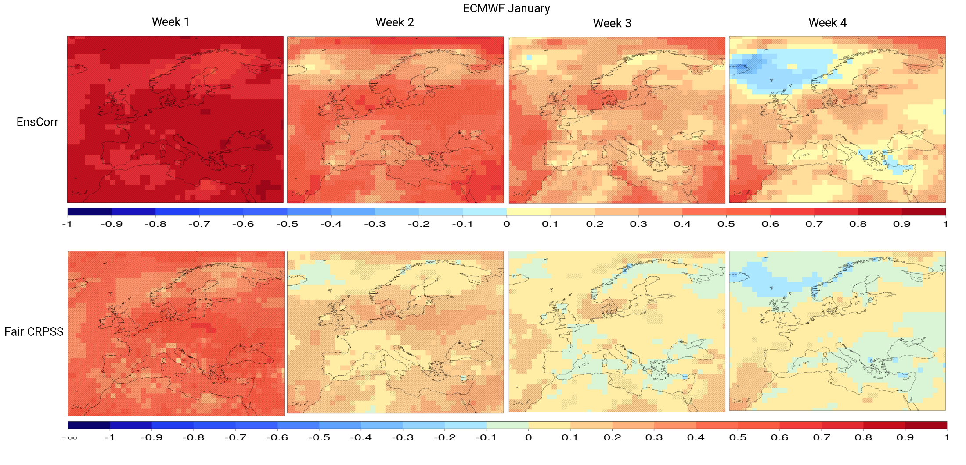
Sub-seasonal verification: 2m temperature ECMWF hindcast - January
Week 1: days 5-11 Week 2: days 12-18 Week 3: days 19-25 Week 4: days 26-32
Ensemble mean correlation up to week 4 in some areas of Europe
Fair CRPSS: Significant skill over climatology up to week 2 (Central-Eastern Europe)

Slide 11
Sub-seasonal verification: Precipitation ECMWF hindcast - January
Week 1: days 5-11 Week 2: days 12-18 Week 3: days 19-25 Week 4: days 26-32
Ensemble mean correlation up to week 2, noisier pattern than for temperature
Fair CRPSS: Significant skill over climatology up to week 2 (Central-Eastern Europe)
(very low skill score in Southern latitudes associated to the scarce precipitation)

Slide 12
Improvement due to soil moisture initialization
Target: JJA
1981-2010
Ceglar et al. (2017) Nat Sci Rep

Slide 13
Improvement due to soil moisture initialization
$$a×{SPEI}_{t}+b×{HDD}_{jja,t}+ε_{t}={CSI}_{t}+ε_{t}$$
Ceglar et al. (2017) Nat Sci Rep

Slide 14
Data provision
Politecnico Milano: Seasonal data from EC-Earth
CIMA Research Foundation: Seasonal data from (ECMWF S4, Meteo-France S5 and EC-Earth)
Technical University of Crete (GloSea5, ECMWF S4)
All seasonal (NMME (6), EUROSIP (4)) and sub-seasonal (6) available listed in MS10 table (or ask me).

Slide 15
Results by M36
Skill of sub-seasonal systems over Europe (D3.3)
Skill of EUROSIP systems over Europe (D3.3)
Impact of increasing model resolution on seasonal skill of EC-Earth (D3.4)
Impact of land surface initialization on seasonal skill for EC-Earth (D3.4)
Impact of land surface initialization on agriculture relevant indices (D3.4)
Comparison of System4 and System5 skill (D3.4)

Slide 16
Acknowledgement
IMPREX is a research project supported by the European Commission under the Horizon 2020 Framework Programme
Grant Agreement No 641811
Duration: 01/10/15 - 01/10/19
Contact details
Barcelona Supercomputing Center
Louis-Philippe Caron
Louis-philippe.caron@bsc.es

