Slide 1
EDITO-Model Lab - VOML Co-design technical meeting
Oct 2023
T5.2 Back-end architecture
Miguel Castrillo, Daniel Beltrán, Bruno P. Kinoshita
Barcelona Supercomputing Center

Slide 2
Motivation

Slide 3
VOML back-end requirements
Enable co-development → Discover and replicate experiments
Model-agnostic experiment configuration
Hide complexity → Scientific language interface
Automatic and reproducible workflow orchestration
Portability → Python, better if containerized
Monitorization
Robustness and efficiency in using shared resources →Job aggregation
Interactivity
Experiment manager
Workflow manager

Slide 4
Open source python tool, created at IC3-CFU (now BSC-ES) more than 10 years ago to manage and automate climate experiments.
Received funding by European initiatives such as SPECS, IS-ENES and ESiWACE.
Development driven by scientific needs.
Contributed to dozens of scientific initiatives such as CMIP5, CMIP6, PRIMAVERA, DustCLIM, FORCES, OptimESM, RESCUE, ASPECT, EERIE…
Used for weather and atmospheric composition experimentation, data processing and AI in different machines at MareNostrum, LUMI, JUWELS, Levante, HPC2020, MeluXina, etc.
Supporting 9 operational forecasts such as SDS-WAS or the CAMS40 AQ suite.
Now contributing to Destination Earth (Climate DT) and DTO (EDITO Model Lab) back-ends.

Slide 5
Autosubmit
Experiment configuration
Workflow engine
Workflow monitoring and analysis
Workflow definition
Workflow parametrization
Workflow control
Workflow logging
Workflow visualization
Statistics
Performance metrics

Slide 6
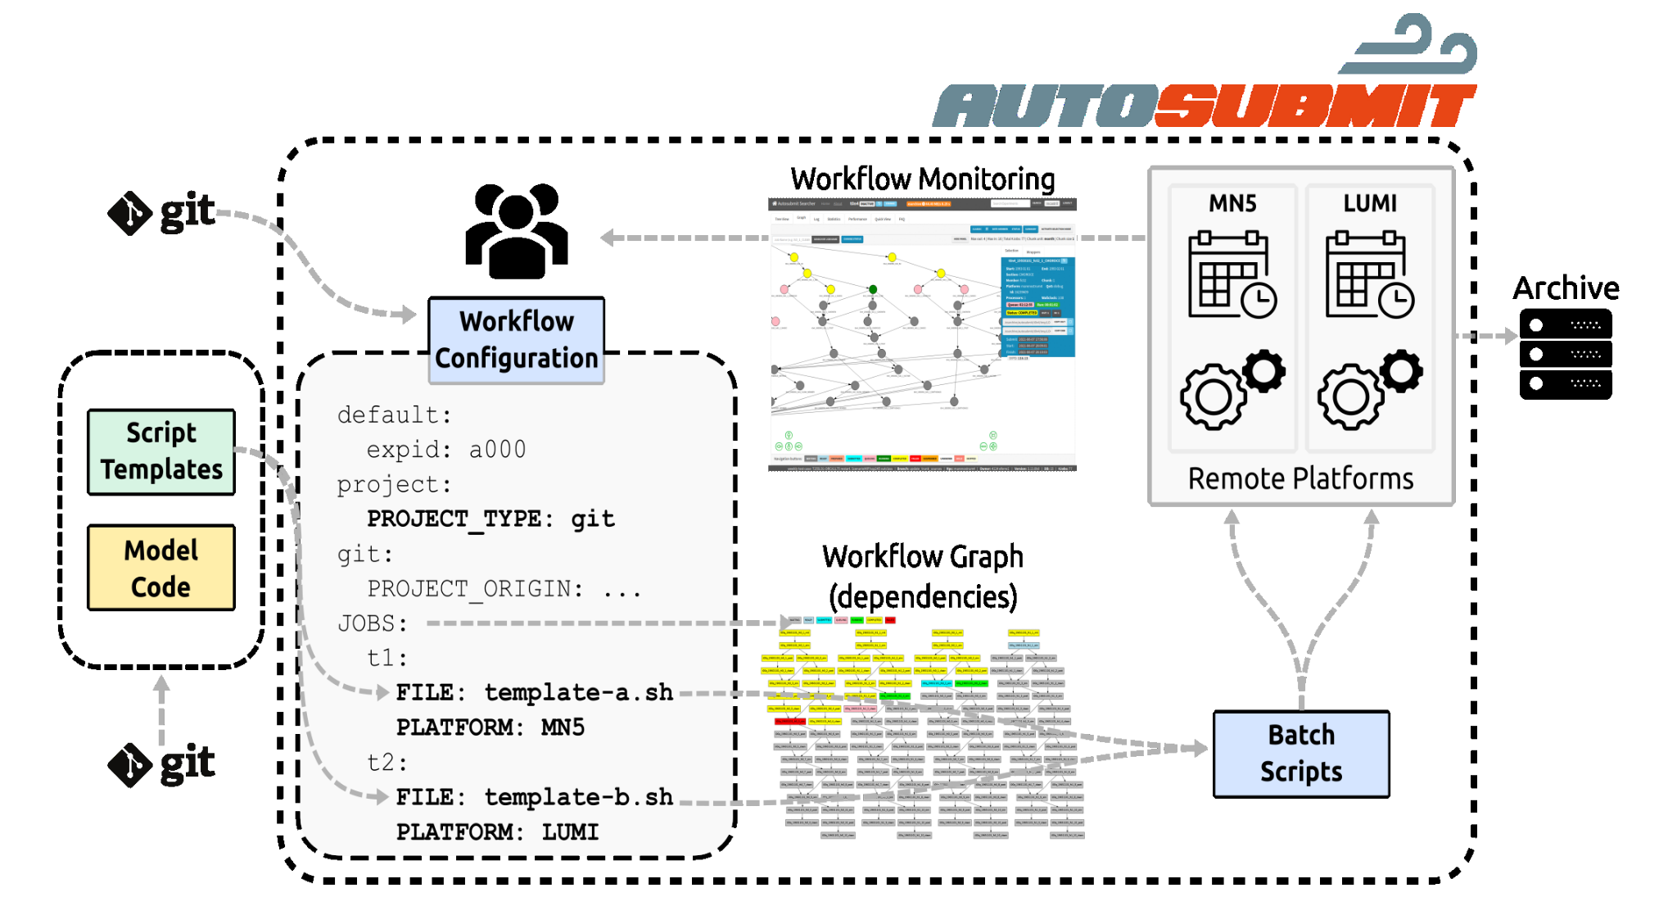
Autosubmit architecture

Slide 7
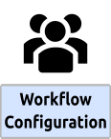
Autosubmit configuration manager
Declarative
YAML
Validation, Inheritance, Imports
Consistent
Start Dates, Members, Chunks, Job Splits variables
Same meaning across different experiments and science users
Experiment Management
Unique and standardised IDs
Create, Copy, Migrate, Monitor
Separate Workflow and Model code (via Projects)

Slide 8
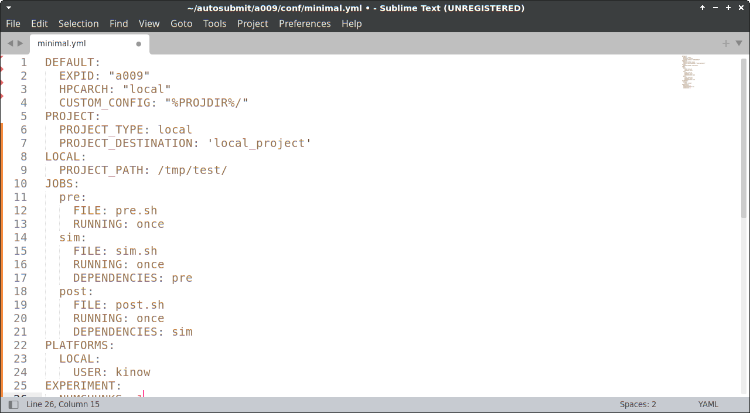
Autosubmit configuration

Slide 9
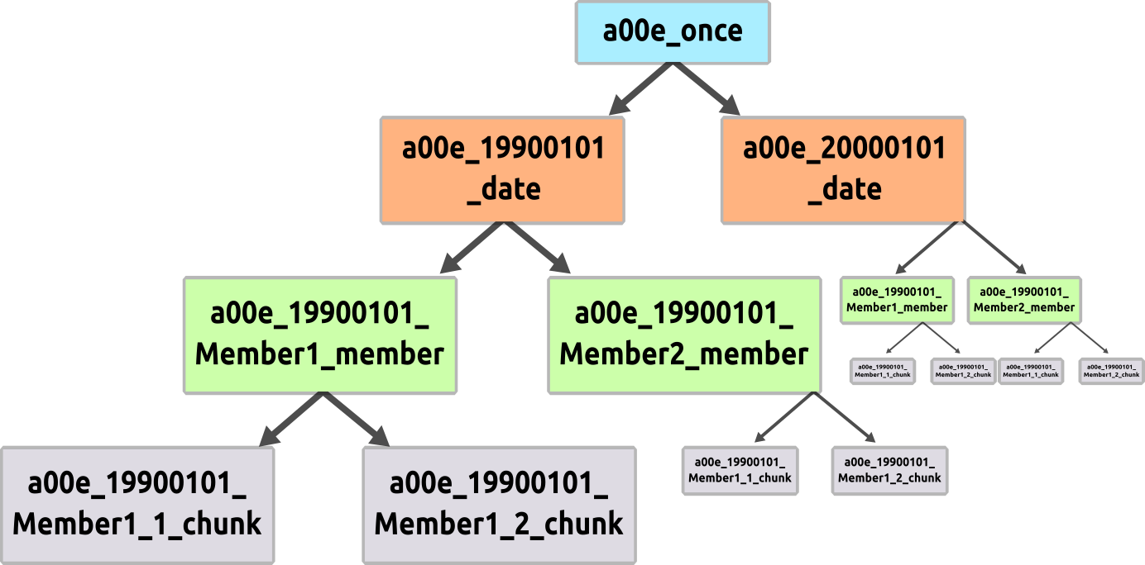
Autosubmit configuration
Workflow Hierarchy
JOBS:
ONCE:
FILE: Once.sh
RUNNING: once
DATE:
FILE: date.sh
DEPENDENCIES: once
RUNNING: date
MEMBER:
FILE: Member.sh
DEPENDENCIES: date
RUNNING: member
CHUNK:
FILE: Chunk.py
DEPENDENCIES = member
RUNNING: chunk

Slide 10
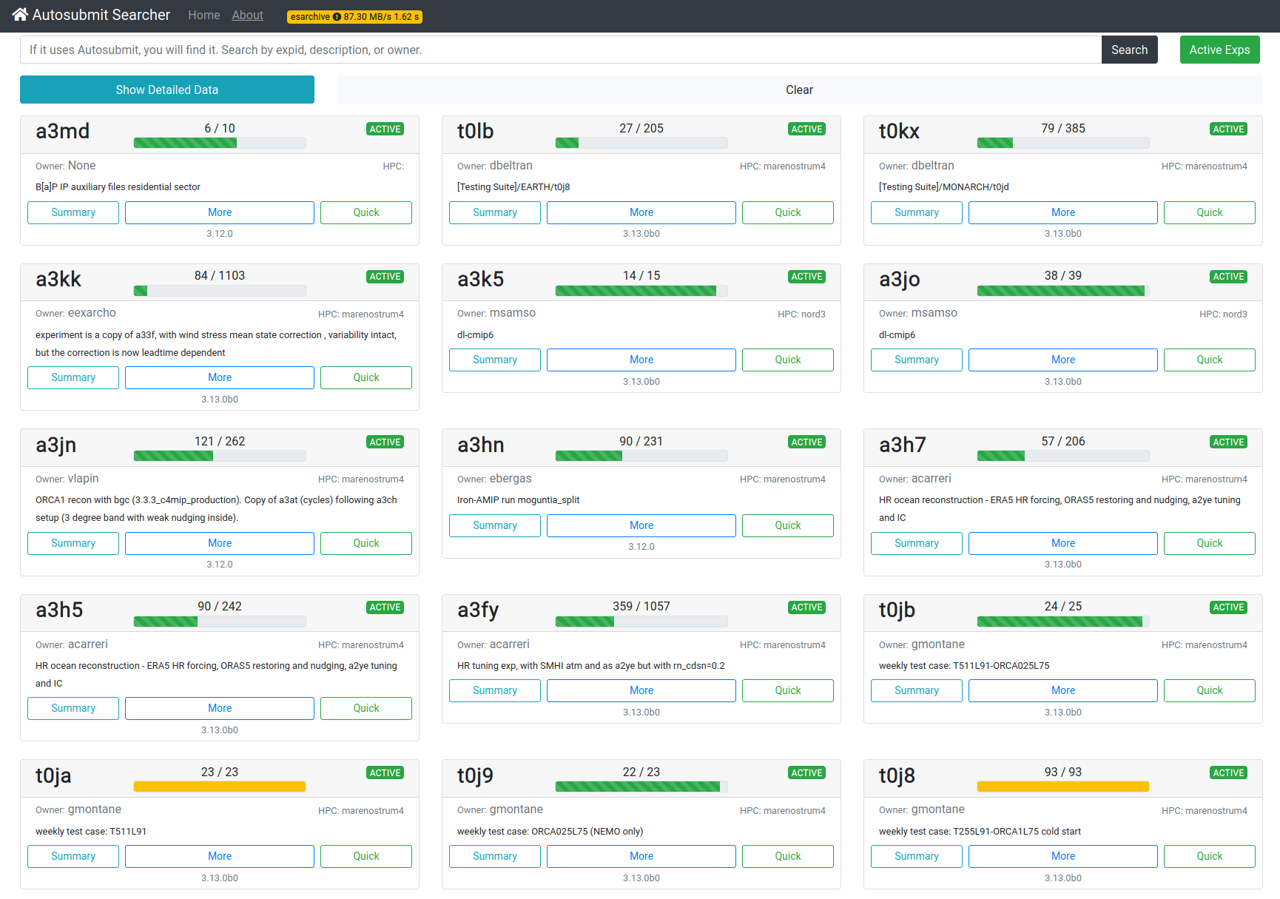
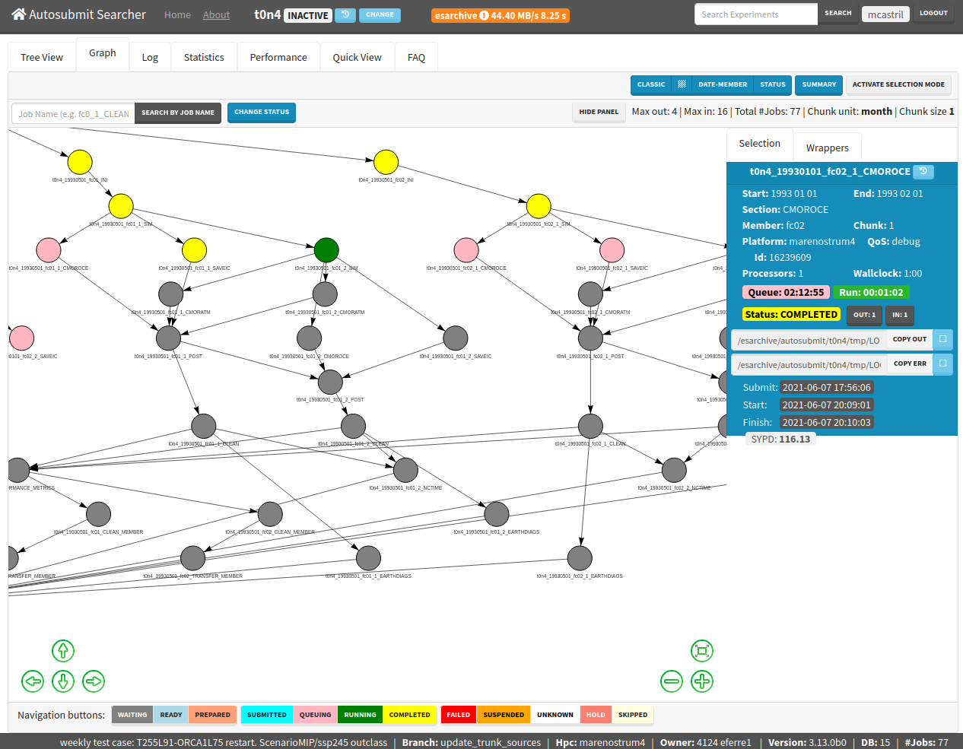
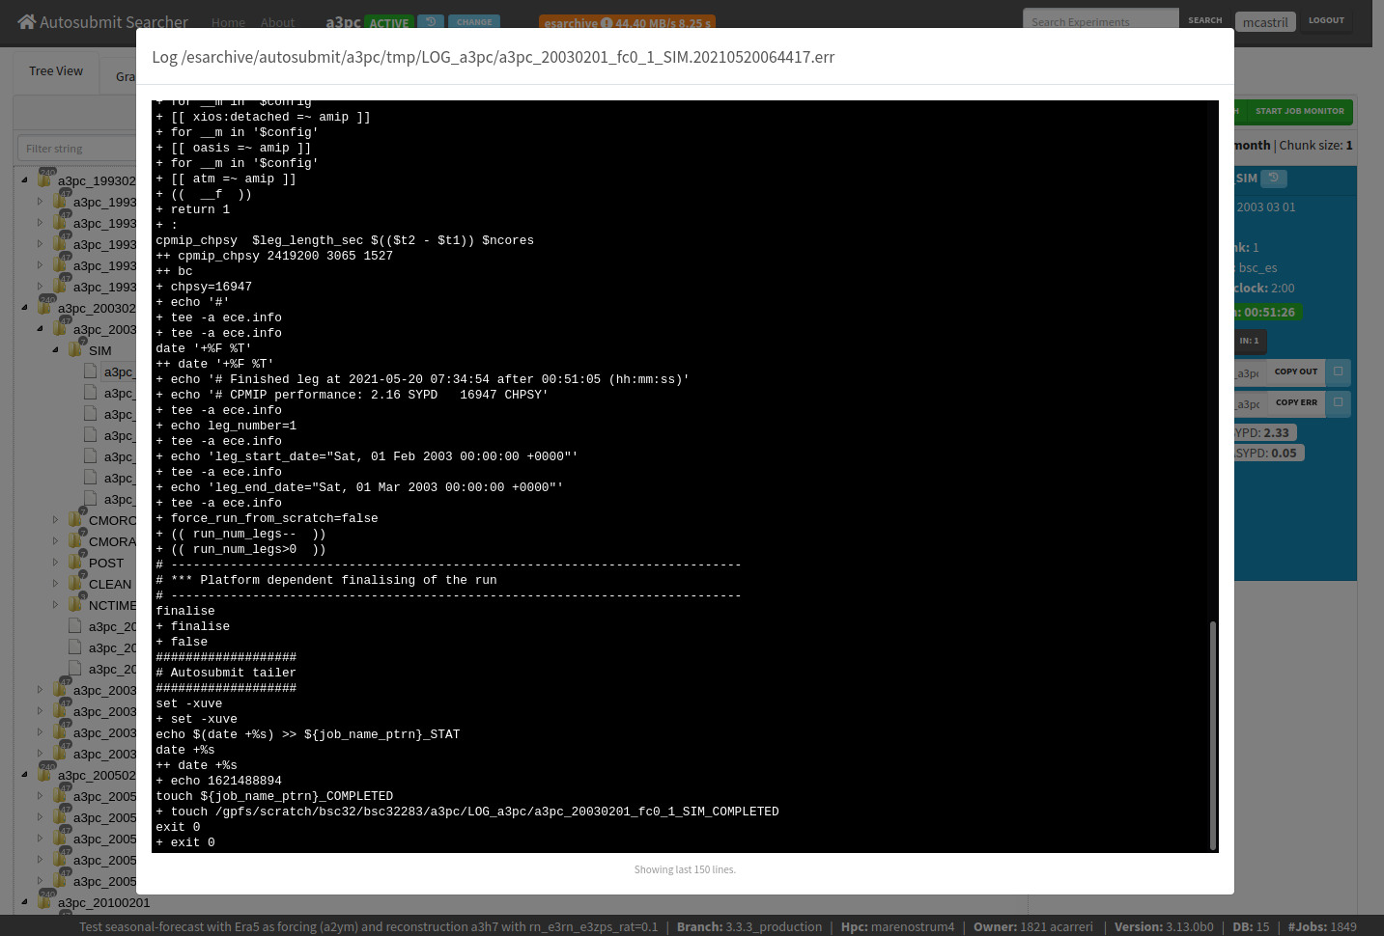
The workflow manager
The Autosubmit workflow manager has been designed to meet climate research necessities. It supports workflows based on different hierarchical levels (once, startdate, member, chunk) and provides multiple features developed after years of operation on climate investigation.
Automatization
High-level workflow definition
Based on task dependencies
Seamless communication with remote job scheduler
Automatic retries in case of error
Multi-platform
Combines different platforms and partitions in the same workflow
Centralized user authentication
Efficiency
Possibility to refine granularity (chunks)
Wrap individual tasks in bigger allocations to better suit running rules
Robustness
Scalable database
Use multiple login nodes
Auto-recovery (after network or filesystem issues)
Mail notifications
Full traceability
Portability
Python tool (container available)
Shared database across platforms with option to copy experiments
Web-based GUI
Monitoring
Real time workflow status
Unique end point to all jobs with polling method
Access job log files from the GUI
Stats and performance metrics
D. Manubens-Gil, J. Vegas-Regidor, C. Prodhomme, O. Mula-Valls and F. J. Doblas-Reyes, (2016). “Seamless management of ensemble climate prediction experiments on HPC platforms”, 2016 International Conference on High Performance Computing & Simulation (HPCS), Innsbruck, pp. 895-900. https://doi.org/10.1109/HPCSim.2016.7568429
W. Uruchi, M. Castrillo and D. Beltrán, (2021). “Autosubmit GUI: A Javascript-based Graphical User Interface to Monitor Experiments Workflow Execution”, Journal of Open Source Software, 6(59), 3049. https://doi.org/10.21105/joss.03049

Slide 11
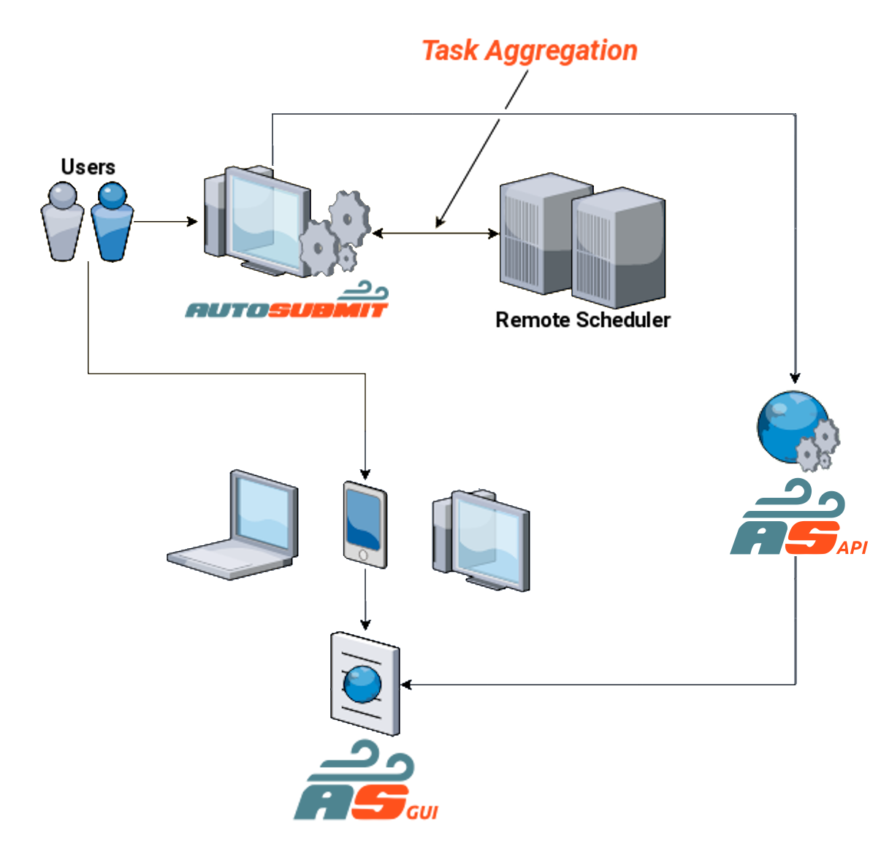
Achieving interactivity with the system
Interactivity is an essential feature of the DTO (and Digital Twins in general).
Users must be able to monitor the core engine, the available data, and their applications.
Users must be able to interact with the system through requests.
The workflow manager, as backend component, must enable this interactivity.

Slide 12
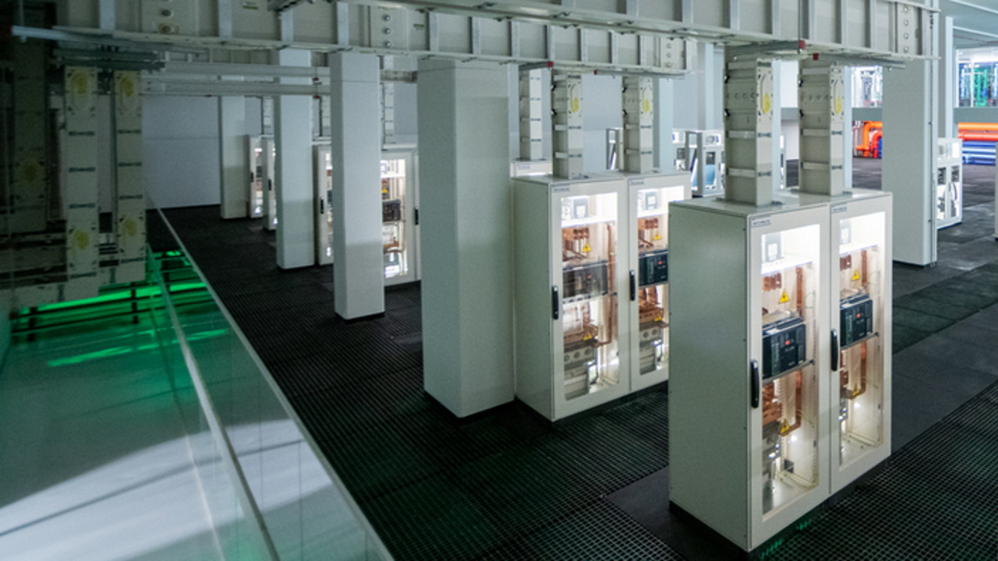
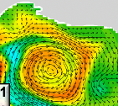
Autosubmit in EDITO Model Lab
GUIs
Domain tools
Model + AI
User applications
DTO data
Data lake

Slide 13
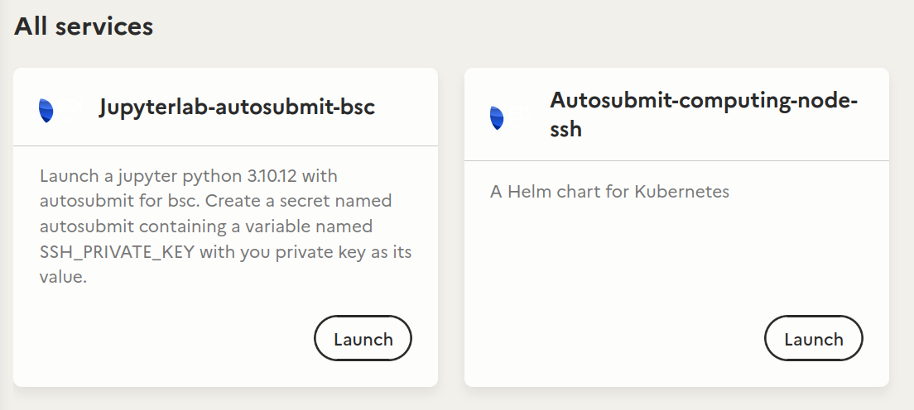
Autosubmit v4 features exploited in EDITO Model Lab
New, flexible, YAML-based configuration system, allowing distributed experiment configuration.
Pre-defined configurations under CVS.
Users switch between configurations and customize them.
Increased interoperability and portability (containers)
Cloud service running in Jupyter Hub (EDITO Model Lab).
Export workflows to other backends.
Increased flexibility in defining workflows
Dependencies customization.
FAIR principles
Conforms the RO-Crate standard.
Autosubmit service in EDITO Infra

Slide 14
Autosubmit
Useful links
Autosubmit (AS)
Pip install and docs: https://autosubmit.readthedocs.io/en/master/installation/index.html
Repository: https://earth.bsc.es/gitlab/es/autosubmit
Contact: support-autosubmit@bsc.es
Autosubmit GUI
Public mockup: https://earth.bsc.es/gitlab/wuruchi/autosubmitreact
Demo: https://autosubmitgui.bsc.es/presentation/
Other
Microsoft Teams for WP5 - T5.2: https://teams.microsoft.com/_?tenantId=3d82bbb3-068b-4359-8fd8-4bc494e79a17#/conversations/WP5?threadId=19:059182519fe74b3fafdd248cd01570e3@thread.tacv2&ctx=channel

Slide 15
Basic Usage
Learn the basic Autosubmit commands

Slide 16
Autosubmit
Basic Usage - Experiment Lifecycle
1. CREATE
2. CONFIGURE
3. PREPARE
4. RUN
5. MONITOR

Slide 17
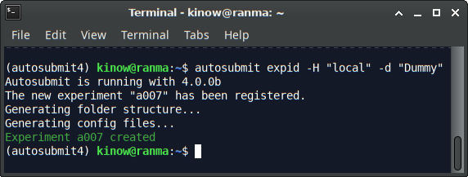
Autosubmit
Basic Usage - Create an Experiment
Create a new experiment
autosubmit expid -H "local" -d "Description"
Copy an existing experiment
autosubmit expid -H "local" -d "Copy a00x" --copy a00x
In this example, a007 is the $expid created
Expected output:
The new experiment "$expid" has been registered.
1. CREATE
https://autosubmit.readthedocs.io/en/master/userguide/create/index.html#create-new-experiment

Slide 18
Autosubmit
Basic Usage - Directory Structure
/appl/AS/AUTOSUBMIT_DATA/$expid/conf -> Experiment Configuration
/appl/AS/AUTOSUBMIT_DATA/$expid/proj -> Project (scripts, configuration, …)
/appl/AS/AUTOSUBMIT_DATA/$expid/plot -> Visualization
/appl/AS/AUTOSUBMIT_DATA/$expid/tmp -> Logs,templates
/appl/AS/AUTOSUBMIT_DATA/$expid/pkl -> Workflow database
2. CONFIGURE

Slide 19
Autosubmit
Basic Usage - Configuration
# File: conf/minimal.yml
CONFIG:
AUTOSUBMIT_VERSION: “4.x.x”
DEFAULT:
EXPID: $expid # From `autosubmit expid`
HPCARCH: “local” # -H “local”
CUSTOM_CONFIG: “%PROJDIR%/” # Other files?
PROJECT:
PROJECT_TYPE: “git” # or local, svn
PROJECT_DESTINATION: “”
GIT: # Because PROJECT_TYPE is “git”
PROJECT_ORIGIN: “https://gitlab.bsc.es/…”
PROJECT_BRANCH: “v1.2.3”
PROJECT_COMMIT: “123456…”
Autosubmit configuration files are written in YAML
Autosubmit will try to load other files located at the CUSTOM_CONFIG value.
%PROJDIR% is a placeholder variable. Autosubmit replaces this by a value from the workflow configuration.
2. CONFIGURE
https://autosubmit.readthedocs.io/en/master/userguide/configure/index.html

Slide 20
Autosubmit
Basic Usage - Project
In Autosubmit, the Project is something external to the experiment configuration that contains extra resources that must be copied before the workflow is run.
e.g. configuration files, namelists, YAML files, bash scripts, Python code, etc.
3. PREPARE
https://autosubmit.readthedocs.io/en/master/userguide/configure/index.html#how-to-configure-experiments https://autosubmit.readthedocs.io/en/master/userguide/run/index.html#running-experiments

Slide 21
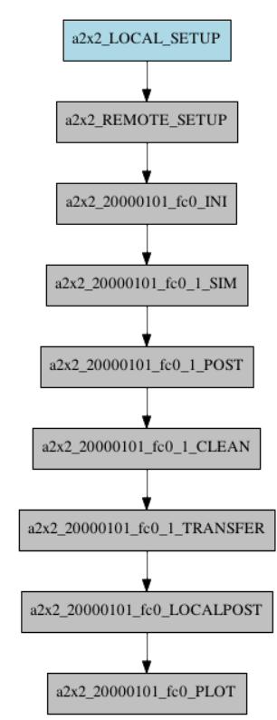
Autosubmit
Basic Usage - Project
PROJECT:
PROJECT_TYPE: “git”
PROJECT_DESTINATION: “”
GIT:
PROJECT_ORIGIN: “https://gitlab.bsc.es/…”
PROJECT_BRANCH: “v1.2.3”
PROJECT_COMMIT: “123456…”
autosubmit create $expid
The first time, it copies the project content into $expid/proj
Generates the experiment workflow
Generates plot/${expid}_${current_timestamp}.pdf
3. PREPARE
https://autosubmit.readthedocs.io/en/master/userguide/configure/index.html#how-to-configure-experiments https://autosubmit.readthedocs.io/en/master/userguide/run/index.html#running-experiments

Slide 22
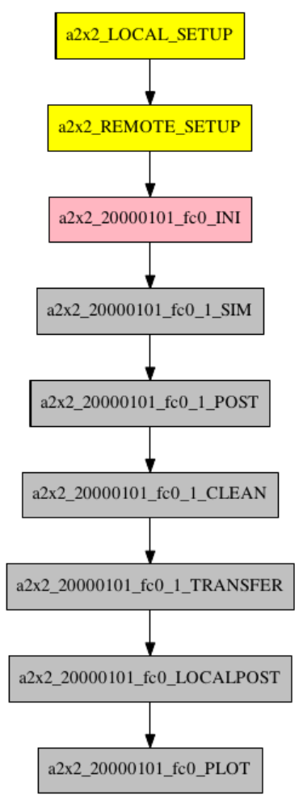
Autosubmit
Basic Usage - Run
autosubmit run $expid
Runs the experiment.
Generates tmp/Log_${expid} <= template logs
Expected output:
[local] Connection successful to host localhost
[local] Correct user privileges for host localhost
* All commands generate command logs in tmp/ASLOG for traceability
4. RUN
https://autosubmit.readthedocs.io/en/master/userguide/configure/index.html#how-to-configure-experiments https://autosubmit.readthedocs.io/en/master/userguide/run/index.html#running-experiments

Slide 23
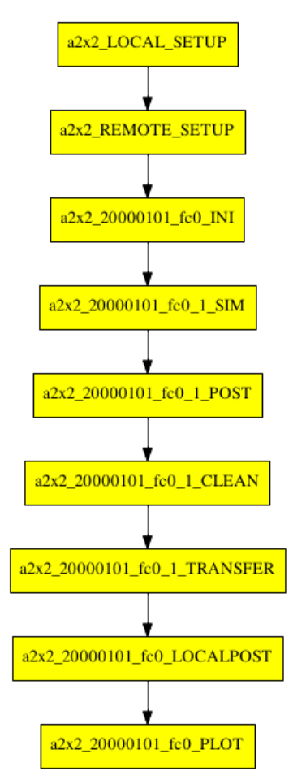
Autosubmit
5. MONITOR
5. MONITOR
autosubmit monitor $expid
https://autosubmit.readthedocs.io/en/master/userguide/monitor_and_check/index.html#how-to-monitor-an-experiment

Slide 24
Adding your code using Template Scripts
Learn how to use your code (model, application) in a workflow

Slide 25
Autosubmit
Script templates
Autosubmit jobs uses Shell Script to submit jobs
A script template is preprocessed by Autosubmit to produce the final script
Preprocessing validates and replaces placeholder variables such as %DEFAULT.EXPID%
Script templates can be written in Shell Script (default), Python, or R
You create script templates inside your experiment Project
https://earth.bsc.es/gitlab/es/autosubmit/-/merge_requests/342/diffs
https://autosubmit.readthedocs.io/en/master/userguide/variables.html
https://autosubmit.readthedocs.io/en/master/userguide/configure/develop_a_project.html#developing-a-project

Slide 26
Autosubmit
Script templates
Autosubmit jobs uses Shell Script to submit jobs
A script template is preprocessed by Autosubmit to produce the final script
Preprocessing validates and replaces placeholder variables such as %DEFAULT.EXPID%
Script templates can be written in Shell Script (default), Python, or R
You create script templates inside your experiment Project
https://earth.bsc.es/gitlab/es/autosubmit/-/merge_requests/342/diffs
https://autosubmit.readthedocs.io/en/master/userguide/variables.html
https://autosubmit.readthedocs.io/en/master/userguide/configure/develop_a_project.html#developing-a-project

Slide 27
Autosubmit
Script templates
Tuned for the experiment
Added by AS,
platform dependent
Completion flag file
workflow configuration
LOCAL
header
COMPLETED
body
PS
LOG
template.sh
footer
Status polling
STATS
batch_script.cmd
SCHEDULER
Added by AS,
generic footer
Status polling
Process / job stats file
Generic and included in the project

Slide 28
Autosubmit
Script templates
Job t1 uses script template template.a.sh
https://earth.bsc.es/gitlab/es/autosubmit/-/merge_requests/342/diffs

Slide 29
How to integrate a platform
Execute jobs in remote platforms via SSH (Slurm, PBS, LFS, Linux process scheduler, etc.)

Slide 30
Autosubmit
Autosubmit talks SSH!
It uses SSH to communicate with each platform
2FA is supported
Easier to use passwordless connection
Or you can use ssh-agent
22/TCP is the only port you will have to enable in your firewall, one-way
Communication goes from Autosubmit to the remote nodes (never bidirectional, never incoming to Autosubmit)
https://autosubmit.readthedocs.io/en/master/qstartguide/index.html#pre-requisites

Slide 31
Autosubmit
Autosubmit supports different schedulers for jobs
Linux processes (ps)
Slurm
PBS
SGE
LSF
PJM
ecaccess
https://autosubmit.readthedocs.io/en/master/userguide/configure/develop_a_project.html#detailed-platform-configuration

Slide 32
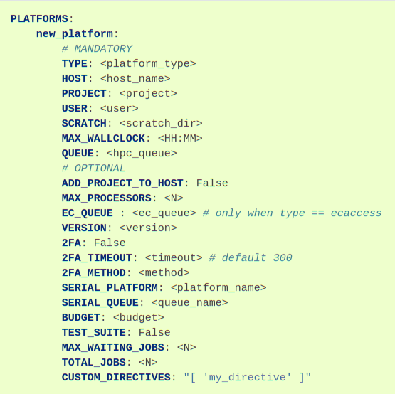
Autosubmit
How to add a new platform
In your experiment configuration (YAML) you will need to define, under the key “PLATFORMS”, a new entry for your platform.
https://autosubmit.readthedocs.io/en/master/userguide/configure/index.html#how-to-add-a-new-platform

Slide 33
Autosubmit
Using your platform
Simply set the PLATFORM in your job configuration
https://autosubmit.readthedocs.io/en/master/userguide/configure/index.html#how-to-add-a-new-platform

Slide 34
Troubleshooting
How to solve common issues, where to find help

Slide 35
Autosubmit
Log level
If your Autosubmit command failed for whatever reason, you can increase the verbosity of the command output logs with autosubmit -lc DEBUG -lf DEBUG <CMD>
https://autosubmit.readthedocs.io/en/master/troubleshooting/error-codes.html

Slide 36
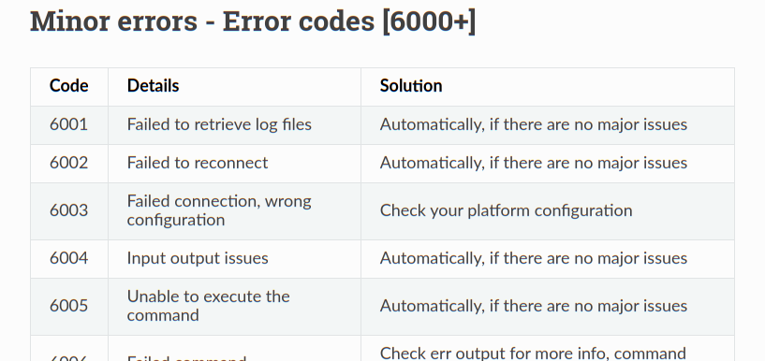
Autosubmit
Error codes
Autosubmit error messages may contain an Error Code like 6002. The documentation page for error codes contains the explanation and workaround.
https://autosubmit.readthedocs.io/en/master/troubleshooting/error-codes.html

Slide 37
Autosubmit
Log files, scripts, platforms
Each experiment will contain log directories inside the ~/autosubmit/<EXPID> directory. Autosubmit will also try to copy the job output of remote jobs locally.
You can run `autosubmit inspect <EXPID>` and it will generate the scripts Autosubmit will use for your workflow.
If you have platform errors, try ssh -vvv $USER@$HOST, and make sure your credentials work, and that you have a password-less SSH connection (or ssh-agent configured).
https://autosubmit.readthedocs.io/en/master/troubleshooting/error-codes.html

Slide 38
Autosubmit
Ask for Help
Feel free to report any issues or questions via https://earth.bsc.es/gitlab/es/autosubmit/-/issues
To chat with Autosubmit developers, you can message us via the WP5 - T5.2 Microsoft Teams for: https://teams.microsoft.com/_?tenantId=3d82bbb3-068b-4359-8fd8-4bc494e79a17#/conversations/WP5?threadId=19:059182519fe74b3fafdd248cd01570e3@thread.tacv2&ctx=channel
or via the email support-autosubmit@bsc.es
https://autosubmit.readthedocs.io/en/master/troubleshooting/error-codes.html

Slide 39
Questions?
Thank you!

Slide 40
Backup slides

Slide 41
Autosubmit
Basic Usage - Create an Experiment (different options)
To generate a new experiment using standard configuration
autosubmit expid -H "local" -d "Description"
To generate a new experiment using minimal / custom conf
autosubmit expid -H "local" -d "Minimal" -min
To copy an existing experiment
autosubmit expid -H "local" -d "Copy a00x" --copy a00x
In this example, a007 is the $expid created
Expected output:
The new experiment "$expid" has been registered.
1. CREATE
https://autosubmit.readthedocs.io/en/master/userguide/create/index.html#create-new-experiment

Slide 42
Autosubmit
Basic Usage - Configuration
# FILE: $expid/conf/minimal.yml (-min)
CONFIG:
AUTOSUBMIT_VERSION: “4.x.x”
DEFAULT:
EXPID: $expid # From `autosubmit expid`
HPCARCH: “local” # -H “local”
CUSTOM_CONFIG: “%PROJDIR%/” # Other files?
PROJECT:
PROJECT_TYPE: “git” # or local, svn
PROJECT_DESTINATION: “”
GIT: # Because PROJECT_TYPE is “git”
PROJECT_ORIGIN: “https://gitlab.bsc.es/…”
PROJECT_BRANCH: “v1.2.3”
PROJECT_COMMIT: “123456…”
PROJECT_SUBMODULES: “”
FETCH_SINGLE_BRANCH: True
# FILE: %PROJDIR%/config.yml
EXPERIMENT: # dates, members, chunks
DATELIST: 20000101
NUMCHUNKS: 1
MEMBERS: "fc0"
PLATFORMS: # Where the tasks run
LOCAL:
TYPE: ps
HOST: localhost
USER: “mary.jane”
. . .
lumi:
TYPE: slurm
HOST: “abcde.lumi.csc.fi”
. . .
# FILE: %PROJDIR%/jobs.yml
JOBS: # your workflow tasks
LOCAL_SETUP:
FILE: templates/ini.sh
PLATFORM: LOCAL # or lumi, etc.
RUNNING: once
REMOTE_SETUP:
FILE: templates/sim.sh
PLATFORM: lumi
DEPENDENCIES: REMOTE_SETUP
RUNNING: one
. . .
2. CONFIGURE
https://autosubmit.readthedocs.io/en/master/userguide/configure/index.html
‹#›

Slide 43
Launching Autosubmit in the EDITO Model Lab

Slide 44
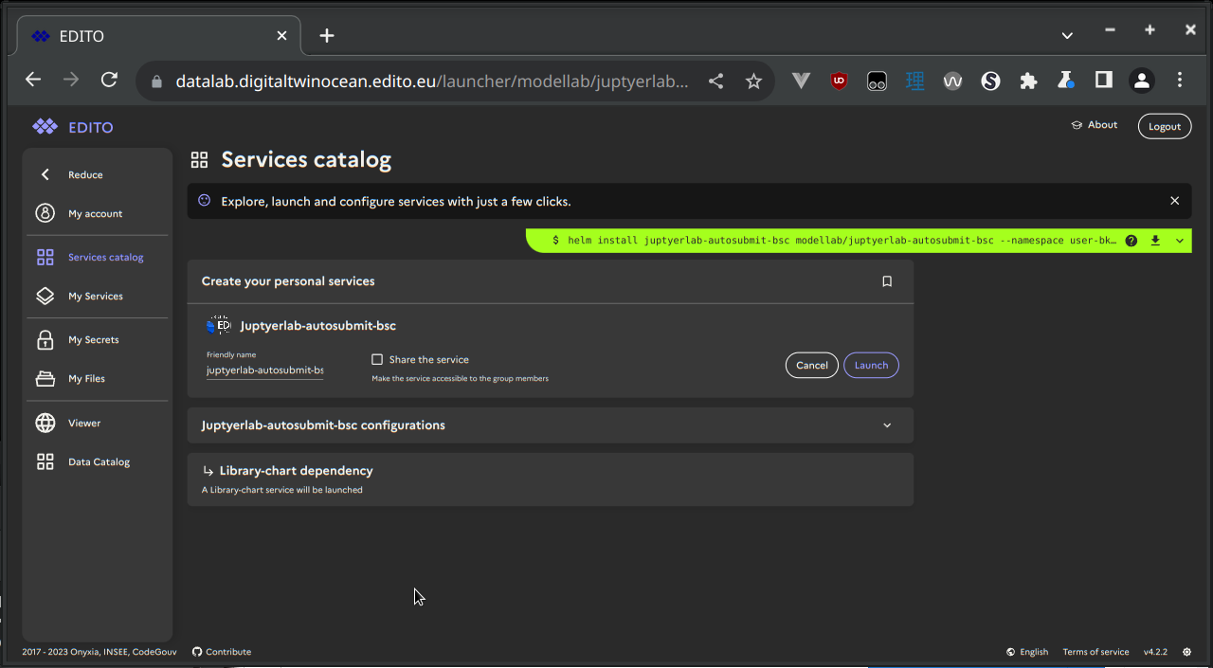
Autosubmit
Step 1. Log in to EDITO Model Lab and clik on the “Services catalog”

Slide 45
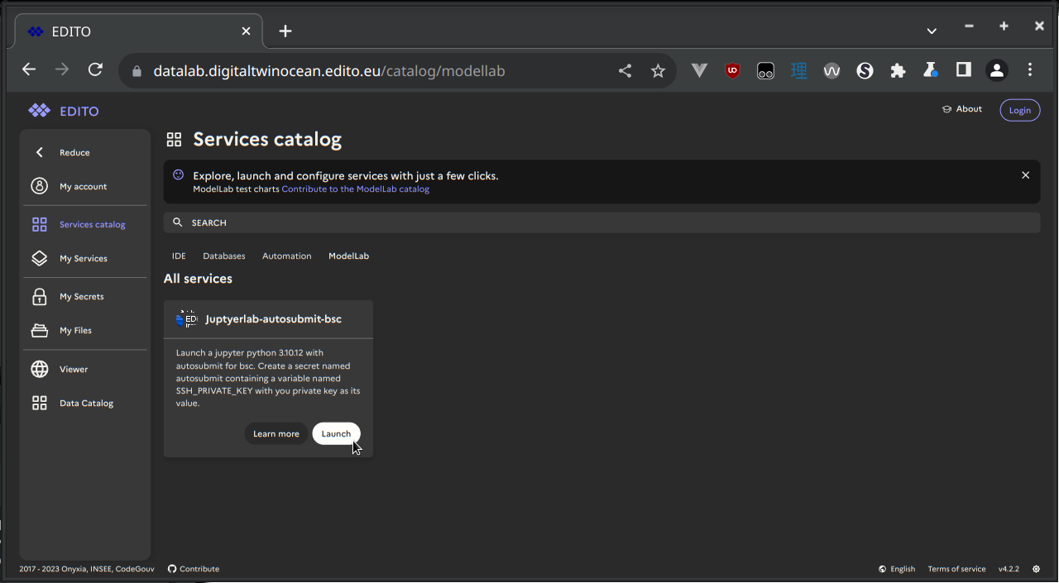
Autosubmit
Step 2. Launch “jupyterlab-autosubmit-bsc” service (under “ModelLab”)

Slide 46
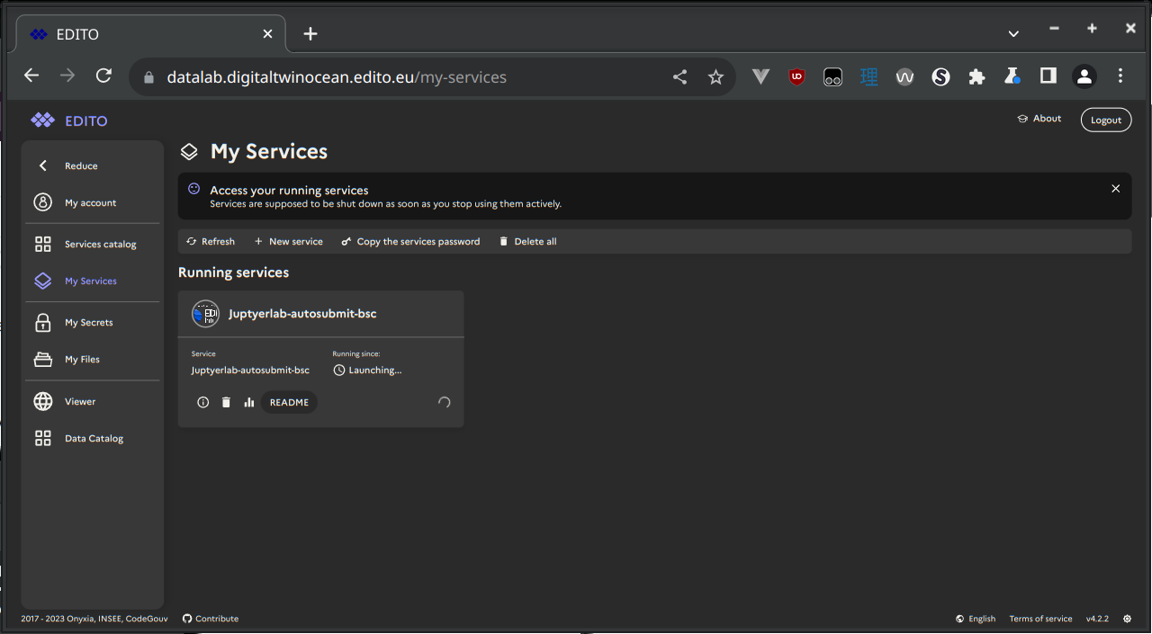
Autosubmit
Step 3. Wait for your service to finish launching (it may take a few minutes)

Slide 47
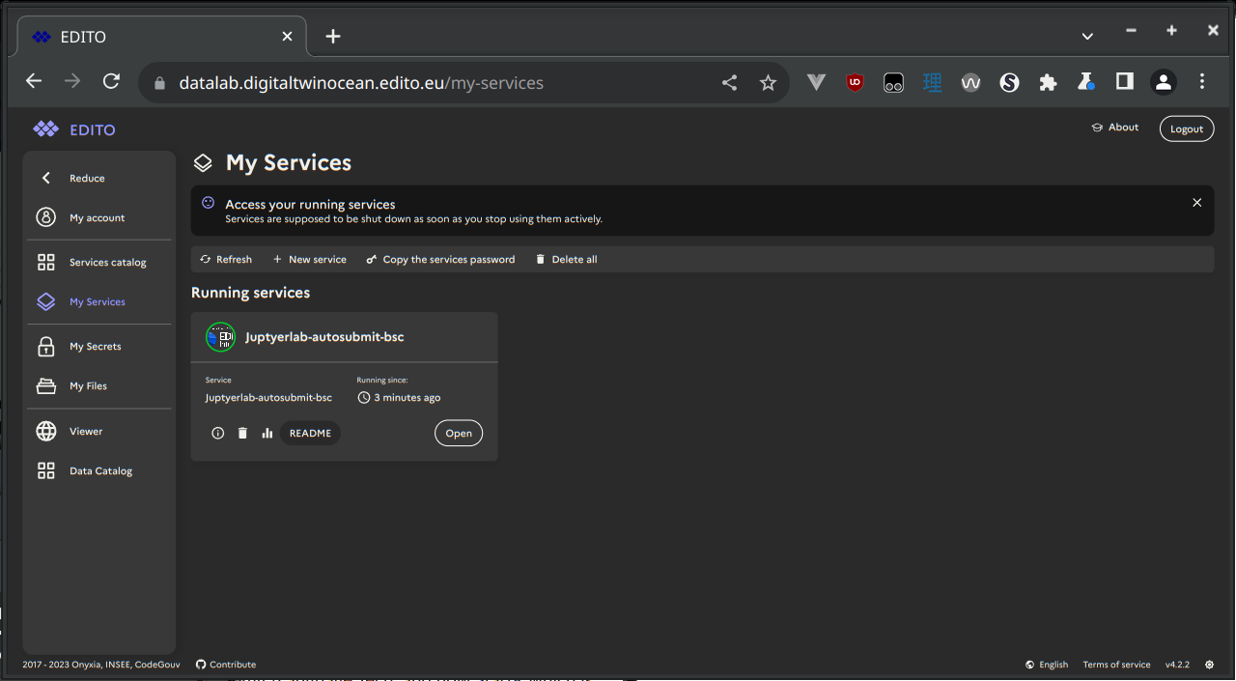
Autosubmit
Step 4. Click on “Open” to open the service

Slide 48
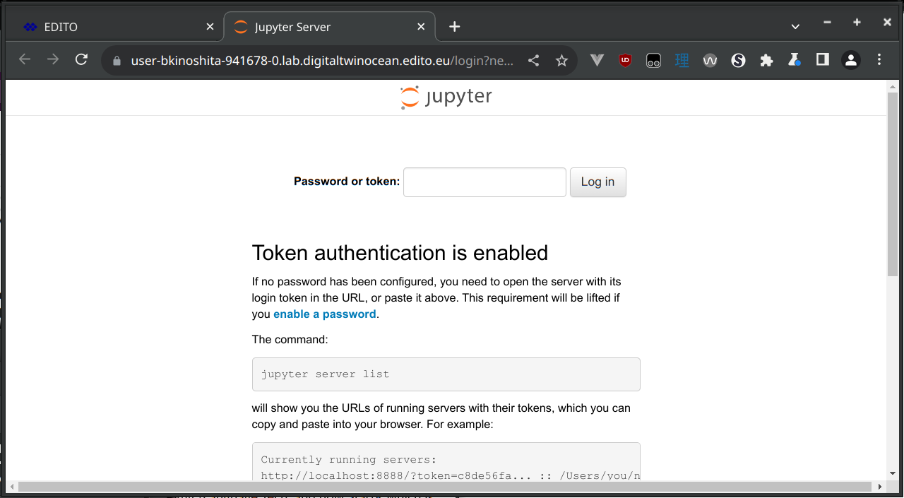
Autosubmit
Step 5. If you see this page, you have to get a token

Slide 49
Autosubmit
Step 6. Click on “Copy the services password” option to copy the Jupyter Lab token.

Slide 50
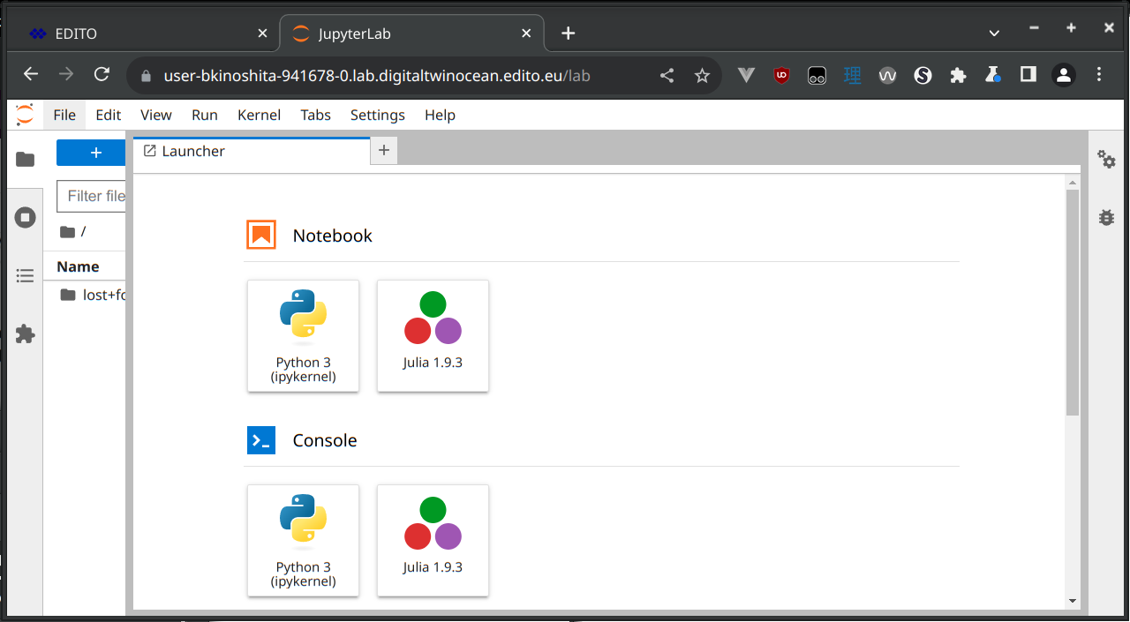
Autosubmit
Step 7. Now you can create a Python 3 notebook for your Autosubmit experiments

Slide 51
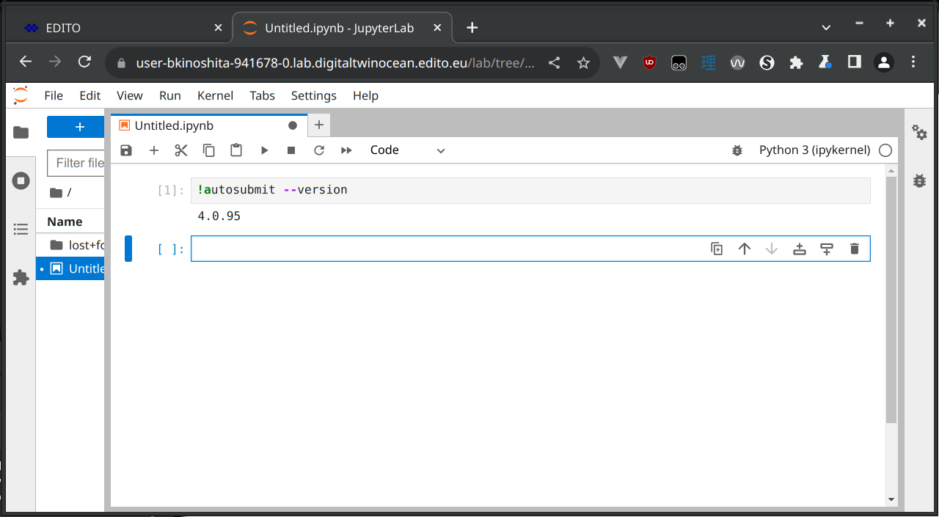
Autosubmit
Step 8. Now you can start a Terminal or Python 3 notebook for your Autosubmit experiments

Slide 52
This project has received funding from the European Union’s Horizon Europe research and innovation programme under the grant No 101093293

