Slide 1
Historias del Norte Cambio Climático en el Ártico
Dragana Bojović
Earth Sciences Department
Earth System Services Group - Knowledge Transfer Team

Slide 2
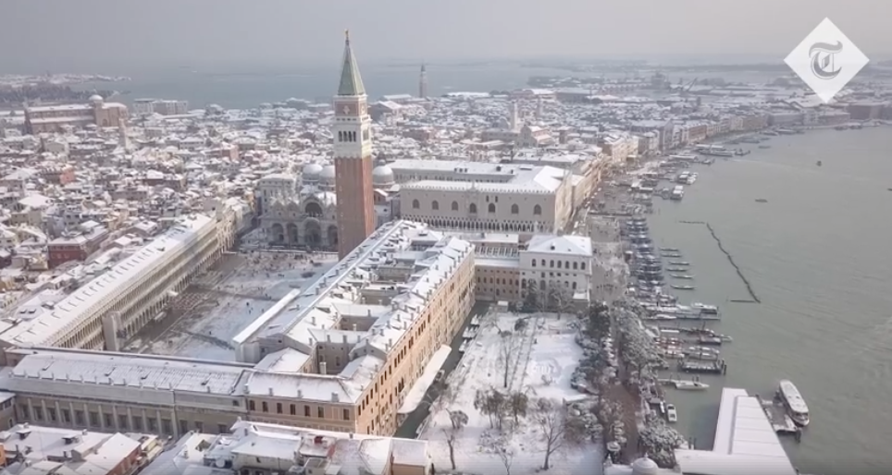
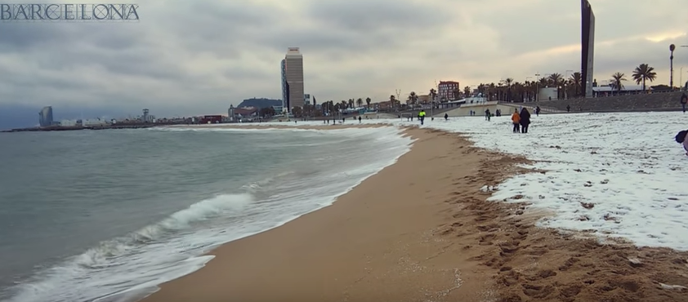
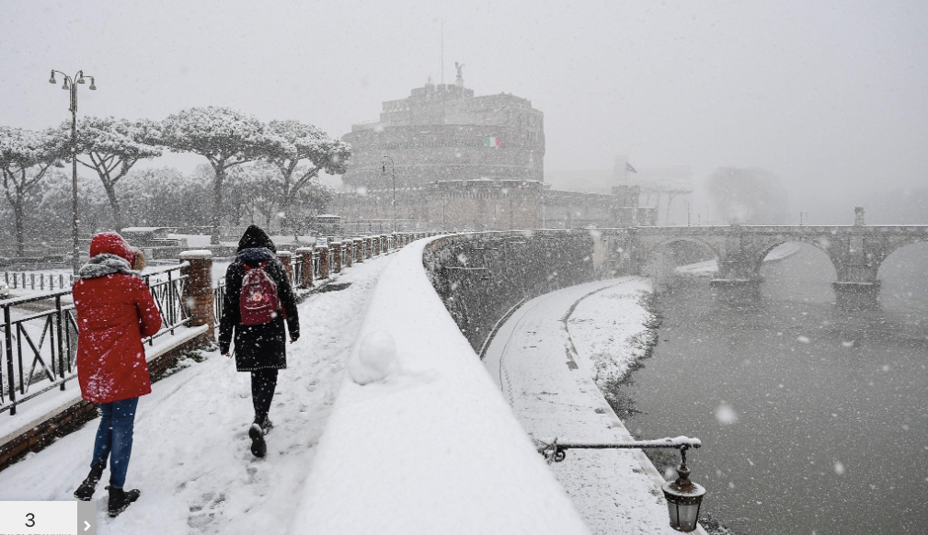
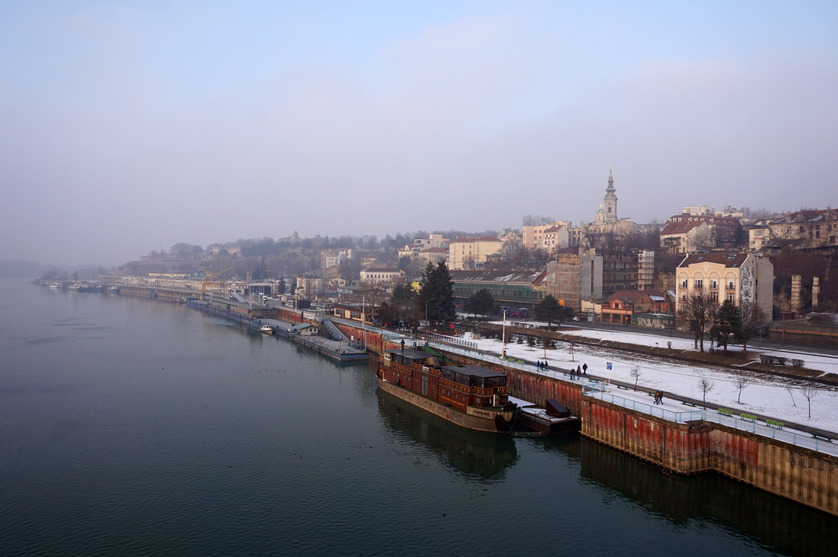
credit: NYTimes

Slide 3
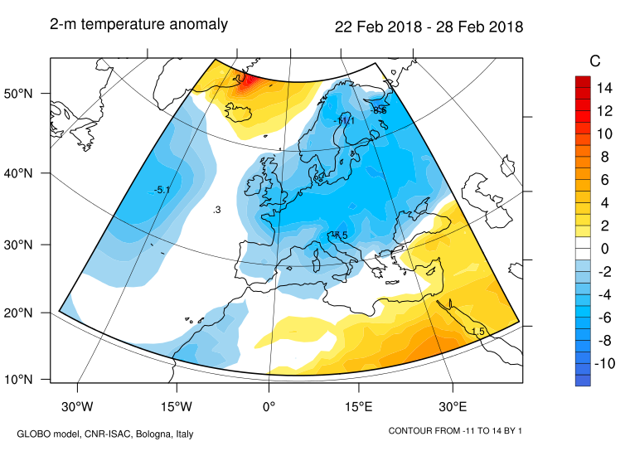

Slide 4
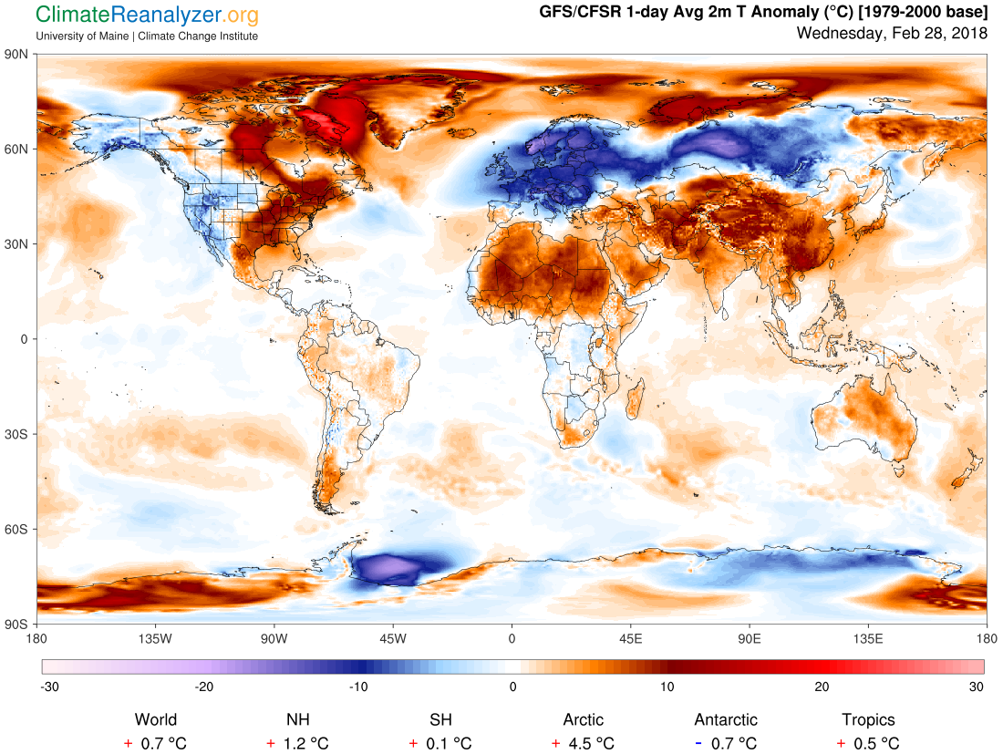

Slide 5
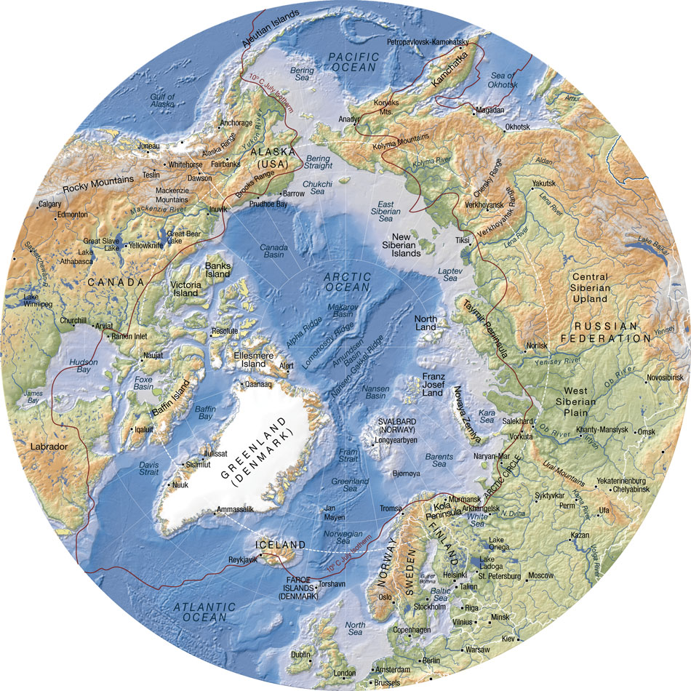

Slide 6
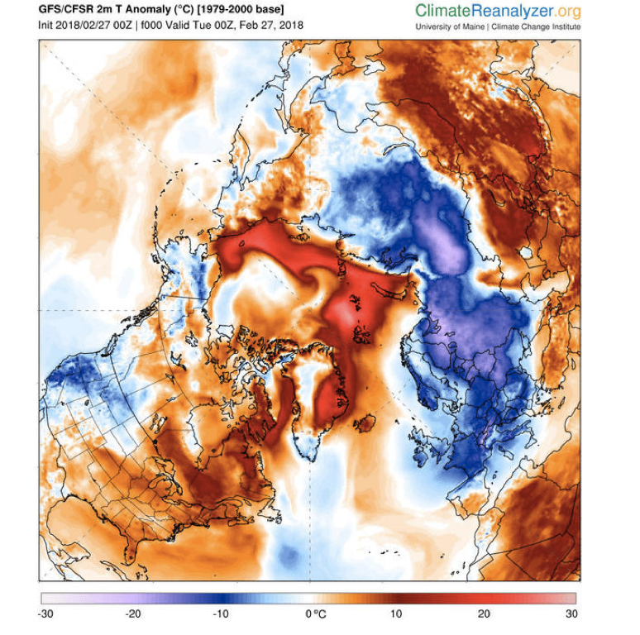

Slide 7
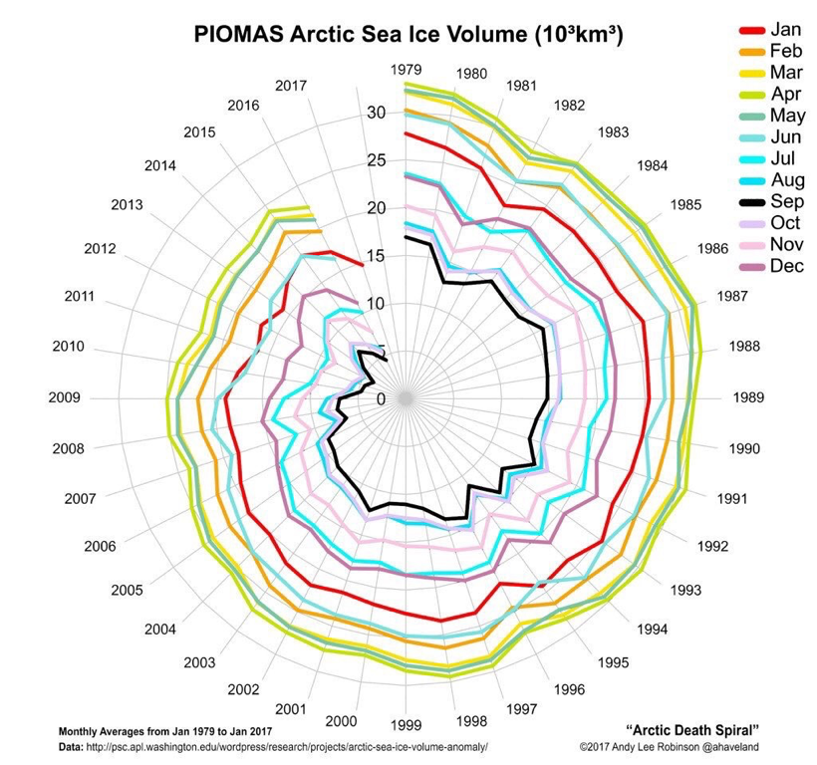

Slide 8
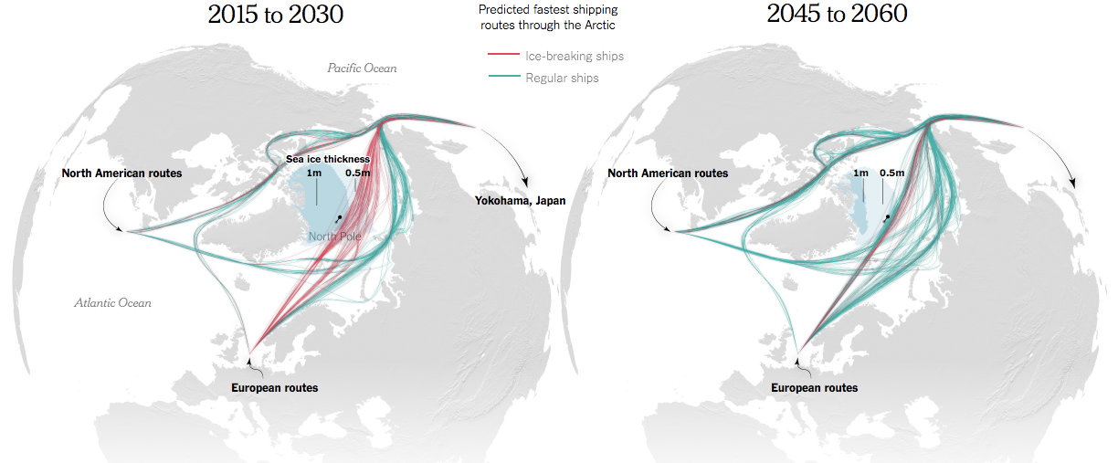
ice breaking ships
regular ships

Slide 9
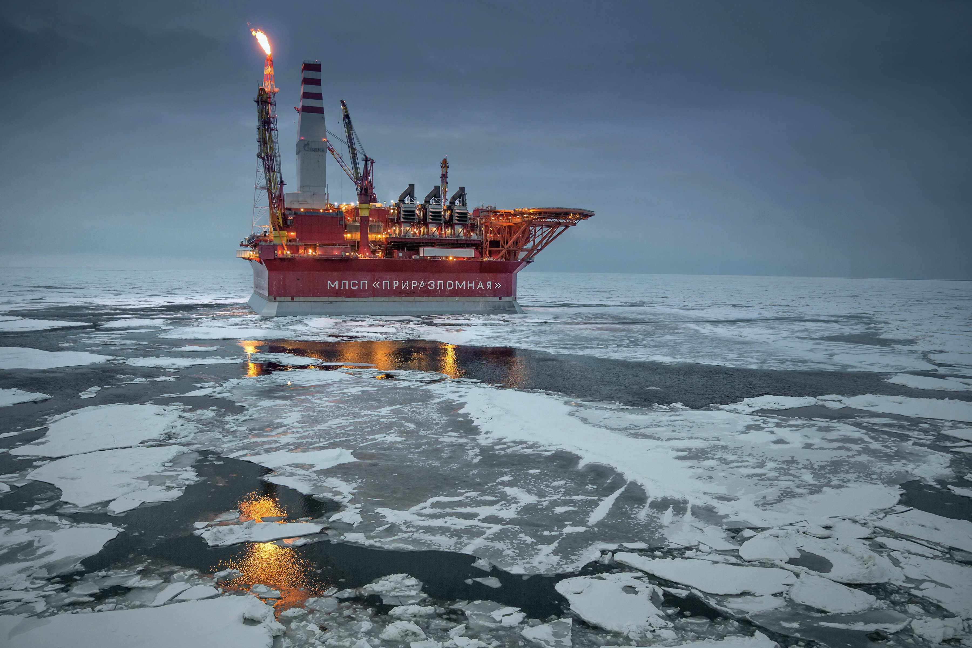
CREDIT: Sergey Anisimov

Slide 10
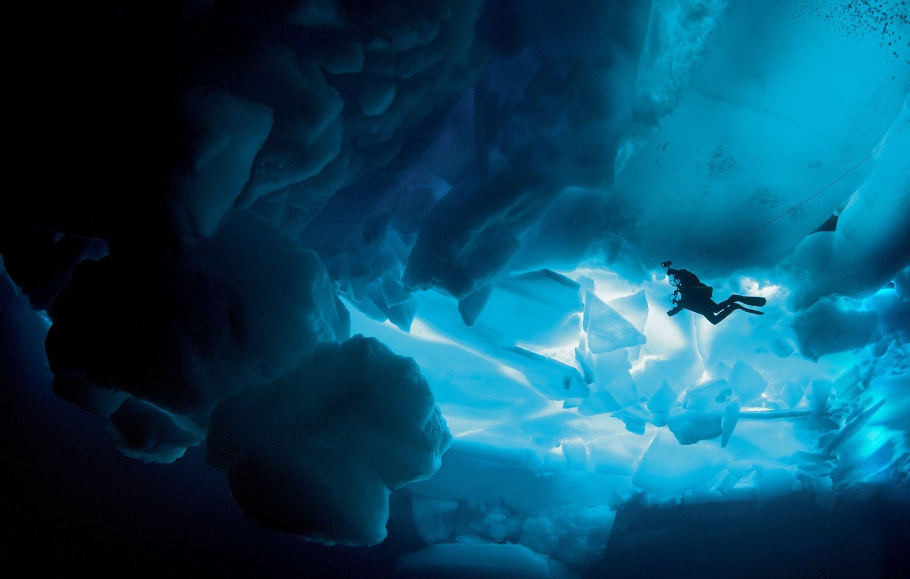

Slide 11
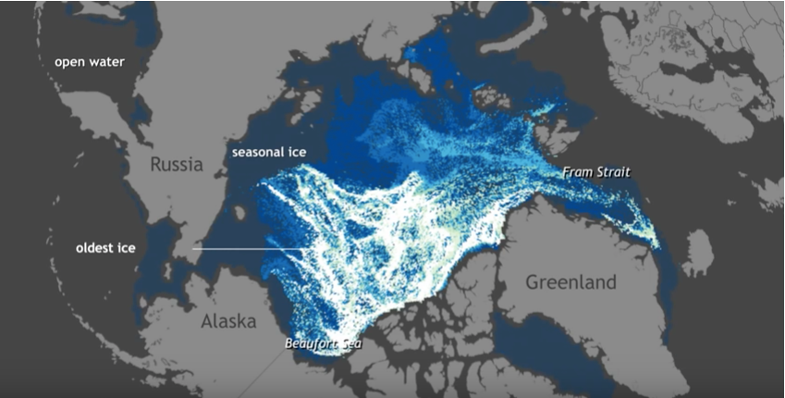
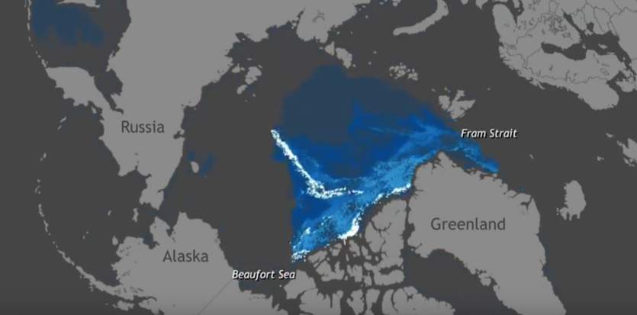
Sea ice age
1992
NOAA climate.org
2012

Slide 12
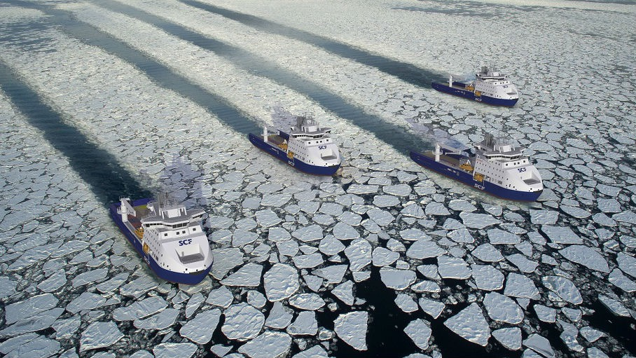
CREDIT: Wendy Laursen

Slide 13
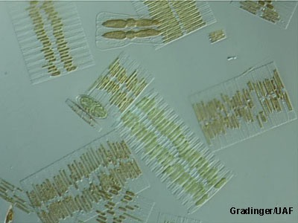
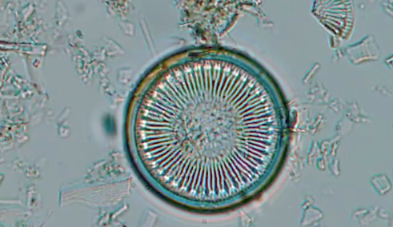
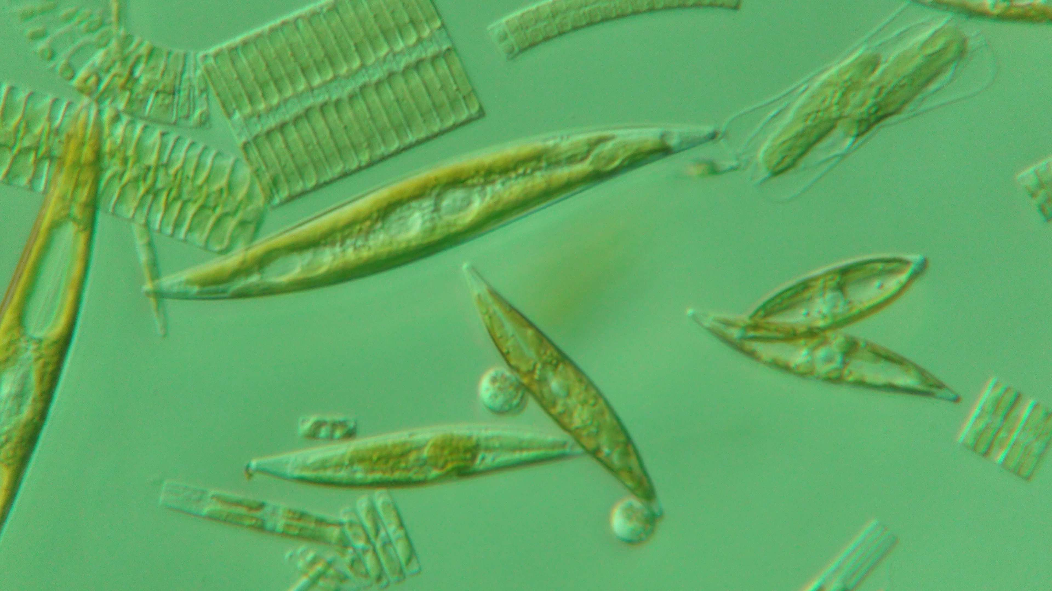
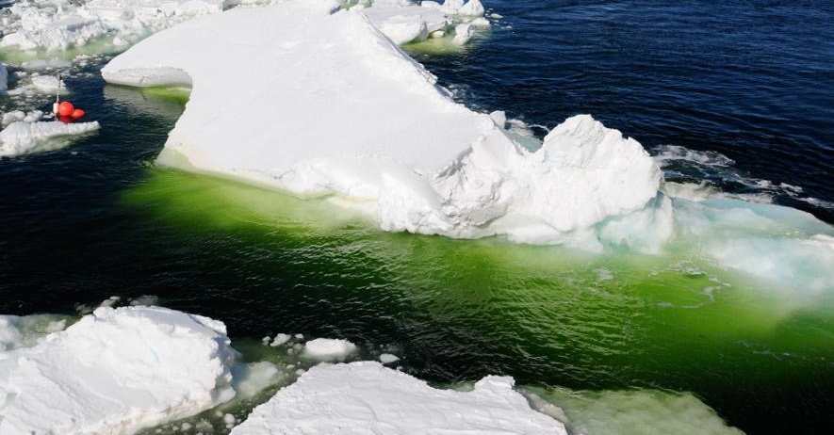
CREDIT: Rolf Gradinger
CREDIT: David Munroe

Slide 14
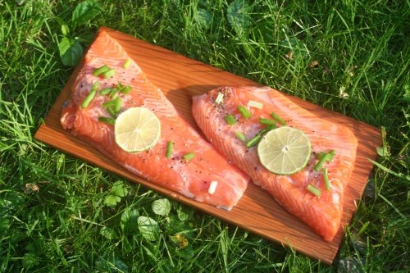
CREDIT: M. Tibbles

Slide 15
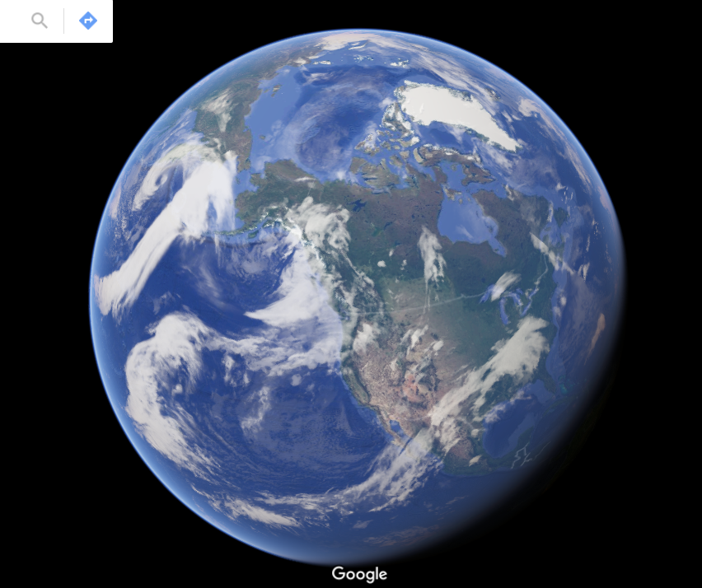

Slide 16
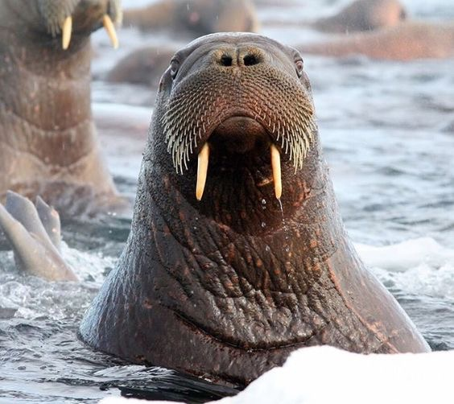

Slide 17
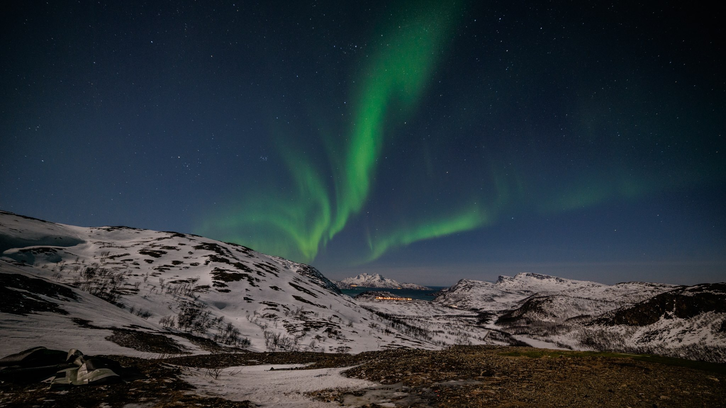

Slide 18
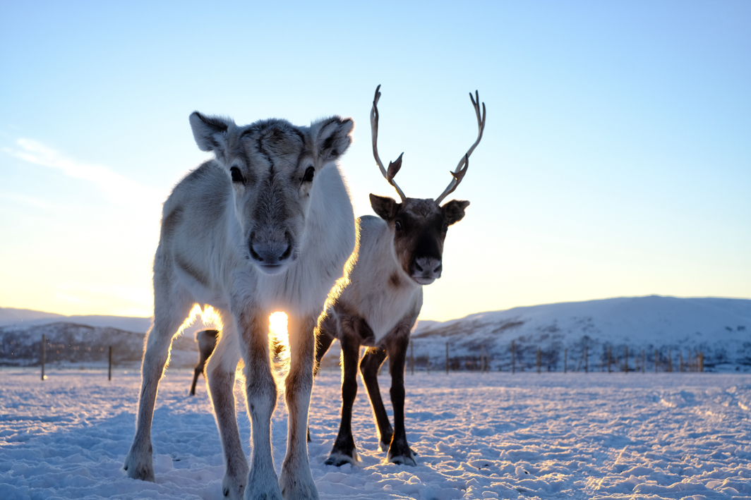
CREDIT:Trams safari

Slide 19
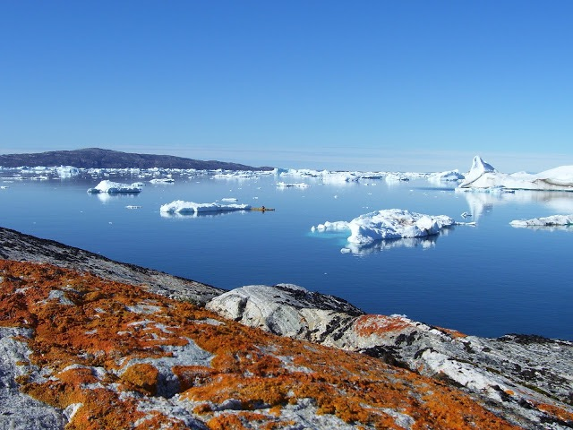
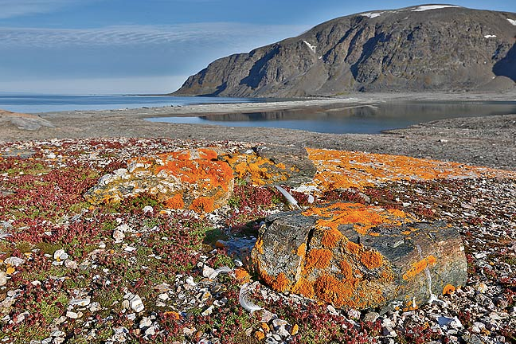
CREDIT: Rebecca Barfoot
CREDIT: Clemens Vanderwerf

Slide 20
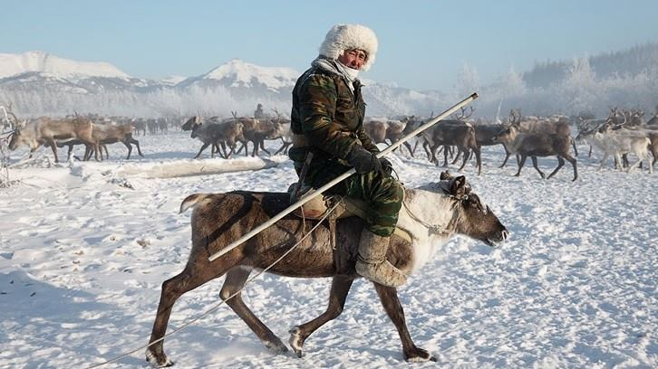
Reindeers

Slide 21
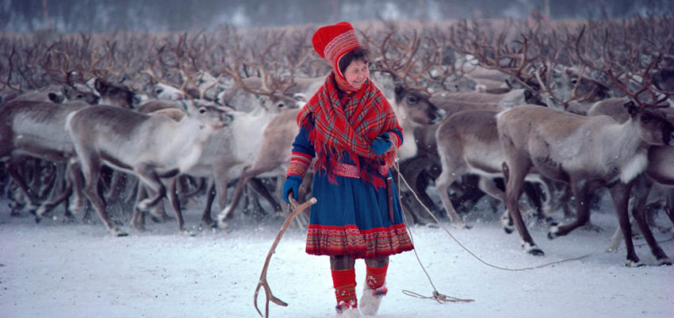
sami woman

Slide 22
EU H2020 Project APPLICATE
Advanced Prediction in Polar regions and beyond: Modelling, observing system design, and LInkages associated with a Changing Arctic climaTE
www.applicate.eu
@applicate_eu

