Slide 1
Proyecto BOREAS
Generación de información climática multi-escala para aumentar la resiliencia del sector energético Español.
A. Soret, V. Torralba, V. Agudetse-Roures, A. Batalla, E. Baulenas, D. Bojovic, C. Delgado-Torres, S. Moreno-Montes, Á. G. Muñoz, M. Olmo, N. Pérez-Zanón, P. Trascasa-Castro, Sheetal Saklani
Esta publicación/resultados es parte del proyecto PID2022-140673OA-I00 financiado por MICIU/AEI/10.13039/501100011033 y por FEDER, UE

Slide 2
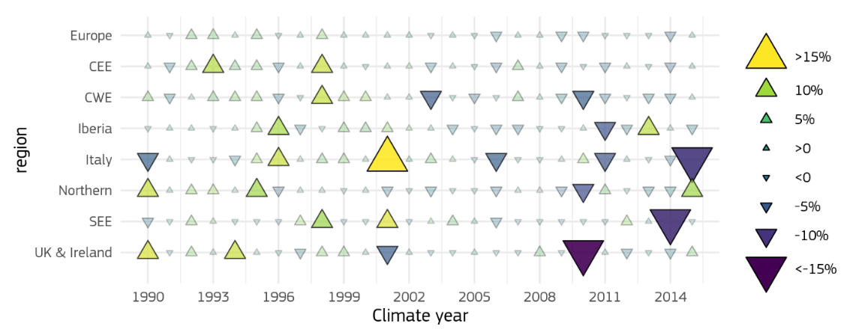
Introduction. Motivation
Annual variability (percentage deviation from the average) of onshore wind resources in the 26 climate years for the considered regions. Source: JRC, 2020

Slide 3
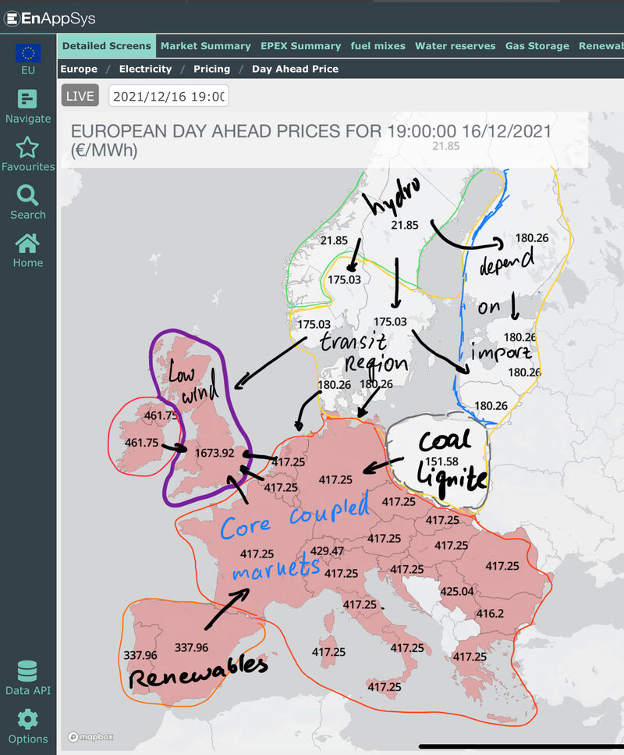
Introduction. Motivation
The day ahead prices for 16/12/2021. Large differences across the continent, with a core region of around €420. UK prices are the highest in Europe due to low wind energy production, while Iberian system prices are the lowest due to high wind resources (source: EnAppSys).

Slide 4
Aplications

Slide 5
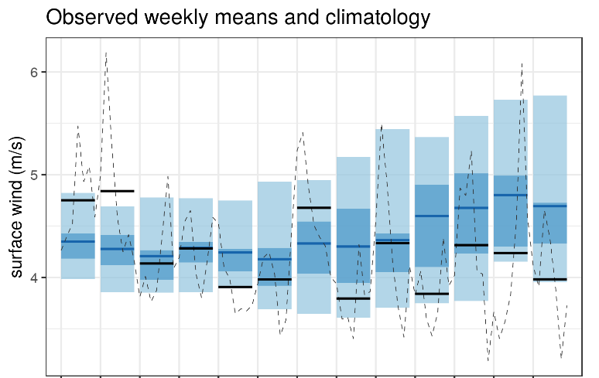
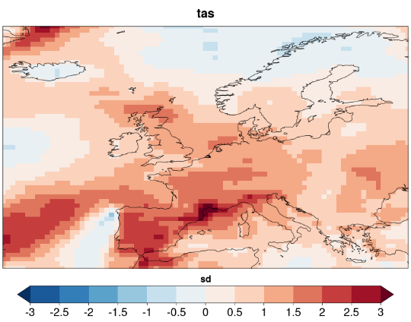
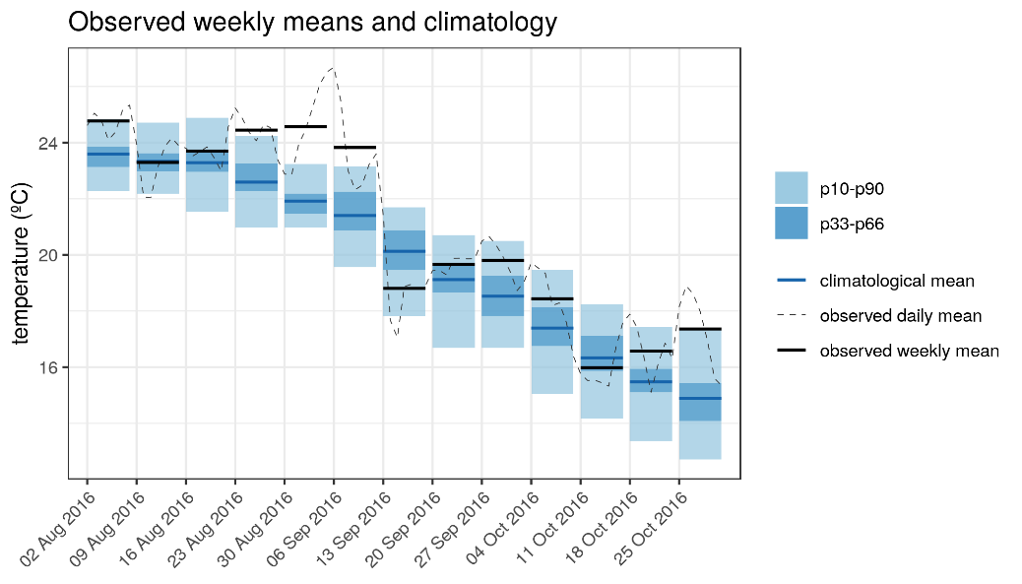
Heat wave and wind drought in Spain. Sep 2016
A heat wave and wind drought over Iberian Peninsula created a combination of:
large increase in electricity demand
lower than usual wind power generation
Surface wind and temperature anomalies for the week 30/08/2016-5/09/2016. ERA-Interim with respect to climatology (1981-2017)

Slide 6
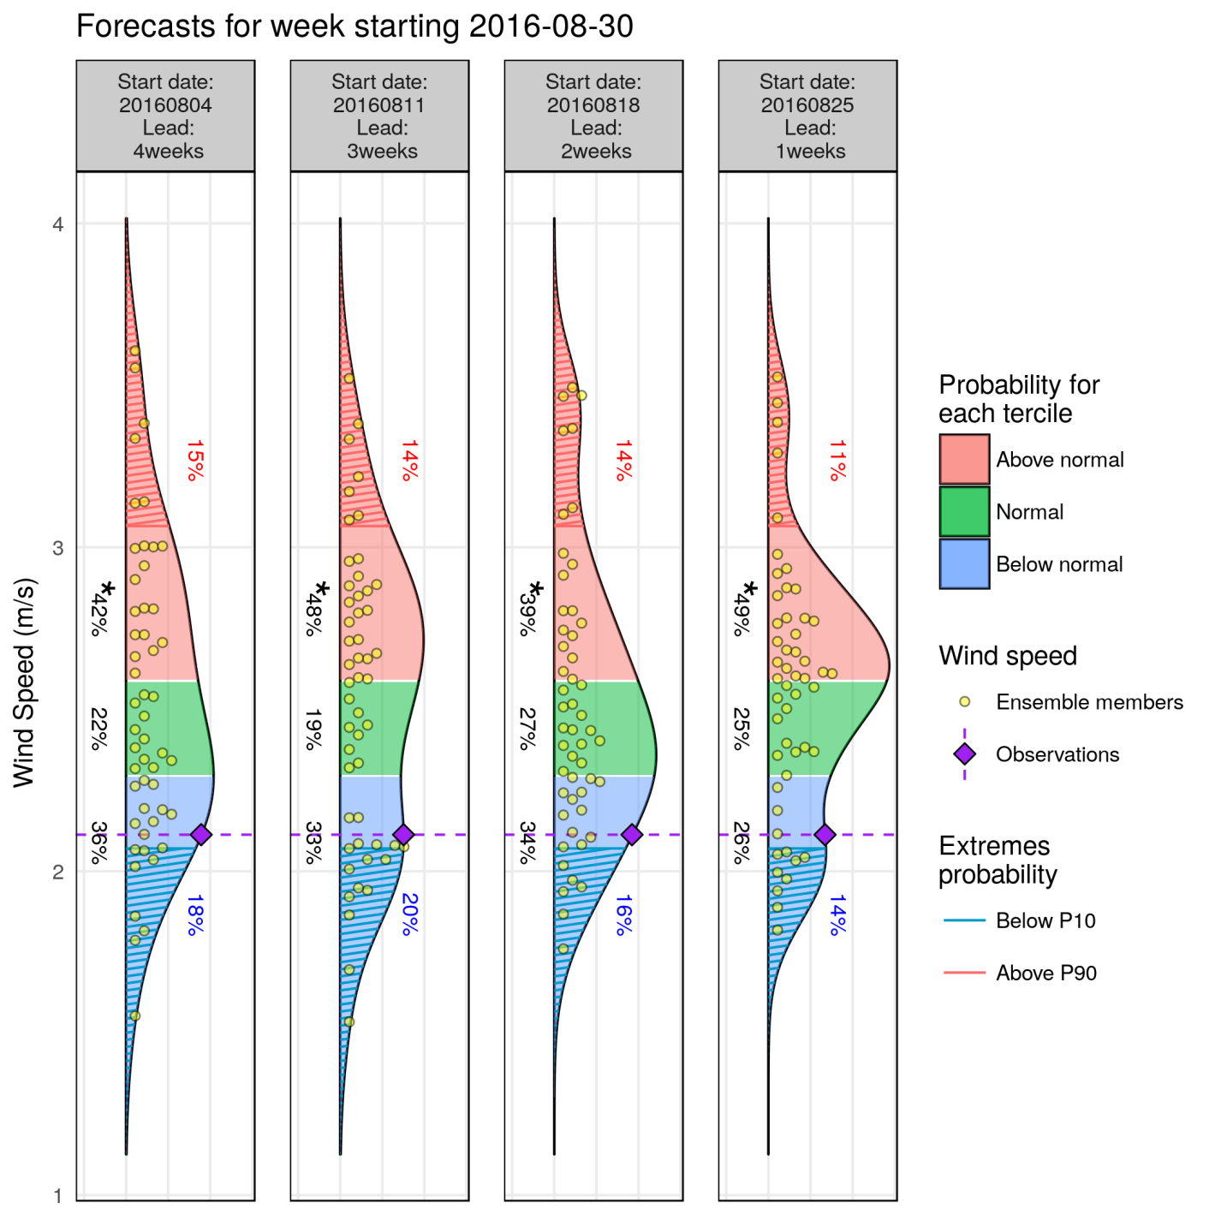
Heat wave and wind drought in Spain. Sep 2016
fairRPSS: -0.01 -0.02 0.02 0.09
System: ECMWF monthly prediction system
Reanalysis: ERA-Interim
Bias adjusted –calibrated
Hindcast: 1996-2015
Lat= 40.5 N/Lon = 358.5 E

Slide 7
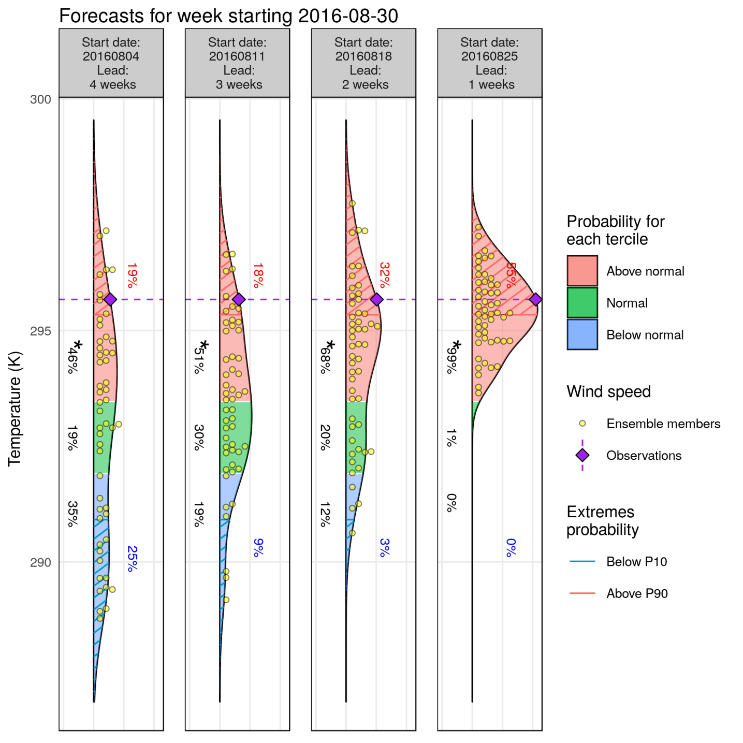
Heat wave and wind drought in Spain. Sep 2016
fairRPSS: 0.05 0.05 0.03 0.42
System: ECMWF monthly prediction system
Reanalysis: ERA-Interim
Bias adjusted –calibrated
Hindcast: 1996-2015
Lat= 40.5 N/Lon = 358.5 E

Slide 8
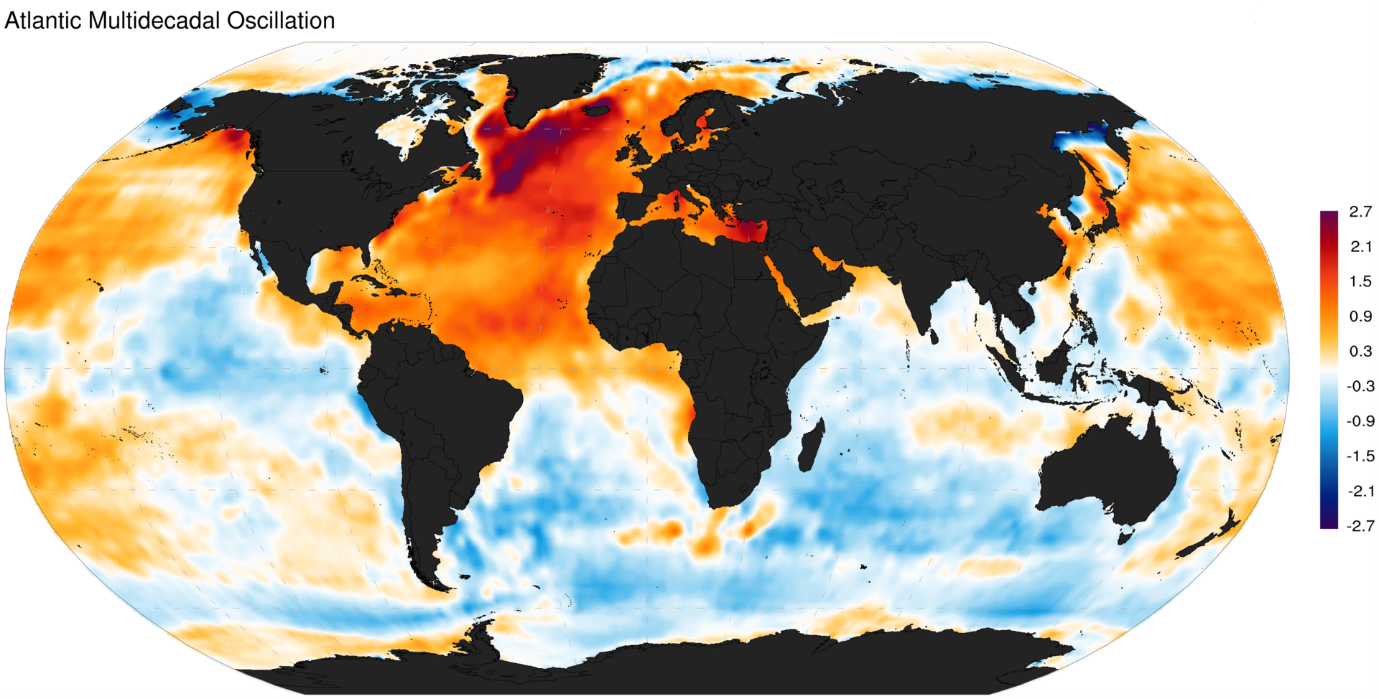
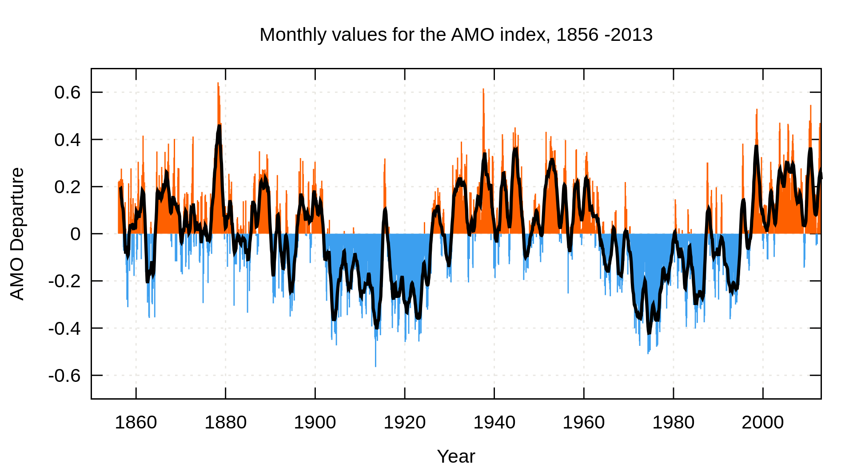
Novel research lines: Decadal predictions
Between seasonal predictions and climate projections
Both initial value and boundary condition problems
Different sources of predictability

Slide 9
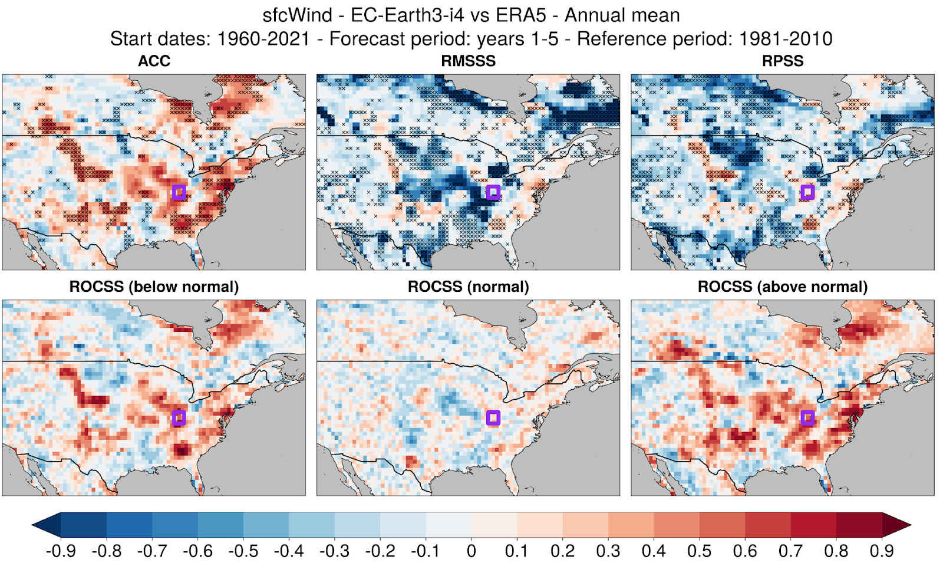
Novel research lines: Decadal predictions

Slide 10
Novel research lines: Seamless seasonal to decadal predictions

Slide 11
Novel research lines: DestinationEarth

Slide 12
Novel research lines: Economic assessment
Decision tree explaining user choices based on skill scores and probability distribution functions. In step 1, decision-makers look at the skill. In step 2, decision-makers look at the probability distribution of the forecast compared to the climatology of the weather variable of interest and, if this is informative, it can be incorporated into the decision-making either as qualitative or quantitative information in step 3.

Slide 13
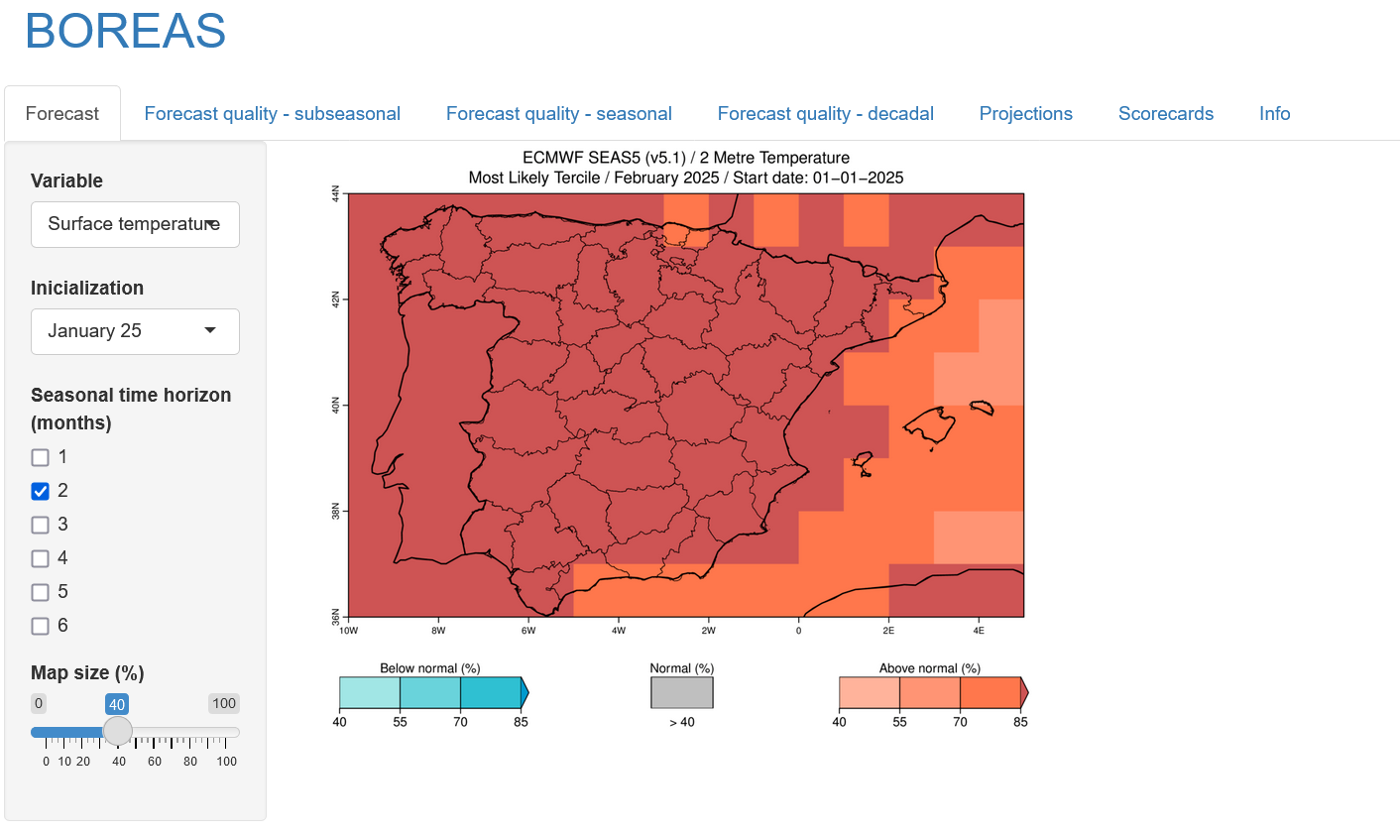
If you have exciting case studies or see a connection with our research, let’s collaborate—reach out to us!
Forecast outlooks
albert.soret@bsc.es https://ess.bsc.es/

Slide 14
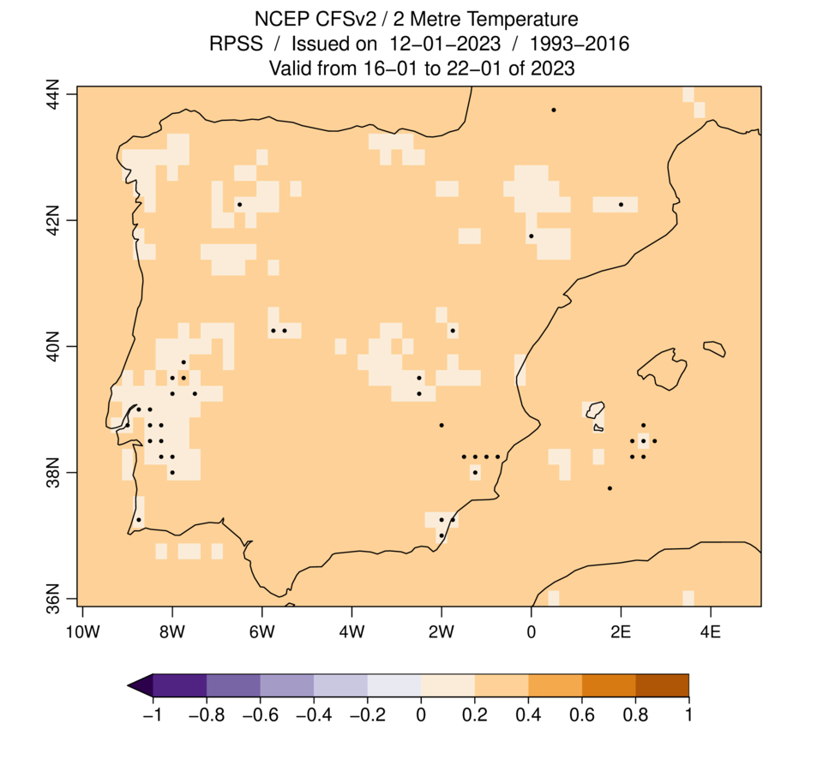
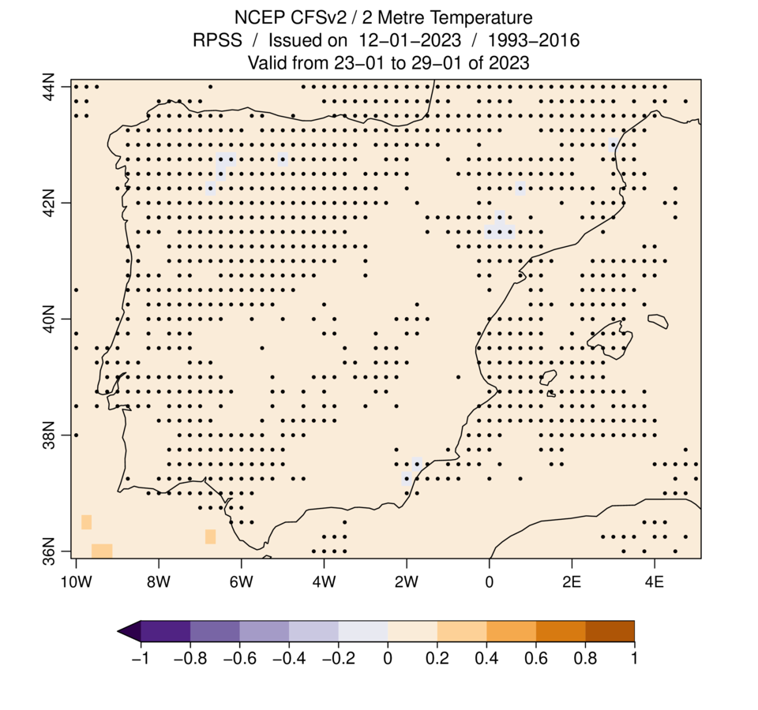
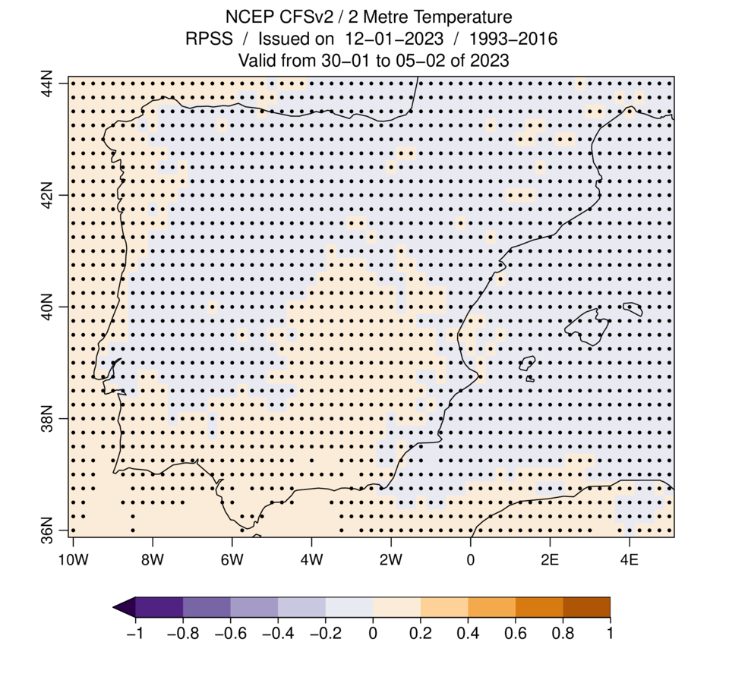
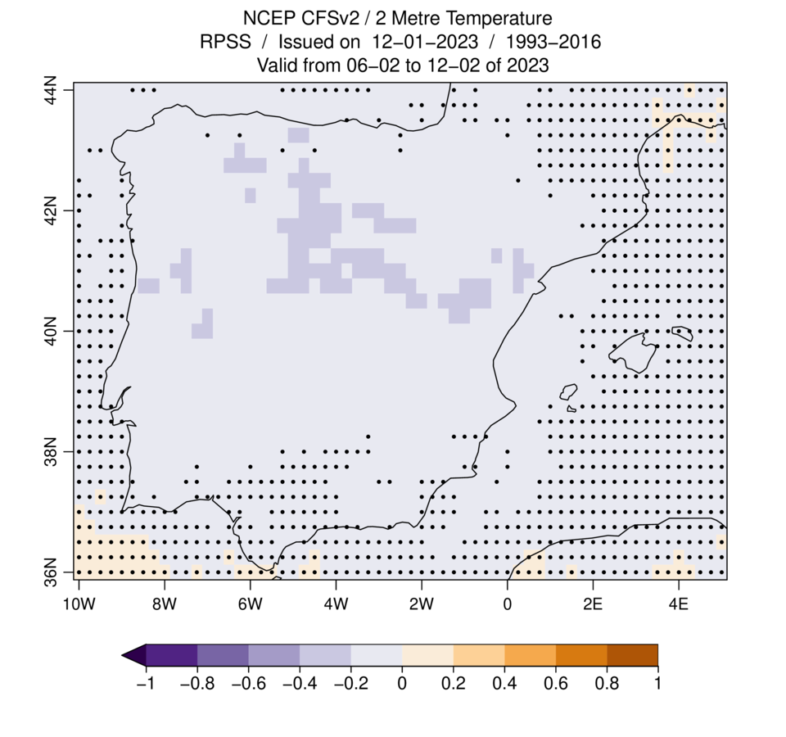
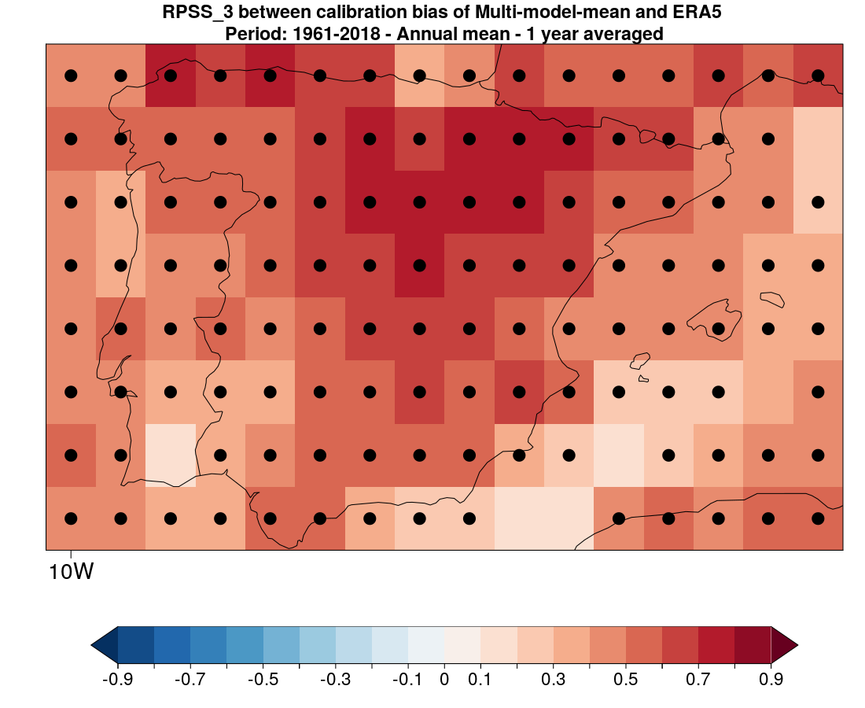
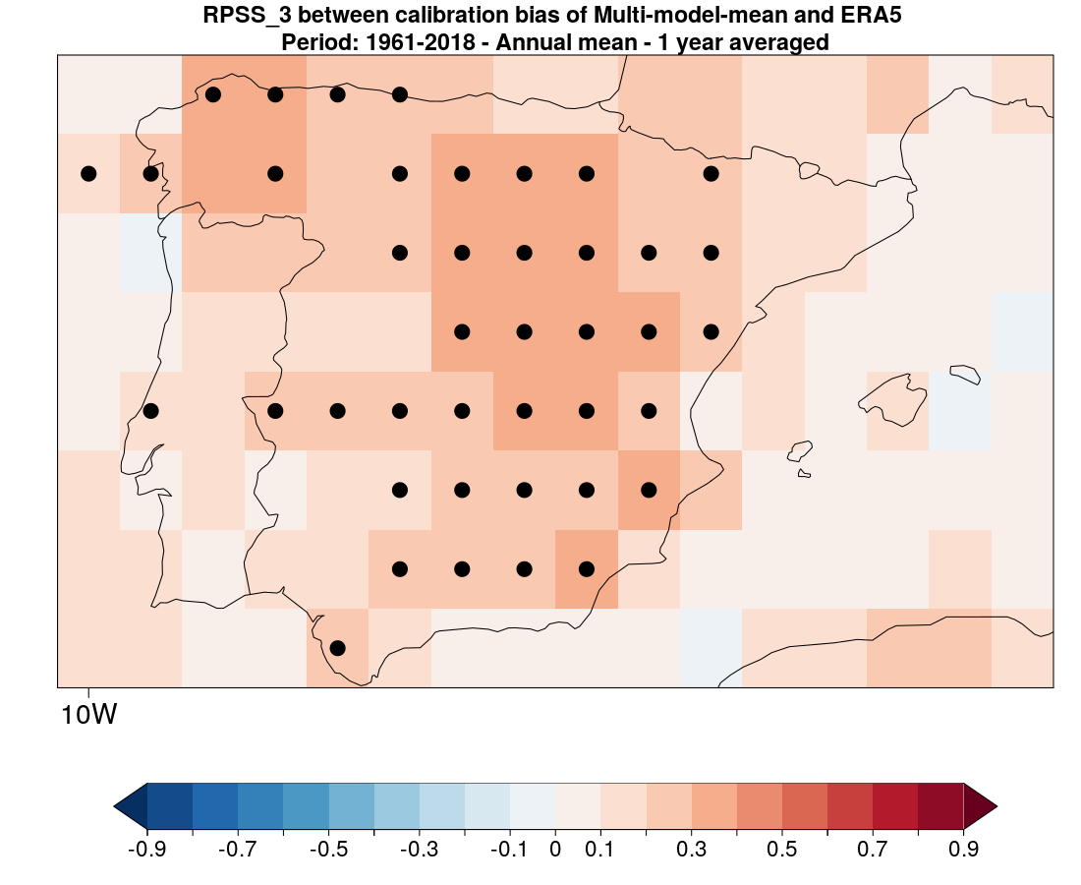
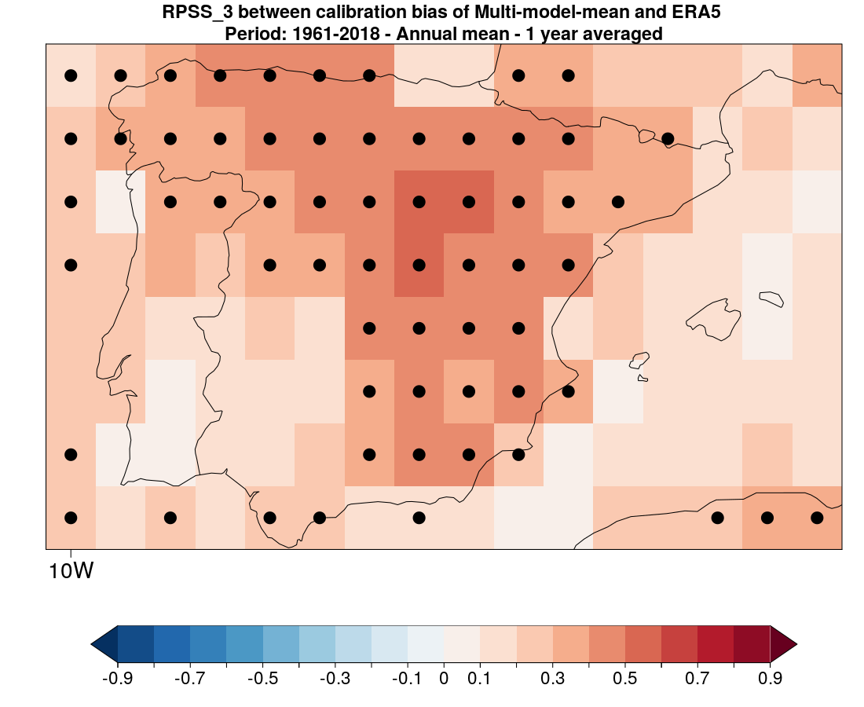
Forecast outlooks
albert.soret@bsc.es https://ess.bsc.es/

