Slide 1
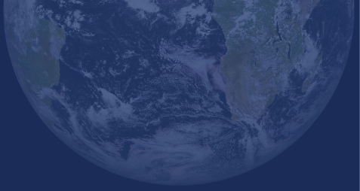
Forecast Briefing
February 2025
Aleksander Lacima-Nadolnik, Paloma Trascasa-Castro, Xavi Domingo, Diego Campos, Matías Olmo
Climate Services Team (CST)
Earth System Services (ESS)
Barcelona Supercomputing Center (BSC)
Tuesday, 18th Feb 2025

Slide 2
Outline
Recent state of the climate
Seasonal forecasts
Intra-seasonal forecasts
Discussion
Notes:
‹#›

Slide 3
Outline
Recent state of the climate
Seasonal forecasts
Intra-seasonal forecasts
Discussion
Notes:
‹#›

Slide 4
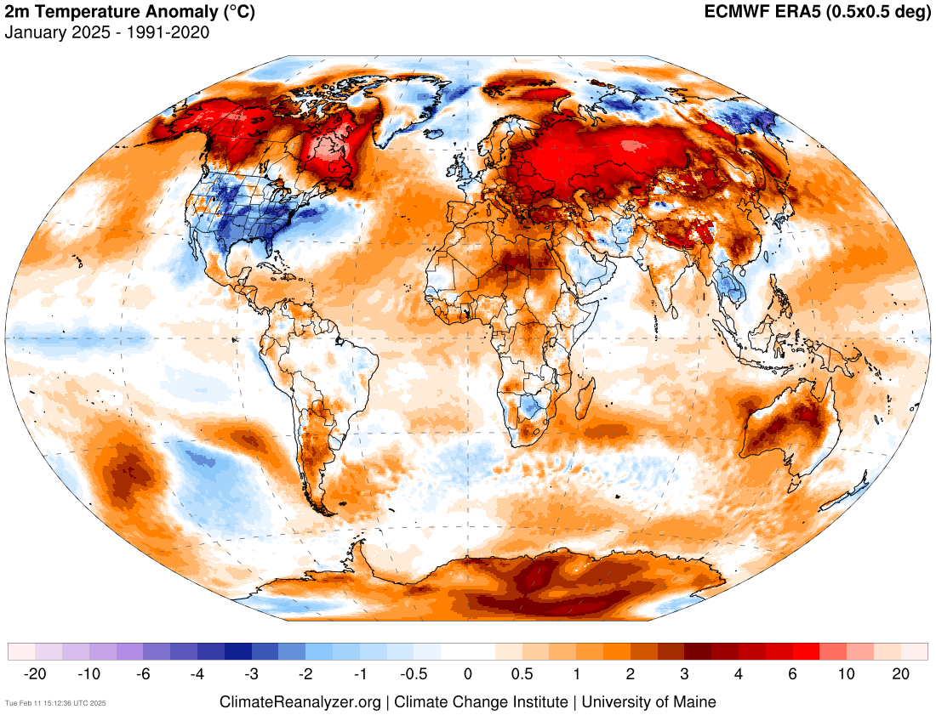
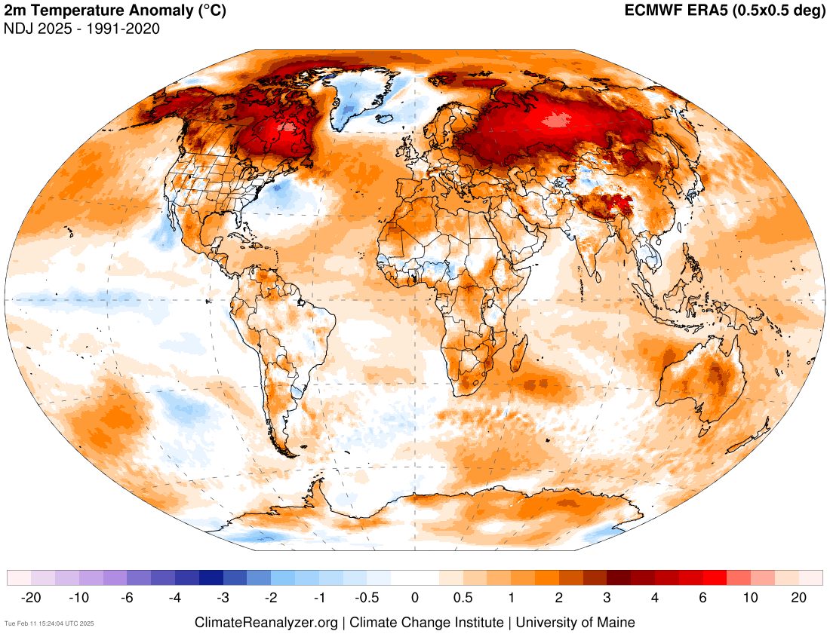
Recent state of the climate
Temperature
Last month’s signal is pretty similar to last season’s, with some notable exceptions: Alaska, Continental US, UK, Sahel, Botsuana, Arabia, parts of Iran and Afghanistan, Southeast Asia, parts of Siberia, Kamchatka
Source: https://climatereanalyzer.org/research_tools/monthly_maps/
Notes:
https://iridl.ldeo.columbia.edu/maproom/Global/Precipitation/Anomaly.html
https://iridl.ldeo.columbia.edu/maproom/Global/Precipitation/Seasonal.html
https://iridl.ldeo.columbia.edu/maproom/Global/Precipitation/WASP_Indices.html
‹#›

Slide 5
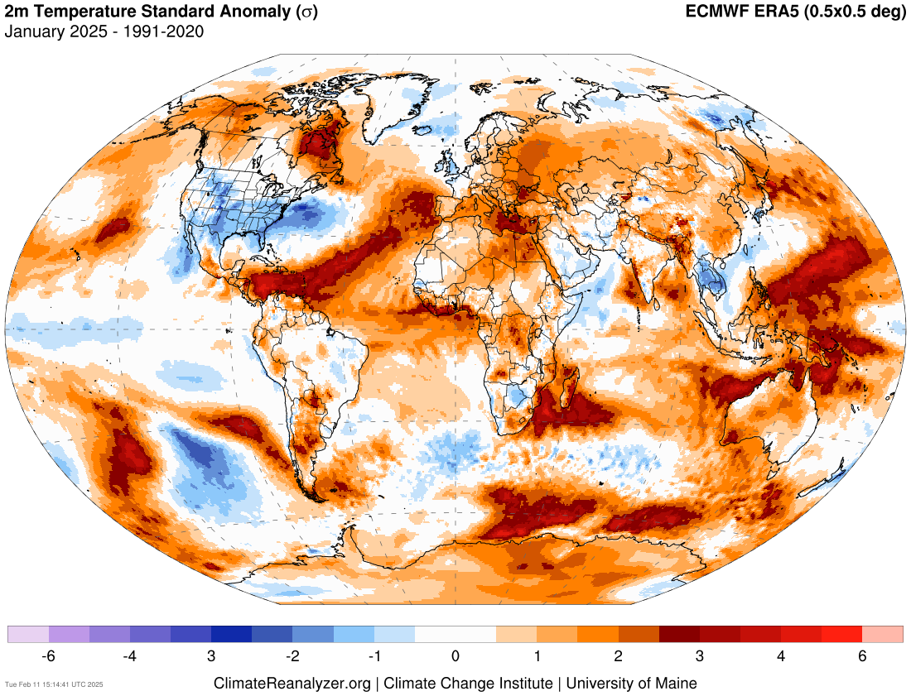
The standardized anomaly gives a measure of how large an anomaly is compared to the climatological (i.e. typical) variability. It is measured in number of 𝞼 (i.e. number of standard deviations)
Source: https://climatereanalyzer.org/research_tools/monthly_maps/
Notes:
https://iridl.ldeo.columbia.edu/maproom/Global/Atm_Temp/Anomaly.html
https://iridl.ldeo.columbia.edu/maproom/Global/Atm_Temp/Seasonal.html
https://iridl.ldeo.columbia.edu/maproom/Global/Atm_Temp/Std_Anom_Chnge.html
‹#›

Slide 6
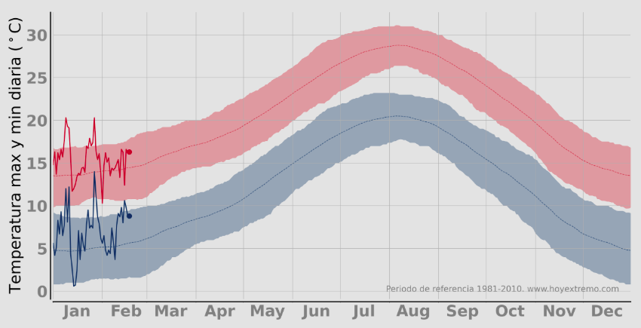
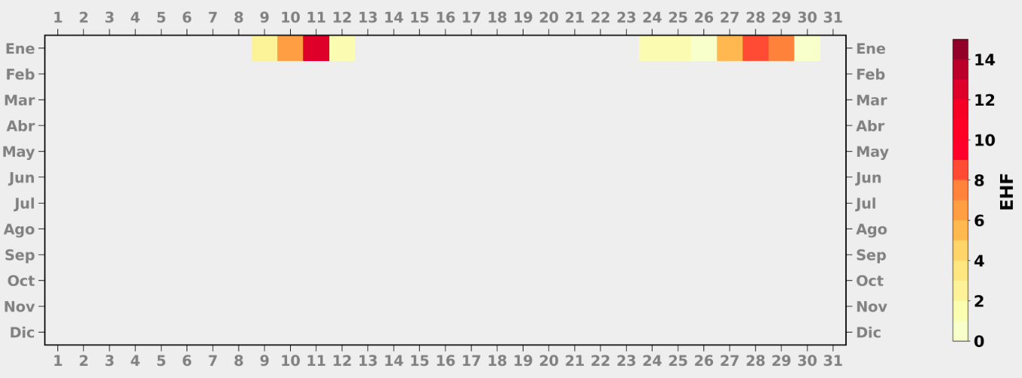
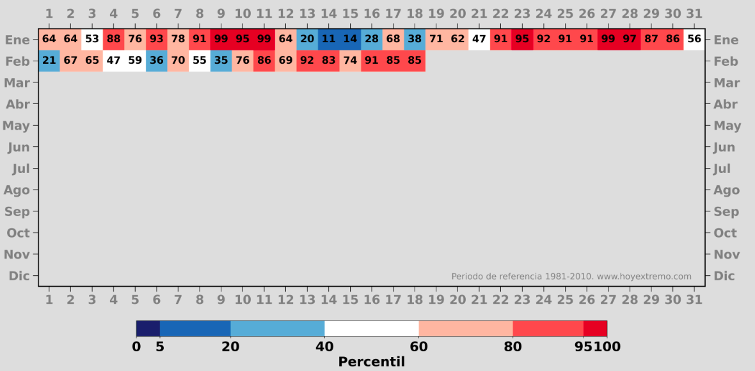
Recent state of the climate
Barcelona
Excess Heat Factor (EHF): Temperature-based index that allows to monitor the extension, duration and intensity of a heat wave.
Source: https://hoyextremo.com/city_pages/barcelona/#summary
Notes:
https://iridl.ldeo.columbia.edu/maproom/Global/Precipitation/Seasonal.html
https://iridl.ldeo.columbia.edu/maproom/Global/Precipitation/WASP_Indices.html
‹#›

Slide 7
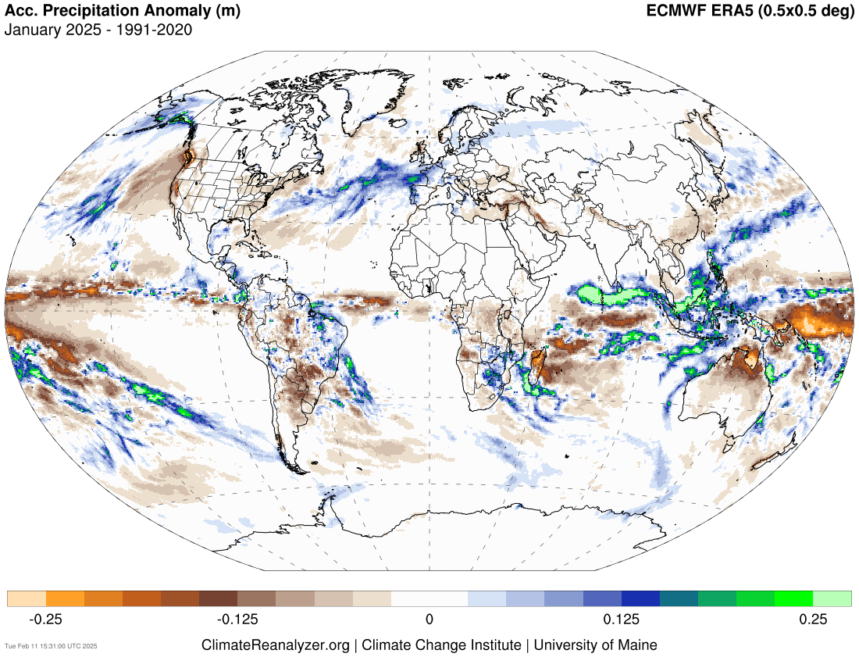
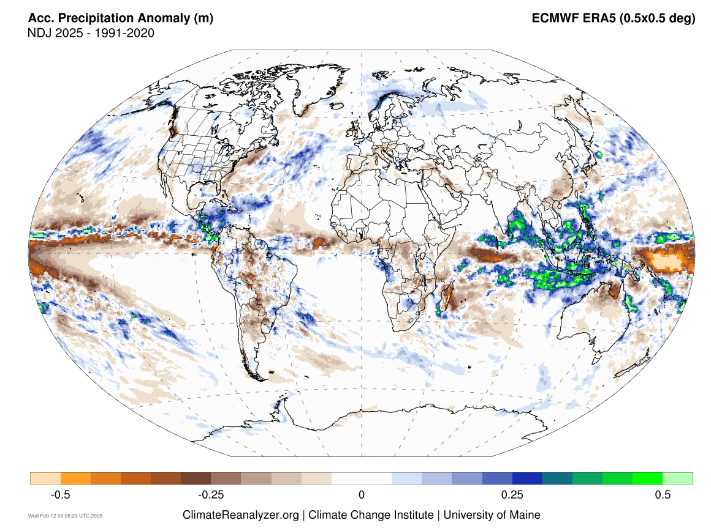
Recent state of the climate
Precipitation
Storm Éowyn: extremely powerful extratropical cyclone which hit Ireland and the UK on 24 Jan 2025, and Norway on the 25th.
High precipitation over Indonesia.
Dryness over Australia and central South America.
Source: https://climatereanalyzer.org/research_tools/monthly_maps/
Notes:
https://iridl.ldeo.columbia.edu/maproom/Global/Precipitation/Anomaly.html
https://iridl.ldeo.columbia.edu/maproom/Global/Precipitation/Seasonal.html
https://iridl.ldeo.columbia.edu/maproom/Global/Precipitation/WASP_Indices.html
‹#›

Slide 8
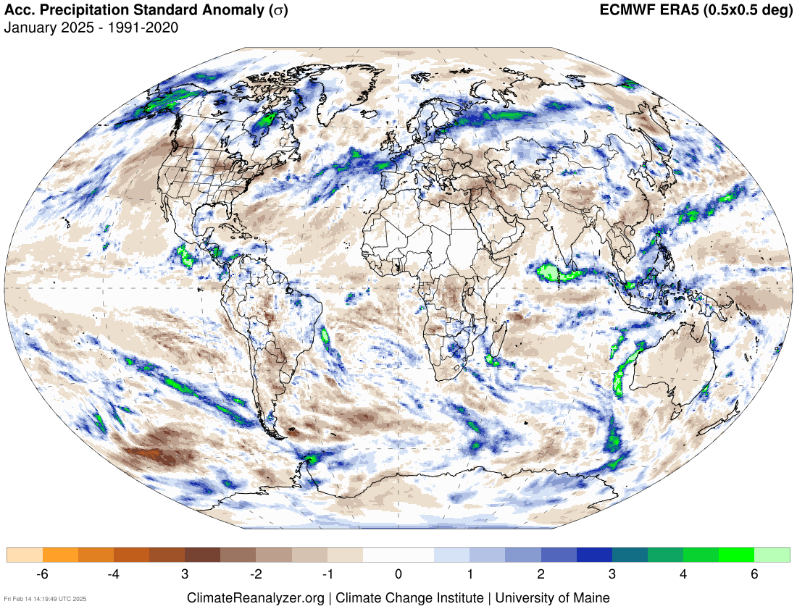
Source: https://climatereanalyzer.org/research_tools/monthly_maps/

Slide 9
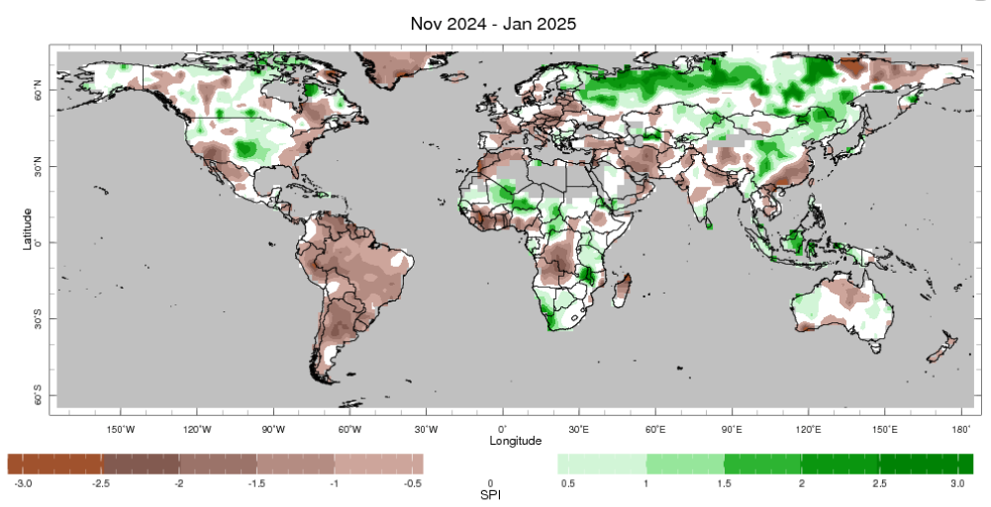
Recent state of the climate
Standardized Precipitation index (SPI)
SPI-3
SPI
The Standardized Precipitation Index (SPI; McKee 1993) is the number of standard deviations that observed cumulative precipitation (over x number of months) deviates from the climatological average.
SPI-x: Cumulative distribution over x-months.
Shorter SPI values (SPI-1, SPI-3): Respond quickly to rainfall changes, useful for early warning systems.
Longer SPI values (SPI-6, SPI-12, SPI-24): Reflect cumulative precipitation trends, useful for long-term water resource management.
Grey = Regions with an annual average precipitation of less than 0.2 mm/day have been "masked" from the plot.
Other information: 2.5º lat/lon grid, 1979-present climatological base period
Source: https://iridl.ldeo.columbia.edu/maproom/Global/Precipitation/SPI.html?var=.SPI-CAMSOPI_3-Month
Notes:
https://iridl.ldeo.columbia.edu/maproom/Global/Precipitation/Persistence.html
‹#›

Slide 10
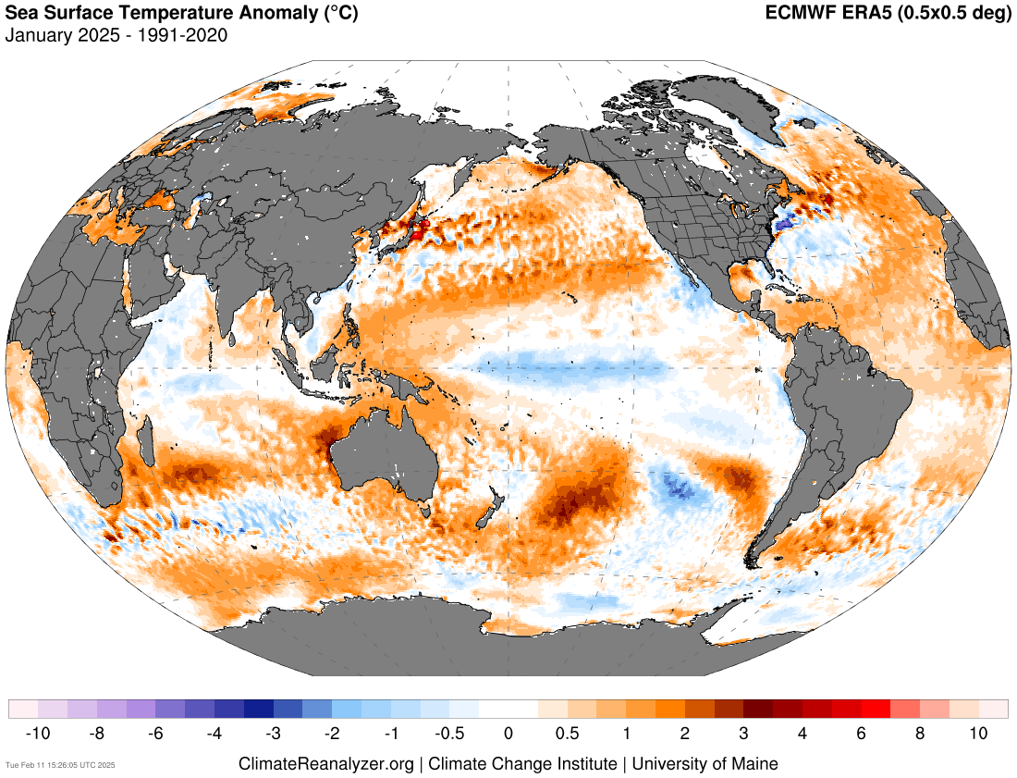
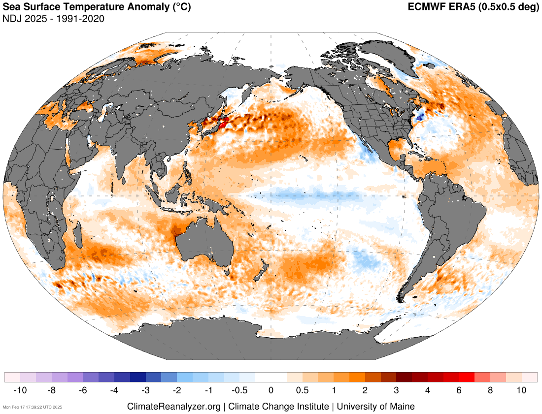
Recent state of the climate
Sea surface temperature (SST)
Last month’s signal very similar to last season’s.
Source: https://climatereanalyzer.org/research_tools/monthly_maps/
Notes:
https://iridl.ldeo.columbia.edu/maproom/Global/Precipitation/Seasonal.html
https://iridl.ldeo.columbia.edu/maproom/Global/Precipitation/WASP_Indices.html
‹#›

Slide 11
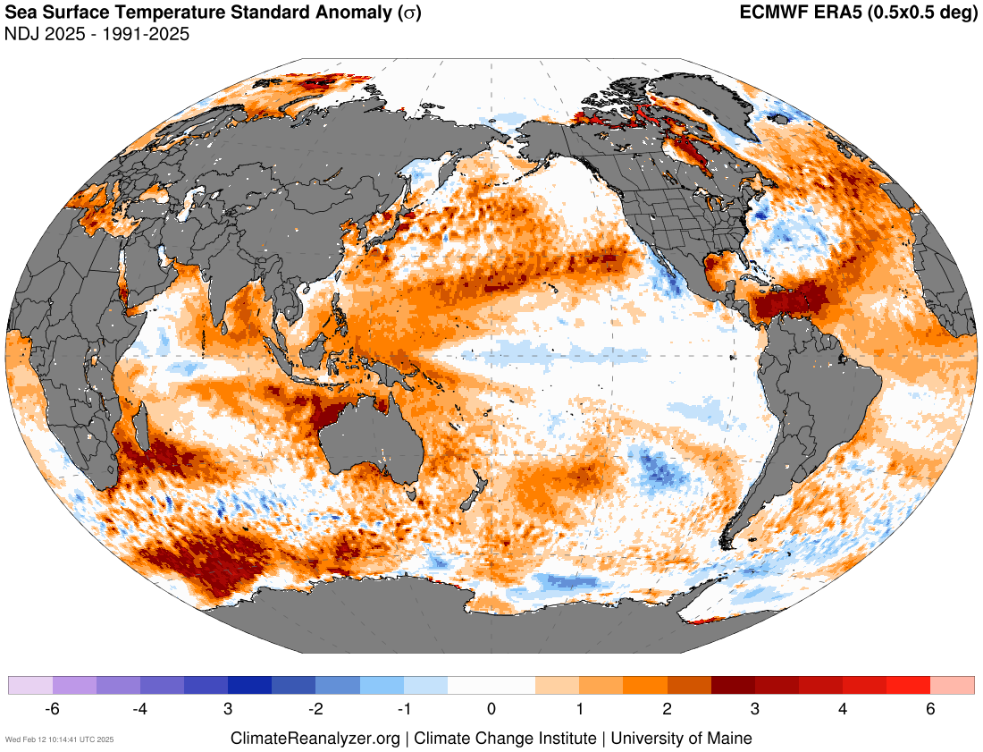
Source: https://climatereanalyzer.org/research_tools/monthly_maps/

Slide 12
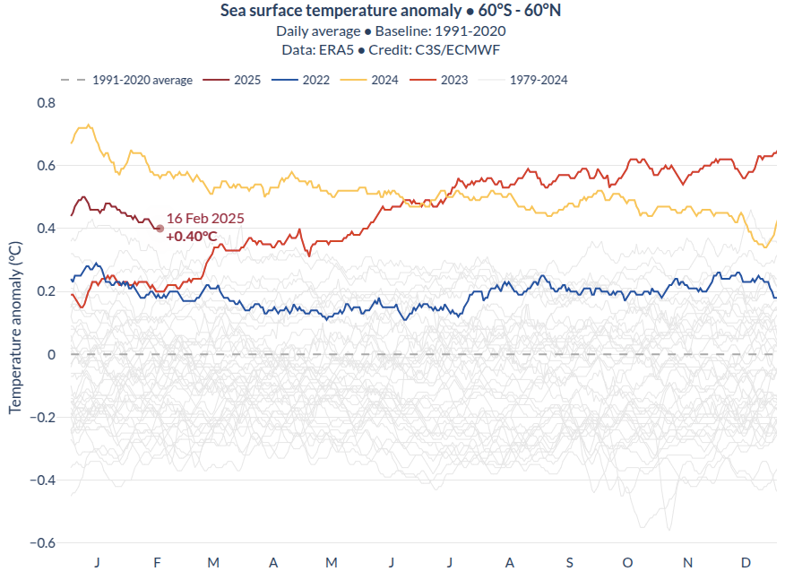
Since mid-2023, global SST anomalies have increased significantly compared to previous years, remaining above +0.4 ºC throughout all seasons (except for December 2024).
Source: https://pulse.climate.copernicus.eu/

Slide 13
Recent state of the climate
El Niño-Southern Oscillation (ENSO)
ENSO is the leading mode of natural variability at seasonal to interannual (S2I) time scales and is considered as an internally occurring coupled ocean–atmosphere phenomenon.
Notes:
https://iridl.ldeo.columbia.edu/maproom/Global/Atm_Temp/Anomaly.html
https://iridl.ldeo.columbia.edu/maproom/Global/Atm_Temp/Seasonal.html
https://iridl.ldeo.columbia.edu/maproom/Global/Atm_Temp/Std_Anom_Chnge.html
‹#›

Slide 14
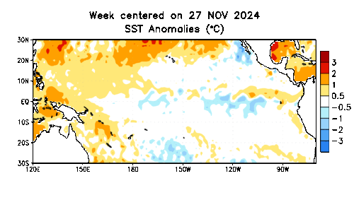
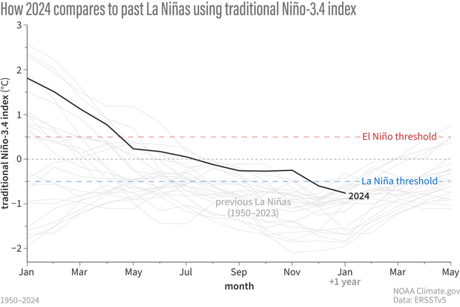
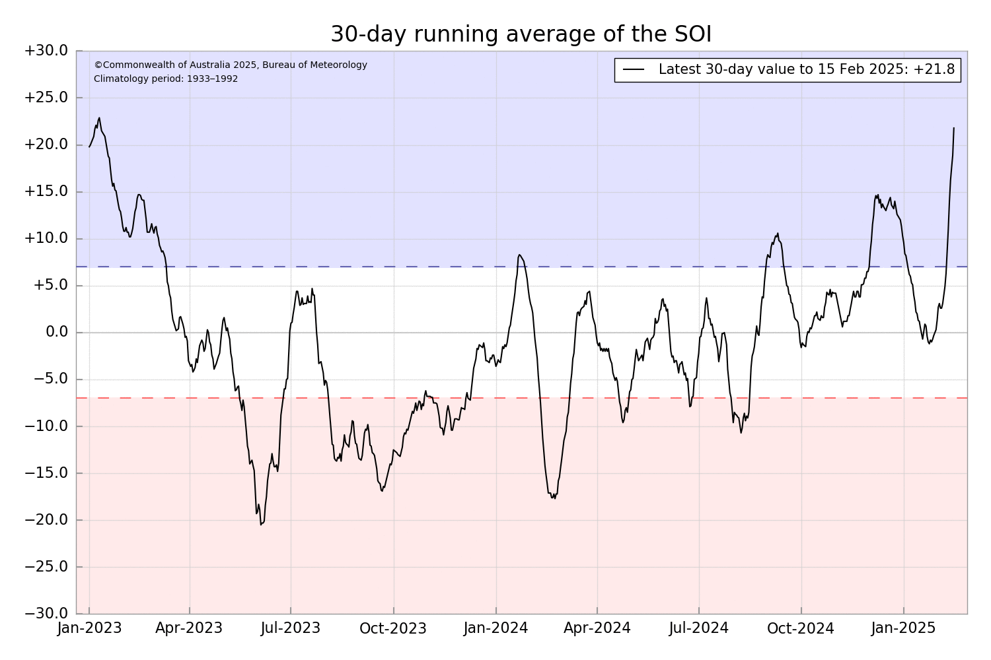
ENSO status is traditionally diagnosed by looking at SST anomalies in the Niño 3.4 region, known as the Oceanic Niño Index (ONI), and the difference in mean sea level pressure between Darwin and Tahiti, known as the Southern Oscillation Index (SOI).
ENSO alert system status: La Niña Advisory
Source: https://www.climate.gov/news-features/blogs/enso / http://www.bom.gov.au/climate/enso/?ninoIndex=nino3.4&index=nino34&period=weekly#tabs=Pacific-Ocean&pacific=SOI
Notes:
Tropical Instability Waves (see Philander, 1976, 1978). Recent mechanism paper here: https://doi.org/10.1175/JPO-D-19-0094.1
https://www.cpc.ncep.noaa.gov/products/precip/CWlink/MJO/enso.shtml#current
https://www.cpc.ncep.noaa.gov/products/analysis_monitoring/enso_update/gsstanim.shtml
‹#›

Slide 15
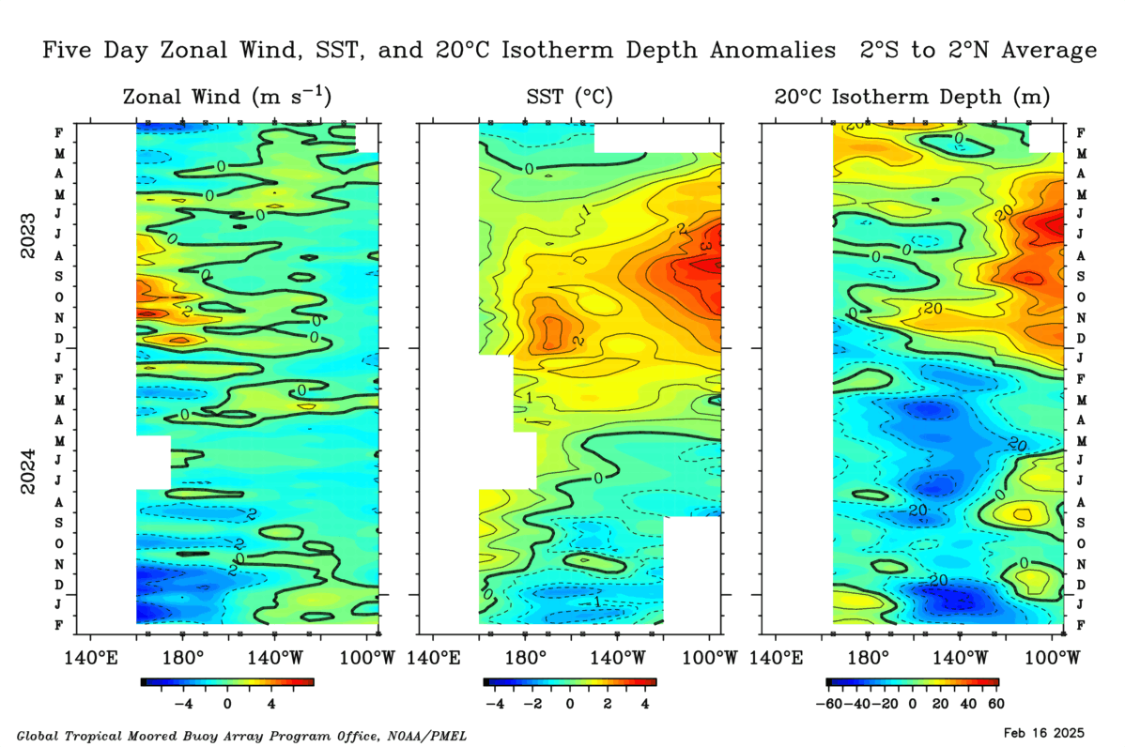
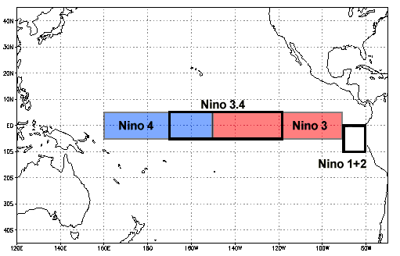
Monitoring regions
Strengthened easterlies over the Central and western Pacific (CP).
Cooler SSTs in the key monitoring region (Niño 3.4)
Shallower thermocline in CP and steeper gradient across the basin.
Source: https://www.cpc.ncep.noaa.gov/products/analysis_monitoring/lanina/enso_evolution-status-fcsts-web.pdf

Slide 16
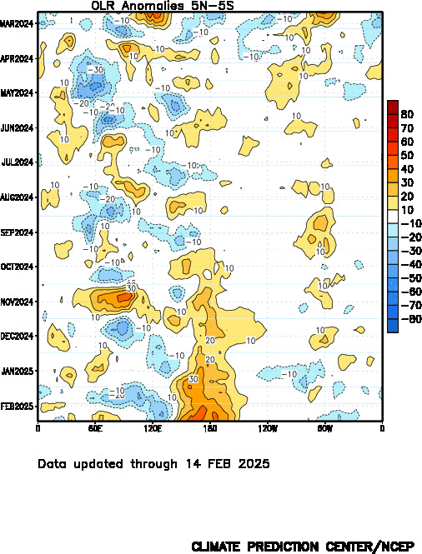
Negative OLR anomalies:
Enhanced convection =
High and deep clouds =
Their top is cold and emits less emission of longwave radiation back to space.
Positive OLR anomalies:
Suppressed convection over the central Pacific is associated with La Niña.
Subsidence (orange/red shading)
Enhanced convection (blue shading)
Source: https://www.cpc.ncep.noaa.gov/products/analysis_monitoring/lanina/enso_evolution-status-fcsts-web.pdf
Notes:
https://www.cpc.ncep.noaa.gov/products/precip/CWlink/MJO/enso.shtml#current
http://www.bom.gov.au/climate/enso/indices.shtml
http://www.bom.gov.au/climate/enso/#tabs=Pacific-Ocean&pacific=SOI
‹#›

Slide 17
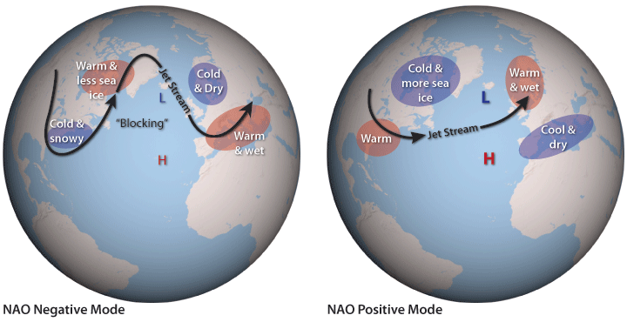
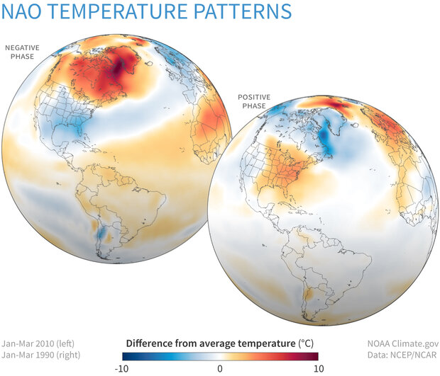
Recent state of the climate
North Atlantic Oscillation (NAO)
The North Atlantic Oscillation (NAO) is the leading mode of large-scale atmospheric variability in the North Atlantic basin.
NAO index: Standardized 3-month Running Mean Index (through Jan 2025)
Source: https://www.cpc.ncep.noaa.gov/data/teledoc/nao_ts.shtml
Notes:
https://www.cpc.ncep.noaa.gov/products/CDB/CDB_Archive_html/CDB_archive.shtml
https://www.cpc.ncep.noaa.gov/products/CDB/Extratropics/fige7.shtml
https://www.cpc.ncep.noaa.gov/data/teledoc/nao_ts.shtml
‹#›

Slide 18
Recent state of the climate
NAO forecast
Source: https://www.cpc.ncep.noaa.gov/products/precip/CWlink/pna/nao_index_ensm.shtml
Notes:
https://www.cpc.ncep.noaa.gov/products/CDB/CDB_Archive_html/CDB_archive.shtml
https://www.cpc.ncep.noaa.gov/products/CDB/Extratropics/fige7.shtml
https://www.cpc.ncep.noaa.gov/data/teledoc/nao_ts.shtml
‹#›

Slide 19
Recent state of the climate
Weather regimes
Source: https://charts.ecmwf.int/products/extended-regime-probabilities?forecast_from=latest

Slide 20
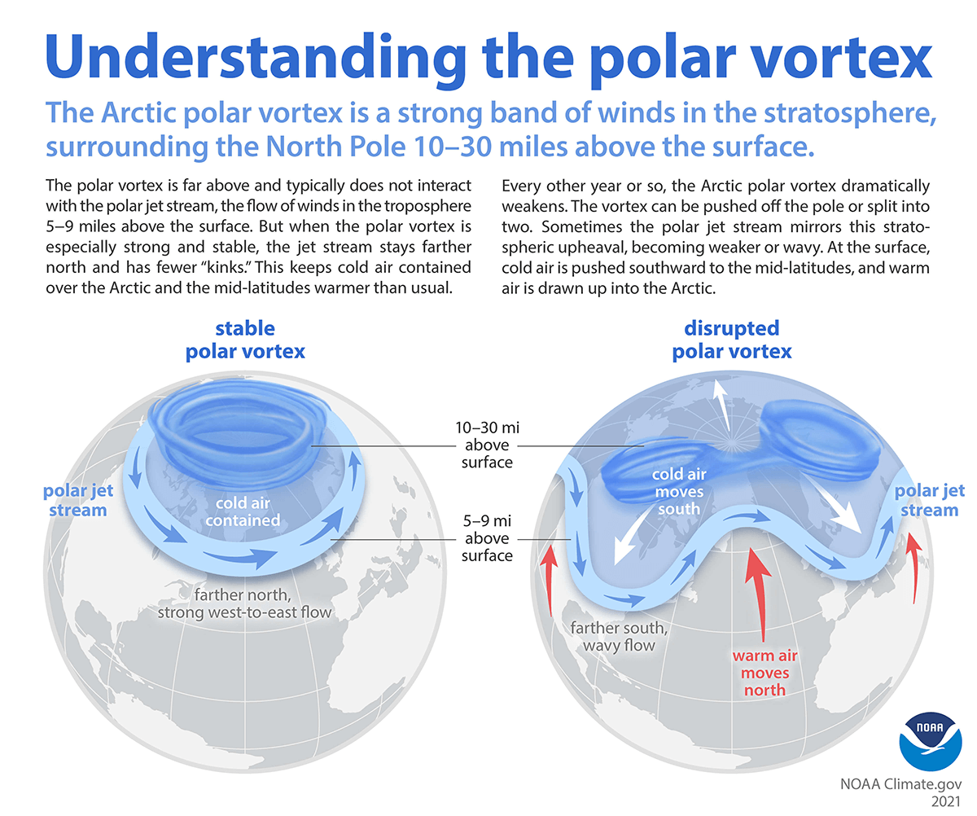
Recent state of the climate
Polar Vortex
Notes:
‹#›

Slide 21
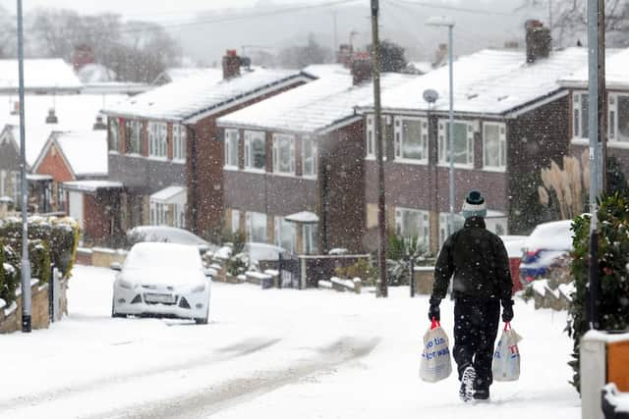
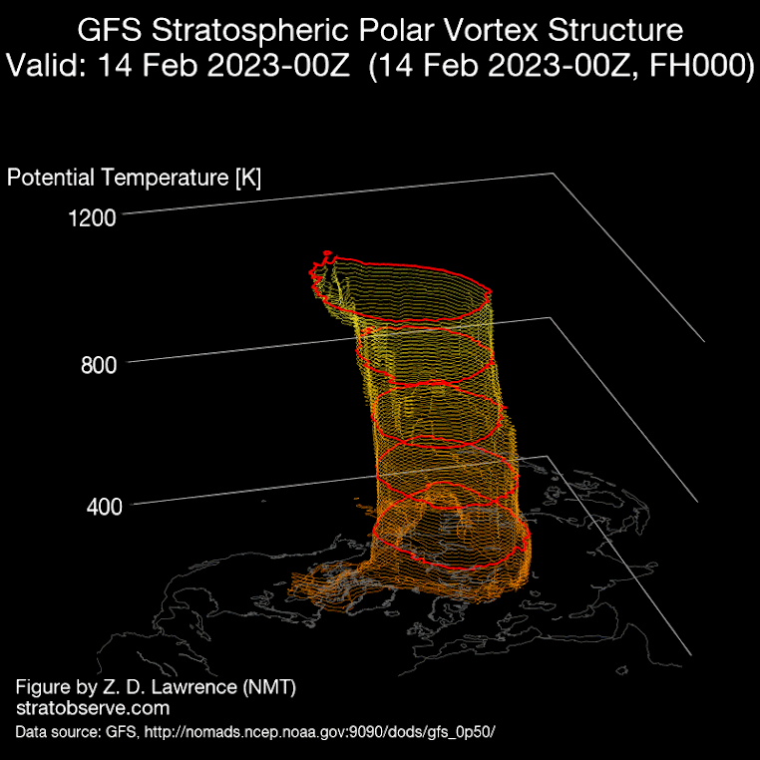
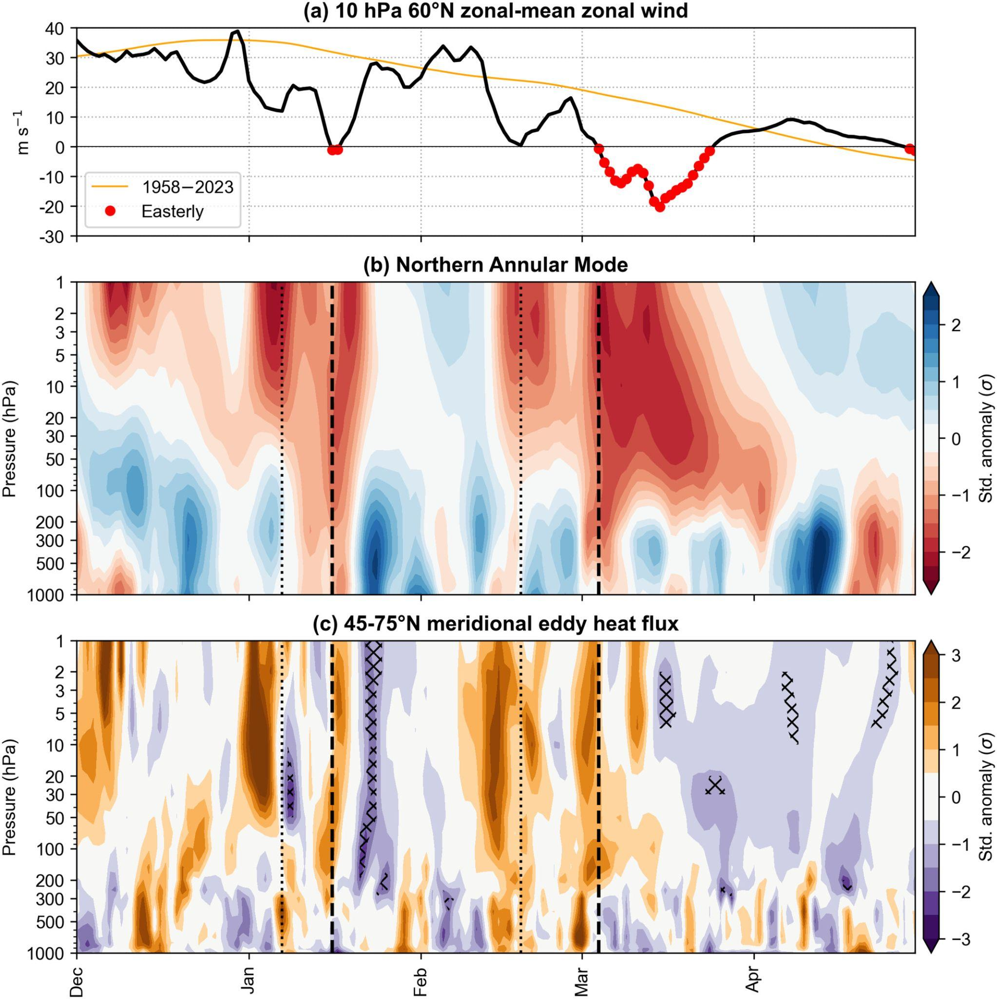
Recent state of the climate
Sudden stratospheric warmings (SSWs)
A sudden stratospheric warming can reach the surface and drive very cold anomalies in northern Europe.
Source: Lee et al. (2024)
https://doi.org/10.1002/wea.7656
Notes:
‹#›

Slide 22
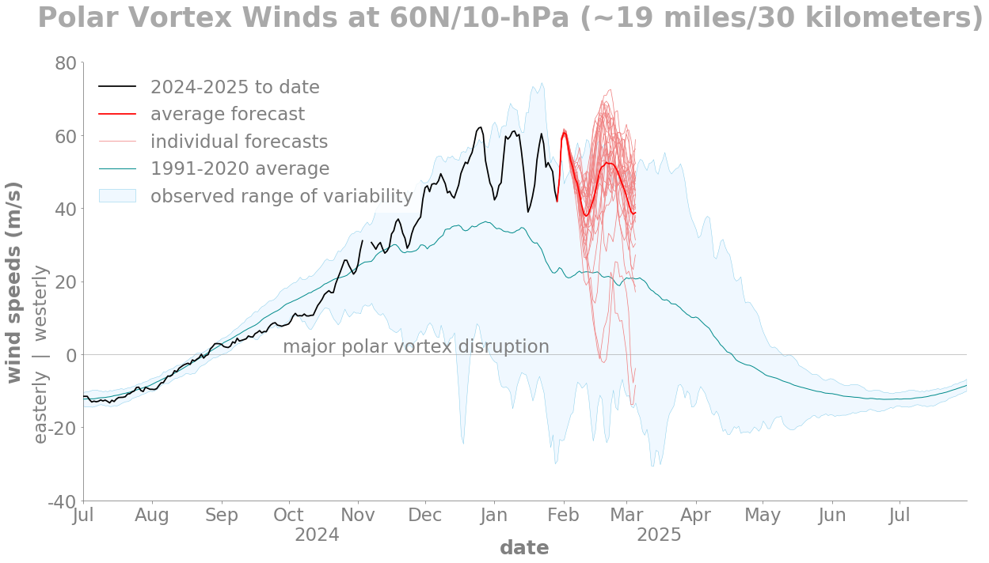
Recent state of the climate
Polar Vortex forecasts
No major vortex disruption expected.
Issued 30th Jan ‘25
Source: https://www.climate.gov/media/16763
Notes:
‹#›

Slide 23
Outline
Recent state of the climate
Seasonal forecasts
Intra-seasonal forecasts
Discussion
Notes:
‹#›

Slide 24
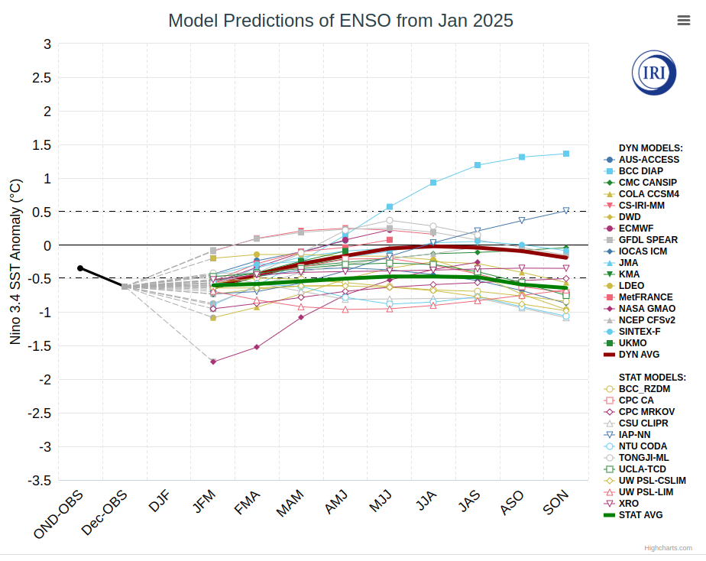
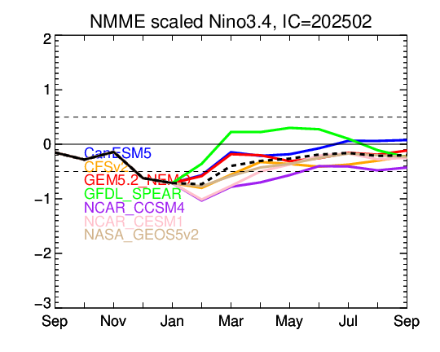
II. Seasonal forecasts
ENSO forecasts
La Niña conditions are now present in the Central Pacific (CP). Most models predict we will return to neutral conditions by March 2025.
NASA model is known to be an outlier.
Source: https://iri.columbia.edu/our-expertise/climate/forecasts/enso/current/?enso_tab=enso-sst_table /
https://www.cpc.ncep.noaa.gov/products/NMME/current/plume.html
Notes:
https://iri.columbia.edu/our-expertise/climate/forecasts/enso/current/?enso_tab=enso-sst_table
https://www.cpc.ncep.noaa.gov/products/NMME/current/plume.html
‹#›

Slide 25
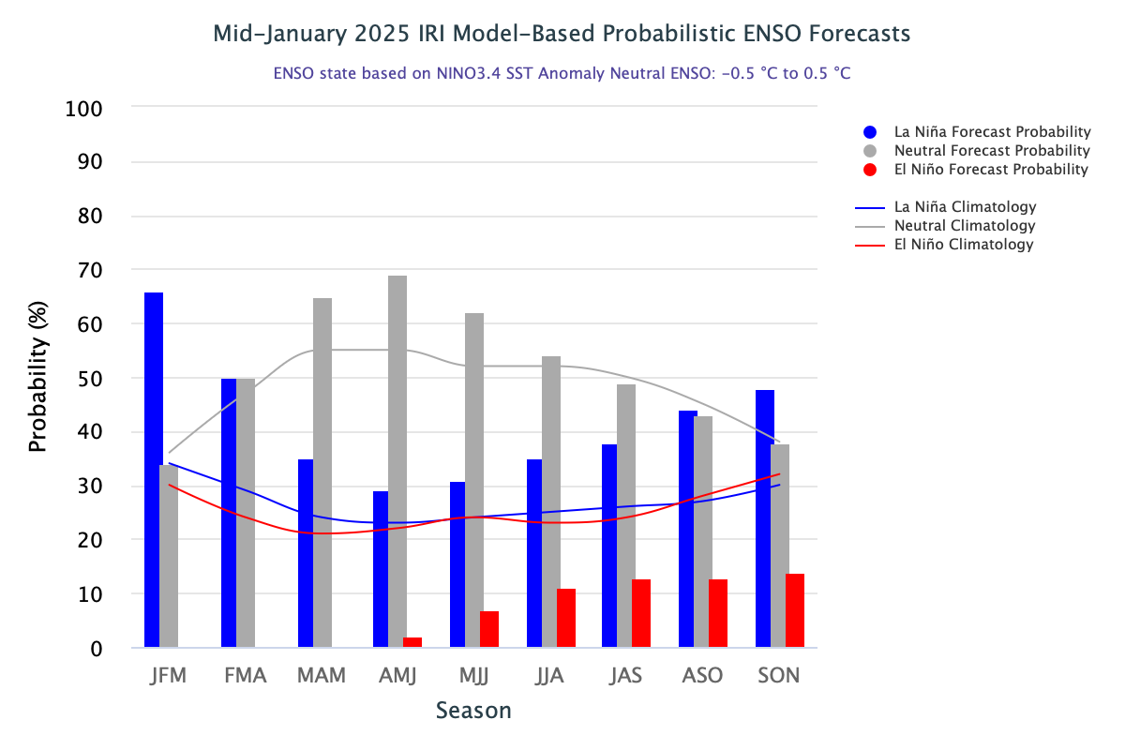
Higher probability for La Niña to persist throughout FMA.
Return to neutral conditions is expected during MAM.
Forecast probability needs to be always compared against climatological probability.
Source: https://iri.columbia.edu/our-expertise/climate/forecasts/enso/current/
Notes:
https://iri.columbia.edu/our-expertise/climate/forecasts/enso/current/?enso_tab=enso-iri_plume
https://iri.columbia.edu/our-expertise/climate/forecasts/enso/current/?enso_tab=enso-cpc_plume
‹#›

Slide 26
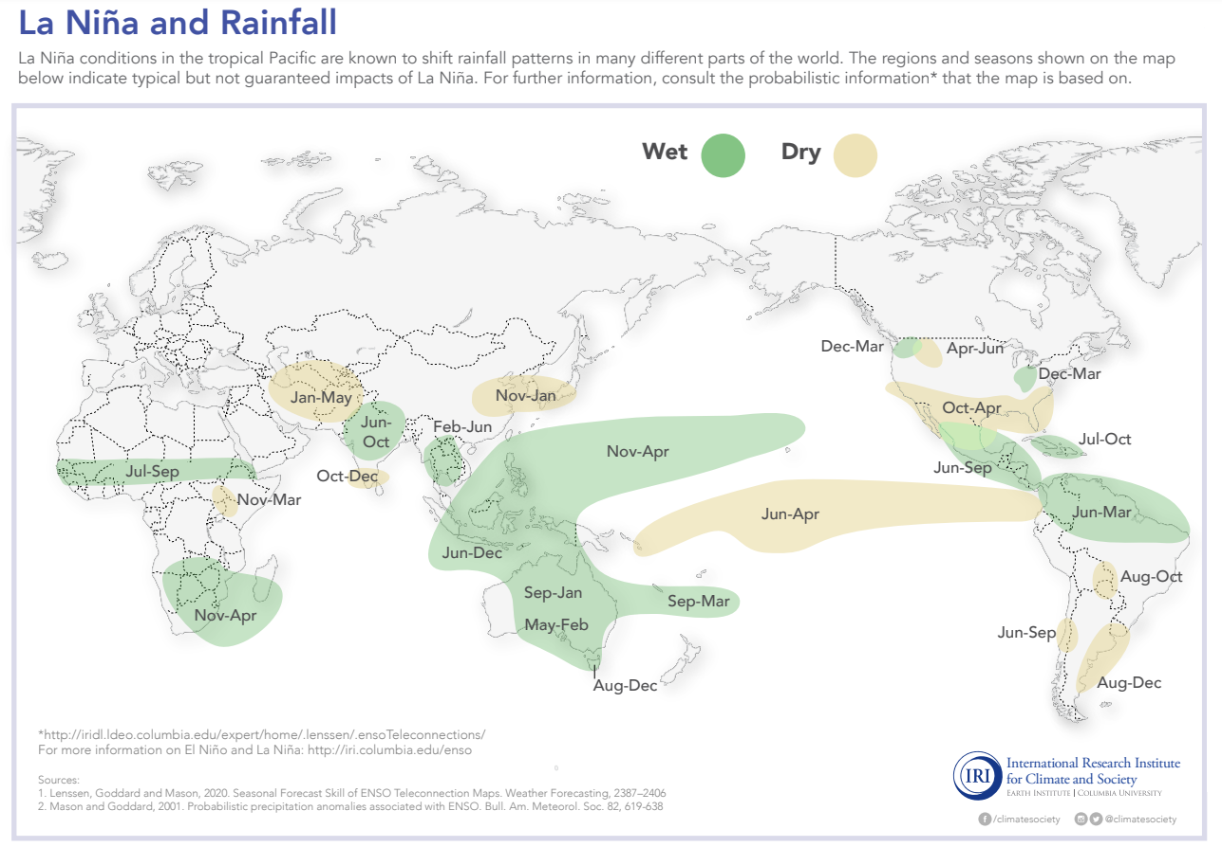
Canonical La Niña impacts on rainfall patterns across the globe.
For MAM drier anomalies are expected in: Parts of US and Mexico, parts of eastern Africa, parts of central Asia
Wetter anomalies are expected in: northern South America, Southeast Asia, Philippines, Eastern Pacific, southern Africa, parts of Australia, Great Lakes area
Source: https://iridl.ldeo.columbia.edu/maproom/IFRC/FIC/laninarain.html
Notes:
ENSO diags https://www.cpc.ncep.noaa.gov/products/precip/CWlink/MJO/enso.shtml#current
ENSO Blog https://www.climate.gov/news-features/blogs/enso?page=1
https://www.pmel.noaa.gov/gtmba/assorted-plots
https://www.pmel.noaa.gov/tao/drupal/disdel/
‹#›

Slide 27
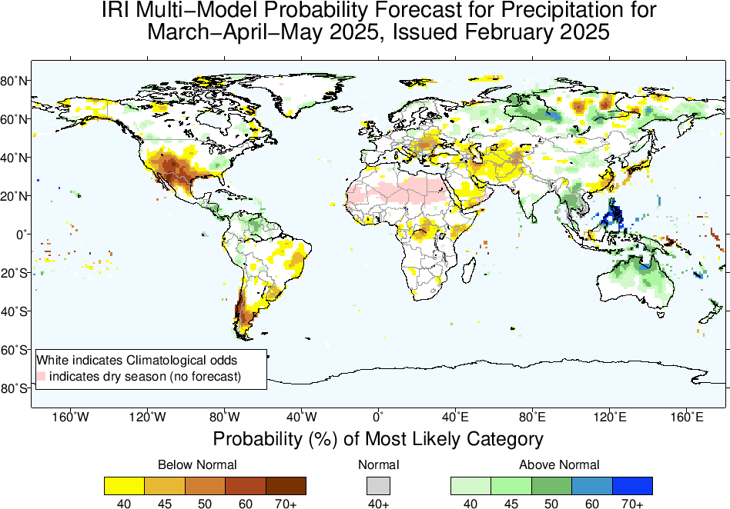
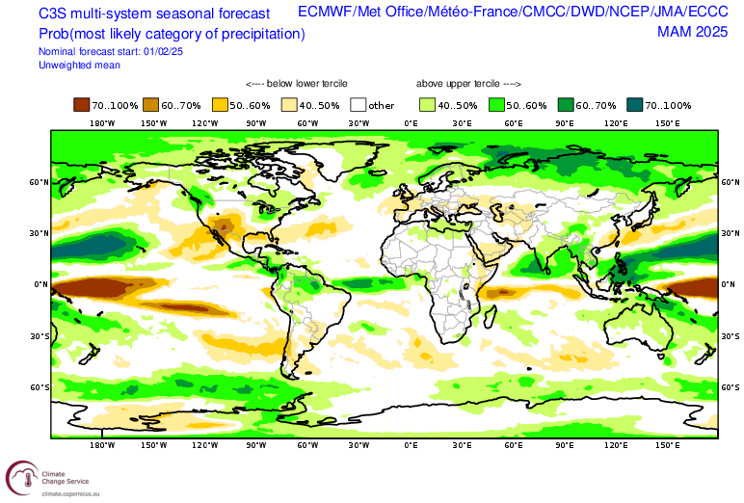
II. Seasonal forecasts
Precipitation
Coherent seasonal signal in models, consistent with a La Niña.
Source: https://climate.copernicus.eu/charts/packages/c3s_seasonal/ / https://iri.columbia.edu/our-expertise/climate/forecasts/seasonal-climate-forecasts/
Notes:
https://charts.ecmwf.int/products/seasonal_system5_standard_rain
https://iri.columbia.edu/our-expertise/climate/forecasts/seasonal-climate-forecasts/
http://cmdp.ncc-cma.net/eng/index.php?FromYear=2024&FromMonth=10&region=Global&Search=Search&channel=11&elem=Prec&cmmeCat=CMME-S2D&timeScale=season#
https://climate.copernicus.eu/charts/packages/c3s_seasonal/
‹#›

Slide 28
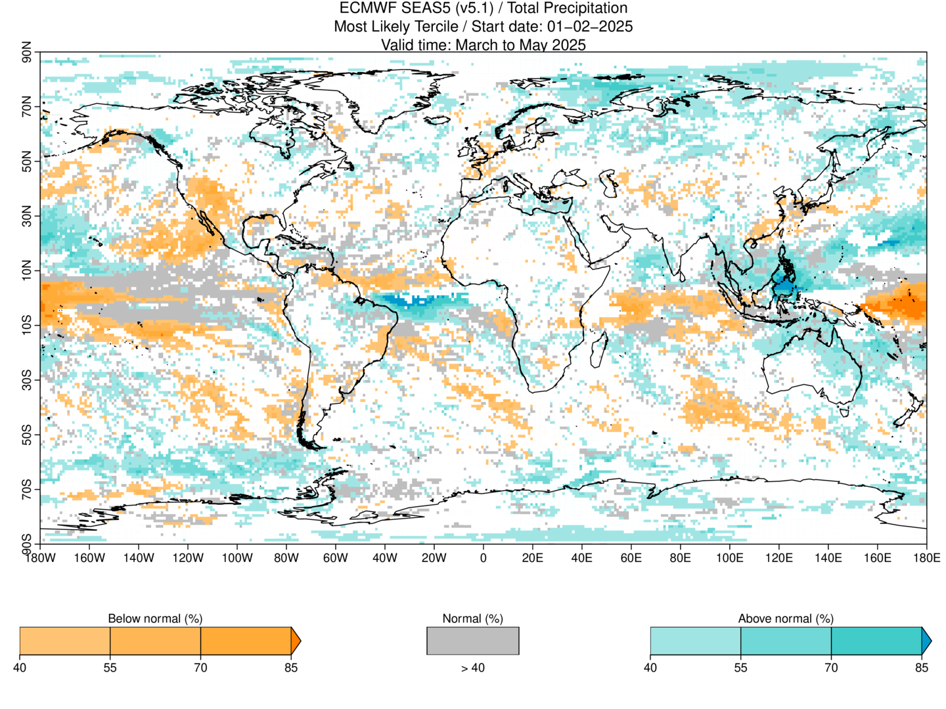
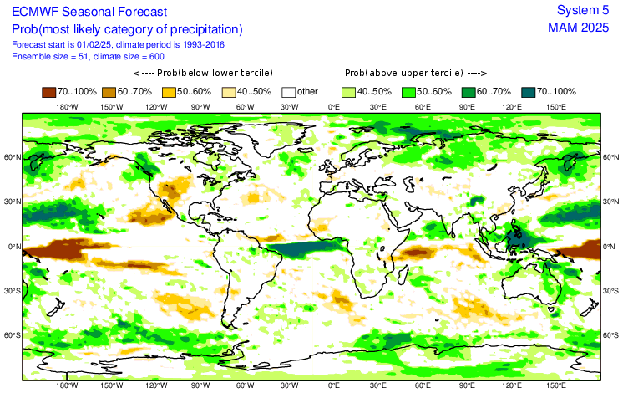
Calibrated
Uncalibrated
Source: SUNSET (CST) / https://charts.ecmwf.int/

Slide 29
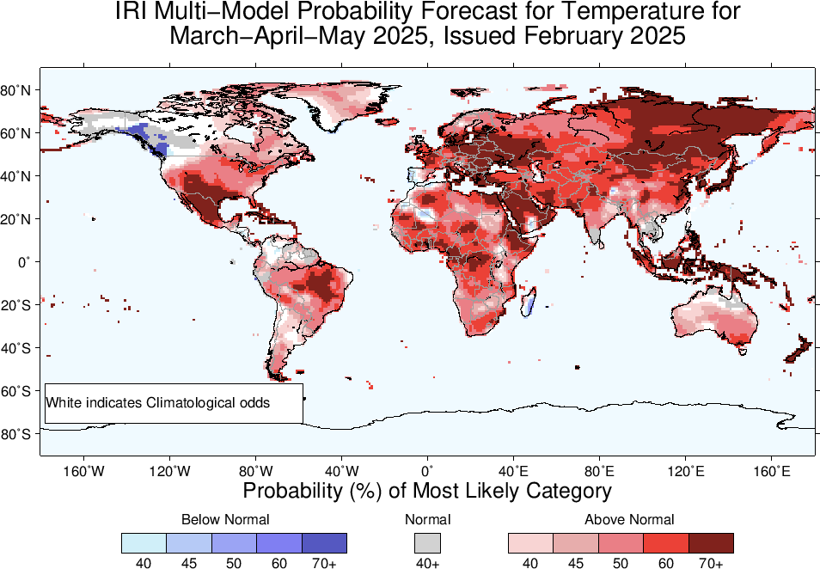
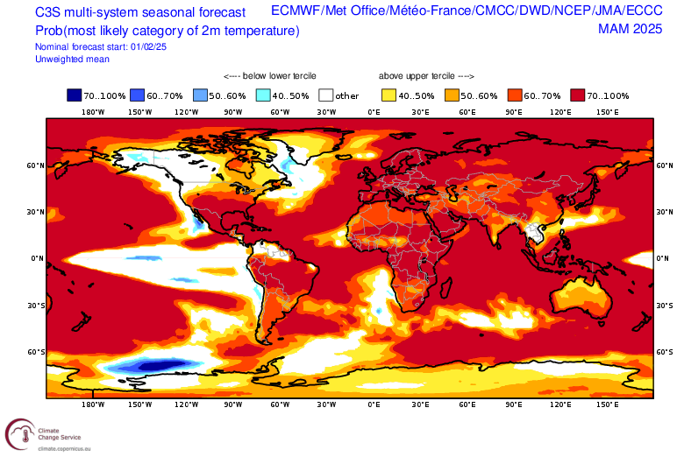
II. Seasonal forecasts
Temperature
Typical global warming signal.
Parts of North Atlantic, Alaska, Baja California with cooler anomalies.
Source: https://climate.copernicus.eu/charts/packages/c3s_seasonal/ / https://iri.columbia.edu/our-expertise/climate/forecasts/seasonal-climate-forecasts/
Notes:
https://charts.ecmwf.int/products/seasonal_system5_standard_rain
https://iri.columbia.edu/our-expertise/climate/forecasts/seasonal-climate-forecasts/
http://cmdp.ncc-cma.net/eng/index.php?FromYear=2024&FromMonth=10&region=Global&Search=Search&channel=11&elem=Prec&cmmeCat=CMME-S2D&timeScale=season#
https://climate.copernicus.eu/charts/packages/c3s_seasonal/
‹#›

Slide 30
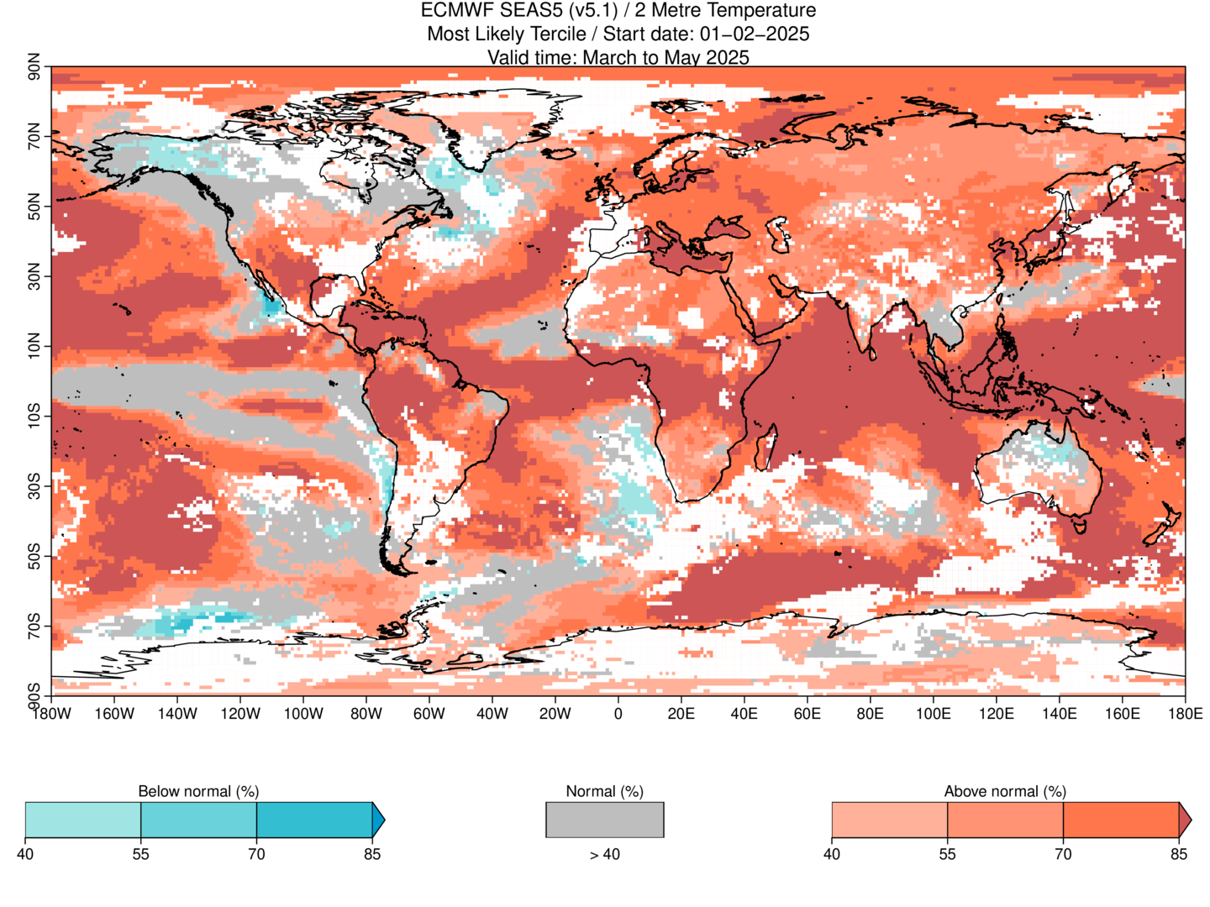
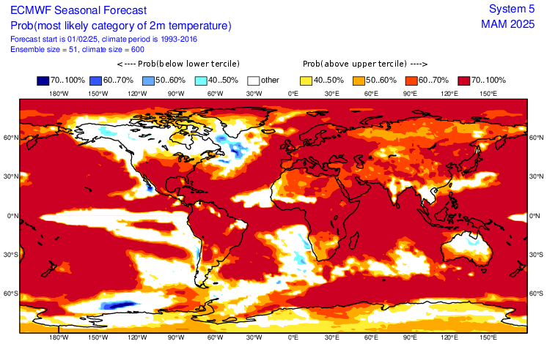
Calibrated
Uncalibrated
Source: SUNSET (CST) / https://charts.ecmwf.int/

Slide 31
Outline
Recent state of the climate
Seasonal forecasts
Intra-seasonal forecasts
Discussion
Notes:
‹#›

Slide 32
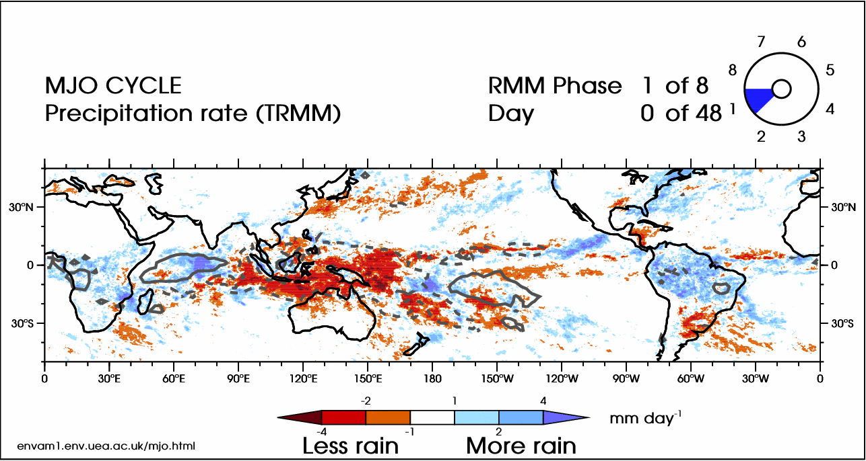
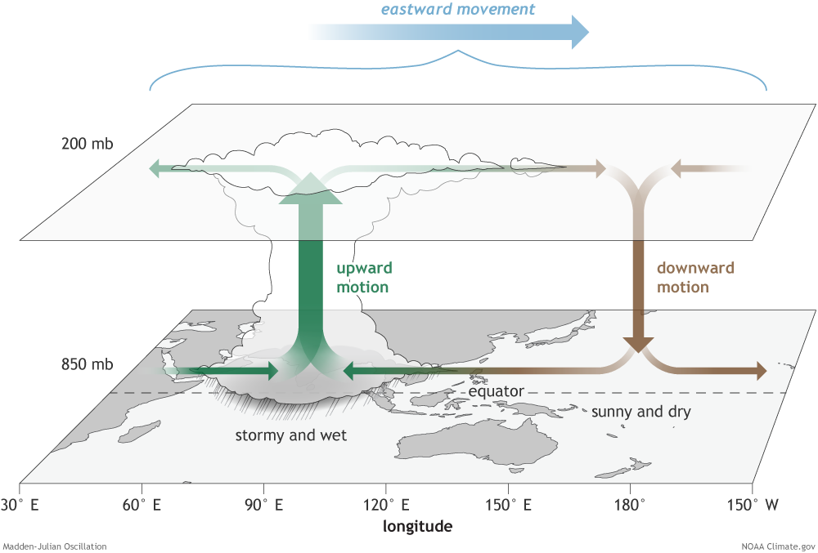
III. Intra-seasonal forecasts
Madden-Julian Oscillation (MJO)
The MJO is the leading mode of tropical intra-seasonal variability with a 20–90 days time scale. It is an important source of regional climate variability and predictability across the globe at intra-seasonal time scales.
Source: https://www.climate.gov/news-features/blogs/enso/what-mjo-and-why-do-we-care
Notes:
OVERsimplified MJO animation
‹#›

Slide 33
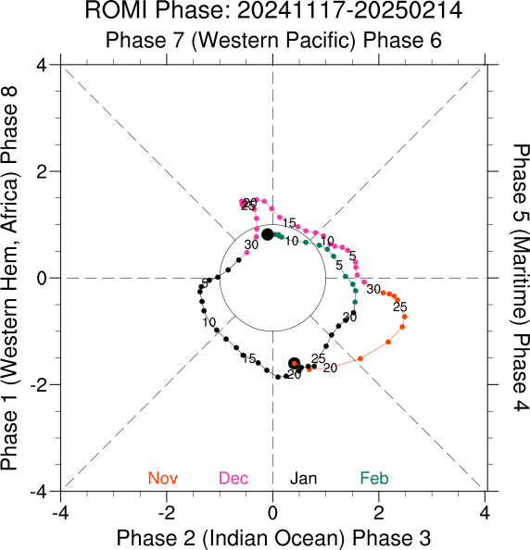
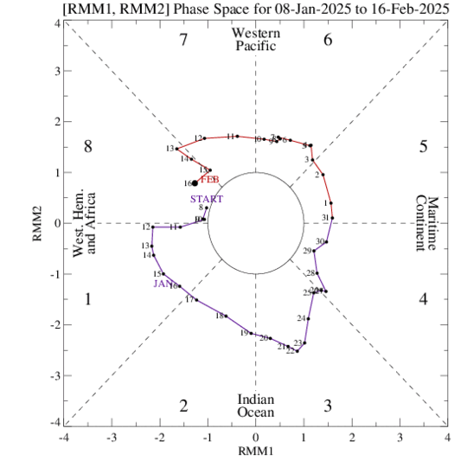
III. Intra-seasonal forecasts
MJO phase status
RMM phase diagram for the latest 40 days
ROMI phase diagram for the latest 90 days
RMM index
RMM = Real-time Multivariate MJO Index
Developed by Matthew Wheeler and Harry Hendon (2004).
A multivariate index that combines:
Outgoing Longwave Radiation (a proxy for convection/cloudiness)
Zonal winds at 850 hPa (low-level winds)
Zonal winds at 200 hPa (upper-level winds)
Projects these variables onto two principal components (RMM1 and RMM2) to define the MJO’s location and intensity in an 8-phase diagram.
ROMI index
ROMI = Real-time OLR MJO Index
Developed as a simpler alternative to RMM.
Based only on OLR data.
Uses empirical orthogonal function (EOF) analysis of OLR to define MJO phases.
Subsidence around the Date Line associated with La Niña (see negative OLR anomalies) mutes the phase 8 of the MJO.
Source: https://www.cpc.ncep.noaa.gov/products/precip/CWlink/MJO/whindex.shtml / https://psl.noaa.gov/mjo/
Notes:
https://psl.noaa.gov/mjo/
‹#›

Slide 34
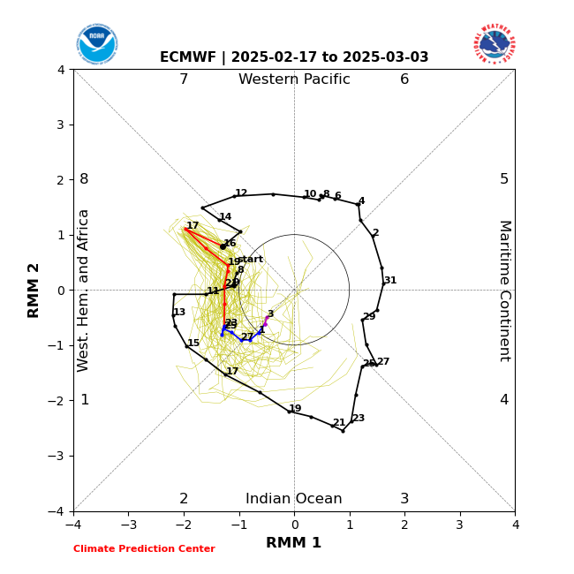
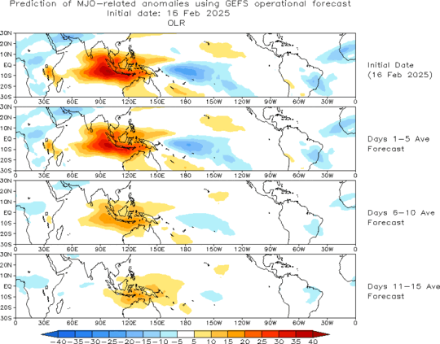
III. Intra-seasonal forecasts
MJO forecasts
OLR anomalies [W/m2] (ensemble mean GEFS)
Evolution of last 40 days of observations + ensemble forecast
Time
Low OLR (enhanced convection) / High OLR (suppressed convection)
Mean forecasts: 1-7 day, 8-14 day, >= 15 days
Despite unfavourable conditions (strong subsidence and easterlies), the forecasts predicts that the MJO will move briefly to phase 8 on the 17th of February and then quickly transition to phase 1 but with reduced activity.
Source: https://www.cpc.ncep.noaa.gov/products/precip/CWlink/MJO/foregfs.shtml /
https://www.cpc.ncep.noaa.gov/products/precip/CWlink/MJO/CLIVAR/ecmf.shtml
Notes:
https://www.cpc.ncep.noaa.gov/products/precip/CWlink/MJO/forca.shtml
https://www.cpc.ncep.noaa.gov/products/precip/CWlink/MJO/CLIVAR/clivar_wh.shtml
http://www.bom.gov.au/climate/enso/#tabs=Tropics
‹#›

Slide 35
III. Intra-seasonal forecasts
MJO forecasts
Just for the discussion:
It is interesting that during the last few weeks, the MJO has avoided the central Pacific (phase 8). Expected, perhaps, from an ENSO perspective: La Niña development has suppressed the convection in the central Pacific, where the descending branch of the Walker Circulation is.
Despite this, the MJO forecast insists on a brief passage through phase 8 in the coming days. This could lead to a couple of things (speculation alert!):
Westerlies associated with the MJO might weaken easterlies associated with La Niña (westerly wind bursts over the warm pool), meaning the end of this weak La Niña.
The MJO weakens and avoids the phase 8 region once again.
If both forecasts are right (ENSO's and MJO's), the first scenario could be possible, and then the MJO in phase 8 could partially explain the weakening of La Niña in the coming months.
Source: https://www.cpc.ncep.noaa.gov/products/precip/CWlink/MJO/foregfs.shtml /
https://www.cpc.ncep.noaa.gov/products/precip/CWlink/MJO/CLIVAR/ecmf.shtml
Notes:
https://www.cpc.ncep.noaa.gov/products/precip/CWlink/MJO/forca.shtml
https://www.cpc.ncep.noaa.gov/products/precip/CWlink/MJO/CLIVAR/clivar_wh.shtml
http://www.bom.gov.au/climate/enso/#tabs=Tropics
‹#›

Slide 36
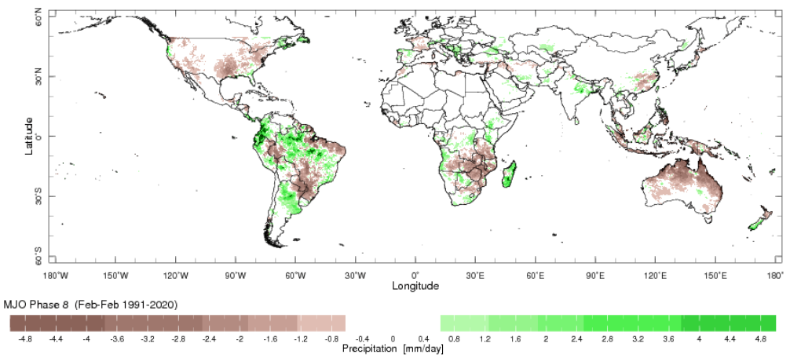
Precipitation composite during MJO Phase 8
Composite = average pattern
Source: IRI link
Notes:
‹#›

Slide 37
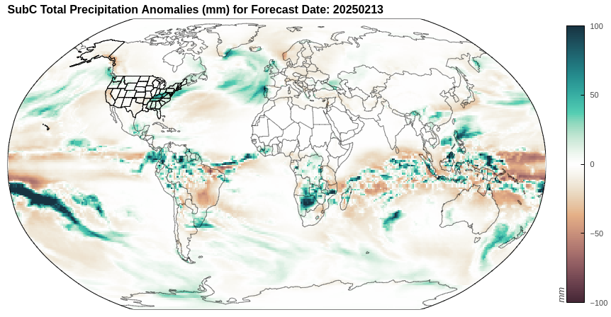
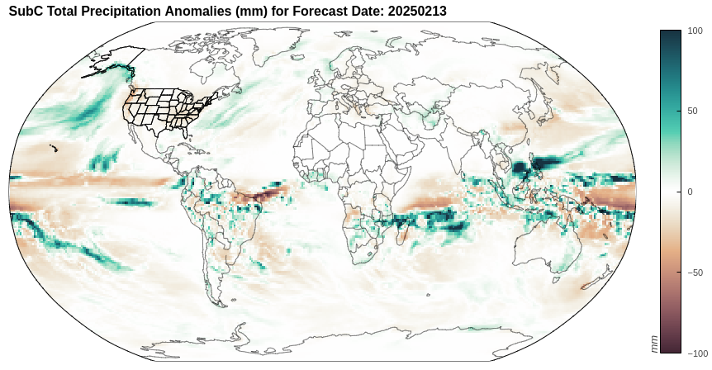
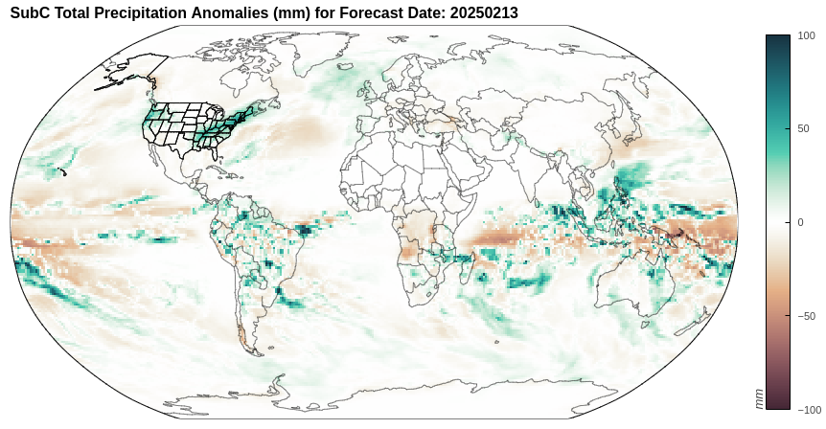
III. Intra-seasonal forecasts
Precipitation
Week 1
Week 2
Model used:
ESRL FIMr1p1 from Models SubC: Subseasonal Consortium (SubC).
Provided by IRI
Link for more info.
Week 3
Week 4
Source: http://weather.ou.edu/~kpegion/subc/forecasts/images/Latest/Interactive.html

Slide 38
III. Intra-seasonal forecasts
Temperature
Week 1
Week 2
Model used:
ESRL FIMr1p1 from Models SubC: Subseasonal Consortium (SubC).
Provided by IRI.
Link for more info.
Week 3
Week 4
Source: http://weather.ou.edu/~kpegion/subc/forecasts/images/Latest/Interactive.html

Slide 39
Outline
Recent state of the climate
Seasonal forecasts
Intra-seasonal forecasts
Discussion
Notes:
‹#›

Slide 40
Summary
Persistent observed dry anomalies in most of the Americas, the Guinean coast, Congo, central Asia, parts of Australia, most of Europe, Southeast Asia, eastern China, Madagascar, eastern Siberia, parts of India and Australia.
La Niña conditions present in the Central Pacific (CP) , with striking warm anomalies off the coast of Peru (where upwelling of cold deep water typically occurs). Neutral conditions are expected to set in again by March 2025.
Notes:
‹#›

Slide 41
Summary
Coherent seasonal signal forecast for rainfall in models, more or less consistent with a La Niña.
Typical global warming signal in seasonal temperature forecasts. Parts of Alaska, Baja California, the North Atlantic and Central and Eastern Pacific exhibit cooler anomalies.
La Niña conditions might prevent the MJO from entering phase 8, although forecasts say the opposite = possible end of La Niña?
Notes:
‹#›

Slide 42
Forecast Briefing
February 2025
Aleksander Lacima-Nadolnik, Paloma Trascasa-Castro, Xavi Domingo, Diego Campos, Matías Olmo
Climate Services Team (CST)
Earth System Services (ESS)
Barcelona Supercomputing Center (BSC)
Tuesday, 18th Feb 2025

Slide 43
UPDATE ON TUESDAY 18
Since mid-September 2024, positive OLR anomalies (suppressed convection/ rainfall) have persisted near the Date Line.
Since early December 2024, negative OLR anomalies (enhanced convection/ rainfall) have emerged over Indonesia.
Drier-than-average conditions (orange/red shading)
Wetter-than-average conditions (blue shading)
Source: https://www.cpc.ncep.noaa.gov/products/analysis_monitoring/lanina/enso_evolution-status-fcsts-web.pdf
Notes:
https://www.cpc.ncep.noaa.gov/products/precip/CWlink/MJO/enso.shtml#current
http://www.bom.gov.au/climate/enso/indices.shtml
http://www.bom.gov.au/climate/enso/#tabs=Pacific-Ocean&pacific=SOI
‹#›

Slide 44
Notes:
https://www.cpc.ncep.noaa.gov/products/precip/CWlink/MJO/enso.shtml#current
‹#›

Slide 45
Simulation by Dave DeWitt (IRI, now at CPC), using a simplified model, with a wind stress forcing at the Equator and Dateline.
Notes:
https://www.cpc.ncep.noaa.gov/products/precip/CWlink/MJO/enso.shtml#current
‹#›

Slide 46
Canonical El Niño impacts across the globe.
Notes:
ENSO diags https://www.cpc.ncep.noaa.gov/products/precip/CWlink/MJO/enso.shtml#current
ENSO Blog https://www.climate.gov/news-features/blogs/enso?page=1
https://www.pmel.noaa.gov/gtmba/assorted-plots
https://www.pmel.noaa.gov/tao/drupal/disdel/
‹#›

Slide 47
WASP index
Source: https://iridl.ldeo.columbia.edu/maproom/Global/Precipitation/WASP_Indices.html
Notes:
https://iridl.ldeo.columbia.edu/maproom/Global/Precipitation/Persistence.html
‹#›

