Slide 1
An Overview of European Union-Funded Project APPLICATE
Pablo Ortega, on behalf of APPLICATE partners
This project has received funding from the European Union’s Horizon 2020 research and innovation programme under grant agreement No 727862.

Slide 2
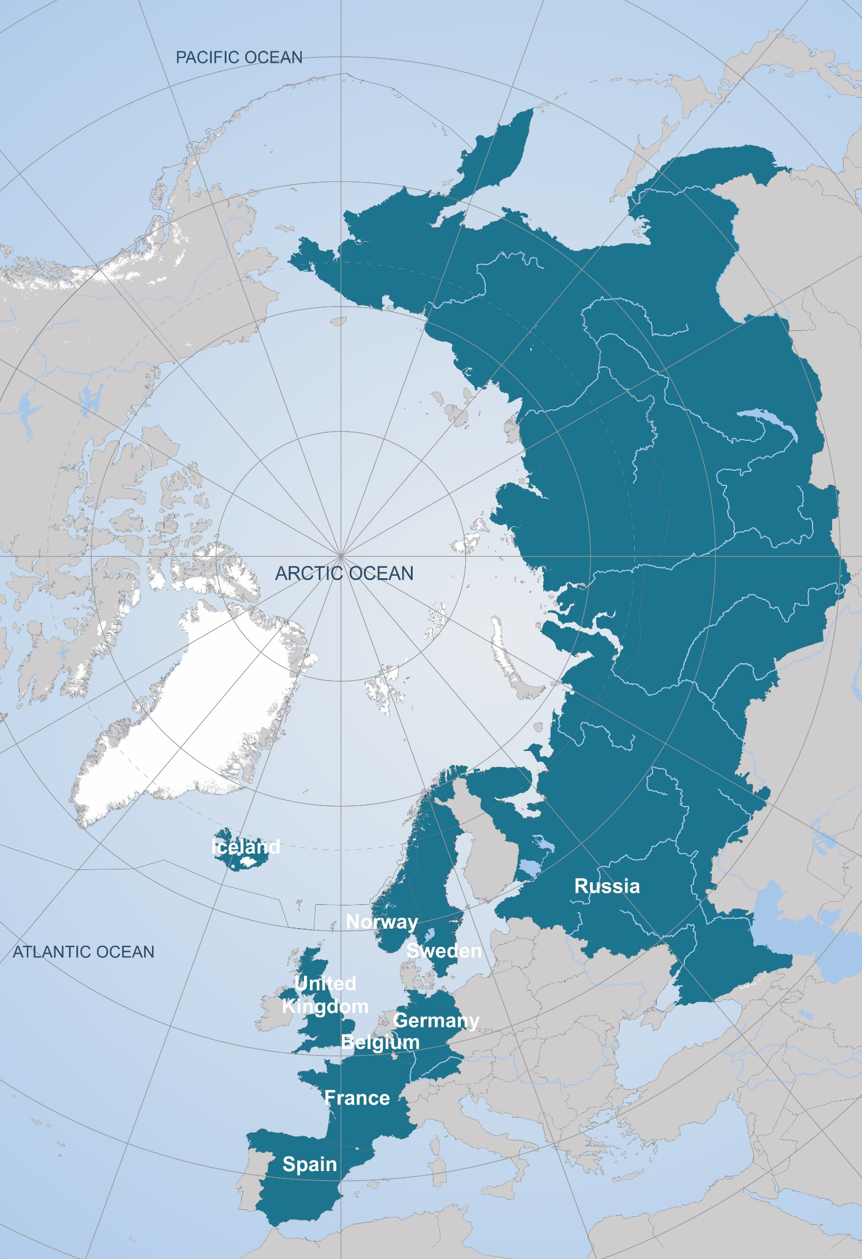
The Consortium
16 partners and 1 third-party from 9 countries
… and many collaborators!

Slide 3
Budget and duration
€ 8 Mio + separate Russian contribution
1st November 2016–31st October 2020 (4-years)
6 month no-cost extension requested

Slide 4
Mission statement
Develop enhanced predictive capacity for weather and climate in the Arctic and beyond, and determine the influence of Arctic climate change on Northern Hemisphere mid-latitudes, for the benefit of policy makers, businesses and society.

Slide 5
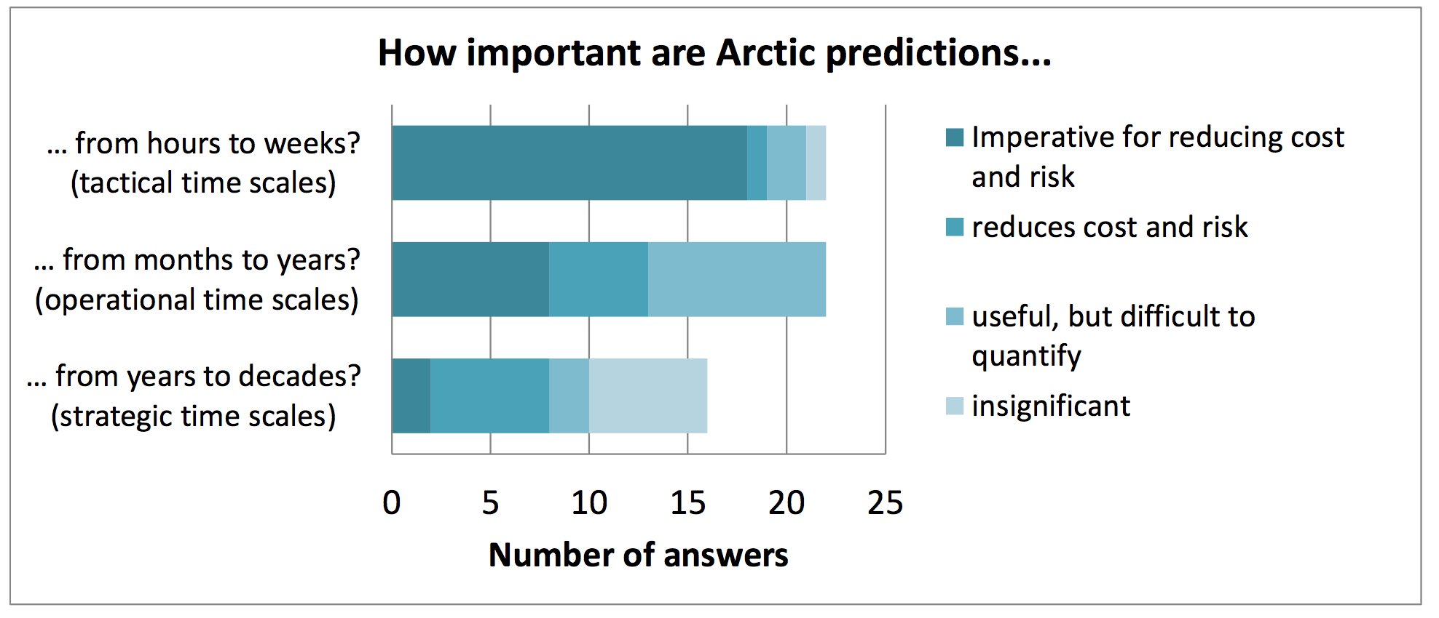
General approach
Bringing together the NWP and climate communities
How important are Arctic predictions for marine stakeholders
Survey: EC-PHORS Services Task Team

Slide 6
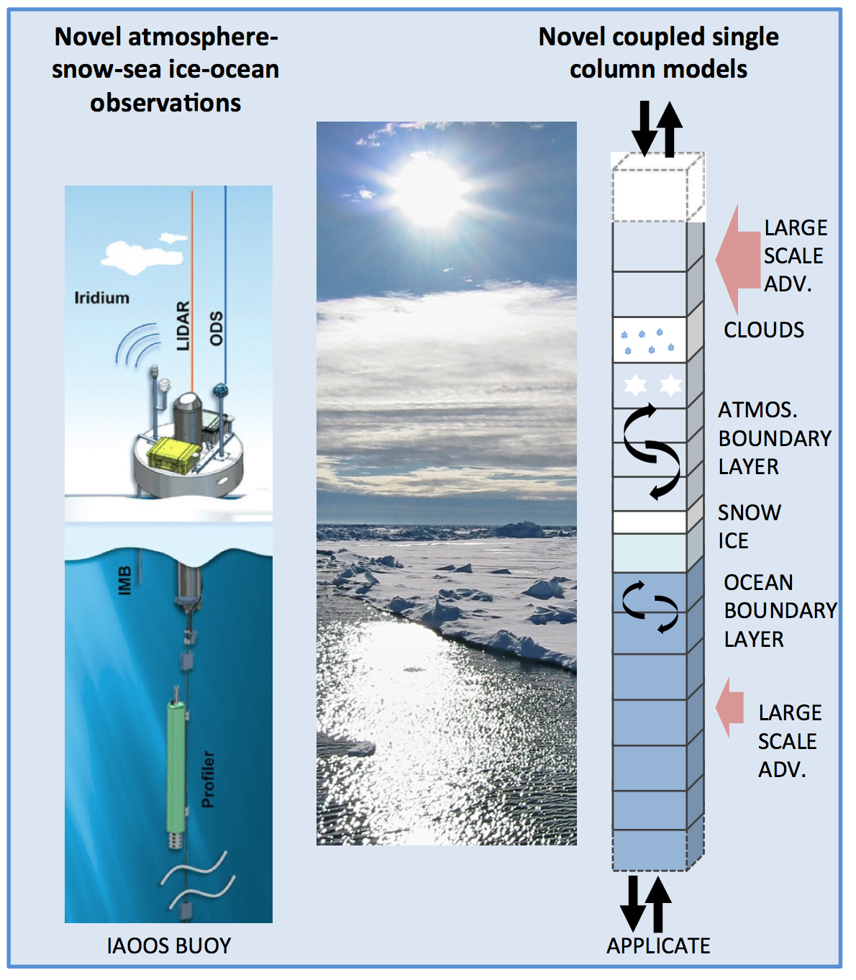
General approach
Involving experts on the Arctic and midlatitudes
Engaging operational centres for maximizing impact
Effectively combining models and observations

Slide 7
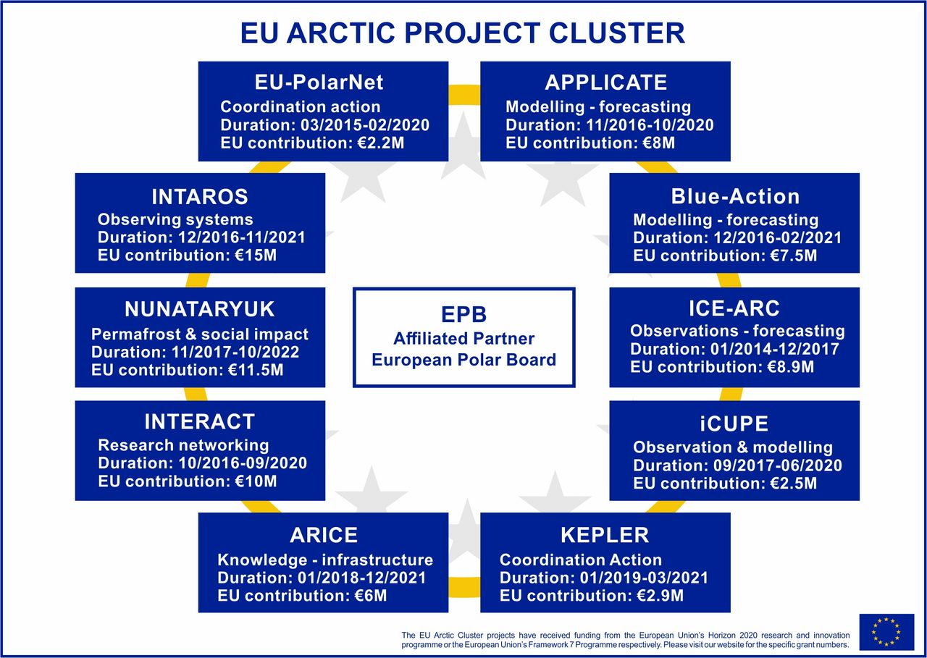
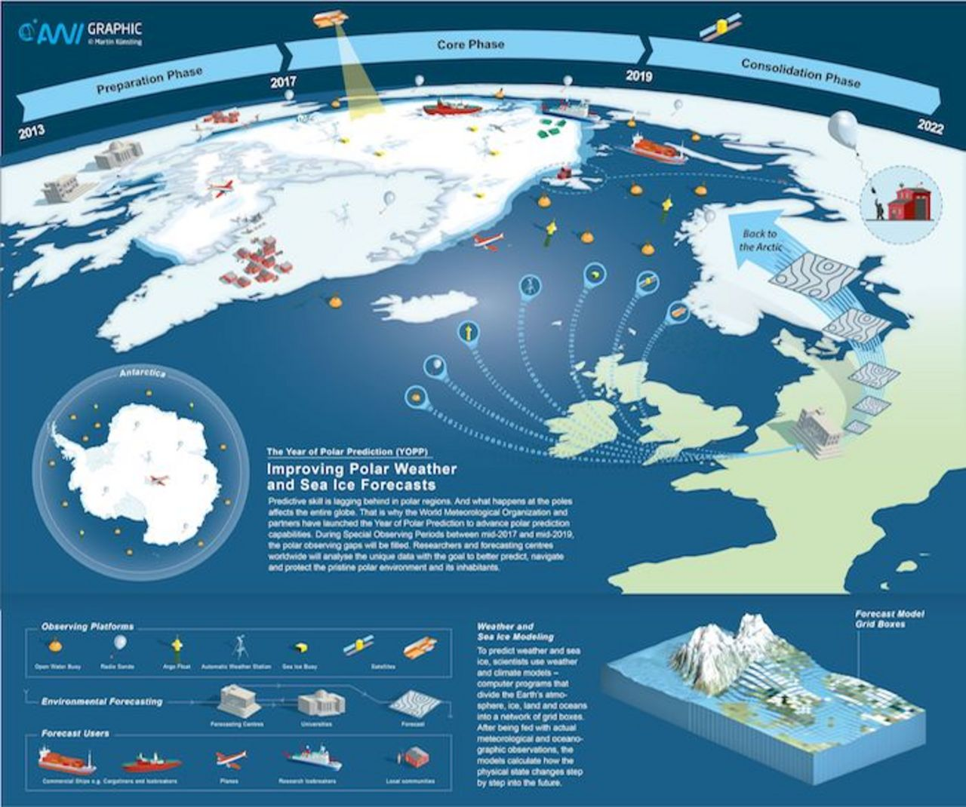
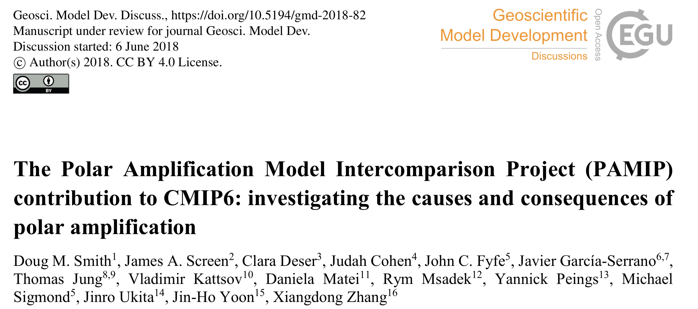
General approach
Exploiting European and international collaboration (e.g. Arctic Cluster, YOPP and PAMIP)

Slide 8
Strategy
Delivering enhanced predictions
Establish
Baseline
Develop Enhancements
Test Enhancements
Recommen-dations
Enhanced Predictions
New metrics and diagnostics
NWP
Subseasonal to seasonal prediction
CMIP5/6
Enhanced models
Optimized Arctic observing systems
Improved initial and boundary conditions
Enhanced NWP
Enhanced Subseasonal to Seasonal Prediction
Enhanced CMIP6
Presentations
Reports
Publications
Contribution to assessment reports
CMIP6-Interim and CMIP7
Enhanced operational:
NWP
Subseasonal to Seasonal Prediction
Interannual to Decadal Prediction

Slide 9
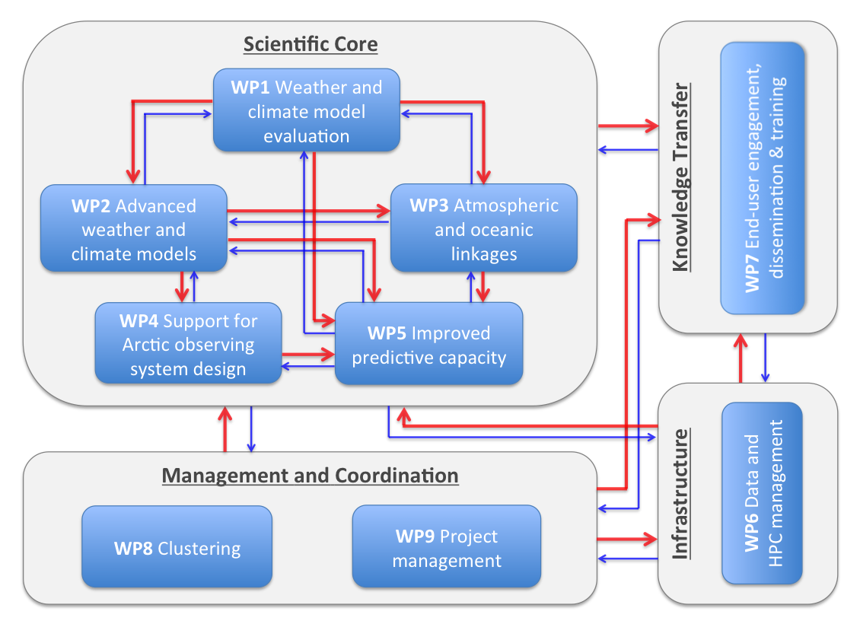
Project structure

Slide 10
WP5: Main goals
Advance our understanding of predictability mechanisms operating at 3 different timescales:
NWP – Seasonal Prediction – Climate Projections
CRNS (CNRM)
CRNS (CNRM)
AWI
Met Norway
Met Office
BSC
ECMWF
BSC
UCLouvain
deterministic/ensemble
global/limited area models
focus on YOPP period
10 members
1993-2014 period
May/November ICs
HiResMIP:
1950 fixed forcing control
1950-2050 transient

Slide 11
WP5: Main goals
Advance our understanding of predictability mechanisms operating at 3 different timescales:
NWP – Seasonal Prediction – Climate Projections
Investigate whether and how linkages between the Arctic and mid-latitudes contribute to prediction skill
Assess the added-value of APPLICATE developments on prediction skill in the Arctic and beyond

Slide 12
WP5: Main goals
Advance our understanding of predictability mechanisms operating at 3 different timescales:
NWP – Seasonal Prediction – Climate Projections
Enhance the exploitation of Arctic Observations, and advance our understanding of linkages between the Arctic and mid-latitudes
Assess the added-value of APPLICATE developments on prediction skill in the Arctic and beyond
APPLICATE
TIMELINE
STREAM 1
Baseline skill of APPLICATE prediction systems
STREAM 2
Skill after including APPLICATE developments
Improved Initialization (WP4, WP5)
Improved Models/Components (WP2,WP5)
Better ensemble generation (WP5)
New diagnostics (WP1)

Slide 13
WP5: Main tasks
✔
Task 5.1: Production of Stream 1 experiments
Task 5.2: State-of-the-art of weather/climate prediction and projections
(sources of predictability, links with mid-latitudes, forecasts of extremes,...)
Task 5.3: Added-value of improved process representation on predictive skill
(enhanced sea ice models, increased resolution, improved ensemble generation)
Task 5.4: Production and evaluation of Stream 2 Experiments
Task 5.5: Recommendations for future forecasting system development
✔
✔

Slide 14
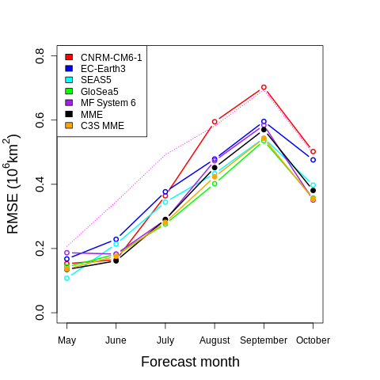
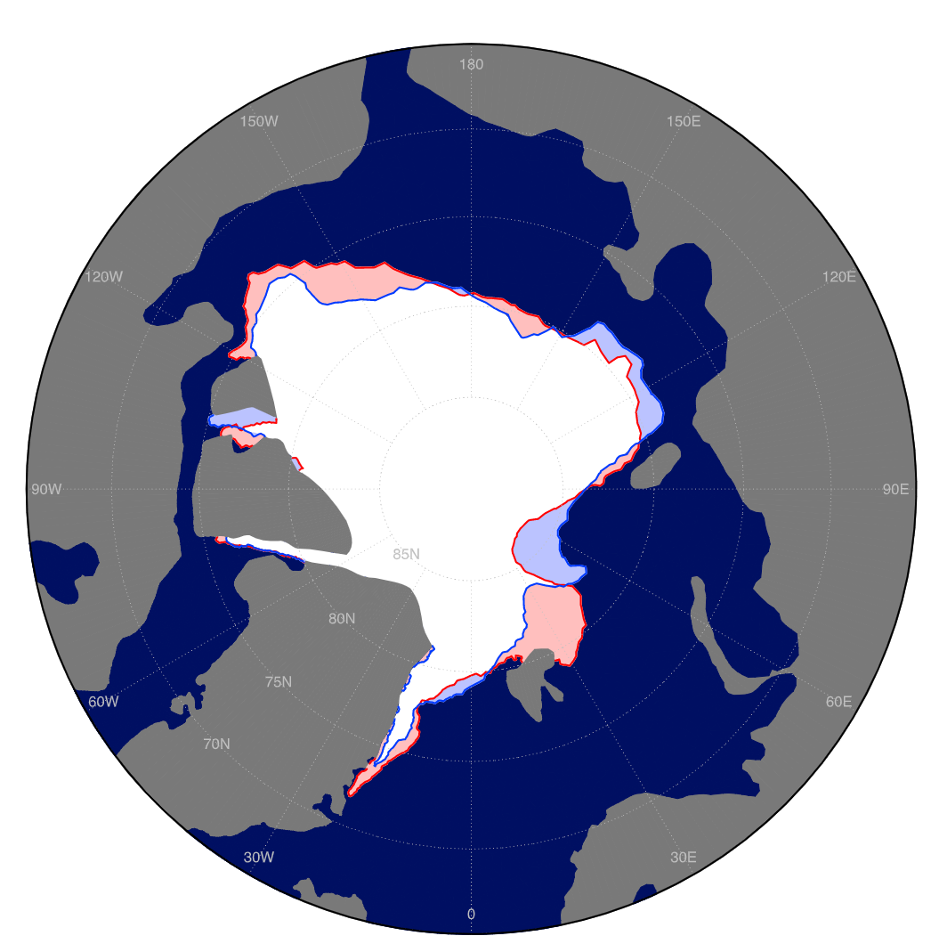
WP5: Stream 1 baseline skill
Lauriane Batté
STREAM 1 + C3S systems
RMSE of total Arctic SIE
Integrated Ice Edge Error
Ref: NSIDC
Goessling et al. 2016
1st May Initialized Forecasts (1993-2014)

Slide 15
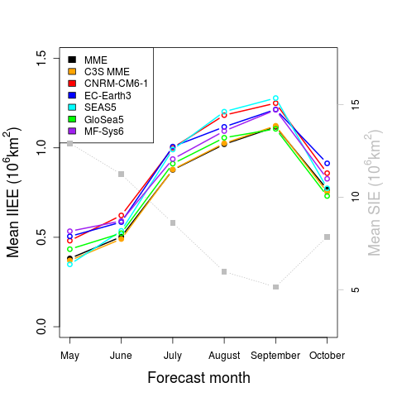
WP5: Stream 1 baseline skill
Lauriane Batté
STREAM 1 + C3S systems
RMSE of total Arctic SIE
Pan-Arctic IIEE
Inter-model differences are smaller in IIEE
Multi-models are better than individual models
Ref: NSIDC
1st May Initialized Forecasts (1993-2014)

Slide 16
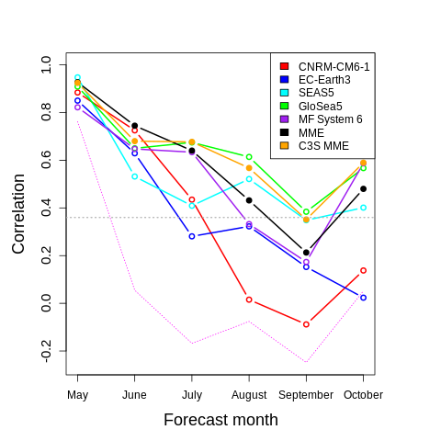
WP5: Stream 1 baseline skill
Lauriane Batté
STREAM 1 + C3S systems
RMSE of total Arctic SIE
ACC of total Arctic SIE
Most models exhibit skill up to 3-4 months lead
Forecasting September SIE minimum is still challenging
Ref: NSIDC
April SIE
Persistence
1st May Initialized Forecasts (1993-2014)

Slide 17
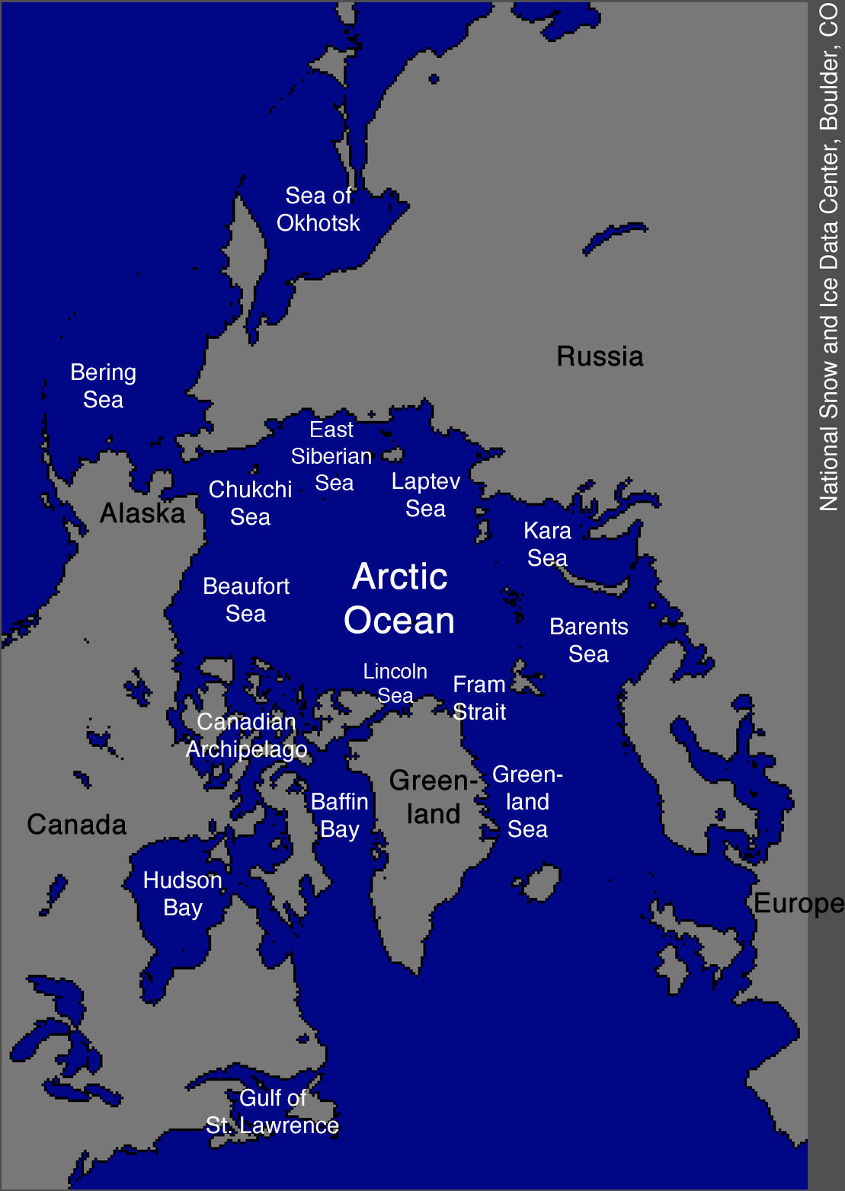
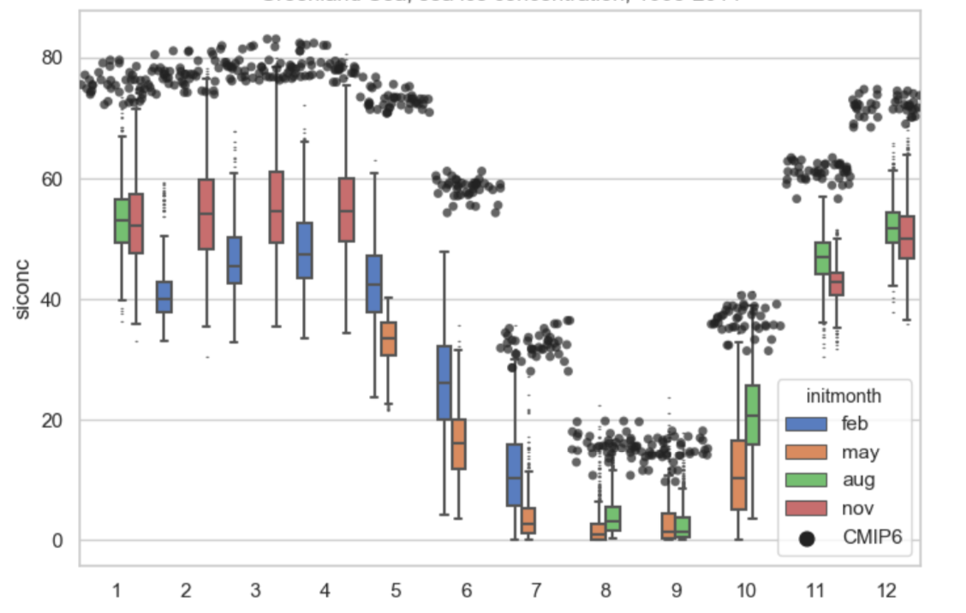
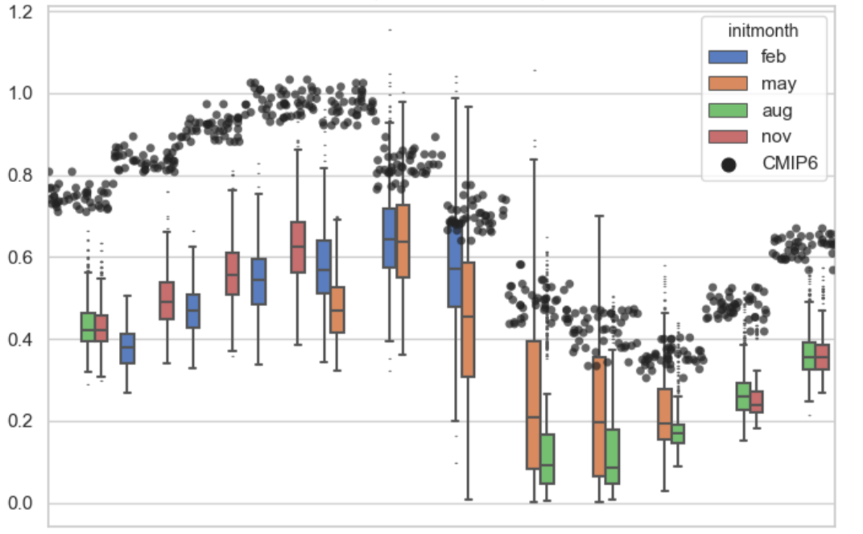
WP5: Role of Initialization
Greenland Sea
Ilona Valisuo
Sea Ice Concentrations
Sea Ice Thickness
1.2
80%
CMIP6-Historical
1.0
60%
0.8
40%
0.6
0.4
20%
0.2
0%
0.0
Jan
Feb
Mar
Apr
May
Jun
Jul
Aug
Sep
Oct
Nov
Dec
Jan
Feb
Mar
Apr
May
Jun
Jul
Aug
Sep
Oct
Nov
Dec
CMIP6-Historical has too much and too thick ice in Greenland Sea
Forecasts show huge spread in thickness during the melt season
Systematic error not fully developed by the end of the forecasts
CNRM-CM6-1 Seasonal Forecasts (1993-2014)

Slide 18
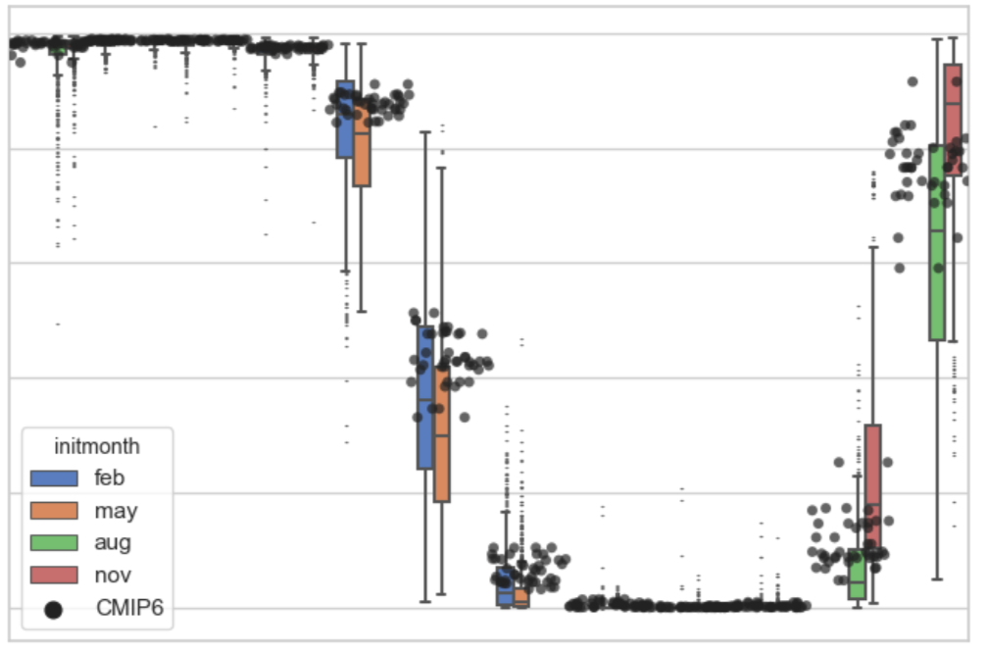
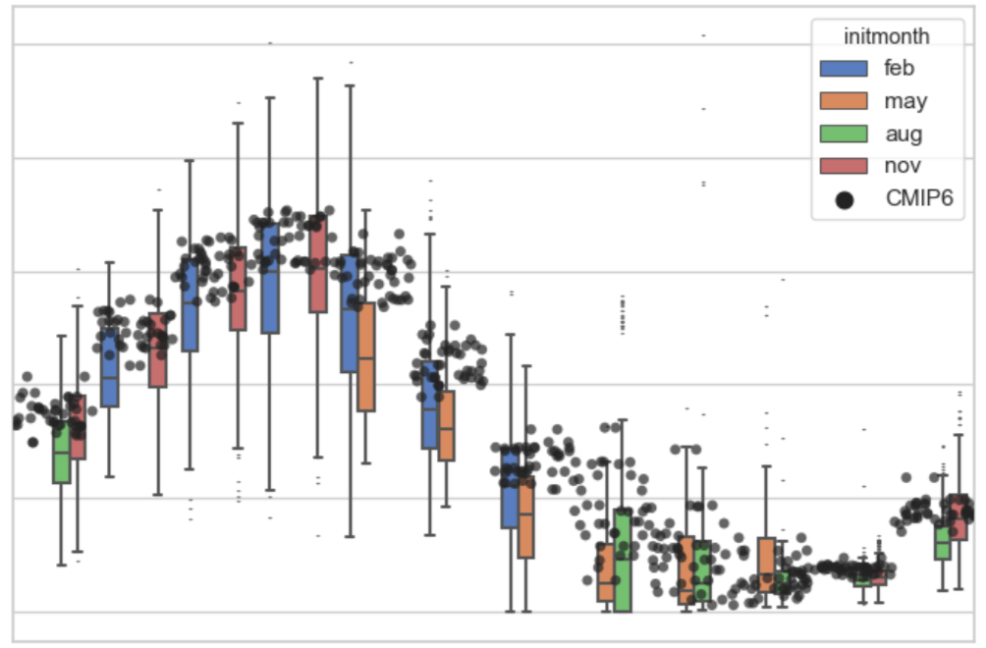
WP5: Role of Initialization
Chukchi Sea
Ilona Valisuo
Sea Ice Concentrations
Sea Ice Thickness
100%
CMIP6-Historical
2.5
80%
2.0
60%
1.5
40%
1.0
20%
0.5
0%
0.0
Jan
Feb
Mar
Apr
May
Jun
Jul
Aug
Sep
Oct
Nov
Dec
Jan
Feb
Mar
Apr
May
Jun
Jul
Aug
Sep
Oct
Nov
Dec
Better agreement between initialized/non initialized forecasts
CNRM-CM6-1 Seasonal Forecasts (1993-2014)

Slide 19
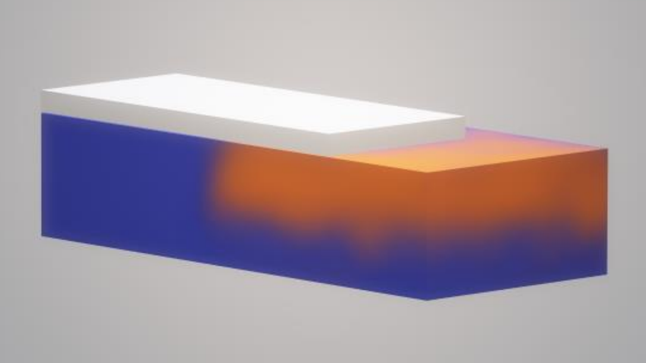
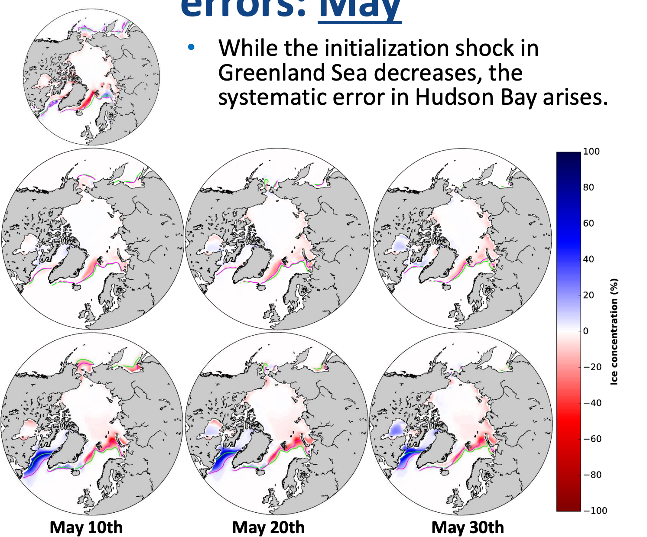
WP5: Development of forecast errors
Ruben Cruz-García
Inconsistency of ICs
Evolution of errors with forecast day
Initial
Inconsistency
Initialization Strategy
Sea Ice: NEMO-LIM3 forced w. ERA-Interim
ENKF assimilation of SICs from ESA
Ocean: ORAS4
Atmos: ERA-Interim
Initialized
Forecast
Non-initialized
forecasts
EC-Earth3.2 Seasonal Forecasts (1993-2008)

Slide 20
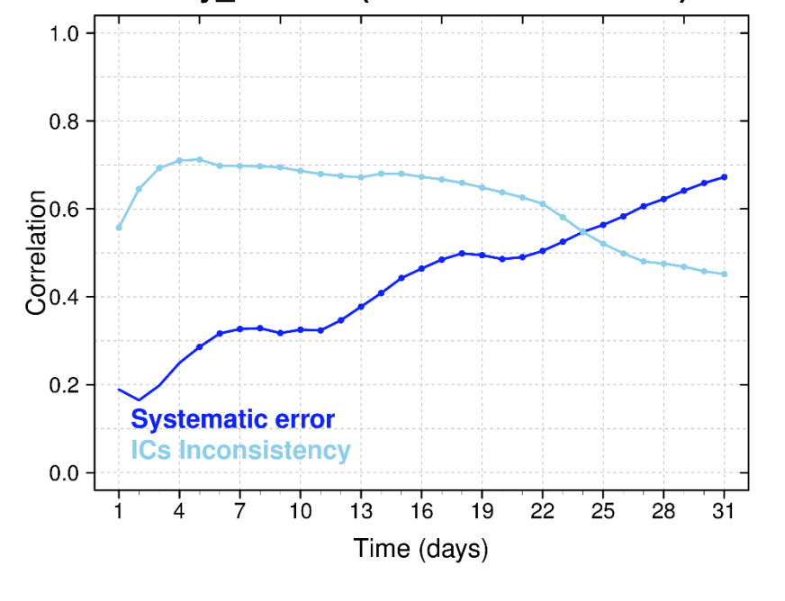
WP5: Development of forecast errors
Ruben Cruz-García
Evolution of errors with forecast day
IC inconsistency vs systematic error
Initial
Inconsistency
1.0
0.8
0.6
Initialized
Forecast
Spatial correlation
0.4
0.2
0.0
1
4
7
10
13
16
19
22
25
28
31
Non-initialized
forecasts
EC-Earth3.2 Seasonal Forecasts (1993-2008)

Slide 21
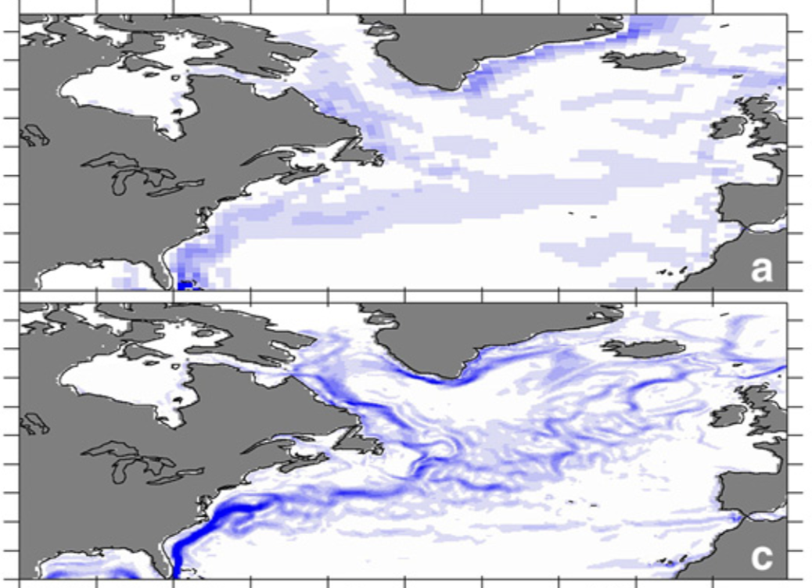
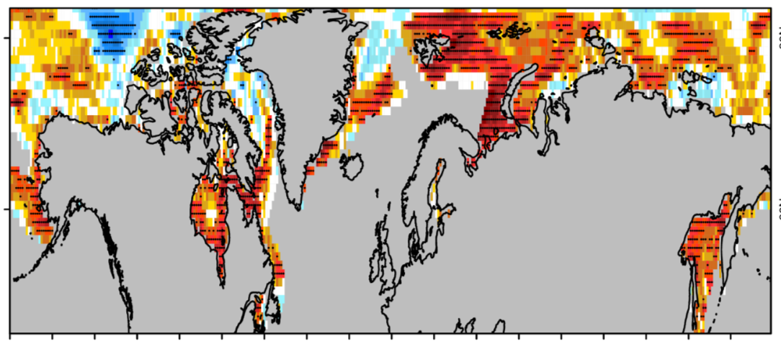
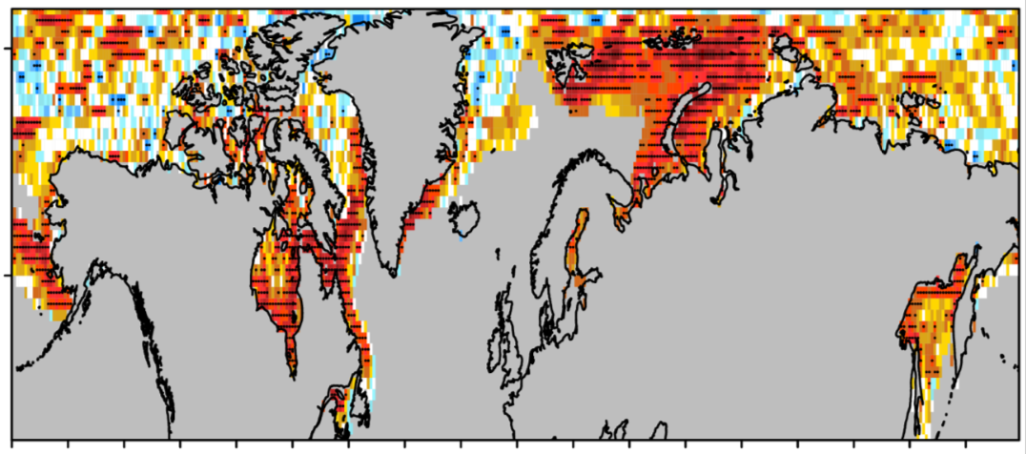
WP5: Impact of model resolution
ACC in Sea Ice Concentration in DJF (ORCA1)
Juan C. Acosta-Navarro
NEMO/LIM3 (ORCA1)
Ref: NSDIC
Ocean ICs: forced run nudged to ORAS4
ACC in Sea Ice Concentration in DJF (ORCA025)
NEMO/LIM3 (ORCA025)
Ref: NSDIC
Ocean ICs: forced run nudged to ORAS5
EC-Earth3.3 November Forecasts (1993-2014)

Slide 22
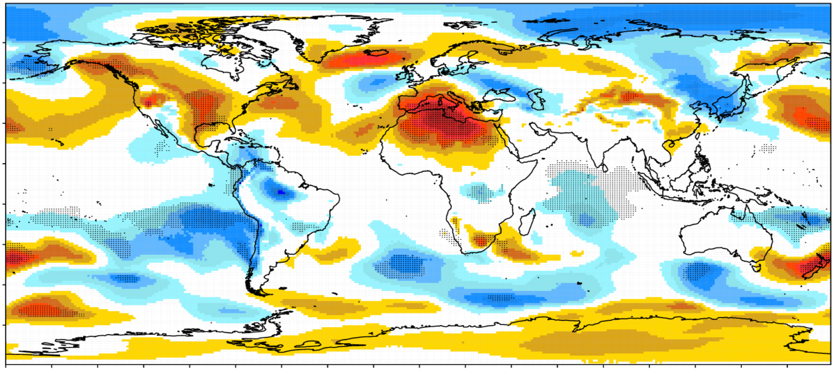
WP5: Impact of model resolution
Juan C. Acosta-Navarro
NEMO/LIM3 (ORCA1)
ACC difference in DJF SLP (ORCA025 – ORCA1)
Ocean ICs: forced run nudged to ORAS4
NEMO/LIM3 (ORCA025)
Ocean ICs: forced run nudged to ORAS5
Ref: ERA-Interim
EC-Earth3.3 November Forecasts (1993-2014)

Slide 23
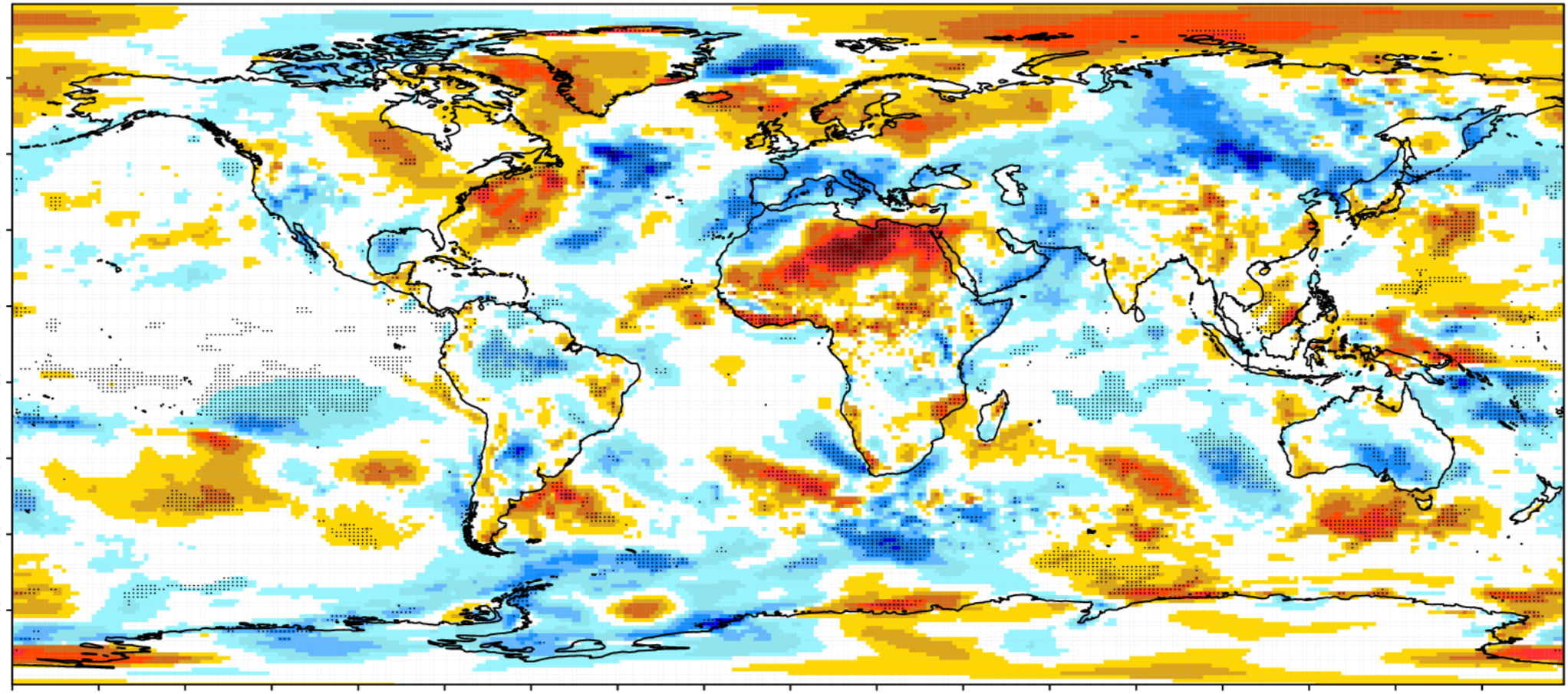
WP5: Impact of model resolution
Juan C. Acosta
NEMO/LIM3 (ORCA1)
ACC difference in DJF TAS (ORCA025 – ORCA1)
Ocean ICs: forced run nudged to ORAS4
NEMO/LIM3 (ORCA025)
Ocean ICs: forced run nudged to ORAS5
Ref: ERA-Interim
EC-Earth3.3 November Forecasts (1993-2014)

Slide 24
WP5: Impact of model resolution
Juan C. Acosta
NEMO/LIM3 (ORCA1)
Systematic Analysis with three GCMs
Ocean ICs: forced run nudged to ORAS4
NEMO/LIM3 (ORCA025)
CNRM-CM6
CanCM
EC-Earth3
Ocean ICs: forced run nudged to ORAS5
EC-Earth3.3 November Forecasts (1993-2014)

Slide 25
WP5: Statistical climate predictions
Leandro Ponsoni
7 different predictors
SIV: Sea Ice Volume SIA: Sea Ice Area
OHT: Ocean Heat Transport SIT: Sea Ice Thickness
SIC: Sea Ice Concentration SST: Sea Surface Temperature
SID: Sea Ice Drift
Outputs from 6 models
Statistical predictability of September SIV Anomaly for 1 to 12 preceding months
HadGEM3-LL
HadGEM3-MM
ECMWF-LR
ECMWF-HR
AWI-LR
AWI-HR
Statistical Predictions: Perfect model (1950-2014)

Slide 26
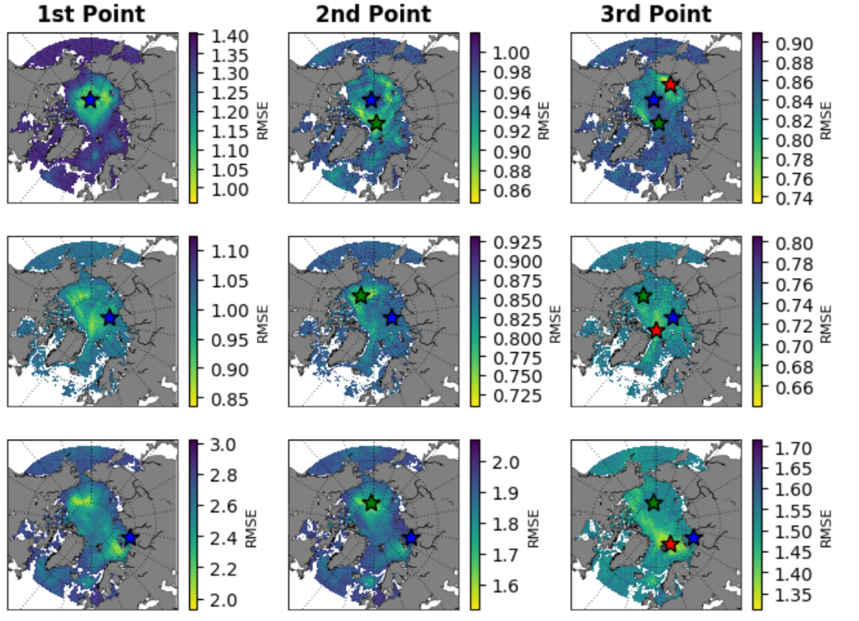
WP5: Optimal sampling locations
Leandro Ponsoni
RMSE of Sea Ice Volume
4 predictors (easily observable)
Sea Ice Drift (in-situ)
Sea Ice Thickness (in-situ)
Sea Ice Concentration (satellite)
Sea Surface Temperature (in-situ)
HadGEM3-LL
HadGEM3-MM
Optimal locations:
Placed at the grid points where predictors minimise RMSE in SIV
ECMWF-LR
Statistical Predictions: Perfect model (1950-2014)

Slide 27
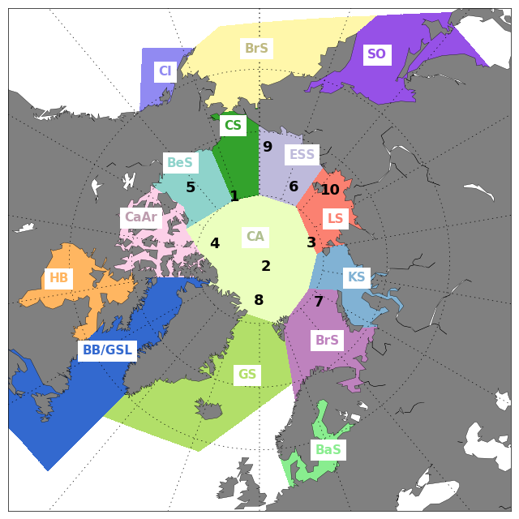
WP5: Optimal sampling locations
Leandro Ponsoni
4 predictors (easily observable)
Sea Ice Drift (in-situ)
Sea Ice Thickness (in-situ)
Sea Ice Concentration (satellite)
Sea Surface Temperature (in-situ
RMSE of Total SIV
R² of Total SIV
5 to 6 locations can guarantee a relatively low RMSE and high R
ECMWF-LR has a strong RMSE bias, which creates too thick sea ice
Statistical Predictions: Perfect model (1950-2014)

Slide 28
APPLICATE in a nutshell
Advances predictive capacity in polar regions and beyond:
Develops models with enhanced representation of Arctic processes
Contributes to improving the Arctic observing system
Enhances our understanding of Arctic-midlatitude linkages (also from a prediction perspective)
Brings different communities closer together

Slide 29
Highlights of APPLICATE WP5
Experimental framework to foster the predictive skill over the Arctic
APPLICATE Stream 1 seasonal forecasts show skill to predict summer SIE up to 3-4 months beforehand
Increasing the resolution seems to lead to higher predictive skill in the Northern Hemisphere, although it is unclear if the improvement comes from the ICs or from the resolution itself
Statistical models can achieve high level of skill up to 12 months ahead

Slide 30
Thanks for your attention!!
For further questions, please contact me at: pablo.ortega@bsc.es

