Slide 1
27th – 29th June 2017, Bari, Italy
a Climate Service for the
Wind Power Industry
within Clim4Energy project
Llorenç Lledó, Albert Soret, Verónica Torralba,
Nube González-Reviriego, Francisco J. Doblas-Reyes
ICEM 2017
4th International Conference on Energy & Meteorology

Slide 2
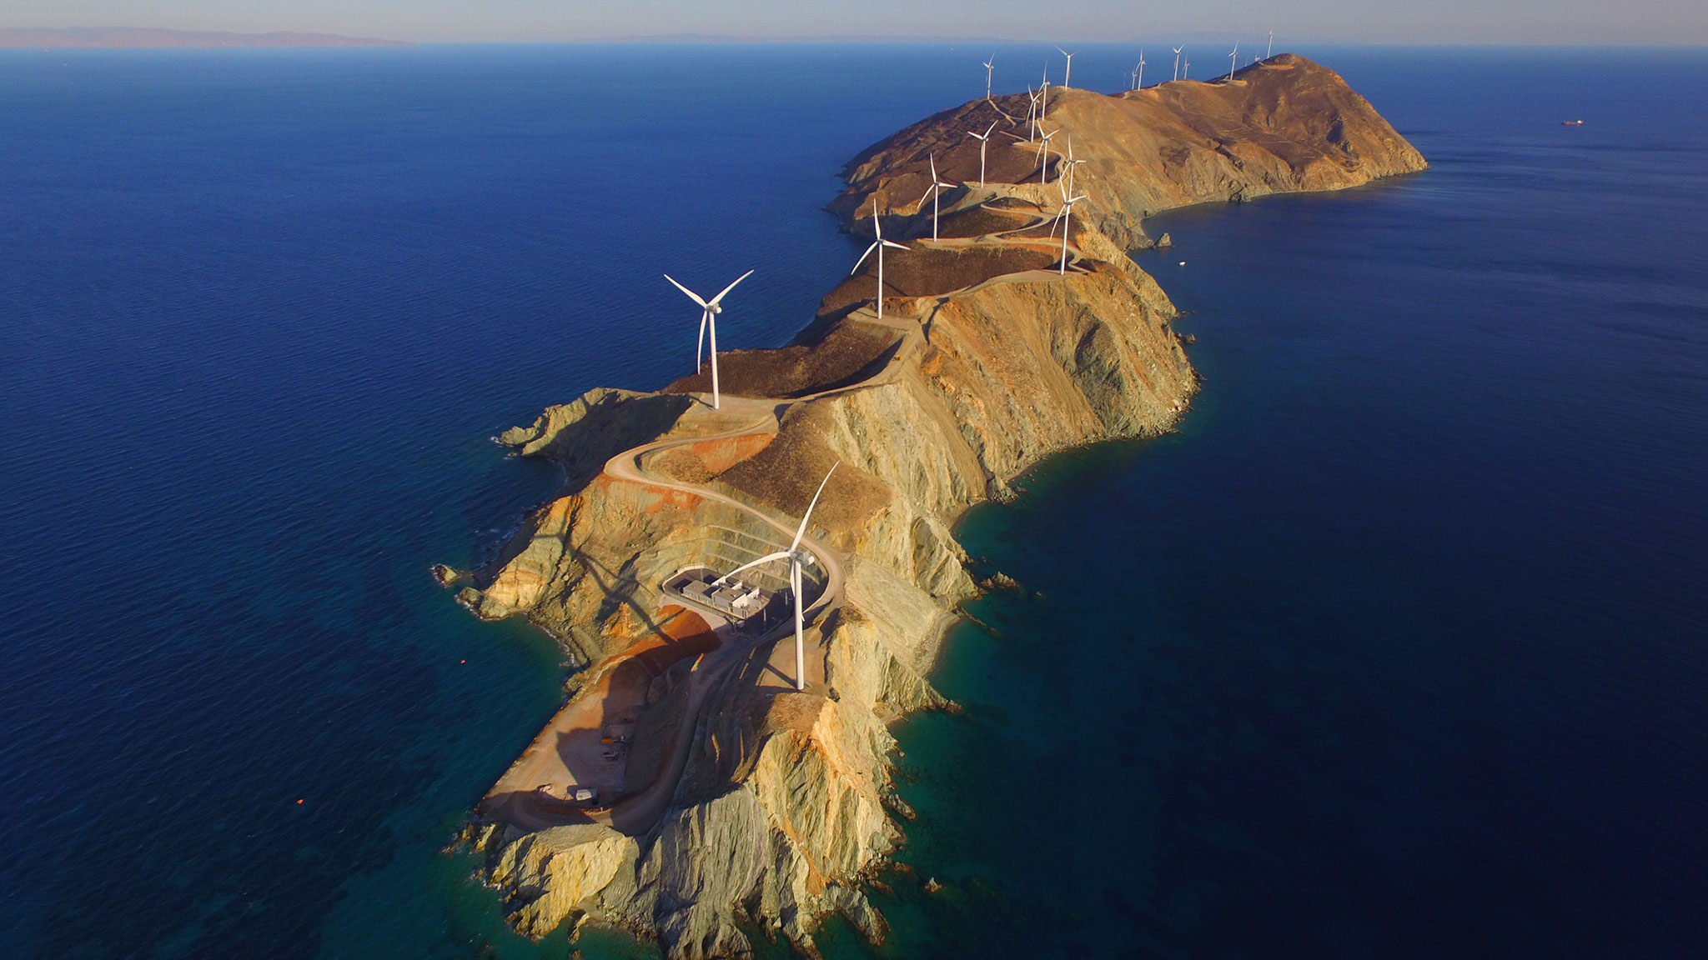
Wind Power growth
CONGRATULATIONS!!
Installed capacity: >500GW
WP generation: ~3.8%
RE generation: ~24%
UN SDG
Paris agreements
EU RE targets
A future with higher penetration of renewables
BUT
Energy & Heating still the largest GHG emitting sector
Understand climate variability.
Anticipate changes.
Build resilience.
Photo: Marios Zangas

Slide 3
COPERNICUS Program
CLIM4ENERGY
Tailoring climate services
for the energy industry
Seasonal forecast service
for wind power
Providing a wealth of free climate data
clim4energy.climate.copernicus.eu

Slide 4
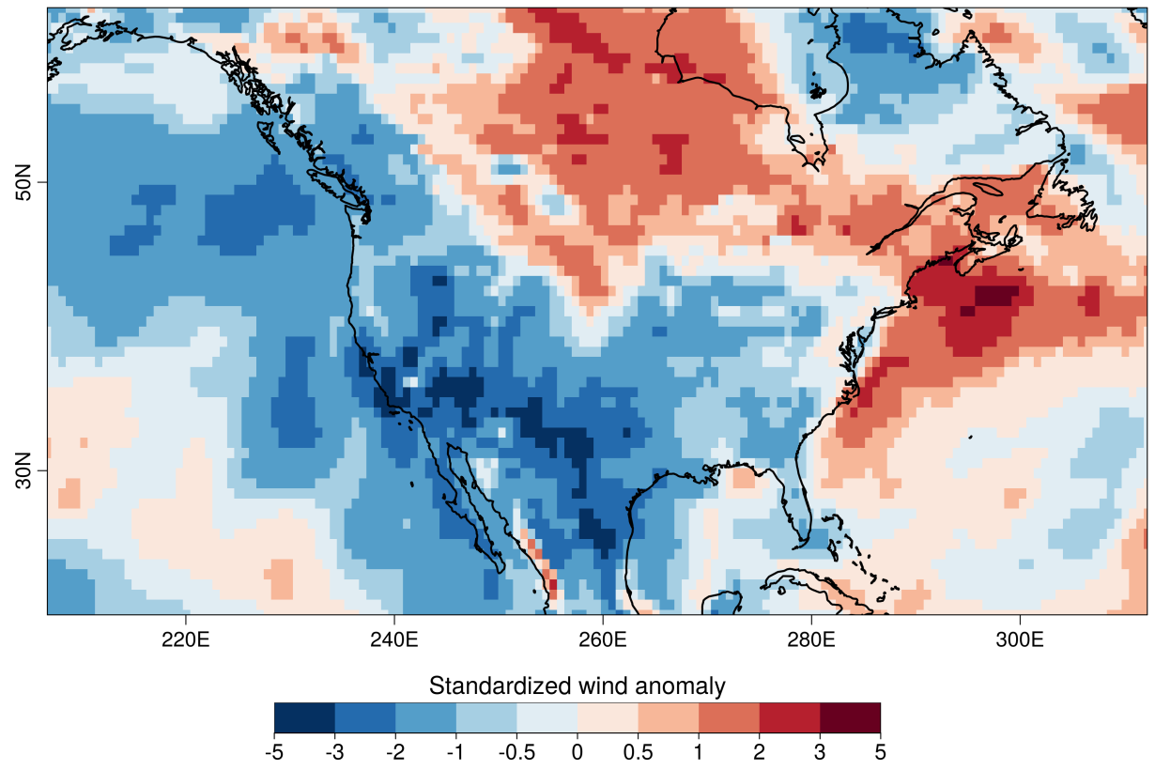
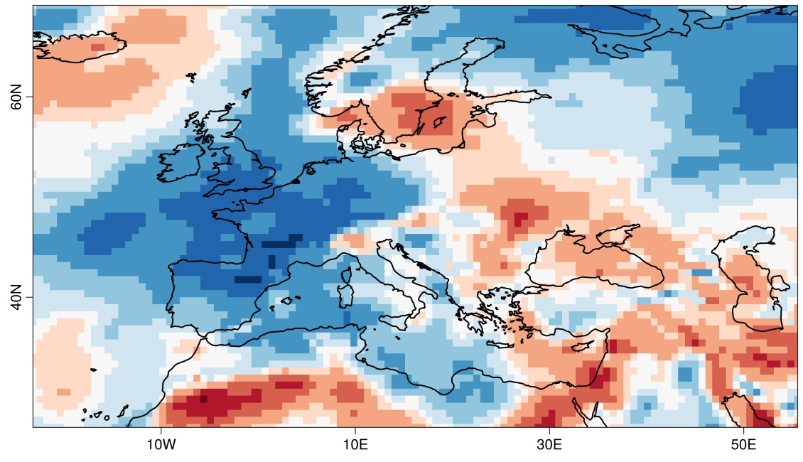
Wind droughts
source: ERA-Interim
ref. period: 1985-2014
Q1 2015
Q4 2016

Slide 5
Can we anticipate anomalies?
ATMOSPHERE
OCEAN
CIRCULATION
SEA ICE EXTENT
Coupled
Ocean-Atmosphere
Ensemble Prediction Systems
SNOW COVER
SOIL MOISTURE
ECMWF System4
MeteoFrance System5
UKMO GloSea5
NCEP CFSv2

Slide 6
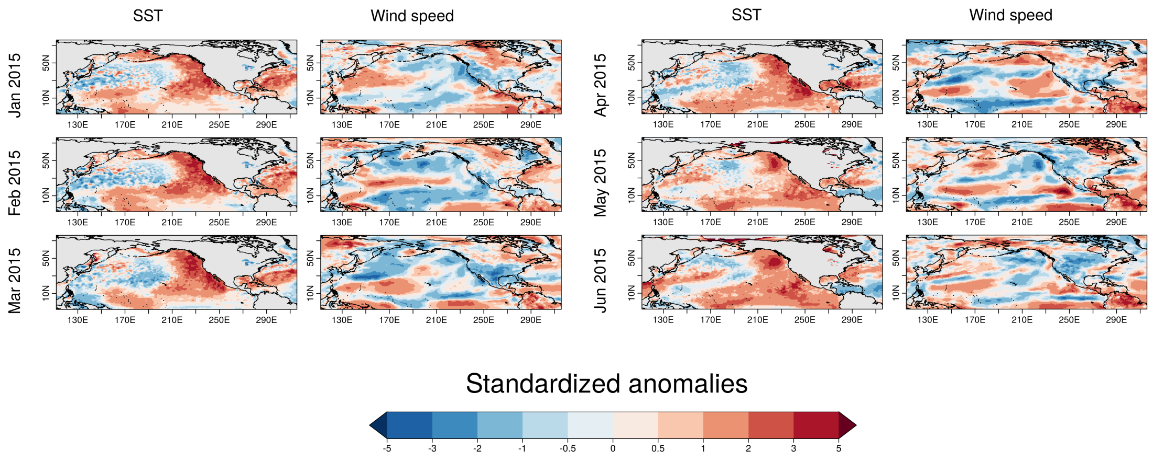
SST influencing Wind Speed
source: ERA-Interim
ref. period: 1981-2010

Slide 7
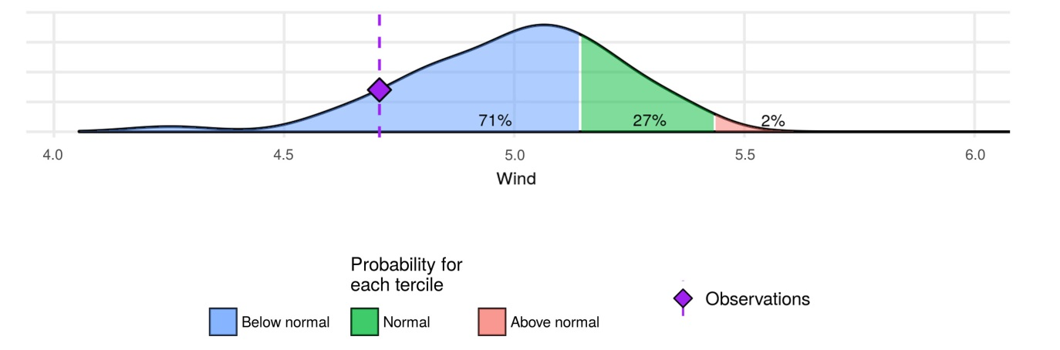
Probabilistic forecasts
QUESTION
ANSWER
Will the coming season be:
less windy than normal?
normal?
more windy than normal?
Bias adjust model output
Average whole season
Distribute the ensemble members into 3 categories
Compute probability

Slide 8
Forecast quality
A prediction has no value without an estimate of forecasting skill based on past performance
SKILL SCORES
CRPSS = -0.01
RPSS = 0.08
EnsCorr = 0.44

Slide 9
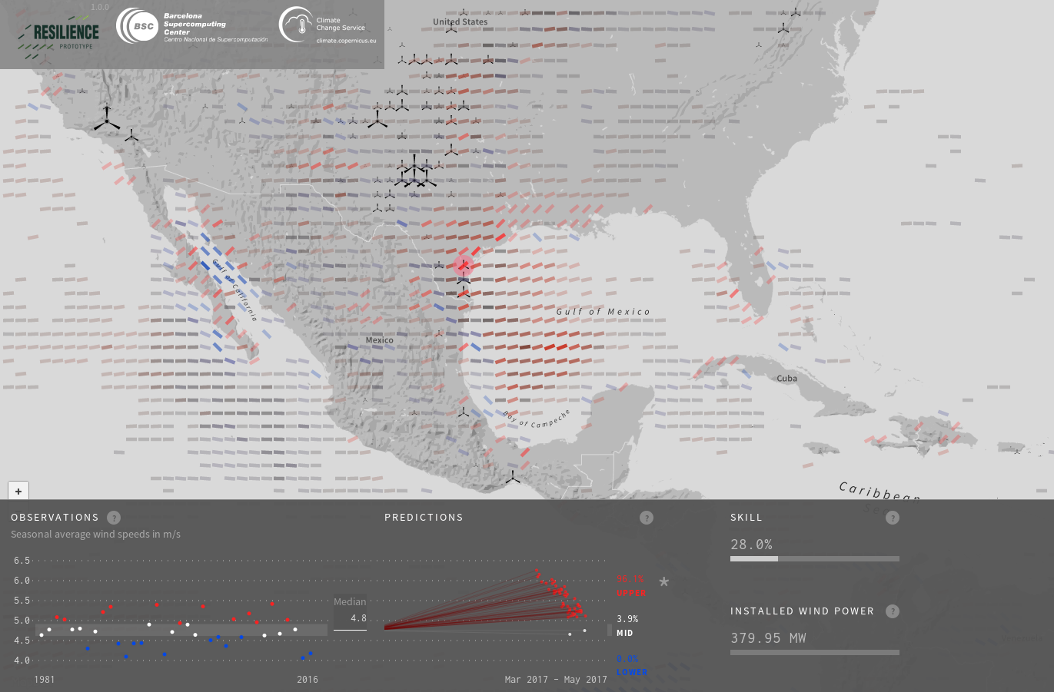
RESILIENCE visualization
www.bsc.es/projects/earthscience/resilience/

Slide 10
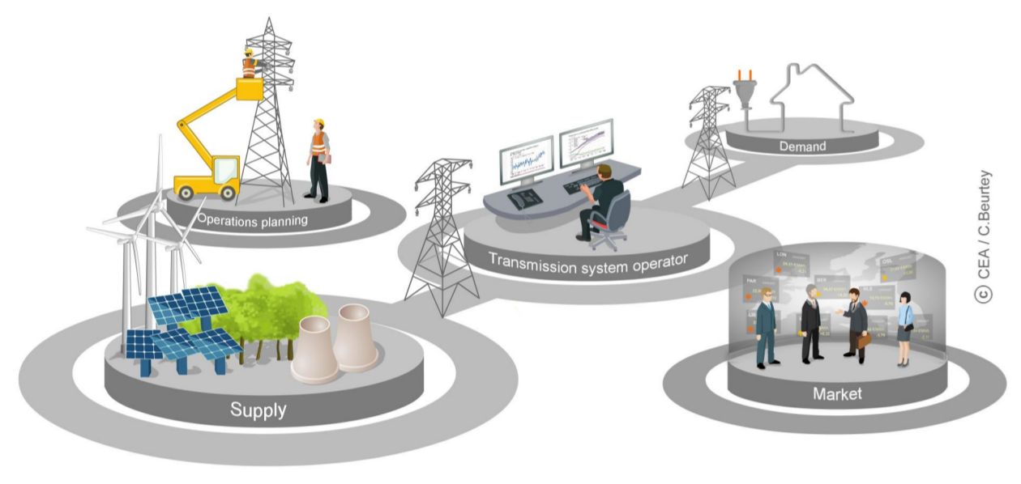
Applications
Balance between supply and demand
O&M planning
Energy trading
Cash flow anticipation

Slide 11
Capacity factor indicator
Capacity Factor of an installed wind farm is a normalized energy generation indicator that explains how good the meteorological conditions have been for producing energy during a specific period.
Capacity Factor of an installed wind farm is a normalized generation indicator that explains how good the meteorological conditions have been for producing energy during a specific period.
$$CF (\%)=\frac{Actual generation}{Installed capacity∗hours}$$
Independent of:
number of installed turbines
nameplate capacity of installed turbines
Depends on other turbine specifications:
cut-in speed
rated speed
cut-out speed
Impossible to compute a Capacity Factor that is valid for all windfarms

Slide 12
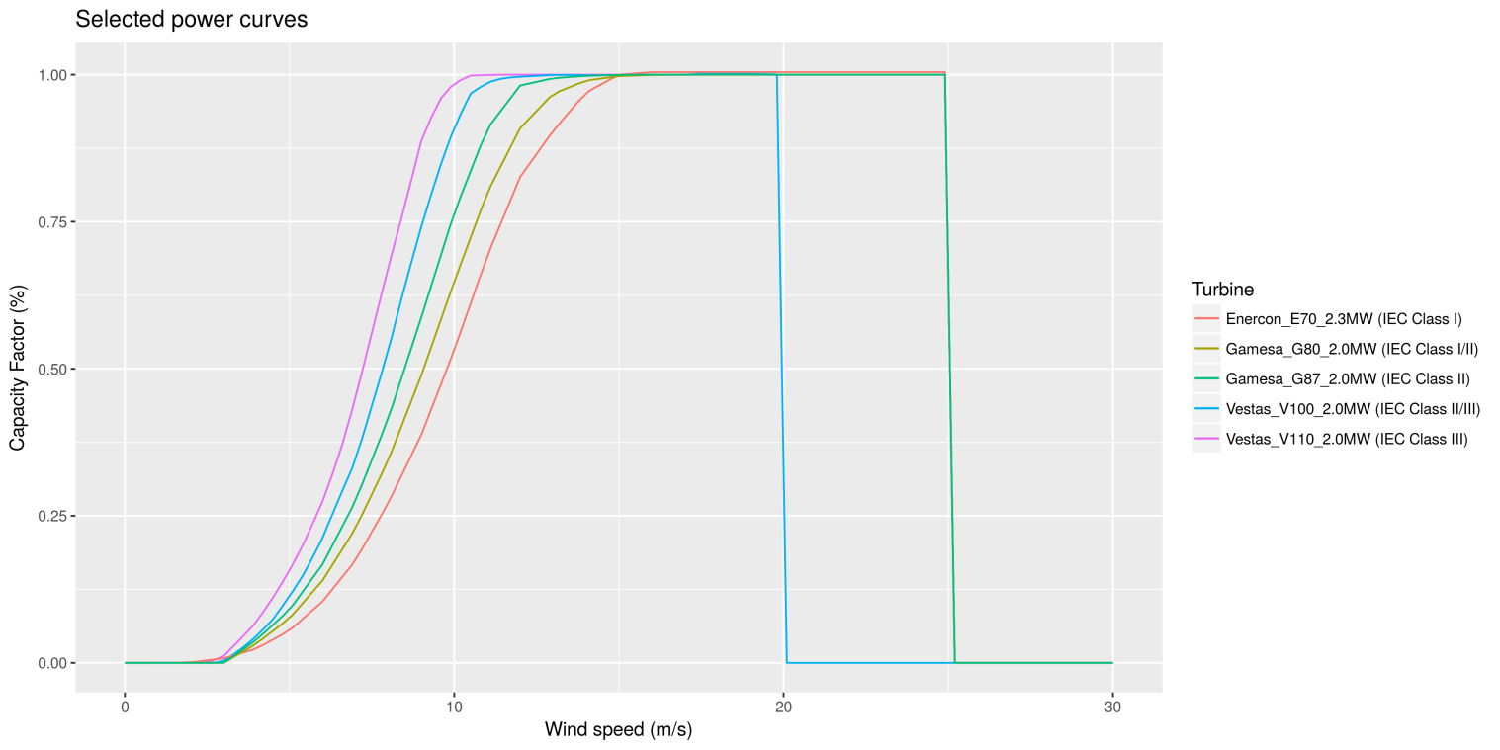
Turbine Classification
The IEC-61400-1 standard defines 3 classes of turbines.
 | Mean wspd | Max 10’ wspd | Structural loads | Rotor size | Hub height | Materials
IEC I | 10 m/s | 50 m/s | high | small | low | stronger
IEC II | 8.5 m/s | 42.5 m/s | med | med | med
IEC III | 7.5 m/s | 37.5 m/s | low | big | high | weaker
We select one turbine model to represent each class.

Slide 13
Capacity factor anomalies
Observed anomalies (ERA-Interim)

Slide 14
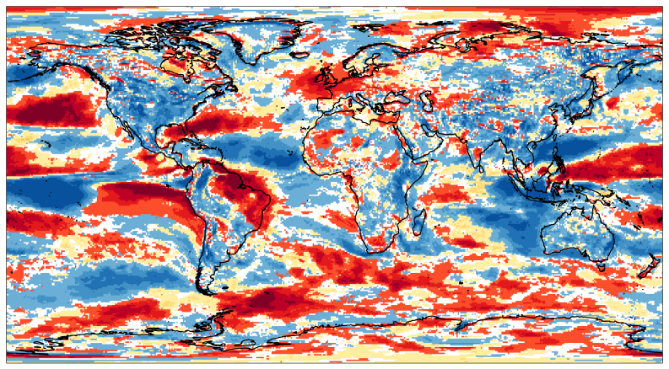
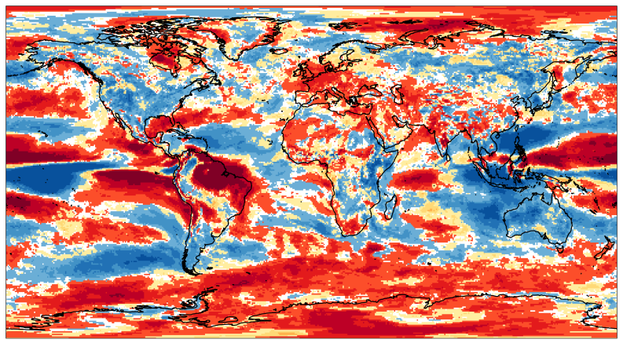
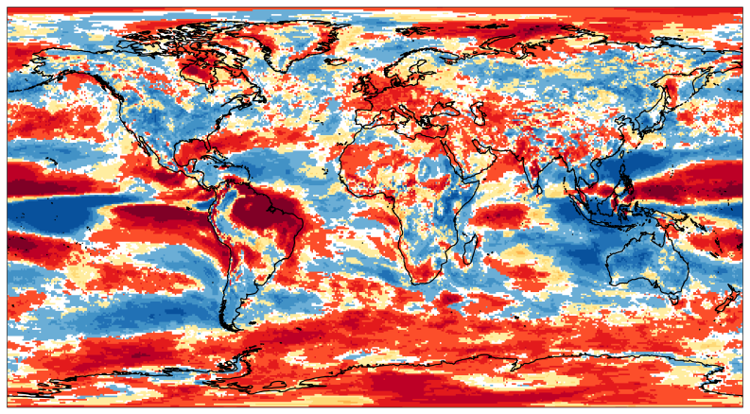
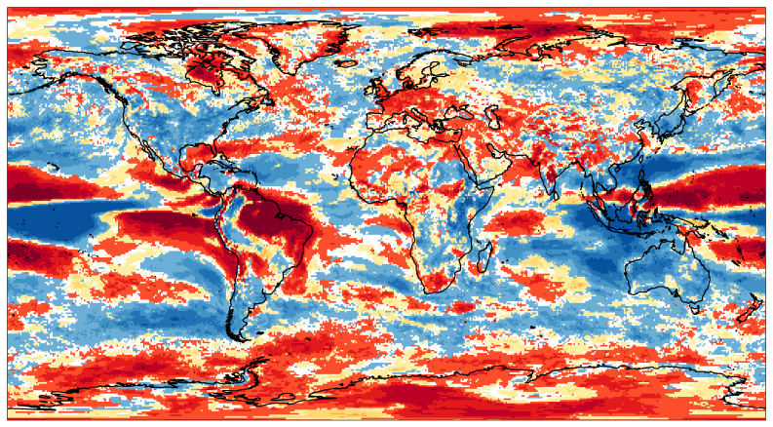
Capacity Factor forecasts
Most likely tercile
DJF 2015/16
ECMWF System4
[probability>40%]
WSPD
CF IEC1
NON-LINEAR effects
CF IEC2
CF IEC3

Slide 15
Conclusions
Conclusions
Essential to understand climate variations
Dynamical models can anticipate extreme events
Tailored service helpful for several applications
Assessing forecast quality is crucial before making decisions
Open questions
Which decisions would you take in view of those forecasts?

Slide 16
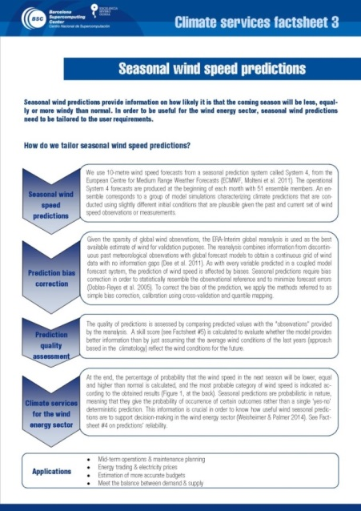
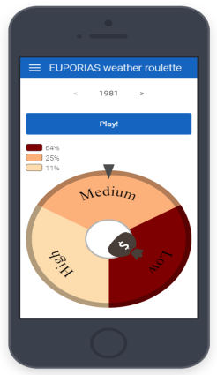
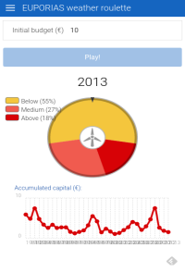
More information
CLIM4ENERGY website
http://clim4energy.climate.copernicus.eu/
ARECS User Interface Platform:
http://www.bsc.es/ESS/arecs/resources
Bulletins
Factsheets
Case studies
Weather Roulette APP

Slide 17
Thank you!
llledo@bsc.es
www.bsc.es
Photo: Marios Zangas

Slide 18
Skill assessment
Skill assessment for DJF (1981-2013)
Displaying: Ranked Probability Skill Score [RPSS]

Slide 19
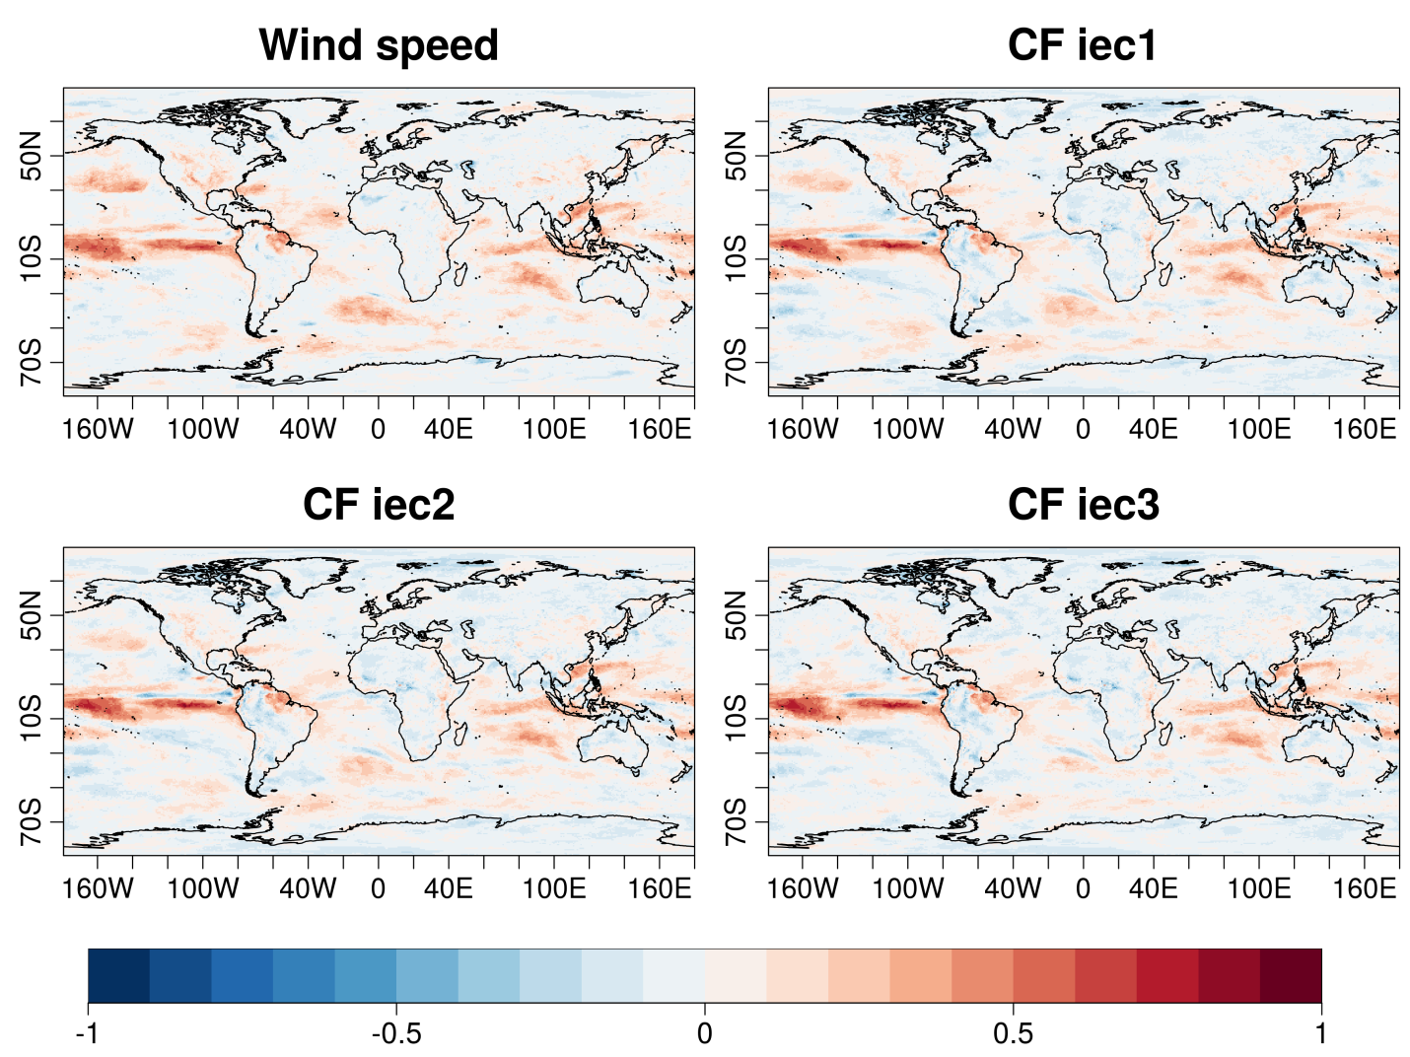
Skill assessment
Skill assessment for DJF (1981-2015)
Displaying: Ranked Probability Skill Score [RPSS]

Slide 20
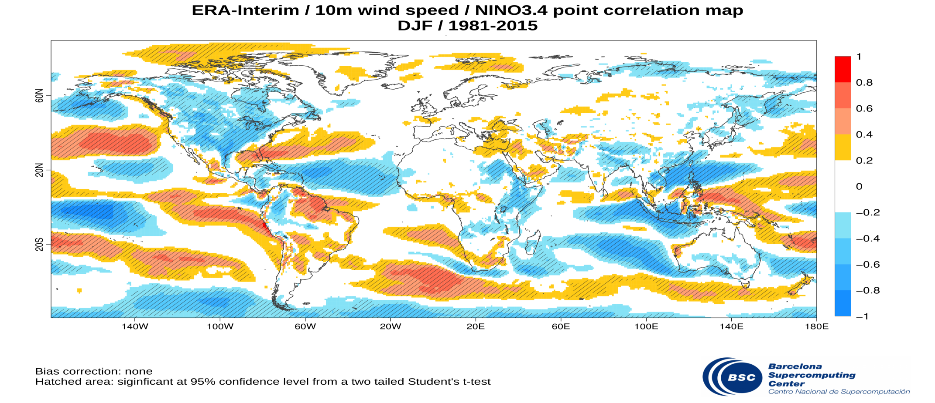
Impact of ENSO on wind

Slide 21
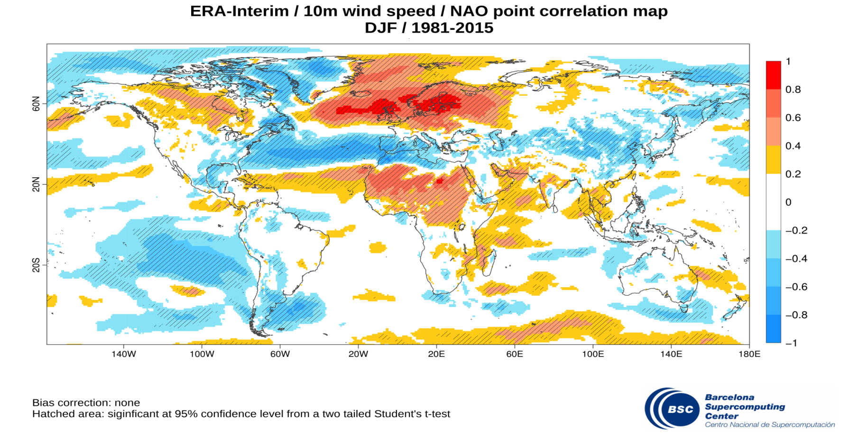
Impact of NAO on wind

