Slide 1
EC-Earth meeting 5-6 May 2015
Do different machines simulate different climates?
François Massonnet
M. Asif, O. Bellprat, E. Exarchou, M. Ménégoz, C. Prodhomme, F. J. Doblas-Reyes
Notes:
Are you afraid?

Slide 2
Identifying sources of model error
OBS
MOD
Notes:
First things first, let’s start from the beginning. I’ve understood very recently that a the proper way to estimate model quality is to understand all possible reasons why it could be wrong. We know that a model prediction…

Slide 3
Identifying sources of model error
OBS
MOD
Initial conditions are wrong
Notes:
…will never be matching observations exactly, because of our incomplete knowledge of initial conditions. But this is not what I want to talk about here. In fact, even if a model is initialized perfectly,

Slide 4
Identifying sources of model error
Boundary conditions are wrong
OBS
MOD
Initial conditions are wrong
Notes:
It will be far away from the target because we cannot specify exactly the forcing that control its variability at the boundaries. But that’s not what I want to talk about. In fact, even with perfect knowledge of initial and boundary conditions, the model has an error

Slide 5
Identifying sources of model error
Boundary conditions are wrong
OBS
MOD
Initial conditions are wrong
Model physics is wrong
Notes:
Due to the wrong formulation of physical laws that exist in Nature. But that’s not what I want to talk about. Even with a perfect model,

Slide 6
Identifying sources of model error
Boundary conditions are wrong
Discretization errors
OBS
MOD
Initial conditions are wrong
Model physics is wrong
Notes:
we make discretization errors when we solve partial differential equations on our sometimes very coarse grids. But this is really not what I want to talk about now.

Slide 7
Identifying sources of model error
Boundary conditions are wrong
Discretization errors
OBS
MOD
Initial conditions are wrong
Softwares / hardwares are wrong
Model physics is wrong
Notes:
The platforms, infrastructure and programs that we are using on a daily basis also have errors. There must be thousands of papers about these sources of uncertainty.
I found less than ten on this issue.
And because no one really knows how this error compares to these ones, or no one really wants to know, we decided at IC3 to the clear the air and address this problem following a systematic and controlled approach.

Slide 8
Hardware/software as sources of model error
Bit-reproducibility of EC-Earth
Clim-reproducibility of EC-Earth
Notes:
One of the strengths of EC-Earth is that it is run by a community, but one of the weakness is that the community is using completely different platforms, compilation options, libraries or number of processors. And this allows us to have an idea of how big this source of model error is. And I will show indeed that these overlooked, underconsidered sources of model error are not only real, but also non-negligible at all.

Slide 9
Hardware/software as sources of model error
Bit-reproducibility of EC-Earth
Clim-reproducibility of EC-Earth
Notes:
Now the first characteristic of a computer is that

Slide 10
Software / harwdare is a multiple and underestimated source of model error
Round-off errors and floating-point representation
The order matters: associativity is no longer valid
$$(\sqrt{2}. π).e=\sqrt{2}.( π.e)$$
12.0771
≠
12.0777
Notes:
It represents real numbers using a finite number of bits. And therefore some mathematical properties like simple associativity are no longer true. While the mathematical expression on the top is correct, it is not if you truncate each of the term to the fourth decimal. Both solutions are perfectly valid, but still they’re different.

Slide 11
Software / harwdare is a multiple and underestimated source of model error
Round-off errors and floating-point representation
The order matters: associativity is no longer valid
$$(\sqrt{2}. π).e=\sqrt{2}.( π.e)$$
12.0771
≠
12.0777
Agressive optimization
Can degrade accuracy [Thomas et al. Wea. And Forecast., 2002]
Notes:
Then our codes are compiled using certain flags, and some studies have suggested that most agressive and demanding optimization levels should be applied with care: studies found that O3 optimization permits floating point reordering that could adversely affect the solution

Slide 12
Software / harwdare is a multiple and underestimated source of model error
Round-off errors and floating-point representation
The order matters: associativity is no longer valid
$$(\sqrt{2}. π).e=\sqrt{2}.( π.e)$$
12.0771
≠
12.0777
Agressive optimization
Can degrade accuracy [Thomas et al. Wea. And Forecast., 2002]
Number of processors and their distribution
Processor topology defines order of operations [Thomas et al., Wea. And Forecast., 2002; Senoner et al., AIAA, 2008]
Notes:
A well known and largely covered source of error is the number of processors used in parallel computing. We all agree that it should not, but again, processor distribution is automatically associated to an ordering of operations

Slide 13
Software / harwdare is a multiple and underestimated source of model error
Round-off errors and floating-point representation
The order matters: associativity is no longer valid
$$(\sqrt{2}. π).e=\sqrt{2}.( π.e)$$
12.0771
≠
12.0777
Agressive optimization
Can degrade accuracy [Thomas et al. Wea. And Forecast., 2002]
Number of processors and their distribution
Processor topology defines order of operations [Thomas et al., Wea. And Forecast., 2002; Senoner et al., AIAA, 2008]
Compiler version
Different FORTRAN compilers can produce different outcomes [Lawrence et al., EOS, 1999]
Notes:
Then it was shown, perhaps surprisingly for you, that even the compiler versions induce errors; this study showed that the Fortran 90 compiler developed by Cray produced inconsistent results that were not present with other compilers

Slide 14
Software / harwdare is a multiple and underestimated source of model error
Round-off errors and floating-point representation
The order matters: associativity is no longer valid
$$(\sqrt{2}. π).e=\sqrt{2}.( π.e)$$
12.0771
≠
12.0777
Agressive optimization
Can degrade accuracy [Thomas et al. Wea. And Forecast., 2002]
Number of processors and their distribution
Processor topology defines order of operations [Thomas et al., Wea. And Forecast., 2002; Senoner et al., AIAA, 2008]
Compiler version
Different FORTRAN compilers can produce different outcomes [Lawrence et al., EOS, 1999]
Unpredictable hardware failures
[Düben and Palmer, Mon. Wea. Rev., 2014]
Notes:
And finally some aspects are just out of control: supercomputers are tired sometimes, too, and temporary faults can lead to number truncation.

Slide 15
Hardware/software as sources of model error
This aspect has been overlooked but is of non-negligible importance
Bit-reproducibility of EC-Earth
Clim-reproducibility of EC-Earth
Notes:
So to summarize my first point: this is clear: our machines introduce errors in our codes. There have been already attempts to investigate with weather models, how large these errors would be. In some cases these errors were even found to be comparable to errors introduced by initial conditions perturbation, so we’d rather take this … seriously.
I’m now asking this question for EC-Earth and I want to examine two types of reproducibility: bit reproducibility on the one hand, where we are looking for conditions allowing for a bitwise, exact reproduction of binary output; and clim-reproducibility, where we no longer require the instantaneous time series to be equal but only their statistics to be indistinguishable from each other.

Slide 16
Hardware/software as sources of model error
This aspect has been overlooked but is of non-negligible importance
Bit-reproducibility of EC-Earth
Clim-reproducibility of EC-Earth
Notes:
The good news

Slide 17
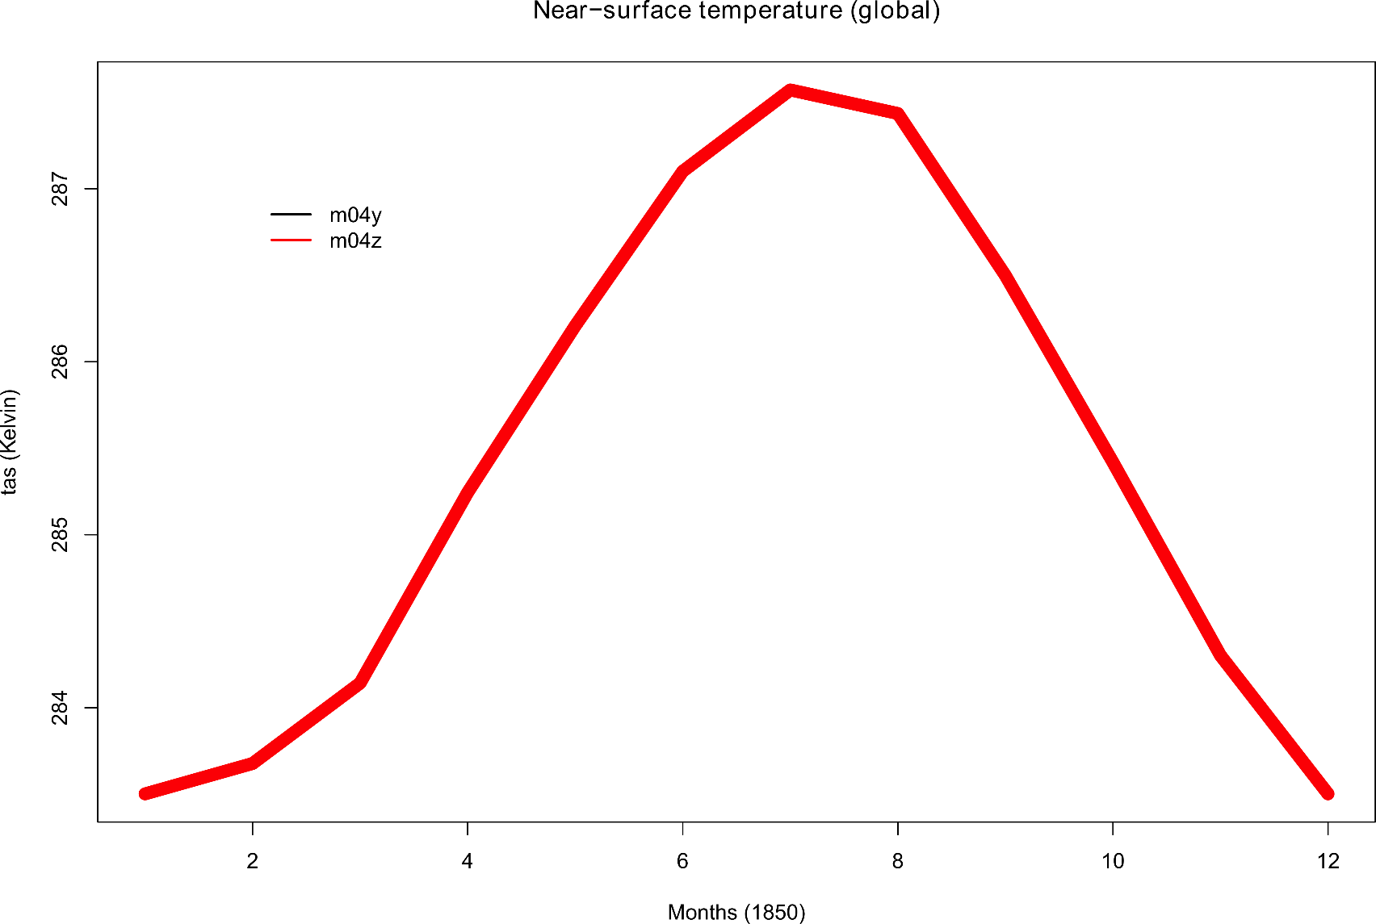
All things being equal, EC-Earth is reproducible bitwise
Near-surface global temperature
Mare Nostrum
# of processors
287
22 +384 +96
22 +384 +96
286
K
285
284
J
F
M
A
M
J
J
A
S
O
N
D
Notes:
Is that two EC-Earth simulations carried out following exactly the same conditions are purely identical. Run a simulation now, run it again tomorrow, you won’t see any difference. This is the first check that everyone does, and in fact you cannot see the black curve here simply because it is hidden behind the red curve.

Slide 18
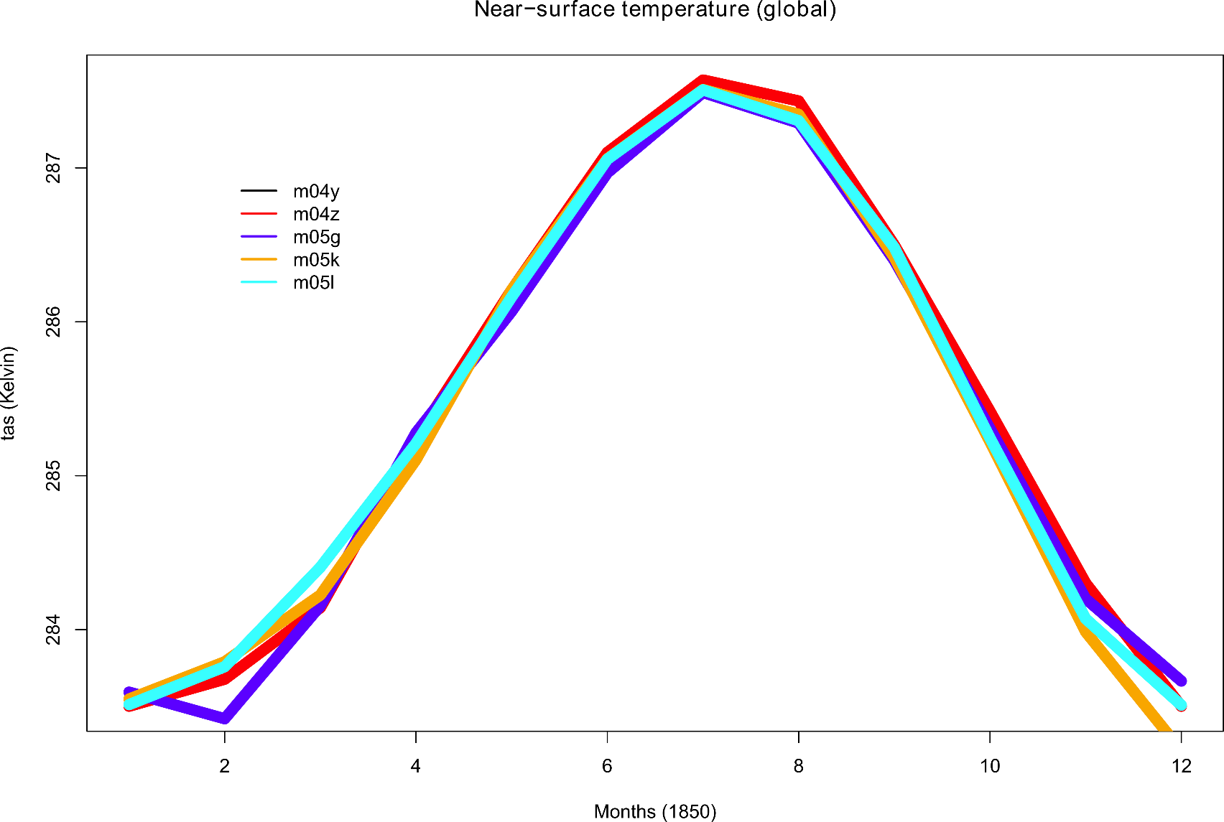
All things being equal, EC-Earth is sensitive to processor distribution
Near-surface global temperature
Mare Nostrum
# of processors
287
22 +384 +96
22 +384 +96
22 +96 +16
22 +352 +96
22 +384 +32
286
K
285
284
J
F
M
A
M
J
J
A
S
O
N
D
Notes:
Now if we relax a bit our test and allow a different number of processors then we start to see differences which are not negligible. We are talking here about something between a 1/10 of degree and ½ degree celsius in global mean. Also it is interesting to note that this is not an IFS or a NEMO problem

Slide 19
Hardware/software as sources of model error
This aspect has been overlooked but is of non-negligible importance
Bit-reproducibility of EC-Earth
Two identical runs give exactly matching output
No reproducibility for different processor (IFS or NEMO) distribution
Clim-reproducibility of EC-Earth
Notes:
So the first thing to note is that even on the same machine, EC-Earth is sensitive to the arbitrary choice of processor distribution

Slide 20
Hardware/software as sources of model error
This aspect has been overlooked but is of non-negligible importance
Bit-reproducibility of EC-Earth
Two identical runs give exactly matching output
No reproducibility for different processor (IFS or NEMO) distribution
Clim-reproducibility of EC-Earth
Notes:
And now comes the main course, we want to assess the reproducibility of EC-Earth on different machines. This is not an easy task, between the model has its own variability that can mask what we are looking for

Slide 21
Assessing climate-reproducibility is not straightforward
Three necessary conditions to validate ports of global atmospheric GCMs [Rosinski and Williamson, 1995]
1. During the first few time steps, difference between two runs should be much less than rounding error,
2. During the first few days, difference should not exceed error growth induced by bit-change on a machine,
3. The statistics of a long simulation must be unchanged.
Notes:
There were several conditions that were proposed to validate the porting of a climate model code, and I will focus on the third one

Slide 22
Restart from EC-Earth v3.1b
500 yr-spinup (CNR: tome) + white noise SST (σ=10⁻⁴ K)
5 members
1850
1860
1870
Forcing: pre-industrial

Slide 23
Machine 1
(Mare Nostrum, BSC)
Machine 2
(ECMWF)
Machine 3
(Ithaca, CFU)
Motherboard
Operating system
LINUX environment
Compilation flags
Identical
Identical
Identical
NetCDF, GRIB, HDF5 libraries
Different
Different
Different
# of processors
22+384+96
22+480+96
22+32+16
Autosubmit ensures identical configurations
Notes:
Focus on these two

Slide 24
The simulations are evaluated against the same, static data set
ECMWF
Ithaca, IC3
Mare Nostrum, BSC
Reference
[Reichler and Kim, BAMS, 2008]
[ECMean: Paolo Davini, CNR]
Notes:
Instead of computing distance between pairs of simulations, we chose to compare all members
Euclidean distance

Slide 25
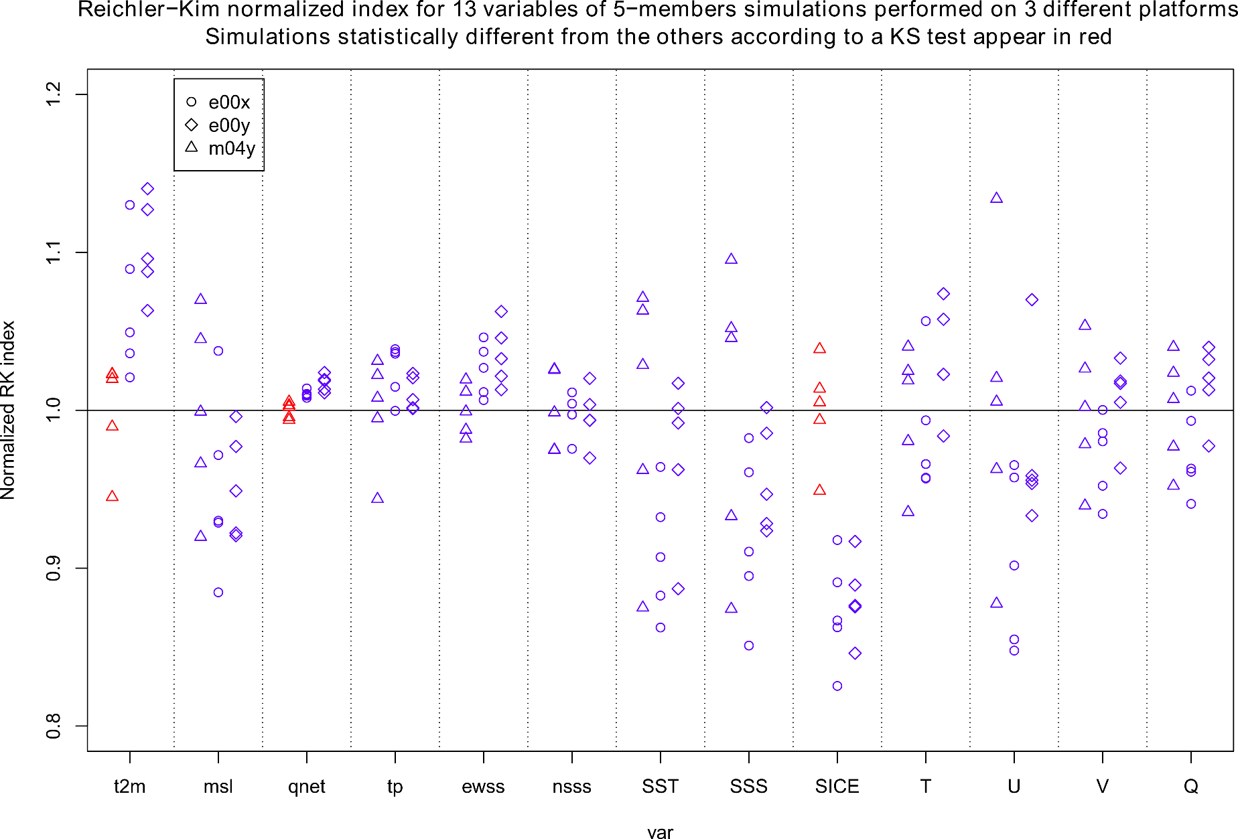
Statistically significant differences are found in the performance indices
Mare Nostrum
ECMWF
Red = difference according to Kolmogorov-Smirnov test (alpha=5%; overestimates true rejection rate for small samples)
Notes:
Say that small sample…
Also mention a third exp exists

Slide 26
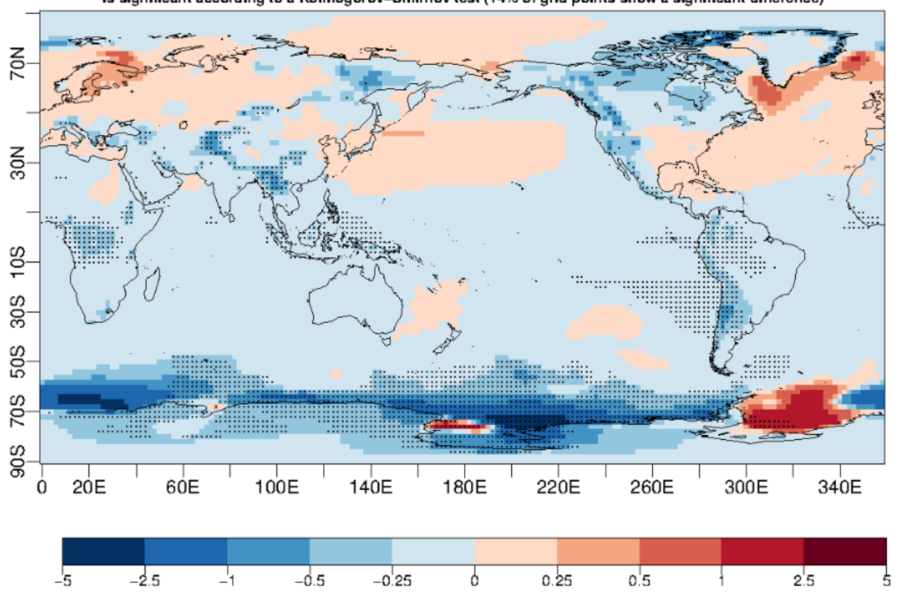
Difference (ECMWF − Mare Nostrum) near-surface temperature
°C

Slide 27
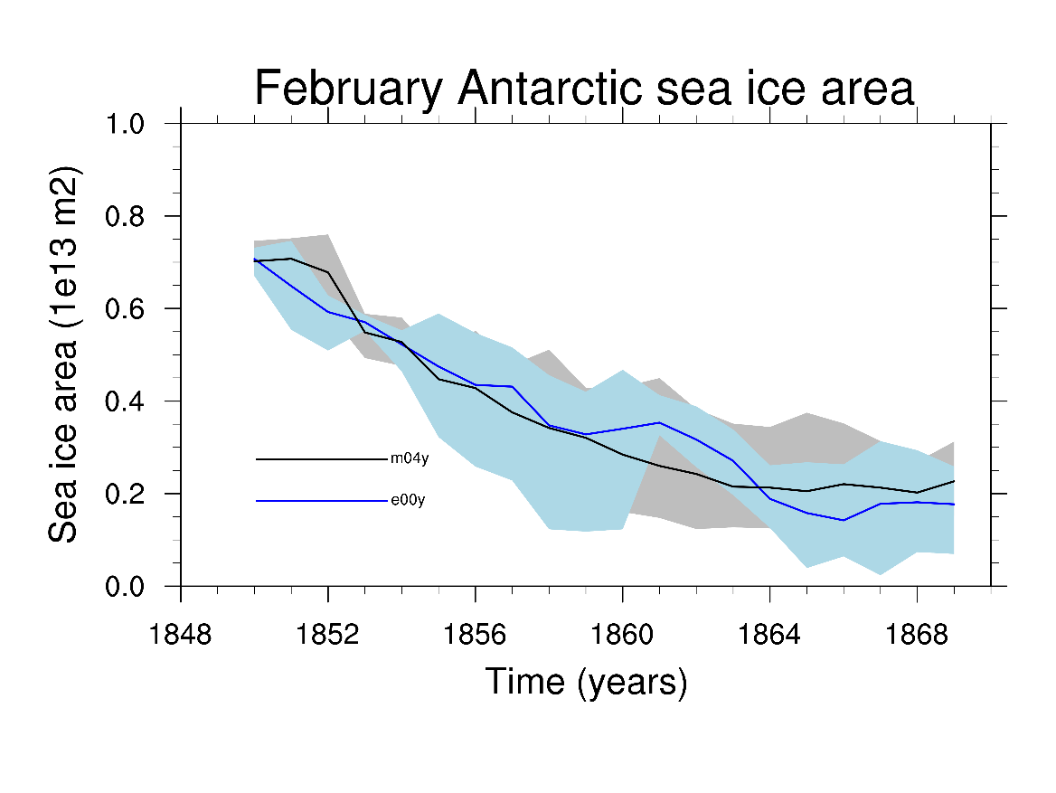
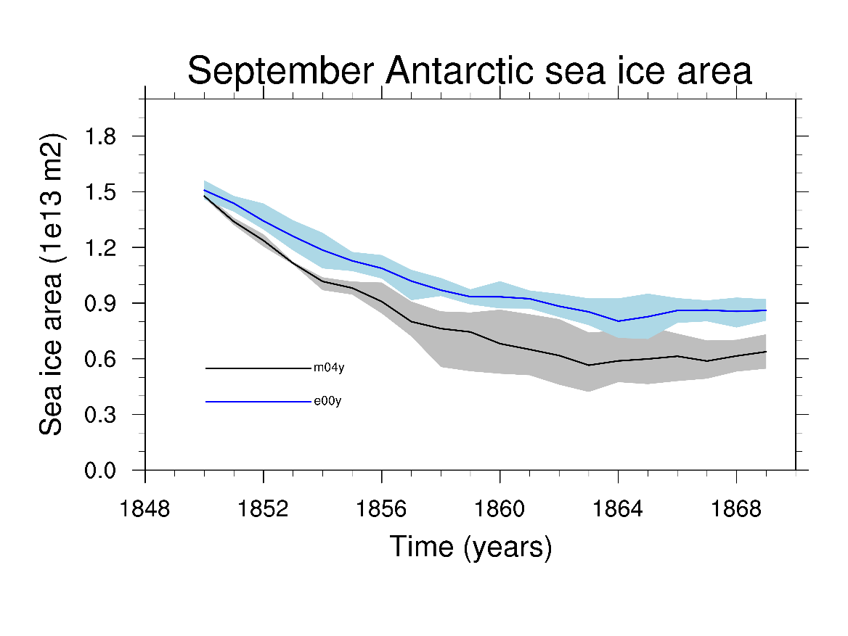
Differences originate in winter. Associated to deep oceanic convection and parameterizations?
10
Mare Nostrum
18
8
15
ECMWF
6
12
10⁶ km²
4
9
ECMWF
6
2
3
Mare Nostrum
0
0
Notes:
Curves depart in the first year.
Why is the model drifting? It was supposed to be at equilibrium. (Jost)

Slide 28
Hardware/software as sources of model error
This aspect has been overlooked but is of non-negligible importance
Bit-reproducibility of EC-Earth
Two identical runs give exactly matching output
No reproducibility for different processor (IFS or NEMO) distribution
Clim-reproducibility of EC-Earth
EC-Earth is not climate-reproducible on different platforms

Slide 29
Take home messages and implications
Machines introduce an additional, non negligible
source of error in climate simulations
The results are supported by several published studies,
unpublished documents, colloquial discussions, good practices
Following the precautionary principle, CMIP6 simulations should be centralized…
… unless a benchmark experiment is produced to re-assess reproducibility with the next EC-Earth version
Model evaluation should account for dependency of results on software/hardware
Machines sample uncertainty just as
members sample internal variability
Control and sensitivity experiments must be designed on the same machine
Notes:
Good news:
An inconclusive result (climates cannot be said different) could have hidden true, but not detected differences (other machines)
Policy at MétéoFrance and IPSL: never run a family of experiments on different platforms
2. We don’t know if this could be a consequence of model bug.

Slide 30
Thank you!
francois.massonnet@uclouvain.be
www.climate.be/u/fmasson
@FMassonnet

