Slide 1
Making global coupled 15km climate simulations possible
Miguel Castrillo, Thomas Arsouze, Kim Serradell, Mario Acosta
Barcelona Supercomputing Center
Glob15km – Global 15km coupled climate simulations PRACE project (ref. 2016163939)

Slide 2
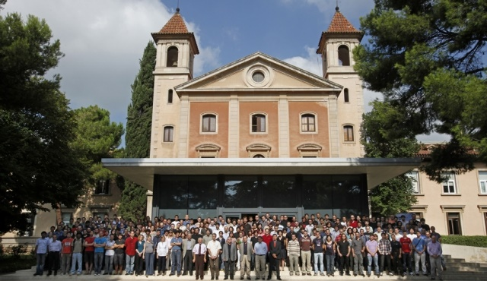
The Barcelona Supercomputing Center
Barcelona Supercomputing Center
Created in 2005; more than 400 600 employees
Research, develop and manage information technology
Facilitate scientific progress and its application in society
Earth Sciences department
Environmental modelling and forecasting, with a particular focus on weather, climate and air quality
>100 people
Funding from H2020, COPERNICUS, private contracts, ESA, Spanish and regional governments
Climate Prediction
Atmospheric Composition
Computational Earth Sciences
Earth System Services

Slide 3
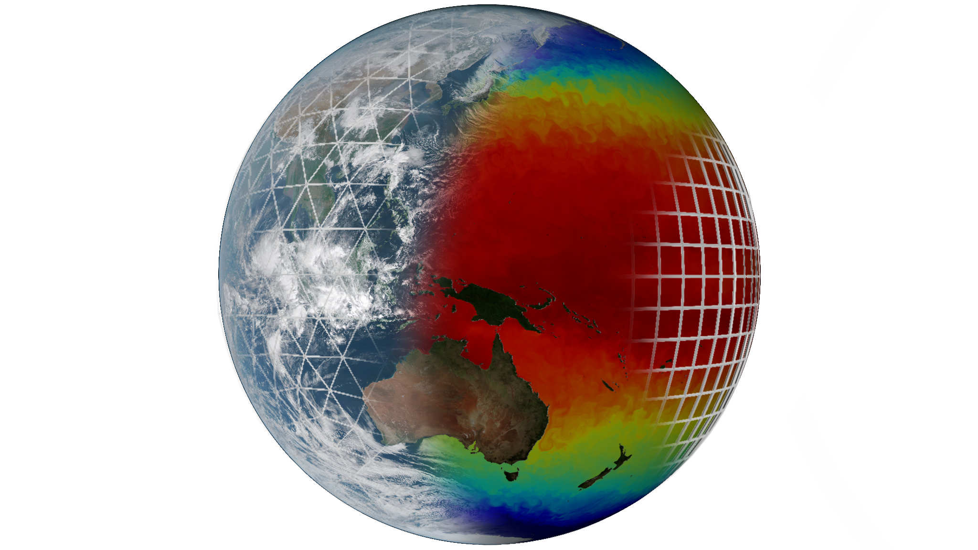
The EC-Earth model
Ocean - ICE:
NEMO - LIM
Atmosphere:
IFS
Coupler:

Slide 4
EC-Earth structure
29 partner institutes
8 core partners
KNMI, AEMET, DMI, Met Éireann, FMI, IPMA, CNR-DTA, SMHI
Workgroups
Technical
Tuning
Atmospheric Composition and Land
Ocean
Millennium scale studies
CMIP6

Slide 5
Efficiency in Earth Science models
Especially critical in Earth science models
Simulations use a huge amount of computational resources
I/O !
Future simulations will need much more resources
0.84M points
67.72M points
991M points
~2000M points

Slide 6
EC-Earth coupled 15km
EC-Earth 10km coupled demonstrator for ESiWACE H2020 project
IFS (atmosphere)
T1279L91: ~16km grid point distance, 2.1M grid points
NEMO-LIM (ocean – sea-ice)
ORCA12L75: ~9km grid point distance, 13.2M grid points
Total 3D space: 1,024kM vertices

Slide 7
Development of EC-Earth T1279-ORCA12
Develop initial data
Including OASIS interpolation weight files
Create namelists for IFS, NEMO-LIM (XIOS) and OASIS
Adapt source code and existing runscripts
Introduce required changes in the experiment workflow
Scalability tests / load balance studies / profiling

Slide 8
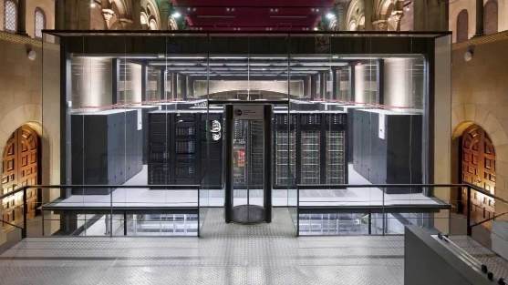
EC-Earth T1279-ORCA12 in MareNostrum3
First global, coupled ~10km simulations (T1279 - ORCA12):
EC-Earth 3.2 (IFS36r4 + NEMO 3.6 + OASIS3-MCT)
2,035 MPI tasks - 60 SDPD
1,170 NEMO
848 IFS
16 XIOS
1 runoff mapper
MareNostrum3 @ BSC

Slide 9
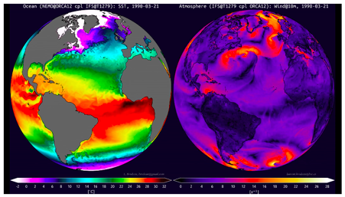
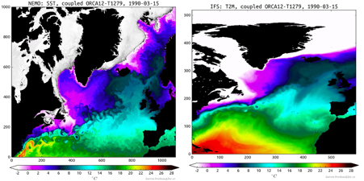
First simulations from EC-Earth T1279-ORCA12
First global, coupled ~16km simulations (T1279 – ORCA12):
Left, Global Sea Surface Temperature of the ocean component NEMO. Right, Global Speed Wind at 10m of atmosphere component IFS.
Left, regional crop Sea Surface Temperature of the ocean component NEMO. Right, regional crop Temperature at 2m of the atmosphere component IFS.

Slide 10
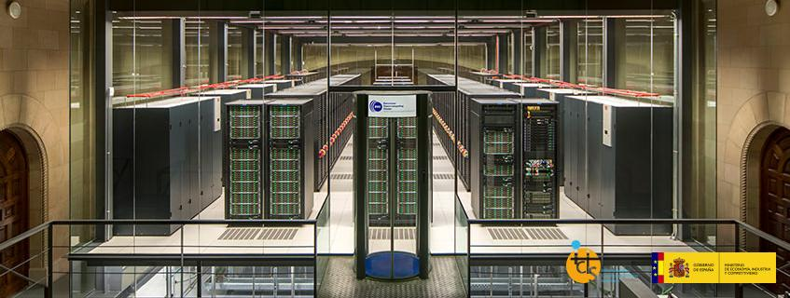
MareNostrum evolution
MareNostrumIV in operation since July 2017
 | MareNostrum III | MareNostrum IV
Processor | Intel Xeon E5-2670 2.6 GHz | Intel Xeon Platinum 8160 2.1 GHz
#Cores per socket / #Sockets | 8 / 2 | 24 / 2
Memory | 32Gb DDR3-1600 | 96Gb DDR4-2667
Interconnection | Infiniband FDR10 10Gb | Intel Omni-Path 100Gb
MareNostrum IV – 11.15 petaFLOPS
MareNostrum III – 1.1 petaFLOPS

Slide 11
Deployment for production in MareNostrum4: Tackled issues
I/O management
Use of MareNostrum4 data-transfer nodes
Optimal libraries and dependencies
Come up with a stable environment
OmniPath: numerous tests and collaboration with operations to find optimal configuration (tmi, PSM2)
XIOS update: decrease number of communications
Controlling process pinning: better memory management

Slide 12
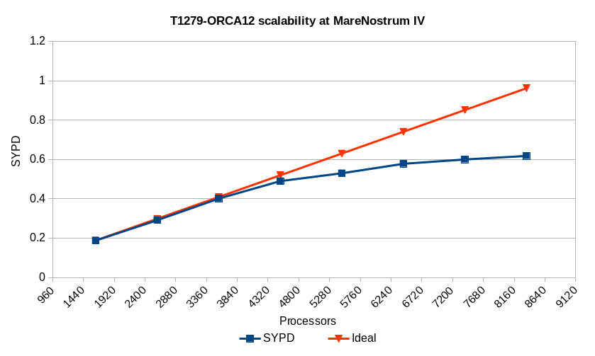
EC-Earth T1279-ORCA12 in MareNostrum4
Load balance study
Load balance study
…

Slide 13
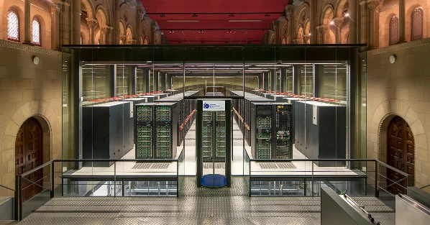
EC-Earth T1279-ORCA12 in MareNostrum4
Operational global, coupled ~10 km simulations (T1279 - ORCA12):
EC-Earth 3.2 (IFS36r4 + NEMO 3.6 + OASIS3-MCT)
5,040 MPI tasks - 0.44 SYPD, 160 SDPD
3,209 NEMO
1,584 IFS
69 XIOS
1 runoff mapper
MareNostrum4 @ BSC
100 year exp ~40M ch !!!

Slide 14
An operational EC-Earth workflow in BSC-ES
Model setup
Deployment on remote HPC
Initial data pre-processing
Configure experiment
Set up platform-specific files
Prepare run scripts
Tar & send model files / Synchronize updated files
Compile the model
Choose and deploy initial data
Pre-process initial conditions / restarts
Simulation
Output post-processing
Verification & diagnostics
Find best domain distribution
Run simulation
Assimilation / adaptive ensembles
Post-process / normalize output data
Archive restarts / output files
Transfer results
Calculate diagnostics
Generate visualization plots

Slide 15
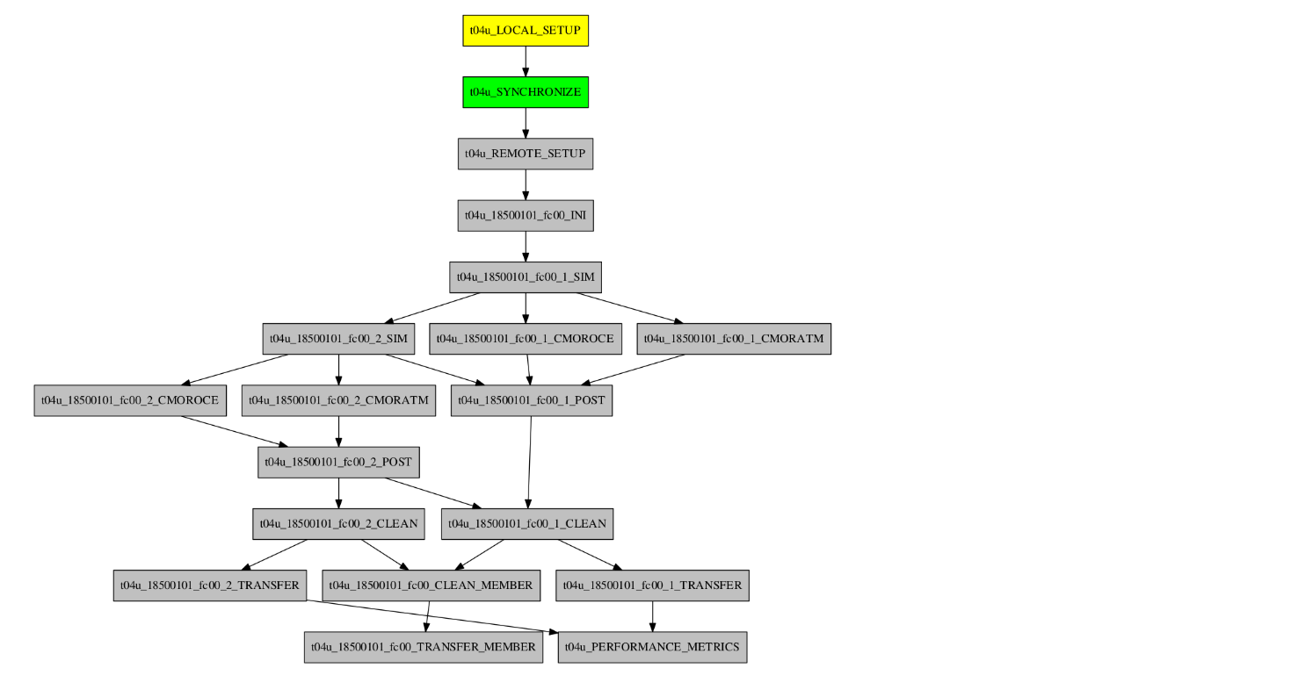
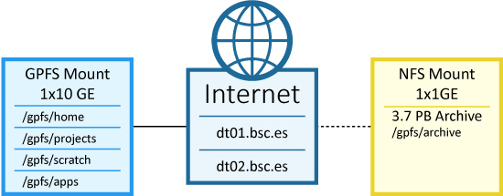
Running production runs in Autosubmit
Adapting workflow for production: data transfer nodes
localhost
dt01.bsc.es
dt01.bsc.es
dt01.bsc.es

Slide 16
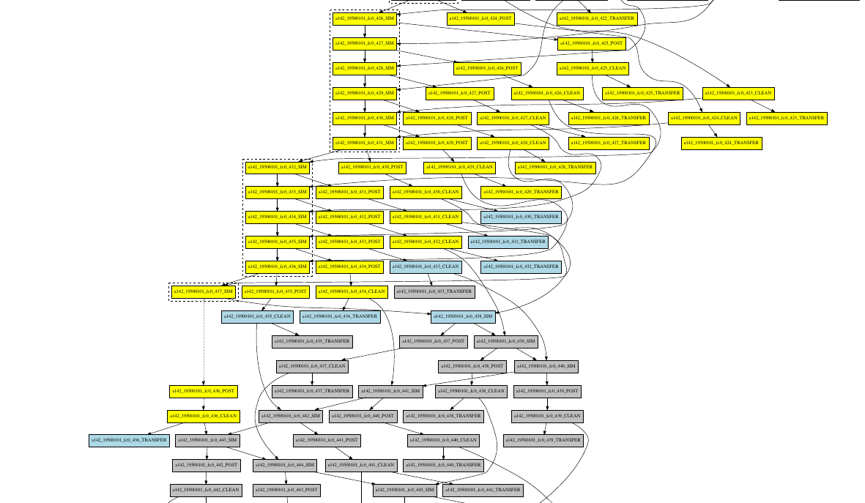
Running production runs in Autosubmit
Production runs: Managing the workflow

Slide 17
EC-Earth T1279-ORCA12: production runs
PRIMAVERA is a Horizon 2020 project which aims to develop a new generation of advanced and well-evaluated high-resolution global climate models, capable of simulating and predicting regional climate with unprecedented fidelity, for the benefit of governments, business and society in general.
The High Resolution Model Intercomparison Project (HighResMIP) is a CMIP6 endorsed MIP that applies, for the first time, a multi-model approach to the systematic investigation of the impact of horizontal resolution.

Slide 18
H2020: European HPC & science integration case
Research
infrastructure
HPC applications (CoEs)
Climate science and HPC
Community

Slide 19
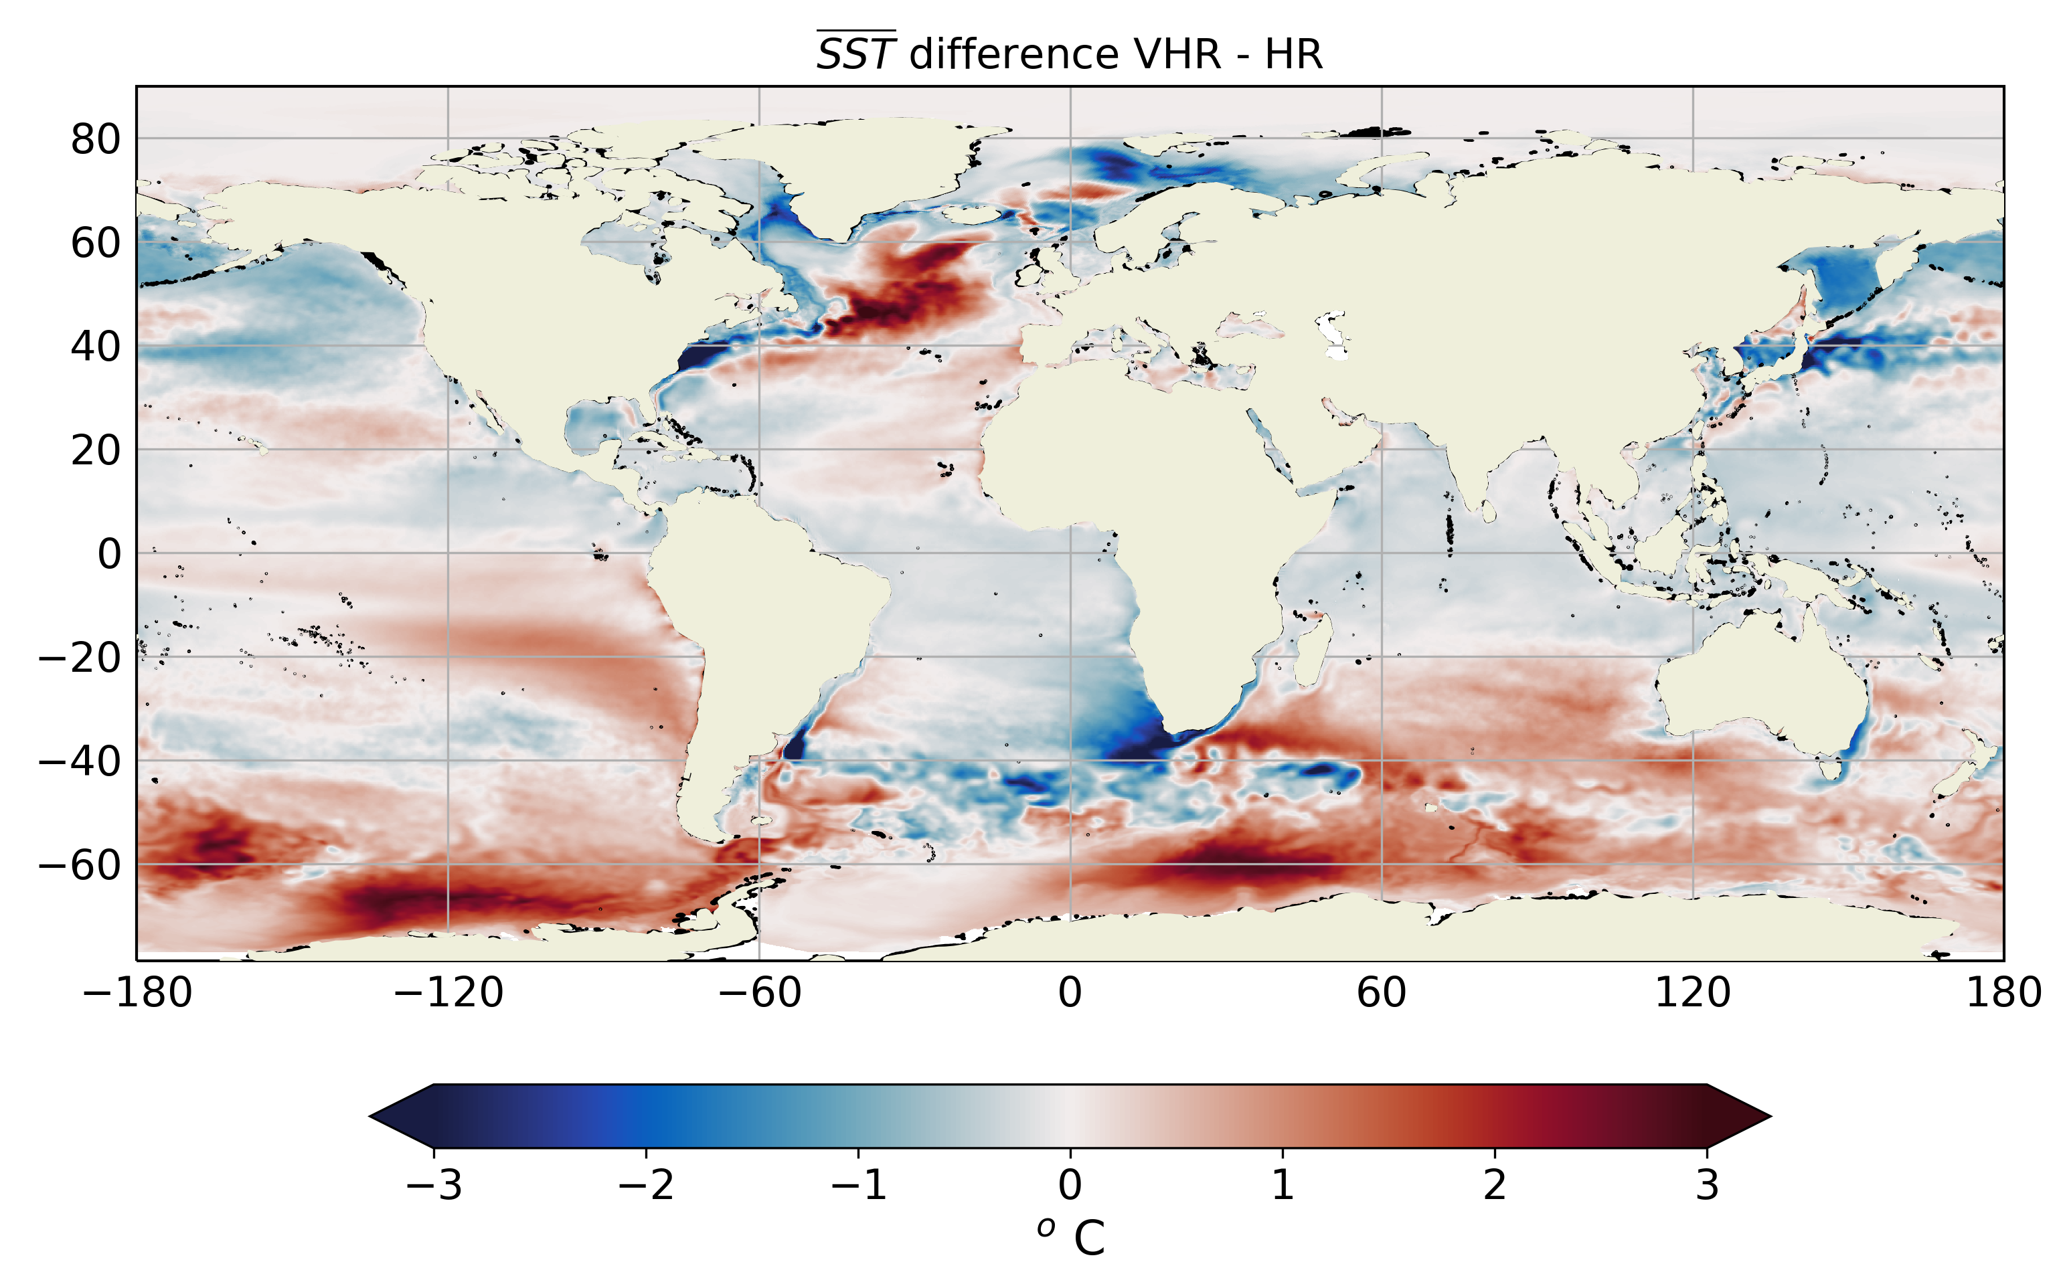
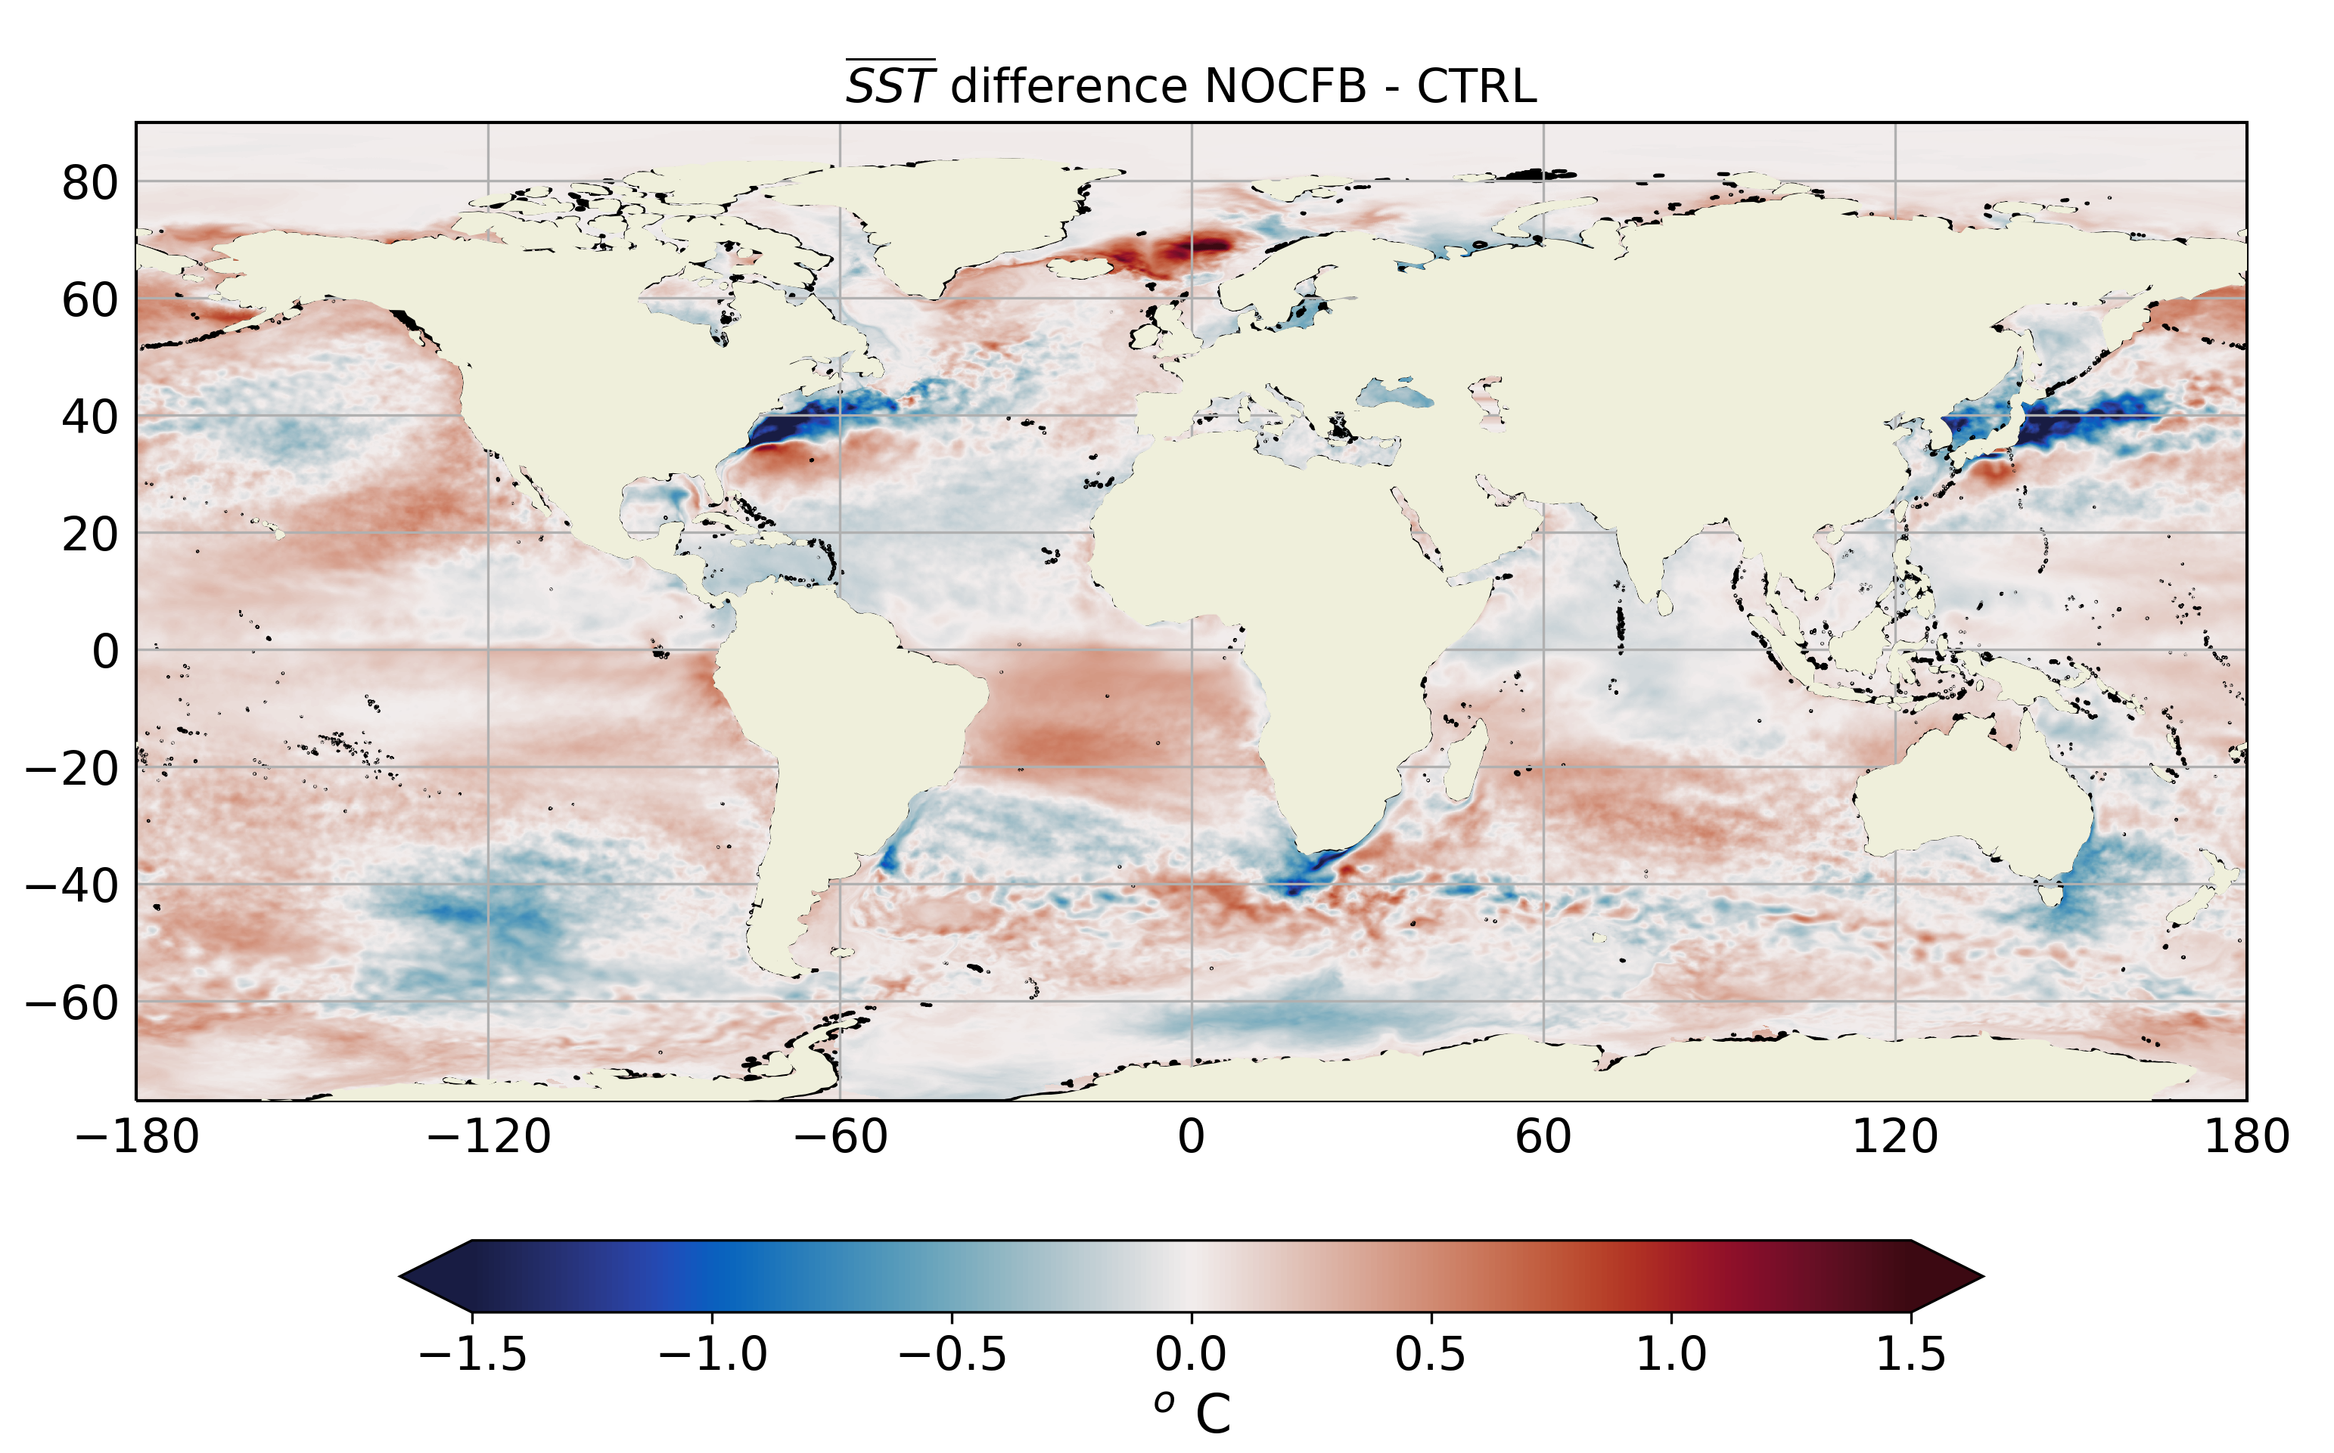
Scientific objectives
Develop and prepare a new generation of global high-resolution climate models
Evaluating global high-resolution climate models at a process level
Focus on air-sea interactions at oceanic mesoscale:
Thermal feedback
Evaluate the role of the mechanical interactions between oceanic surface currents and atmospheric winds (“current-feedback”)

Slide 20
EC-Earth T1279-ORCA12: production runs
Courtesy of: Thomas Arsouze

Slide 21
EC-Earth T1279-ORCA12: production runs
Courtesy of: Thomas Arsouze

Slide 22
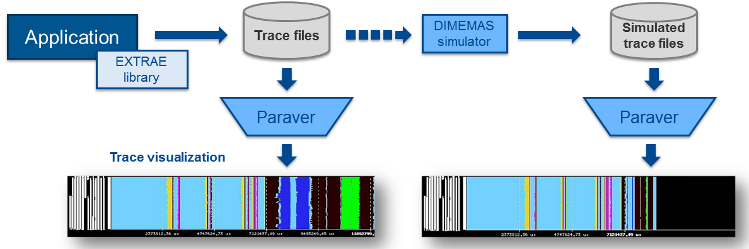
Performance analysis
Since 1991
Based on traces
Open Source: https://tools.bsc.es
Extrae: Package that generates Paraver trace-files for a post-mortem analysis
Paraver: Trace visualization and analysis browser
Dimemas: Message passing simulator

Slide 23
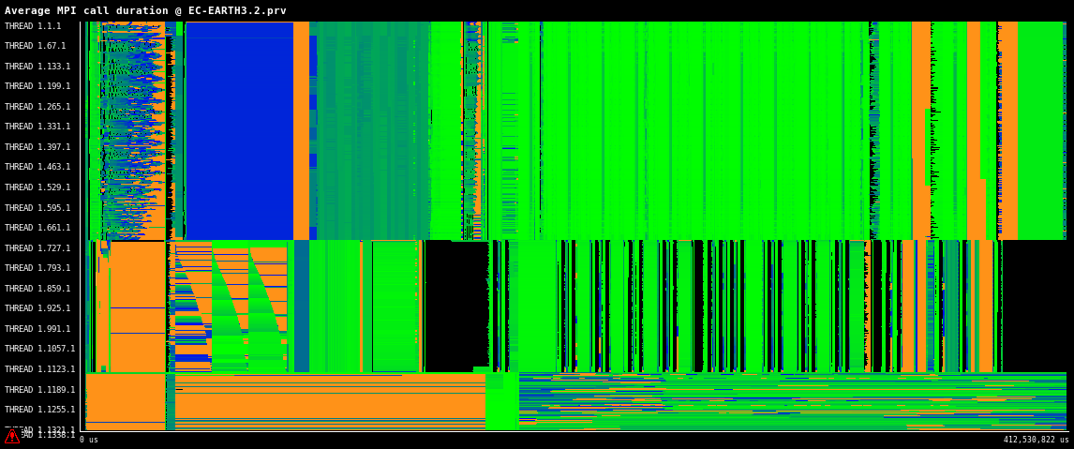
EC-Earth T1279-ORCA12: Performance analysis

Slide 24
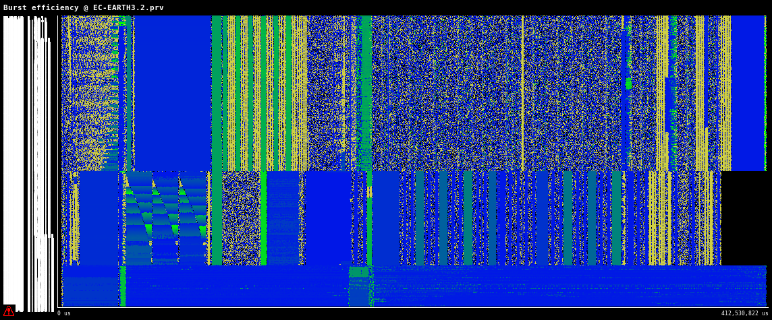
EC-Earth T1279-ORCA12: Performance analysis

Slide 25
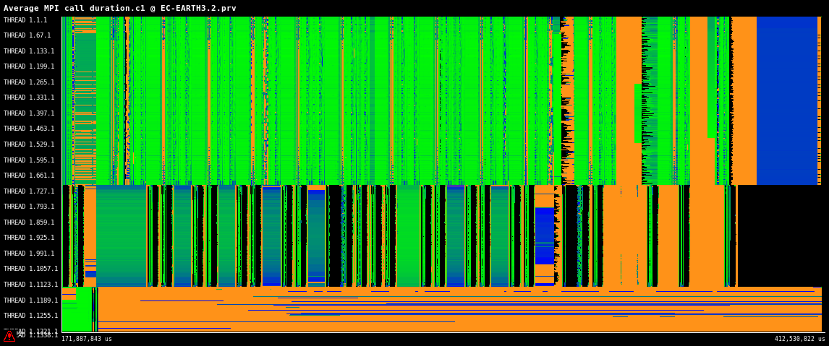
EC-Earth T1279-ORCA12: Performance analysis

Slide 26
Challenges (bottlenecks)
Reduce I/O overhead → Interface IFS with XIOS
NEMO-LIM (ORCA12): Up to 3 SYPD in MareNostrum4 (LIM -> 2OCE stp)
Detach sea-ice from NEMO. Couple through OASIS.
Update IFS to newest cycle, using octahedral grid
Update NEMO to NEMO4 (and beyond)
Most of these improvements can be real in EC-Earth4

Slide 27
Results and conclusions
Now the EC-Earth T1279-ORCA12 configuration is:
Developed and shared among EC-Earth consortium partners
Deployed and tested in MareNostrum3 and MareNostrum4 HPC systems
Used in production for H2020 projects such as PRIMAVERA using PRACE resources
Used to investigate the scalability of ultra-high resolution coupled models, enabling to push computational challenges of the current HPC generation

Slide 28
Thank you
THANK YOU
miguel.castrillo@bsc.es
The Implementation Phase of PRACE receives funding from the EU’s Horizon 2020 Research and Innovation Programme (2014-2020) under grant agreement 730913
The ESiWACE project has received funding from the European Union’s Horizon 2020 research and innovation program under grant agreement No 675191
This material reflects only the author's view and the Commission is not responsible for any use that may be made of the information it contains.

