Slide 1
Sub-seasonal to seasonal climate predictions for wind energy forecasting
A Soret (1), V Torralba (1), N Cortesi (1), I Christel (1), Ll Palma (1), A Manrique-Suñén (1), Ll Lledó (1), N González-Reviriego (1) and F J Doblas-Reyes (1,2)
(1) Barcelona Supercomputing Center (BSC), Barcelona, Spain
(2) Institució Catalana de Recerca i Estudis Avançats (ICREA), Barcelona, Spain

Slide 2
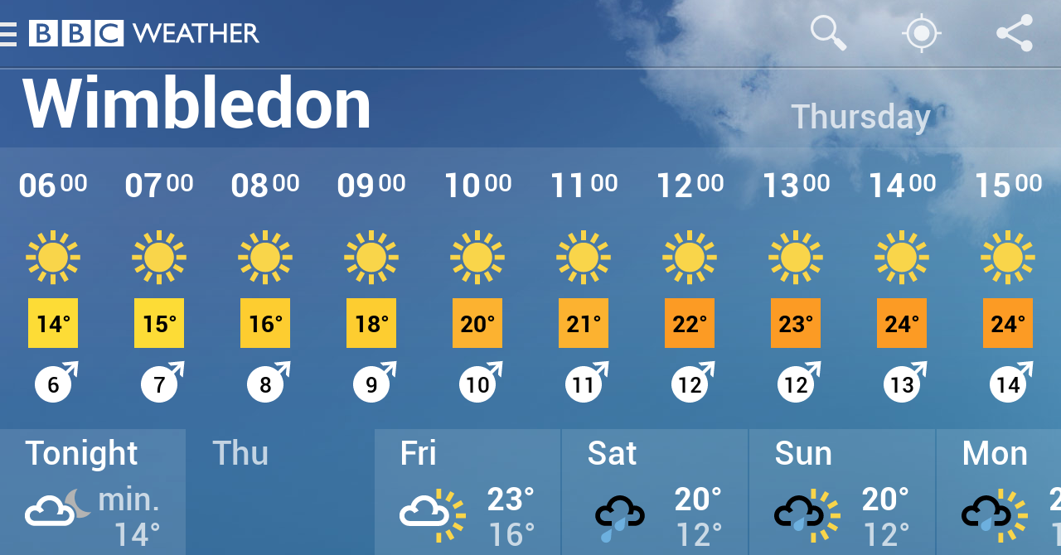
Weather forecast is a familiar concept …
Notes:
2

Slide 3
… and climate change too, but what about climate variability?
Link: https://youtu.be/PhbdyNnUliM

Slide 4
Context and motivation
Energy sector routinely uses weather forecast, especially between day-ahead and one week. Beyond this time horizon, climatological data are used.
Notes:
While the energy sector has routinely been using weather forecasts of up to 15 days (Dubus, 2010), beyond this time horizon, climatological data (typically 30-year averages) are used. A common assumption in this method is that future conditions will be similar to past conditions. This assumption entails two inherent shortcomings. The first one is that past conditions can be highly variable, which can make them of limited use to forecast future ones. The second one is that climatology cannot predict events which have never happened before, e.g. extreme events, which can be particularly harmful and whose prediction is of special interest for stakeholders. Our knowledge of climatology is based on a finite sample of past events. This sample is limited in time, and doesn’t need to be fully representative of what can happen. Moreover, a climatological approach does not take into account changes in atmospheric dynamics, such as those caused by climate change. Climate change may render past conditions useless for predicting future events, as they may no longer be reproduced.

Slide 5
Predictability
How can we predict climate for the coming season if we cannot predict the weather next week? Slow components (sea surface temperature, soil moisture, etc.) force the atmosphere.
OCEAN
CIRCULATION
SOIL MOISTURE
ATMOSPHERE
SNOW COVER
SEA ICE EXTENT
Notes:
Even if the chaotic behaviour of the atmosphere does not allow predicting with accuracy the changing weather beyond a few days, climate predictions are feasible because atmospheric variability on monthly/seasonal time-scales is modulated by slowly-varying boundary conditions and can retain memory from internal processes with very slow damping
These atmospheric fluctuations drive substantial surface climate variability over land. Indeed, covariability between remote regions - often called teleconnections - explain a large part of Earth’s climate variations and represent an important source of climate predictability (e.g. North Atlantic Oscilation; Figure 2). Tropospheric and stratospheric pathways have been found to play a key role in connecting internally-generated and radiatively-forced anomalies at mid-latitudes, as well as in settling tropical-extratropical and polar-nonpolar interactions (e.g. Smith et al., 2012, 2016; Scaife et al., 2014). These large-scale atmospheric variability modes are usually described in terms of (low-frequency) teleconnection patterns and/or (high-frequency) weather regimes.
The feasibility of seasonal prediction largely rests
on the existence of slow, and predictable, variations
in the soil moisture, snow cover, sea-ice, and ocean
surface temperature,
2
and how the atmosphere inter-
acts and is affected by these boundary conditions. At
seasonal time scales, the storage of heat and moisture
by the ocean and the land and the presence or absence
of snow and sea ice become important factors. The
El Ni
̃
no-Southern Oscillation (ENSO
3
) is the main
process that contributes to the forecast quality on sea-
sonal time scales.
4–7
A warm sea surface temperature
anomaly (SSTA) in the tropical Pacific Ocean leads to
increased heat flux from the ocean to the atmosphere
which, if sufficiently large can alter the atmospheric
boundary layer and ultimately change the structure of
the rainfall and the release of latent heat in the tropo-
sphere. The extra latent heat release will impact the
atmospheric circulation leading to climatic anomalies
in remote regions of the globe.
At time scales shorter than a season, efforts to formu-
late forecasts at the sub-seasonal time scale have only
recently begun with the development of a Madden-
Julian Oscillation (MJO)

Slide 6
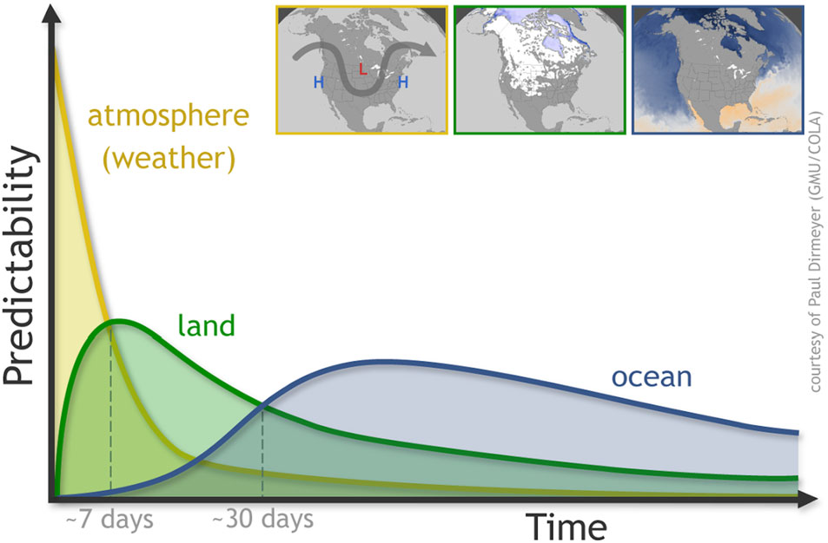
S2S Forecast range and skill
(Source: Mariotti et al. 2018 )

Slide 7
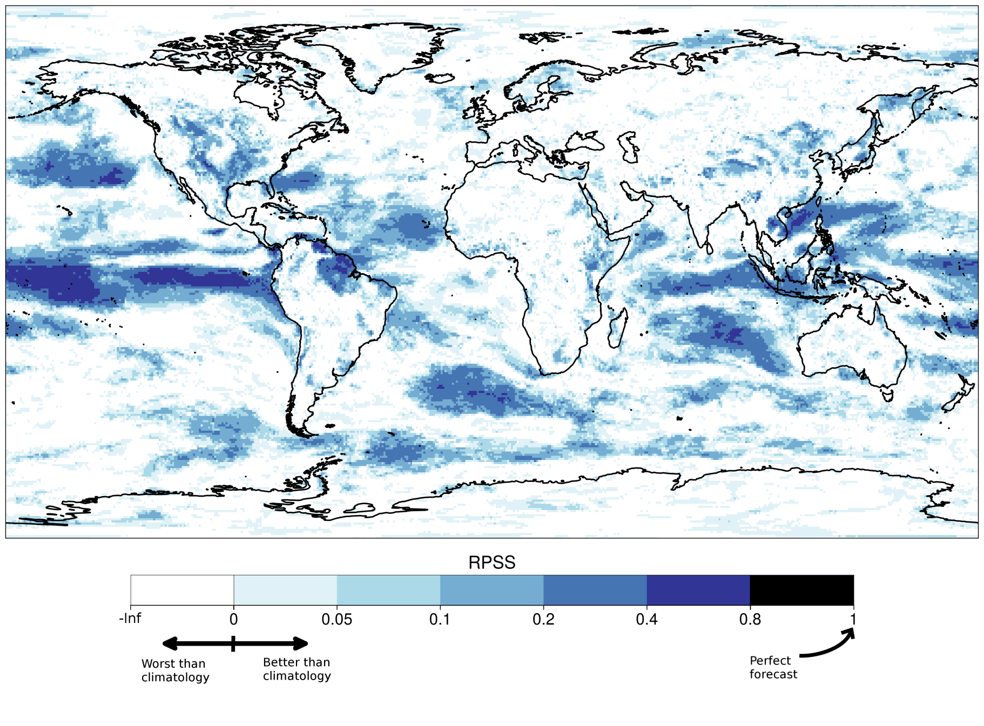
S2S skill
Skill assessment for DJF (1981-2013)
System: ECMWF S5
Reanalysis: ERA-Interim
Displaying: Ranked Probability Skill Score [RPSS]
“A prediction has no value without an estimate of forecasting skill based on past performance”

Slide 8
S2S skill evolution with lead time
Fair RPSS of 10-m wind speed for the Monthly Prediction System of February (1996-2015).

Slide 9
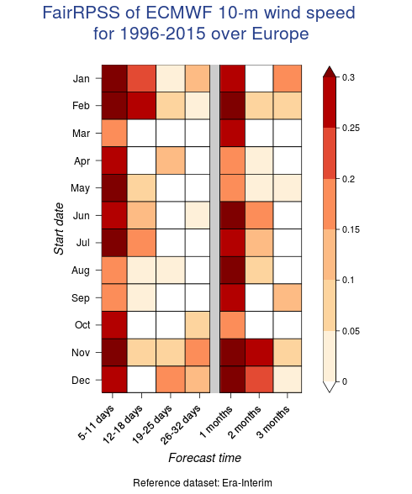
S2S skill evolution over the year
Forecast skill characterization in the Fino 1 area for different start dates (Y axis) and forecast window (X axis).

Slide 10
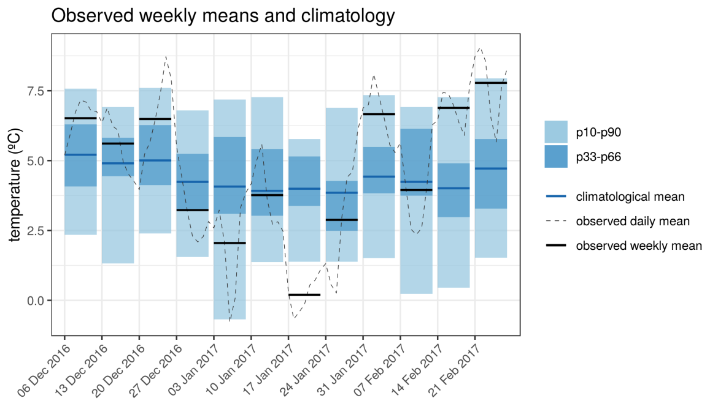
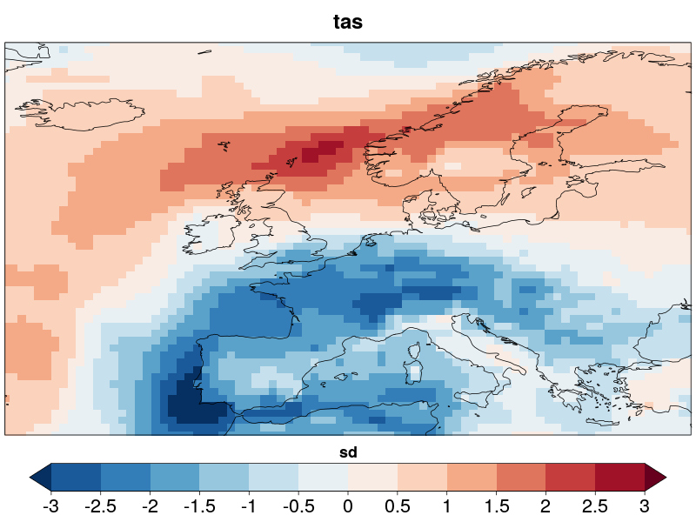
Cold spell over Europe and lower than usual wind power generation: 17-23/01/2017
.. and its consequences in monthly electricity demand in France:
2m Temperature (17-23 Jan)
Source: https://www.rte-france.com
On 20/01/2017 demand reached a peak high of 94.2 GW (highest since Feb 2012)
Temperature anomalies for the week 17-23/01/2017. ERA-Interim with respect to climatology (1981-2017).
Notes:
10

Slide 11
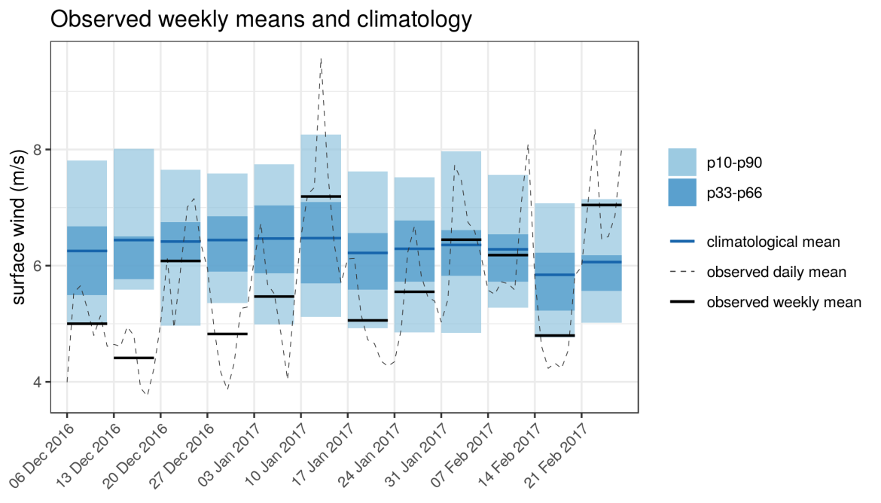
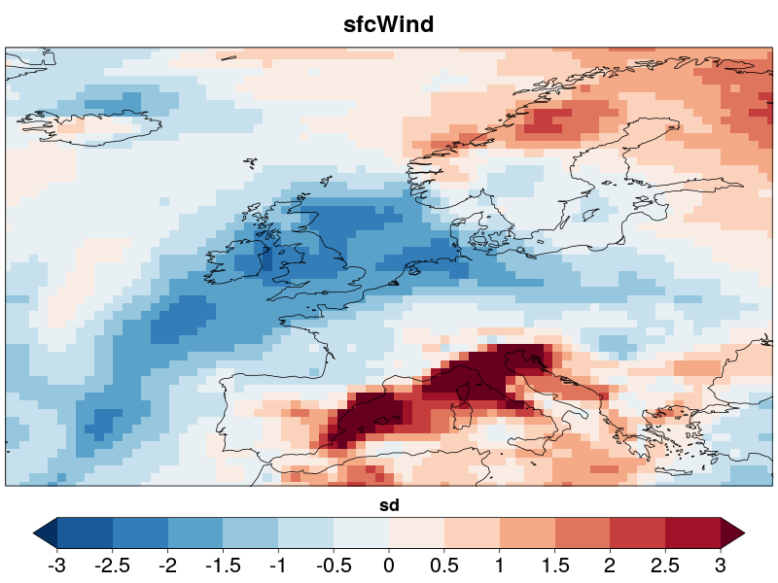
Cold spell over Europe and lower than usual wind power generation: 17-23/01/2017
Monthly wind power generation in France:
10m wind speed (17-23 Jan)
Source: https://www.rte-france.com
The high demand and low winds led to an increase in energy prices in France (highest since Feb 2012)
Wind speed anomalies for the week 17-23/01/2017. ERA-Interim with respect to climatology (1981-2017).
Notes:
11

Slide 12
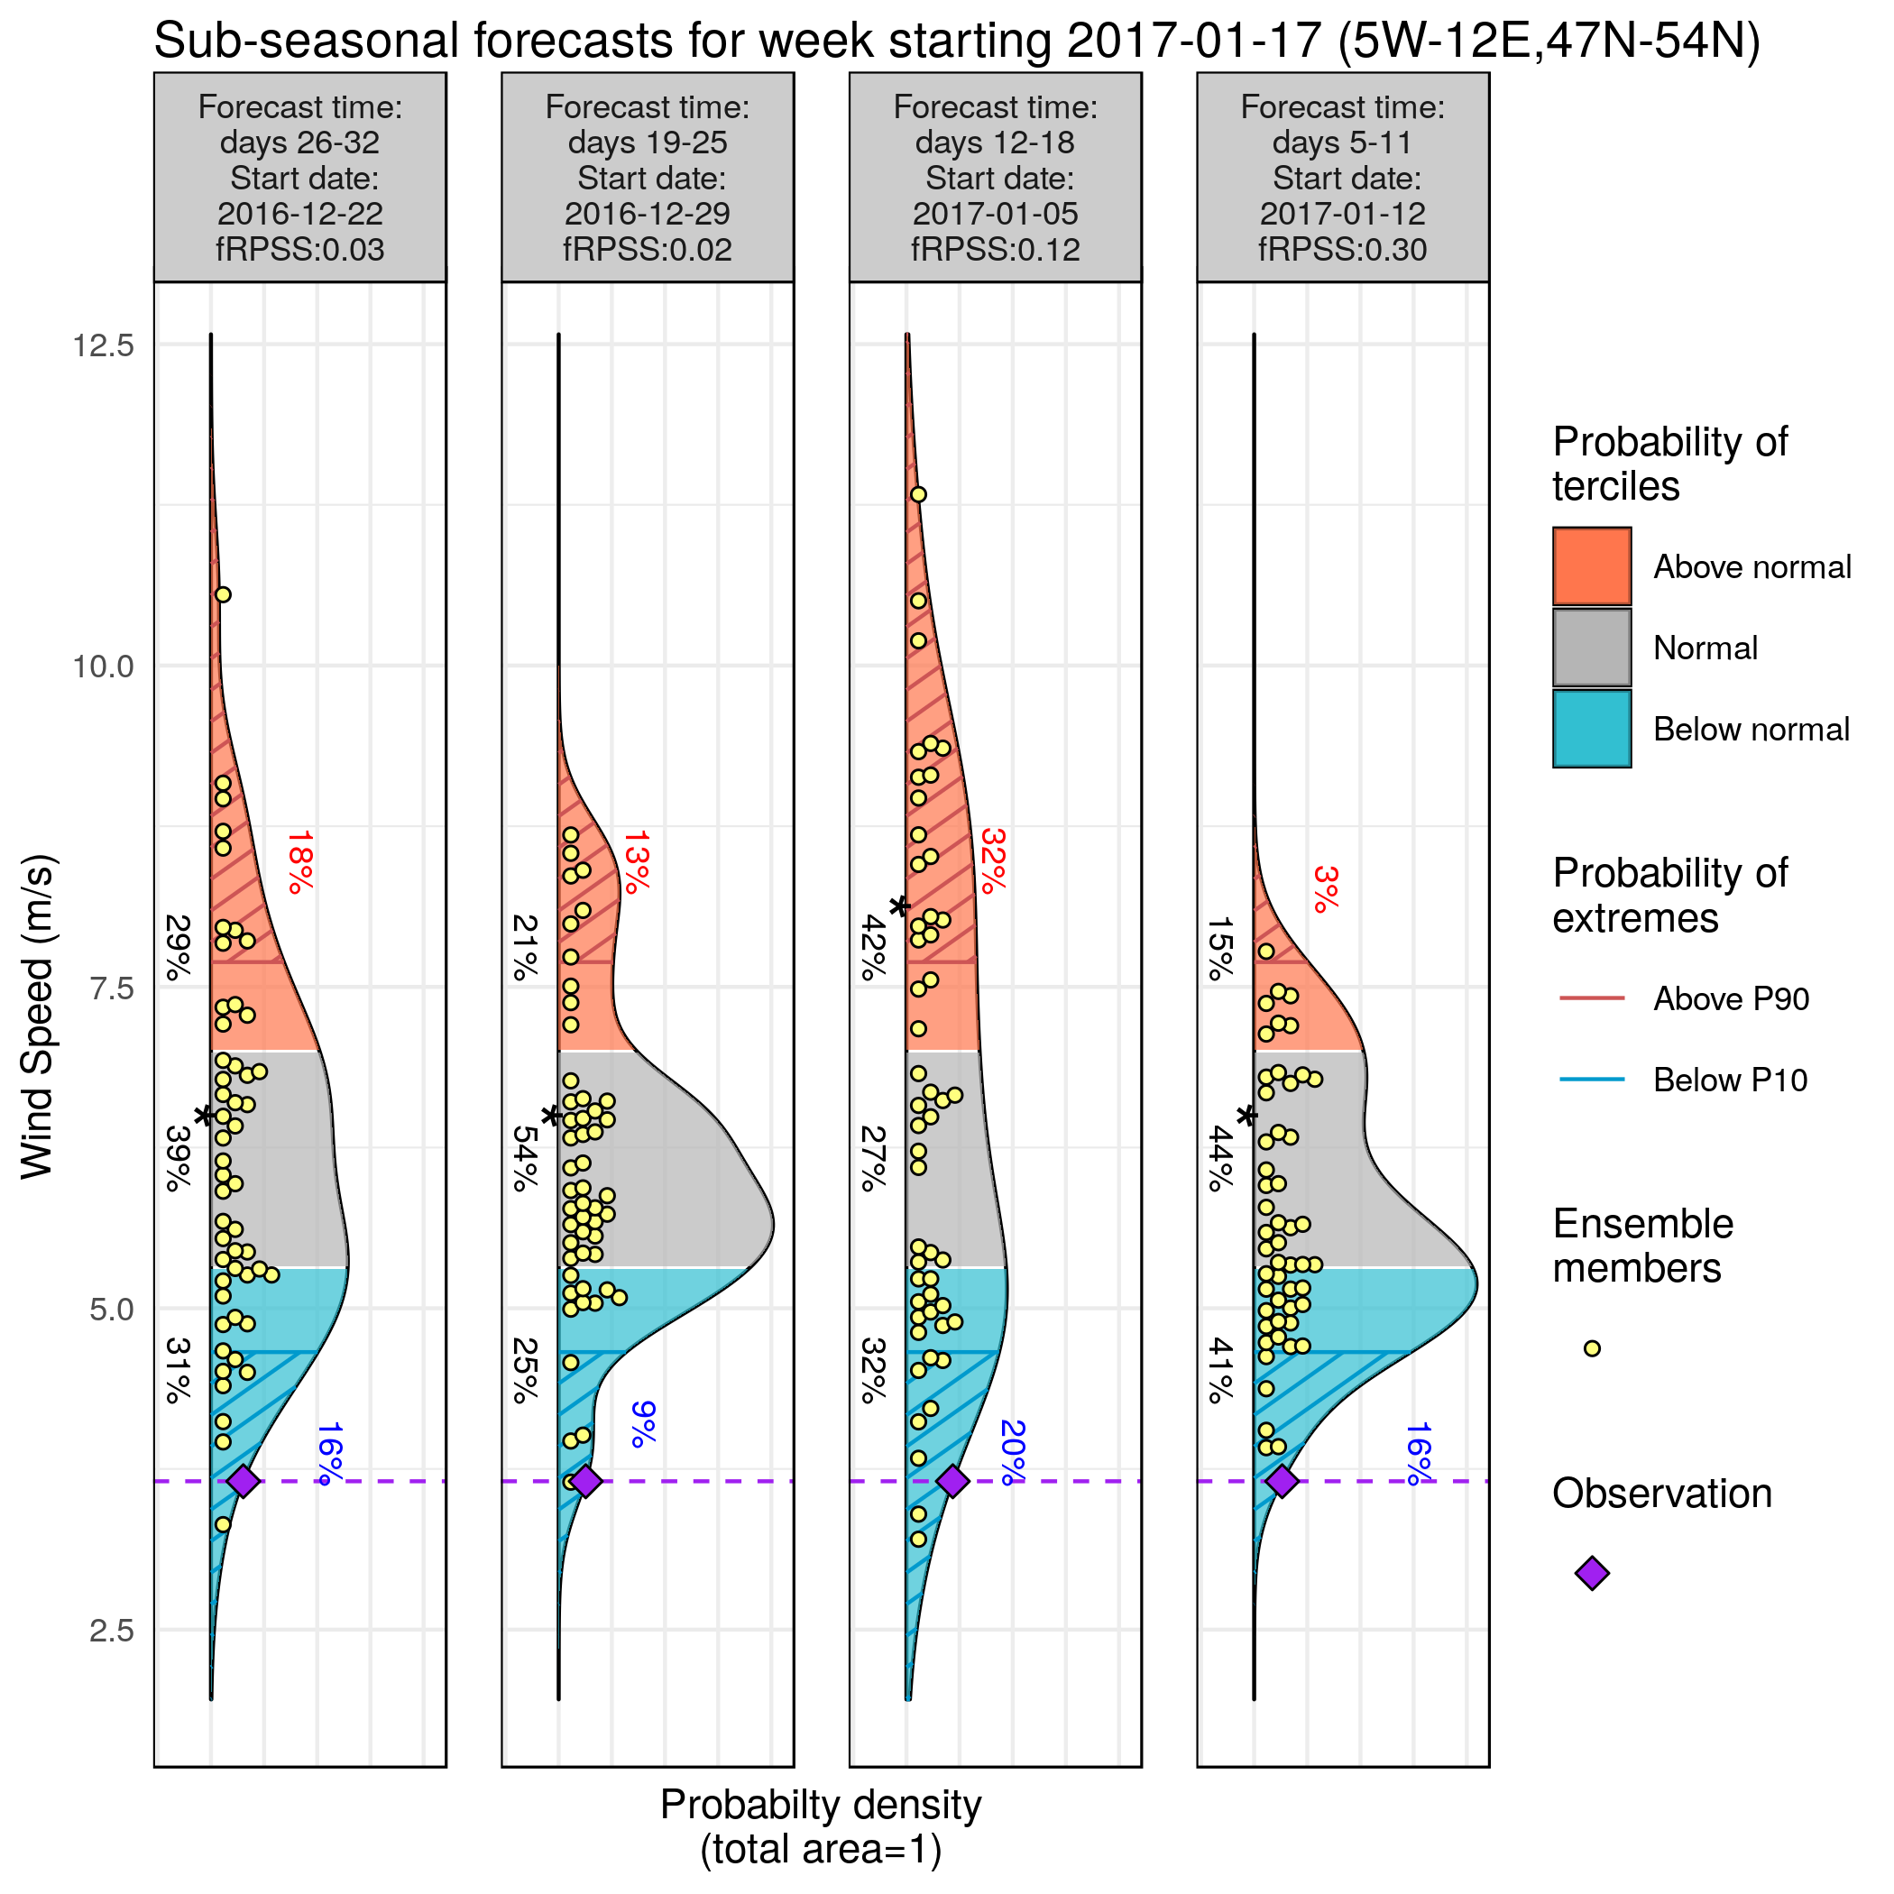
Wind speed forecasts
System: ECMWF monthly prediction system
Reanalysis: ERA-Interim
Bias adjusted –calibrated
Hindcast: 1996-2015
Area: 5W-12E/47N-54N
Notes:
12

Slide 13
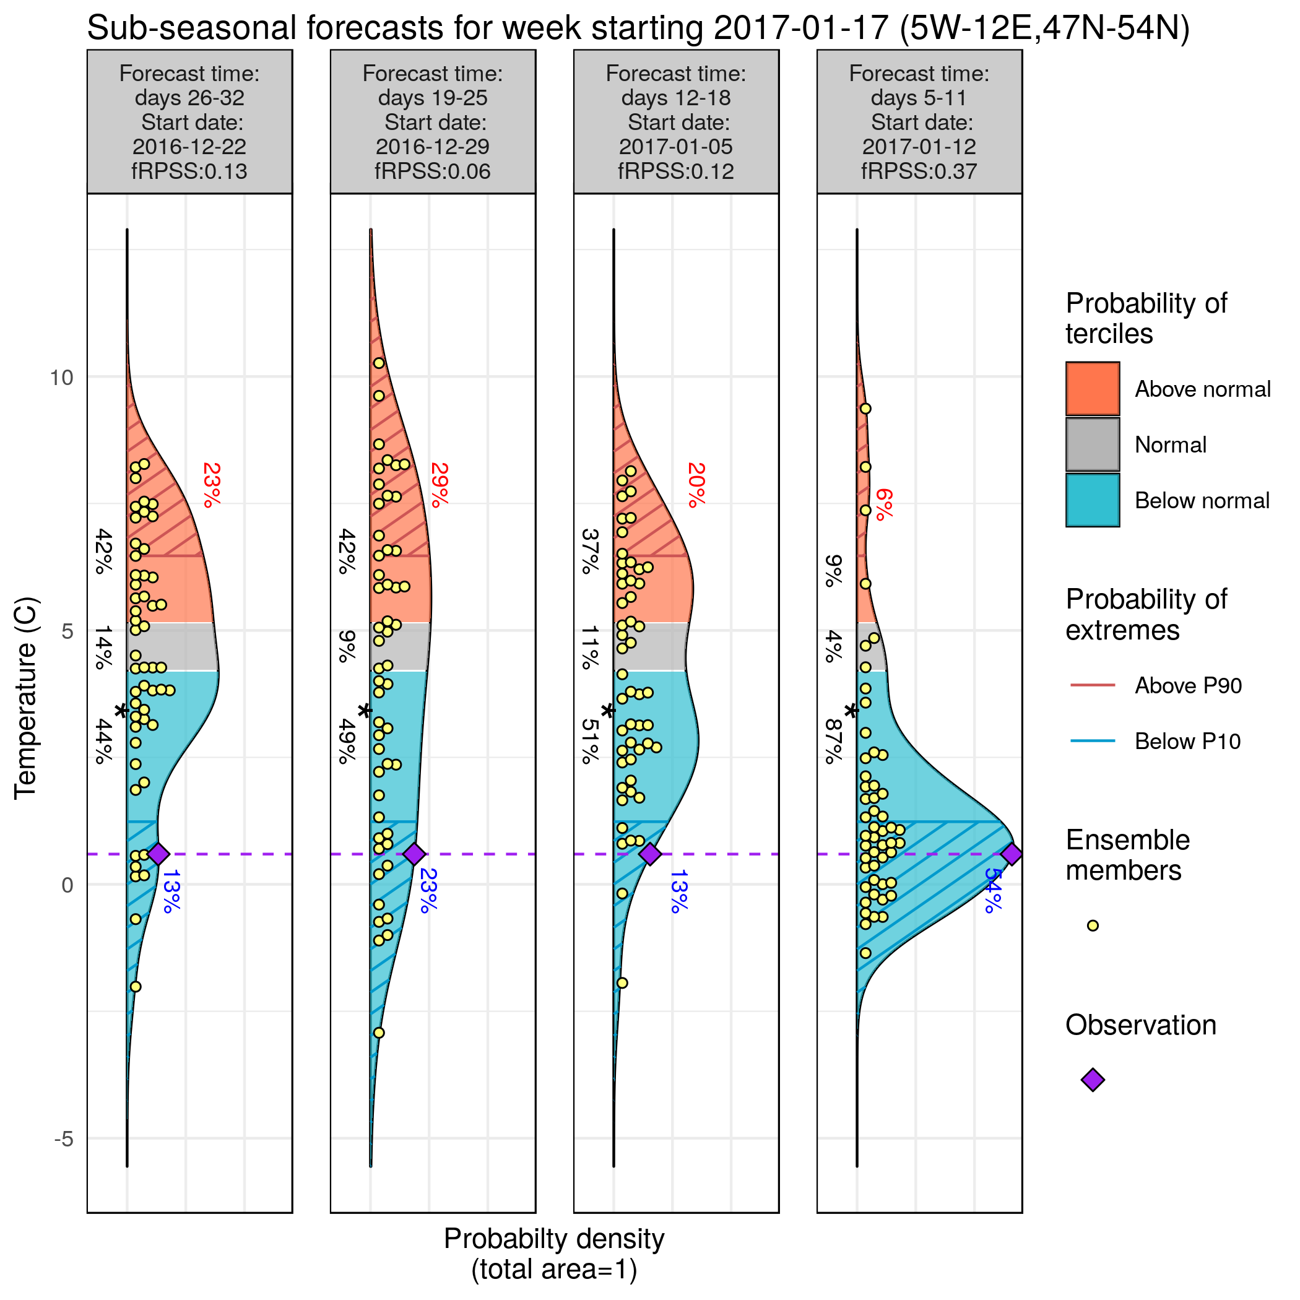
Temperature forecasts
Confidence in anticipating episodes of high electricity demand a few weeks in advance, although less confidence in ensuring that wind energy supply can meet the demand.
System: ECMWF monthly prediction system
Reanalysis: ERA-Interim
Bias adjusted –calibrated
Hindcast: 1996-2015
Area: 5W-12E/47N-54N
Notes:
13

Slide 14
Conclusions
Current methodologies assume that future conditions will be like those of the past. This approach makes impossible to anticipate extreme events that have never happened before.
Wind speed forecasted by S2S exhibits predictability some weeks and months in advance in important regions for the energy sector such as the North Sea.
Future work:
From the scientific point of view: to improve the utility of forecasts by incorporating skilful information of the large-scale teleconnection patterns at different time scales and multi-model ensembles.
From the user point of view: economic assessment of the case studies.

Slide 15
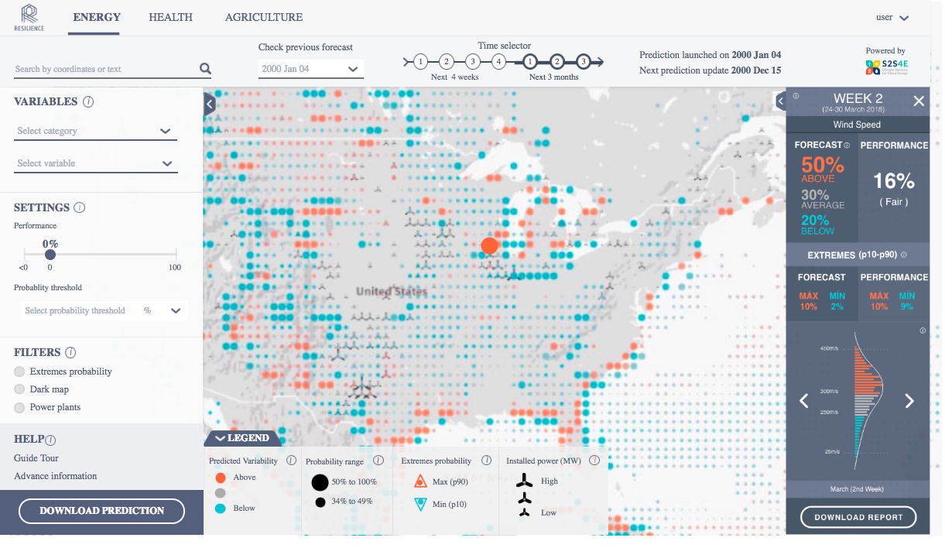
Launch event. EUSEW 2019 20 June, 20th 2019
http://www.bsc.es/ess/resilience/map.html

Slide 16
Supplementary material

Slide 17
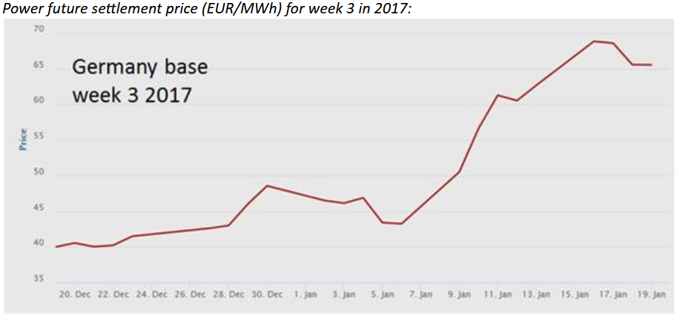
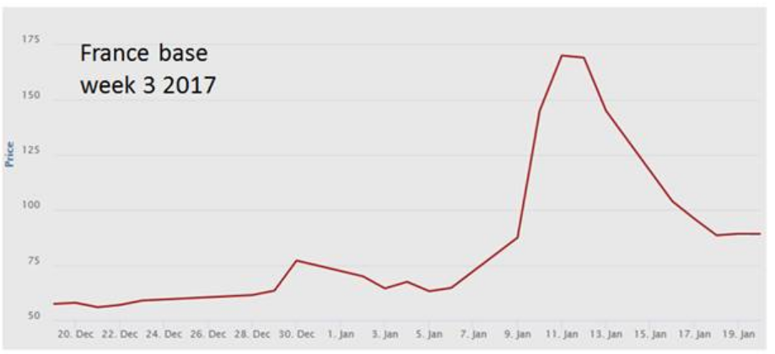
Future work: economic assessment of the case studies
Power Future Settlement Price / France & Germany 2017

