Slide 1
Helsinki, 20 May 2017
EC-Earth users needs: survey on workflows tools
TWG

Slide 2
Introduction
BSC asked the TWG about the need to build a strategy for a common workflow manager tool.
It could be Autosubmit, Cylc or another tool.
The workflow management system should remain optional.
Workflow tools are not only made for production runs but also for new users, allowing them to start earlier to use the model.
They are also useful in the testing/development phase.
The needs of the community should be taken into account.
BSC asked the TWG about taking the lead in this topic in order to build a strategy to deploy a workflow tool endorsed by the TWG.
The first action was to create a survey to know how the users are running the model and which are their needs.

Slide 3
Results
Participants: 34 ( 12 countries / 18 institutions )
Country | Institution | # participants
Sweden | Lund (3), SU (2), SMHI (2) | 7
Spain | BSC | 6
Netherlands | KNMI (3), NSC (1), IMAU(1) | 5
Finland | FMI (3), CSC (1) | 4
Belgium | UCL | 3
Germany | AWI (1), KIT (1) | 2
Denmark | DMI | 2
Italy | ENEA | 1
Norway | UiB | 1
Portugal | UL | 1
United Kingdom | University of Oxford | 1
Ireland | ICHEC | 1

Slide 4
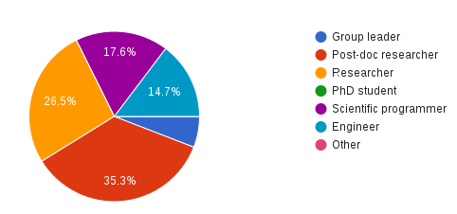
Results
Participants profile

Slide 5
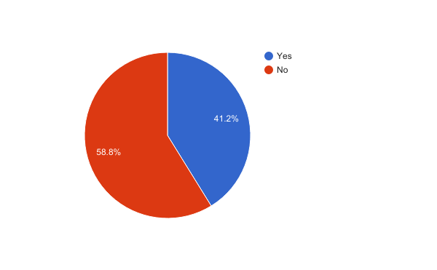
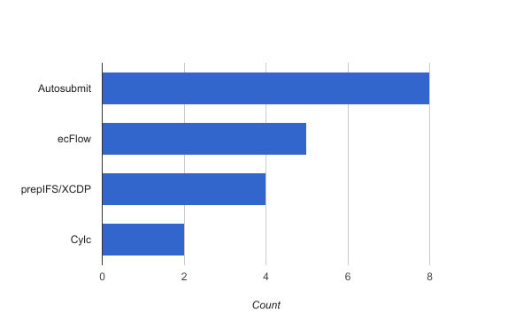
Results
Have you used a workflow management system?

Slide 6
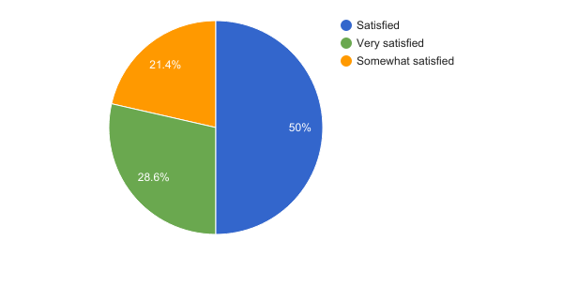
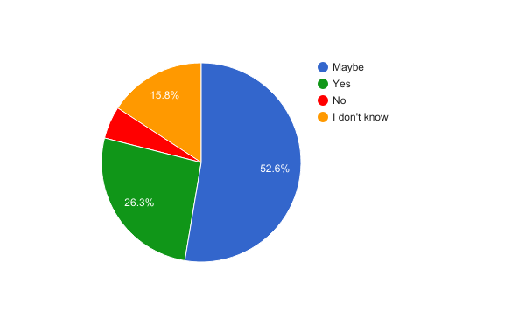
Results
15 responses (Yes)
How satisfactory your experience is?
19 responses (No)
Would a workflow management system be useful to your work?

Slide 7
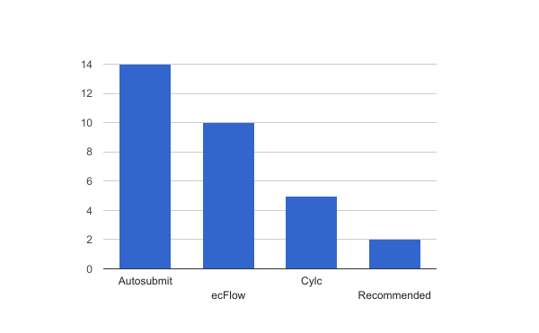
Results
Which one of the following workflow management systems would you be interested to learn about?

Slide 8
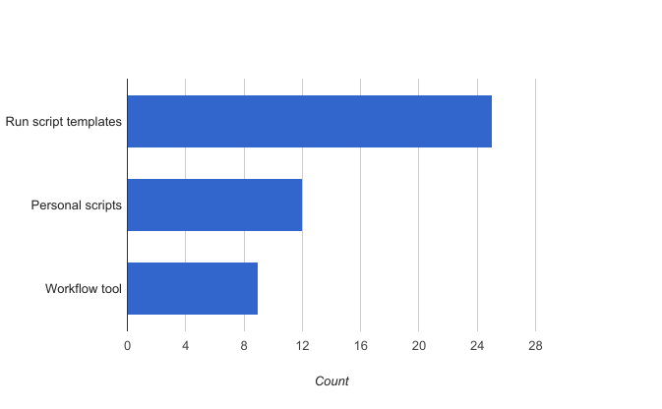
Results
How do you run EC-Earth?

Slide 9
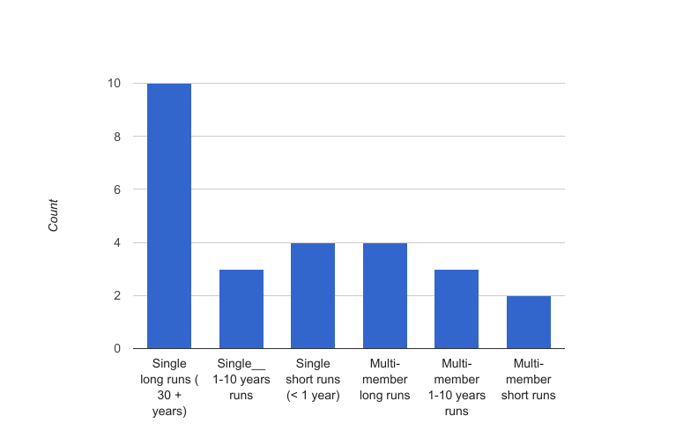
Results
Model simulation production

Slide 10
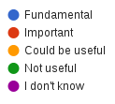
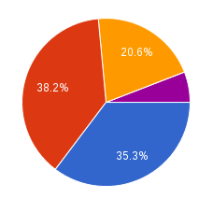
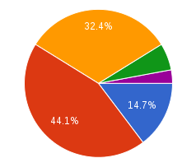
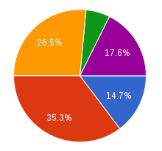
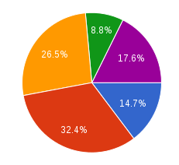
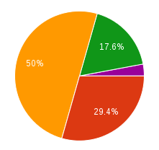
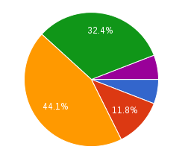
Results
Database
E-mail notifications
Complex workflows
Jobs wrapper
GUI
Clock triggered jobs

Slide 11
Conclusions
Some people are interested in a workflow management system common for EC-Earth.
Option Autosubmit is available and will be maintained.
Option Cylc will be implemented in the next 1-2 years.

Slide 12
Q & A

Slide 13
Thank you!
For further information please contact
domingo.manubens@bsc.es

Slide 14
EXTRA

Slide 15
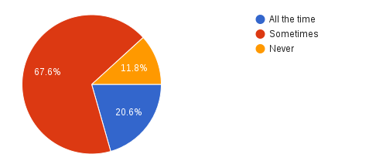
Results
Do you modify the code?

Slide 16
Results
Participants activities

