Slide 1
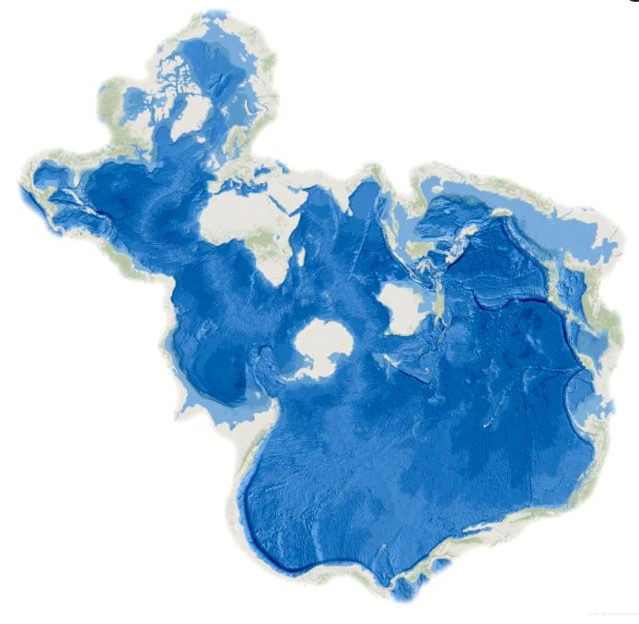
Climate knowledge coproduction
Dragana Bojović
Earth Sciences Department | Earth System Services
Knowledge Integration Team
8 April 2024
Image credits: John M Nelson

Slide 2
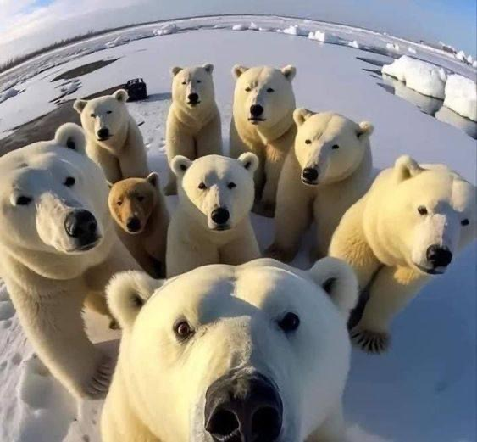
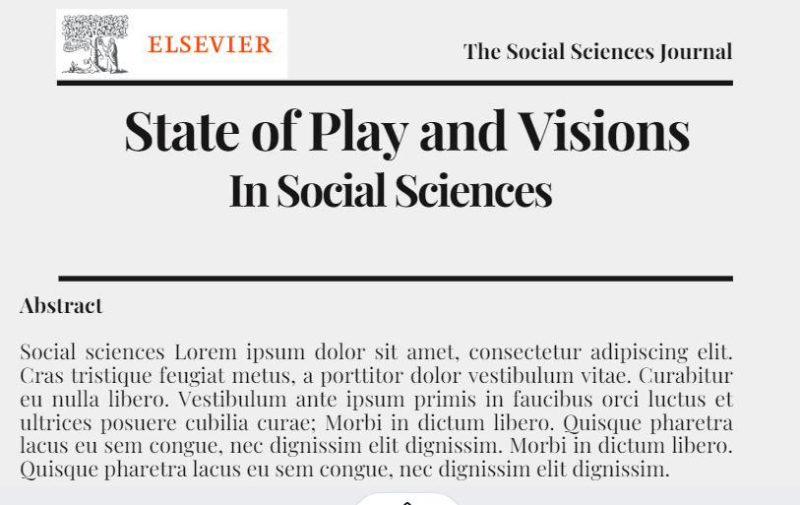
Notes:
a viewpoint from a social science / climate change adaptation direction

Slide 3
Agenda
Inclusive climate change knowledge
leave no one behind
the role of bridging agents
Climate change adaptation in different contexts
from the warm heart of Africa
to here, round the corner
New kids on the block
but the good old power hierarchies
Scales in climate services
“The problem of relating phenomena across scales is the central problem in biology and in all of science” (Levin, 1992, p. 1961)
User engagement
Science communication/dissemination

Slide 4
Moving from a binary/polarized to inclusive approach
To transform society we need to shift from the “us vs them” perspective, acknowledging the entanglements and connectedness and our shared reality (O’Brien, 2021)
Transdisciplinarity and knowledge coproduction
Image credits: John M Nelson

Slide 5
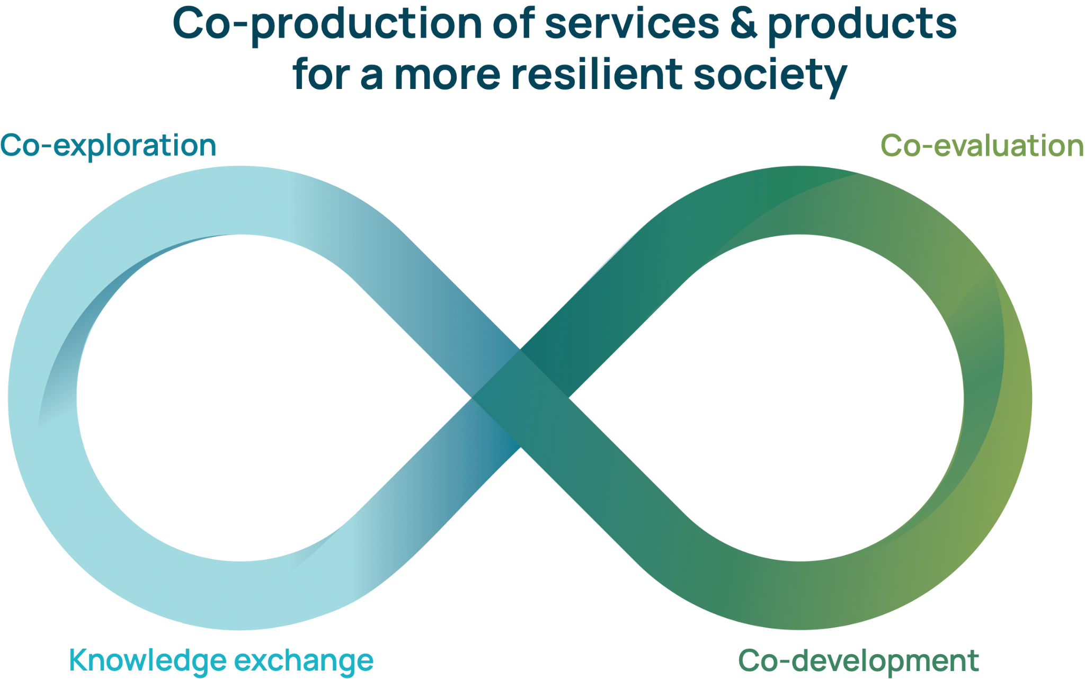
Transdisciplinarity & knowledge coproduction
“Transdisciplinarity, more than a new discipline or super-discipline is, actually, a different manner of seeing the world, more systemic and more holistic.” Max-Neef, 2005
Coproduction is “a complex meeting place where several different academic traditions and practices converge, overlap, affect each other, come into conflict, or cooperate” Bremer and Meisch, 2017

Slide 6
Inclusive approach: crowd or gestalt
"An integrating synthesis is not achieved through the accumulation of different brains." Max-Neef, 2004

Slide 7
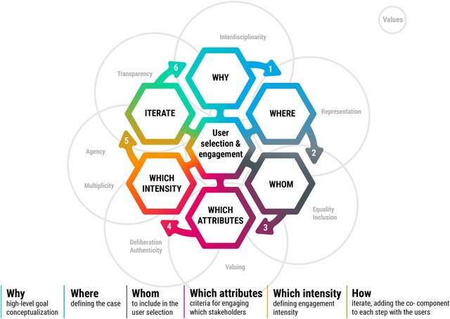
Stakeholder mapping and selection
Baulenas et al. (2023) User Selection and Engagement for Climate Services Coproduction. Weather, Climate and Society 15

Slide 8
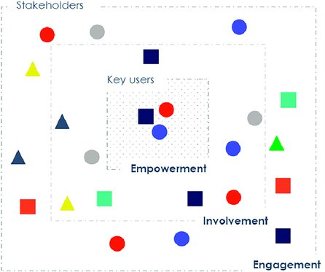
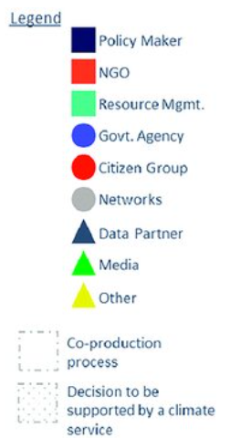
Group F
+’ves
Keen
-’ves
Stakeholder
Well connected
Limited scope to use CS
Department D
+’ves
Influential
Well resourced
-’ves
Low availability
Outsources most technical studies
Agency S
+’ves
Existing CS user
Influential
Well resourced
-’ves
Established protocol with other CS
Minor User
Key User
Notes:
Steps 4 and 5 seek to identify an engagement level for the co-production process of each stakeholder to ensure the service includes attributes such as legitimacy, and balancing power and influence of stakeholder groups
Step 6, “iterate”, explicitly recognises that the mapping and selection is ongoing throughout the project

Slide 9
Boundary work
Boundary organisations or bridging agents that play intermediary role and facilitate partnerships
Boundary objects – artifacts which act as a common focus and bridge across knowledge systems, e.g., the 2ºC goal (Bremer and Meisch, 2017)
Knowledge networks – “It is precisely by rescaling processes that networks have the potential to bypass or subvert conventional hierarchies of power.” (Sayre, 2007)

Slide 10
Climate change adaptation: decision-making in practice

Slide 11
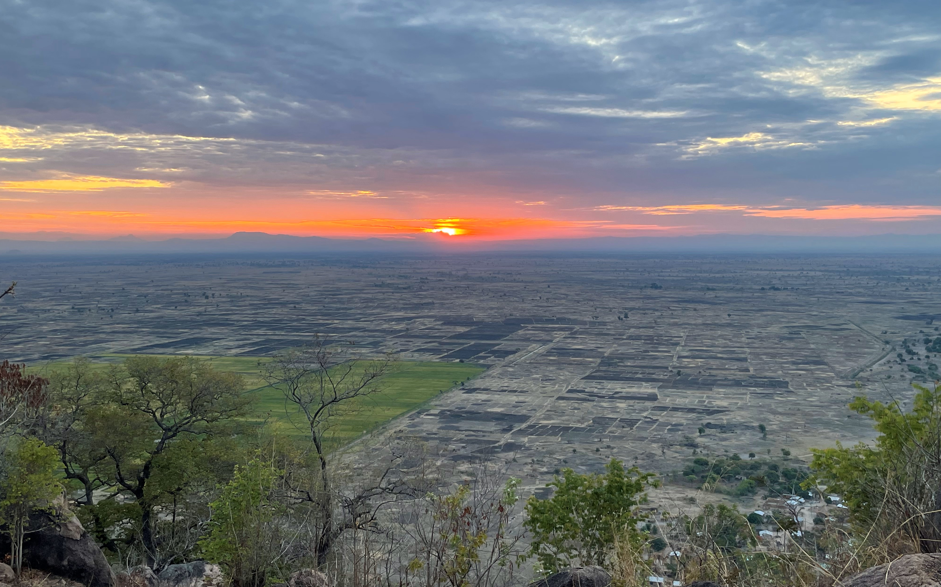
Climate services for food security in Malawi
Maize is the dominant staple crop in the country (97% of smallholders cultivate it), cultivated without irrigation
Average maize yields in Zomba were 1,56 t/ha well bellow the 8-10 t/ha optimum
Volatility in the onset, cessation and intensity of rainy season reduces the yields increasing risk of hunger
Cyclone Freddie killed 200 people and destroyed Blantyre in March 2023
Notes:
“NHMS is a partner in the Project
DCCMS is part of the SARCOF process
The project engaged various stakeholders in a conversation

Slide 12
Seasonal climate forecasting in practice
Regional Climate Outlook Forum (RCOF) - SARCOF
Consensus-based decision making, the forecasts based on:
atmospheric circulation models from regional and international centres
statistical models
participants’ expert interpretation
Verification of African RCOFs: - evidence of systematic errors, - over-forecasting of the normal category
“Encouraging the forecasters to forecast their true beliefs rather than their safest bets”. Position Paper: Verification of African RCOF Forecasts (Mason & Chidzambwa, 2009)
WMO (2020): “Guidance on Operational Practices for Objective Seasonal Forecasting”
Use a procedure that is traceable, reproducible, well-documented
Use dynamical climate models as the primary basis
Notes:
RCOFs serve as an important platform for providing seasonal forecasts. These forums
bring together national, regional and international climate experts, policymakers and other
stakeholders within a region to provide consensus-based, user-relevant climate predictions
(Ogallo et al. 2008; WMO 2016).

Slide 13
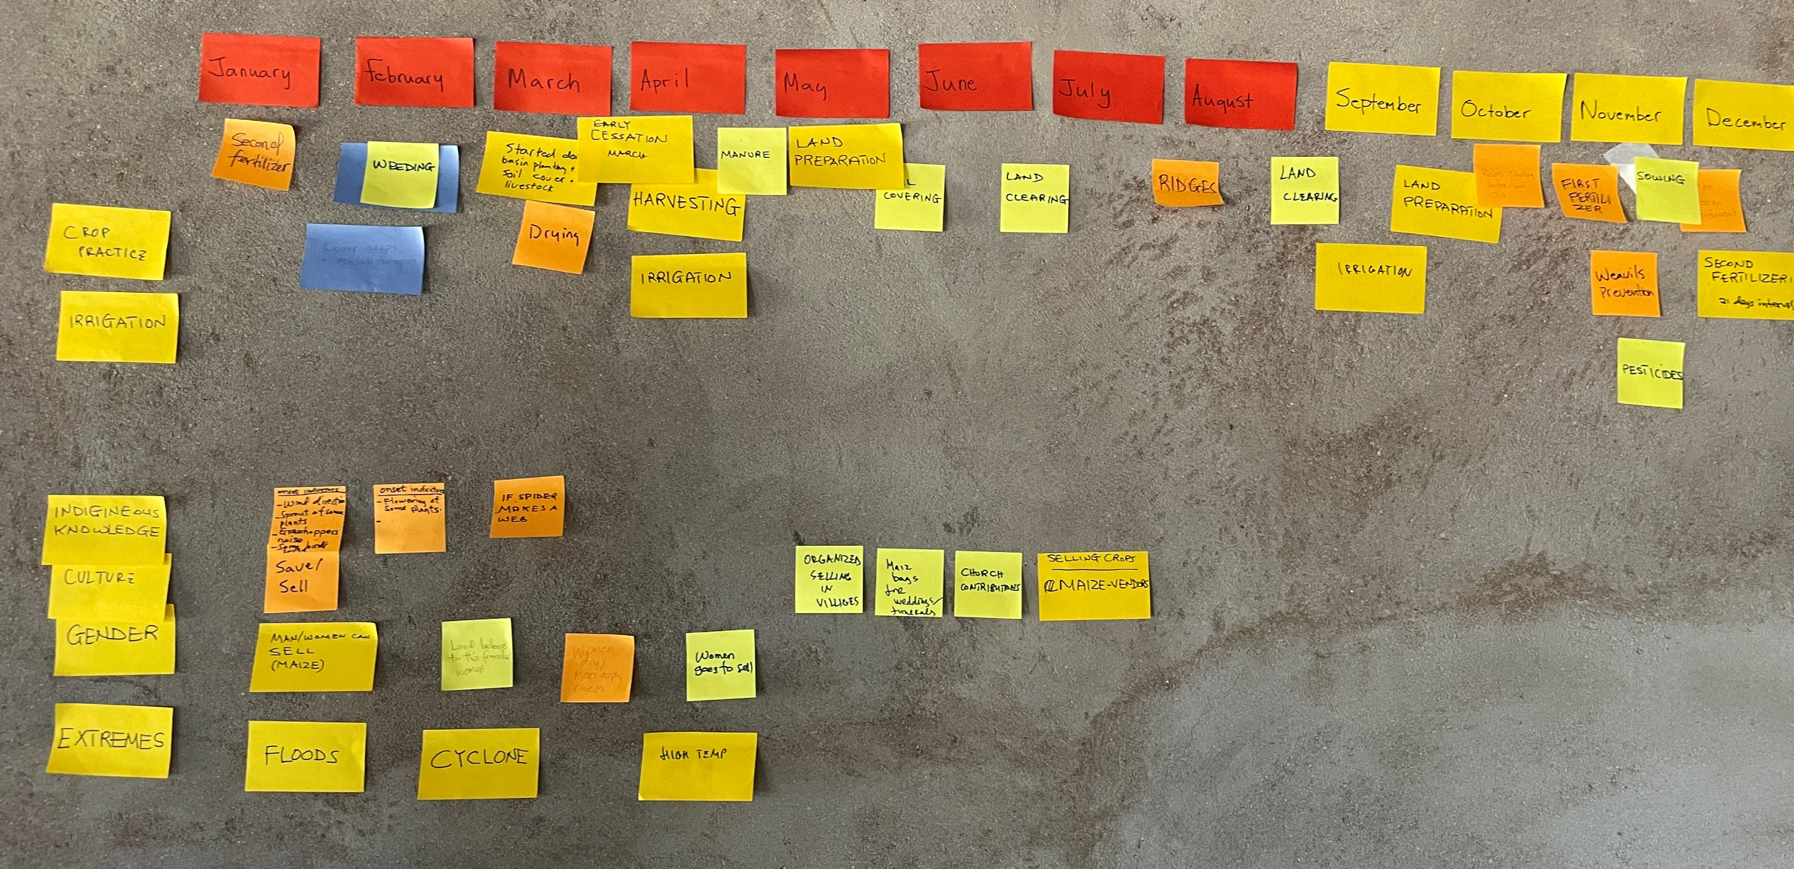
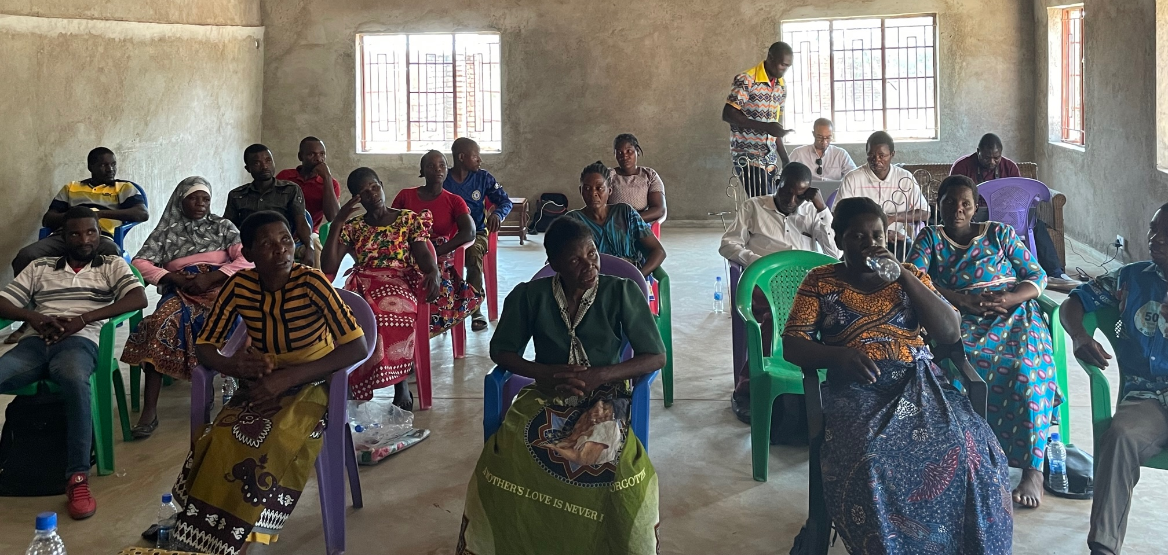
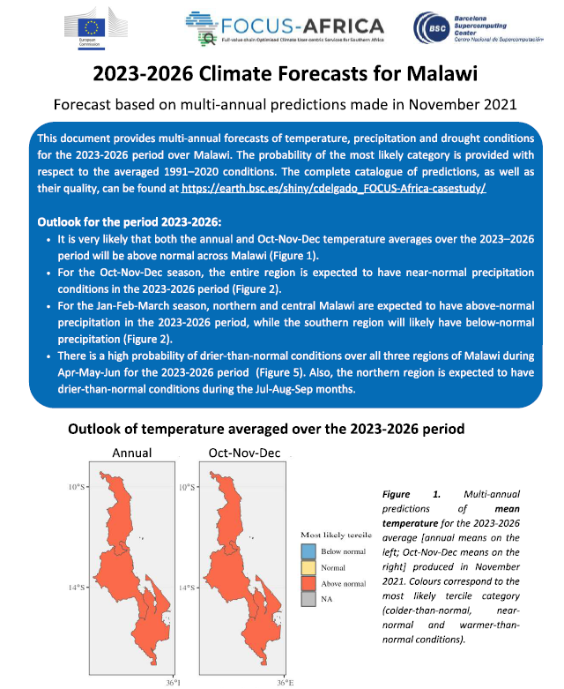
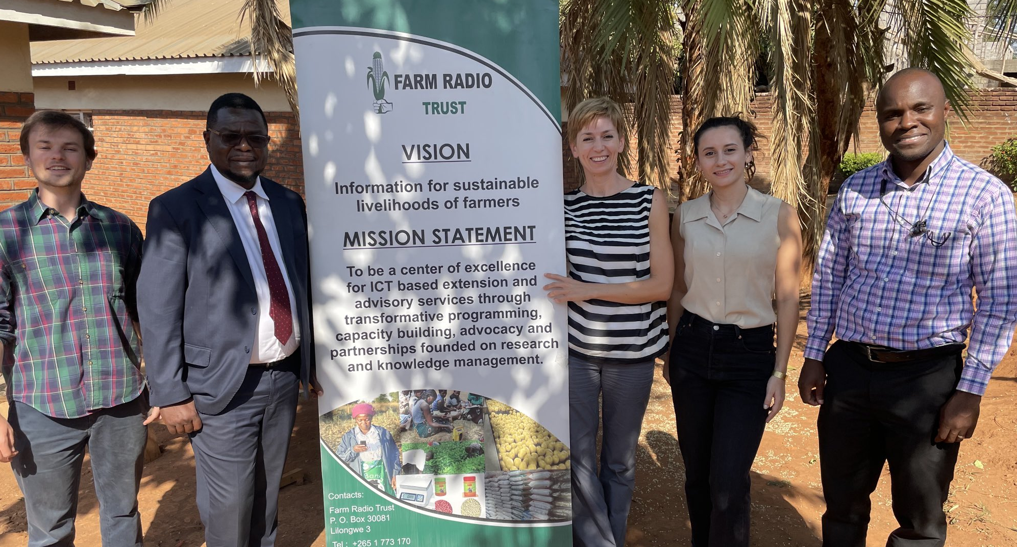
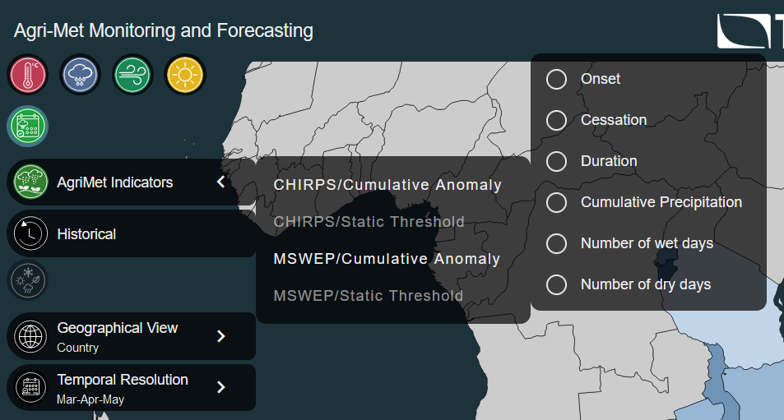
Climate services for food security in Malawi
Map and speak with a broad array of stakeholders
Co-evaluate services with users and keep improving them
Translate user needs into climate indicators
Earlier release of the seasonal outlook
Seasonal forecast updates
Onset and cessation of the rainy season
Time of the dry spell – consecutive dry/wet days
Multi-annual climate information
Co-develop climate services
Zampieri et al. (2023) Seasonal forecasts of the rainy season onset over Africa: Preliminary results from the FOCUS-Africa project. Climate Services, 32

Slide 14
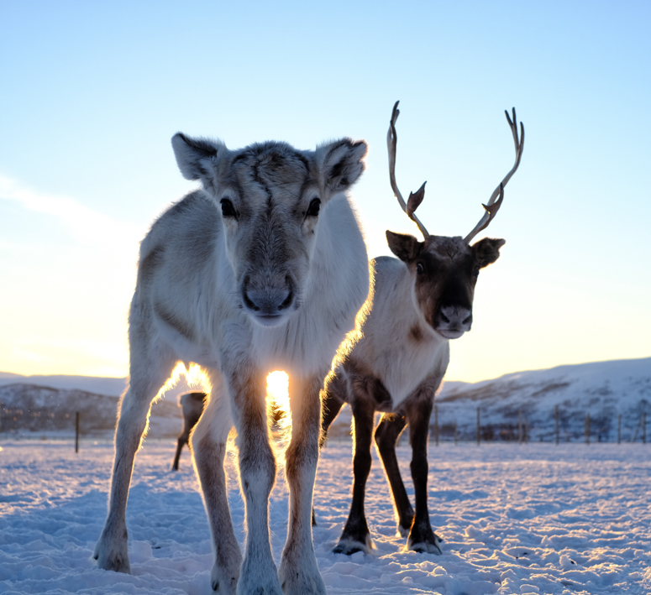
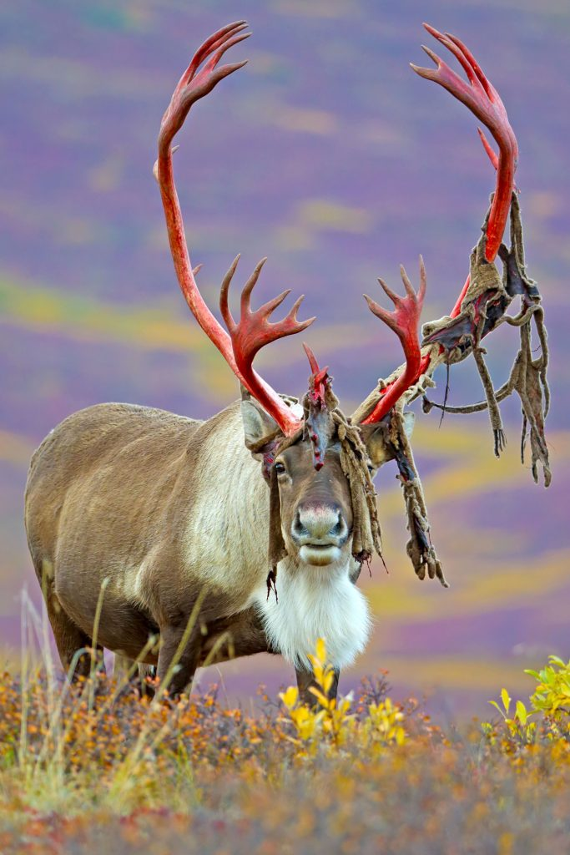
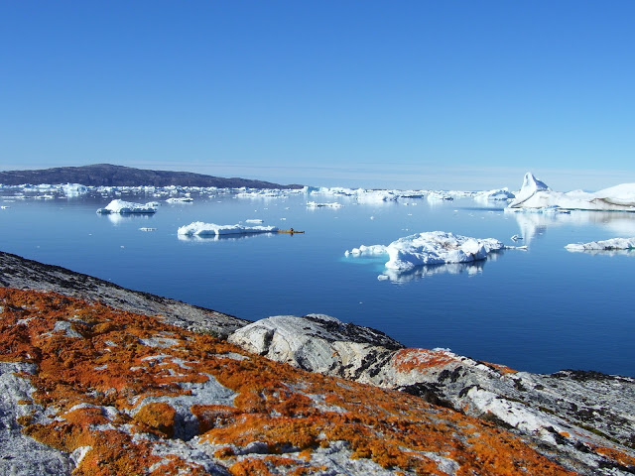
How about emerging needs?
Climate Change Adaptation
in the Arctic
Reindeer and reindeer-herding communities
How to formulate climate services for new and changing adaptation needs?

Slide 15
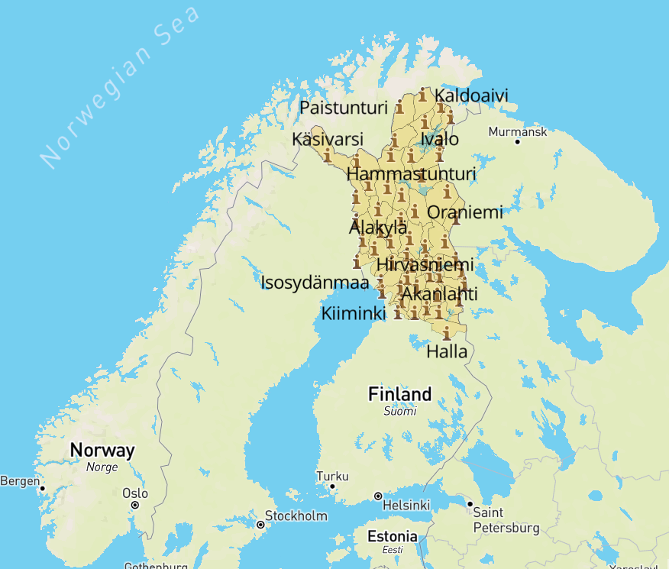
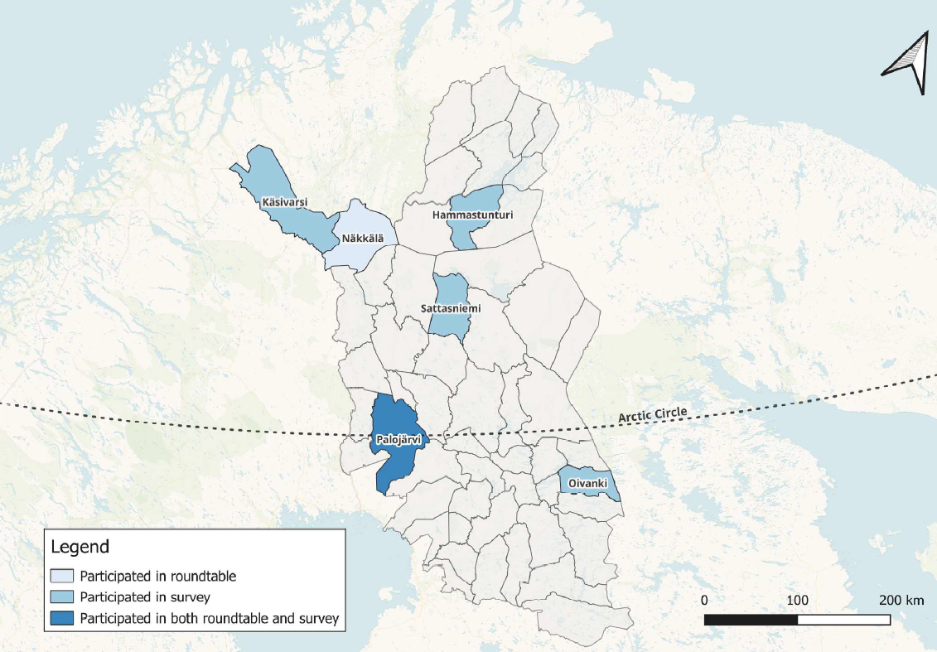
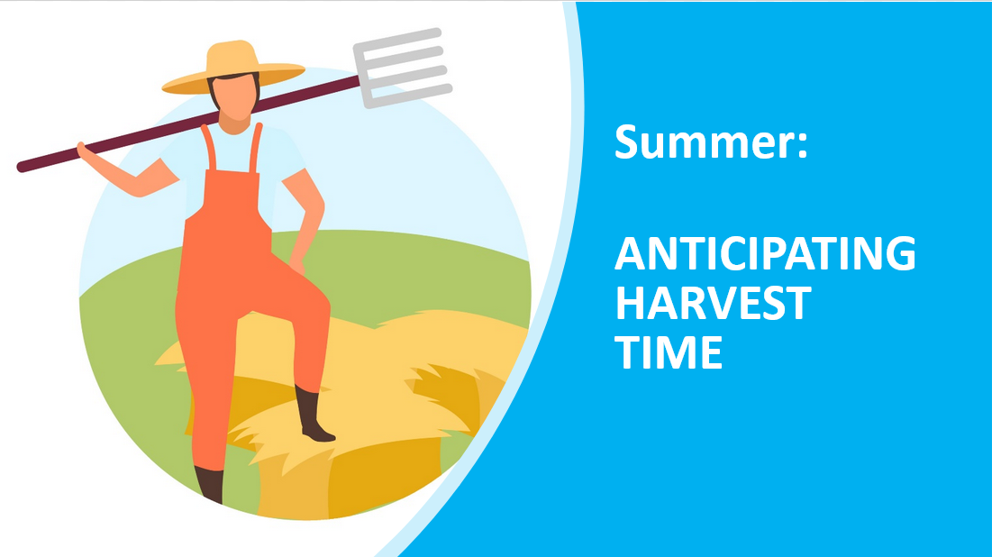
Co-creating climate adaptation sorties
From past case studies to anticipating the future
Finnish Lapland is divided into 54 herding cooperatives called paliskunta
Terrado, M., Bojovic, D. et al. (2023). Good practice for knowledge co-development through climate related case studies. Climate Risk Management
Terrado et al. (2024) Climate change adaptation stories: Co-creating climate services with reindeer herders in Finland. Science of the Total Environment

Slide 16
Spring: Anticipating backwinter
Backwinter (takatalvi) refers to a situation when it is very cold in spring/summer when the calves are just born.
Colder than normal weather can affect calves’ development and survival. Knowing in advance about backwinter can help herders decide if they keep reindeer for longer in fences to be fed.
Identified springs: 2004, 2014
QUESTION: Is it useful to know a few weeks in advance whether April or May will have some colder than normal weeks?
Notes:
Check with roundtable participants for how long cold weather is needed to have an impact on claves. 1 week? or is 1-2 days enough?

Slide 17
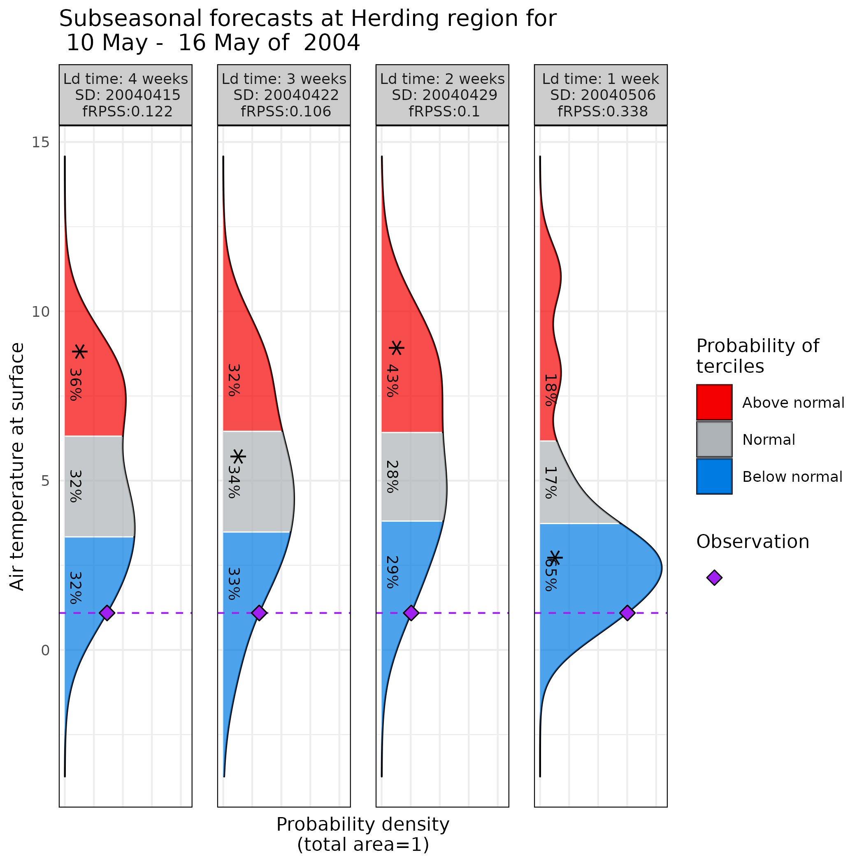
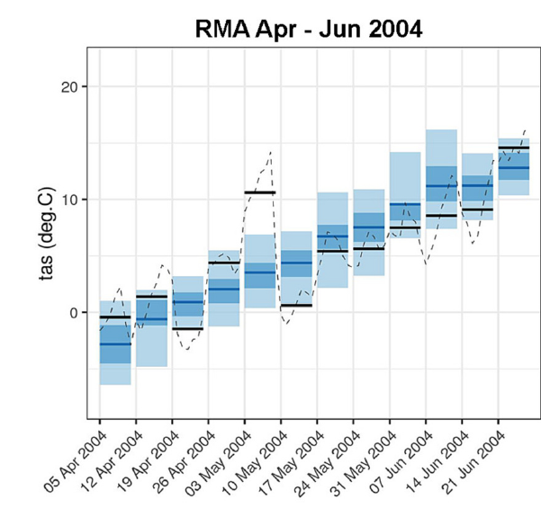
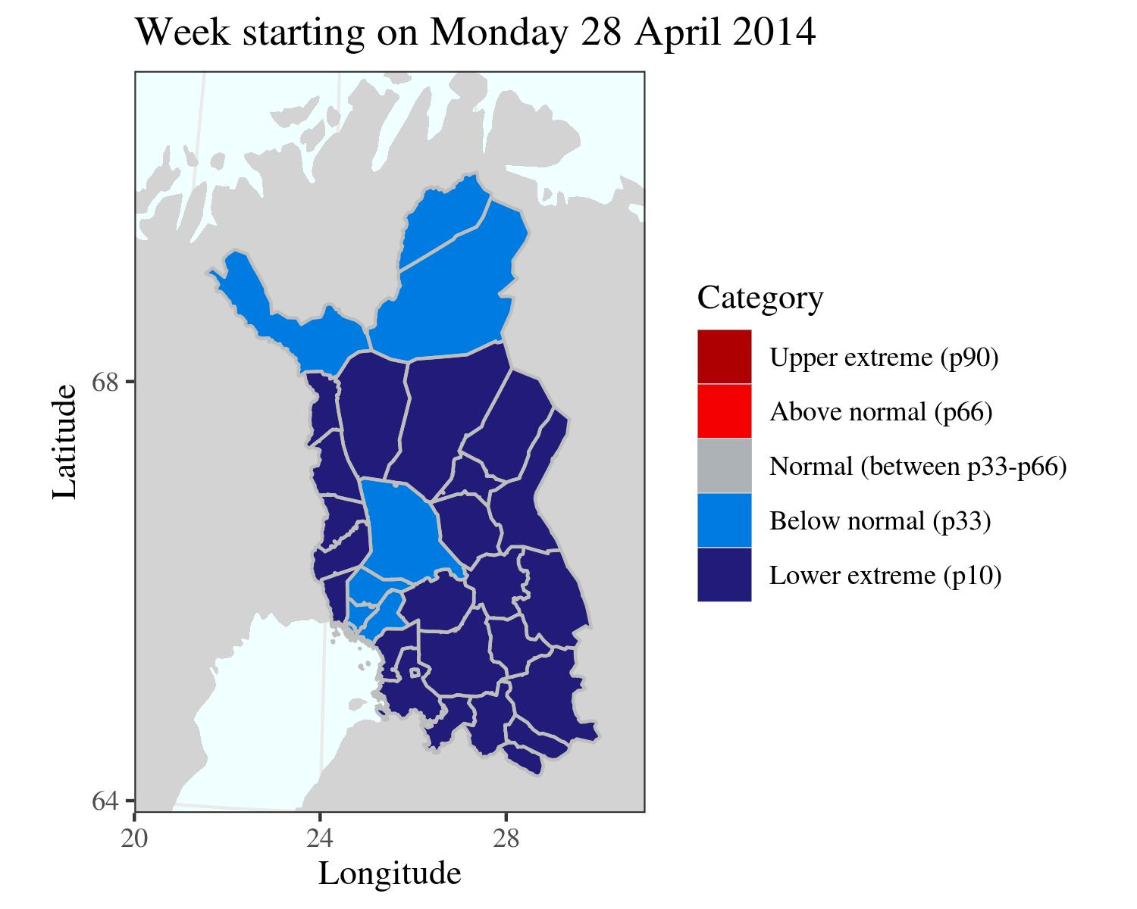
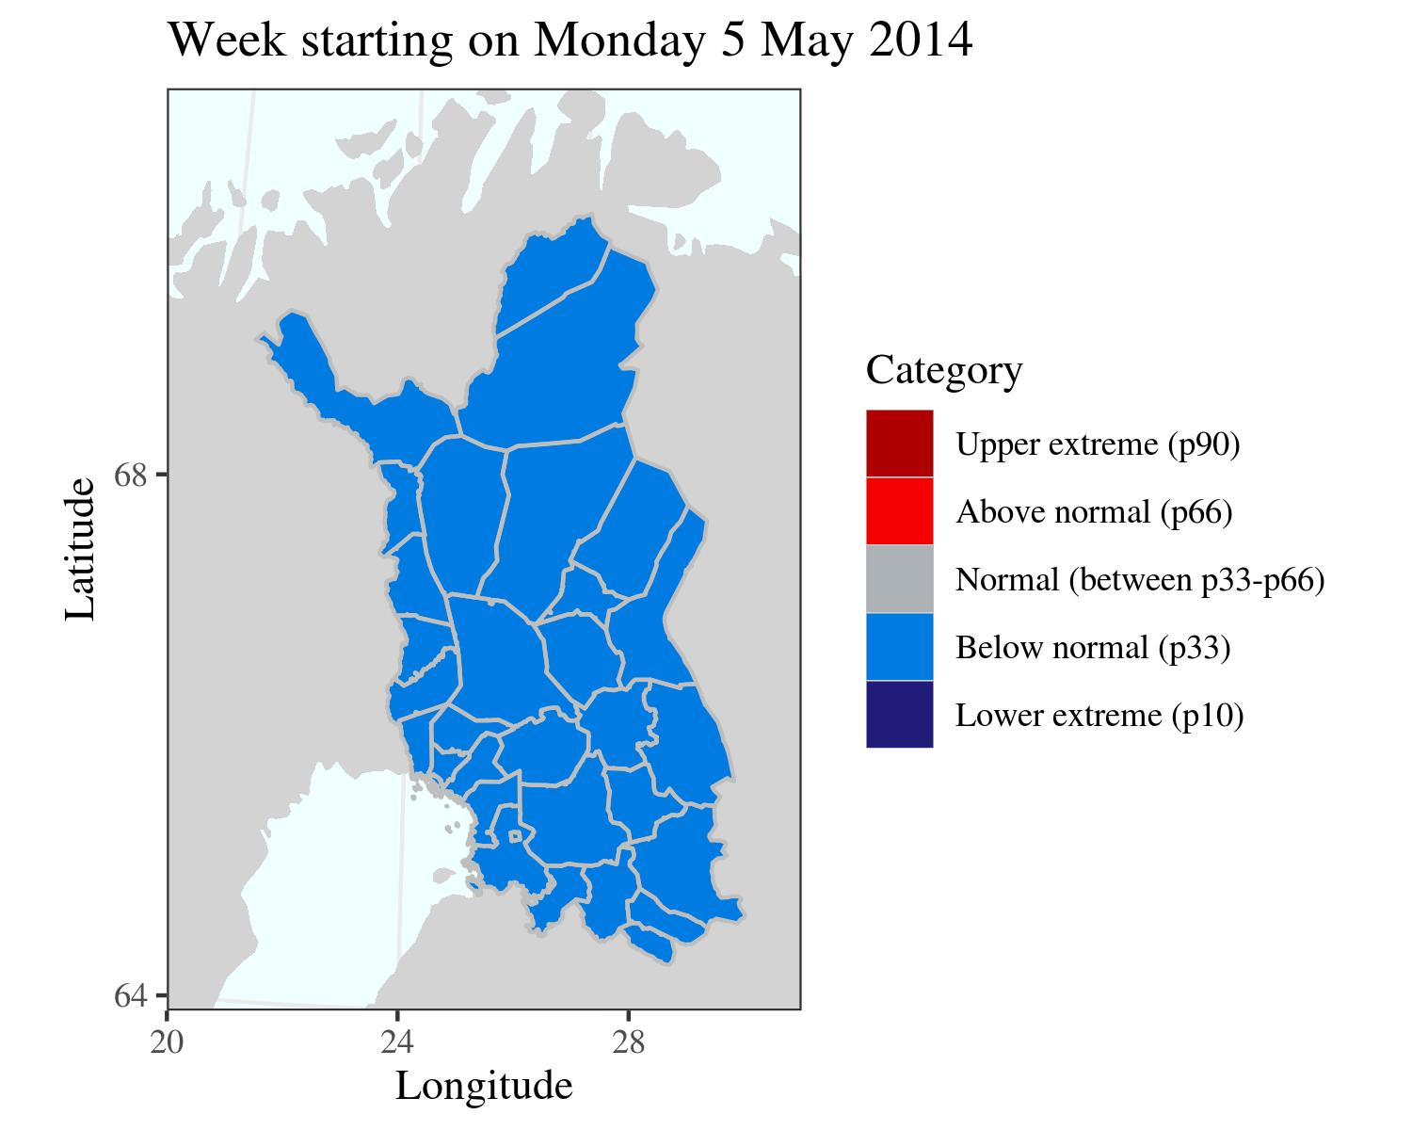
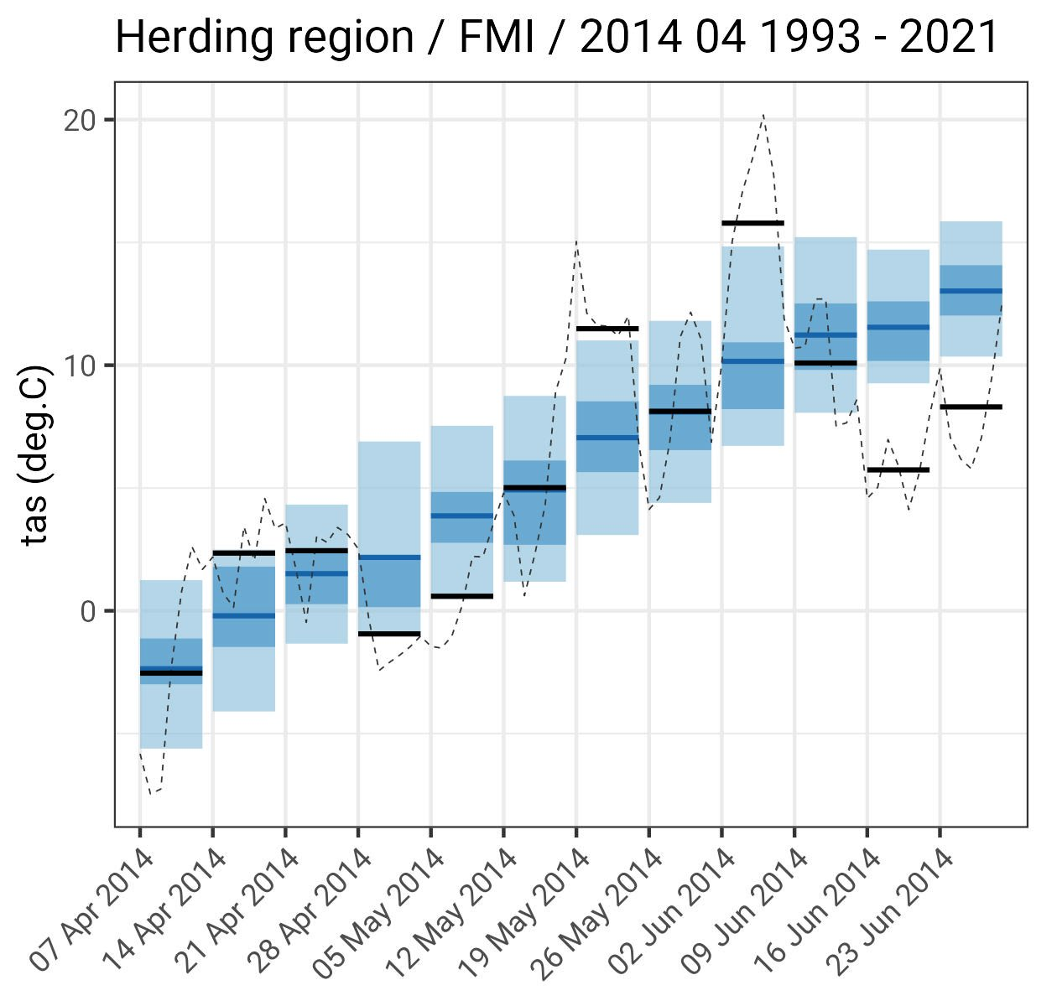
Anticipating backwinter
Upper extreme
Above normal
Normal
Below normal
Lower extreme
Notes:
Do we need two consecutive weeks or is 1week enough? Are the lower temperatures in June relevant?

Slide 18
1. Demand-driven vs demand-relevant
“many climate services would more accurately be described as relevant to assumed demand rather than driven by actual demand”
2. Process vs products
“Does this process [of objective forecasting] exclude the role of NHMS?” (a SADC NHMS representative)
Established practice
Downstream products
Believes and trust
3. Evaluation vs valuation
Valuation ignores process and addresses only quantifiable outcomes
It precludes learning because as it uses prior assumptions

Slide 19
Power and new climate knowledge
Different power asymmetries
Between scientists: genuine interdisciplinary collaboration
Between scientists and non-scientific knowledge holders
Between groups, or members of the community we engage with –without understanding of power histories and structures, we risk to add to inequalities
Between different scale framings - How we define and frame scale can affect power dynamics and distribution of interests making certain actors more important and excluding interests and needs of other actors (Van Lieshout et al., 2014, 2017)

Slide 20
Forms of power
Power over, in the previous examples
Positive forms of power:
Power to, or agency
Power within, or self-confidence (VeneKlasen and Clark, 2002)
Power with, or collective power - neutralizes coercive forms of power
such as domination and strategic manipulation (Habermas, 1977; Hendriks, 2009)
Power to empower (Chambers, 1997, 2017) - convening power of coproduction processes

Slide 21
Knowledge coproduction across the scale
New knowledge implies a particular scale frame, but “scales are neither apolitical nor static, rather scales are socially and politically constructed dimensions”
(Grainger et al., 2019)
Scale as size
Spatial scale
Temporal scale
Observational vs Operational scale
Scale as level
Geographical scale and governance levels
Hierarchical theory
Scale as relation “Scale as relation is central to the current notion of sustainability and resilience in complex systems involving humans and the environment.”
Nested hierarchies: interaction of processes that link upwards and downwards to adjacent levels
Notes:
Common definitions do not exist for scale – even within disciplines.

Slide 22
Thank you!
“One person had one-eight billionth of the power that humanity had. This assumes everyone had an equal amount of power, which wasn’t true”
Kim Stanley Robinson | The Ministry for the Future
dragana.bojovic@bsc.es
By Beth Moon

Slide 23
Please, help us to reimagine the concept of scale in climate services

