Slide 1
C3S_51 Lot 3:
EQC for Seasonal Forecasts
Francisco Doblas-Reyes^{1,2}
1 Barcelona Supercomputing Center (BSC)
2 Institució Catalana de Recerca i Estudis Avançats (ICREA)

Slide 2
Challenges of the EQC for seasonal forecasts
Adaptation: provide information for all kind of services.
Consistency: build trust, ensuring a high degree of coherence across products.
Innovation: transfer recent developments from research to operations.
Efficiency: information should respond to users’ queries with a delay as short as possible.
Targets: define data, products, verification, guidance, etc.

Slide 3
C3S_51 Lot 3: What
C3S_51 Lot 3 aims at developing a strategy for the evaluation and quality control (EQC) of the multi-model seasonal forecasts provided by the Copernicus Climate Change Service (C3S) to respond to the needs identified among a wide range of stakeholders.
Some important elements:
Users are consulted to identify needs in terms of products and EQC information
Forecast data are quality controlled and forecast products (not forecast systems) are verified
A quality assurance template is required to summarise the information
A framework is designed that serves as a reference to the community

Slide 4
C3S_51 Lot 3: The strategy
C3S_51 Lot 3 aims at developing a strategy for the evaluation and quality control (EQC) of the multi-model seasonal forecasts provided by the Copernicus Climate Change Service (C3S) to respond to the needs identified among a wide range of stakeholders.
Assessment of user needs
Scientific assessment
Technical assessment and KPIs
Quality assurance
Data sources, standards and conventions
Forecast quality prototype

Slide 5
C3S_51 Lot 3: Who
Partner | Nature | Role
BSC-CNS (ES) | Main contractor | Coordination, data inventory and EQC framework and prototype
Univ. Leeds (UK) | Subcontractor | Assess user requirements
Meteoswiss (CH) | Subcontractor | Scientific quality assessment and gap analysis
Predictia (ES) | Subcontractor | CDS requirements and development of the prototype
Univ. Exeter (UK) | Subcontractor | Expert statistical advice
IFCA-CSIC (ES) | Subcontractor | Downscaling

Slide 6
C3S_51 Lot 3: The users
Assessing forecast quality
Beware of user fatigue
Preferences for forecast quality format
M. Soares (Univ. of Leeds)

Slide 7
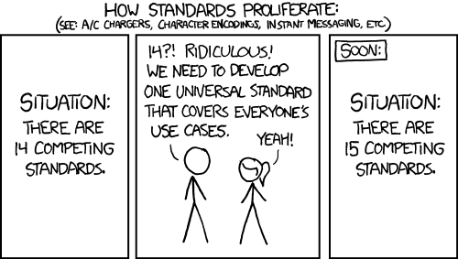
C3S_51 Lot 3: Standards and metadata
All necessary metadata have been defined for the seasonal forecasts using all standards available (CHFP, SPECS).
Similar standards could not be found for the reference observations.
But beware
Additional checks still necessary (data checker).
xkcd.com

Slide 8
C3S_51 Lot 3: Scientific assessment
Forecast quality assessment
Verification procedure of existing forecast systems based on scoring rules (e.g. RPS for multi-category probabilities, CRPS for ensembles)
Products, and not data, are verified; forecast products are scrutinised
Impact of lagged ensembles and adequate product generation
Calibration
All bias correction and recalibration methods effectively remove bias
Added value of sophisticated methods (e.g. EMOS) small to inexistent due to limited hindcast length (and low skill)
Multi-model combination
No forecast system consistently outperforms others
Multi-model combination is beneficial
Avoid the temptation of identifying inadequate data sources to e.g. discard “bad” forecast systems.
These points address questions raised by users that lead to new products
Notes:
In addition:
Calibration is more important than combination for ensemble forecasts
Construction of ‘best performing’ lagged ensemble: two most recent initializations appear to be enough for short lead times

Slide 9
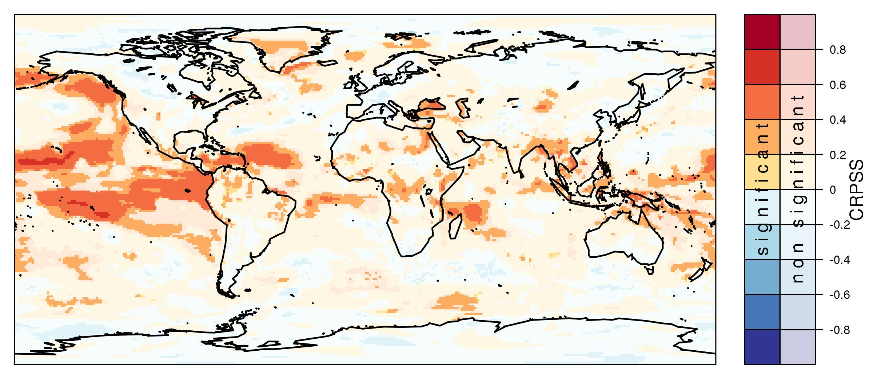
C3S_51 Lot 3: Forecast quality assessment and calibration
Skill of JJA temperature from ECMWF SEAS5 + recalibration*
Better
than constant climatological forecast
Worse
* CRPS of JJA near-surface temperature from
ECMWF SEAS 5 initialized in May
calibrated with the climate-conserving recalibration (CCR) and verified against
ERA Interim for 1993-2014
S. Hemri (Meteoswiss)
Notes:
CRPS of JJA near-surface temperature from
ECMWF SEAS 5 initialized in May
calibrated with the climate-conserving recalibration (CCR) and verified against
ERA Interim for 1993-2014

Slide 10
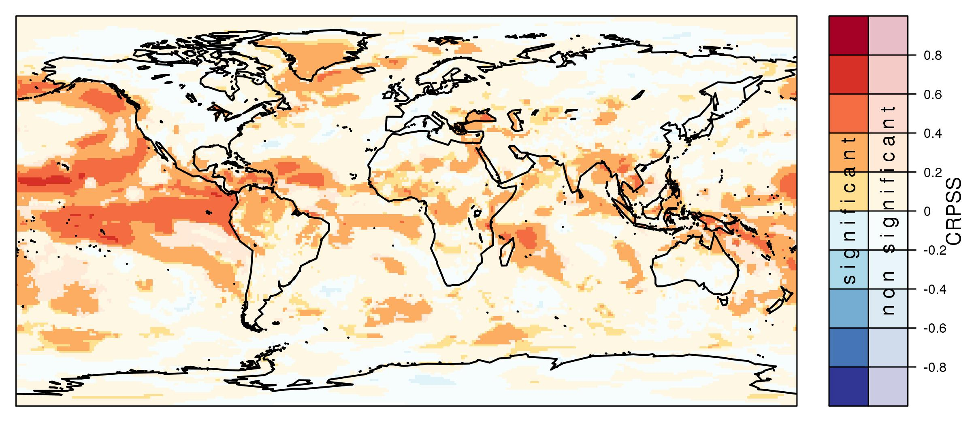
C3S_51 Lot 3: Forecast quality assessment and multi-model
Skill of JJA temperature from C3S multi-model*
Better
than constant climatological forecast
Worse
* CRPS of JJA near-surface temperature from
ECMWF SEAS 5, Meteo France System 5, MetOffice GloSea5 initialized in May CCR + weighted (RMSE) averaging of forecast PDF and verified against ERA Interim for 1993-2014
S. Hemri (Meteoswiss)
Notes:
CRPS of JJA near-surface temperature from
ECMWF SEAS 5 initialized in May
calibrated with the climate-conserving recalibration (CCR) and verified against
ERA Interim for 1993-2014

Slide 11
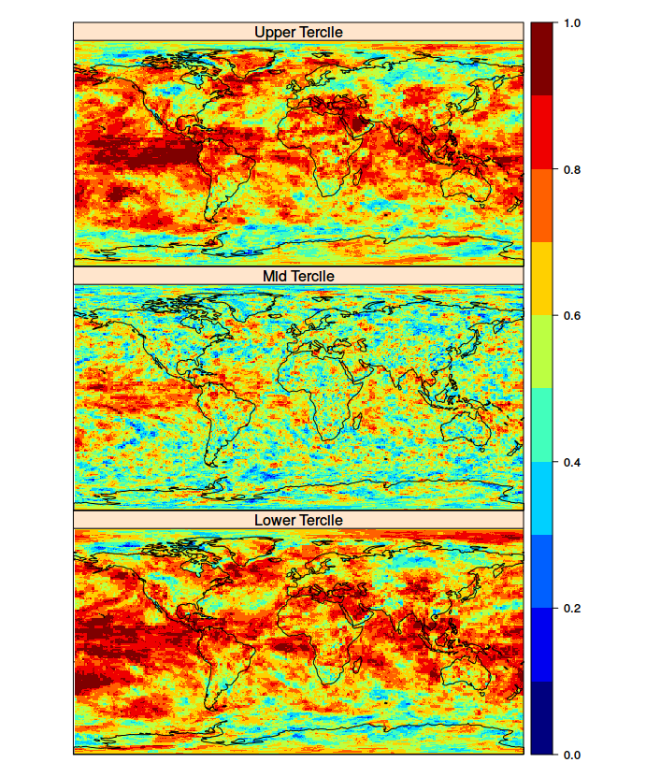
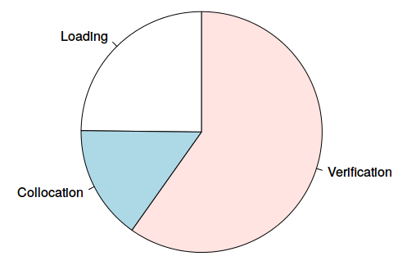
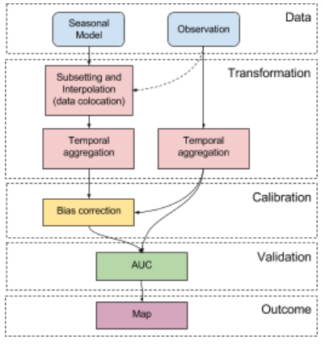
C3S_51 Lot 3: Timeliness and provenance
Computing performance and product provenance are key.
Forecast verification (ROC area) with performance analysis and workflow definition using SpecsVerification and easyVerification.
J. Bedia, D. San Martín (Predictia)

Slide 12
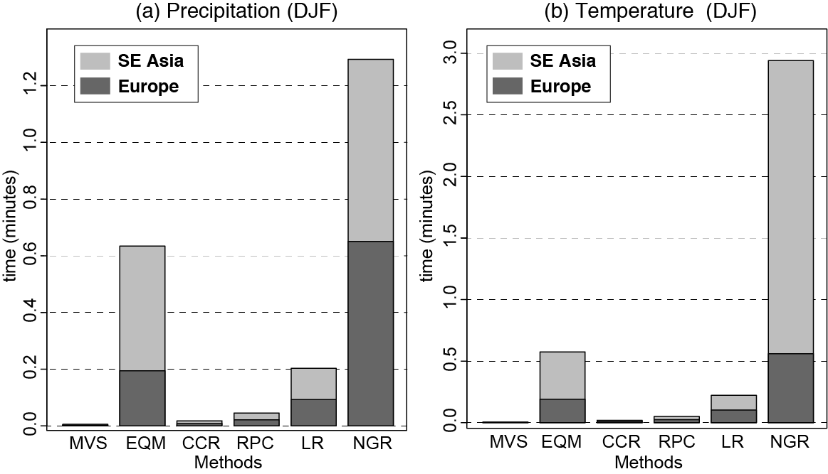
C3S_51 Lot 3: Timeliness and provenance
Computing performance and product provenance are key.
Users need to generate products from the forecasts.
Users require bias adjustment.
Computational cost estimates are fundamental for user satisfaction.
R. Manzanas (IFCA-CSIC)

Slide 13
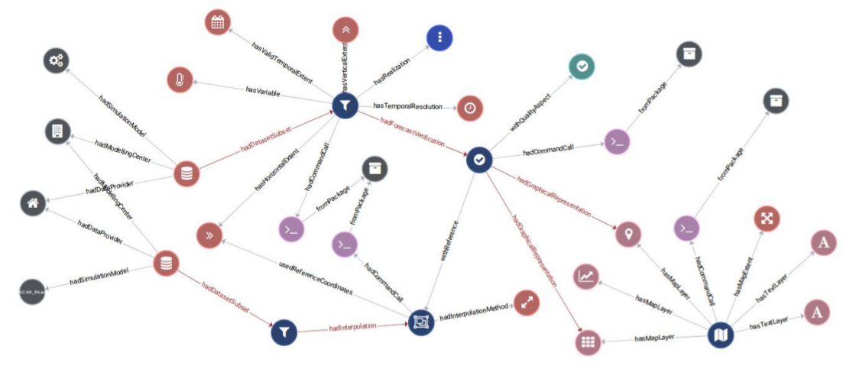
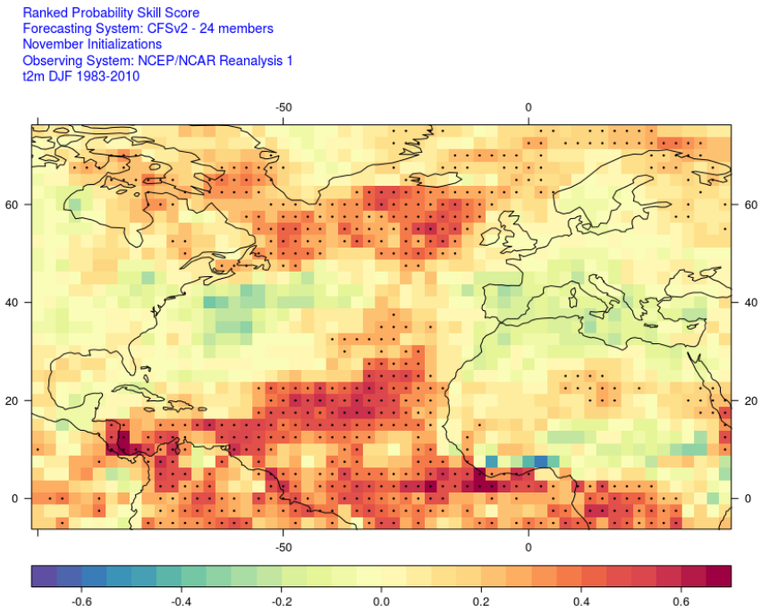
C3S_51 Lot 3: Timeliness and provenance
Prepare products for reproducibility, traceability, reuse and context
METACLIP ensures the reproducibility of objects (NetCDF file, image) with human and machine-readable solution http://metaclip.org.
It uses an RDF-based semantic metadata model that builds the vocabularies on existing initiatives (e.g. VALUE, PROV) and stores information in JSON files.
“De facto” the IPCC WGI standard for AR6.
Visualisation of provenance information
J. Bedia, D. San Martín (PREDICTIA)

Slide 14
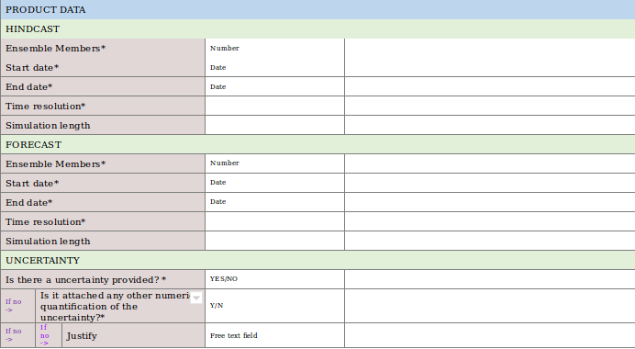
C3S_51 Lot 3: Where
Quality assurance template and reports
The quality information of the climate forecast datasets should be input into a quality assurance template to produce reports that are made available along with the datasets in the CDS.
Reports include dataset documentation, quality flags and an independent assessment.

Slide 15
C3S_51 Lot 3
The contract has
documented a metadata standard to feed the common data model and created a provenance solution for products
provided comprehensive forecast quality assessment of products
illustrated the benefits of bias adjustment and multi-model solutions
demonstrated that scalability and computational efficiency of the solutions should be taken into account to ensure timeliness
identified relevant user requirements
Relevant gaps: 1) guidance and context for forecast products, 2) metadata, vocabularies and provenance governance, 3) observational uncertainty, 4) criteria to identify relevant forecast products …

