Slide 1
Improving the I/O scalability for the next generation of Earth system models: OpenIFS-Cassandra integration as a case study
Authors: Xavier Yepes-Arbós, Pol Santamaria
Co-authors: Kim Serradell, Yolanda Becerra
Contributors: Jesus Labarta, Harald Servat
26/09/2019
NEXTGenIO Workshop on applications of NVRAM storage to exascale I/O, ECMWF, UK

Slide 2
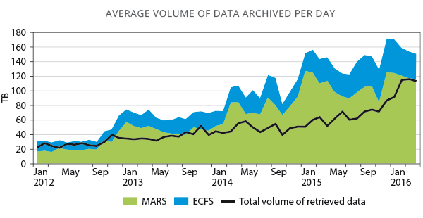
Introduction
Earth system models have benefited of the exponential growth of supercomputing power
This allows to use more complex computational models to find more accurate solutions
As a consequence, the generated amount of data has grown considerably
Source: Annual Report 2015, ECMWF

Slide 3
Introduction
However, since the I/O was not significant enough in the past, not much attention was paid to improve it
Due to this reason, some Earth system models output data using inefficient sequential I/O schemes
This type of scheme requires a serial process:
Gather all data in the master process of the model
Then, the master process sequentially writes all data
This is not scalable for higher grid resolutions, and even less, for future exascale machines
This is the case of the I/O scheme of the OpenIFS model

Slide 4
OpenIFS model
OpenIFS is a free and simplified version of the Integrated Forecasting System (IFS), available under a license from the European Centre for Medium-Range Weather Forecasts (ECMWF)
IFS is a global data assimilation and forecasting system which includes the modelling of the atmospheric composition
Originally developed for weather forecasting, IFS writes using the GRIB format

Slide 5
GRIB format
General Regularly-distributed Information in Binary form (GRIB) is a concise data format commonly used for Numerical Weather Prediction (NWP) output
It is designed to be:
Self-describing
Compact
Portable across computer architectures
In addition, it offers high performance for I/O operations to meet critical time-to-solution requirements

Slide 6
Post-processing in OpenIFS
OpenIFS can be also used for climate modelling if coupled into an Earth system model, such as EC-Earth
However, it is necessary to perform some post-processing, including, but not limited to:
Convert GRIB files to netCDF files
Regridding
Transform spectral fields to grid-point fields
Compute diagnostics
Post-processing turns into an expensive process, which will increase in cost, complexity and size as a result of increasing the resolution

Slide 7
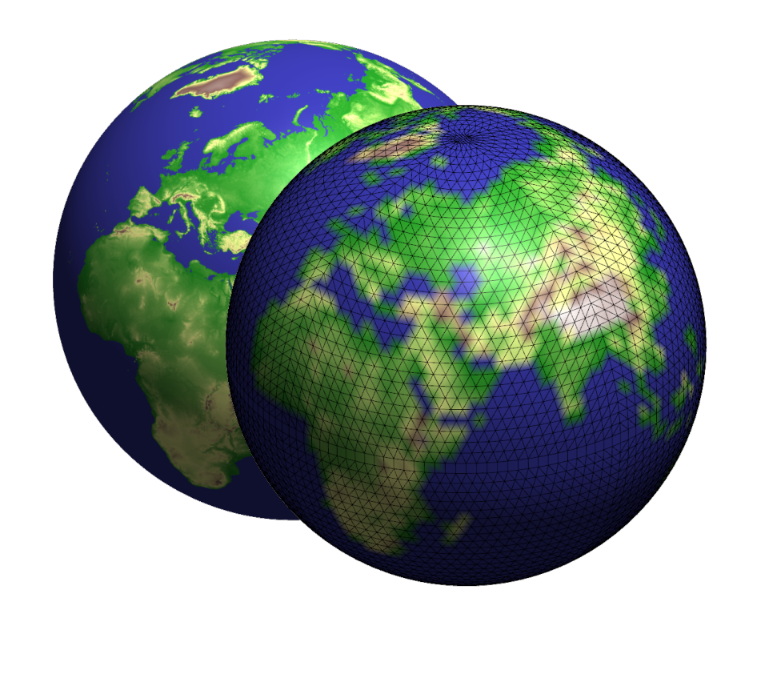
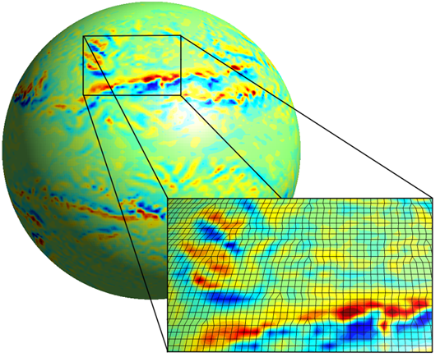
Queries in OpenIFS
Global-scale simulations over a large period of time produce a huge amount of data
OpenIFS data is written “as it is” into the storage system
However, most of the time users are not interested in all data
When users want to query a subset of the data, they have to post-process (or filter) entire files
This is a slow and inefficient process difficult to parallelize
GRIB files
Storage system
netCDF files
Sequential write
Data visualization
Sequential post-processing

Slide 8
Proposed I/O scheme
As said, OpenIFS has a bottleneck in the sequential I/O scheme which uses a master-workers architecture
This known issue is being addressed in the ESiWACE2 project
Our solution is to adapt OpenIFS to perform distributed I/O
To avoid moving the bottleneck from the model to the storage system, we opted for a distributed masterless database to store and query data: Apache Cassandra
The main reasons are:
Resilience and scalability: to petabytes of data and thousands of nodes
Indexation: efficient distributed queries
Open-source

Slide 9
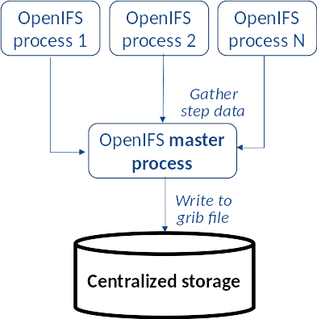
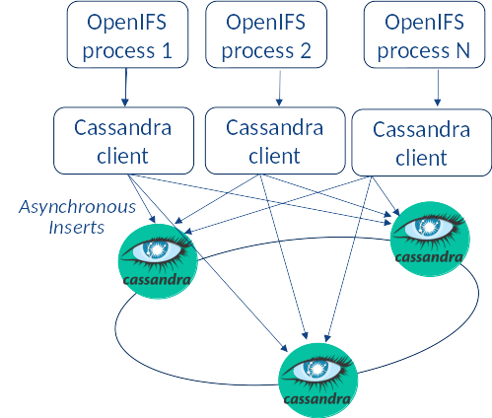
Distributed architecture
Traditional architecture
Proposed architecture

Slide 10
Why Cassandra?
Apache Cassandra is a distributed, highly-scalable, and fault-tolerant Key-Value database.
Pros:
Distributed storage, highly scalable
Manages coherency, corruption and concurrent access
Cons: Bad HPC integration
IPoverIB
Scales up to few cores
Client based on thread pool that interferes with simulation
Not integrated with HPC queue systems

Slide 11
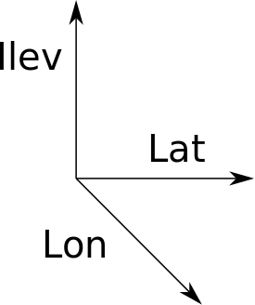
We tested several data models
Represent each grid point as a row to distributed arrays.
Pros: Easy to implement
Cons: Millions of small insertions → Overhead
Arrays are partitioned and distributed.
Our tool Hecuba partitions the arrays
Transparent to the client → simplifies its implementation
We chose to partition the array into 4K chunks to avoid congesting Cassandra.

Slide 12
OpenIFS configurations evaluated
OpenIFS 40r1
Initial conditions: storm Xaver (1 December 2013) → maximum forecast length of 8 days
 | AMIP | HighResMIP | Theoretical
Resolution | T255L91 | T639L137 | T1279L137
# MPI processes | 47 | 141 | 752
# OpenMP threads | 2 | 2 | 2
Time step | 2700 seconds | 900 seconds | 600 seconds

Slide 13
OpenIFS configurations evaluated (2)
 | AMIP | HighResMIP | Theoretical
Resolution | T255L91 | T639L137 | T1279L137
Forecast length | 8 days | 8 days | 4 days*
Output frequency | 3 hours (4 time steps) | 3 hours (12 time steps) | 1 hour (6 time steps)
Total size GRIB files | 9 GB | 80 GB | 795 GB
Total size Cassandra (replication factor 1) | 37 GB | 355 GB | 4224 GB
*Quota exceeded issue

Slide 14
HPC platform used
MareNostrum 4
Lenovo system composed of:
SD530 Compute Racks
Intel Omni-Path high performance network interconnect
SuSE Linux Enterprise Server
Compute nodes are equipped with:
2 sockets Intel Xeon Platinum (Skylake) with 24 cores each (48 cores per node)
96 GB of main memory
100 Gbit/s Intel Omni-Path
10 Gbit/s Ethernet
IBM GPFS file system

Slide 15
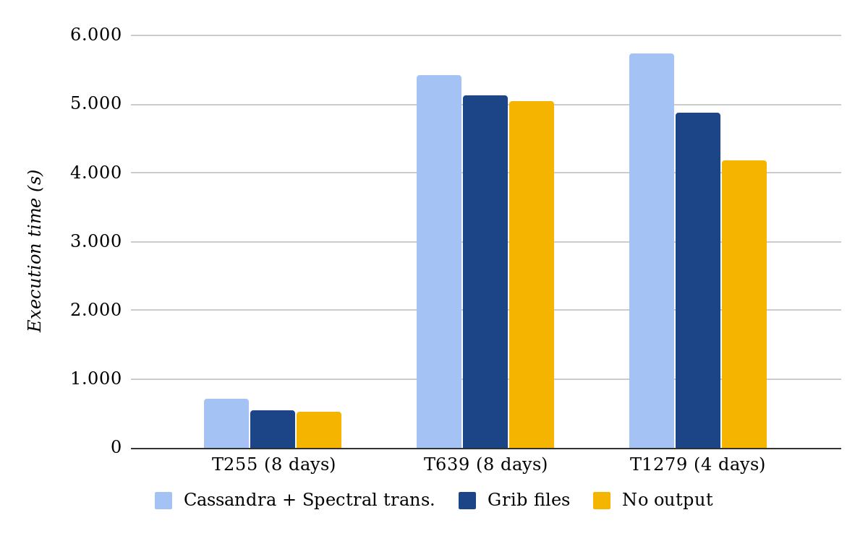
OpenIFS performance comparison

Slide 16
Performance Analysis
Different output size (1 to 4.5 ratio GRIB files vs. Cassandra)
Data is stored in Cassandra using double precision but GRIB stores using a scale factor + offset to use variable precision
Spectral fields transformed to grid-point fields prior to output only with Cassandra
Cassandra integration with HPC hardware could be improved
Slightly slower than files but the benefits are on queries:
Efficient filtering (post-processing operations) and sampling
Distributed computing
Concurrent access while data is generated

Slide 17
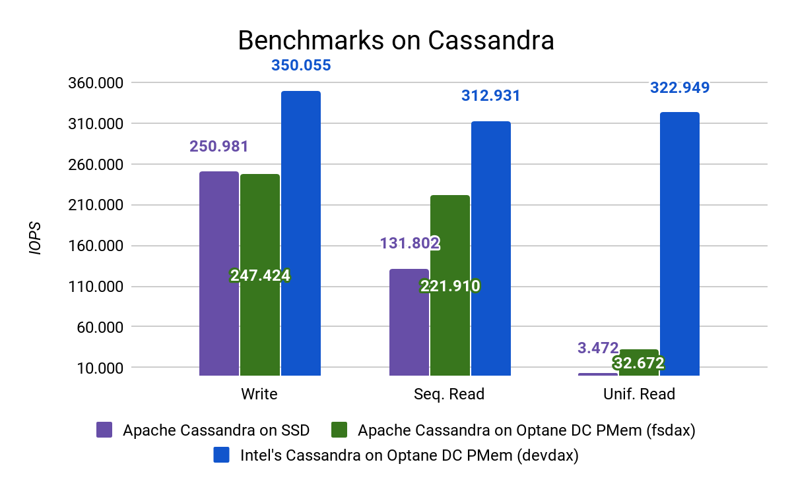
BSC-Intel collaboration
Apache Cassandra adapted by Intel to run on the Intel(R) Optane(TM) DC Persistent Memory
Will boost the performance of both OpenIFS and post-processing applications

Slide 18
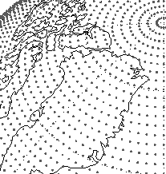
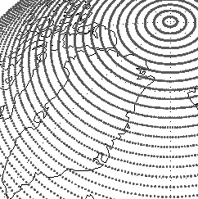
Common post-process operations
Regridding
Reduced Gaussian to
rectangular
Temporal queries over a period of time: average, maximum, minimum, cumulate, etc
Spatial queries: regional domain extraction, collapsing in the vertical direction or in the horizontal, etc

Slide 19
Post-process workflow
Typical approach for implementing queries in the Earth Science domain:
Bash or Python script that manipulates the OpenIFS output files. Filters entire files, and each post-process step generates new files.
Our proposal: parallel post-processing using PyCOMPSs and Hecuba
PyCOMPSs offers an automatic parallelization of sequential code
Hecuba offers a transparent access to persistent objects in Cassandra

Slide 20
Conclusions
Room for improvement: Cassandra’s C++ Client makes use of threads, which conflict with MPI
Potential benefits for the post-processing operations
Parallel execution
Easy to implement
Possibility of using standard libraries to manipulate the data (NumPy)
Intel’s Cassandra is promising: we expect a performance boost thanks to the Intel(R) Optane(TM) DC Persistent Memory

Slide 21
Future work
Understand the impact on OpenIFS of the Cassandra client threads
Complete and evaluate the distributed queries
Write data in double, single or smaller precision depending on the user needs
Evaluate OpenIFS taking advantage of Intel’s Cassandra in a distributed environment

Slide 22
Thank you
xavier.yepes@bsc.es
pol.santamaria@bsc.es

