Slide 1
A 10-year regional reanalysis of desert dust aerosol at high spatial resolution
Access: prace-ri.eu/hpc-access
Access: bsc.es/res-intranet
Enza Di Tomaso*
Jerónimo Escribano, Paul Ginoux, Sara Basart, Francesca Macchia, Francesca Barnaba, Miguel Castrillo, Paola Formenti, Oriol Jorba, Lucia Mona, Gilbert Montané Pinto, Michail Mytilinaios, Vincenzo Obiso, Nick Schutgens, Athanasios Votsis, Ernest Werner, and Carlos PérezGarcía-Pando
*Barcelona Supercomputing Center, Spain
EGU General Assembly 2021
EGU21-11644 vPICO: Fri, 30 Apr, 09:00–12:30 (CEST)

Slide 2
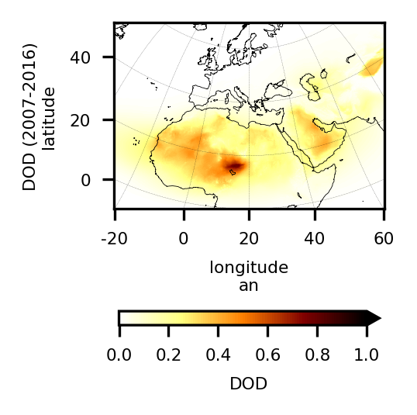
A novel regional desert dust reanalysis
We have produced a complete and consistent, four dimensional, regional reconstruction of desert dust in a recent decade
Unprecedented high resolution
Specific dust observational constraint
Uncertainty estimates in the reanalysis output
Linked to specific air quality and climate services
10-year published
2007 2008 2009 2010 2011 2012 2013 2014 2015 2016

Slide 3
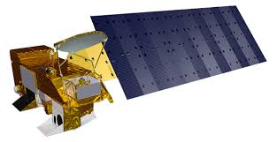
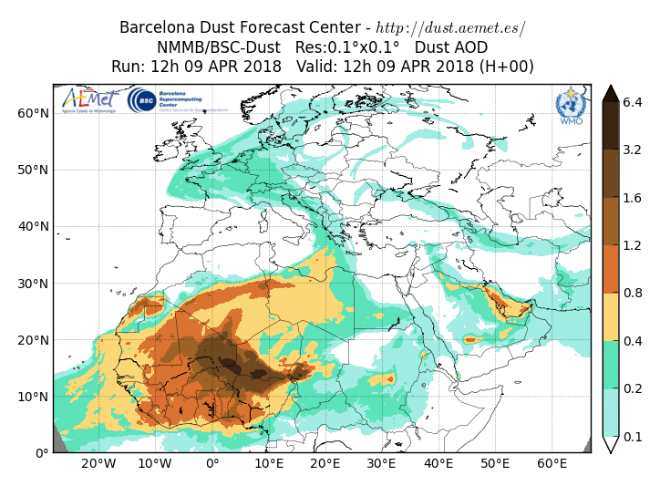
Reanalysis production: the methodology
Assimilated observations:
satellite retrievals of coarse dust optical depth
Assimilation scheme:
Local Ensemble Transform Kalman Filter
Chemical weather modelling system:
Multiscale Online Non-hydrostatic AtmospheRe Chemistry (MONARCH) ensemble forecast

Slide 4
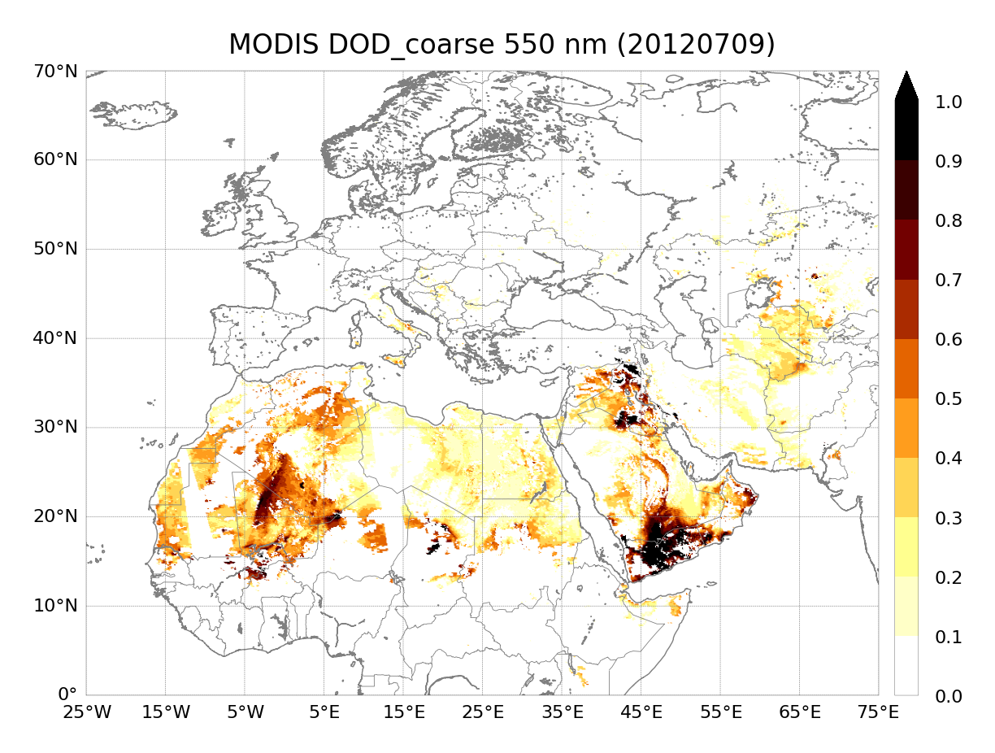
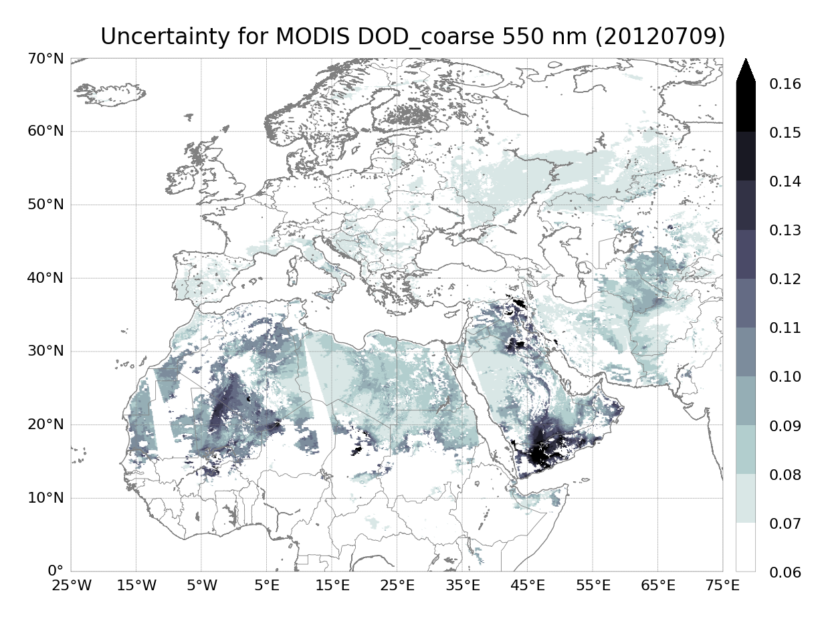
Assimilated observations: a daily sample
coarse-mode dust optical depth retrieved from MODIS Deep Blue L2 aerosol products (Ginoux et al. 2010, 2012; Pu and Ginoux 2016)
observation uncertainty estimated using a prognostic approach (Sayer et al. 2014)
~120,000 observations assimilated daily (after quality control)

Slide 5
Characteristics of the reanalysis data set
Data set length: 10 years (2007-1016)
Geographical domain: regional (Northern Africa, the Middle East and Europe)
Horizontal resolution: 0.1° lat × 0.1° lon
Output frequency: 3-hourly and climatology values (monthly, seasonal, annual)
Type of fields: analysis (AN) and/or first-guess (FG)
Ensemble statistics: ensemble (ENS) mean, max, median, std
std
obs
obs
obs
obs
obs
obs
obs
The first-guess is an analysis-initialized forecast

Slide 6
Reanalysis data set
variable description | unit | spatial dimension | description of dust particle size | first-guess | analysis
dust mass concentration | kg m⁻³ | 3D | 8 bins | x | x
dust extinction coefficient | m⁻¹ | 3D | total | x | x
mid-layer height | m | 3D | NA | x
dust dry deposition flux | kg m⁻² s⁻¹ | 2D | 8 bins | x
dust wet deposition flux | kg m⁻² | 2D | 8 bins | x
dust mass surface concentration | kg m⁻³ | 2D | 8 bins | x | x
dust loading | kg m⁻² | 2D | 8 bins | x | x
dust optical depth | unitless | 2D | total | x | x
coarse dust optical depth | unitless | 2D | total | x | x
dust surface extinction coefficient | m⁻¹ | 2D | total | x | x
direct normal irradiance | W m⁻² | 2D | NA | x
global horizontal irradiance | W m⁻² | 2D | NA | x

Slide 7
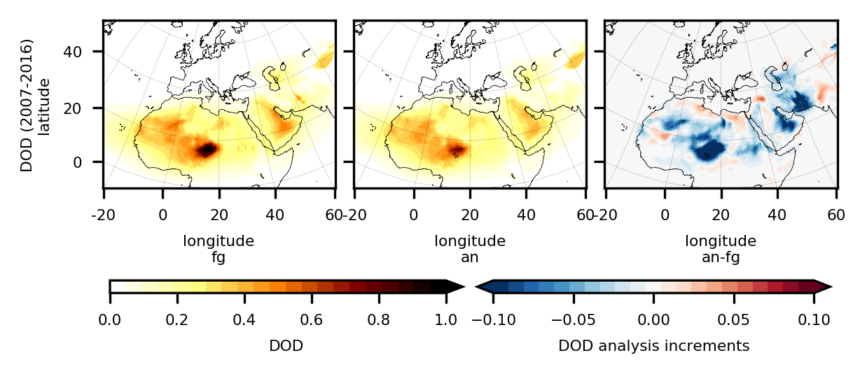
Observation increments
Systematic negative corrections linked to overestimation of the major sources’ strength in Africa and the Middle East (the Bodélé depression in Chad, in the Saudi Arabia lowlands and in the Balochistan region of south-western Asia)
Positive mean increments over the Thar desert, in the north part of Syria, inland from the Mediterranean sea in the north of Africa, and between Mauritania and Mali might indicate an underestimation of source strength or issues with the the transport downwind from the sources

Slide 8
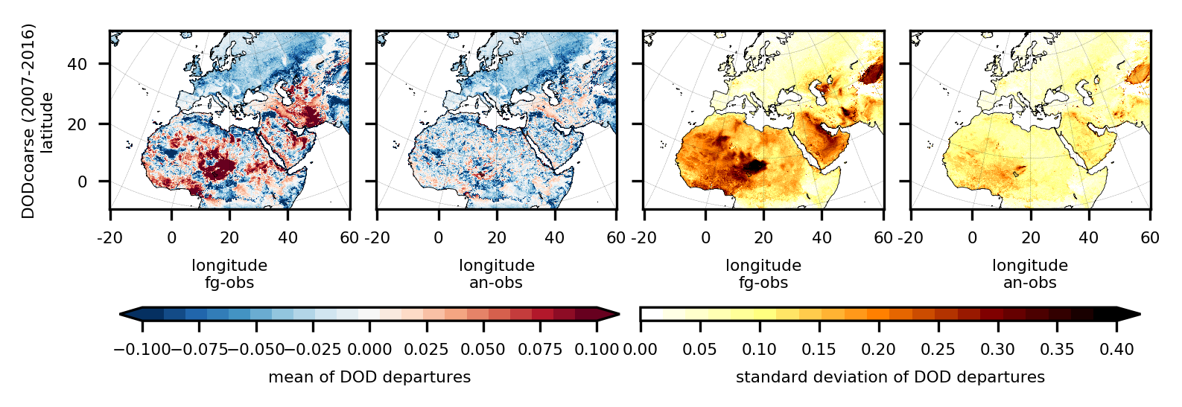
Departures from assimilated observations
The reduction of the standard deviation of the analysis departures compared to the first-guess proves the consistency of our assimilation procedure
The positive mean departures decrease considerably in the analysis compared to the first-guess
Some of the negative mean departures remain unchanged: lower DOD not analyzed efficiently or contamination of other aerosols than dust in the observations

Slide 9
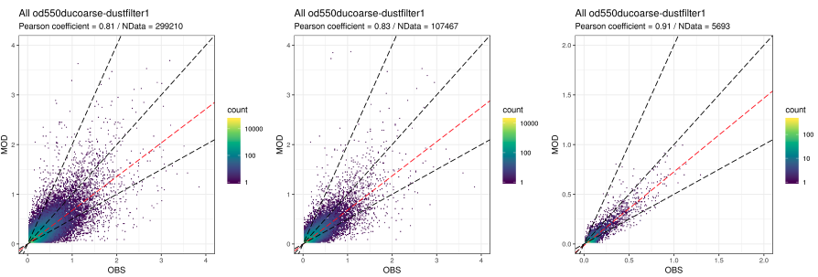
Validation against independent observations
N. data = 299210
Reference data set:
AERONET v3
SDA retrievals
Level 2.0
counts
Bias = -0.05
RMSE = 0.12
Pearson coef. = 0.81
Reanalysis DOD_coarse 550 nm
10000
100
1
AERONET SDA AOD 500 nm

Slide 10
Pilot services based on the reanalysis
The reanalysis variables have been used to produce dust-relevant information for different sectors and related validation exercises:
EGU21-14490: vPico Mon 26 Apr 15:43–15:45
AS1.27 Convective and Volcanic Clouds (CVC) and possible impact on aviation management
Sara Basart et al.: Operating in risky sand and dust storm environments in Northern Africa, the Middle East and Europe: a portfolio of aviation climate services
EGU21-12819: vPico Thu 29 Apr 11:24–11:26
CL2.1 Climate Services - Underpinning Science
Athanasios Votsis et al.: Addressing the impacts of sand and dust storms in North Africa, the Middle East and Europe for air quality, aviation and solar energy: the DustClim approach to climate services

Slide 11
Acknowledgments
The authors acknowledge the DustClim project which is part of ERA4CS, an ERA-NET initiated by JPI Climate, and funded by FORMAS (SE), DLR (DE), BMWFW (AT), IFD (DK), MINECO (ES), ANR (FR) with co-funding by the European Union (Grant 690462).
Carlos Pérez García-Pando acknowledges support from the European Research Council (grant agreement no. 773051; FRAGMENT), the AXA Research Fund, the Spanish Ministry of Science, Innovation and Universities (grant nos. RYC-2015-18690 and CGL2017-88911-R), and the ICREA program.
Jerónimo Escribano has received funding from the European Union’s Horizon 2020 research and innovation programme under the Marie Skłodowska-Curie grant agreement H2020-MSCA-COFUND-2016-754433.
The authors acknowledge PRACE (eDUST, eFRAGMENT1, and eFRAGMENT2) and RES (AECT-2019-3-0001, AECT-2020-1-0007, AECT-2020-3-0013) for awarding access to MareNostrum at the Barcelona Supercomputing Center and for providing technical support.
The authors thank all the PIs and their staff for establishing and maintaining the AERONET sites, and the MODIS mission scientists and associated NASA personnel for the production of the AOD data used in this study.

Slide 12
Access: prace-ri.eu/hpc-access
Access: bsc.es/res-intranet
Thank you
enza.ditomaso@bsc.es

