Slide 1
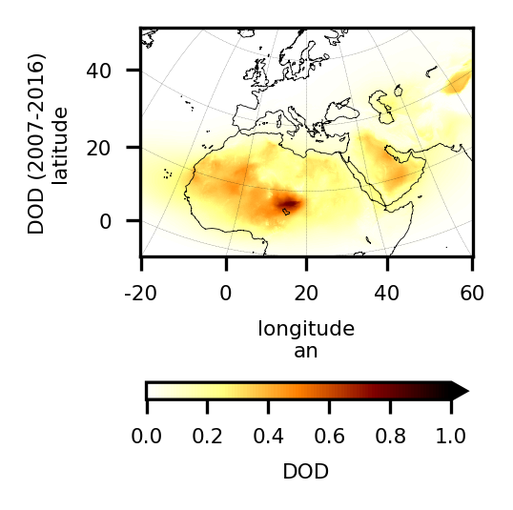
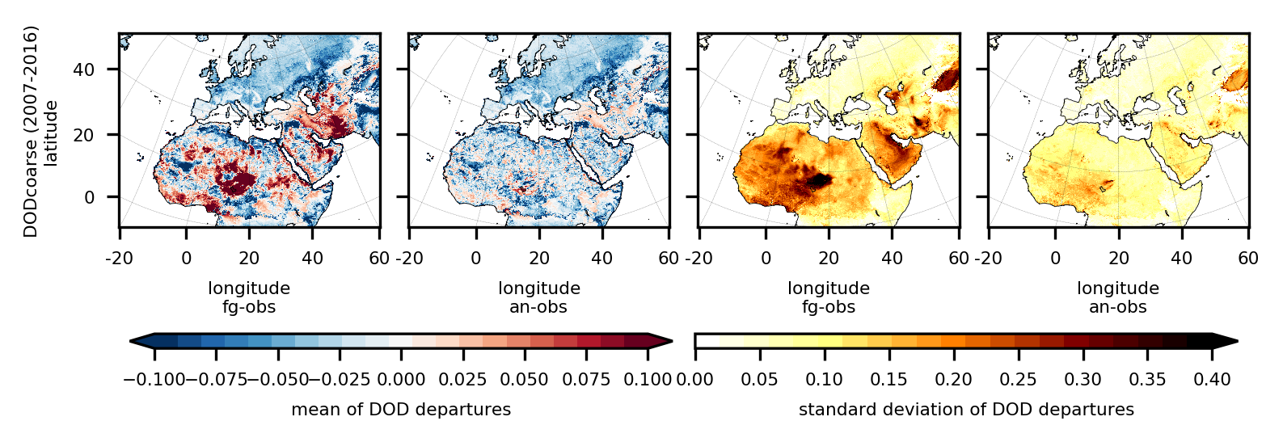
A 10-year regional reanalysis of desert dust aerosol at high spatial resolution
Enza Di Tomaso*, Jerónimo Escribano, Paul Ginoux, Sara Basart, Francesca Macchia, Francesca Barnaba, Miguel Castrillo, Paola Formenti, Oriol Jorba, Lucia Mona, Gilbert Montané Pinto, Michail Mytilinaios, Vincenzo Obiso, Nick Schutgens, Athanasios Votsis, Ernest Werner, and Carlos PérezGarcía-Pando
*Barcelona Supercomputing Center
We have produced a complete and consistent, four-dimensional, regional reconstruction of desert dust in a recent decade
Unprecedented high resolution: 0.1° latitude × 0.1° longitude
Specific dust observational constraint (DOD from MODIS DB L2)
on the MONARCH model by means of a LETKF
Uncertainty estimates in the reanalysis output
Data set output linked to specific air quality and climate services
DOD 550 nm (2007-2016)
Before DA
After DA
Before DA
After DA
mean
mean
std
std
bias = -0.05 RMSE = 0.12 r = 0.81
DOD 550 nm
counts
Reanalysis DODcoarse
550 nm
10000
100
1
Fig 1: Decadal mean analysis
AERONET AOD SDA 500nm
Fig 2: Departures from assimilated observations
Fig 3: Independent validation

