Slide 1
Forecast quality assessment of multi-annual predictions of mean and extreme temperature and precipitation: multi-model evaluation and impact of model initialisation
Carlos Delgado-Torres, Markus G. Donat, Panos J. Athanasiadis, Pierre-Antoine Bretonnière, Louis-Philippe Caron, Nick J. Dunstone, Nube Gonzalez-Reviriego, An-Chi Ho, Dario Nicolì, Klaus Pankatz, Andreas Paxian, Núria Pérez-Zanón, Margarida Samsó-Cabré, Balakrishnan Solaraju-Murali, Albert Soret, and Francisco J. Doblas-Reyes
This project has received funding from the European Union’s Horizon Europe – the Framework Programme for Research and Innovation (2021-2027) under grant agreement No. 101081460.
15IMSC
Toulouse, June 2024
carlos.delgado@bsc.es
Notes:
Good morning and thank you
Introduce myself
Introduce thesis
Introduce department
Introduce supervisors

Slide 2
Objectives
Evaluate the forecast quality of the decadal predictions contributing to CMIP6/DCPP in predicting near-surface air temperature, precipitation, the AMV index and the GSAT anomalies.

Slide 3
Objectives
Evaluate the forecast quality of the decadal predictions contributing to CMIP6/DCPP in predicting near-surface air temperature, precipitation, the AMV index and the GSAT anomalies.
Assess whether the approach used to build a multi-model ensemble has a significant impact on the prediction skill.

Slide 4
Objectives
Evaluate the forecast quality of the decadal predictions contributing to CMIP6/DCPP in predicting near-surface air temperature, precipitation, the AMV index and the GSAT anomalies.
Assess whether the approach used to build a multi-model ensemble has a significant impact on the prediction skill.
Compare the multi-model ensemble against the individual forecast systems to assess the benefit and drawbacks of combining predictions from different forecast systems.

Slide 5
Objectives
Evaluate the forecast quality of the decadal predictions contributing to CMIP6/DCPP in predicting near-surface air temperature, precipitation, the AMV index and the GSAT anomalies.
Assess whether the approach used to build a multi-model ensemble has a significant impact on the prediction skill.
Compare the multi-model ensemble against the individual forecast systems to assess the benefit and drawbacks of combining predictions from different forecast systems.
Estimate the impact of model initialisation by comparing the skill of the decadal predictions and historical forcing simulations multi-model ensembles.

Slide 6
Objectives
Evaluate the forecast quality of the decadal predictions contributing to CMIP6/DCPP in predicting near-surface air temperature, precipitation, the AMV index and the GSAT anomalies.
Assess whether the approach used to build a multi-model ensemble has a significant impact on the prediction skill.
Compare the multi-model ensemble against the individual forecast systems to assess the benefit and drawbacks of combining predictions from different forecast systems.
Estimate the impact of model initialisation by comparing the skill of the decadal predictions and historical forcing simulations multi-model ensembles.
Estimate how much skill is lost for not having all the predictions available in real-time by comparing a research multi-model ensemble (13 forecast systems) against an operational multi-model ensemble (4 forecast systems).

Slide 7
Data and methods
Forecast period: forecast years 1-5
Evaluation period: 1961-2014
Variables: temperature and precipitation
Indices: AMV index and GSAT anomalies
Reference forecasts:
Climatological forecast
Individual forecast systems
Historical simulations
Operational multi-model
Forecast system | DCPP members | HIST members | Initialisation month
BCC-CSM2-MR | 8 | 3 | January
CanESM5 | 20 | 40 | January
CESM1-1-CAM5-CMIP5 | 40 | 40 | November
CMCC-CM2-SR5 | 10 | 1 | November
EC-Earth3-i1 | 10 | 10 | November
EC-Earth3-i2 | 5 | - | November
HadGEM3-GC3.1-MM | 10 | 4 | November
IPSL-CM6A-LR | 10 | 32 | January
MIROC6 | 10 | 10 | November
MPI-ESM1.2-HR | 10 | 10 | November
MPI-ESM1.2-LR | 16 | 10 | November
MRI-ESM2-0 | 10 | 5 | November
NorCPM1 | 10 | 30 | October
 | 169 members | 195 members

Slide 8
DCPP multi-model skill
Temperature Precipitation
ACC for forecast years 1-5
DCPP multi-model ensemble: 169 members from 13 forecast systems

Slide 9
DCPP multi-model skill
Temperature Precipitation
Atlantic Multidecadal Variability Global Surface Air Temperature

Slide 10
Multi-model vs individual forecast systems
Highest ACC Highest RPSS
Forecast system or multi-model with the highest skill in
predicting temperature for the forecast years 1-5

Slide 11
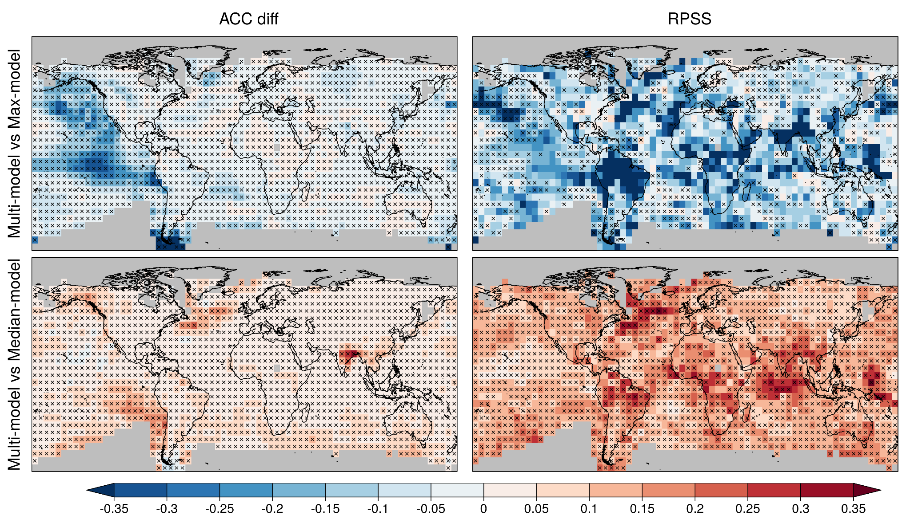
Multi-model vs individual forecast systems
Highest ACC - Temperature
Multi-model generally worse than the best forecast system.
Multi-model generally better than the 50% of the forecast systems.

Slide 12
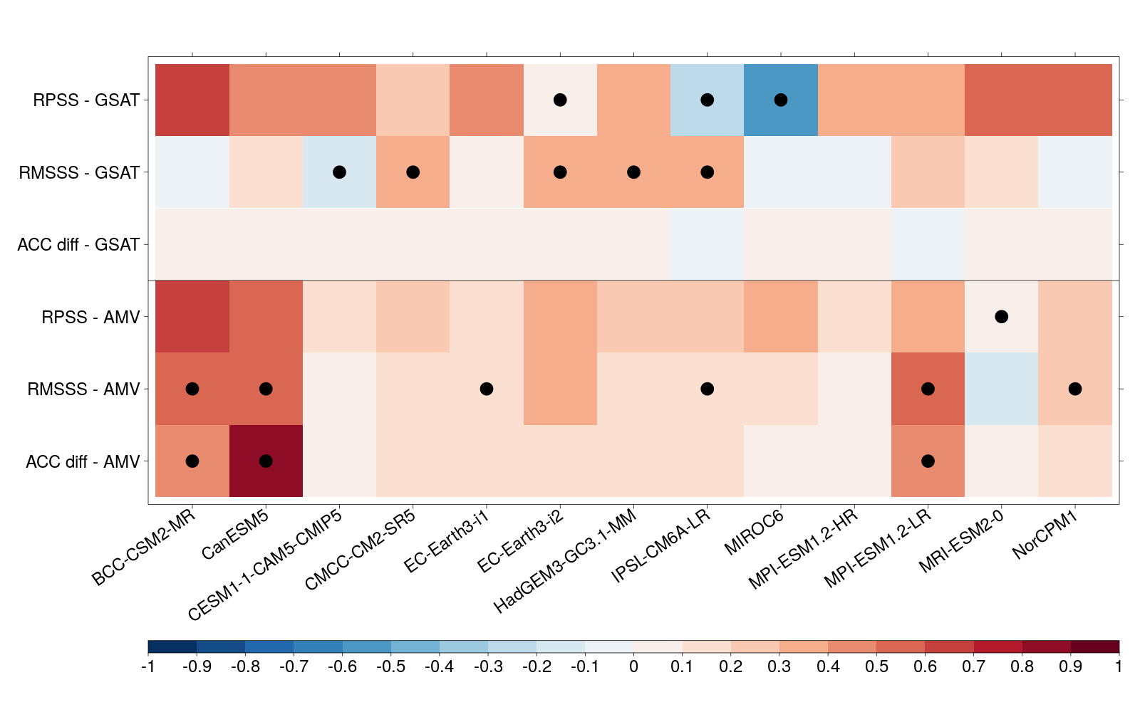
Multi-model vs individual forecast systems
Multi-model worse than forecast system ← | → Multi-model better than forecast system

Slide 13
Impact of initialisation
Temperature Precipitation
DCPP worse than HIST ← |→ DCPP better than HIST
Residual correlation for forecast years 1-5
DCPP multi-model ensemble: 169 members from 13 forecast systems
HIST multi-model ensemble: 195 members from the same forecast systems

Slide 14
Impact of initialisation
Temperature Precipitation
Atlantic Multidecadal Variability
Index | Residual ACC | RPSS
AMV | 0.75* | 0.32*
GSAT | 0.45* | -0.06
DCPP multi-model ensemble: 169 members
HIST multi-model ensemble: 195 members

Slide 15
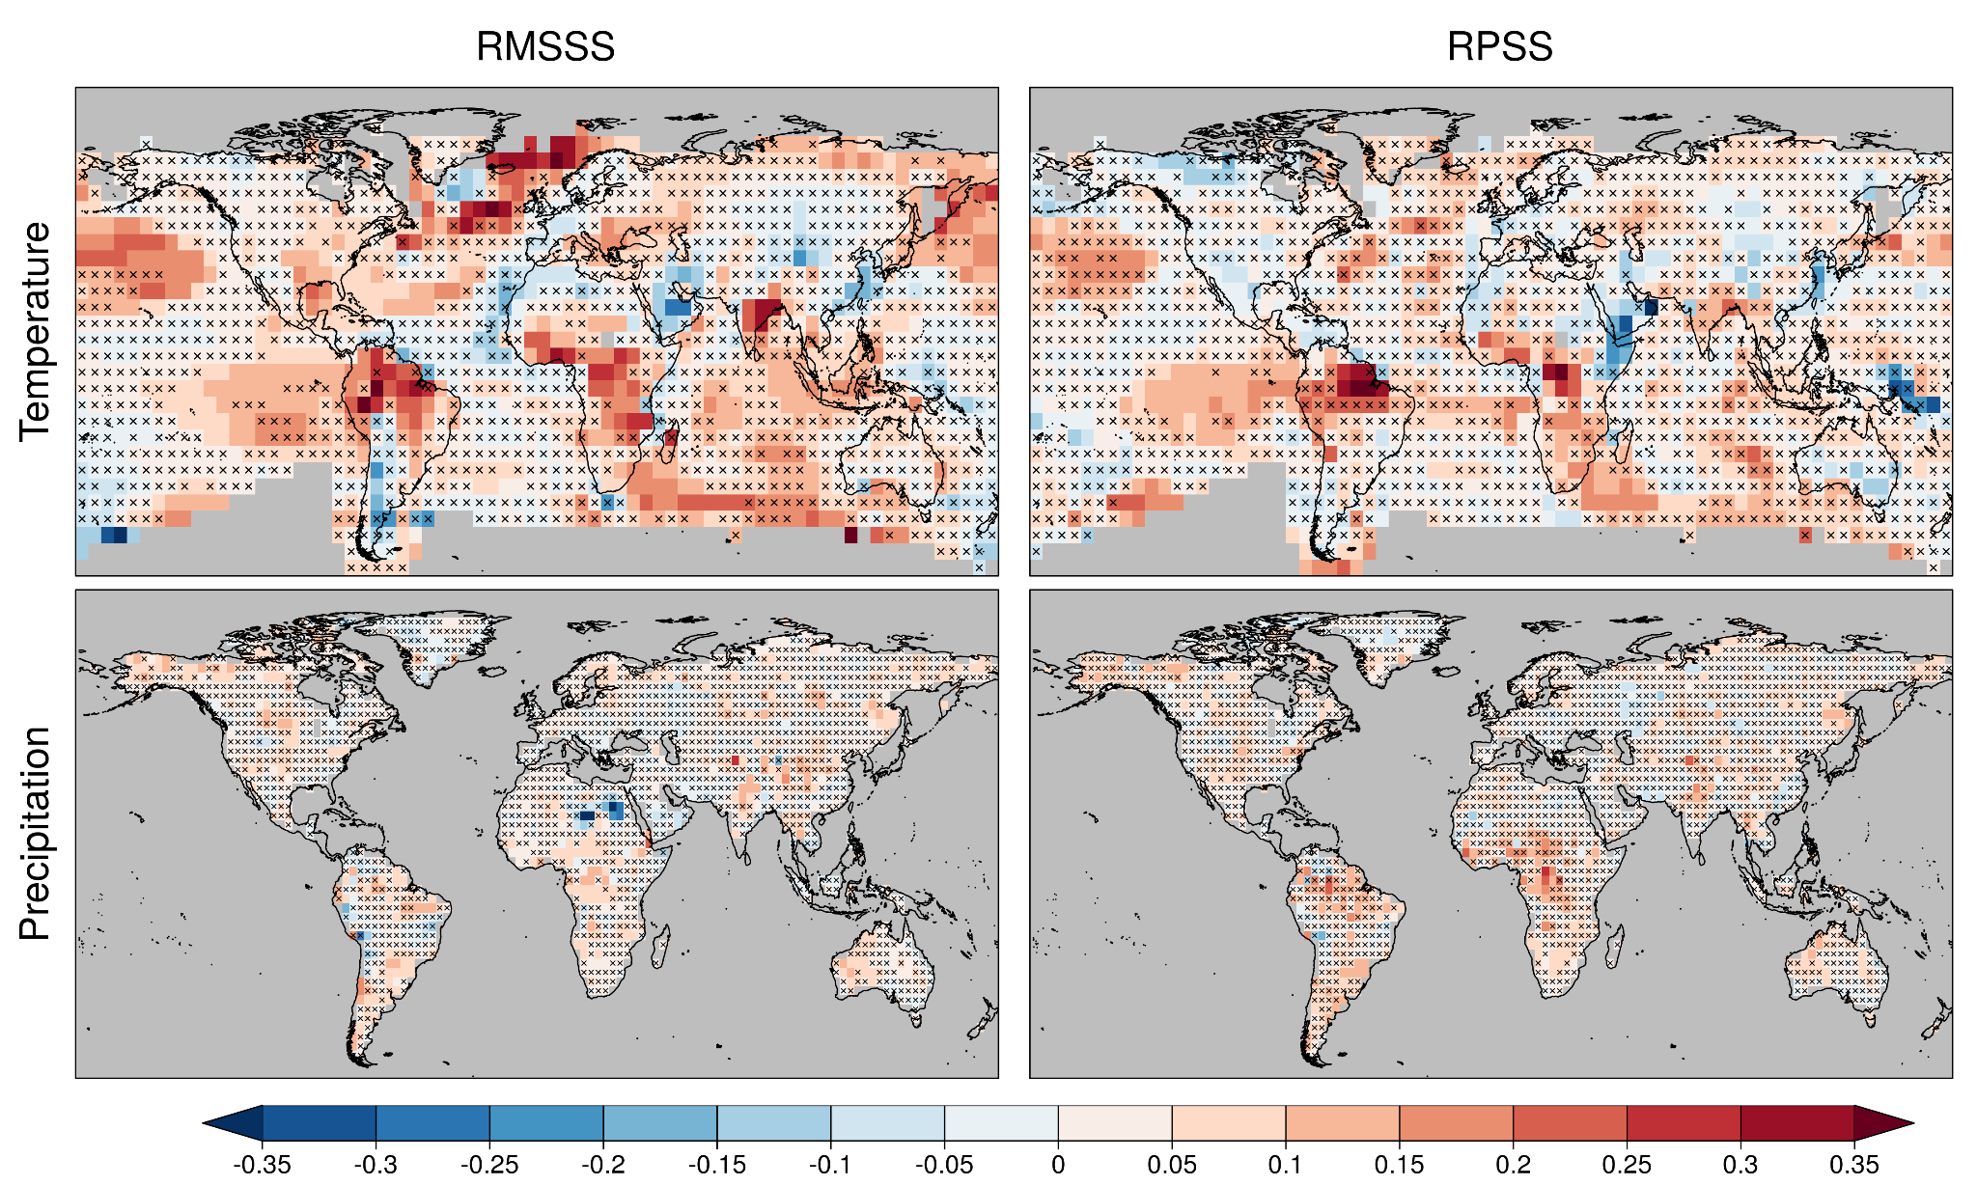
DCPP vs C3S_34c multi-model (13 vs 4 systems)
DCPP multi-model worse than C3S_34c multi-model ← | → DCPP multi-model better than C3S_34c multi-model
DCPP multi-model: 169 members from 13 forecast systems.
C3S_34c multi-model: 40 members from 4 forecast systems (CMCC-CM2-SR5, EC-Earth3-i1, HadGEM3-GC3.1-MM and MPI-ESM1.2-HR).
Importance of having more real-time predictions!

Slide 16
Main findings
DCPP multi-model skill:
Generally high for temperature, particularly over land regions.
Lower for precipitation (limited to regions over Central Africa, Europe, and Asia).

Slide 17
Main findings
DCPP multi-model skill:
Generally high for temperature, particularly over land regions.
Lower for precipitation (limited to regions over Central Africa, Europe, and Asia).
Multi-model vs forecast systems:
The best system generally provides the highest skill for a particular location, variable and forecast period.
Highest forecast quality for a particular climate service.
The multi-model provides higher skill than, at least, the 50% of the systems.
More straightforward operational forecast generation.
More real-time predictions would allow selecting the best forecast system or multi-model (sub)ensemble for each specific region, variable and forecast period.

Slide 18
Main findings
DCPP multi-model skill:
Generally high for temperature, particularly over land regions.
Lower for precipitation (limited to regions over Central Africa, Europe, and Asia).
Multi-model vs forecast systems:
The best system generally provides the highest skill for a particular location, variable and forecast period.
Highest forecast quality for a particular climate service.
The multi-model provides higher skill than, at least, the 50% of the systems.
More straightforward operational forecast generation.
More real-time predictions would allow selecting the best forecast system or multi-model (sub)ensemble for each specific region, variable and forecast period.
DCPP vs HIST multi-models:
Added value of initialisation over some ocean and land regions for temperature and precipitation.
Added value for AMV and GSAT.

Slide 19
Delgado-Torres, C., Donat, M. G., Gonzalez-Reviriego, N., Caron, L., Athanasiadis, P. J., Bretonnière, P., Dunstone, N. J., Ho, A., Nicoli, D., Pankatz, K., Paxian, A., Pérez-Zanón, N., Cabré, M. S., Solaraju-Murali, B., Soret, A., and Doblas-Reyes, F. J. (2022). Multi-Model forecast quality assessment of CMIP6 decadal predictions. Journal of Climate, 35(13), 4363-4382. https://doi.org/10.1175/JCLI-D-21-0811.1
Delgado-Torres, C., Donat, M. G., Soret, A., Gonzalez-Reviriego, N., Bretonnière, P.-A., Ho, A.-C., Pérez-Zanón, N., Samsó Cabré, M., and Doblas-Reyes, F. J. (2023). Multi-annual predictions of the frequency and intensity of daily temperature and precipitation extremes. Environmental Research Letters, 18 034031. https://doi.org/10.1088/1748-9326/acbbe1
Thank you!
This project has received funding from the European Union’s Horizon Europe – the Framework Programme for Research and Innovation (2021-2027) under grant agreement No. 101081460.
15IMSC
Toulouse, June 2024
carlos.delgado@bsc.es

Slide 20
Objectives
Assess the multi-model forecast quality for extreme indices based on daily minimum and maximum temperature and precipitation at multi-annual time scales.

Slide 21
Objectives
Assess the multi-model forecast quality for extreme indices based on daily minimum and maximum temperature and precipitation at multi-annual time scales.
Compare the skill in predicting temperature and precipitation extremes to that for mean temperature and precipitation.

Slide 22
Objectives
Assess the multi-model forecast quality for extreme indices based on daily minimum and maximum temperature and precipitation at multi-annual time scales.
Compare the skill in predicting temperature and precipitation extremes to that for mean temperature and precipitation.
Compare the forecast quality for annual and seasonal (DJF and JJA) aggregations.

Slide 23
Objectives
Assess the multi-model forecast quality for extreme indices based on daily minimum and maximum temperature and precipitation at multi-annual time scales.
Compare the skill in predicting temperature and precipitation extremes to that for mean temperature and precipitation.
Compare the forecast quality for annual and seasonal (DJF and JJA) aggregations.
Estimate the impact of model initialisation on the skill in predicting climate extremes.

Slide 24
Data and methods
Forecast period: forecast years 1-5
Evaluation period: 1961-2014 (start dates 1960-2009)
Variables: monthly temperature (TAS) and precipitation (PR)
Extreme indices (ETCCDI)
Daily maximum temperature: TXx and TX90p
Daily minimum temperature: TNn and TN10p
Daily precipitation: Rx5day and R95p
Forecast system | DCPP members | HIST members | Initialisation month
BCC-CSM2-MR | 8 | 2 | January
CanESM5 | 20 | 25 | January
CMCC-CM2-SR5 | 10 | 6 | November
EC-Earth3-i1 | 10 | 10 | November
EC-Earth3-i2 | 5 | - | November
EC-Earth3-i4 | 10 | - | November
HadGEM3-GC3.1-MM | 10 | 4 | November
IPSL-CM6A-LR | 10 | 31 | January
MIROC6 | 10 | 10 | November
MPI-ESM1.2-HR | 10 | 10 | November
MRI-ESM2-0 | 10 | 6 | November
NorCPM1-i1 | 10 | 30 | October
NorCPM1-i2 | 10 | - | October
 | 133 members | 134 members

Slide 25
Data and methods
Forecast period: forecast years 1-5
Evaluation period: 1961-2014 (start dates 1960-2009)
Variables: monthly temperature (TAS) and precipitation (PR)
Extreme indices (ETCCDI)
Daily maximum temperature: TXx and TX90p
Daily minimum temperature: TNn and TN10p
Daily precipitation: Rx5day and R95p
Forecast system | DCPP members | HIST members | Initialisation month
BCC-CSM2-MR | 8 | 2 | January
CanESM5 | 20 | 25 | January
CMCC-CM2-SR5 | 10 | 6 | November
EC-Earth3-i1 | 10 | 10 | November
EC-Earth3-i2 | 5 | - | November
EC-Earth3-i4 | 10 | - | November
HadGEM3-GC3.1-MM | 10 | 4 | November
IPSL-CM6A-LR | 10 | 31 | January
MIROC6 | 10 | 10 | November
MPI-ESM1.2-HR | 10 | 10 | November
MRI-ESM2-0 | 10 | 6 | November
NorCPM1-i1 | 10 | 30 | October
NorCPM1-i2 | 10 | - | October
 | 133 members | 134 members
Related to intensity

Slide 26
Data and methods
Forecast period: forecast years 1-5
Evaluation period: 1961-2014 (start dates 1960-2009)
Variables: monthly temperature (TAS) and precipitation (PR)
Extreme indices (ETCCDI)
Daily maximum temperature: TXx and TX90p
Daily minimum temperature: TNn and TN10p
Daily precipitation: Rx5day and R95p
Forecast system | DCPP members | HIST members | Initialisation month
BCC-CSM2-MR | 8 | 2 | January
CanESM5 | 20 | 25 | January
CMCC-CM2-SR5 | 10 | 6 | November
EC-Earth3-i1 | 10 | 10 | November
EC-Earth3-i2 | 5 | - | November
EC-Earth3-i4 | 10 | - | November
HadGEM3-GC3.1-MM | 10 | 4 | November
IPSL-CM6A-LR | 10 | 31 | January
MIROC6 | 10 | 10 | November
MPI-ESM1.2-HR | 10 | 10 | November
MRI-ESM2-0 | 10 | 6 | November
NorCPM1-i1 | 10 | 30 | October
NorCPM1-i2 | 10 | - | October
 | 133 members | 134 members
Related to intensity
Related to frequency

Slide 27
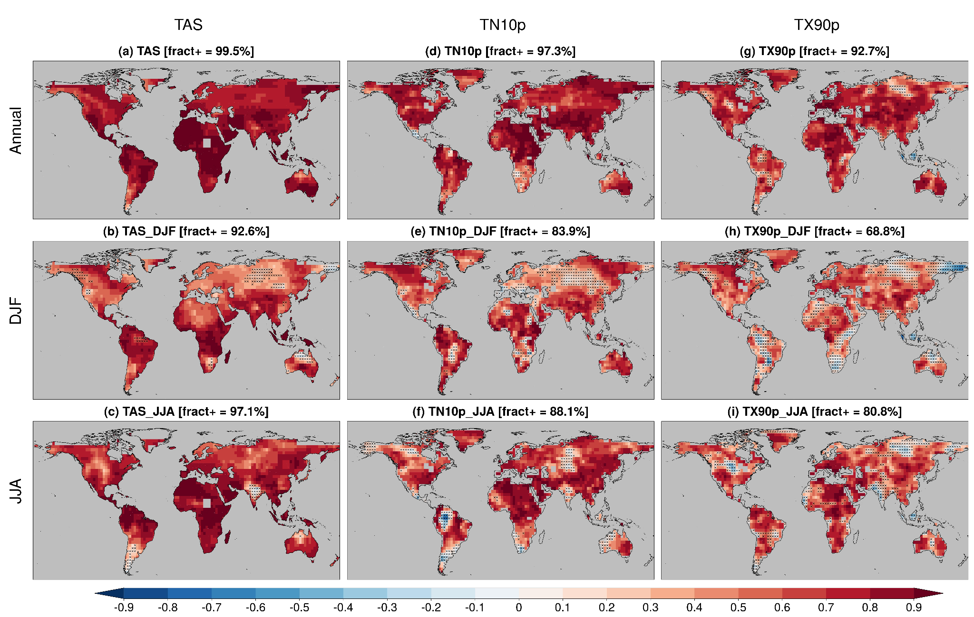
Multi-model skill - Temperature extremes
The DCPP multi-model ensemble skillfully predicts variations in the temperature extremes over most land regions.
The extreme indices are predicted with lower skill than the mean quantities.

Slide 28
Multi-model skill - Temperature extremes
The DCPP multi-model ensemble skillfully predicts variations in the temperature extremes over most land regions.
The extreme indices are predicted with lower skill than the mean quantities.
Higher skill for indices based on minimum temperature than those based on maximum temperature.
Generally higher prediction skill in summer than in winter.

Slide 29
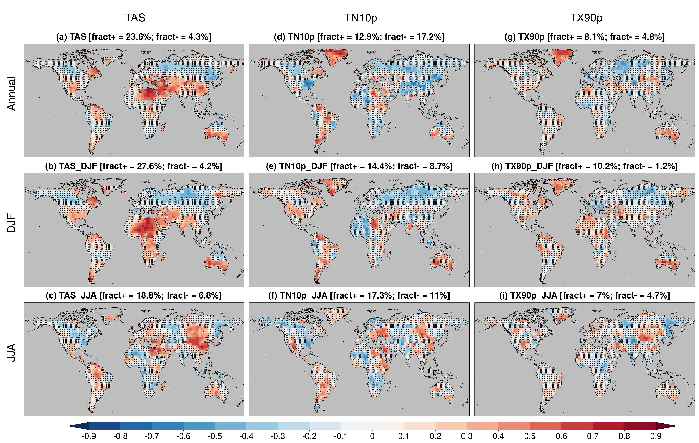
Impact of initialisation - Temperature extremes
Different impact of model initialisation depending on the season.
Some regions show added value for predictions of mean temperature.

Slide 30
Impact of initialisation - Temperature extremes
Different impact of model initialisation depending on the season.
Some regions show added value for predictions of mean temperature.
For extreme temperature, the impact of initialisation is generally low and highly region-dependent.

Slide 31
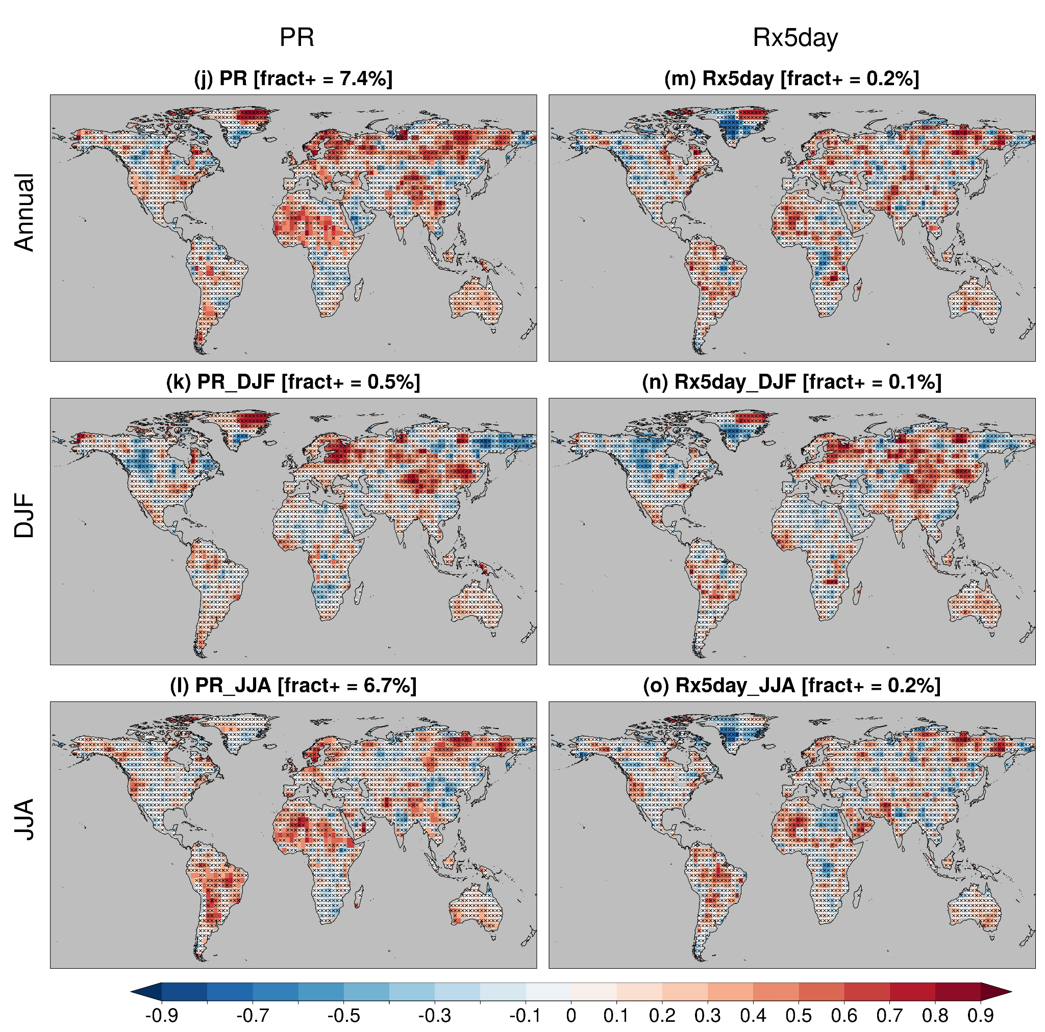
Multi-model skill - Precipitation extremes
The prediction skill for precipitation extremes is much more limited than for temperature extremes.
Different regions where the multi-model is skillful for summer and winter.
Generally similar patterns for mean and extreme precipitation.

Slide 32
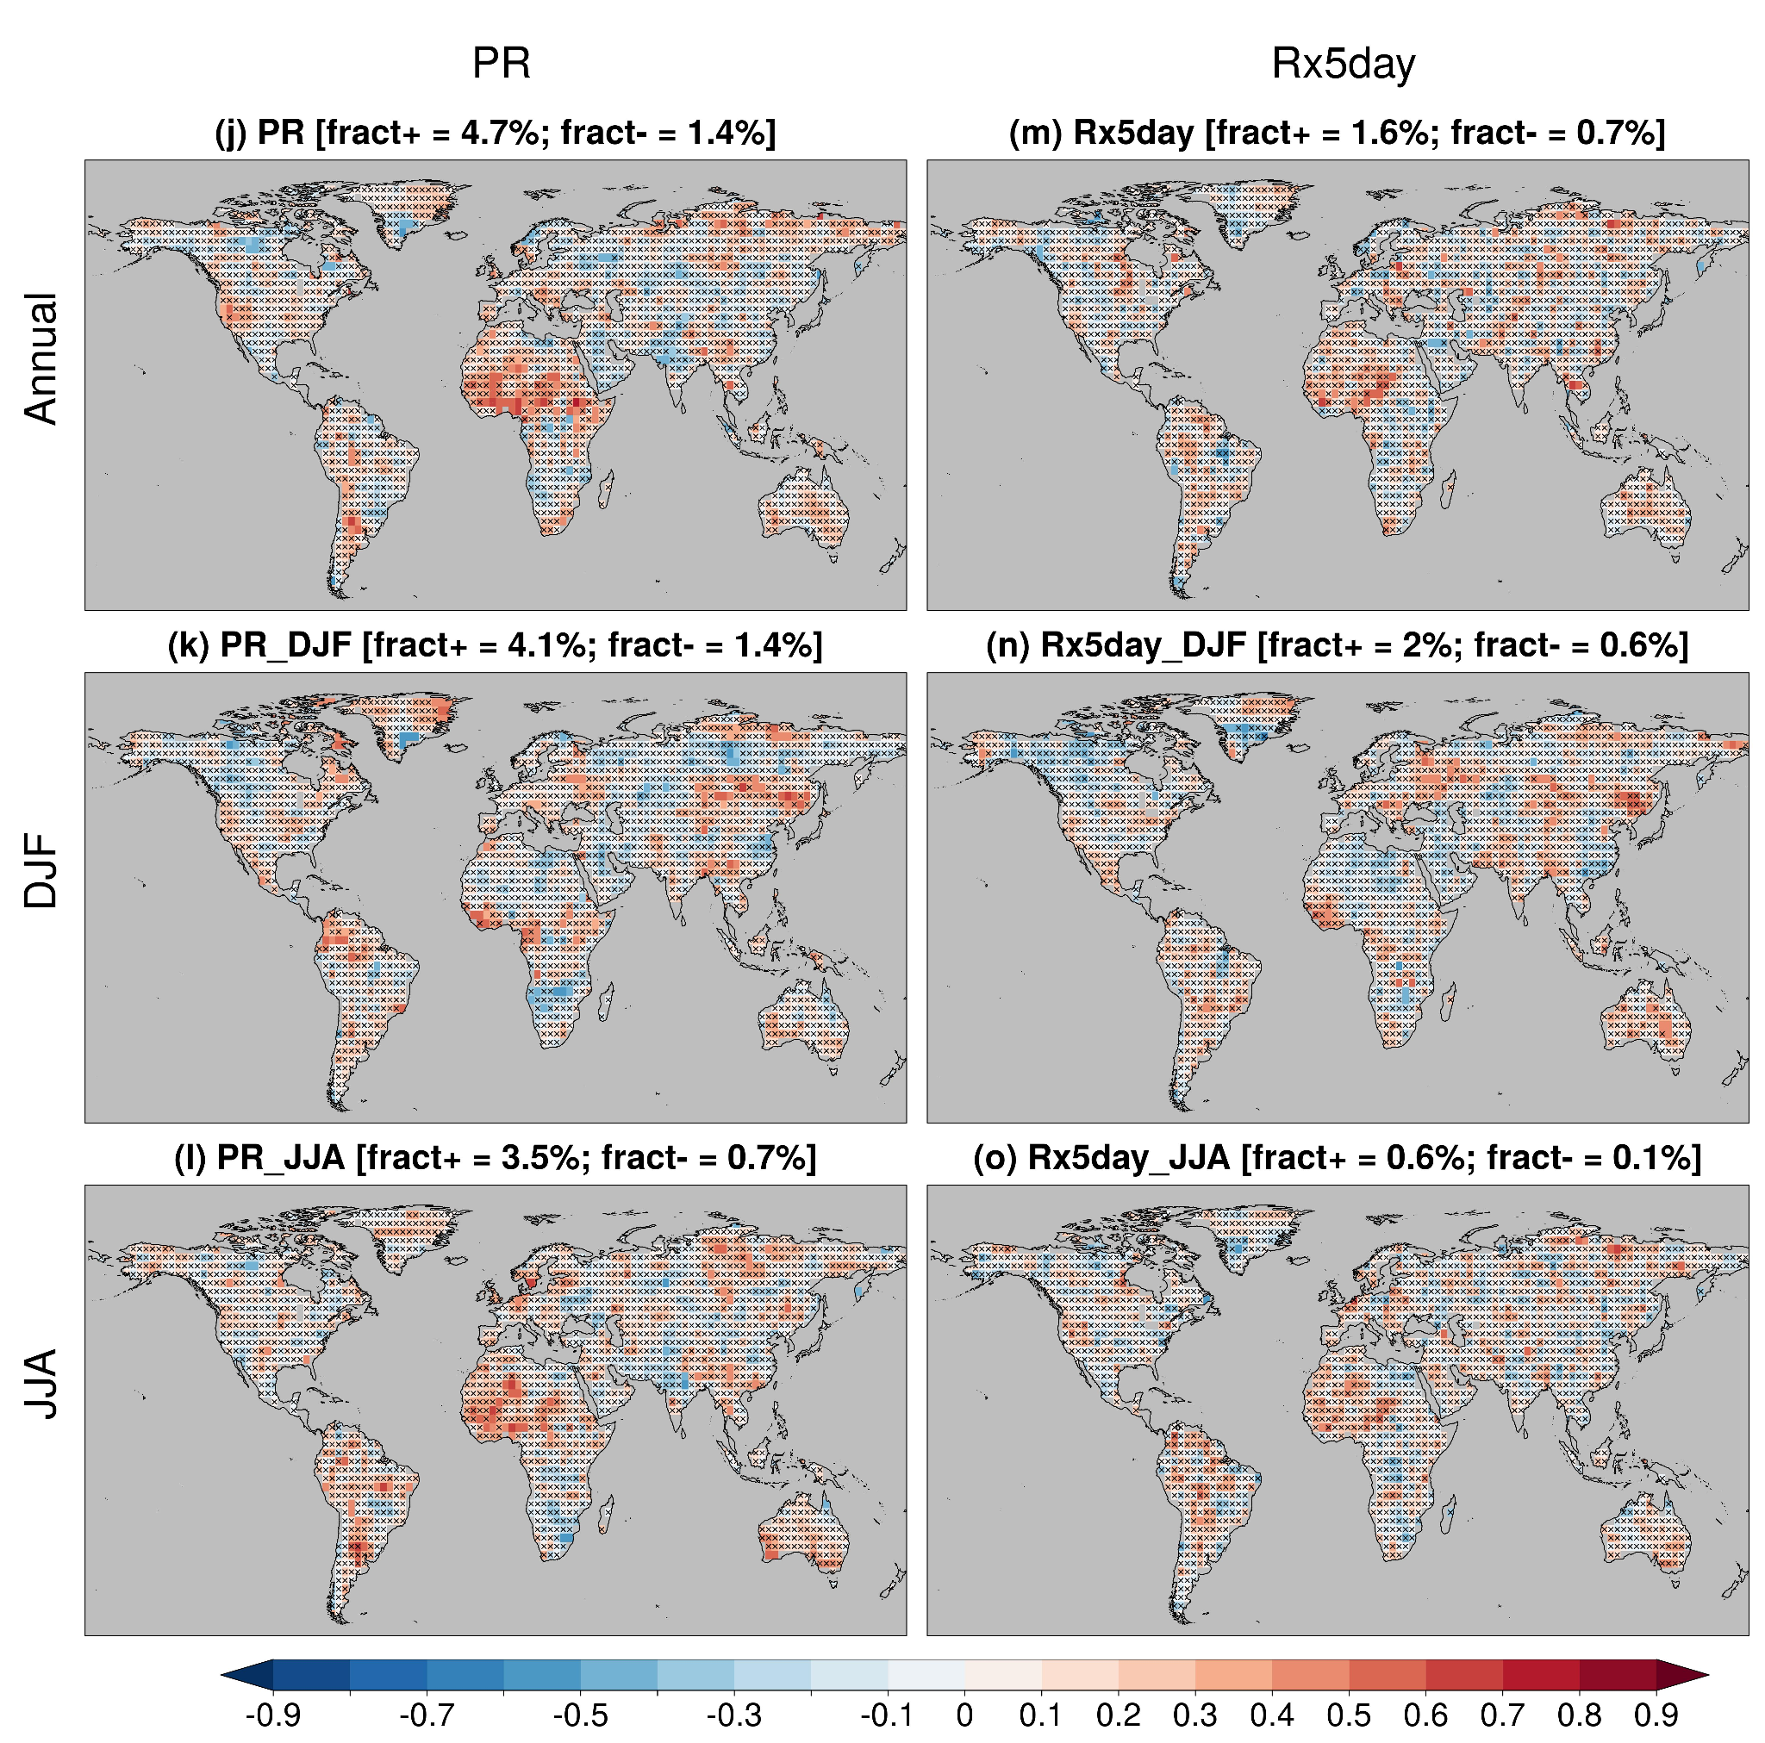
Impact of initialisation - Precipitation extremes
Low added value from model initialisation for prediction of mean and extreme precipitation.

Slide 33
Main findings
The multi-model ensemble provides skillful predictions of temperature extremes over most land regions, while the prediction skill is more limited for precipitation extremes.

Slide 34
Main findings
The multi-model ensemble provides skillful predictions of temperature extremes over most land regions, while the prediction skill is more limited for precipitation extremes.
The extreme indices are predicted with lower skill than the mean quantities.

Slide 35
Main findings
The multi-model ensemble provides skillful predictions of temperature extremes over most land regions, while the prediction skill is more limited for precipitation extremes.
The extreme indices are predicted with lower skill than the mean quantities.
The prediction skill extreme indices based on minimum temperature is generally higher than that for indices based on maximum temperature.

Slide 36
Main findings
The multi-model ensemble provides skillful predictions of temperature extremes over most land regions, while the prediction skill is more limited for precipitation extremes.
The extreme indices are predicted with lower skill than the mean quantities.
The prediction skill extreme indices based on minimum temperature is generally higher than that for indices based on maximum temperature.
The skill for predicting both extreme temperature and precipitation is higher for the moderate extremes (TN10p, TX90p and R95p; related to frequency) than for the most extreme extremes (TNn, TXx and Rx5day, related to intensity).

Slide 37
Main findings
The multi-model ensemble provides skillful predictions of temperature extremes over most land regions, while the prediction skill is more limited for precipitation extremes.
The extreme indices are predicted with lower skill than the mean quantities.
The prediction skill extreme indices based on minimum temperature is generally higher than that for indices based on maximum temperature.
The skill for predicting both extreme temperature and precipitation is higher for the moderate extremes (TN10p, TX90p and R95p; related to frequency) than for the most extreme extremes (TNn, TXx and Rx5day, related to intensity).
Higher prediction skill in summer than in winter.

Slide 38
Main findings
The multi-model ensemble provides skillful predictions of temperature extremes over most land regions, while the prediction skill is more limited for precipitation extremes.
The extreme indices are predicted with lower skill than the mean quantities.
The prediction skill extreme indices based on minimum temperature is generally higher than that for indices based on maximum temperature.
The skill for predicting both extreme temperature and precipitation is higher for the moderate extremes (TN10p, TX90p and R95p; related to frequency) than for the most extreme extremes (TNn, TXx and Rx5day, related to intensity).
Higher prediction skill in summer than in winter.
The added value from model initialisation for predictions of extremes is generally low and highly region-dependent.

