Slide 1
Forecast Briefing
March 2025
Lluís Palma, Paloma Tracasa-Castro, Josep Cos, Aleksander Lacima-Nadolnik, Matías Olmo
Climate Services Team (CST)
Earth System Services (ESS)
Barcelona Supercomputing Center (BSC)
Friday 28th Mar 2025

Slide 2
Outline
Recent state of the climate
Seasonal forecasts
Intra-seasonal forecasts
Discussion
Notes:
‹#›

Slide 3
Recent state of the climate
Notes:
‹#›

Slide 4
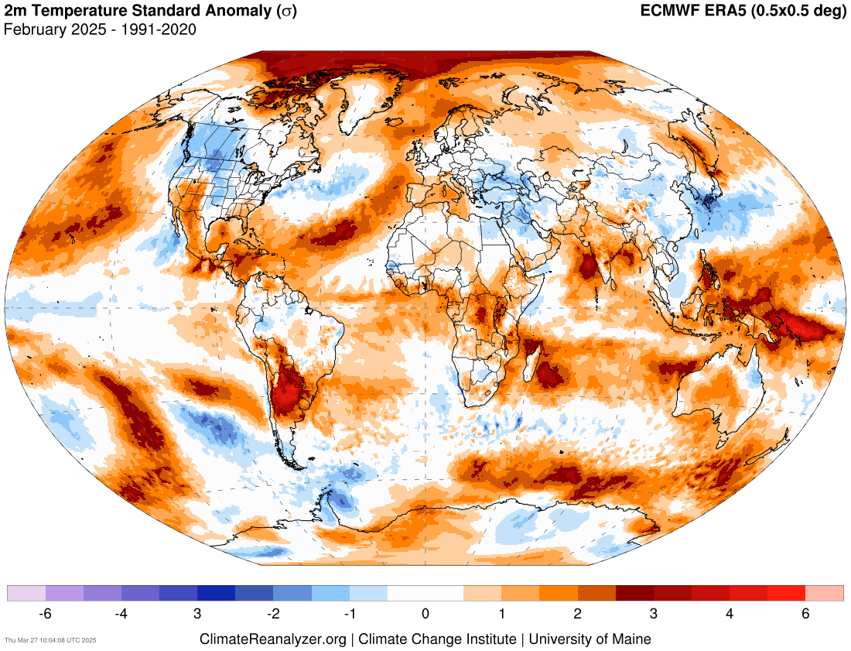
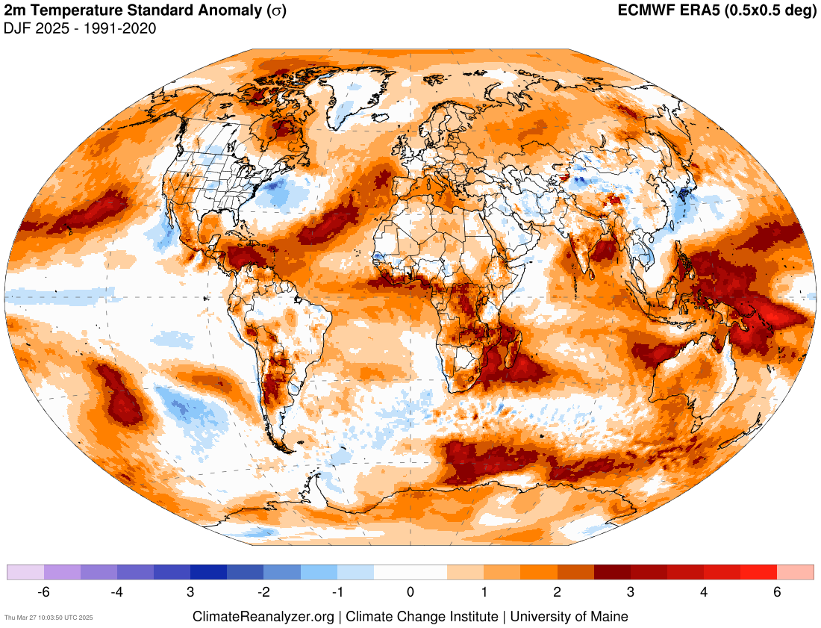
Recent state of the climate
Temperature
Last month’s signal is pretty similar to last season’s, with some notable exceptions: Middle East, eastern Europe, China, parts of North America, Antarctica, northeastern Australia, Arctic, north of Argentina
Source: https://climatereanalyzer.org/research_tools/monthly_maps/
Notes:
https://iridl.ldeo.columbia.edu/maproom/Global/Precipitation/Anomaly.html
https://iridl.ldeo.columbia.edu/maproom/Global/Precipitation/Seasonal.html
https://iridl.ldeo.columbia.edu/maproom/Global/Precipitation/WASP_Indices.html
‹#›

Slide 5
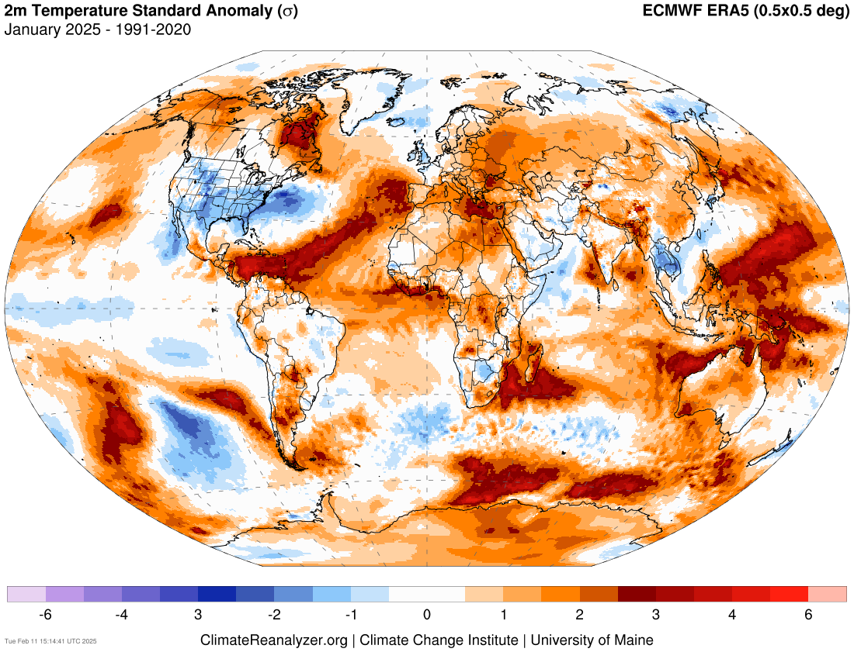
The standardized anomaly gives a measure of how large an anomaly is compared to the climatological (i.e. typical) variability. It is measured in number of 𝞼 (i.e. number of standard deviations)
Source: https://climatereanalyzer.org/research_tools/monthly_maps/
Notes:
https://iridl.ldeo.columbia.edu/maproom/Global/Atm_Temp/Anomaly.html
https://iridl.ldeo.columbia.edu/maproom/Global/Atm_Temp/Seasonal.html
https://iridl.ldeo.columbia.edu/maproom/Global/Atm_Temp/Std_Anom_Chnge.html
‹#›

Slide 6
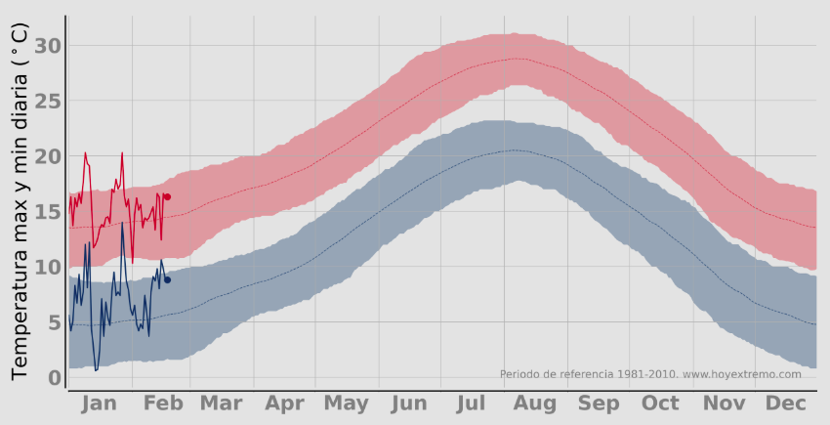
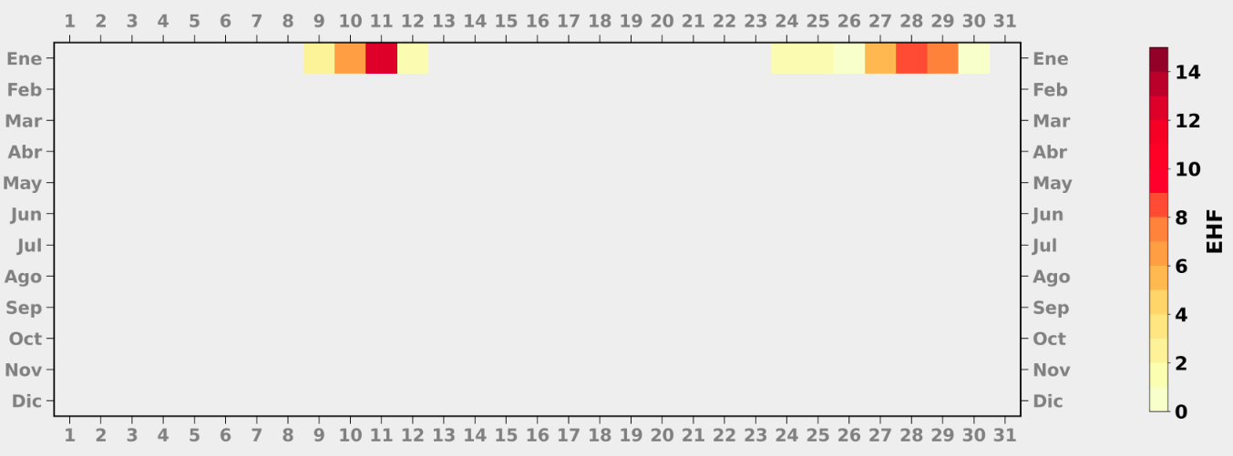
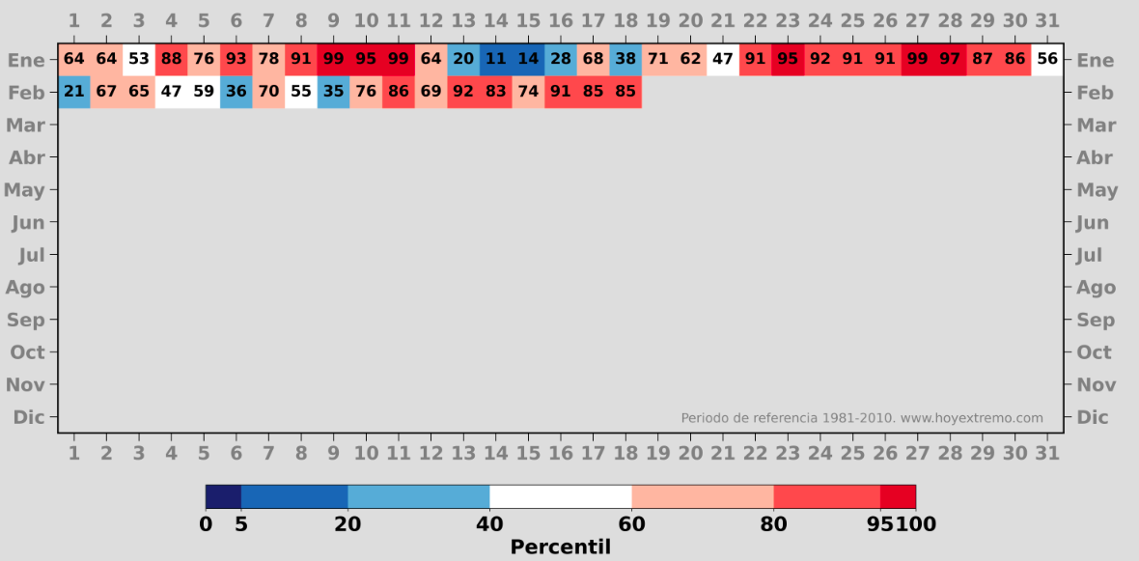
Recent state of the climate
Barcelona
Excess Heat Factor (EHF): Temperature-based index that allows to monitor the extension, duration and intensity of a heat wave.
Source: https://hoyextremo.com/city_pages/barcelona/#summary
Notes:
https://iridl.ldeo.columbia.edu/maproom/Global/Precipitation/Seasonal.html
https://iridl.ldeo.columbia.edu/maproom/Global/Precipitation/WASP_Indices.html
‹#›

Slide 7
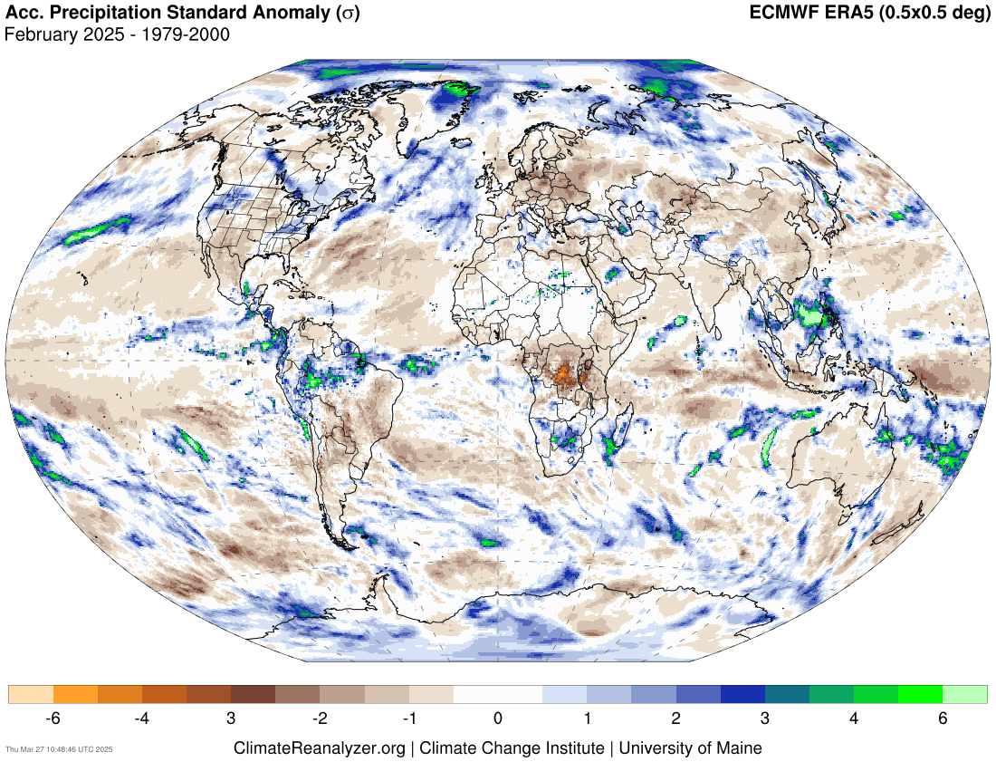
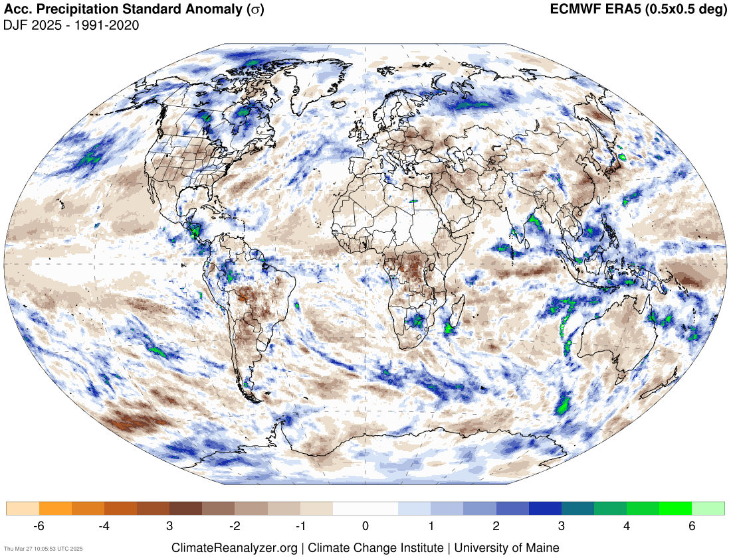
Recent state of the climate
Precipitation
High precipitation over the Maritime Continent, parts of the ITCZ (Brazil, Peru, Colombia, eastern Pacific), southern Africa, Arctic.
Dryness over Congo, most of Europe, Mexico and southern US, Australia and central South America.
Source: https://climatereanalyzer.org/research_tools/monthly_maps/
Notes:
https://iridl.ldeo.columbia.edu/maproom/Global/Precipitation/Anomaly.html
https://iridl.ldeo.columbia.edu/maproom/Global/Precipitation/Seasonal.html
https://iridl.ldeo.columbia.edu/maproom/Global/Precipitation/WASP_Indices.html
‹#›

Slide 8
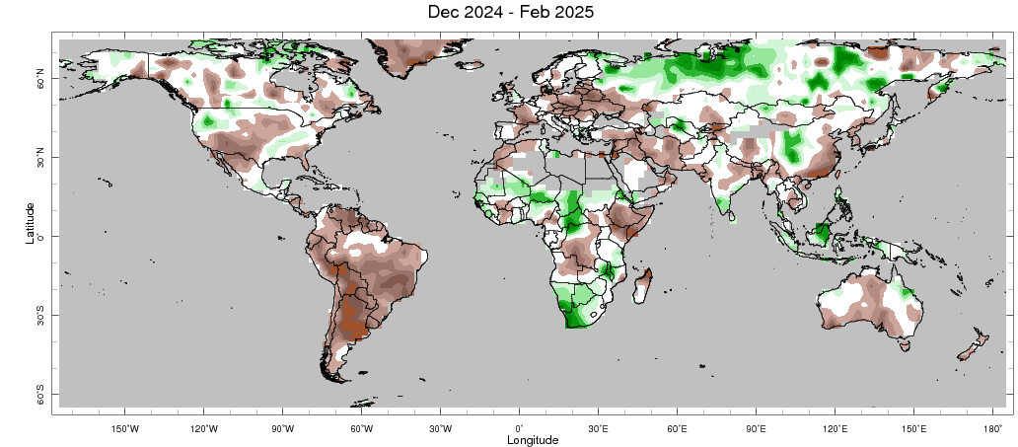
Recent state of the climate
Standardized Precipitation index (SPI)
SPI-3
SPI
The Standardized Precipitation Index (SPI; McKee 1993) is the number of standard deviations that observed cumulative precipitation (over x number of months) deviates from the climatological average.
SPI-x: Cumulative distribution over x-months.
Shorter SPI values (SPI-1, SPI-3): Respond quickly to rainfall changes, useful for early warning systems.
Longer SPI values (SPI-6, SPI-12, SPI-24): Reflect cumulative precipitation trends, useful for long-term water resource management.
Grey = Regions with an annual average precipitation of less than 0.2 mm/day have been "masked" from the plot.
Other information: 2.5º lat/lon grid, 1979-present climatological base period
Source: https://iridl.ldeo.columbia.edu/maproom/Global/Precipitation/SPI.html?var=.SPI-CAMSOPI_3-Month
Notes:
https://iridl.ldeo.columbia.edu/maproom/Global/Precipitation/Persistence.html
‹#›

Slide 9
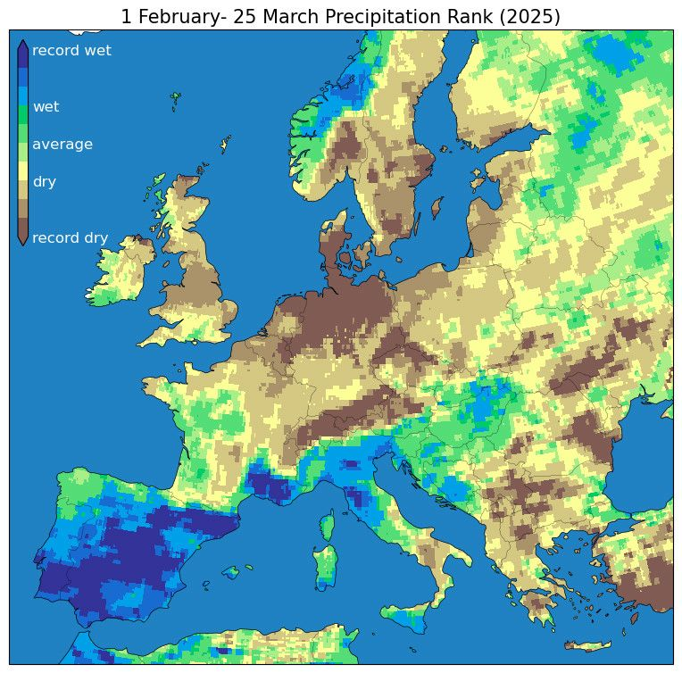
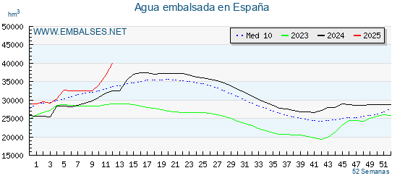
Recent state of the climate
Precipitation
Record wet in most of the Iberian Peninsula (since 1940; ERA5), south of France and north of Italy.
Record dry in north of Germany, Denmark, Netherlands, the Alps and parts of the Scandinavian Peninsula.
Turkey also shows a relevant negative rank.
Source: https://www.embalses.net/
Notes:
https://iridl.ldeo.columbia.edu/maproom/Global/Precipitation/Anomaly.html
https://iridl.ldeo.columbia.edu/maproom/Global/Precipitation/Seasonal.html
https://iridl.ldeo.columbia.edu/maproom/Global/Precipitation/WASP_Indices.html
‹#›

Slide 10
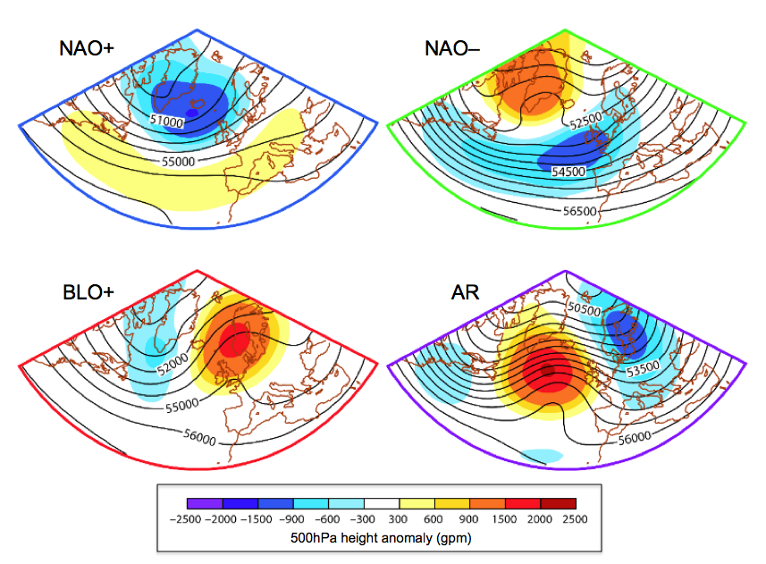
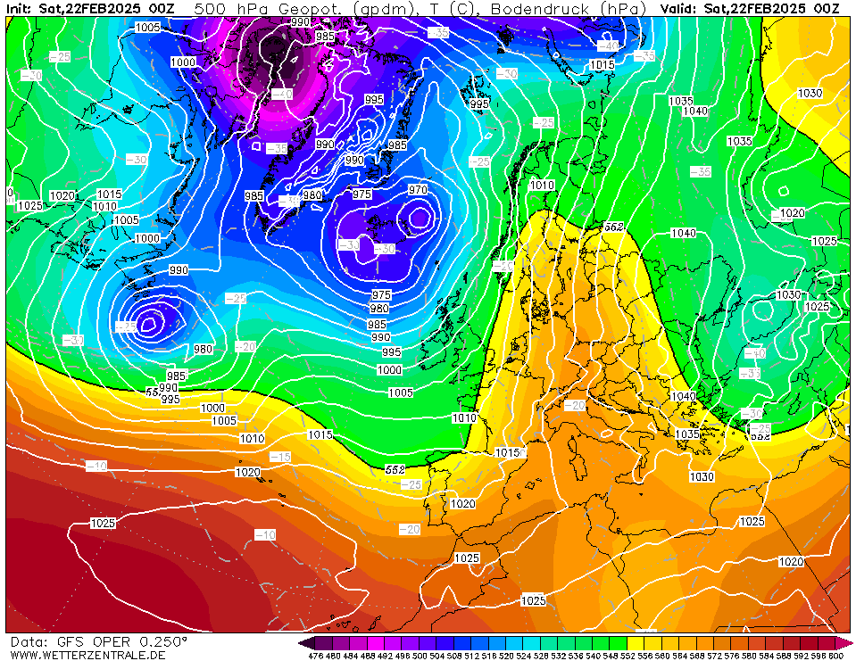
Recent state of the climate
Weather regimes
Blocking: Onset through anticyclonic wave breakings over Europe in the upper troposphere (Michel et al., 2012). Two main precursors of Euro-Atlantic blocking events are a retrograding high-latitude planetary-scale wave and an enhanced baroclinic wavetrain across the North Atlantic (Michelangeli & Vautard, 1998)
Future tool on evaluation of weather regimes.
GFS analysis
Source: https://www.wetterzentrale.de/reanalysis.php?map=1&model=avn&var=2&jaar=2025&maand=3&dag=26&h=0&nmaps=64
Notes:
https://iridl.ldeo.columbia.edu/maproom/Global/Precipitation/Anomaly.html
https://iridl.ldeo.columbia.edu/maproom/Global/Precipitation/Seasonal.html
https://iridl.ldeo.columbia.edu/maproom/Global/Precipitation/WASP_Indices.html
‹#›

Slide 11
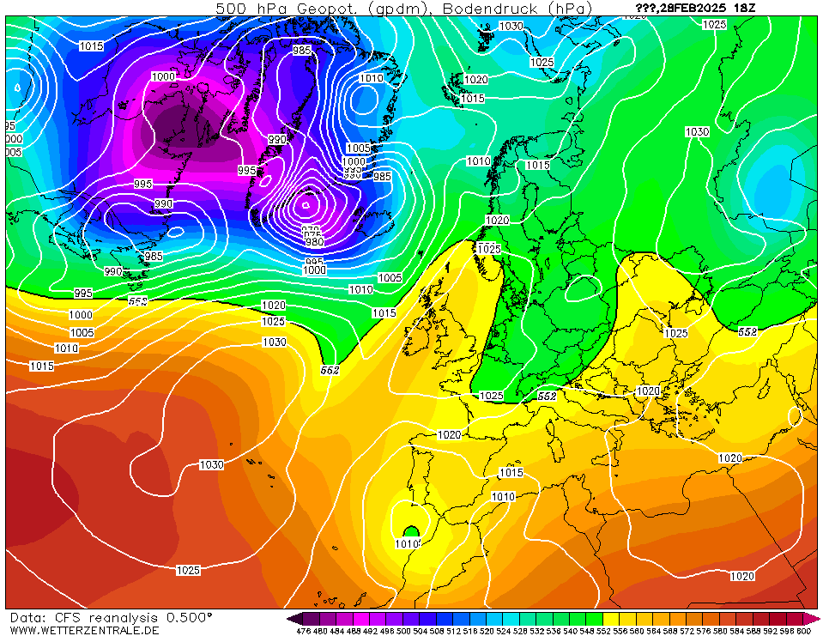
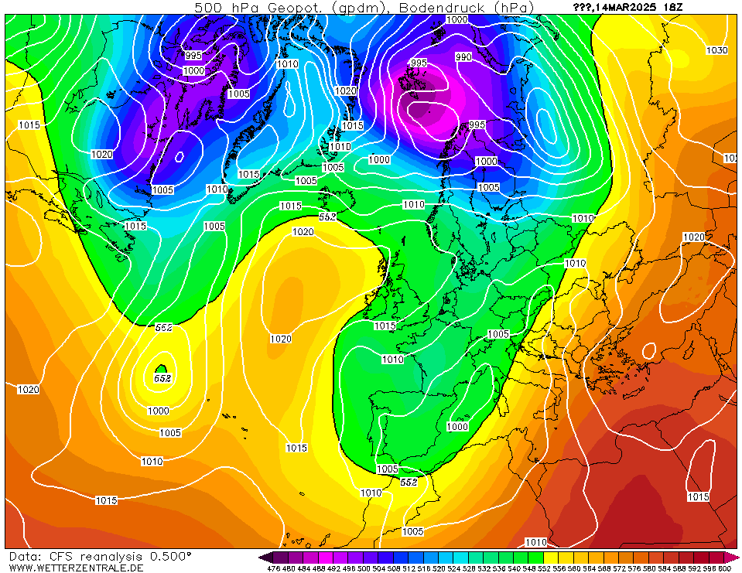
Weather regimes
GFS analysis
Future tool on evaluation of weather regimes
Source: https://www.wetterzentrale.de/reanalysis.php?map=1&model=avn&var=2&jaar=2025&maand=3&dag=26&h=0&nmaps=64
Notes:
https://iridl.ldeo.columbia.edu/maproom/Global/Precipitation/Anomaly.html
https://iridl.ldeo.columbia.edu/maproom/Global/Precipitation/Seasonal.html
https://iridl.ldeo.columbia.edu/maproom/Global/Precipitation/WASP_Indices.html
‹#›

Slide 12
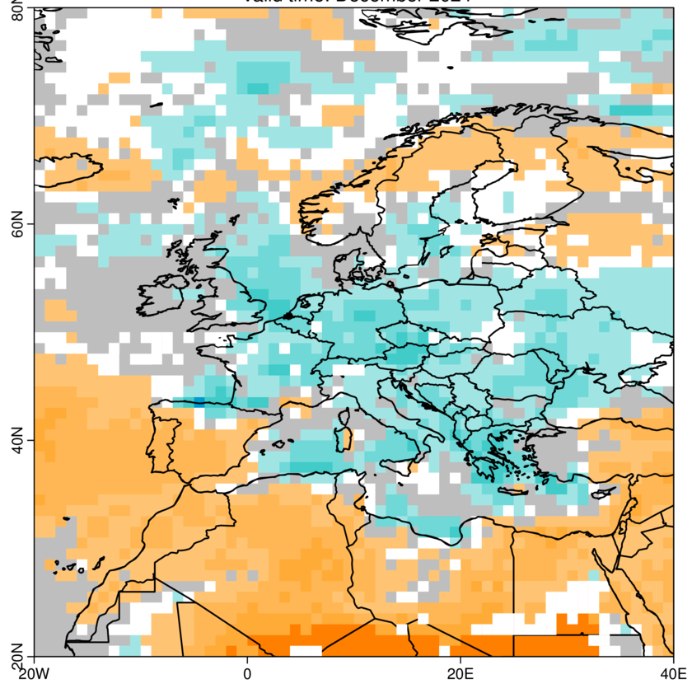
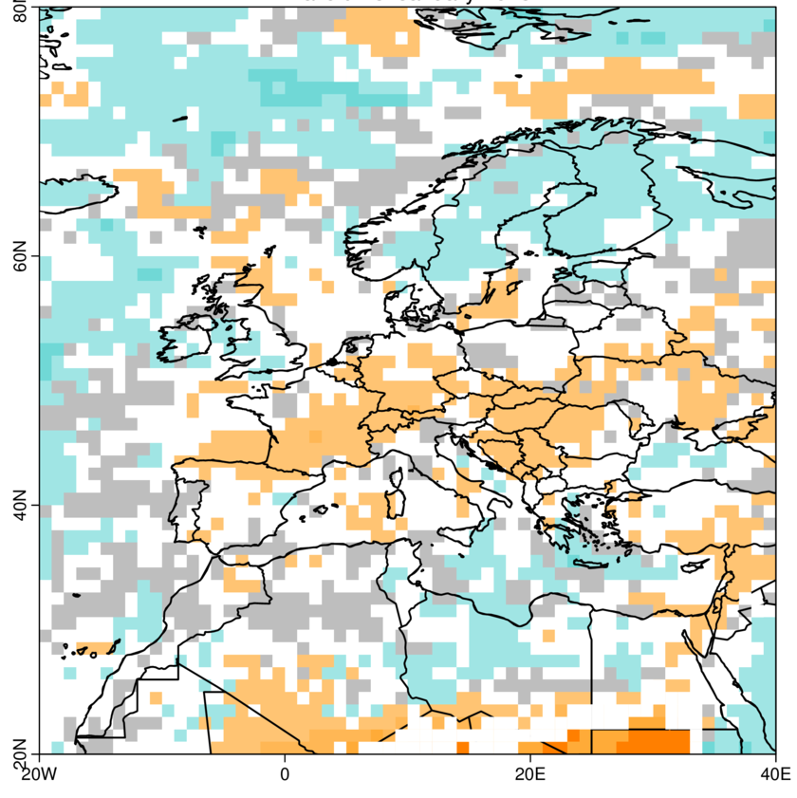
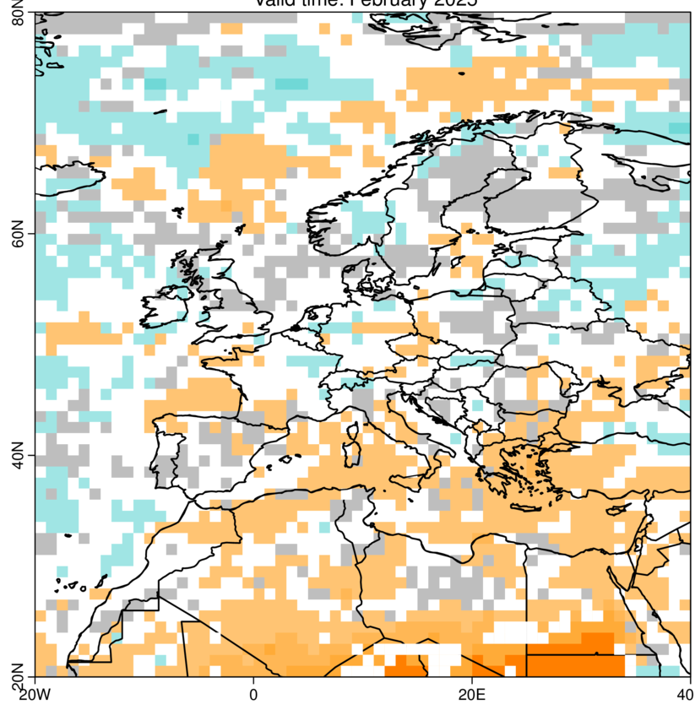
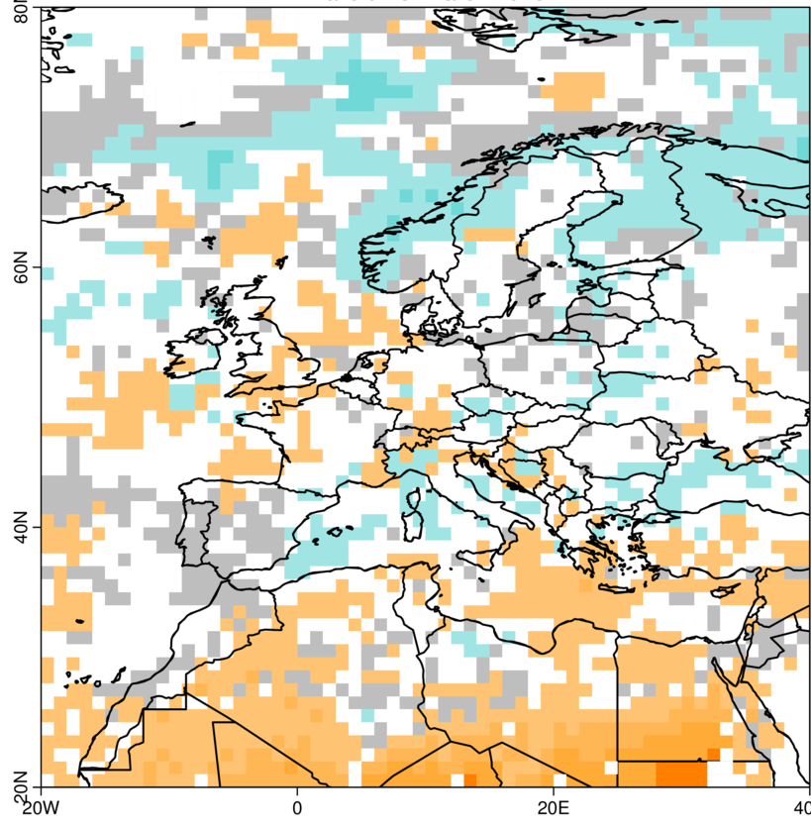
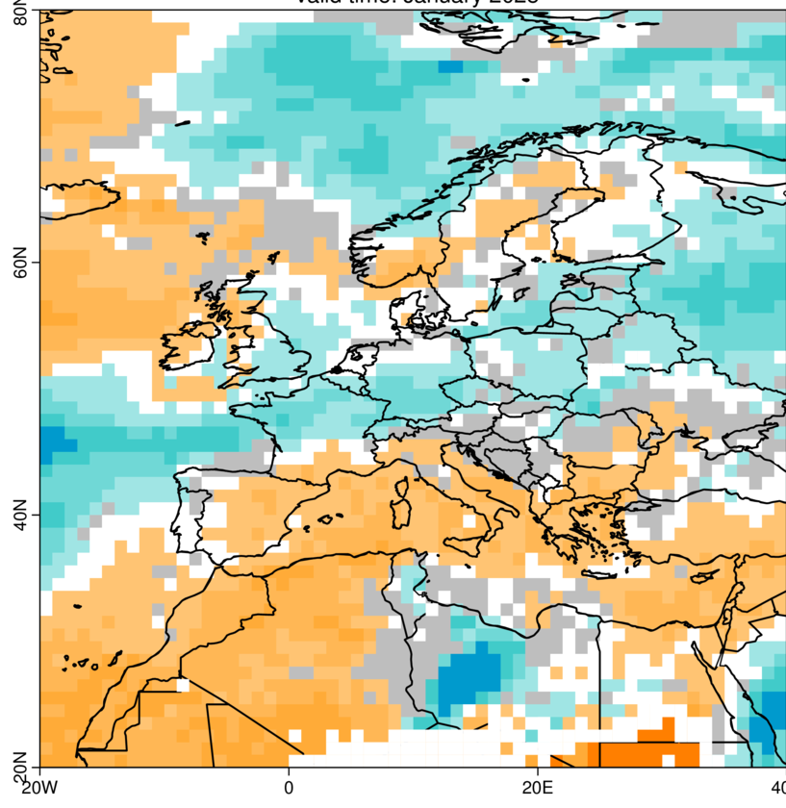
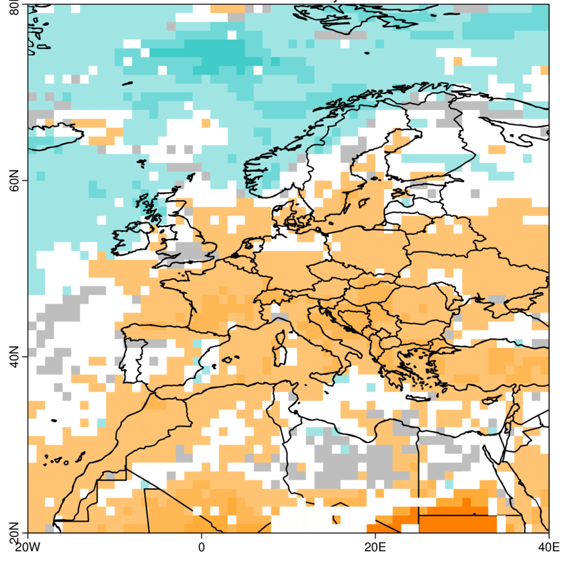
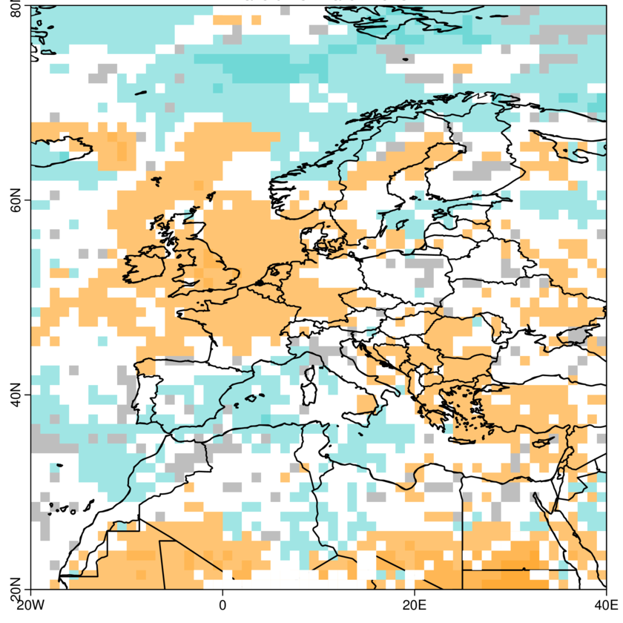
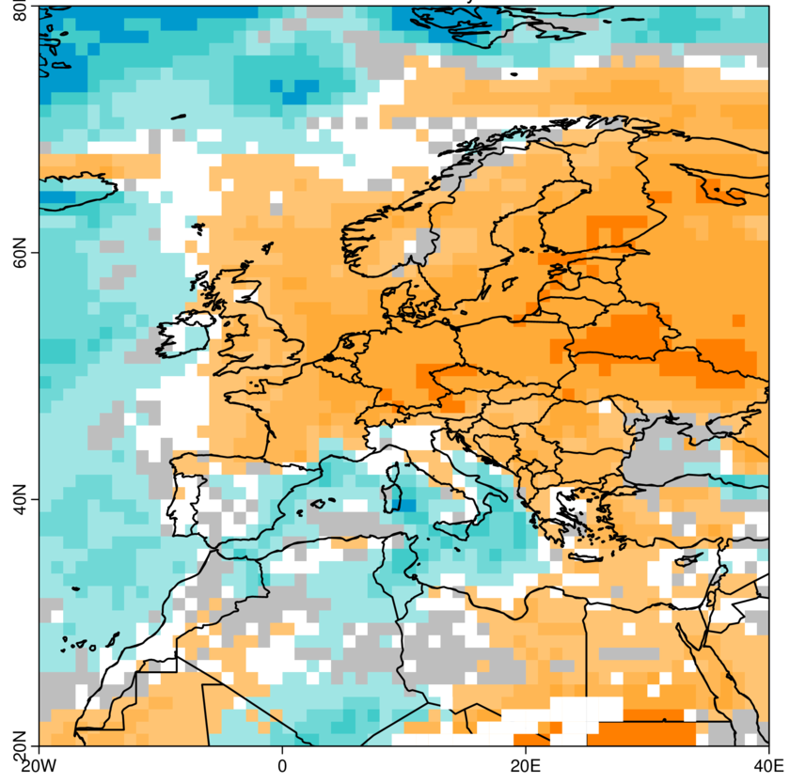
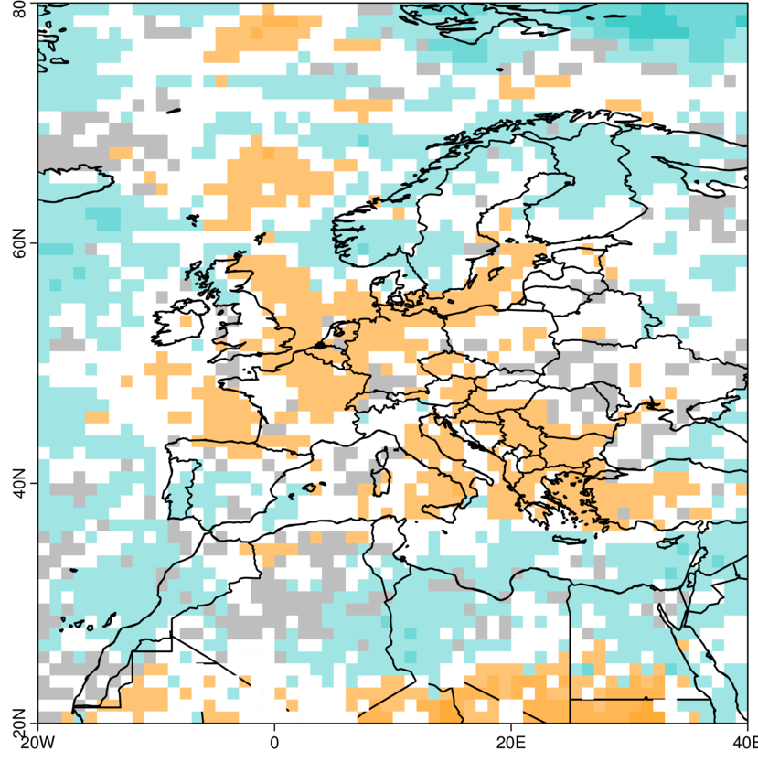
Forecast month →
December January February March
Did we anticipate above normal precipitation in Iberia?
A bit!
Since January
Start date ↓
December ‘24 →
January ‘25 →
February ‘25 →
Calibrated seasonal forecast ECMWF System5 with SUNSET
March ‘25 →
Notes:
https://iridl.ldeo.columbia.edu/maproom/Global/Precipitation/Anomaly.html
https://iridl.ldeo.columbia.edu/maproom/Global/Precipitation/Seasonal.html
https://iridl.ldeo.columbia.edu/maproom/Global/Precipitation/WASP_Indices.html
‹#›

Slide 13
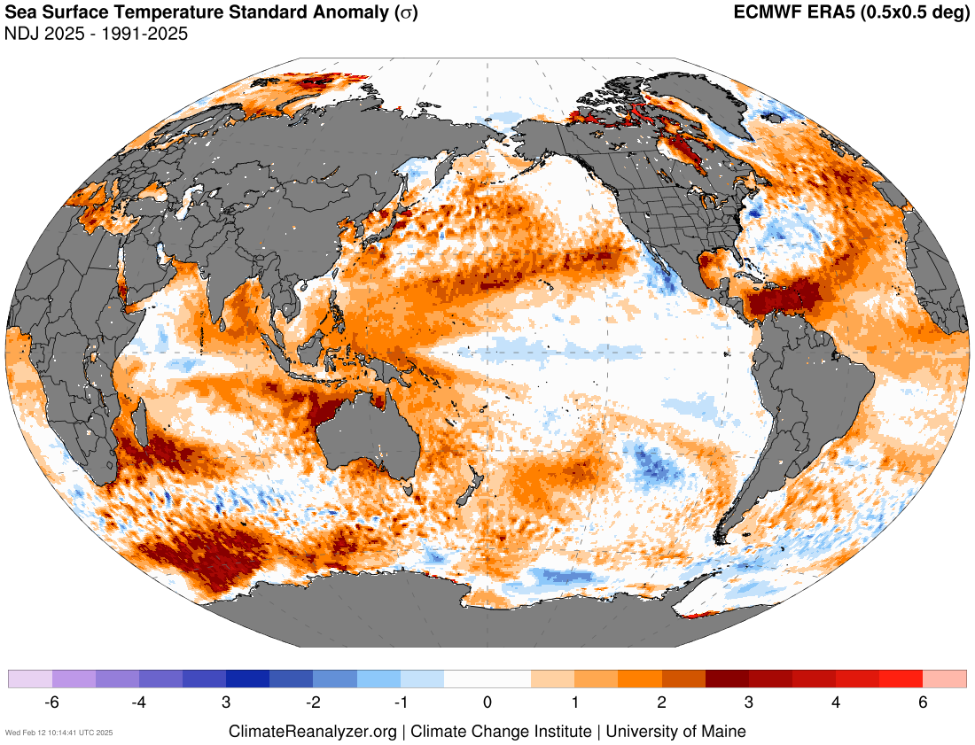
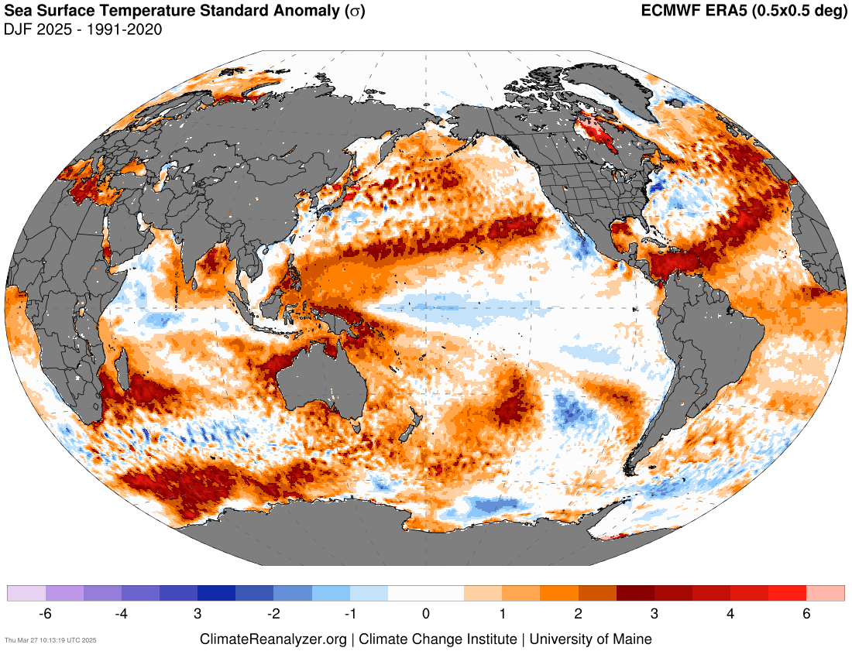
UPDATE
Source: https://climatereanalyzer.org/research_tools/monthly_maps/

Slide 14
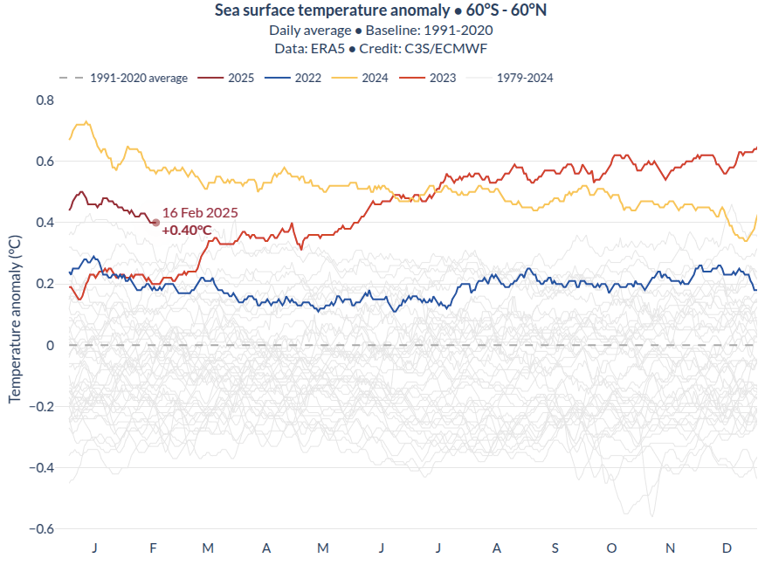
UPDATE
Since mid-2023, global SST anomalies have increased significantly compared to previous years, remaining above +0.4 ºC throughout all seasons (except for December 2024).
Source: https://pulse.climate.copernicus.eu/

Slide 15
Recent state of the climate
El Niño-Southern Oscillation (ENSO)
ENSO is the leading mode of natural variability at seasonal to interannual (S2I) time scales and is considered as an internally occurring coupled ocean-atmosphere phenomenon.
Notes:
https://iridl.ldeo.columbia.edu/maproom/Global/Atm_Temp/Anomaly.html
https://iridl.ldeo.columbia.edu/maproom/Global/Atm_Temp/Seasonal.html
https://iridl.ldeo.columbia.edu/maproom/Global/Atm_Temp/Std_Anom_Chnge.html
‹#›

Slide 16
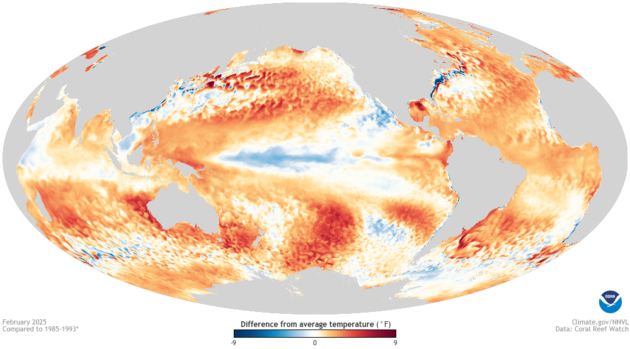
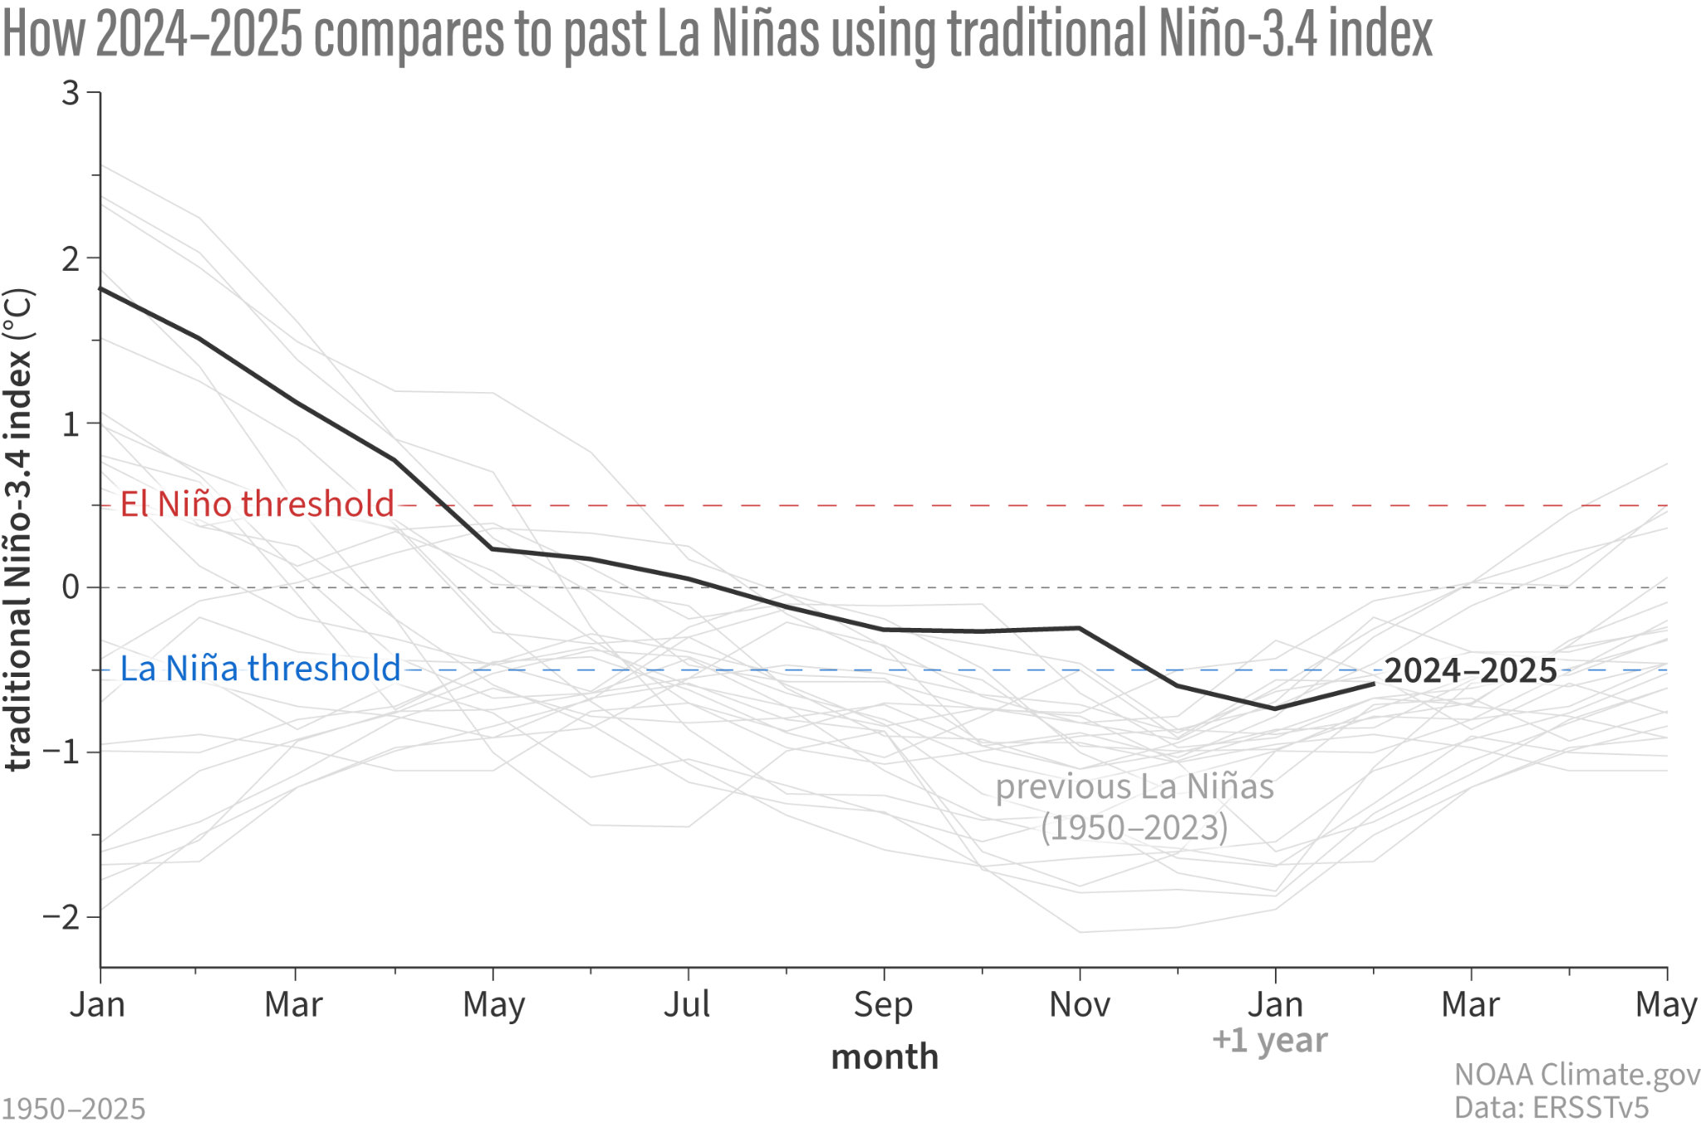
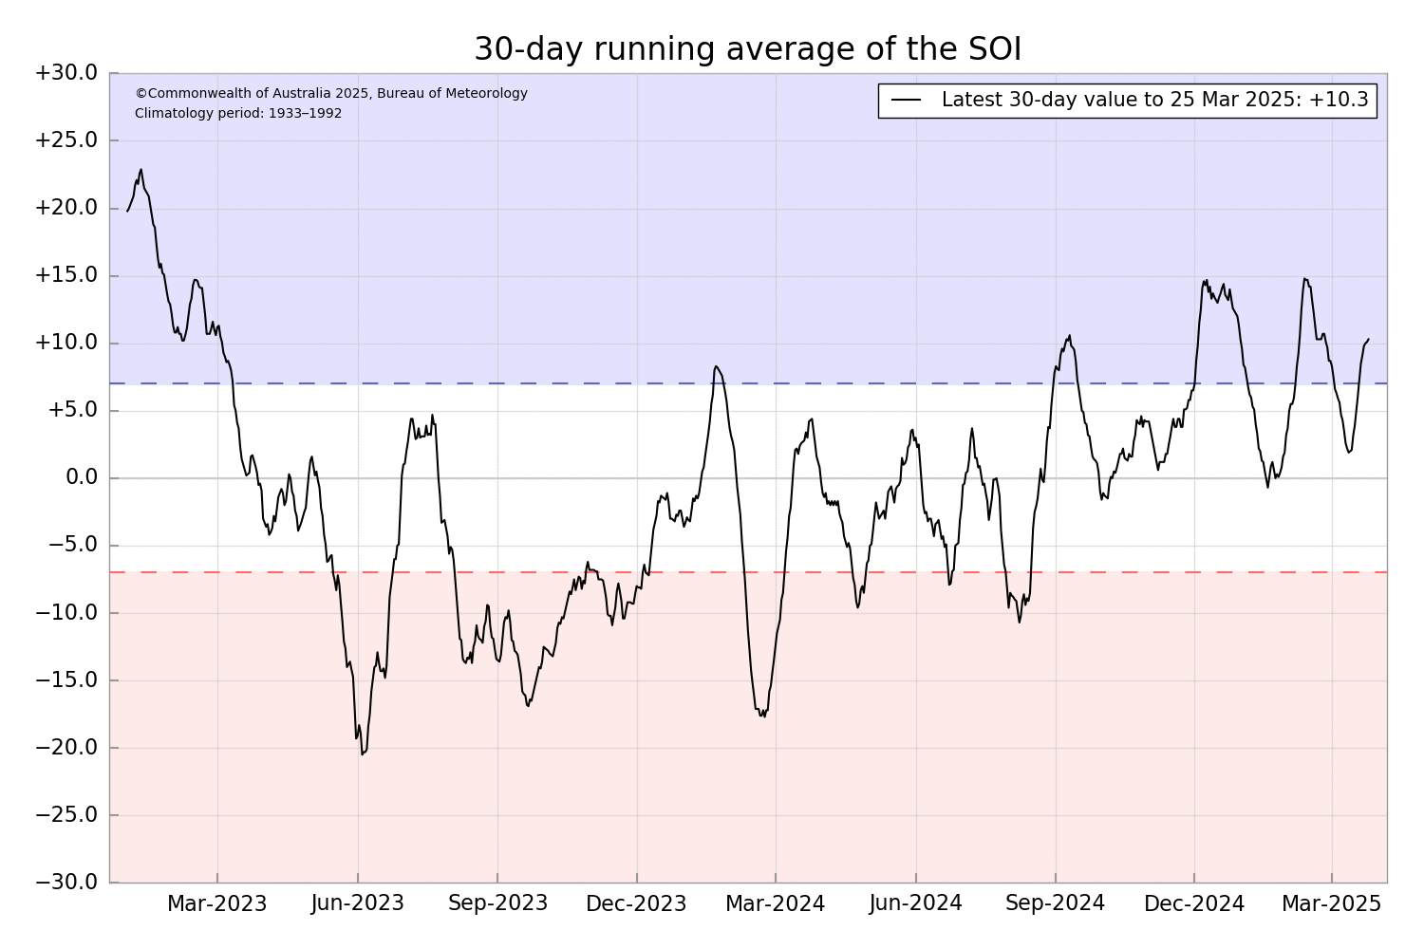
ENSO status is traditionally diagnosed by looking at SST anomalies in the Niño 3.4 region, known as the Oceanic Niño Index (ONI), and the difference in mean sea level pressure between Darwin and Tahiti, known as the Southern Oscillation Index (SOI).
ENSO alert system status: La Niña Advisory
Source: https://www.climate.gov/news-features/blogs/enso / http://www.bom.gov.au/climate/enso/?ninoIndex=nino3.4&index=nino34&period=weekly#tabs=Pacific-Ocean&pacific=SOI
Notes:
Tropical Instability Waves (see Philander, 1976, 1978). Recent mechanism paper here: https://doi.org/10.1175/JPO-D-19-0094.1
https://www.cpc.ncep.noaa.gov/products/precip/CWlink/MJO/enso.shtml#current
https://www.cpc.ncep.noaa.gov/products/analysis_monitoring/enso_update/gsstanim.shtml
‹#›

Slide 17
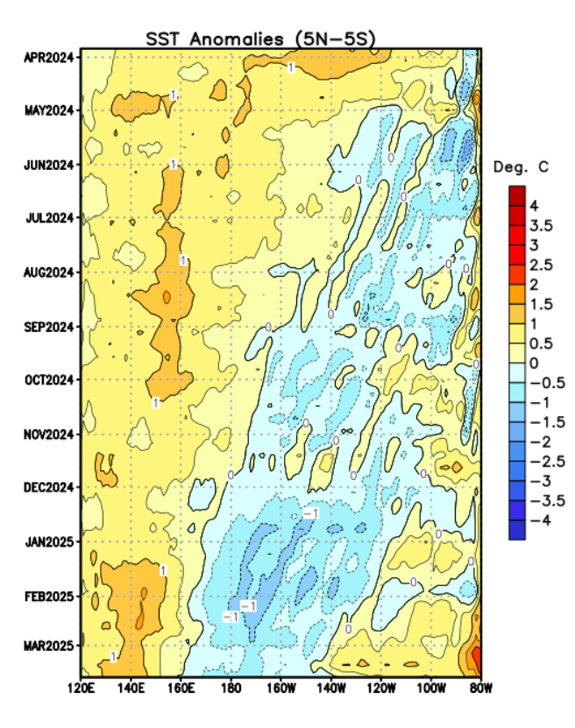
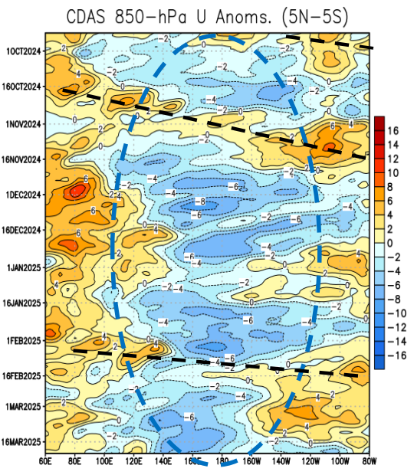
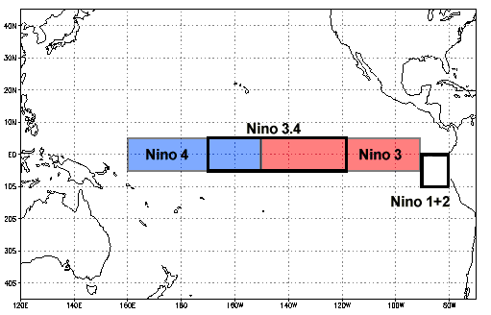
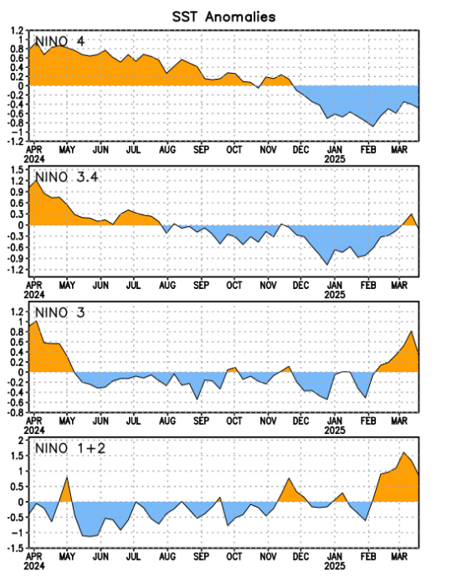
Monitoring regions
Strengthened easterlies over the Central Pacific (CP). Strong westerlies during March in Eastern Pacific (EP).
Cooler SSTs in the key monitoring region (Niño 3.4), but warm anomalies in the Niño 1+2 region: Coastal El Niño
Source: https://www.cpc.ncep.noaa.gov/products/analysis_monitoring/lanina/enso_evolution-status-fcsts-web.pdf / https://www.pmel.noaa.gov/gtmba/assorted-plots

Slide 18
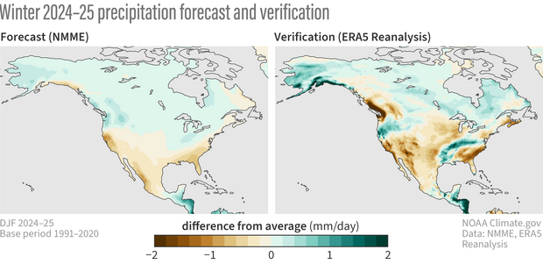
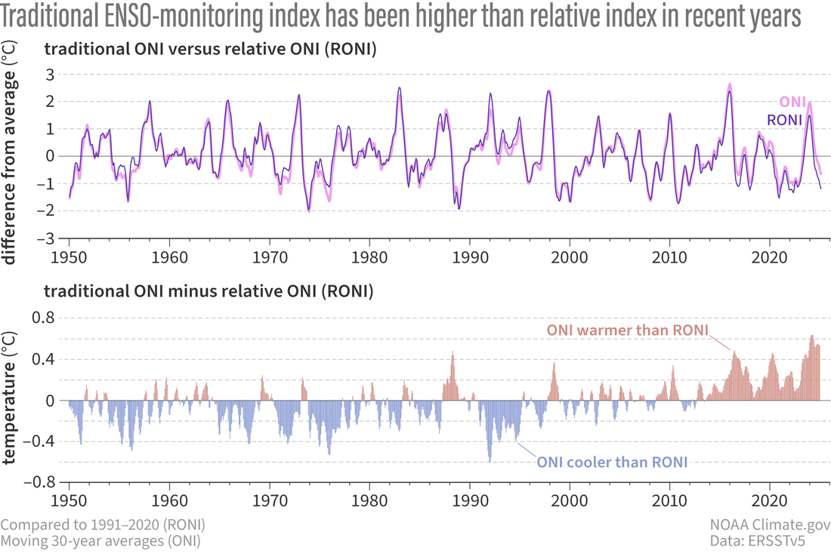
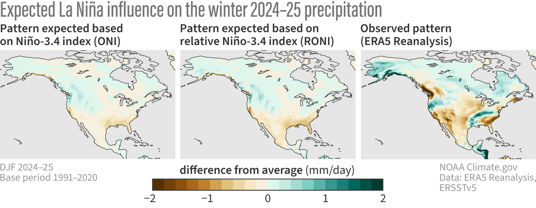
ONI has been consistently higher than RONI during the past 15 years (climate change signal).
The observed anomaly pattern is much stronger than the one forecasted by NMME.
Source: https://www.climate.gov/news-features/blogs/enso/winner-or-bust-did-la-nina-shape-north-american-precipitation-winter

Slide 19
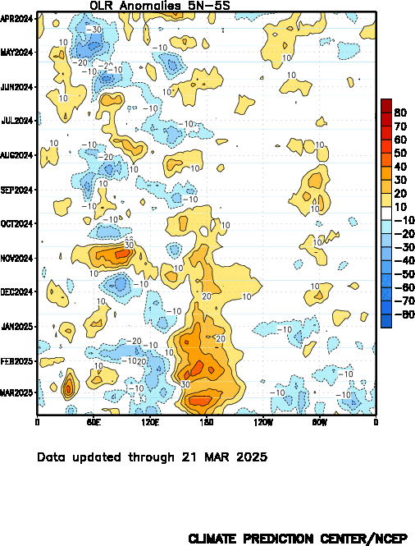
Negative OLR anomalies:
Enhanced convection =
High and deep clouds =
Their top is cold and emits less emission of longwave radiation back to space.
Positive OLR anomalies:
Suppressed convection over the central Pacific is associated with La Niña.
Subsidence (orange/red shading)
Enhanced convection (blue shading)
Source: https://www.cpc.ncep.noaa.gov/products/analysis_monitoring/lanina/enso_evolution-status-fcsts-web.pdf
Notes:
https://www.cpc.ncep.noaa.gov/products/precip/CWlink/MJO/enso.shtml#current
http://www.bom.gov.au/climate/enso/indices.shtml
http://www.bom.gov.au/climate/enso/#tabs=Pacific-Ocean&pacific=SOI
‹#›

Slide 20
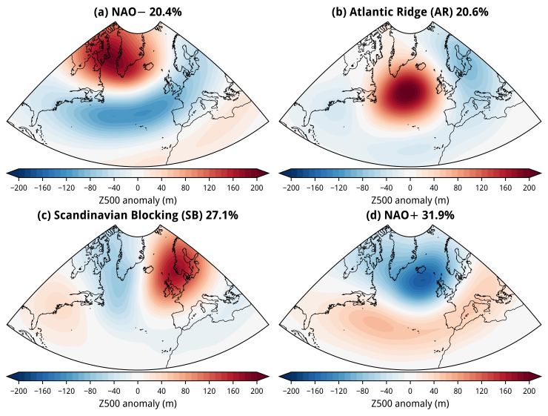
Source: https://simonleewx.com/north-atlantic-wintertime-weather-regimes/

Slide 21
Recent state of the climate
NAO forecast
Source: https://www.cpc.ncep.noaa.gov/products/precip/CWlink/pna/nao_index_ensm.shtml
Notes:
https://www.cpc.ncep.noaa.gov/products/CDB/CDB_Archive_html/CDB_archive.shtml
https://www.cpc.ncep.noaa.gov/products/CDB/Extratropics/fige7.shtml
https://www.cpc.ncep.noaa.gov/data/teledoc/nao_ts.shtml
‹#›

Slide 22
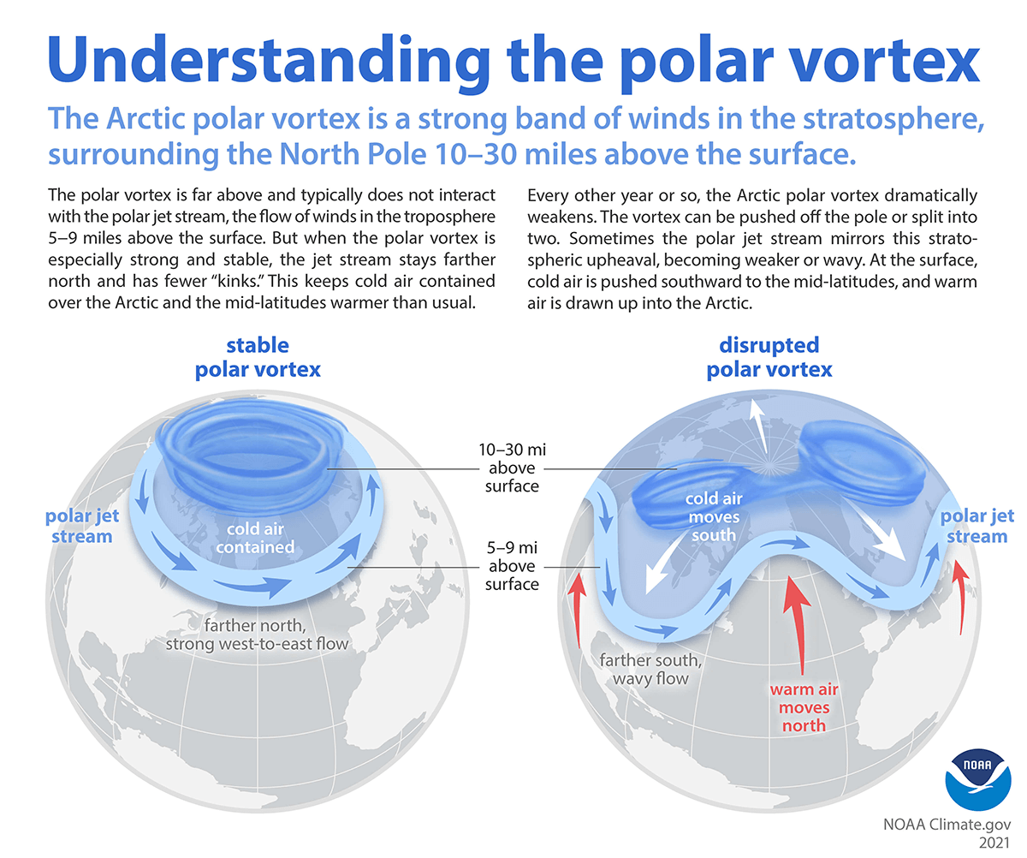
Recent state of the climate
Polar Vortex
Notes:
‹#›

Slide 23
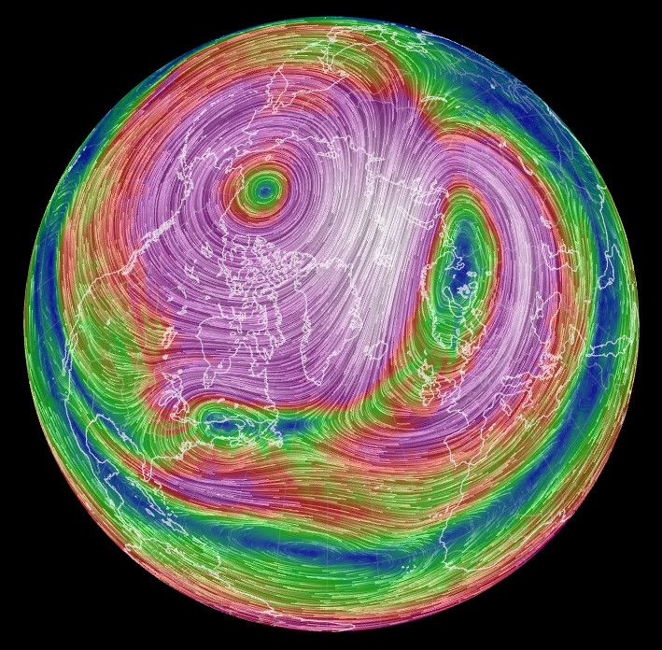
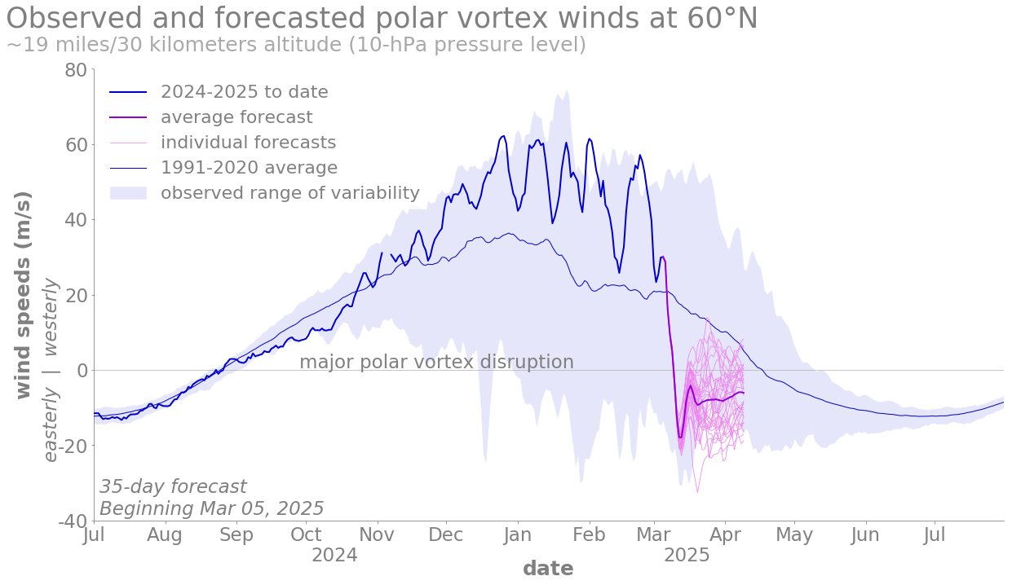
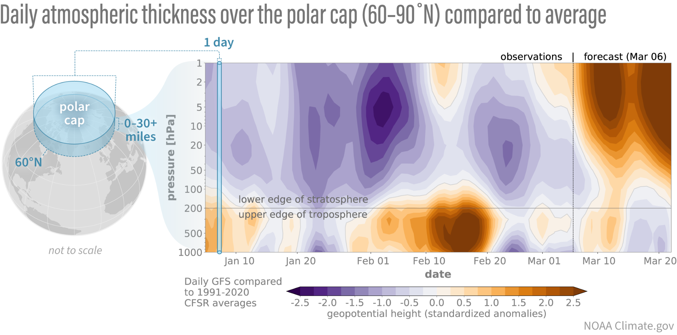
Recent state of the climate
Polar Vortex forecasts
A vortex disruption was forecasted at the beginning of the month.
Likely final stratospheric warming of the season.
Source: https://www.climate.gov/news-features/blogs/polar-vortex/polar-vortex-hitting-brakes / https://earth.nullschool.net/ (12th March)
Notes:
‹#›

Slide 24
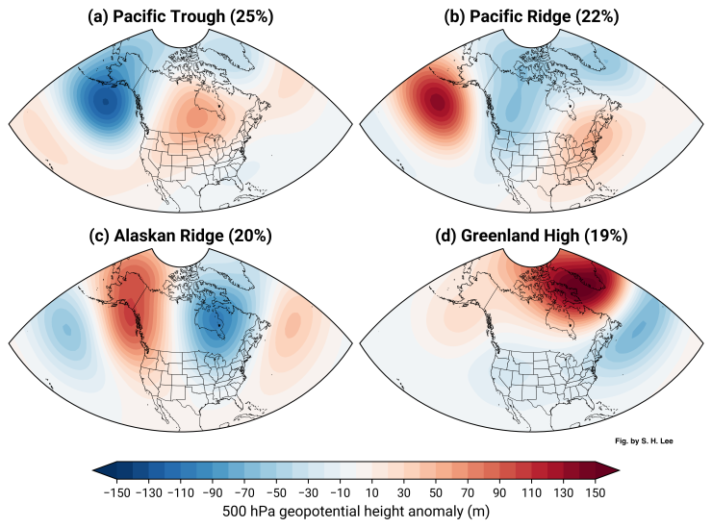
Source: https://simonleewx.com/north-atlantic-wintertime-weather-regimes/

Slide 25
Recent state of the climate
Seasonal forecasts
Notes:
‹#›

Slide 26
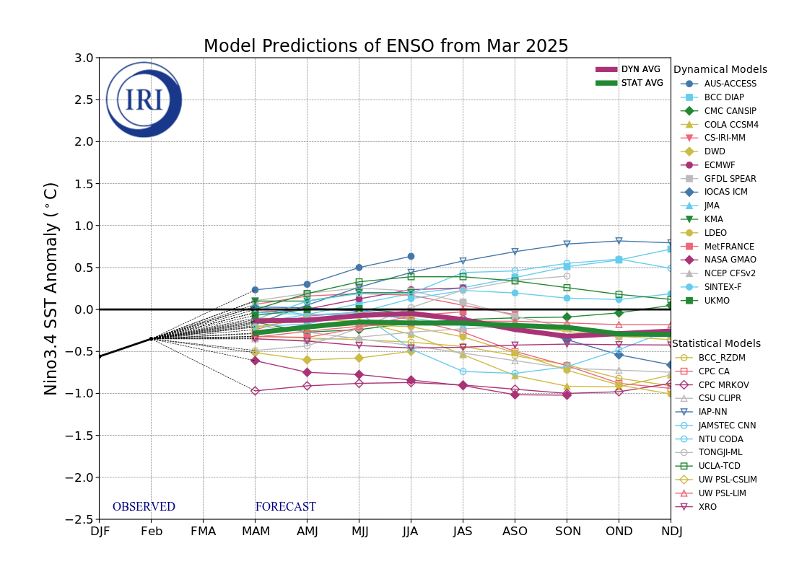
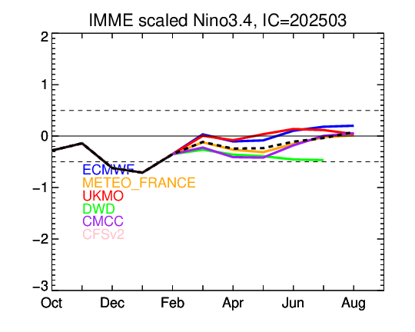
II. Seasonal forecasts
ENSO forecasts
La Niña conditions are now present in the Central Pacific (CP), although weak. Most models predict we will return to neutral conditions during MAM 2025.
Source: https://iri.columbia.edu/our-expertise/climate/forecasts/enso/current/?enso_tab=enso-sst_table /
https://www.cpc.ncep.noaa.gov/products/NMME/current/plume.html
Notes:
https://iri.columbia.edu/our-expertise/climate/forecasts/enso/current/?enso_tab=enso-sst_table
https://www.cpc.ncep.noaa.gov/products/NMME/current/plume.html
‹#›

Slide 27
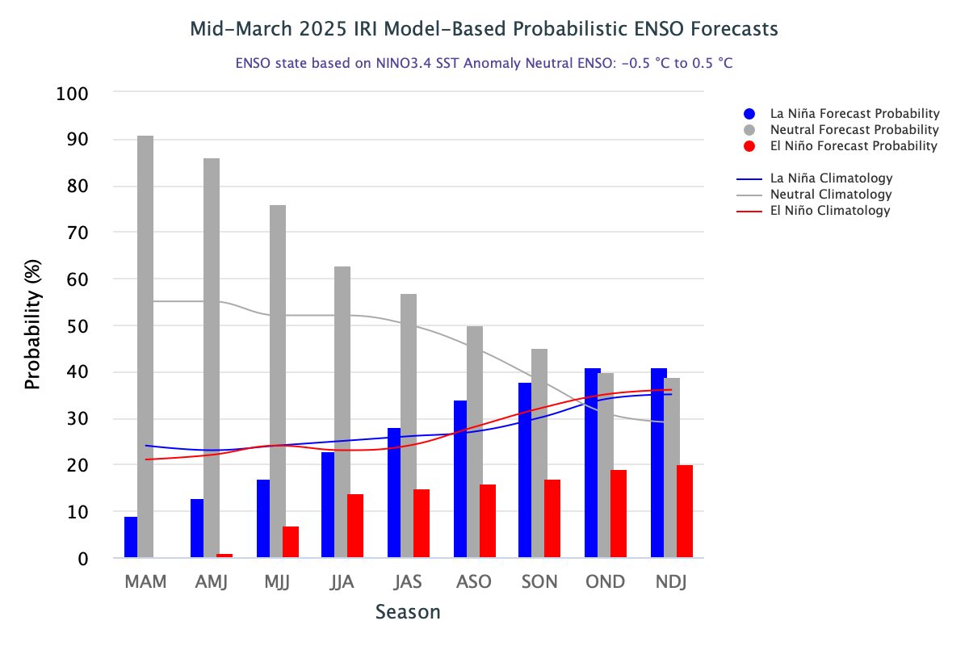
Return to neutral conditions is expected during MAM.
Forecast probability needs to be always compared against climatological probability.
Source: https://iri.columbia.edu/our-expertise/climate/forecasts/enso/current/
Notes:
https://iri.columbia.edu/our-expertise/climate/forecasts/enso/current/?enso_tab=enso-iri_plume
https://iri.columbia.edu/our-expertise/climate/forecasts/enso/current/?enso_tab=enso-cpc_plume
‹#›

Slide 28
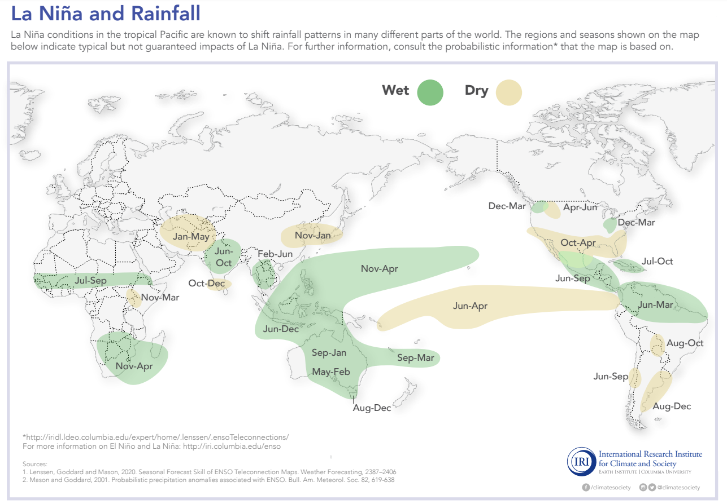
Canonical La Niña impacts on rainfall patterns across the globe.
For MAM drier anomalies are expected in: Parts of US and Mexico, parts of eastern Africa, parts of central Asia
Wetter anomalies are expected in: northern South America, Southeast Asia, Philippines, Eastern Pacific, southern Africa, parts of Australia, Great Lakes area
Source: https://iridl.ldeo.columbia.edu/maproom/IFRC/FIC/laninarain.html
Notes:
ENSO diags https://www.cpc.ncep.noaa.gov/products/precip/CWlink/MJO/enso.shtml#current
ENSO Blog https://www.climate.gov/news-features/blogs/enso?page=1
https://www.pmel.noaa.gov/gtmba/assorted-plots
https://www.pmel.noaa.gov/tao/drupal/disdel/
‹#›

Slide 29
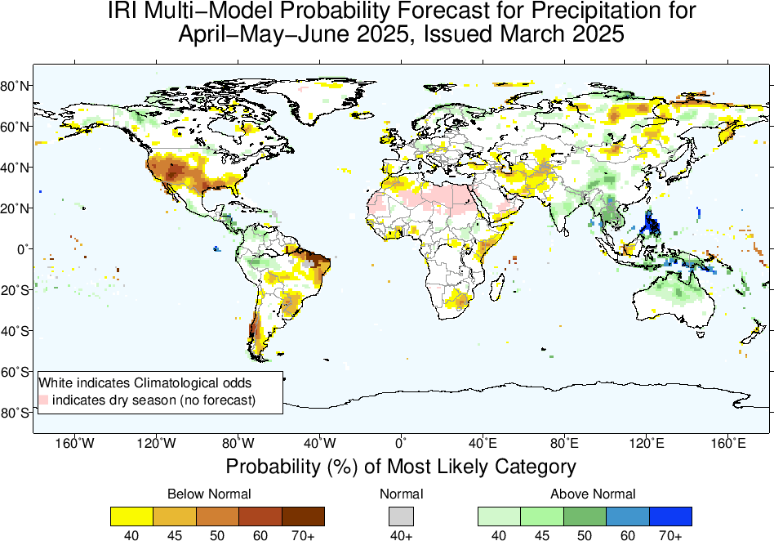
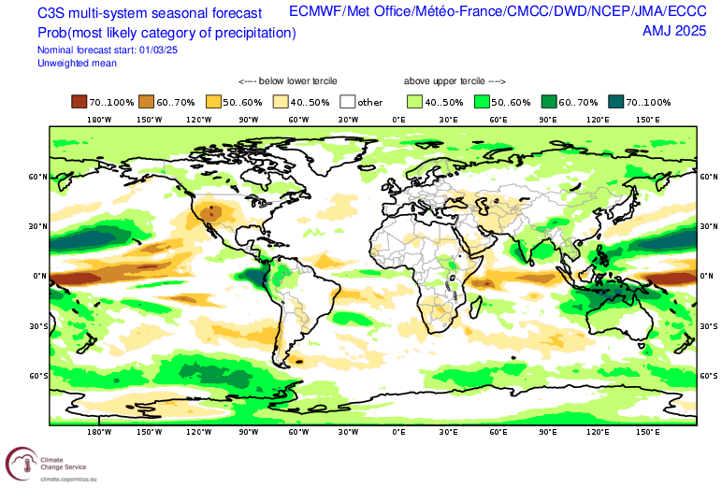
II. Seasonal forecasts
Precipitation
Apart from southern Africa, anomalies in precipitation could be consistent with a La Niña.
Source: https://climate.copernicus.eu/charts/packages/c3s_seasonal/ / https://iri.columbia.edu/our-expertise/climate/forecasts/seasonal-climate-forecasts/
Notes:
https://charts.ecmwf.int/products/seasonal_system5_standard_rain
https://iri.columbia.edu/our-expertise/climate/forecasts/seasonal-climate-forecasts/
http://cmdp.ncc-cma.net/eng/index.php?FromYear=2024&FromMonth=10&region=Global&Search=Search&channel=11&elem=Prec&cmmeCat=CMME-S2D&timeScale=season#
https://climate.copernicus.eu/charts/packages/c3s_seasonal/
‹#›

Slide 30
Calibrated
Uncalibrated
Source: SUNSET (CST) / https://charts.ecmwf.int/

Slide 31
II. Seasonal forecasts
Temperature
Typical global warming signal.
Parts of North Atlantic, Southern sea, Indochinese peninsula with cooler anomalies. Northern North America, southern South America, India and southern Africa with less warm signals.
Source: https://climate.copernicus.eu/charts/packages/c3s_seasonal/ / https://iri.columbia.edu/our-expertise/climate/forecasts/seasonal-climate-forecasts/
Notes:
https://charts.ecmwf.int/products/seasonal_system5_standard_rain
https://iri.columbia.edu/our-expertise/climate/forecasts/seasonal-climate-forecasts/
http://cmdp.ncc-cma.net/eng/index.php?FromYear=2024&FromMonth=10&region=Global&Search=Search&channel=11&elem=Prec&cmmeCat=CMME-S2D&timeScale=season#
https://climate.copernicus.eu/charts/packages/c3s_seasonal/
‹#›

Slide 32
Calibrated
Uncalibrated
Source: SUNSET (CST) / https://charts.ecmwf.int/

Slide 33
Calibrated multi-model
Source: SUNSET (CST)

Slide 34
Recent state of the climate
Seasonal forecasts
Intra-seasonal forecasts
Notes:
‹#›

Slide 35
III. Intra-seasonal forecasts
Madden-Julian Oscillation (MJO)
The MJO is the leading mode of tropical intra-seasonal variability with a 20–90 days time scale. It is an important source of regional climate variability and predictability across the globe at intra-seasonal time scales.
Source: https://www.climate.gov/news-features/blogs/enso/what-mjo-and-why-do-we-care
Notes:
OVERsimplified MJO animation
‹#›

Slide 36
III. Intra-seasonal forecasts
MJO phase status
RMM phase diagram for the latest 40 days
ROMI phase diagram for the latest 90 days
RMM index
RMM = Real-time Multivariate MJO Index
Developed by Matthew Wheeler and Harry Hendon (2004).
A multivariate index that combines:
Outgoing Longwave Radiation (a proxy for convection/cloudiness)
Zonal winds at 850 hPa (low-level winds)
Zonal winds at 200 hPa (upper-level winds)
Projects these variables onto two principal components (RMM1 and RMM2) to define the MJO’s location and intensity in an 8-phase diagram.
ROMI index
ROMI = Real-time OLR MJO Index
Developed as a simpler alternative to RMM.
Based only on OLR data.
Uses empirical orthogonal function (EOF) analysis of OLR to define MJO phases.
During February MJO avoided phase 8 due to strong subsidence in the CP. It became active at the beginning of March (phases 1 and 2) and has since then become inactive.
Source: https://www.cpc.ncep.noaa.gov/products/precip/CWlink/MJO/whindex.shtml / https://psl.noaa.gov/mjo/
Notes:
https://psl.noaa.gov/mjo/
‹#›

Slide 37
III. Intra-seasonal forecasts
MJO forecasts
OLR anomalies [W/m2] (ensemble mean GEFS)
Evolution of last 40 days of observations + ensemble forecast
Time
Low OLR (enhanced convection) / High OLR (suppressed convection)
Mean forecasts: 1-7 day, 8-14 day, >= 15 days
MJO not very active, now around phase 6. Forecast suggests a very weak entrance to phases 7 and 8.
Source: https://www.cpc.ncep.noaa.gov/products/precip/CWlink/MJO/foregfs.shtml /
https://www.cpc.ncep.noaa.gov/products/precip/CWlink/MJO/CLIVAR/ecmf.shtml
Notes:
https://www.cpc.ncep.noaa.gov/products/precip/CWlink/MJO/forca.shtml
https://www.cpc.ncep.noaa.gov/products/precip/CWlink/MJO/CLIVAR/clivar_wh.shtml
http://www.bom.gov.au/climate/enso/#tabs=Tropics
‹#›

Slide 38
Precipitation composite during MJO Phase 6
Composite = average pattern
Source: IRI link
Notes:
‹#›

Slide 39
III. Intra-seasonal forecasts
NAO forecast
Source: https://www.cpc.ncep.noaa.gov/products/precip/CWlink/pna/nao_index_ensm.shtml
Notes:
https://www.cpc.ncep.noaa.gov/products/CDB/CDB_Archive_html/CDB_archive.shtml
https://www.cpc.ncep.noaa.gov/products/CDB/Extratropics/fige7.shtml
https://www.cpc.ncep.noaa.gov/data/teledoc/nao_ts.shtml
‹#›

Slide 40
Increased likelihood of GH (in Europe NAO+, Messori et al., 2023) as expected in the North American regimes.
But we don’t observe an increased likelihood of any regime in the ECMWF S2S forecast?

Slide 41
III. Intra-seasonal forecasts
Weather regimes
Source: https://charts.ecmwf.int/products/extended-regime-probabilities?forecast_from=latest

Slide 42
III. Intra-seasonal forecasts
Precipitation
Week 1
Week 2
Week 3
Week 4
Source: http://weather.ou.edu/~kpegion/subc/forecasts/images/Latest/Interactive.html

Slide 43
III. Intra-seasonal forecasts
Temperature
Week 1
Week 2
Week 3
Week 4
Source: http://weather.ou.edu/~kpegion/subc/forecasts/images/Latest/Interactive.html

Slide 44
Recent state of the climate
Seasonal forecasts
Intra-seasonal forecasts
Discussion
Notes:
‹#›

Slide 45
Summary
Recent state of the climate
Persistent observed dry anomalies in most of the Americas, the Guinean coast, Congo, central Asia, parts of Australia, most of Europe, Southeast Asia, eastern China, Madagascar, eastern Siberia, parts of India and Australia.
Both record wet (Iberian peninsula, south of France, parts of Italy) and dry in central-north Europe (North of Germany, Alps, etc.),
Persistent weak la Niña with warm anomalies in the Niño 1+2 region (Coastal El niño).
Sudden stratospheric warming (likely final event) starting around the 12th of March with likelihood of mild conditions over europe in the upcoming weeks.
During February MJO avoided phase 8 due to strong subsidence in the CP. It became active at the beginning of March (phases 1 and 2) and has since then become inactive.
Notes:
‹#›

Slide 46
Summary
Seasonal forecasts
High likelihood of return to neutral conditions during MAM 2025.
Apart from southern Africa, anomalies in precipitation could be consistent with a La Niña.
Typical global warming signal in seasonal temperature forecasts. Parts of North Atlantic, Southern sea, Indochinese peninsula with cooler anomalies. And northern North America, southern South America, India and southern Africa with less warm signals.
Notes:
‹#›

Slide 47
Summary
Intraseasonal forecasts
High likelihood of inactive MJO for the forthcoming weeks.
Increased likelihood of mild conditions over europe in the upcoming weeks, in-line with SSW impacts and ECMWF forecast.
Increased likelihood of GH in the US.
Notes:
‹#›

Slide 48
Discussion
What lead to the anomalous rainfall in the Iberian peninsula?
What impacts will the final stratospheric warming have?
Inconsistencies between ENSO forecasts and seasonal predictions.
Notes:
‹#›

Slide 49
Forecast Briefing
March 2025
Lluís Palma, Paloma Tracasa-Castro, Josep Cos, Aleksander Lacima-Nadolnik, Matías Olmo
Climate Services Team (CST)
Earth System Services (ESS)
Barcelona Supercomputing Center (BSC)
Friday 28th Mar 2025

Slide 50
Since mid-September 2024, positive OLR anomalies (suppressed convection/ rainfall) have persisted near the Date Line.
Since early December 2024, negative OLR anomalies (enhanced convection/ rainfall) have emerged over Indonesia.
Drier-than-average conditions (orange/red shading)
Wetter-than-average conditions (blue shading)
Source: https://www.cpc.ncep.noaa.gov/products/analysis_monitoring/lanina/enso_evolution-status-fcsts-web.pdf
Notes:
https://www.cpc.ncep.noaa.gov/products/precip/CWlink/MJO/enso.shtml#current
http://www.bom.gov.au/climate/enso/indices.shtml
http://www.bom.gov.au/climate/enso/#tabs=Pacific-Ocean&pacific=SOI
‹#›

Slide 51
Notes:
https://www.cpc.ncep.noaa.gov/products/precip/CWlink/MJO/enso.shtml#current
‹#›

Slide 52
Recent state of the climate
Sea surface temperature (SST)
Source: https://climatereanalyzer.org/research_tools/monthly_maps/
Notes:
https://iridl.ldeo.columbia.edu/maproom/Global/Precipitation/Seasonal.html
https://iridl.ldeo.columbia.edu/maproom/Global/Precipitation/WASP_Indices.html
‹#›

Slide 53
Simulation by Dave DeWitt (IRI, now at CPC), using a simplified model, with a wind stress forcing at the Equator and Dateline.
Notes:
https://www.cpc.ncep.noaa.gov/products/precip/CWlink/MJO/enso.shtml#current
‹#›

Slide 54
Canonical El Niño impacts across the globe.
Notes:
ENSO diags https://www.cpc.ncep.noaa.gov/products/precip/CWlink/MJO/enso.shtml#current
ENSO Blog https://www.climate.gov/news-features/blogs/enso?page=1
https://www.pmel.noaa.gov/gtmba/assorted-plots
https://www.pmel.noaa.gov/tao/drupal/disdel/
‹#›

Slide 55
Recent state of the climate
North Atlantic Oscillation (NAO)
The North Atlantic Oscillation (NAO) is the leading mode of large-scale atmospheric variability in the North Atlantic basin.
NAO index: Standardized 3-month Running Mean Index (through Jan 2025)
Source: https://www.cpc.ncep.noaa.gov/data/teledoc/nao_ts.shtml
Notes:
https://www.cpc.ncep.noaa.gov/products/CDB/CDB_Archive_html/CDB_archive.shtml
https://www.cpc.ncep.noaa.gov/products/CDB/Extratropics/fige7.shtml
https://www.cpc.ncep.noaa.gov/data/teledoc/nao_ts.shtml
‹#›

Slide 56
Recent state of the climate
Sudden stratospheric warmings (SSWs)
A sudden stratospheric warming can reach the surface and drive very cold anomalies in northern Europe.
Source: Lee et al. (2024)
https://doi.org/10.1002/wea.7656
Notes:
‹#›

Slide 57
WASP index
Source: https://iridl.ldeo.columbia.edu/maproom/Global/Precipitation/WASP_Indices.html
Notes:
https://iridl.ldeo.columbia.edu/maproom/Global/Precipitation/Persistence.html
‹#›

