Slide 1
VOLCADEC
DATOS BÁSICOS DEL PROYECTO
Referencia: CGL2015–70177-R
Modalidad: B
Investigador Principal 1: Martin Ménégoz
Organismo: Barcelona Supercomputing Center-Centro Nacional de Supercomputación, Earth Sciences Department
Subvención concedida (Costes directos): 168.190 €
Fecha inicio: 01/01/2015
Fecha finalización (prevista): 31/12/2018

Slide 2
PARTICIPANTES
Entidades participantes: Barcelona Supercomputing Center
Equipo de investigación:
Martin Ménégoz (PI), Nicola Cortesi, Daniel Ortega (baja)
Equipo de trabajo:
Researcher: Roberto Bilbao (Post-Doc)
Technical staff: Xavier Yepes , Adria Quesada, Oriol Mula-Valls (baja)
Junior engineers: Miquel Canal, Eneko Martín (both incorporating)

Slide 3
MOTIVACIÓN, HIPÓTESIS Y ESTRATEGIA DEL PROYECTO
Climate variability is driven by internal variability of the atmosphere and the ocean. It is also affected by natural and anthropogenic forcings. Among them, volcanic forcing has a large impact at seasonal to decadal timescales.

Slide 4
MOTIVACIÓN, HIPÓTESIS Y ESTRATEGIA DEL PROYECTO
The VOLCADEC project aim at defining how volcanic forcing can be implemented in climate models to better simulate past climate variability and to anticipate the stratospheric aerosol forcing in decadal forecasts.

Slide 5
OBJETIVOS PROPUESTOS Y ALCANZADOS
Objective 1: Understanding the climate response to volcanic eruptions under different climate conditions (70%).
Objective 2: Assessing the climate model skill related to volcanic forcing (100%).
Objective 3: Forecasting the climate response to a new volcanic eruption (70%).
All the objectives are expected to be accomplished by the end of the project

Slide 6
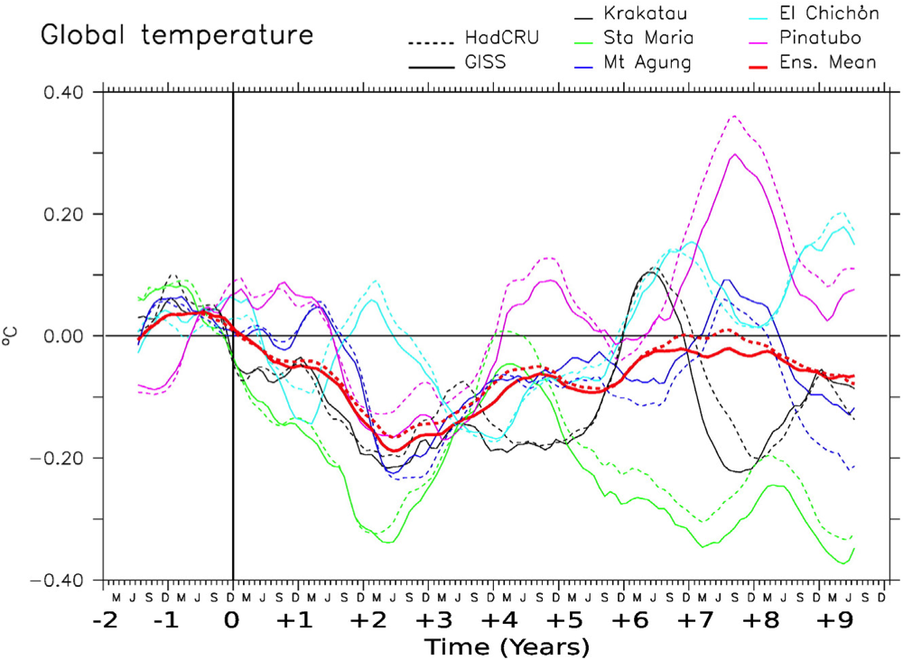
RESULTADOS CIENTÍFICO-TÉCNICOS
Objective 1: Understanding the climate response to volcanic eruptions
Volcanic eruptions (e.g. Pinatubo 1991) cool the atmosphere, with global temperature anomalies that can reach several tenth of degrees.
Global temperature anomaly observed after large eruptions
Swingedouw et al., 2017, Franco-Spanish collaboration

Slide 7
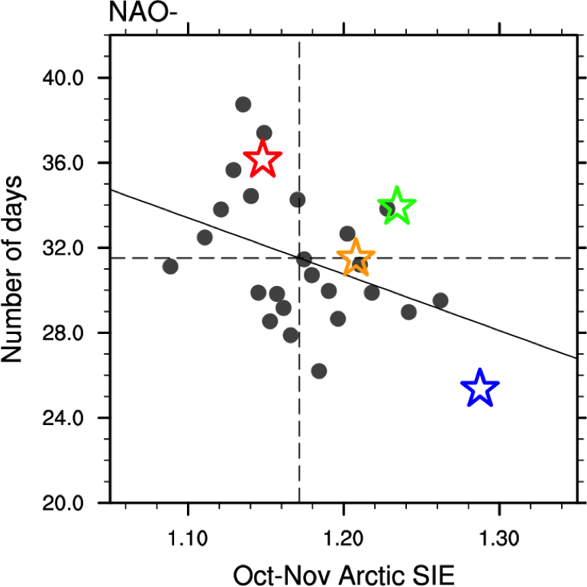
RESULTADOS CIENTÍFICO-TÉCNICOS
Objective 1: Understanding the climate response to volcanic eruptions
Volcanic eruptions (e.g. Pinatubo 1991) cool the atmosphere, with global temperature anomalies that can reach several tenth of degrees.
Volcanic eruptions favours a chain of El-Niño - La Niña (3rd year) events.
Tropical cooling and Arctic sea-ice growing induce a drastic decrease of NAO- conditions the 3rd year after an eruption.
NAO- occurence in function of Arctic sea-ice extent,
Ménégoz al., 2017, Franco-Spanich collaboration

Slide 8
RESULTADOS CIENTÍFICO-TÉCNICOS
Objective 1: Understanding the climate response to volcanic eruptions
Volcanic eruptions (e.g. Pinatubo 1991) cool the atmosphere, with global temperature anomalies that can reach several tenth of degrees.
Volcanic eruptions favours a chain of El-Niño - La Niña (3rd year) events.
Tropical cooling and Arctic sea-ice growing induce a drastic decrease of NAO- conditions the 3rd year after an eruption.
The dynamical response to volcanic forcing has a low signal-to-noise ratio, and its is modulated by natural Atlantic Multi-decadal Variability (AMV).
Ménégoz al., 2017, Franco-Spanish collaboration

Slide 9
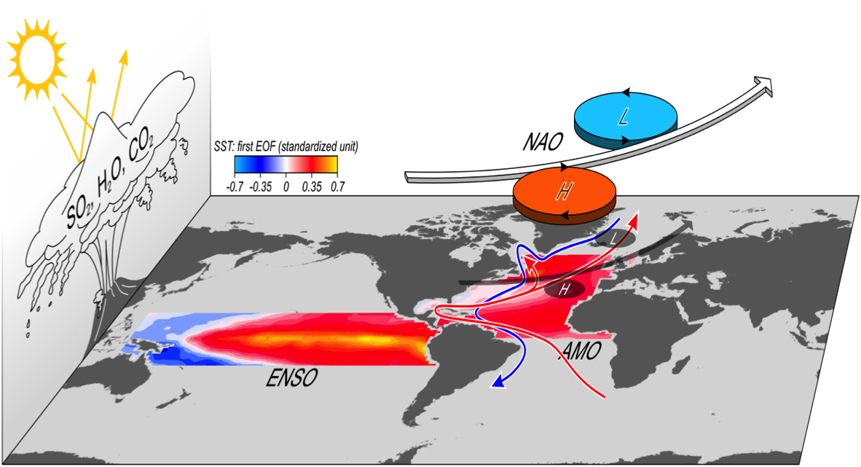
RESULTADOS CIENTÍFICO-TÉCNICOS
Objective 2: Forecasting the climate response to volcanic eruptions
The dynamical response of the NAO and ENSO to volcanic eruptions is model-dependent and has a low signal-to-noise: it is challenging to assess!
Swingedouw et al., 2017, Franco-Spanish collaboration

Slide 10
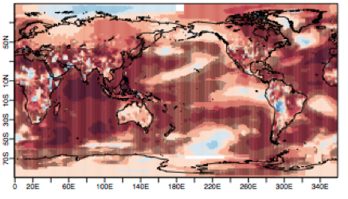
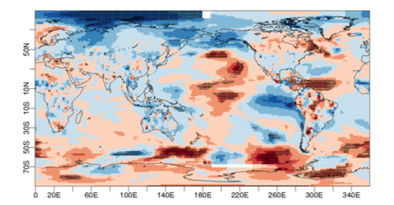
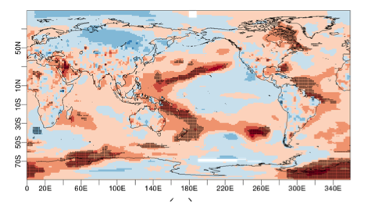
RESULTADOS CIENTÍFICO-TÉCNICOS
Objective 2: Assessing the climate model skill related to volcanic forcing
A large part of the skill of decadal forecast systems is directly related to volcanic forcing in retrospective hindcasts.
ENSO skill is not affected by volcanic forcing in EC-Earth forecasts.
Total skill
(b) Initialisation
(c) Volcanic forcing
Temperature forecast, years 1-3, 1961-2001; (a) skill and contributions from (b) initialisation and (c) volcanic forcing, Siegert et al., 2017; Ménégoz et al., 2018

Slide 11
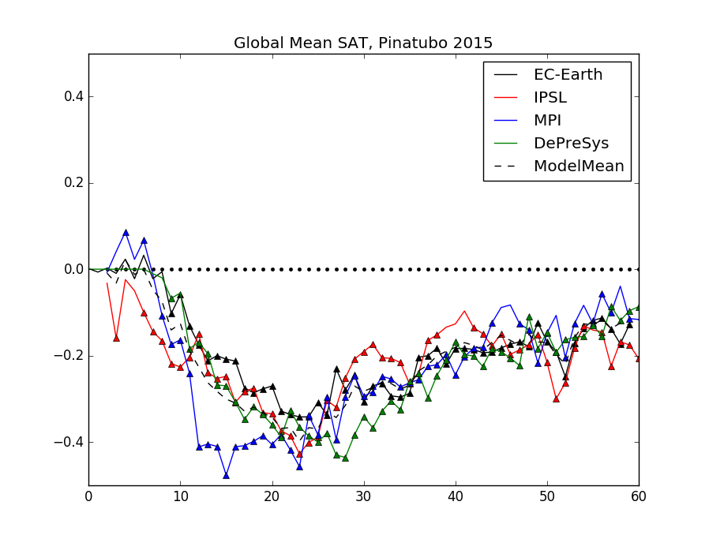
RESULTADOS CIENTÍFICO-TÉCNICOS
Objective 3: Forecasting the climate response to a new volcanic eruption.
Defining volcanic forcing in real-time forecasts
=> Two protocols have been tested and validated (Ménégoz et al., 2018)
Multi-model forecast over 2015-2020 including a fictitious Pinatubo eruption
Multi-model global temperature anomaly forecasted after a 2015 Pinatubo eruption, BSC technical report, in preparation.

Slide 12
RESULTADOS CIENTÍFICO-TÉCNICOS
Objective 3: Forecasting the climate response to a new volcanic eruption.
Defining volcanic forcing in real-time forecasts
=> Two protocols have been tested and validated (Ménégoz et al., 2018)
Multi-model forecast over 2015-2020 including a fictive Pinatubo eruption
Developing a new scheme for stratospheric aerosol forcing in EC-Earth.
Global temperature anomaly estimated from the era-interim reanalysis and simulated over 1990-1995 excluding (background level) and including the Pinatubo forcing with a “simple” and a “full” scheme, ongoing task.

Slide 13
RESUMEN DE LOS RESULTADOS DEL PROYECTO
 | Número | Indicios de calidad
Artículos científicos derivados del proyecto en revistas JCR (de ellos cuantos en acceso abierto) | 4 (1) | 4 Q1
Revisiones (surveys), editoriales y otros artículos científicos (de ellos cuantos en acceso abierto) | 1 (1) | NA
Libros, capítulos de libros y monografías (nac/internac) | 0 | NA
Conferencias en congresos (nacionales/internac, indicando cuántas por invitación). | 6 / 4 | NA
Patentes/Registros Software (indicar estado) | 0 | 0

Slide 14
FORMACIÓN DE PERSONAL
Tesis doctorales realizadas relacionadas con el proyecto (con indicación de título, fecha de inicio y de lectura, e indicadores relativos a publicaciones derivadas)
N/A
Actividades de formación de predoctorales y/o personal técnico relacionadas con el proyecto (destacar / agregar)
N/A
Contrato Predoctoral asociado al proyecto
N/A

Slide 15
INTERNACIONALIZACIÓN DE LA INVESTIGACIÓN
New aerosol scheme implemented in the European model EC-Earth (European consortium, https://www.ec-earth.org/).
Public deliverable devoted to decadal forecasts and stratospheric aerosol (European project SPECS, D43.2; http://www.specs-fp7.eu/).
A Franco-Spanish collaboration have been built through MORDICUS (Mété-France project; 2014-2018) and VOLCADEC to better understand natural and forced climate variability.
The VOLCADEC activities are organised to reinforce the involvement of the BSC in the CMIP6 activities, and in particular in VolMIP (http://volmip.org/).

Slide 16
Otros aspectos destacables relacionados con el proyecto
R Package developed for forecast verification (s2dverification, Manubens et al., 2017), and protocols developed to evaluate forecast systems (Siegert et al., 2017).
Granted from 2 projects from the “Red Española de Supercomputacion (RES), referenced as “Volcanic activity in seasonal to decadal climate forecasts” (AECT-2017-2-0009 and AECT-2018-1-0006, for a total of 876 Kh CPU).

Slide 17
EJECUCIÓN DEL PRESUPUESTO
Concepto | Ejecutado: Cantidad y (%) | Existen cambios relevantes respecto a solicitud original? (*)
Inventariable | 2 012,91 € (100%) | No
Personal | 94 230,34 € (84%) | No
Fungible | 1 505,80 € (25%) | No
Viajes y dietas | 3 907,06 € (21%) | No
Total | 99 643,20 € (72%) | No

Slide 18
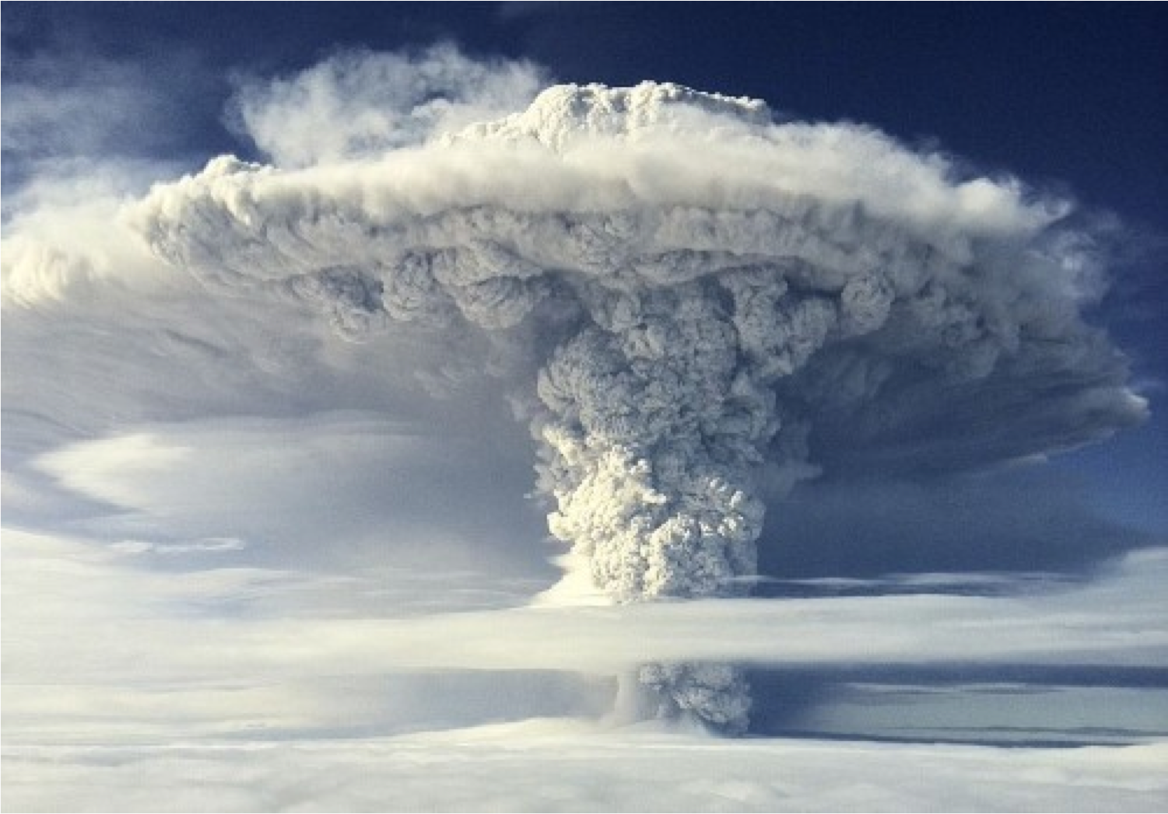
PLANTEAMIENTO FUTURO
The new stratospheric aerosol scheme will be used:
To better understand the dynamical response to volcanic eruptions, in the framework of the VOLMIP activities (CMIP6, international).
To better simulate the stratosphere-troposphere interactions, essential to reproduce the inter-annual variability and to produce seasonal-to-decadal forecasts (EC-Earth European model).

