Slide 1
COST Action InDust (CA16202)
INTERNATIONAL NETWORK TO ENCOURAGE THE USE OF MONITORING AND FORECASTING DUST PRODUCTS

Slide 2
COST InDust - Objectives
The overall objective of the proposed Action is to establish a network involving research institutions, service providers and potential end users of information on airborne dust.
The Action will search to coordinate and harmonise the process of transferring dust observation and prediction data to users as well as to assist the diverse socio-economic sectors affected by the presence of high concentrations of airborne mineral dust.

Slide 3
COST InDust - Concept
Stakeholders Users
Models
Observations
Dust-related Services

Slide 4
COST InDust – Specific Objectives Research Coordination
Identify and exploit dust monitoring observations and forecast products best suited to be transferred/tailored to the needs of end-users.
Establish a network involving research institutions, service providers, and end users of information on airborne dust.
Coordinate the current R&D activities and enhance the availability of appropriate products to assist the diverse socio-economic sectors affected by the presence of airborne mineral dust.

Slide 5
COST InDust – Specific Objectives Capacity Building
Build capacity through the high-level teaching of end-users (stakeholders from different socio-economic sectors) to promote the use of the delivered dust products.
Train technical staff to properly use the available observational and forecast products to design and implement preparedness and mitigation measures.
Enhance the cooperation with institutions from near-neighbouring and international partner countries in Northern Africa and the Middle East to involve them in the European-driven climate change science and mitigation/adaptation strategies.

Slide 6
COST InDust - Work Plan
WP1 Dust observations
GOAL: Identification and catalogue of dust (ground-based and satellite) observations best suited to be transferred to modelling groups and end-users
WP2 Dust modelling and forecast
GOAL: Identification of the most suitable model products (forecasts, hindcasts, reanalysis) for the user’s communities
WP3 Assessment of user and societal benefits
GOAL: Creation of a network that enables fruitful collaborations between researchers and end-user communities
WP4 Transfer of dust products to user-oriented application and service value
GOAL: To propose the most suitable products for the application areas identified by users involved in the Action and also identified by WG3

Slide 7
COST InDust - Work Plan
Any Milestone or deliverable the GP1

Slide 8
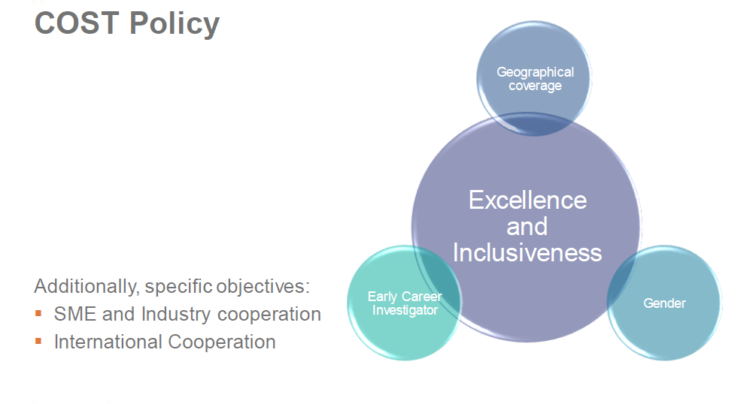
COST InDust – COST Policy

Slide 9
COST Action InDust – Participants
MC Members and MC substitutes:
27 countries signed the MoU
MC Observers (NNC, IPC and RTD):
NNC: Egypt, Jordan and Morocco
IPC: Brazil, Chile, Iran, Japan, Kazakhstan, Namibia, Saudi Arabia, South Africa, USA
Approved institutions: ECMWF and WMO
Other Participants in WGs
You can check the complete list here

Slide 10
COST InDust – Participants
In total 27 countries and 11 are ITC!
20

Slide 11
COST InDust - Grant Holder
http://www.bsc.es/
Notes:
1-day meeting (expenses covering 2 days)
no training the first year
no STSMs the first year
1 conference attendance + 1 publication
OERSA: dissemination materials (website, videos, leaflets, factsheets, visual identity of the project) and a scientific meeting (2 days, coincident with the MCM2) - no user workshop the first year

Slide 12
COST InDust - Core Group’s
Role | Candidate | Role | Candidate
Action Chair |  | Vice Action Chair
WG1 Leader |  | Vice WG1 Leader
WG2 Leader |  | Vice WG2 Leader
WG3 Leader |  | Vice WG3 Leader
WG4 Leader |  | Vice WG4 Leader
STSM Representative |  | Vice STSM Representative
Science Communication |  | Vice Science Communication
Conference Grant Coordinator

Slide 13
COST InDust - Core Group’s
Role | Candidate | Role | Candidate
Action Chair | S. Basart (Spain) | Vice Action Chair | S.Nickovic (Serbia)
WG1 Leader | V. Amiridis (Greece) | Vice WG1 Leader | B. Weinzierl (Austria)
WG2 Leader | A. Vukovic (Serbia) | Vice WG2 Leader | I. Tegen (Germany)
WG3 Leader | S. Kazadzis (Switzerland) | Vice WG3 Leader | H. El-Askary (Egypt)
WG4 Leader | L. Mona (Italy) | Vice WG4 Leader | A. Durant (UK)
STSM Representative | A. Monteiro (Portugal) | Vice STSM Representative | G. Varga (Hungary)
Science Communication | I. Christel-Jiménez (Spain) | Vice Science Communication | A. Nemuc (Romania)
ITC Conference Grant Coordinator | Pavla Dagsson (Iceland)

Slide 14
COST InDust Budget Plan GP1
FSAC apply 15%
~ 79k€
Notes:
1-day meeting (expenses covering 2 days) – 43 EU + 3 NNC
no training the first year
no STSMs the first year
1 conference attendance + 1 publication
OERSA: dissemination materials (website, videos, leaflets, factsheets, visual identity of the project) and a scientific meeting (2 days, coincident with the MCM2, 43 EU + 3 NNC + 7 Participants) - no user workshop the first year

Slide 15
COST InDust: Scientific meeting + MCM2 in mid-March in Barcelona (Spain)
Open until 17 November!
Notes:
1-day meeting (expenses covering 2 days) – 43 EU + 3 NNC
no training the first year
no STSMs the first year
1 conference attendance + 1 publication
OERSA: dissemination materials (website, videos, leaflets, factsheets, visual identity of the project) and a scientific meeting (2 days, coincident with the MCM2, 43 EU + 3 NNC + 7 Participants) - no user workshop the first year

