Slide 1
Reading, 2nd November 2016
OpenIFS Session
EC-Earth Meeting
November 2016

Slide 2
Outline
Introduction (5’)
BSC current activities and plans (10’)
SMHI development status (15’)
Discussion (60’)

Slide 3
Discussion
The main points discussed will be reported back to the plenary tomorrow
Some topics are already defined. But feel free to add new ones during the discussion
Mix of topics:
Scientific
Technical
Planning
The main goal is provide and generate engagement
Ask for and coordinate commitments
Define a communication strategy (telcos, F2F, portal, …)

Slide 4
BSC activities and plans with OpenIFS
M. Acosta, M. Castrillo, F. Doblas-Reyes,
K. Serradell, O. Tintó, X. Yepes

Slide 5
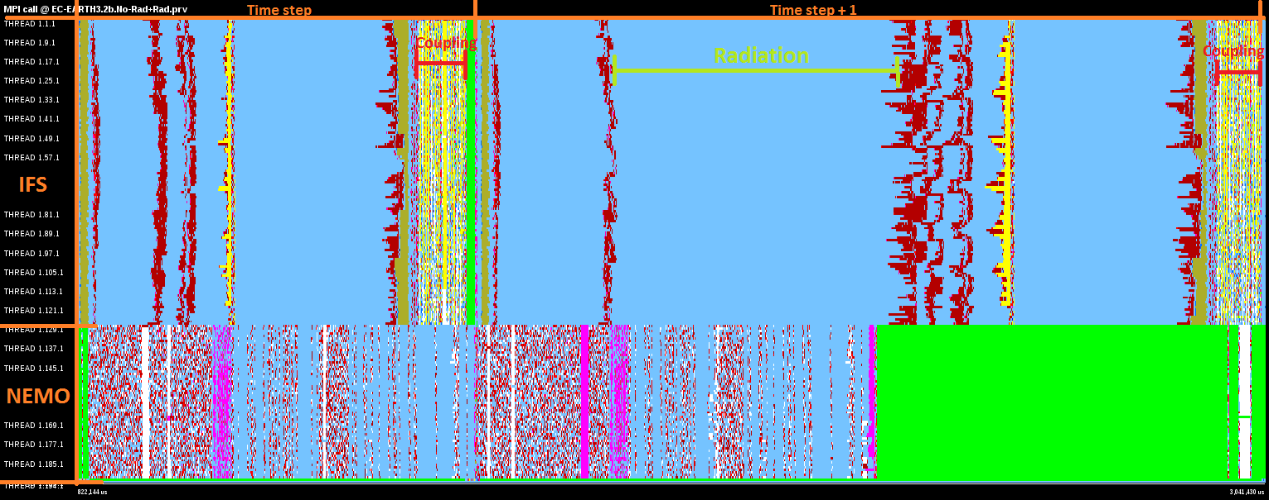
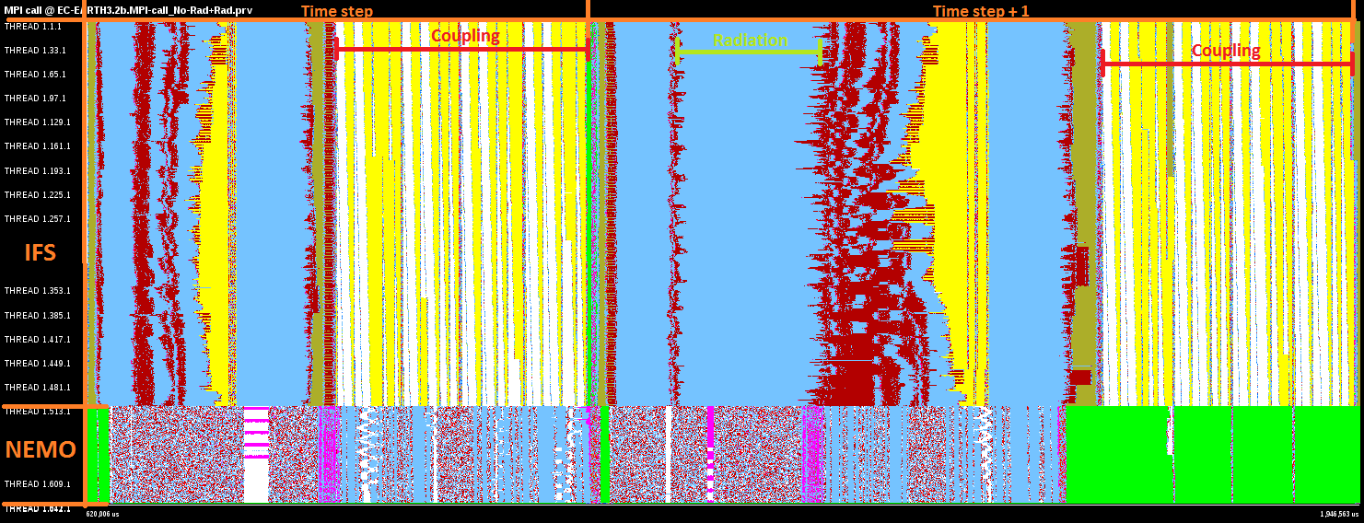
Performance analysis & optimizations
We used to think coupling (IFS-NEMO) was not a big issue
IFS: 128 cores
NEMO: 128 cores
Coupling time
is increased
But it seems that it is when increasing number of cores
TIME
IFS: 512 cores
NEMO: 128 cores

Slide 6
Performance analysis & optimizations
Let’s see what happens inside the coupling

Slide 7
Performance analysis & optimizations
Let’s see what happens inside the coupling
NEMO fields
Runoffmapper
fields
1st Group
2nd Group
3rd Group
4th Group
Why 4 groups of variables? Why not packing in only 2?
40% of improvement
in coupling time
1st Group
2nd Group

Slide 8
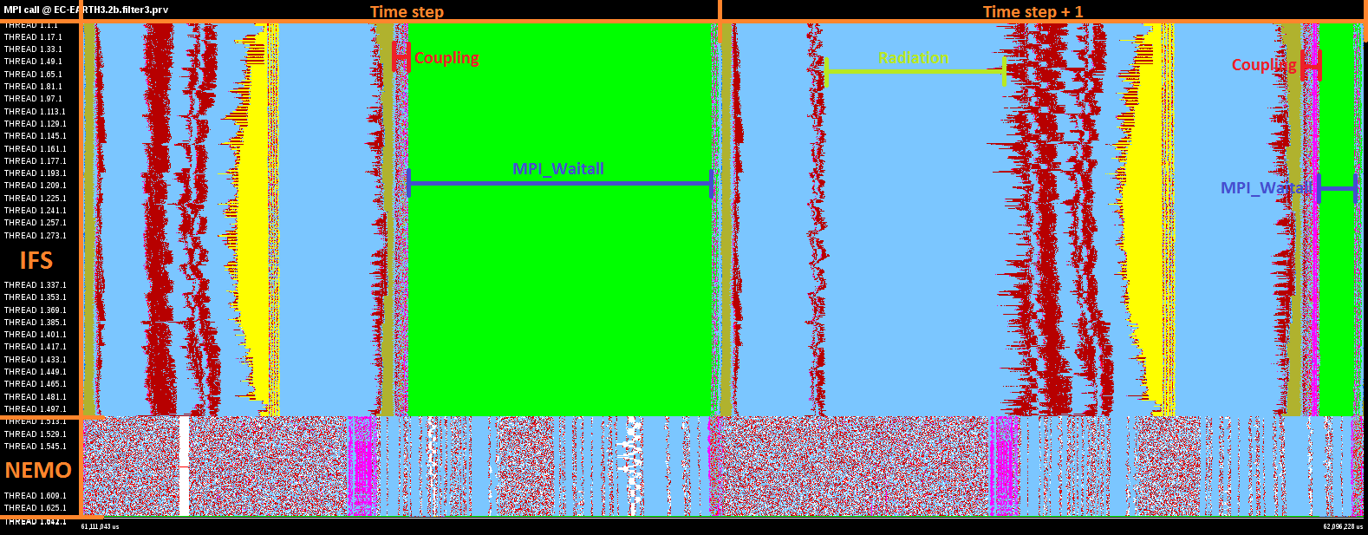
Performance analysis & optimizations
Let’s see (again) what happens inside the coupling
Working with OASIS developers, we explored another implementation for coupling (called OPT)
Coupling time
is reduced by 90%

Slide 9
Performance analysis & optimizations
BSC has been working successfully with the NEMO development team to improve NEMO model
Could a similar collaboration be established with ECMWF?
Original code (ORCA2-LIM3)
16
32
64
128
256
A success case: message packing, reordering and convergence check reduction have been applied
Optimized code
16
32
64
128
256
With these optimizations, 40% improvement in model speed is achieved
These improvements are now in both NEMO3.6 STABLE and EC-Earth 3.2, substantially benefiting our CMIP6 simulations

Slide 10
OpenIFS to test future technologies
New programming models are been developed and ported to weather and climate models
BSC is developing OmpSs (an extension to OpenMP with new directives to support asynchronous parallelism and heterogeneity)
It allows the overlap of communication and computation
Apply the Dynamic Load Balancing library (to reduce load balancing)
WIP. Since 01/11, OpenIFS compiled and runs with OmpSs!
We strongly believe in energy efficient computing (more cores but cheaper ones consuming less energy)
Testing new architectures to run our model
ARM technology (CPU’s used in your smartphones and tablets)
EC-Earth 3.2 ported and executed in ARMv8-64bit Cluster
Successful run but 10x slower than MareNostrum 3
Next test: OpenIFS 40r1

Slide 11
Future plans
OpenIFS 43r1
Why is BSC is so interested in this cycle?
Single precision
Improved performance
Expect large performance impact using octahedral grid in high resolution
More relevant interaction with ECMWF (both technical and scientific)
BSC is interested in these topics but this work is also in the long-term interest of the EC-Earth community

Slide 12
SMHI development status

Slide 13
Discussion

Slide 14
List of potential topics
To what point is important for EC-Earth to follow the OpenIFS cycles?
Could we define a planning timeline?
EC-Earth is expected to be driving the request for 43r1
Potential collaborations between EC-Earth, OpenIFS, ECMWF (both scientific and technical)
Scientific evaluation (how, when, who)
Optimization and performance analysis (how, when, who)
Initial condition generation
Resolutions targeted
T255ORCA1
T511ORCA025
TCo1279ORCA012 (ESiWACE 2nd demonstrator)
C-IFS and the wave model
XIOS in OpenIFS?

Slide 15
Thank you!

