Slide 1
Deploying the MONARCH atmospheric model in the Cloud
Miguel Castrillo, Francesca Macchia, Gilbert Montané, Kim Serradell
Computational Earth Sciences
09/02/2021
Weather and climate in the cloud

Slide 2
Outline
Mineral dust services at BSC
First experience (AWS)
PoC with ORACLE
Main takeaways
Conclusions

Slide 3
Earth Sciences

Slide 4
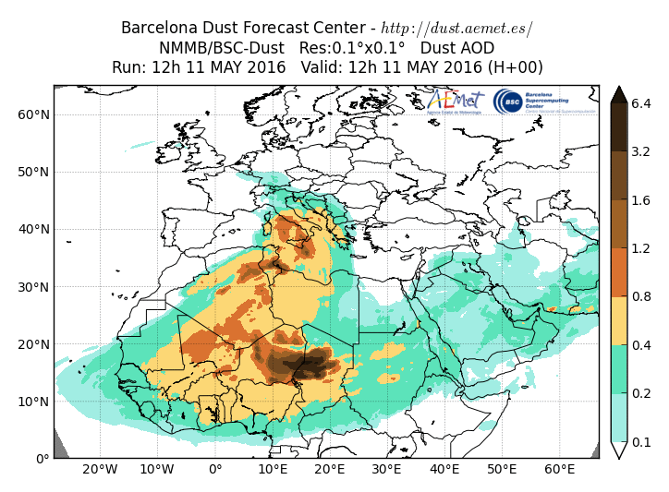
Mineral dust services at BSC
BSC dust operational forecast:
Contribution to the SDS-WAS (regional) and ICAP (global) multi-model ensembles
WMO Dust Regional Centres:
Barcelona Dust Forecast Centre. First specialized WMO Centre for mineral dust prediction. Started in 2014 - Operational
http://dust.aemet.es
@Dust_Barcelona
Sand and Dust Storms Warning Advisory and Assessment System (SDS-WAS). North Africa, Middle East and Europe Regional Center. Started in 2010 – Research
http://sds-was.aemet.es
Both WMO Regional Centres are jointly managed by BSC and AEMET
4

Slide 5
Operational services with some constraints
BSC is a research center not an operational one. That means:
No 24/7 helpdesk for HPC services
No 24/7 forecast managers
[Annual] power maintenances
No HPC redundancy
But…
we need to deliver our products.
Customers are always expecting the daily output (even if they know our constraints)
Two solutions
Duplication of processes
BDFC simulation is executed in Mare Nostrum4 and Nimbus (AEMET)
Cloud

Slide 6
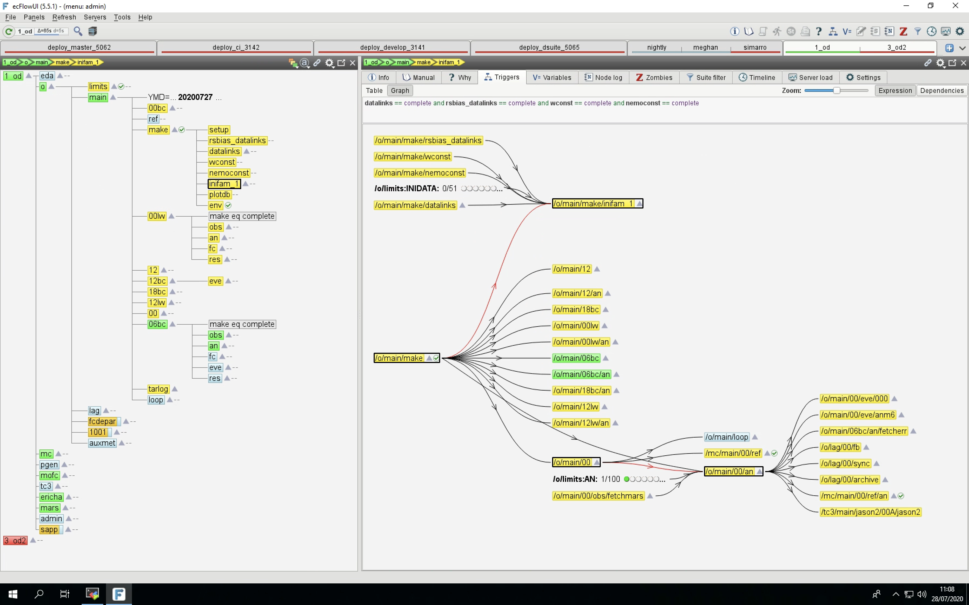
Why moving to the cloud?
Web
HPC
post VM
FTP
…
oper
VM
Inidata
Cloud

Slide 7
Amazon Web Services
In 2019, we contacted AWS for a test
We got some free credits
Work done as final graduate work
Evaluation of AWS for running BSC-EC models, Adrià Quesada, 2019
We deployed NMMB/MONARCH model (previous version)
We did a MANUAL deployment
Starting from scratch from a AWS Ubuntu ISO
Install packages and/or compile dependencies
Build a small SLURM cluster
Compile model (Fortran+MPI)
Run model
Analyse results

Slide 8
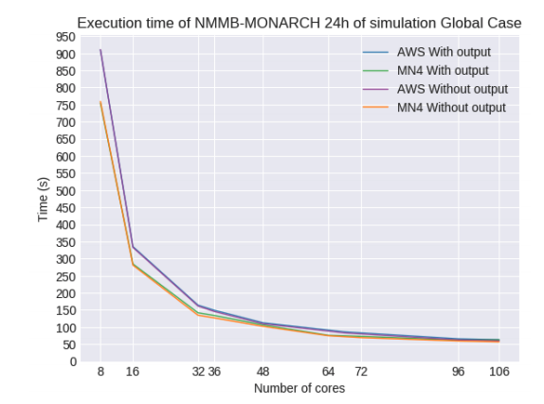
Amazon Web Services (II)
Results
The experience was successful
We validated the idea of running a forecast in the cloud
But everything was manual

Slide 9
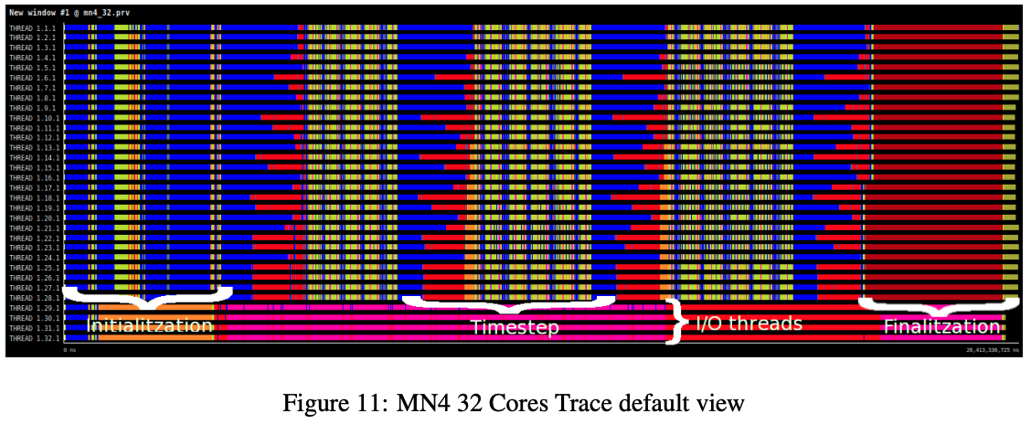
Amazon Web Services (III)
Bonus track: extract traces using EXTRAE + PARAVER

Slide 10
Parallel tasks
In the meantime, many efforts in parallel
Refactor of the code (from NMMB/MONARCH to MONARCH)
Development of Auto-MONARCH (code supported by Autosubmit, our workflow manager)
Gitlab + Jenkins integration
Output checker
Hiring of two Research Engineers

Slide 11
ORACLE
BSC-ES has a partnership with HPCNow!
Spanish consultancy providing advanced supercomputing services for science and engineering.
They become partners with ORACLE Cloud.
Agreement between the three parts for a PoC.
Three roles
Cloud provider (ORACLE Cloud)
HPC consultants (HPCNow!)
Research Engineers (Earth Sciences)

Slide 12
Workflow
HPC
(MN4)
post VM
bscesoper
VM
Web
GFS
Cloud
FTP
…
Management VM
HPC cloud resources
GFS
Cloud

Slide 13
Configuring HPC resources
Between HPCNow! and ORACLE
Provision HPC resources. Configure the resources needed that will be available on request
Deploy a management node (login)
Using SLURM Cloud Scheduling capabilities
Sending a batch job will deploy automatically the resources
Efficient control of these resources
 | Resource for the PoC
Management Node | 1 x VM.Standard.E2.4
Storage | 1 x VM.Standard.E2.4 + 10 VPU (Total: 6TB)
Compute 1 - AMD | 2 x BM.Standard.E2.64
Compute 2 - Intel | 2 x BM.HPC2.36

Slide 14
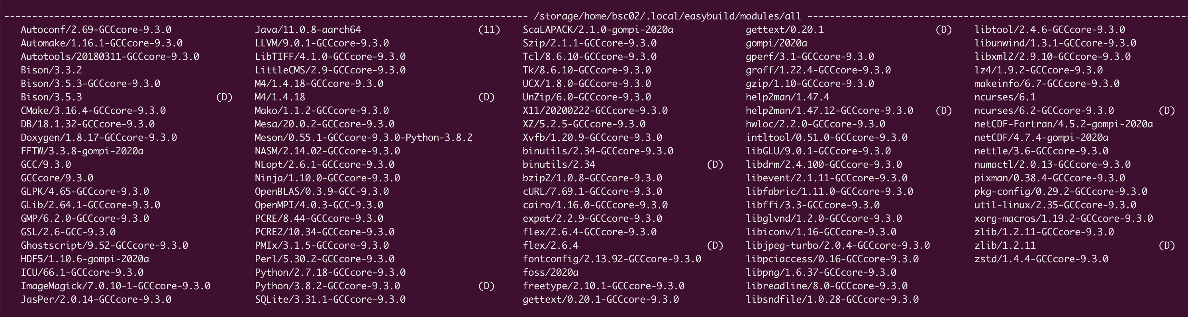
Software deployment
Between BSC-ES and HPCNow!
Deploy the software stack
Using EasyBuild to automate the installation
Reproducibility and performance
Replicate your usual software stack
Compile and optimize your model to get the best performance
You don’t know the hardware

Slide 15
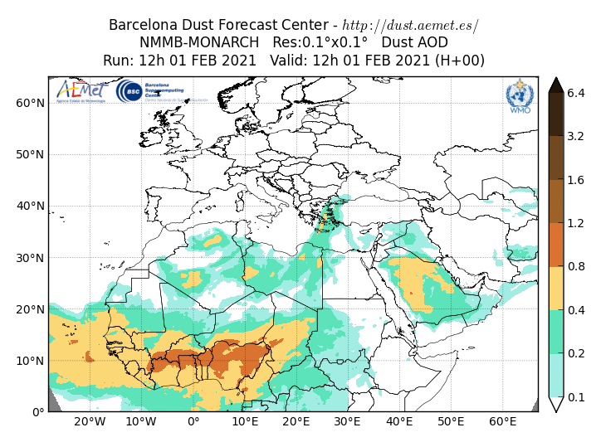
Auto-MONARCH - Configuration
MONARCH NAME-E Regional
Res: 0.1º x 0.1º
Grid: 1021 x 701 x 40
24h Forecast
Scaling exercise: 68, 144, 288 and 576 cores.

Slide 16
Auto-MONARCH - Results

Slide 17
Results (II)

Slide 18
Main Takeaways
The cloud is a feasible solution to replace usual HPC premises as a backup solution
Collaboration with vendors is mandatory
Automate your processes as much as possible
Replicate the software stack is key
Verify your results
Invest on human resources
And Price?

Slide 19
Future work
Deploy operationally this solution
Develop “smart” capabilities for Autosubmit
Extend this approach to other BSC forecasts
Notes:
Including the financial agreement to get those resources

Slide 20
Acknowledgements
ORACLE
HPCNow!
Computational Earth Sciences research engineers and scientists from Atmospheric Composition group and Earth System Services group.

Slide 21
Thank you
kim.serradell@bsc.es

Slide 22
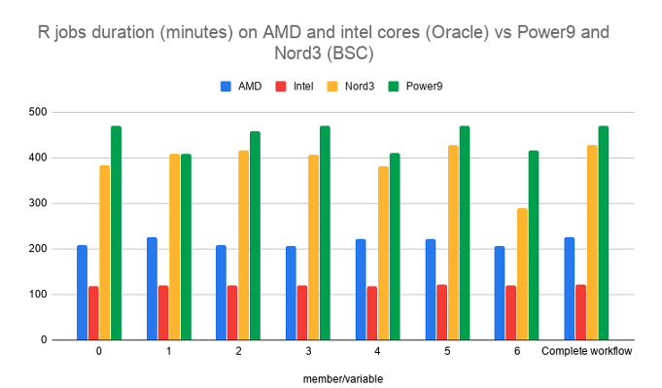
Extending the PoC
At the beggining, we defined a second use case to test the Cloud approach.
From the S2S4E project, we ported the workflow used to compute an ensemble of sub-seasonal climate predictions from the ECMWF monthly system with data from the ERA5 reanalysis.
Serial computing with high I/O needs (volume and performance).

