Slide 1
Exploring the SZ lossy compressor use for the XIOS I/O server
Xavier Yepes-Arbós
The research leading to these results has received funding from the EU H2020 Framework Programme under grant agreement no. 823988
This material reflects only the author’s view and the Commission is not responsible for any use that may be made of the information it contains
25/2/2021
12th JLESC Workshop

Slide 2
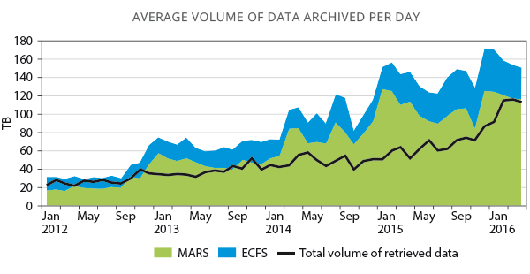
Introduction
Exascale supercomputers will allow Earth System Models (ESMs) to make simulations at an unprecedented level of horizontal resolution.
But this has implications:
A huge amount of data will be generated that must be efficiently written into the storage system.
A high cost of storage systems due to the huge data size.

Slide 3
The XIOS I/O server
The I/O issue is typically addressed by adopting scalable parallel I/O solutions.
In the climate community, a widely I/O tool used is XIOS.
The XML Input/Output Server (XIOS) is an asynchronous MPI parallel I/O server developed by the Institut Pierre-Simon Laplace (IPSL).
XIOS has the following features needed for climate modelling:
Output files are in netCDF format.
Written data is CMIP-compliant (CMORized).
It is able to post-process data inline to generate diagnostics.

Slide 4
XIOS: Some technical features
From a computational point of view, XIOS is thought to address:
The inefficient legacy read/write process.
The unmanageable size of “raw” data.
By implementing:
Scalable parallel I/O.
Inline post-processing.
In addition, it offers lossless data compression using gzip through HDF5.

Slide 5
Test case: OpenIFS and XIOS integration
OpenIFS is a global meteorological forecasting model developed and maintained by the European Centre for Medium-Range Weather Forecasts (ECMWF).
In the past we integrated XIOS into OpenIFS to address the former inefficient sequential I/O scheme.
Although the overhead of outputting data through XIOS is really small for current resolutions, in the future this may well become a bottleneck because of the exponential growth of the output volume.
The default lossless compression filter of HDF5 does not fit our needs:
If compression ratio is high, it takes too much time.
If it takes a reasonable amount of time, compression ratio is not enough.

Slide 6
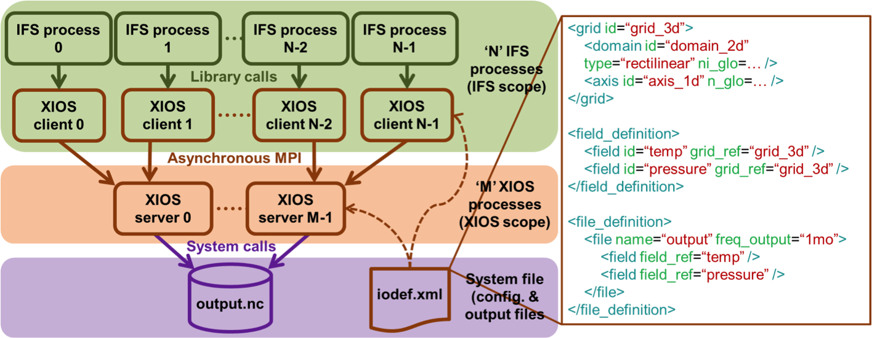
OpenIFS-XIOS integration scheme

Slide 7
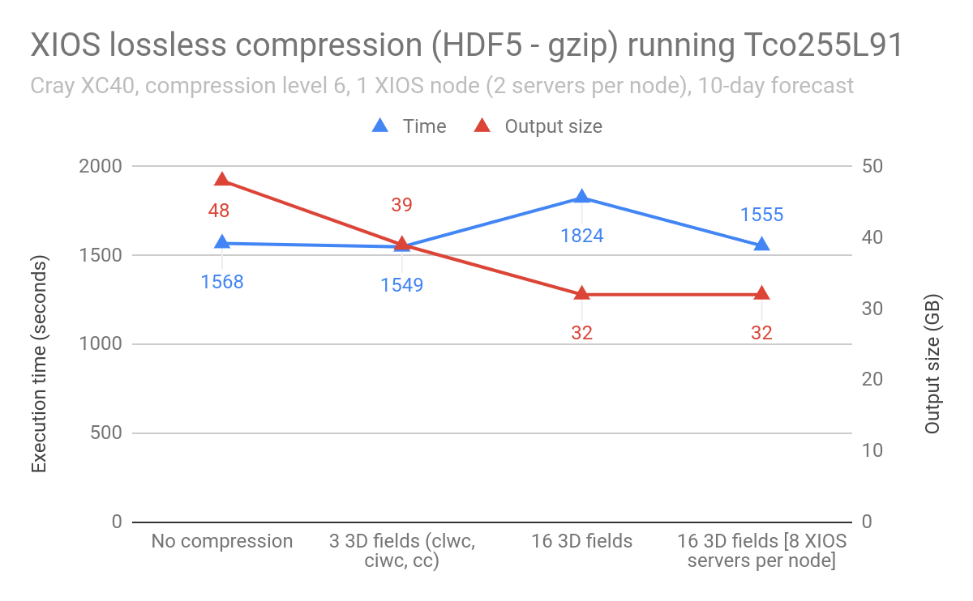
What about XIOS compression?

Slide 8
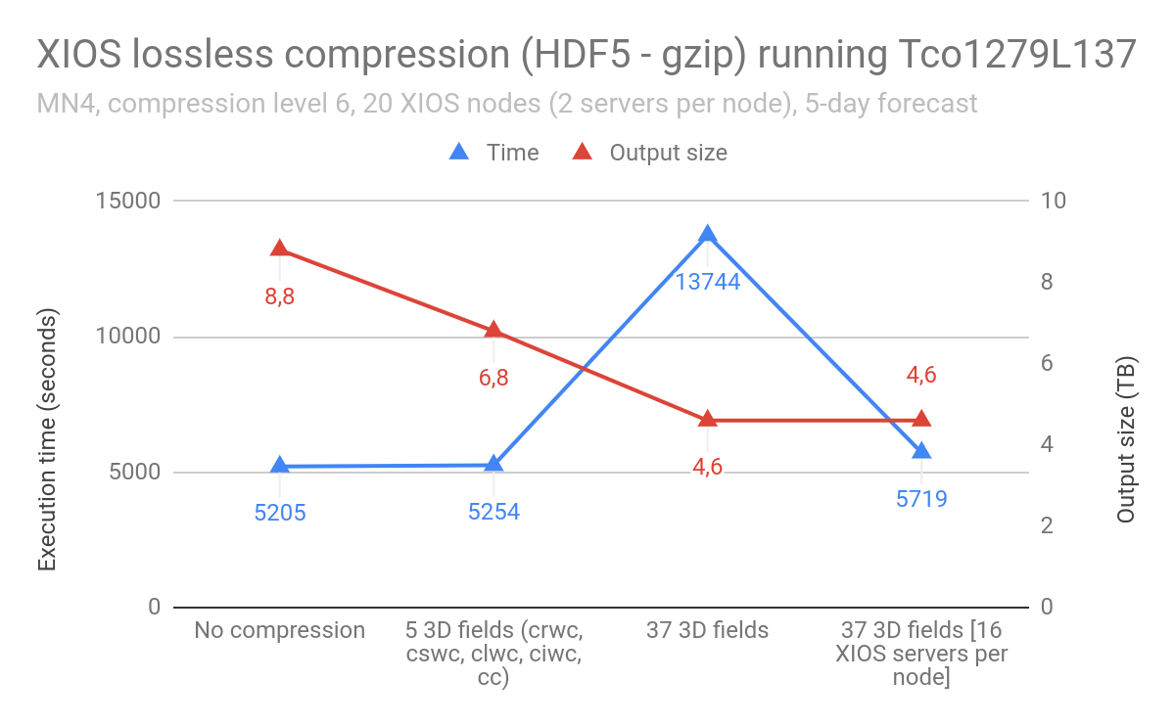
What about XIOS compression?

Slide 9
SZ lossy compression filter in XIOS
Alternatively to lossless compression we wanted to test lossy compression and in particular, the SZ compressor from ANL.
We started a collaboration in the 11th JLESC workshop to explore if SZ is suitable for XIOS regarding these points:
Reach high compression ratios.
Enough compression speed to considerably mitigate the I/O overhead.
Keep high accuracy.
The SZ compressor is registered as a third-party filter of HDF5 which facilitates the integration in XIOS:
XIOS server
NetCDF
library
HDF5
library
SZ filter
NetCDF file
HDF5 structure
Storage
Compressed data

Slide 10
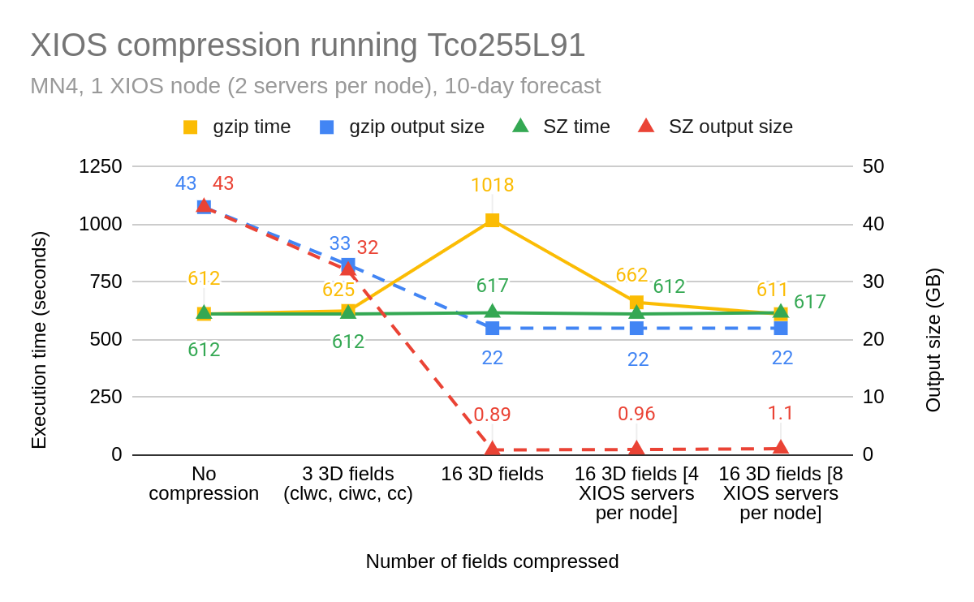
gzip vs. SZ compression: preliminary results
gzip: compression level 6
SZ: relative error bound 0.01

Slide 11
Validation
Specific humidity (q):
Temperature (t):

Slide 12
Ongoing and future work
ANL has added support to set different compression parameters per field.
Change XIOS code to read individual compression parameters and set the SZ filter via the NetCDF API.
This will allow us to tune the accuracy of each field depending on scientific needs.
Discuss with climate scientists the adequate compression parameters for each field, such as specific humidity or temperature.
Test the SZ filter with the experimental HDF5 parallel I/O.

Slide 13
Open questions and collaboration opportunities
Continuing the collaboration between ANL and BSC.
Any feedback will be welcome.

Slide 14
Thank you
xavier.yepes@bsc.es

