Slide 1
MONARCH and Barcelona Dust Regional Center updates
J. Escribano and the Atmospheric Composition Group
18 October 2022
ICAP Monterey 2022

Slide 2
The Atmospheric Composition group at BSC
Carlos P.
Oriol J.
María G.
Enza D.T.
Luka I.
Visitors ex-BSC and collaborators
Marc G.
Sara B.
Jerónimo E.
Dene B.
Elina K.
long list of close collaborators from CES, ESS and CVC Earth Sciences Department
Montse C.
Calum M.
Santiago E.
Roger G.
Franco L.
Open positions (DA, Model dev., SDS)
Hector N.
Ruben S.
Elisa B.
Adolfo G.
Cristina G.
Kevin O.
Notes:
Extremely nice group with open positions

Slide 3
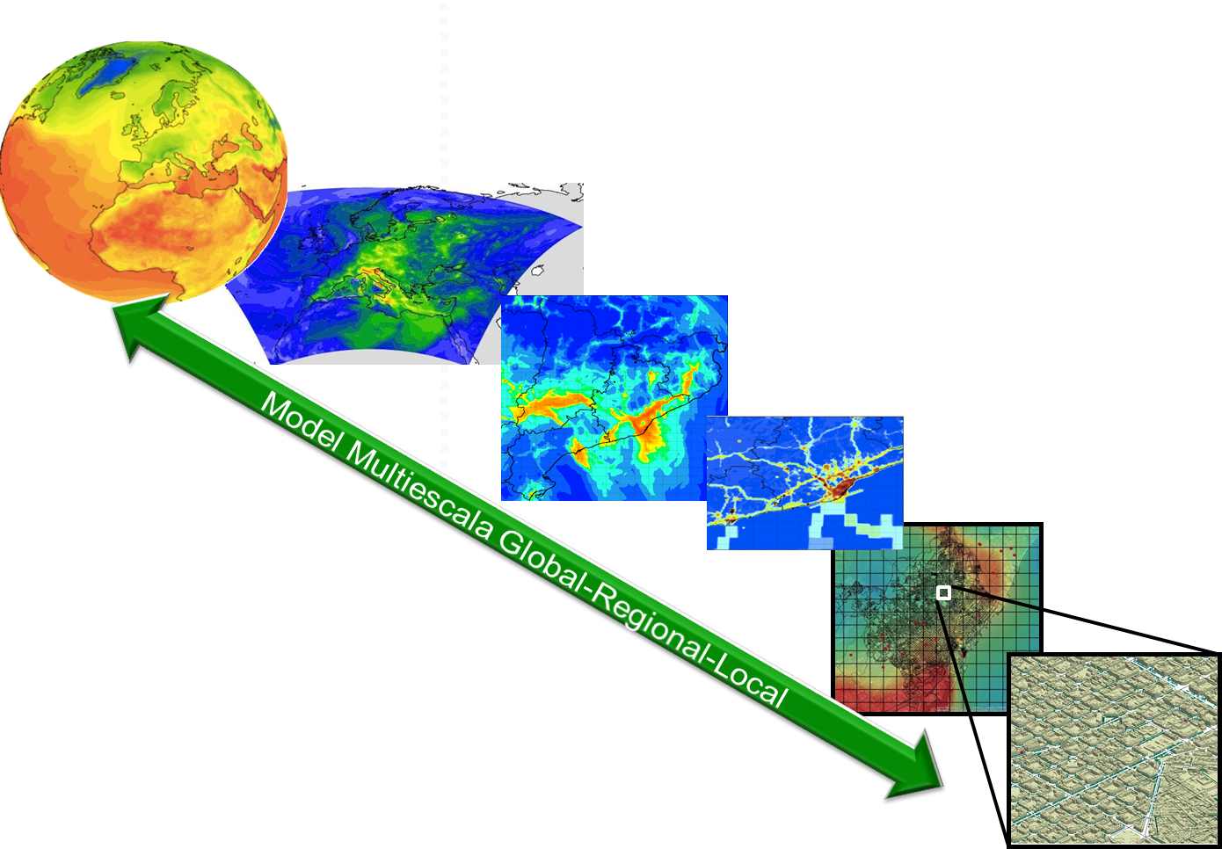
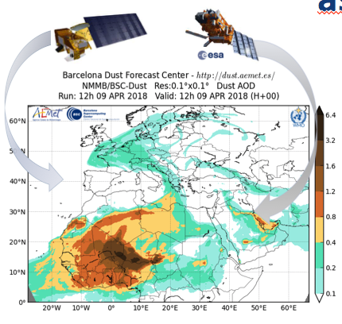
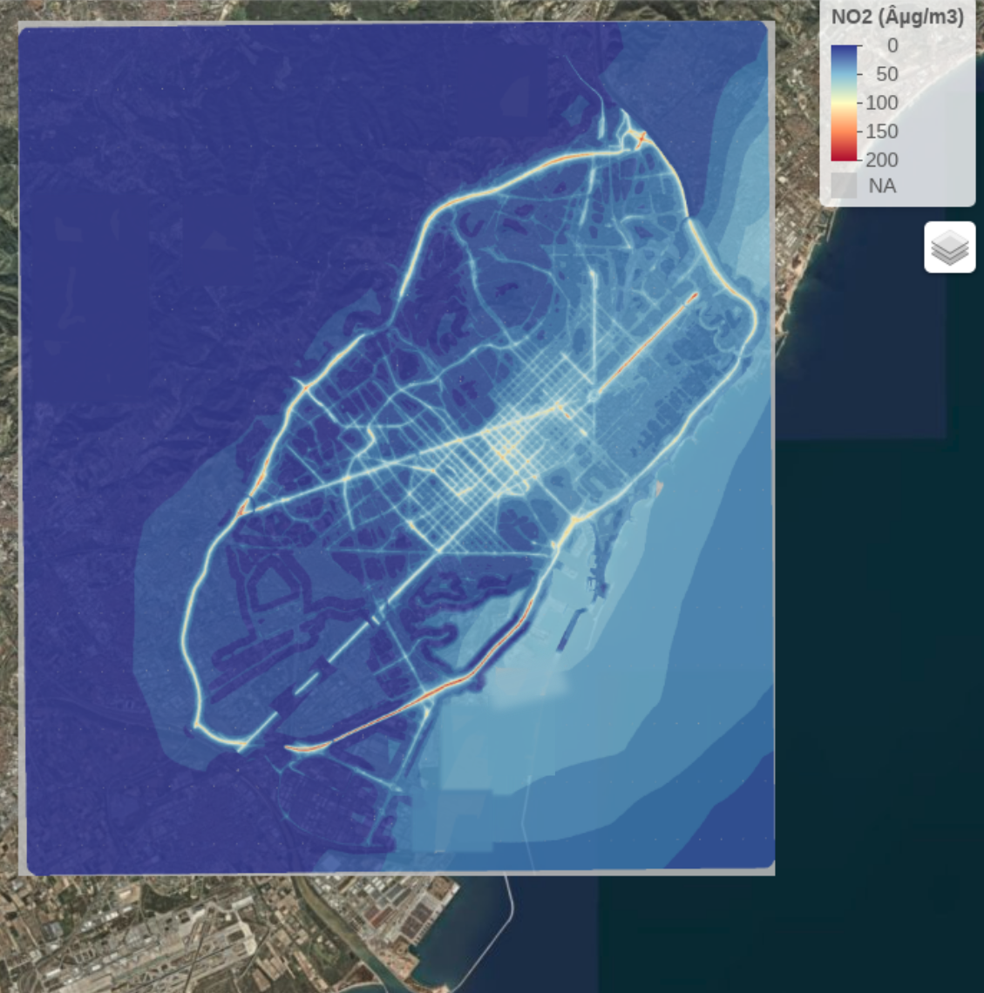
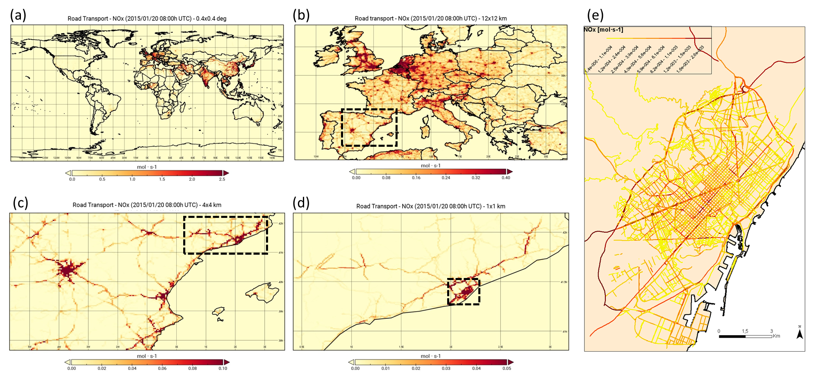
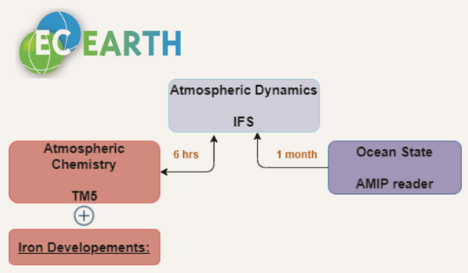
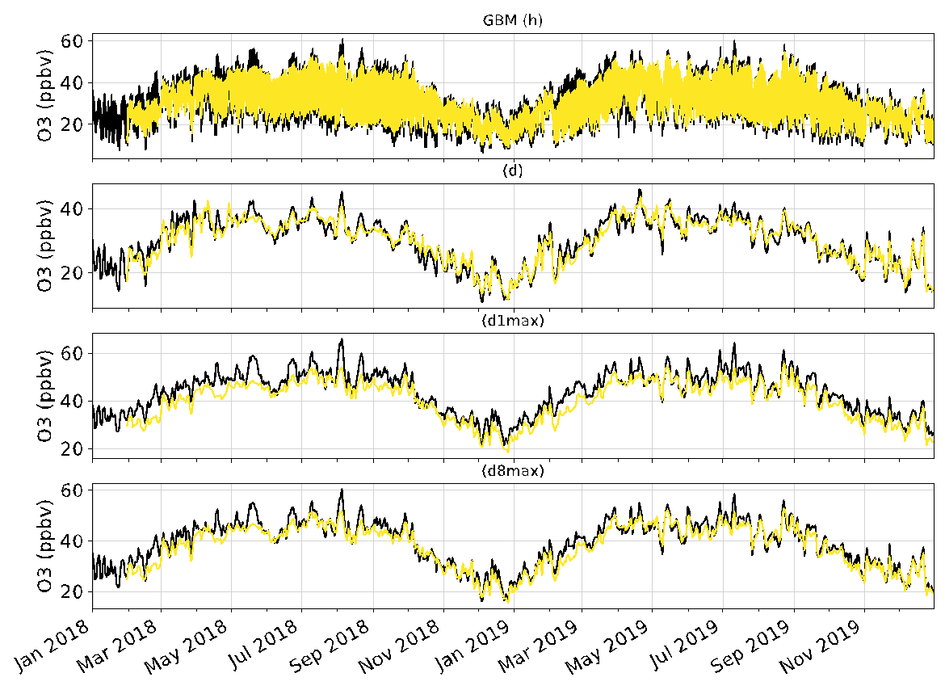
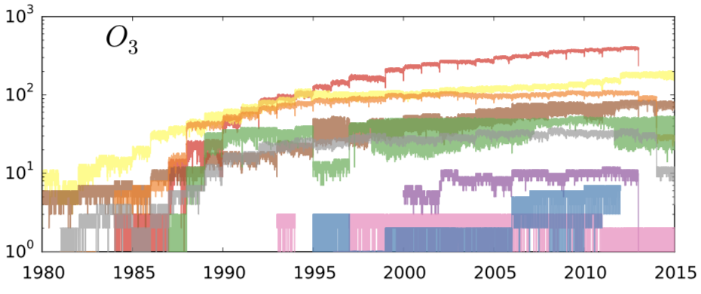
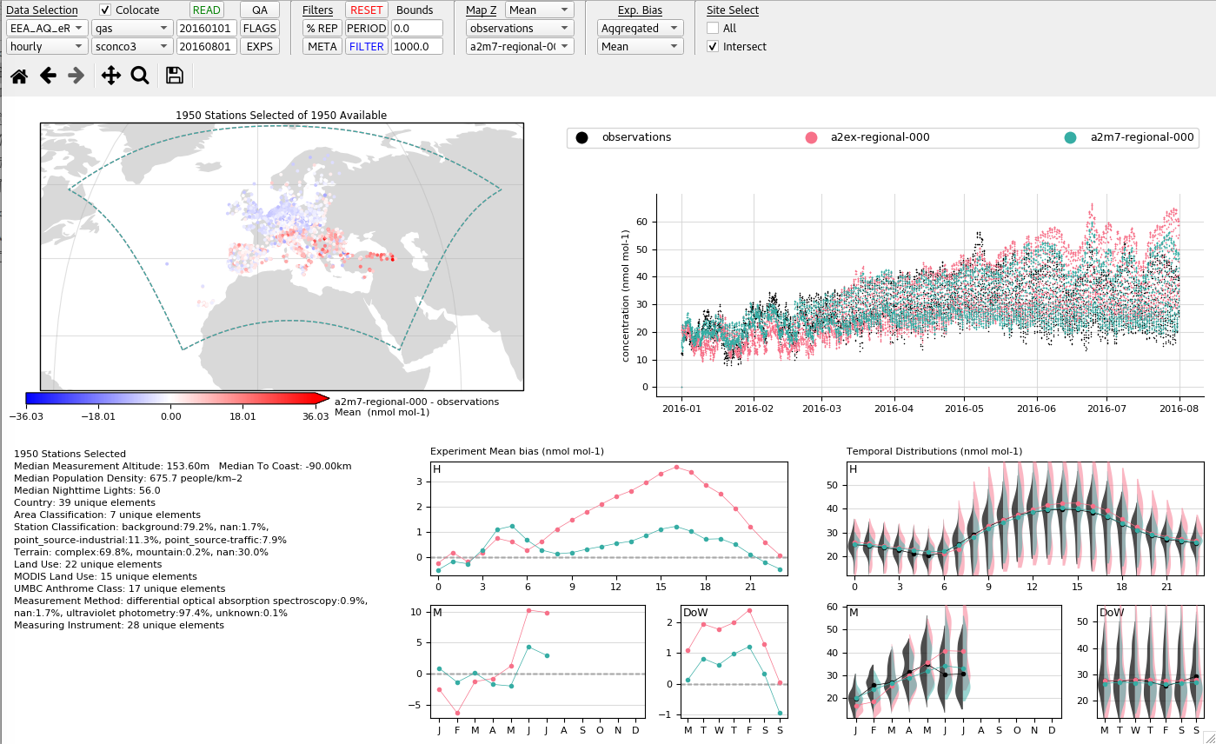
Atmospheric Composition Group
Understand, constrain and predict the spatiotemporal variations of atmospheric pollutants across scales along with their effects upon air quality, health, weather and climate
HERMESv3
MONARCH
LETKF DA
CALIOPE-Urban
A python-based, open source, parallel and multiscale emission model
On-line Atmosphere-Chemistry coupling
Ensemble based Data
Assimilation system
Street-scale dispersion model
Multiscale: global to local (1km)
Telescoping nesting
Ready to be coupled with Urban model
Guevara et al. (2019, GMD)
Guevara et al. (2020, GMD)
Guevara et al. (2021, ESSD)
Peng et al. (2019, QJMRS)
Kok et al. (2021a, 2021b, ACP)
Li et al. (2021, ACP)
Obiso et al. (in prep. Nat. Geo.)
Escribano et al. (2022, ACP)
Escribano et al. (in prep, JAMES)
Di Tomaso et al. (2022, ESSD)
Benavides et al. (2019, GMD)
Benavides et al. (2021, ERL)
Rodriguez-Rey et al. (2021, TR-RES)
Rodriguez-Rey et al. (2021, STOTEN)
EC-Earth3-Iron
Atmospheric iron cycle in EC-Earth
Model Output Statistics
Including machine learning
GHOST
Harmonised treatment of
observations
Providentia
Dynamic/flexible evaluation system
Myriokefalitakis et al. (2021, sub, GMD)
Bergas-Masso et al. (in prep)
Petetin et al. (2020, ACP)
Petetin et al. (2021, sub, ACP)
Bowdalo et al. (in prep, ESSD)
Bowdalo et al. (in prep, Nature Sust.)
Model and tool developments and related research outcomes

Slide 4
MONARCH overview

Slide 5
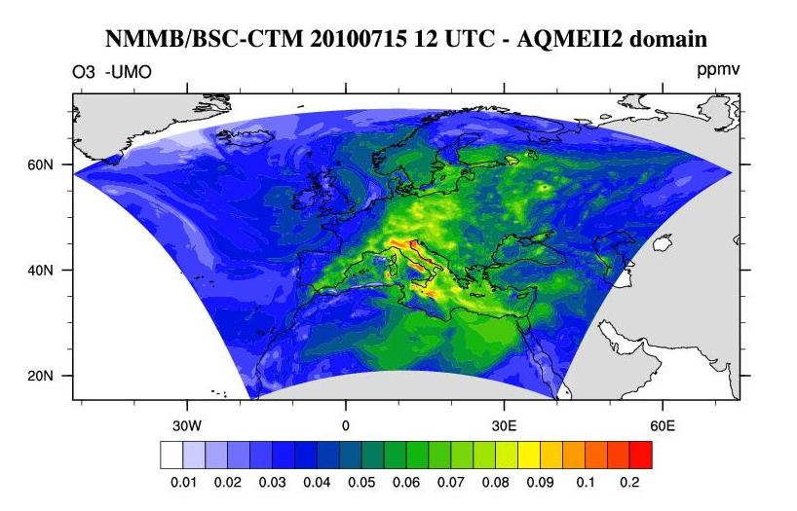
MONARCH overview
Global
Regional
20100715 at 12UTC
BDRC and SDS-WAS dust forecast
Copernicus model CAMS2_40a
It will be implemented in
MONARCH contributes to the ICAP global forecast aerosol multi-model ensemble http://icap.atmos.und.edu
CALIOPE (www.bsc.es/caliope)
AQ Forecast System for Spain
And more products in: http://www.bsc.es/ess/
Notes:
A summary of the ongoing forecast activities conducted by our group based on MONARCH.
At the global scale, MONARCH is providing aerosol forecast for the ICAP (International Cooperative for Aerosol Prediction) initiative
At regional scale, MONARCH is a consolidated system and the operational model of the Barcelona Dust Regional Center of WMO providing mineral dust services for a wide community.
Complementary, MONARCH has been included as an operational model of the Copernicus Regional production service in CAMS this past June 2022
We plan to deploy MONARCH as the main driver of our CALIOPE system, an air quality forecasting for Spain.
The model is used for research and policy assessment (for example assessing national abatement strategies in Spain for the Environment Ministry)

Slide 6
BSC Current forecasts and plans
CURRENT FORECASTING – DEVELOPED/AVAILABLE – UNDER DEVELOPMENT - PLANNED
DOMAIN | GLOBAL (ICAP) | REGIONAL North Africa, Middle East and Europe (SDS-WAS) | REGIONAL Europe (Copernicus)
Model | MONARCH | MONARCH | MONARCH
Status | QO | O | O
Meteorology | Inline: NMMB | Inline: NMMB | Inline: NMMB
Resolution | 0.7x0.5 deg | 0.1x0.1 deg | 0.15x0.15
levels | 48 | 40 | 24
DA | LETKF | LETKF | LETKF (for analysis and reanalysis, not used as IC)
Assimilated Obs | VIIRS DT+DB (DU) VIIRS DT+DB (ALL) | VIIRS DT+DB (DU) | EEA AQreporting Europe in-situ TROPOMI (NO2), VIIRS (AOD)
Aerosol Species | DU, SS, BC, POA, SOA bio, SOA anthro, SOA fires, SU, NI | DU | DU, SS, BC, POA, SOA bio, SOA anthro, SOA fires, SU, NI
Gas phase chemistry | CBM-IV CB05 ONLINE and CLIMATOLOGY |  | CB05
Emissions | HERMESv3 (HTAP v2, CAMS-GLOB) MEGAN ONLINE |  | HERMESv3 (CAMS-REGv5) MEGAN ONLINE
Bio. Burn. Emissions | GFAS NRT |  | GFAS hourly NRT
Notes:
Summary of the main configurations selected in the operational activities
ICAP configuration stable during the last years
Under the HORIZON-EUROPE Copernicus Evolution (CAMEO) project, we plan to develop the capability to assimilate tropospheric column of reactive gases

Slide 7
Other operational products:
WMO Sand and Dust Storm Warning Advisory and Assessment System (SDS-WAS)
Barcelona Dust Regional Center

Slide 8
WMO Barcelona Dust Regional Center
is coordinating the WMO SDS-WAS activities
for Northern Africa, the Middle East and Europe
https://dust.aemet.es/
@Dust_Barcelona
More than 10,000 visits per month in our website
and more than 900 new Twitter followers in the last year (at present 3,948 followers in total)
The WMO Barcelona Dust Regional Center
is managed by AEMET and BSC

Slide 9
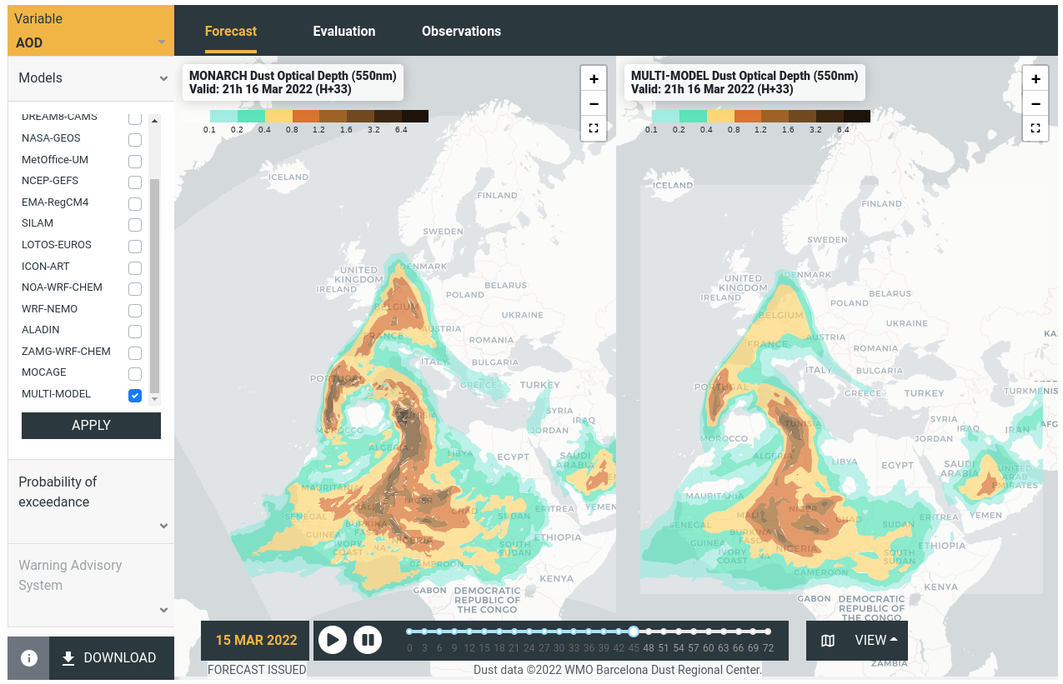
Daily Dust Products
Daily dust forecasts from 15 regional and global models that are evaluated with AERONET and MODIS
Tailored products: Probability of exceedance and Warning Advisory System
Easy access to numerical data through a THREDDS system
Note that five ICAP global models are considered in the intercomparison
Notes:
icap models in NAMEE SDS-WAS: geos, cams, mocage, silam , metoffice

Slide 10
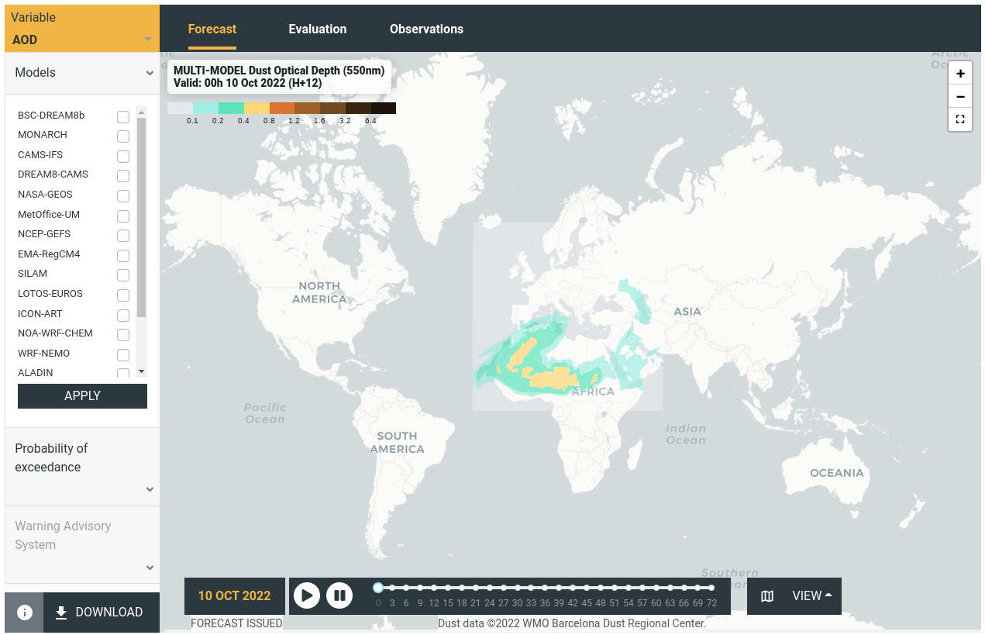
WMO SDS-WAS & ICAP
Ongoing discussions to provide a global dust forecast product based on ICAP
It should be used for the three Regional Centers of the WMO SDS-WAS (i.e. NAMEE, Asia and Pan-American)

Slide 11
Other products:
Contribution to the CAMS regional ensemble
Regional dust forecasts
DustClim 10-yr dust reanalysis

Slide 12
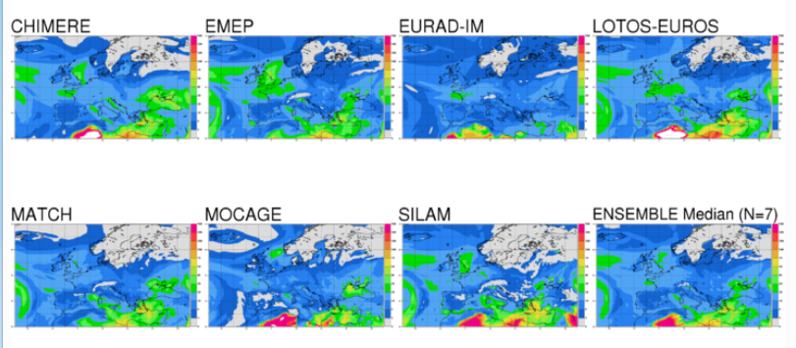
Copernicus Programme: Regional Air Quality Products
Operational Europe-wide Air Quality Service based on:
9 operational AQ models
1 ENSEMBLE model
How? Median of the individual results for each grid-cell
Why? Reliable, robust, performing
DEHM
+
GEM-AQ
NRT Forecasts and Analyses
Daily
Interim & Validated Reanalyses
Annually
New operational models June 2022
O3, NO2, SO2, CO, PM10, PM2.5, SIA, Dust, Pollen (6).
Users
https://atmosphere.copernicus.eu
Notes:
In June 2022, MONARCH is a new member of the multi-model ensemble prediction system of CAMS
We provide forecasts of regulatory pollutants (O3, NO2, SO2, CO, PM10, PM2.5), some PM composition (SIA, Dust) and pollen species (Birch, Grass, Alder, Olive, Ragweed, Mugwort).
Additionally, we apply our LETKF system to produce analysis and re-analysis of O3, NO2, SO2, CO, PM10 and PM2.5 assimilating in-situ European obs.

Slide 13
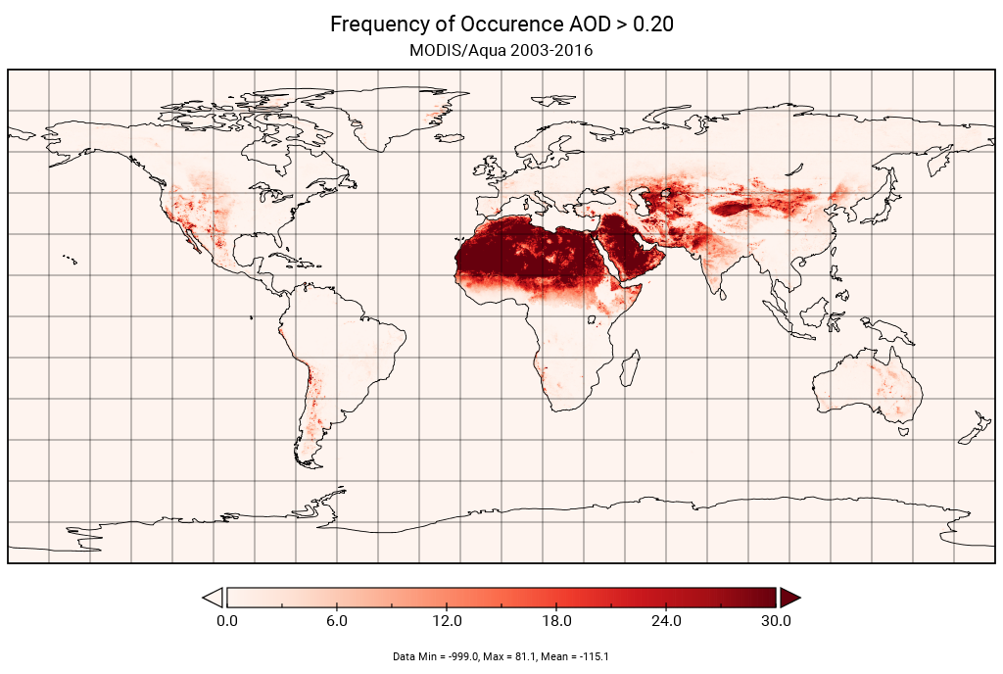
MONARCH-REG Dust Operational forecast
Running 4 domains:
NAMEE is operational since 2010
China, Colorado and Chile started operations in October 2021 within the EU AQ-Watch project
Upgrades (expected for February 2023) for NAMEE includes:
The use of the latest MONARCH code version (Klose et al., 2021)
Revision of the calibration coefficients for wet and dry deposition.
AOD considering triaxial spheroids (~ 2 times larger than spheres)

Slide 14
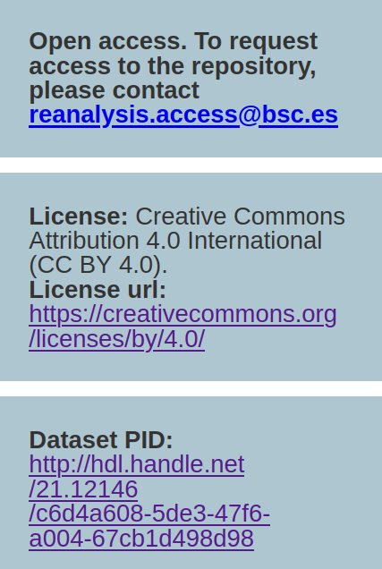
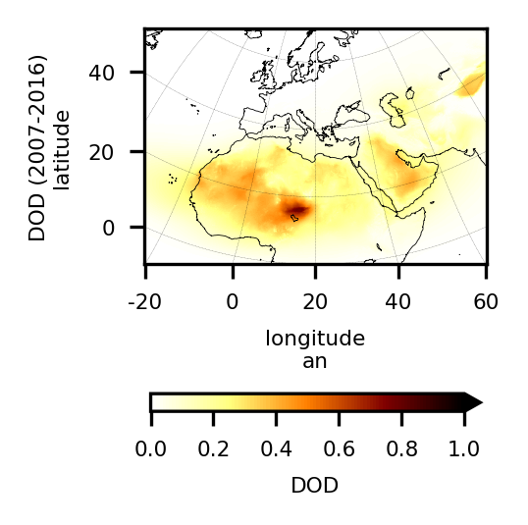
A complete and consistent, four dimensional, regional reconstruction of desert dust in a recent decade (2007-2016)
Unprecedented high resolution: 0.1º x 0.1º
Specific dust observational constraint
Uncertainty estimates in the reanalysis output
Link to specific air quality and climate services
FAIR data guidelines
Di Tomaso et al., 2022, ESSD
Notes:
a 10-year regional reanalysis of dust at HR. this is the homepage for easy access to the data which are FAIR. novelty aspect: High Resolution, having used dust obs and assimilation over sources, uncert in the final product, link to services (more on this later). It covers Northern Africa, the Middle East and Europe, and including the Mediterranean sea and parts of Central Asia, and the Atlantic and Indian Oceans.
Such a reliable high-resolution historical record of atmospheric desert dust allows for a better quantification of dust impacts upon key sectors of society and economy, including health, solar energy production and transportation. useful tool in support of climate research and service, including the support to operational early warning systems and to the development of mitigation strategies.

Slide 15
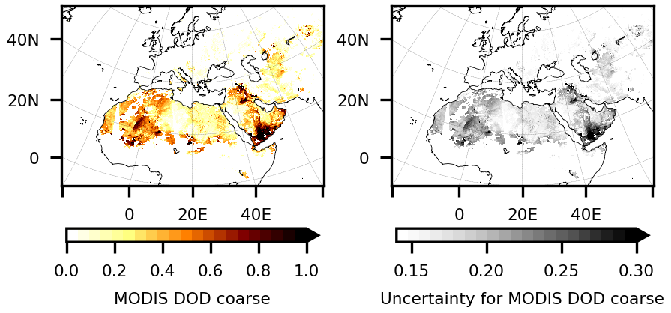
Assimilated observations: a daily sample
(550 nm)
(550 nm)
Coarse-mode dust optical depth retrieved from MODIS Deep Blue L2 aerosol products over cloud- and snow-free land surfaces (Ginoux et al. 2010, 2012; Pu and Ginoux 2016):
interpolated to a regular grid of 0.1 by 0.1 degrees
AE, ω filter, coarse AOD retrieval by an empirical continuous function (Anderson et al., 2005)
highest quality flag
~120,000 observations assimilated daily (after quality control)
Notes:
assimilated obs: product derived from MODIS Deep Blue retrievals. Produced by gfdl, Here we use the derived coarse OD as a proxy for dust coarse OD. AE, ω filter, coarse AOD retrieval by an empirical continuous function.

Slide 16
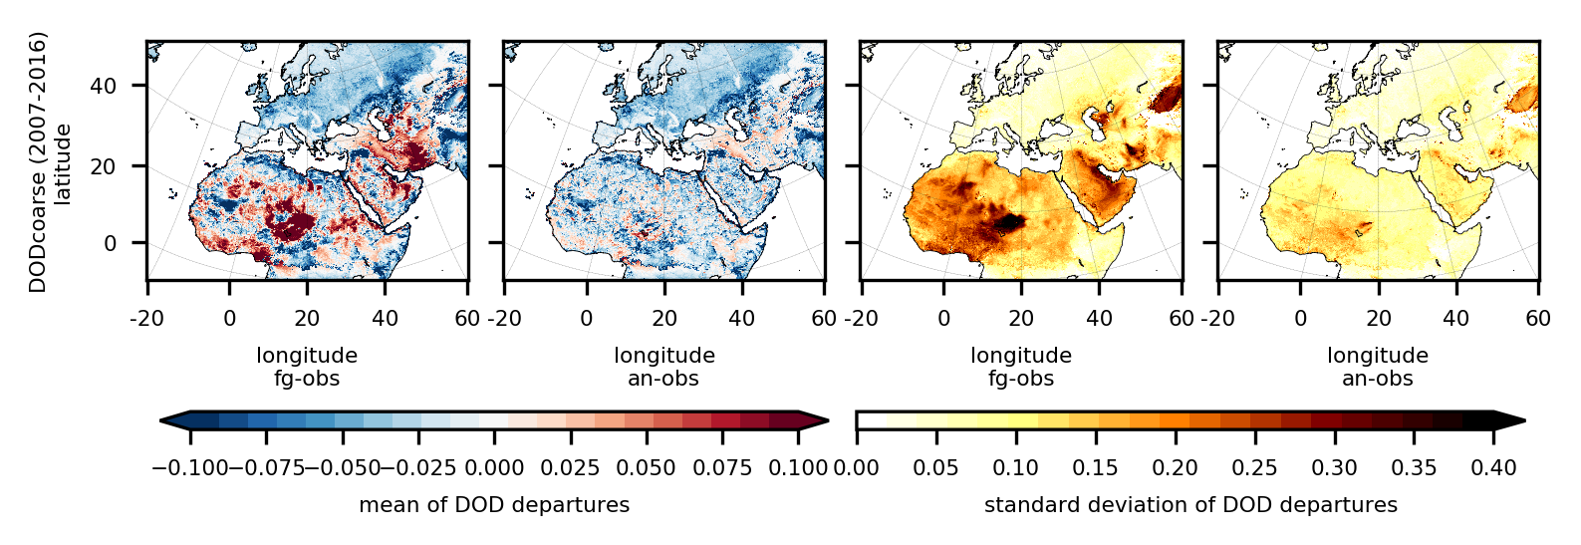
Departures from assimilated observations
(550 nm)
(550 nm)
The reduction of the standard deviation of the analysis departures compared to the first-guess proves the consistency of our assimilation procedure
The positive mean departures decrease considerably in the analysis compared to the first-guess
Some of the negative mean departures remain unchanged: lower DOD not analyzed efficiently or contamination of other aerosols than dust in the observations
Notes:
inner diagnostics to look at the quality of the analysis, sanity check of the DA scheme.
What about the quality of this reanalysis? First of all we looked at Da inner diagnostics based on first-guess and analysis departures from assimilated obs. There is an issue with the bias of the analysis being higher in certain region or seasons that can be explained by the contamination of other aerosols than dust in the observational data set (for example, biomass burning aerosols produced by fires in Central Africa and that are advected further north during summer) or by the presence of fairly low DOD coarse values (mainly over Europe and west Russia) that are not analyzed as efficiently by the assimilation scheme as
the higher DOD coarse values. the reduction of the standard deviation of the analysis departures compared to the first-guess everywhere in the domain of interest, prove the consistency of our assimilation procedure.

Slide 17
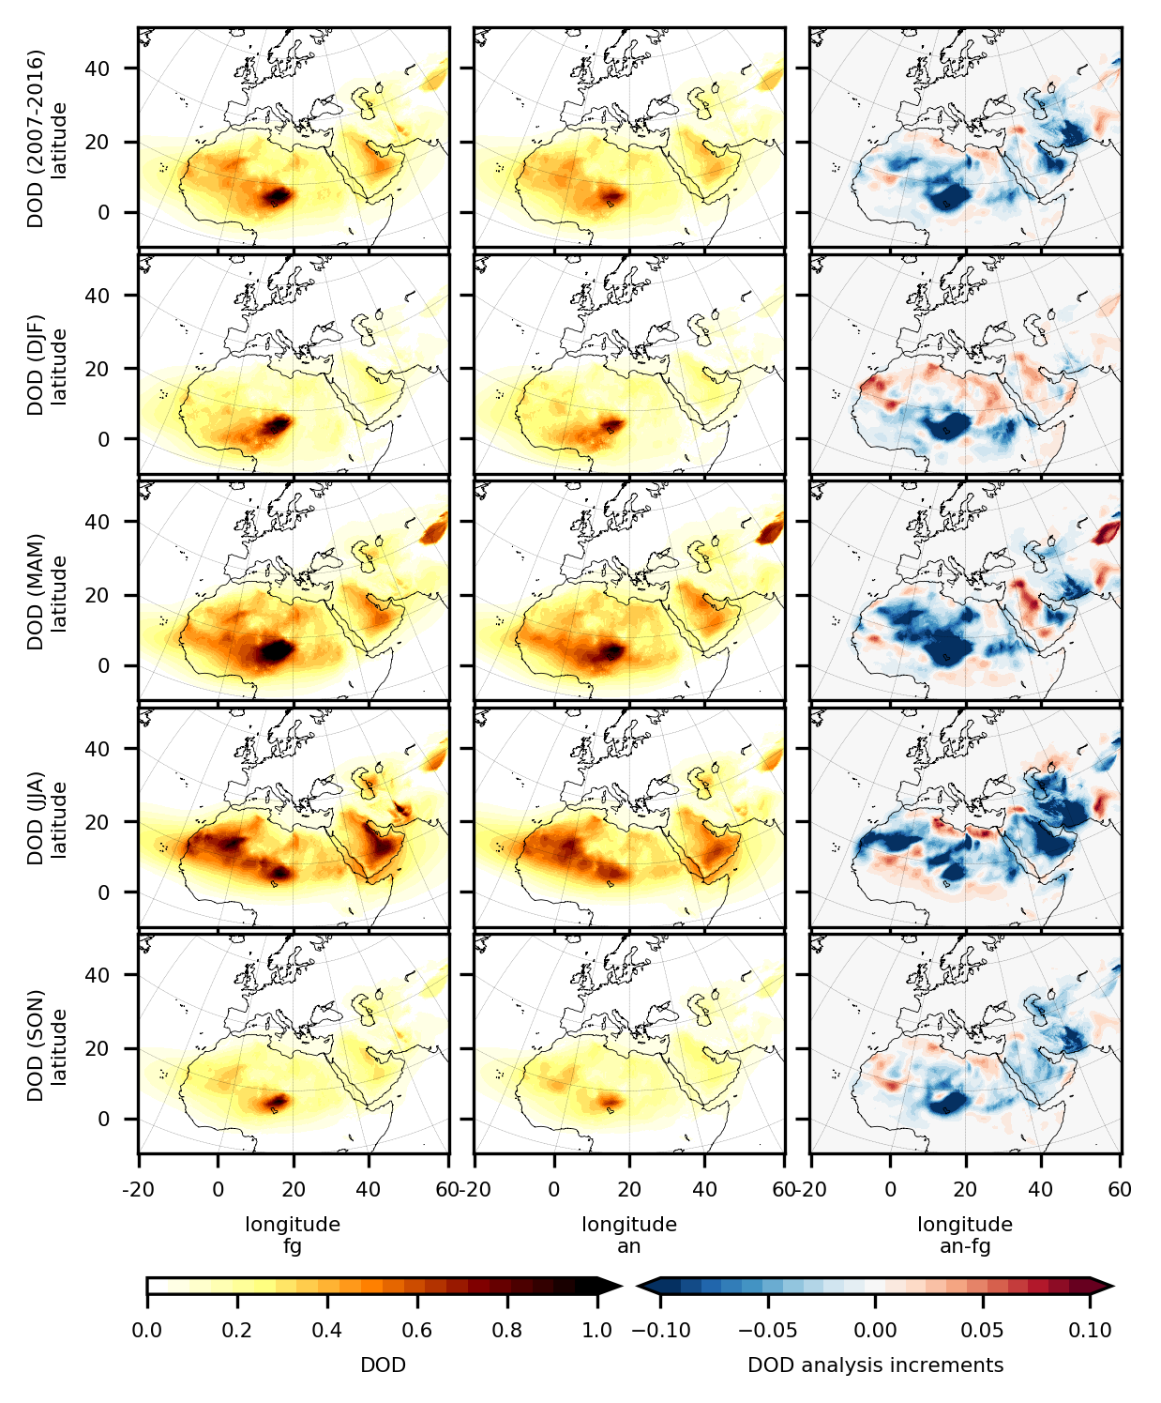
Increments
Systematic negative corrections likely linked to overestimation of the major sources’ strength in Africa and the Middle East (the Bodélé depression in Chad, in the Saudi Arabia lowlands and in the Balochistan region of south-western Asia) or too weak deposition
Positive mean increments over the Thar desert, in the north part of Syria, inland from the Mediterranean sea in the north of Africa, and between Mauritania and Mali
(550 nm)
(550 nm)
Notes:
here we have fg, an and increments. This allows us to check the geographical distribution (there are known patterns that we expect during the different seasons - next plot optional) and also to speculate on model bias looking at systematic deviation from zero
spatial and temporal distribution of the dust fields follows well-known dust cycle features controlled by seasonal changes in meteorology and vegetation cover. If we look at the analysis over the 10 year period, In agreement with observations, the highest DOD values are placed over the major emission areas of the domain, in particular in the Bodélé depression in Chad, the Chech desert in Algeria and the El Djouf between Mauritania and Mali, followed by the Arabian desert, the Taklamakan desert in Northwest China
The decadal mean analysis DOD is generally smaller than the first-guess DOD except in the Taklamakan and Thar deserts, and in areas where the mean DOD is below 0.3. Therefore on average, MONARCH emissions are likely too strong for the configurations used, although this could be due also to a too weak deposition which strongly dependent upon the emitted size distribution that evolves during transport.
Seasonal changes in the geographical distribution of the analysis mean DOD are consistent with well-known patterns: just to mention some of them (i) dust peaks everywhere during spring and summer, in particular, across the Taklamakan desert during spring when more dust-generating cold fronts arrive in the area; (ii) dust from the south Sahara and Sahel is preferentially transported by northeasterly Harmattan winds toward the Gulf of Guinea in winter and spring; (iii) the dust plume originated in Western Africa and transported across the tropical North Atlantic is shifted toward northern latitudes in summer along with the Intertropical Convergence Zone (ITCZ; Moulin et al., 1997); (iv) dust is strongly mobilized in the Arabian peninsula and the Tigris-Euphrates basin in summer by the north-northwesterly Shamal winds; (v) the lowest overall DOD is simulated everywhere in autumn.

Slide 18
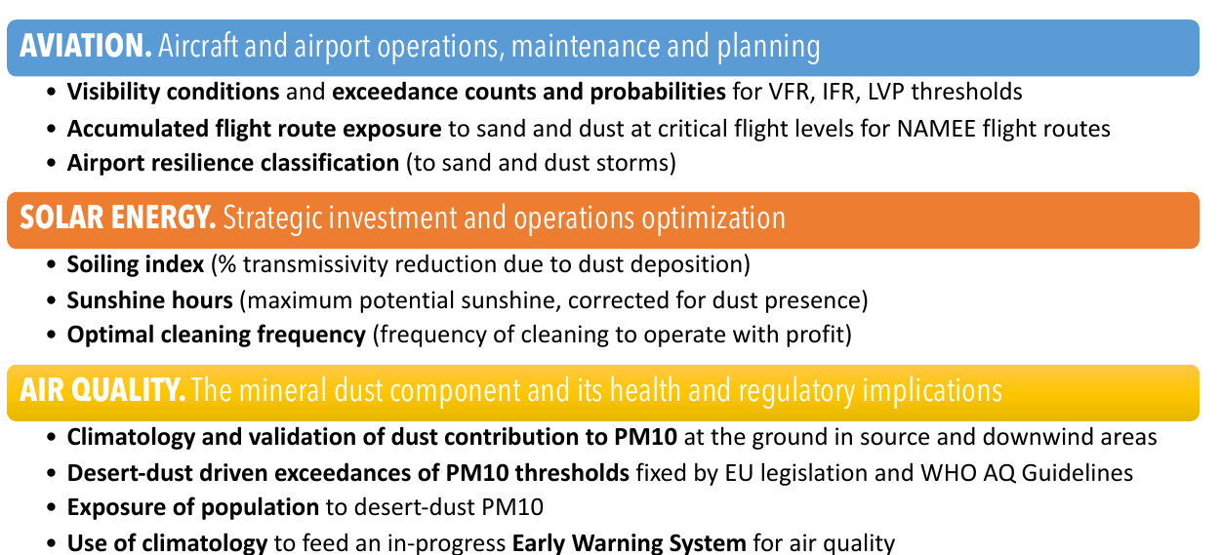
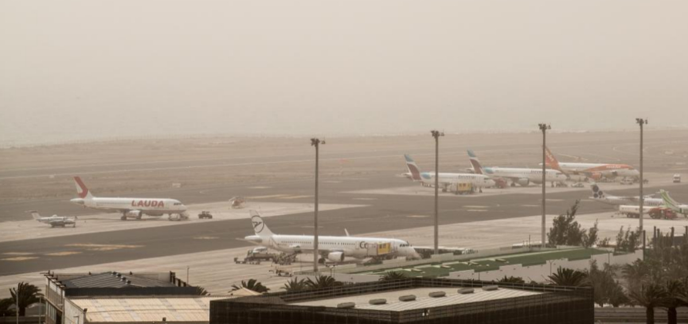
Tenerife Norte, 22 Feb 2020
Aïssa et al., 2016
DustClim methodology is used in the recent UN ESCAP-ADPIM Sand and Dust Storms Risk Assessment report
‹#›
Notes:
this regional reanalysis has already been used to support the provision of pilot services in three socio-economic sectors: aviation, solar energy production, and air quality.
For example, a dust-PM10 field has been derived from the 2D, bin-resolved dust mass surface concentration for air-quality applications, visibility data from 3D dust-extinction coefficient fields have been used for aviation applications, while soiling index based on wet and dry dust deposition has been used to develop products for solar energy production.
There is currently a very limited integration of dust information into practice and policy. In this context, DustClim will not only provide reliable information on SDS trends and current conditions, but will also develop dust impact assessment pilot studies for three key economic sectors (air quality, aviation and solar energy). Since the beginning of the project, there will be a continuous exchange between the scientific teams (from observational and modelling communities) and the main user communities. This collaboration is fundamental for better defining the dust parameters to be investigated and to design and optimise the future provision of dust services.
‹#›

Slide 19
Research activities

Slide 20
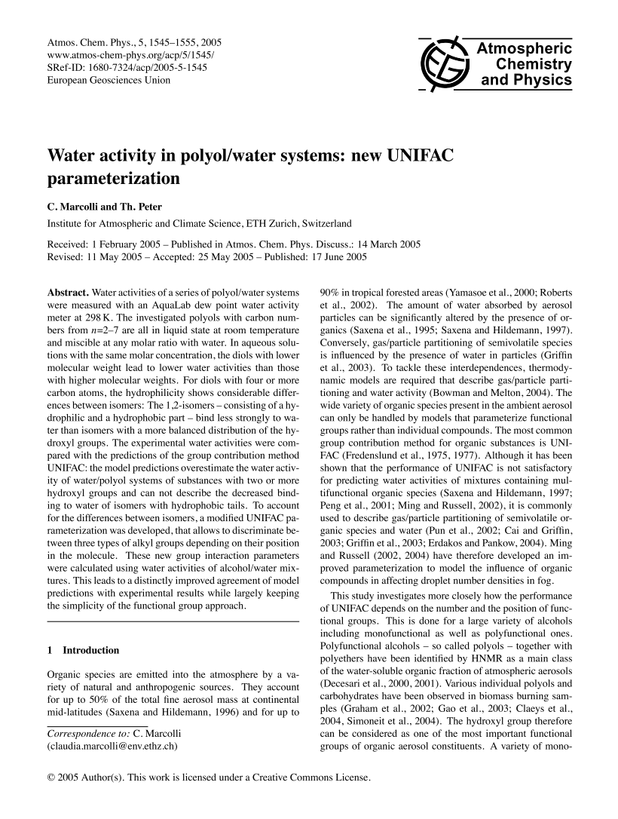
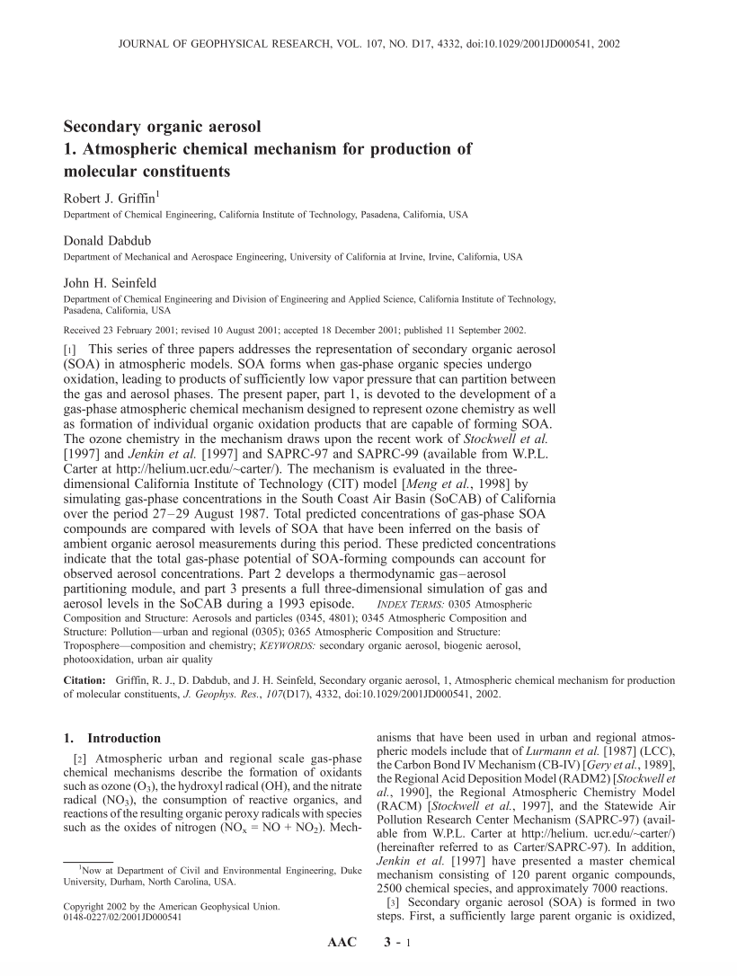
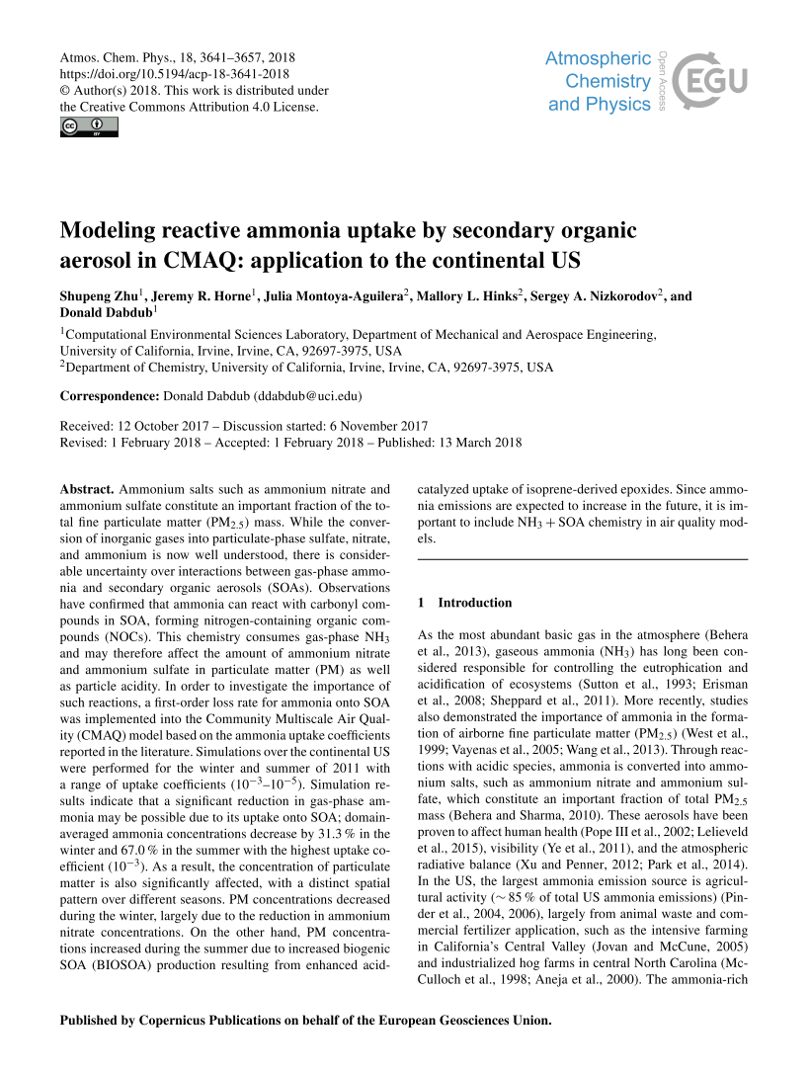
CAMP: Chemistry Across Multiple Phases
{
"reactants" : {
"O3" : {} ,
"NO" : {}
},
"products" : {
"NO2" : {}
},
"type" : "ARRHENIUS",
"A" : 3.0E-12,
"B" : 0.0E+00,
"C" : -1500.0
}
{
"reactants" : {
"O3" : {} ,
"NO" : {}
},
"products" : {
"NO2" : {}
},
"type" : "ARRHENIUS",
"A" : 3.0E-12,
"B" : 0.0E+00,
"C" : -1500.0
}
{
"reactants" : {
"O3" : {} ,
"NO" : {}
},
"products" : {
"NO2" : {}
},
"type" : "ARRHENIUS",
"A" : 3.0E-12,
"B" : 0.0E+00,
"C" : -1500.0
}
Scalable kinetics treatment for chemistry in multi-phase models
Change the chemical mechanism without recompiling
Vary mechanism complexity based on conditions/location
Compare mechanisms in real time
Use same mechanisms across models (MONARCH, PartMC, etc.) changing only Aerosol Representation JSON
{
"reactants" : {
"O3" : {} ,
"NO" : {}
},
"products" : {
"NO2" : {}
},
"type" : "ARRHENIUS",
"A" : 3.0E-12,
"B" : 0.0E+00,
"C" : -1500.0
}
USER
{
"reactants" : {
"O3" : {} ,
"NO" : {}
},
"products" : {
"NO2" : {}
},
"type" : "ARRHENIUS",
"A" : 3.0E-12,
"B" : 0.0E+00,
"C" : -1500.0
}
{
"reactants" : {
"O3" : {} ,
"NO" : {}
},
"products" : {
"NO2" : {}
},
"type" : "ARRHENIUS",
"A" : 3.0E-12,
"B" : 0.0E+00,
"C" : -1500.0
}
Load input files into model objects
SIMPOLPhaseTransfer
State
TroeReaction
load()
initialize()
…
species_state[]
ArrheniusReaction
load()
initialize()
…
UNIFAC
load()
initialize()
…
Your favorite model
PDFITE
load()
initialize()
…
MassOnlyBinsModes
PartMC
advance
state
load()
initialize()
…
Solver
CPU/GPU
load()
initialize()
…
MONARCH
Condensed Data Structure
Dawson et al. (2021 GMD)
The CAMP library is available at: https://github.com/open-atmos/camp
Notes:
Development of scalable kinetics treatment for chemistry in multi-phase models
Collaborative effort between University of Illinois, NCAR and BSC started during Matthew Dawson post-doc at BSC (now at NCAR)
The main design goals of CAMP are focused to:
-Treat chemistry, partitioning…
-Make it flexible
-Make it efficient
Ported to GPU architecture with promising performance results
CAMP is being tested as part of the MUSICA portable chemistry toolset in MusicBox at NCAR.

Slide 21
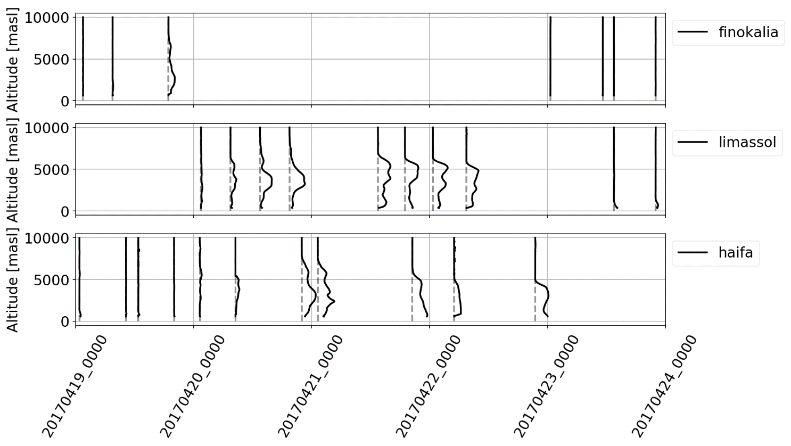
Assimilation of LIVAS extinction coefficient profiles
Three-dimensional analyses of atmospheric dust aerosol concentrations constrained by satellite vertical retrievals of dust properties, and associated uncertainty estimation.
Dust extinction coefficient
Event observed by 3 lidar sensors located in Finokalia (Crete), Limassol (Cyprus) and Haifa (Israel) part of the PollyNet (http://polly.tropos.de/) system. Data (with uncertainty estimation) processed by TROPOS.
Finokalia (Crete)
Limassol (Cyprus)
Escribano et al., 2022, ACP
Haifa (Israel)
Notes:
we move to assimilating vertical information. We look at this case study observed by ground based lidar and assimilation LIVAS caliop.

Slide 22
Assimilation of LIVAS extinction coefficient profiles
Three-dimensional analyses of atmospheric dust aerosol concentrations constrained by satellite vertical retrievals of dust properties, and associated uncertainty estimation.
Escribano et al., 2022, ACP
Notes:
analysis profiles: Properly representing its vertical structure, particularly important for predicting its long-range transport and associated impacts

Slide 23
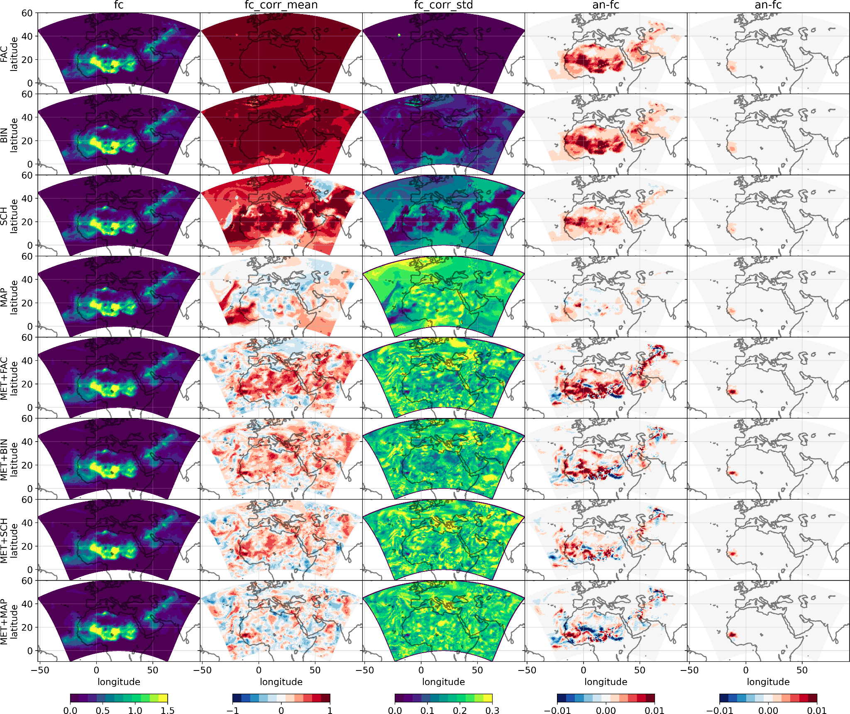
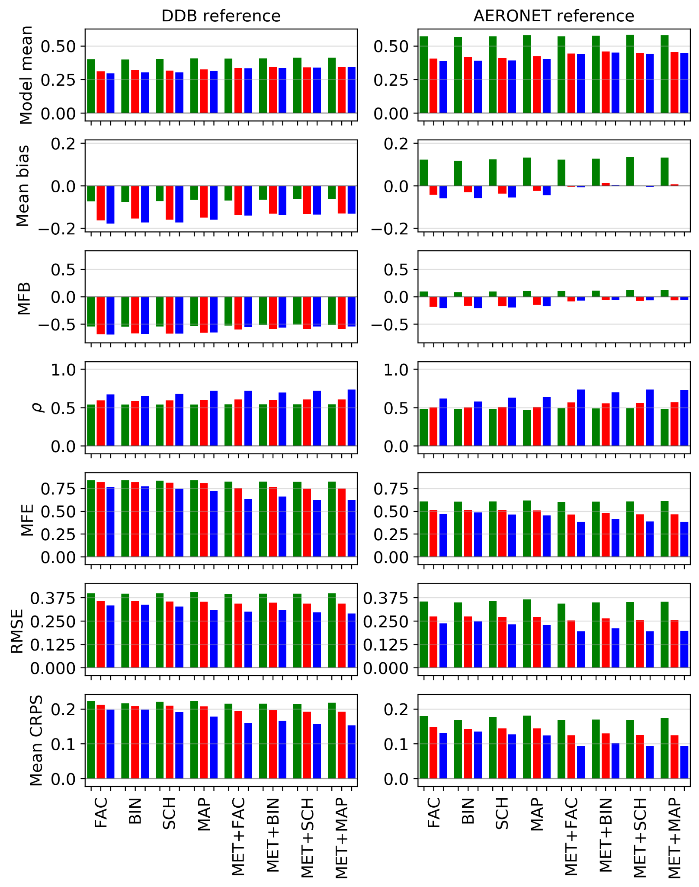
Ensemble generation for dust DA

Slide 24
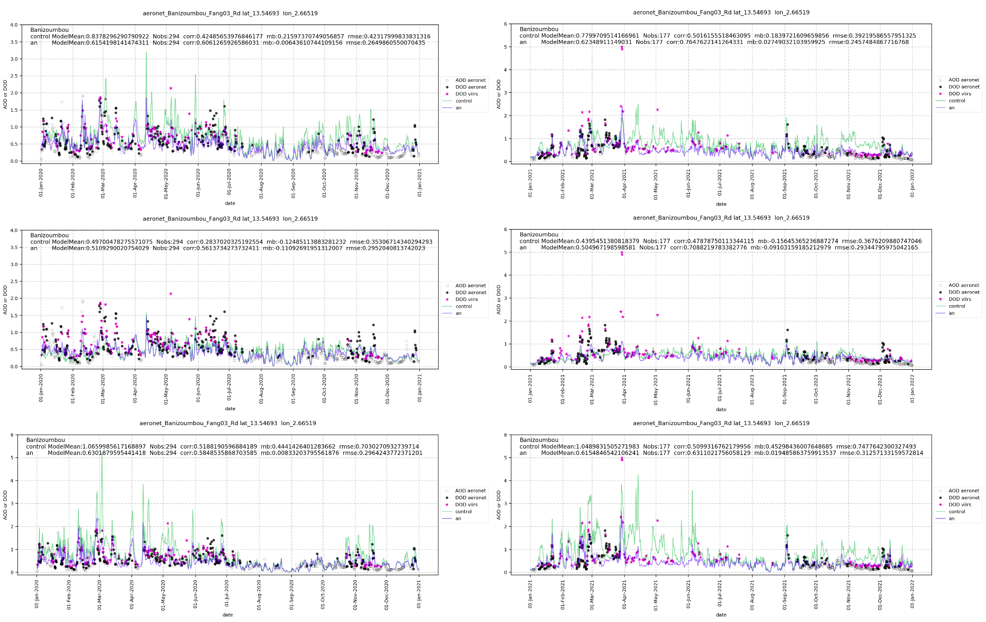
Dust emission top-down inversion/estimation
Only dust emission in control vector of DA, based on LETKF, and assimilating SNPP-VIIRS DB AOD.
5 years: 2017-2021
3 dust emission schemes (runs): Ginoux-GOCART (top), Kok2014 (middle) and Shao2012 (bottom) emission schemes (as in Klose et al 2021 GMD)
Banizoumbou 2020 and 2021 ( Aeronet ALM v3L1.5 , interp 550nm, ang<0.3, Rd).

Slide 25
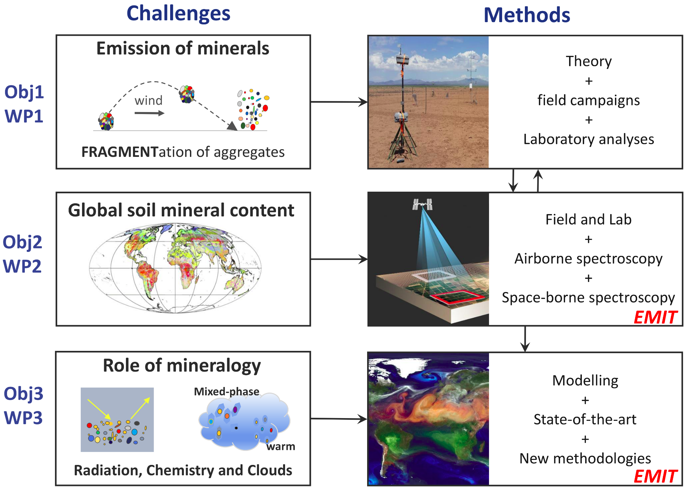
FRontiers in dust minerAloGical coMposition and its Effects upoN climaTe (FRAGMENT ERC)

Slide 26
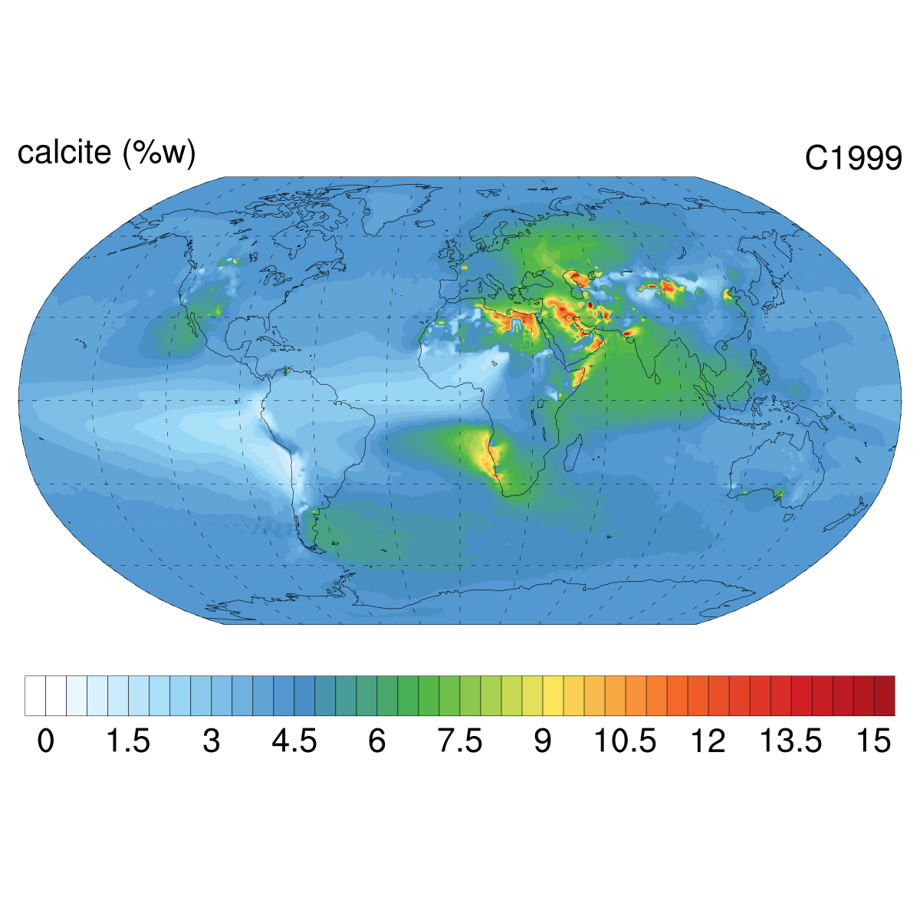
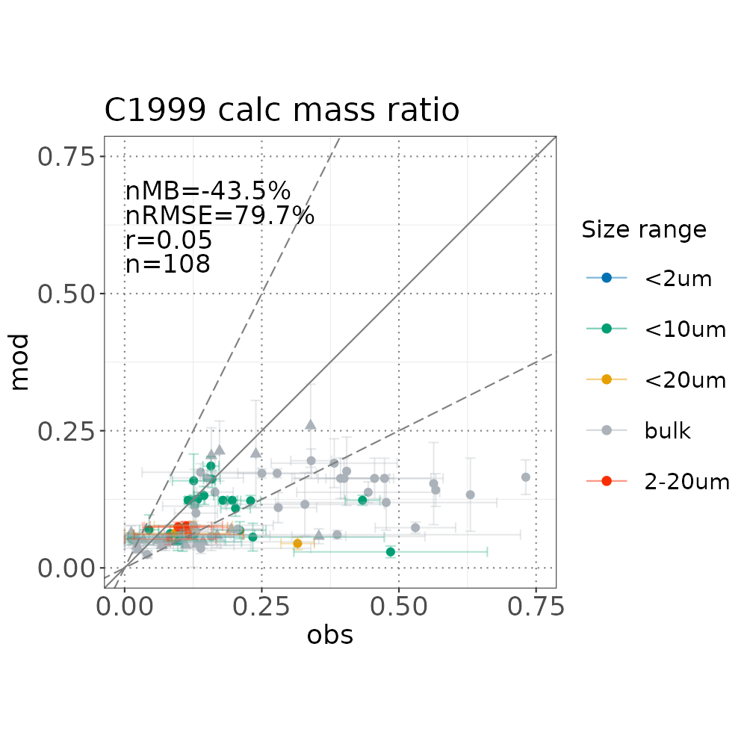
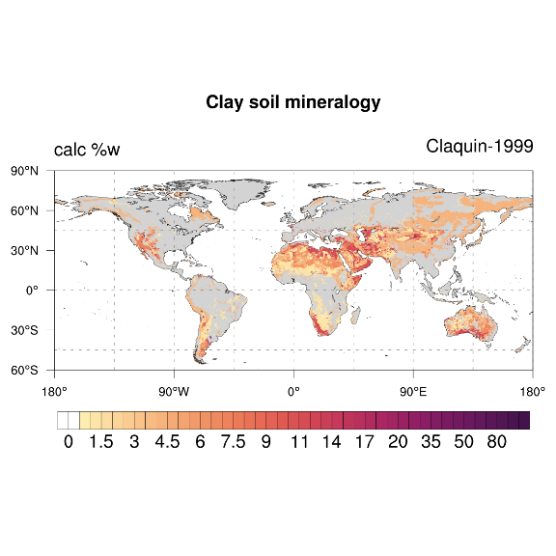
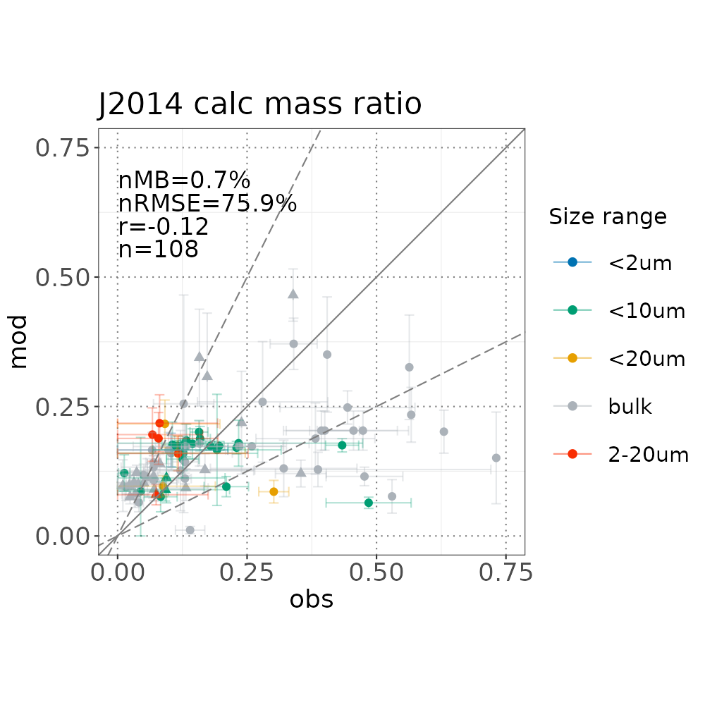
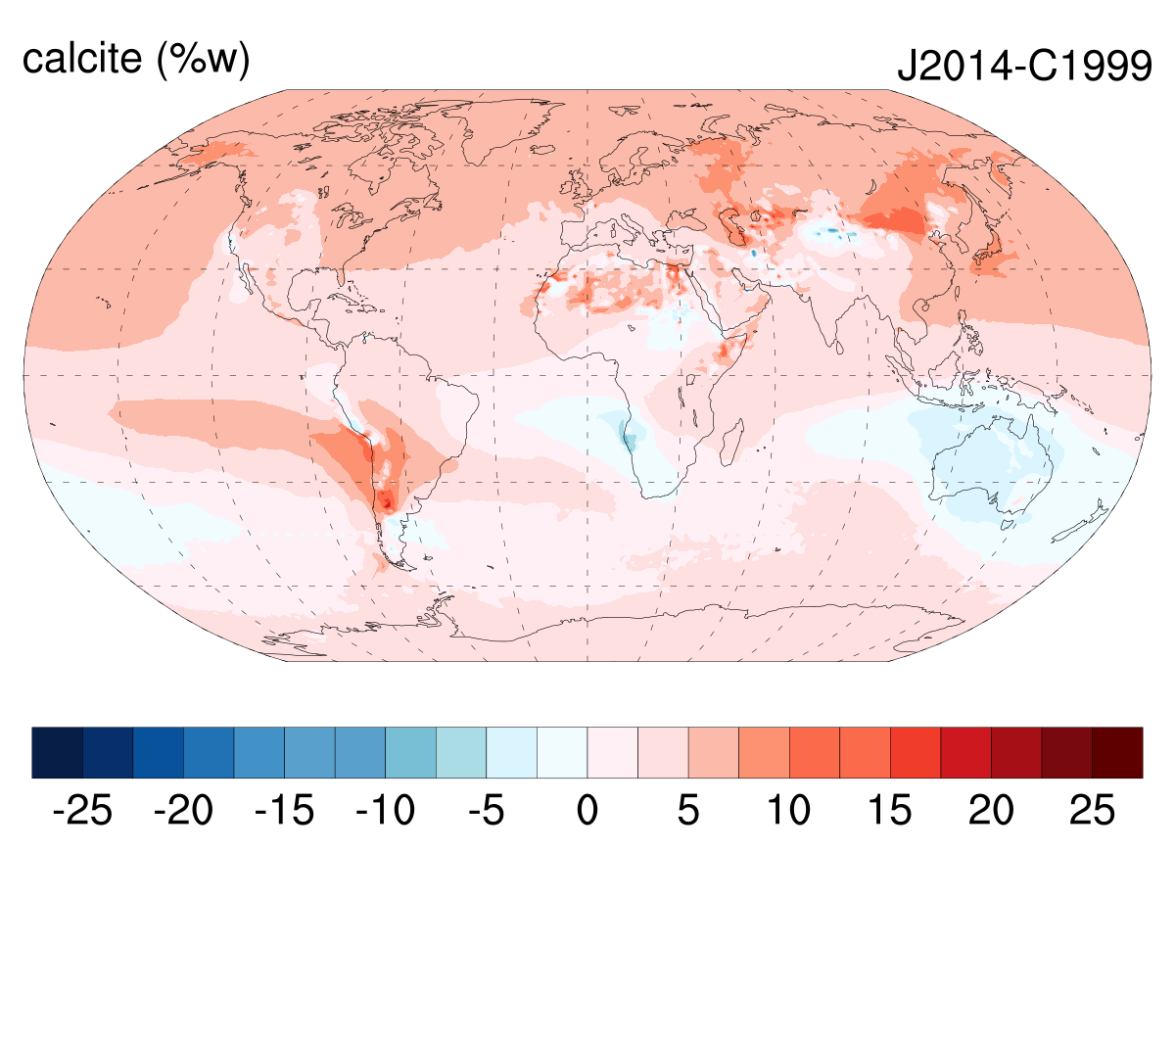
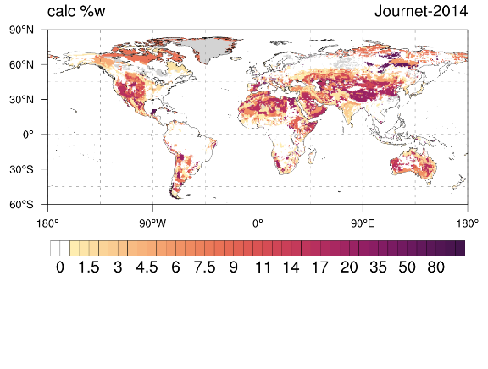
Research on dust mineralogy and its impacts on the Earth System
MONARCH has been developed to explicitly represent dust mineralogy, with the aim of improving our knowledge on its impacts in the Earth System (e.g. interaction with radiation, atmospheric chemistry).
Mineral fraction at surface conc.
(MONARCH 2006-2010, %w)
Evaluation against observations
(following Perlwitz et al. 2015)
2 state of the art Mineralogy Atlases:
Claquin et al. (1999), Nickovic et al. (2012)
8 minerals:
Illite, smectite, kaolinite, quartz, feldspars, calcite, gypsum and hematite (iron oxides).
Journet et al. (2014)
12 minerals:
Illite, smectite, kaolinite, vermiculite, chlorite, mica, quartz, feldspars, calcite, gypsum, hematite and goethite.
Notes:
MONARCH has been recently developed to explicitly represent dust mineralogy.
The main goal is to explore the effect of minerals on different Earth System processes – interaction with radiation, atmospheric chemistry, etc.
It has the capability of using two different state-of-the-art mineralogy maps as inputs, that provide either 8 or 12 minerals relevant for their climate impacts (Claquin and Journet maps are very different – large uncertainty).
The differences in the soil mineralogy drive large differences in the modelled mineralogy (e.g. calcite mineral fractions at the surface when using Claquin – top- and differences when using Journet – bottom-).
In this particular case, when assessing the mineralogy against obs, the calcite mass fraction seems best captured with the Journet map, but this depends on the mineral you’re looking at.
We continue working in improving the representation of minerals in the atmosphere, and assessing their impact. Current model developments – interaction with radiation, in the future – better soil maps through remote sensing (EMIT NASA mission).

Slide 27
thanks!
jeronimo.escribano@bsc.es

