Slide 1
Barcelona, 17th of December 2018
Research Support, Transfer and Dissemination (RSTD) and Project Management Office (PMO) at BSC
Mar Rodríguez and Dorota Jouet,
Project Managers at Earth Sciences (ES) Department

Slide 2
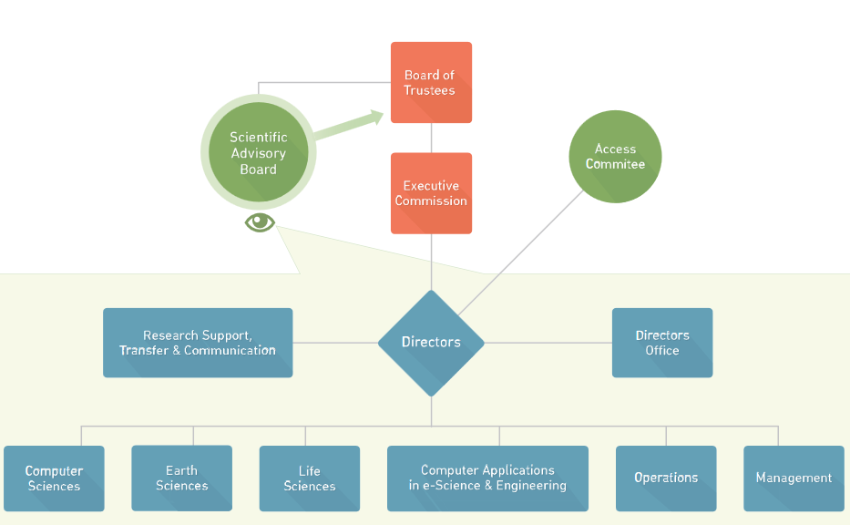
RSTD in BSC Organisation Chart
Research Support, Transfer and Dissemination
Notes:
EuroHPC

Slide 3
Research Support, Transfer and Dissemination at BSC
Research Support, Transfer and Dissemination (23)
Eugene Griffiths
Project Management Office (12)
Tech Transfer Office (3)
Anna Escoda
Project Dissemination (4)
Renata Gimenez
Strategy Support (3)
Computer Science (4)
Guadalupe Moreno
CASE &
Operations (2)
Marta Rosselló
Earth Science (2)
Mar Rodríguez
Life
Science (2)
Ezequiel Mas
Institutional (2)
Francesca Arcara
Notes:
EuroHPC

Slide 4
Main RSTD Responsibilities in Project Lifecycle
Pre-Award Post-Award
Strategy Support
PMO
PMO
PMO
Strategic
Research
Agendas
Coaching
Approach, Eligibility,
Implementation & Budget
Grant Agreement,
Consortium
Agreement
Private Contracts
BSC- Coordinated
Project Management
Open Access
Input to EU work progs
Proposal Preparation
Negotiation
Project Execution
Detection and Communication of Funding Opportunities (PMO)
Impact: including
Communication
Plan, Exploitation
plan
Impact: website, social media, events, printed
materials.
IP & exploitation management
Tech Transfer Dissemination
Tech Transfer Dissemination
Notes:
We help from Day 0

Slide 5
BSC Project Management Office (PMO)
Responsibilities | Details
Pre-award: Funding | Detection, Communication and Exploration (Networking, info-days etc.) of Funding opportunities
Pre-award | Proposal and Grant Preparation We can often help with the impact section too Collaborative Coordinated projects: communication with coordinators
Negotiation Phase projects and contracts | Communication with the Funding organisations Responsibility for negotiating and executing contracts (usually grant agreement or equivalent and consortium agreement)
Post-award | Coordinated projects: Administrative and legal Management Collaborative projects: communications and follow up
Contracts with companies | All contracts checked by PMO with our lawyer to ensure that conditions regarding IPR, confidentiality, payment etc. are correct. Only Mateo Valero can sign on behalf of BSC.
Personnel Grants | H2020 MSCA: Mar Rodríguez & Dorota Jouet H2020 ERC: Francesca Arcara National and Regional Personnel Grants: Isabel García
Project Data | To maintain a database of project information which may be useful to you. Ask your Project Manager for info
Non-reporting aspects of EU projects | Potential problems and communication with the European Commission
Write to us at pmo@bsc.es or come and see us at Nexus II, ground floor.

Slide 6
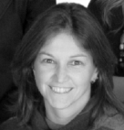
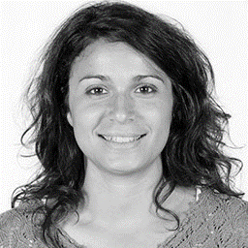
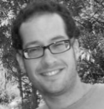
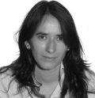
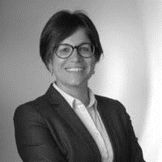
BSC Project Management Office (PMO)
Earth Science
Institutional/Personal grants
Mar
Dorota
Francesca
Isabel
Life Science
CASE
Ezequiel
Simona
Marta
Sergi
Computer Science
Lupe
Yara
Isabel
Anna

Slide 7
Most Relevant Financing Tools
Public funds
Service contracts/ Tenders
Private funds
Private contracts for services with private companies

Slide 8
Earth Science wiki https://earth.bsc.es/wiki/doku.php?id=projects:projects
All proposals and projects are available on the wiki.
Please do not share them outside BSC.

Slide 9
ES ongoing projects and contracts
1 H2020 coordinated project (S2S4E)
2 Copernicus coordinated (QA4Seas and C3S_512)
AEMET “Encomienda”
Project type | Number
Institutional agreements | 3
Personnel grants | 14
Contracts | 10
EU-H2020 (including MSCA and ERC) | 31
EU-OTROS (i.e COPERNICUS) | 12
Other funding (i.e EOS, ADEME, ..) | 4
National projects | 12
TOTAL | 86
Estimated funding budget (2015-2031) | 19,798,671.47 €
Numbers taken from SAP system
(BSC internal system)
Notes:
Coordinated: ESPRESSO (2018) GUARANTY SONNAR POP2 BDEM CoQuA ESTiMatE PerMedCoe OncoHelper EUCANCan ExaMed ELASTIC ChEESE
Others include: BBVA, La Caixa Health, PRIMA, ELIXIR,
Negotiation: CLASS QUAKE FRAGMENT EPEEC ChEESE ESTiMatE POP2 ELASTIC EUCANCan STARS FRAMEWORK EOSC-hub I-BiDaaS ICEI (resub) RDA Europe 4.0 EXDCI-2 EPI ECO-H-MEM - Antonio Peña FireExtinction MATHROCKS MSC HBP SGA2 EUROLAB4HPC2 SOLWATT RECIPE LANDSUPPORT SuPerCom SILICOFCM ExaQUte INADEC HPC-GIG PROTECT ESCAPE-2 IMMERSE DUST.ES EXCELLERAT FAIRPlus CLIM4CROP MAX 2 ENERXICO CompBioMed2 EoCoE-II INFORE euCanSHare EPI SGA1 CYBELE BioExcel2 - IS-ENES3 ESiWACE-2 BioExcel2 EJP RD DeepHealth AI4EU EOSC-Life iPC FocusCoE PRACE-6IP

Slide 10
ES proposals submitted 2018
All proposals currently under preparation are available in the ES wiki (Projects & Proposals section).
This table does not include contracts under negotiation.
Proposal type | Number
Personnel grants | 3
EU-H2020 | 10
EU-OTROS (i.e COPERNICUS) | 2
National proposals | 3
TOTAL | 18
Estimated requested budget (2018-2022) | 3,787,932.62 €
Numbers taken from SAP system
Proposals still pending of approval
Notes:
Coordinated: ESPRESSO (2018) GUARANTY SONNAR POP2 BDEM CoQuA ESTiMatE PerMedCoe OncoHelper EUCANCan ExaMed ELASTIC ChEESE
Others include: BBVA, La Caixa Health, PRIMA, ELIXIR,
Negotiation: CLASS QUAKE FRAGMENT EPEEC ChEESE ESTiMatE POP2 ELASTIC EUCANCan STARS FRAMEWORK EOSC-hub I-BiDaaS ICEI (resub) RDA Europe 4.0 EXDCI-2 EPI ECO-H-MEM - Antonio Peña FireExtinction MATHROCKS MSC HBP SGA2 EUROLAB4HPC2 SOLWATT RECIPE LANDSUPPORT SuPerCom SILICOFCM ExaQUte INADEC HPC-GIG PROTECT ESCAPE-2 IMMERSE DUST.ES EXCELLERAT FAIRPlus CLIM4CROP MAX 2 ENERXICO CompBioMed2 EoCoE-II INFORE euCanSHare EPI SGA1 CYBELE BioExcel2 - IS-ENES3 ESiWACE-2 BioExcel2 EJP RD DeepHealth AI4EU EOSC-Life iPC FocusCoE PRACE-6IP

Slide 11
Key Messages
Keep PMO informed about your plans to submit a proposal and communicate with us during the project/contract implementation stage.
RSTD is always happy to help and provide you with support.
Where to find us?
Ground floor, next to the Aula Formación (Meeting room)
Notes:
EuroHPC

Slide 12
Barcelona
Thank You
Mar Rodríguez: mar.rodriguez@bsc.es
Dorota Jouet: dorota.jouet@bsc.es

