Slide 1
What level of decadal prediction skill would be achievable given perfect initialisation?
Yiling Liu, Markus Donat, Andrea Taschetto, Paco Doblas-Reyes, Lisa Alexander, Matt England
EUCP GA, Venice 4-7 Feb 2019
05/02/2019
EUCP is funded by the European Union under Horizon 2020 Grant Agreement no. 776613

Slide 2
Initialisation versus boundary conditions forcing
[Meehl et al., 2009 BAMS]

Slide 3
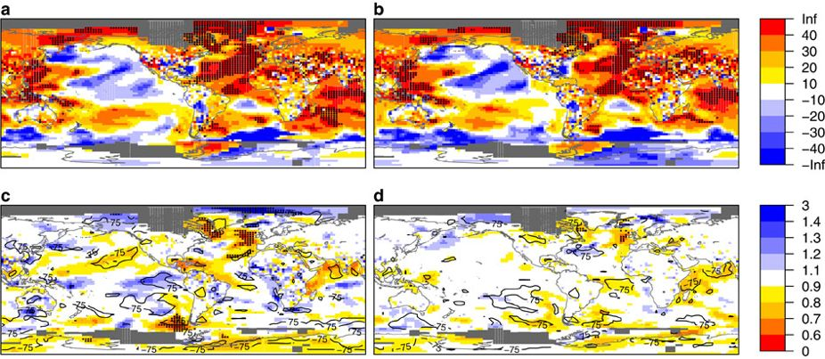
Forecast quality in decadal predictions – added value from initialization?
e.g. near-surface temperature in CMIP5 (RMSSS)
2-5 years 6-9 years
Ini
[Doblas-Reyes et al 2013]
Ini-NoIni
→ Limited predictability from initialisation versus external forcing due to imperfect initialisation?
→ What level of skill may be achievable?
[Interesting scientific question, but also to important to manage expectations!]

Slide 4
Perfect-model prediction experiments
How far can the model predict itself, starting from identical (almost) initial conditions?
CESM1, consistent set-up to decadal hindcasts (just replacing real-world observations with a historical simulation, for both initialisation and evaluation):
decadal simulations started from a historical reference run, 1st Jan each year 1961-2005
5 ensemble members (perturbing air temperature with Gaussian noise order of magnitude 10⁻⁵K)
Historical runs (5 members CMIP5 hist) as un-initialised counterpart
Compare skill for initialised/uninitialised runs, and perfect-model/real-world predictions (real-world hindcasts from CMIP5, Yeager et al 2012)
(focus on near-surface temperature to illustrate the framework)

Slide 5
Comparing the different prediction experiments
 | The initialized perfect model predictions | The initialized real-world decadal hindcasts | The uninitialized climate predictions
Near surface temperature observations |  | The skill of real-world decadal hindcasts (iii) | The skill of the uninitialized real-world climate predictions (iv)
Perfect model temperature reference | The prediction skill of initialized perfect model (i) |  | The prediction skill of the uninitialized perfect model (ii)

Slide 6
Skill measures
Forecast accuracy: Mean Squared (error) Skill Score (MSSS)
$MSSS\left(H,\overline{O,} O\right)=r_{HO}^{2}−{\left[r_{HO}−\frac{S_{H}}{S_{O}}\right]}^{2}−{\left[\frac{\overline{H}−\overline{O}}{S_{O}}\right]}^{2}$
$r_{HO}$: sample correlation between the hindcasts and the observations
${S_{H}}^{2};\text{S}\text{O}\text{2}$: the sample variances of the ensemble mean hindcasts and observations,
$\overline{O}=\sum_{j=1}^{n}{O_{j}}:$climatological forecast (where Oj represents the observations, or perfect-model reference respectively, over j = 1,...,n start times), $\overline{H}$ the mean hindcast
Ensemble dispersion: Logarithmic Ensemble Spread Score (LESS)
$LESS=ln\left(\frac{\overline{σ_{\hat{H}}^{2}}}{σ_{R}^{2}}\right)$
in which,
$\overline{σ_{\hat{H}}^{2}}=\frac{1}{n}\sum_{j=1}^{n}{\frac{1}{m−1}}\sum_{i=1}^{m}{{({\hat{H}}_{ij}−{\hat{H}}_{j})}^{2}}$ (average ensemble variance)
$σ_{R}^{2}=\frac{1}{n−2}\sum_{j=1}^{n}{{\left({\hat{H}}_{j}−O_{j}\right)}^{2}}$ (reference mean square error)
LESS <0: the ensemble is under-dispersive (i.e. overconfident)
LESS >0: the ensemble is over-dispersive (i.e. under-confident)

Slide 7
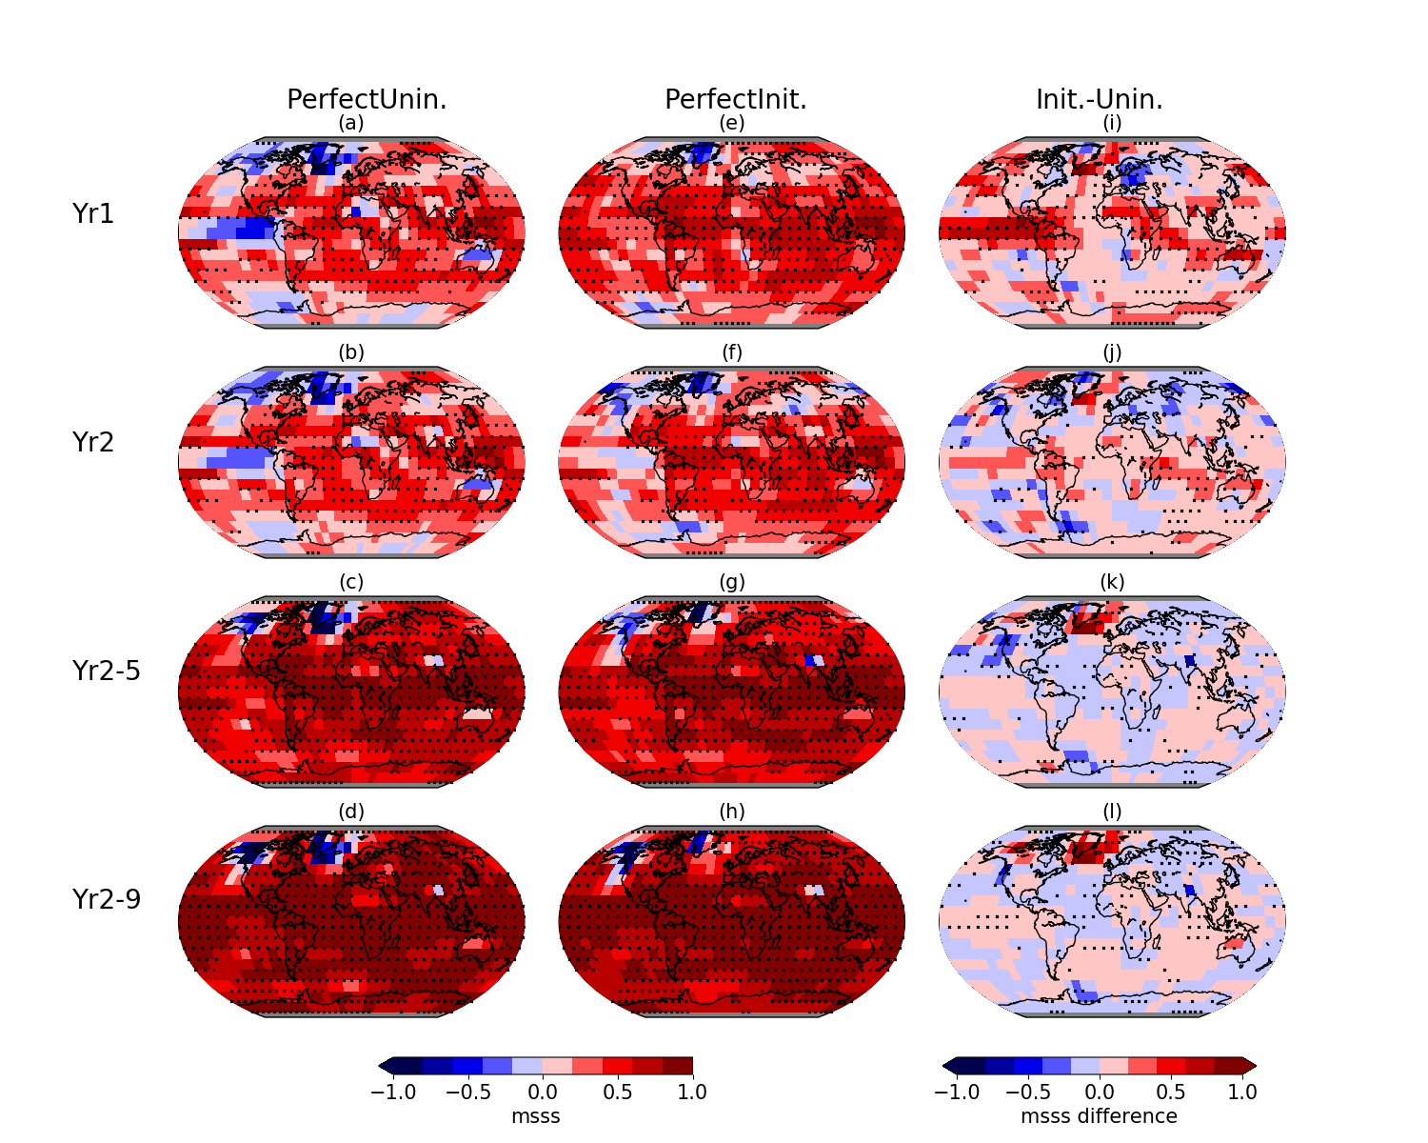
MSSS in initialized and un-initialized perfect-model predictions
[added value from initialization?]

Slide 8
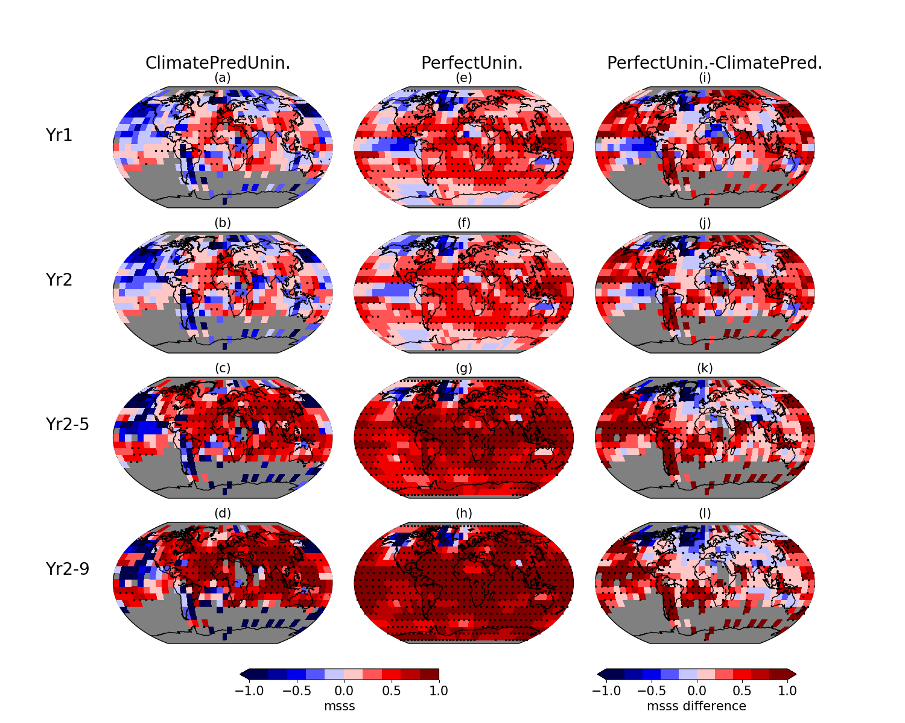
MSSS un-initialized real-world and perfect-model predictions
[inconsistencies model vs. obs?]

Slide 9
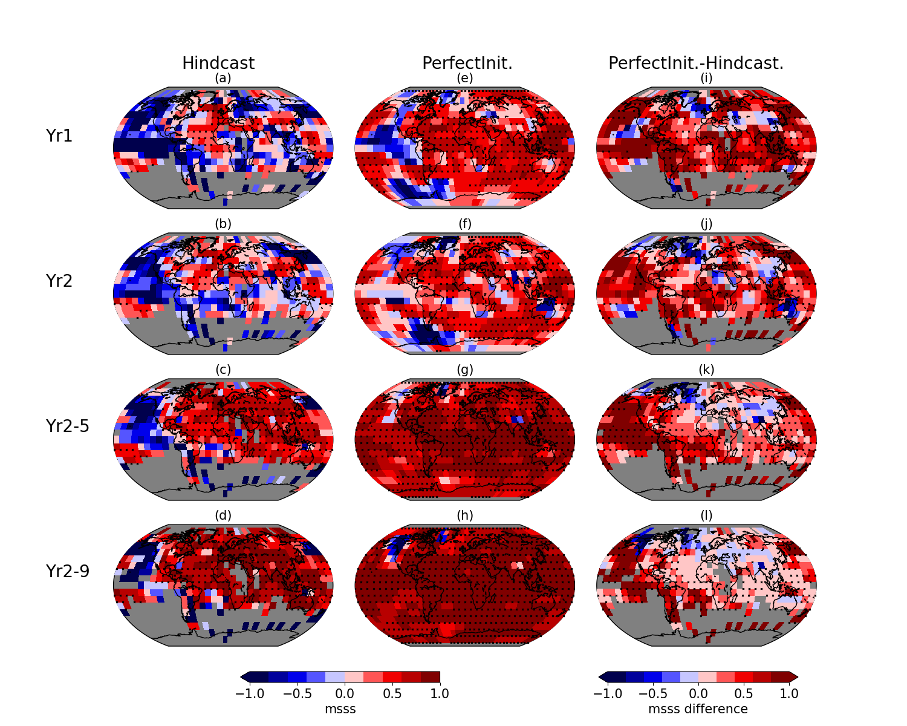
MSSS initialized real-world hindcasts and perfect-model prediction
[total margin of possible improvement?]

Slide 10
Compare areas with increased/decreased skill
 | Lead year | Significant improvement (p<0.1) | Significant negative difference
Initialized perfect model vs ‘uninitialized’ perfect model | 1 | 35% | --
 | 2 | 15% | 5%
 | 2-5 | -- | 12%
 | 2-9 | 13% | 9%
Uninitialized perfect model vs uninitialized climate predictions | 1 | 29% | --
 | 2 | 27% | --
 | 2-5 | 45% | --
 | 2-9 | 44% | 5%
Initialized perfect model vs decadal hindcasts | 1 | 48% | --
 | 2 | 29% | --
 | 2-5 | 61% | --
 | 2-9 | 54% | --
Effect of initialisation

Slide 11
Compare areas with increased/decreased skill
 | Lead year | Significant improvement (p<0.1) | Significant negative difference
Initialized perfect model vs ‘uninitialized’ perfect model | 1 | 35% | --
 | 2 | 15% | 5%
 | 2-5 | -- | 12%
 | 2-9 | 13% | 9%
Uninitialized perfect model vs uninitialized climate predictions | 1 | 29% | --
 | 2 | 27% | --
 | 2-5 | 45% | --
 | 2-9 | 44% | 5%
Initialized perfect model vs decadal hindcasts | 1 | 48% | --
 | 2 | 29% | --
 | 2-5 | 61% | --
 | 2-9 | 54% | --
Inconsistencies
Model - observations

Slide 12
Compare areas with increased/decreased skill
 | Lead year | Significant improvement (p<0.1) | Significant negative difference
Initialized perfect model vs ‘uninitialized’ perfect model | 1 | 35% | --
 | 2 | 15% | 5%
 | 2-5 | -- | 12%
 | 2-9 | 13% | 9%
Uninitialized perfect model vs uninitialized climate predictions | 1 | 29% | --
 | 2 | 27% | --
 | 2-5 | 45% | --
 | 2-9 | 44% | 5%
Initialized perfect model vs decadal hindcasts | 1 | 48% | --
 | 2 | 29% | --
 | 2-5 | 61% | --
 | 2-9 | 54% | --
Overall possible improvement
If perfect-model skill was achievable

Slide 13
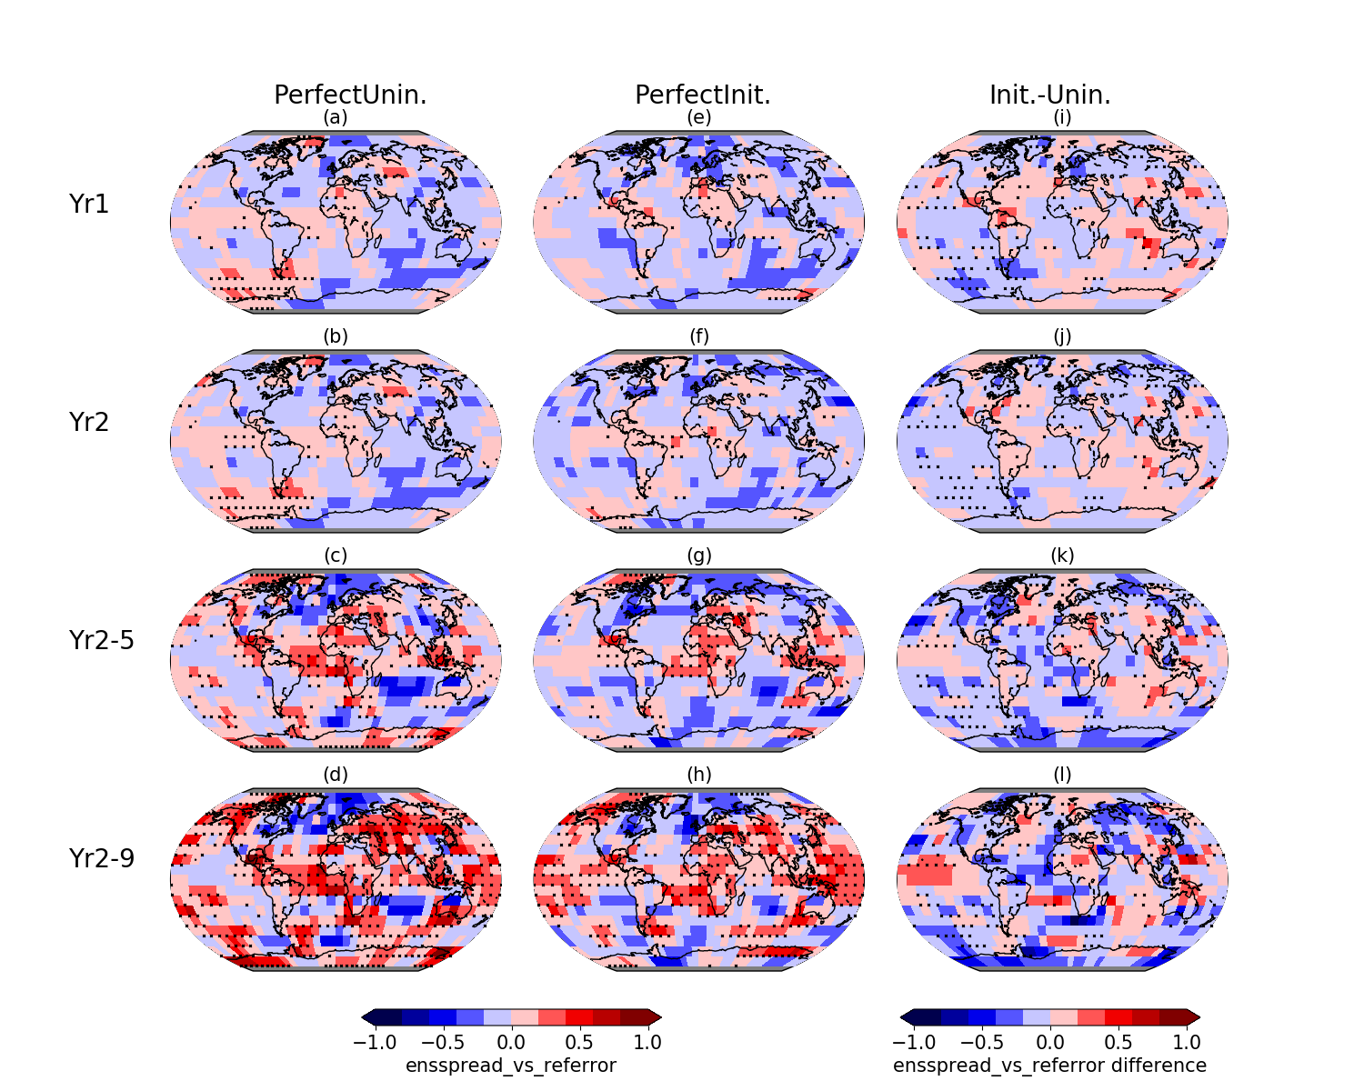
LESS in initialized and un-initialized perfect-model predictions
[no clear effect from initialization!]

Slide 14
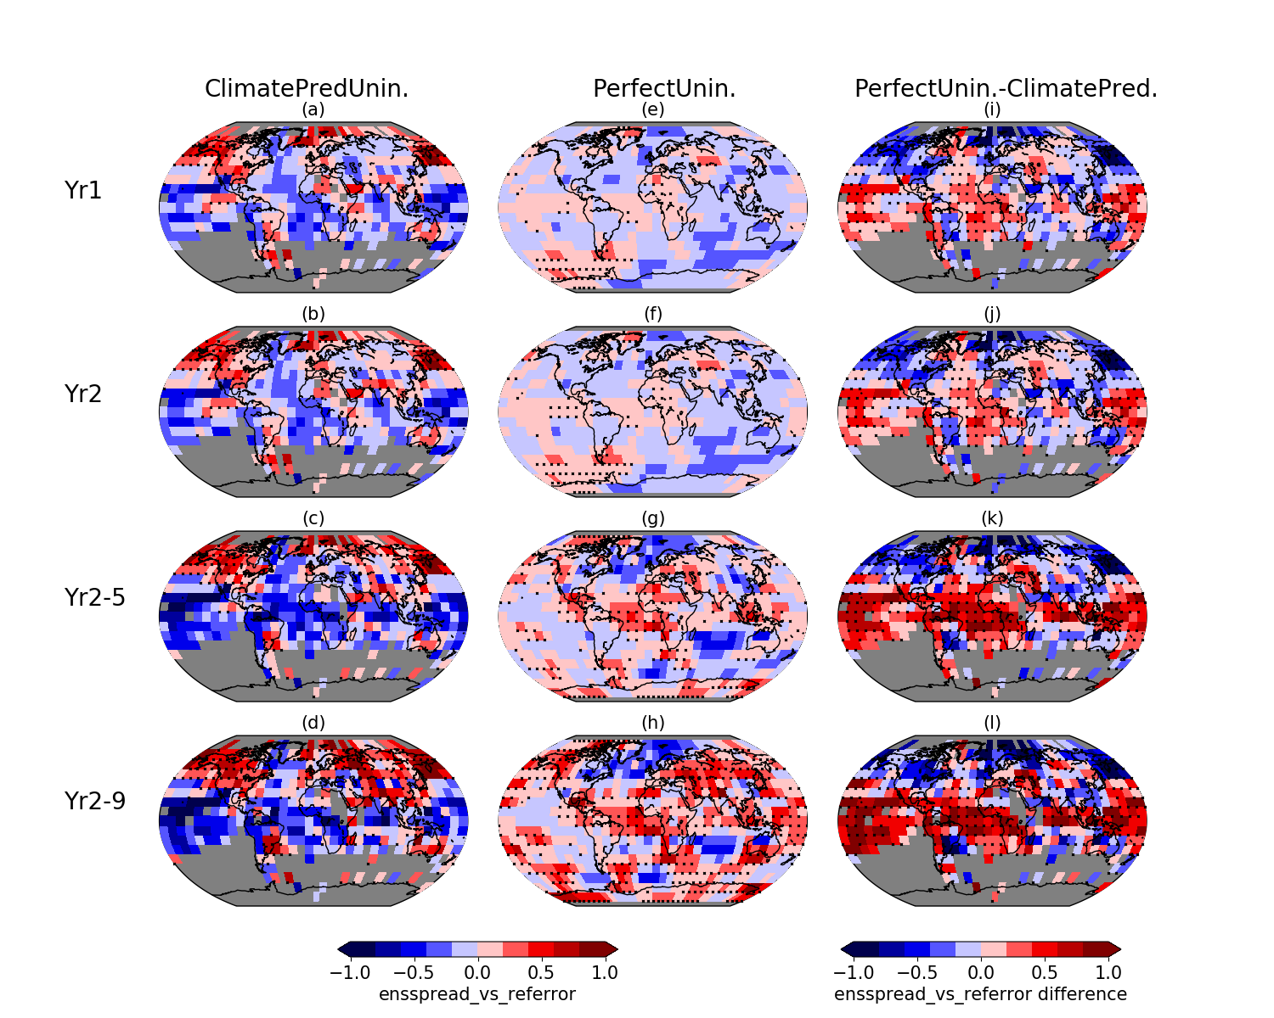
LESS un-initialized real-world and perfect-model predictions
[inconsistencies model vs. obs?]

Slide 15
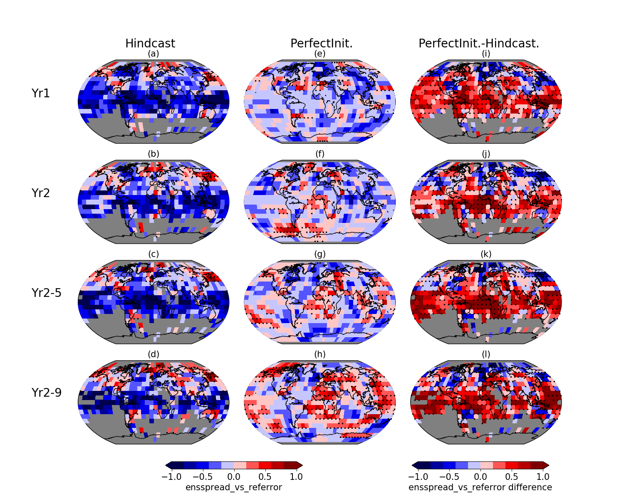
LESS initialized real-world hindcasts and perfect-model prediction
[pattern/differences very similar between initialized/un-initialized]

Slide 16
Summary + Concluding thoughts
perfect-model experiments can be useful to determine the limits of achievable prediction skill (illustrated for tas, but similarly applicable to other variables…)
Helps to better understand predictability (initialisation versus external forcing), and to manage expectations
Added value from initialisation until ~2-3 years forecast time
(ideal) initialisation does not appear to affect ensemble dispersion
Run similar experiments with different models to understand in how far predictability patterns are model-dependent
→ run such perfect-model predictions complementary to DCPP-A real-world hindcasts??!
[Caveat: predictability of real world may be different to predictability within model
missing key processes? Improved models more/less predictable?
→ Perfect-model benchmark informs us what skill is achievable with our existing models (the same used to make predictions!) given ideal initialisation ]
(Larger ensemble sizes to e.g. better estimate robustness of skill differences, reliability, etc.)

Slide 17
Thank you
Liu, Donat, Taschetto, Doblas-Reyes, Alexander, England: A framework to determine the limits of achievable skill for interannual to decadal climate predictions, JGR-Atmosphere (revised)
markus.donat@bsc.es
EUCP is funded by the European Union under Horizon 2020 Grant Agreement no. 776613

