Slide 1
Seasonal wind predictions for the energy sector
Llorenç Lledó
llledo@bsc.es

Slide 2
Context and motivation
A future with higher penetration of renewables
Renewable energy:
essential to reduce GHG emissions
largely impacted by climate variations
Understand climate variability.
Anticipate changes.
Build resilience.

Slide 3
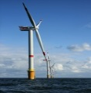
CLIM4ENERGY (SIS energy)
Weather forecast
Climate predictions
Climate projections or multidecadal
Sub-seasonal
Seasonal
Decadal
1-15 days
10 d-1 month
1 month–2 years
2-30 years
20-100 years
Time
wind/solar/hydro generation
transmission
demand
offshore assets
bioenergy

Slide 4
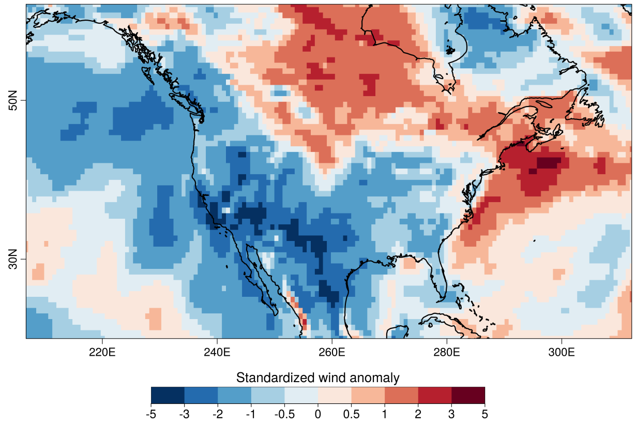
2015 US wind drought
“US clean energy suffers from lack of wind”
Financial Times, September 2015.
“El Niño Buffers U.S. Wind Power Dreams”
Wall Street Daily, September 2015.
“El Niño blowing down wind projections in US”
Fierce Energy, July 2015.
Q1 2015
“We never anticipated a drop-off in the wind resource as we have witnessed over the past six months”
David Crane, RNG, September 2015.

Slide 5
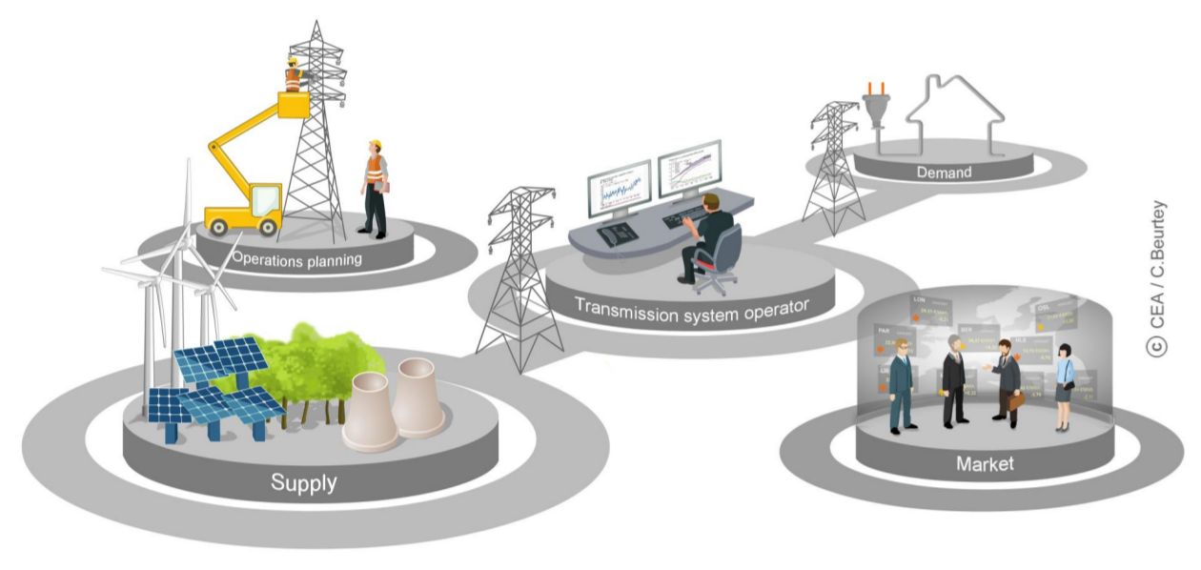
Potential applications
O&M planning
Balance supply
and demand
Energy trading
Cash flow anticipation
Notes:
We want to serve society. We want to identify problems. First identify stakeholders.

Slide 6
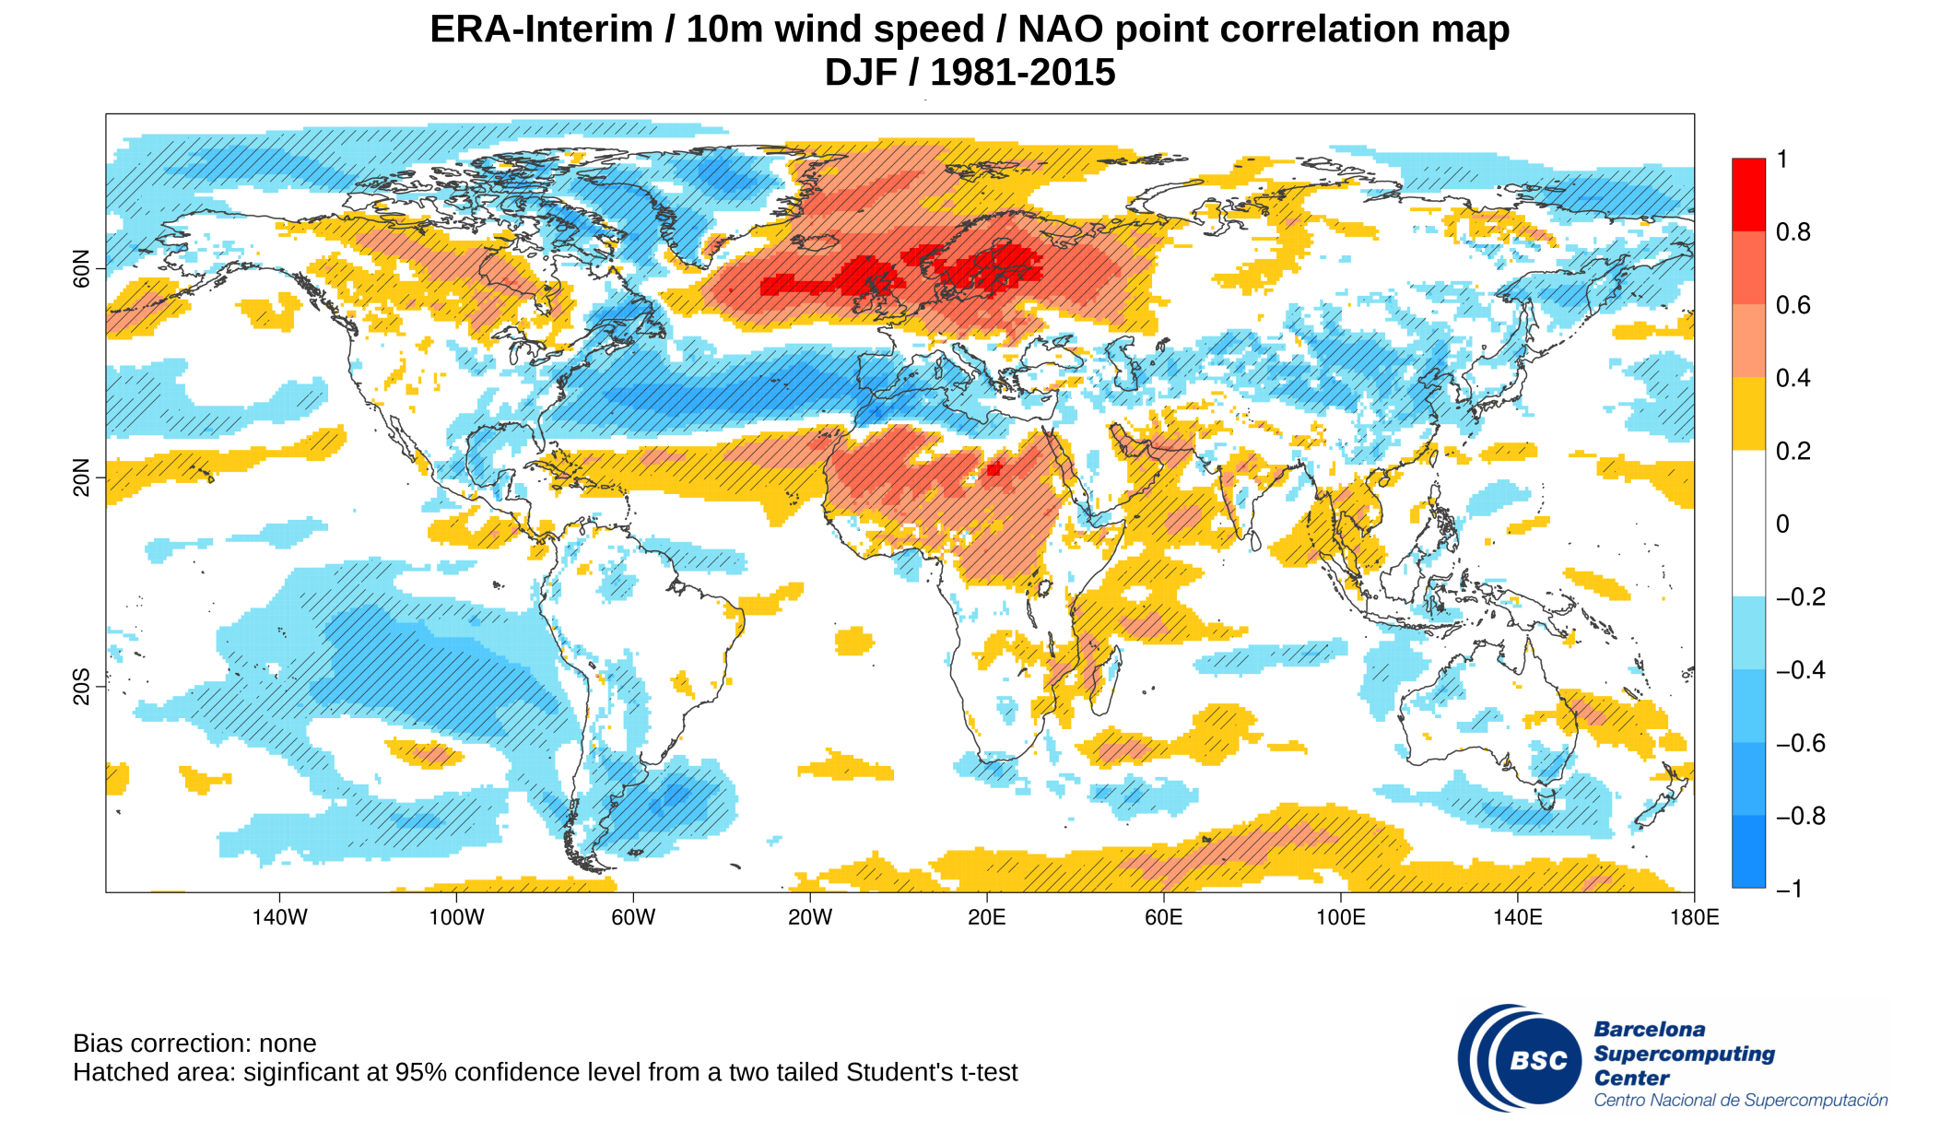
Impact of NAO

Slide 7
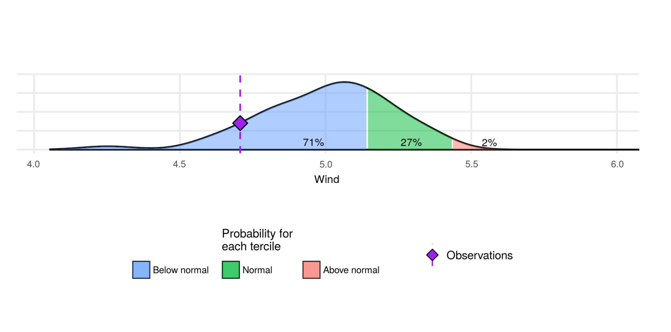
Seasonal forecasts of wind speed
QUESTION
ANSWER
Will the coming season be:
less windy than normal?
normal?
more windy than normal?
Bias adjust/calibrate model output
Average whole season
Distribute the ensemble members into 3 categories
Compute probabilities
Notes:
A simple example of what we can do.

Slide 8
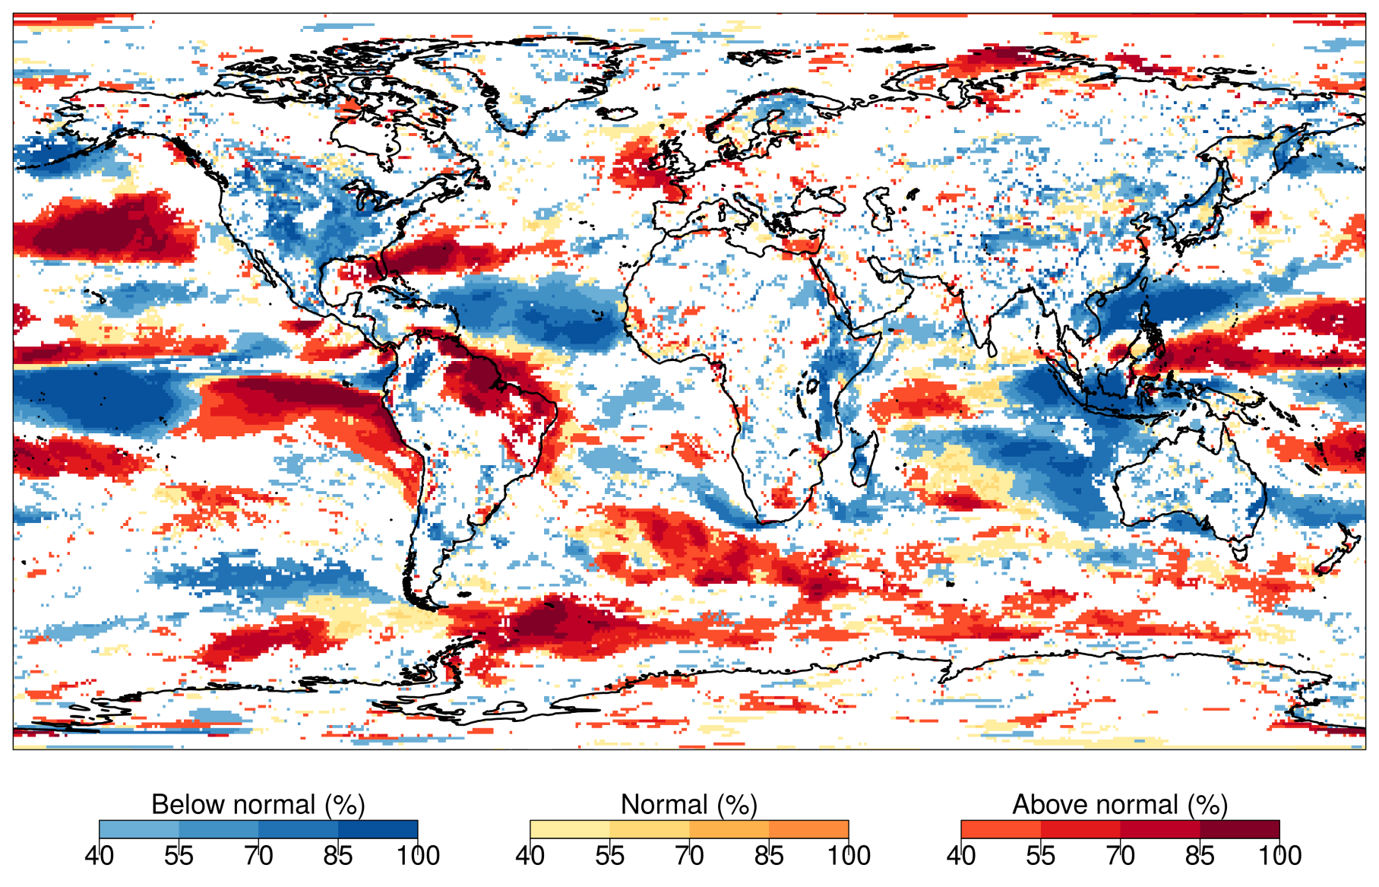
Presenting probabilistic information
Wind speed forecast for DJF 2015/16
(ECMWF System4)
Displaying:
category with more probability to occur
its probability
negative skill masked

Slide 9
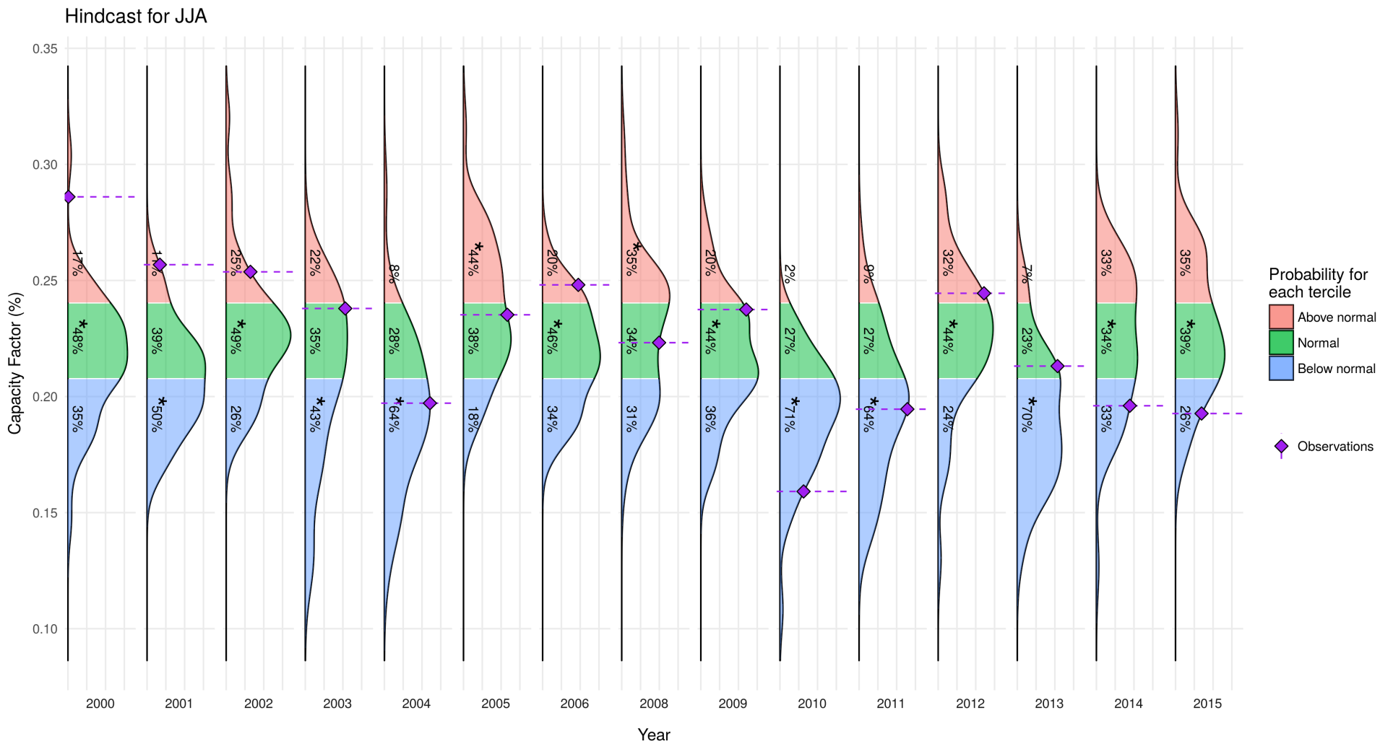
Hindcast
Retrospective forecasts for JJA at Site1 (2000-2015)
CRPSS = -0.01
RPSS = 0.08
EnsCorr = 0.44

Slide 10
Skill Assessment
Ranked Probability Skill Score
Season: DJF
Hindcast: 1981-2013
Source: ECMWF S4
Obs: ERA-Interim
Bias adj.: Calibration
Metric: RPSS
“A prediction has no value without an estimate of forecasting skill based on past performance”

Slide 11
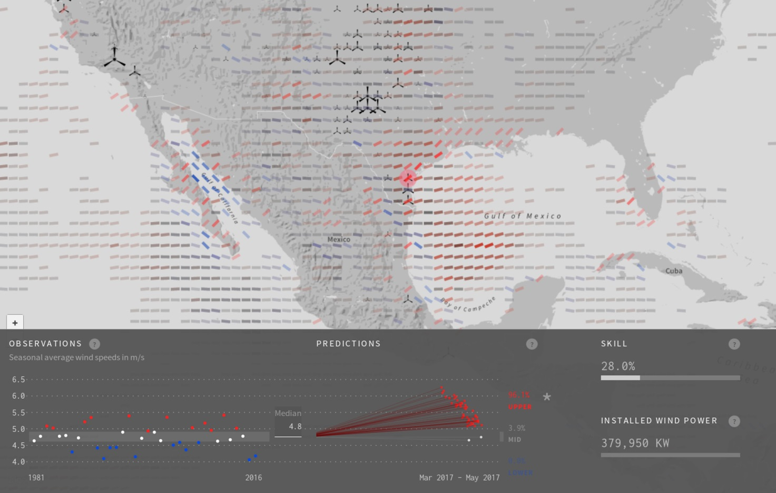
RESILIENCE prototype
http://www.bsc.es/ess/resilience/

Slide 12
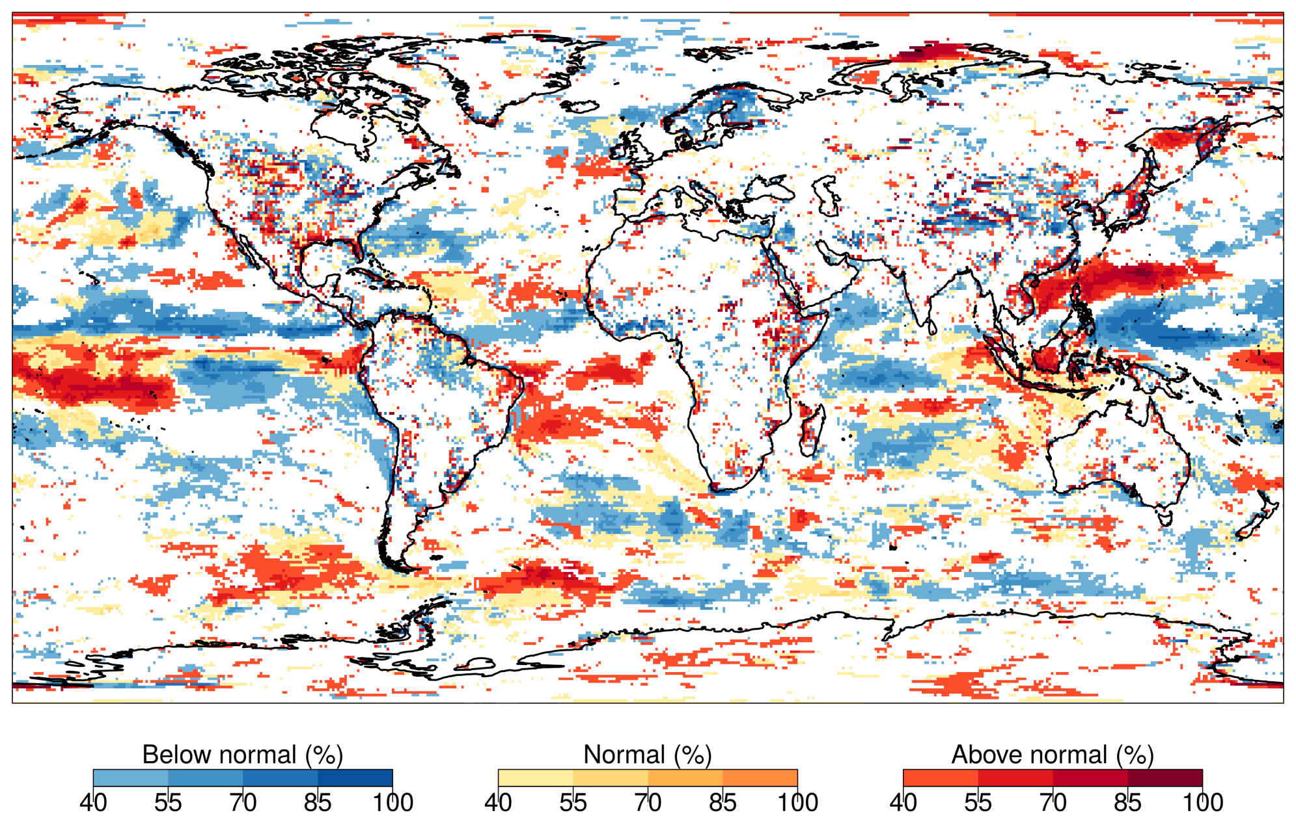
DJF 2017/18 forecast

Slide 13
Stay tuned: S2S4E
Qualitative estimate of forecast skill based on forecast range from short-range weather forecasts to long-range seasonal predictions, including potential sources of predictability. Relative skill is based on differing forecast averaging periods. (Source: White et al., 2017 )

Slide 14
Seasonal wind predictions for the energy sector
Llorenç Lledó
llledo@bsc.es

Slide 15
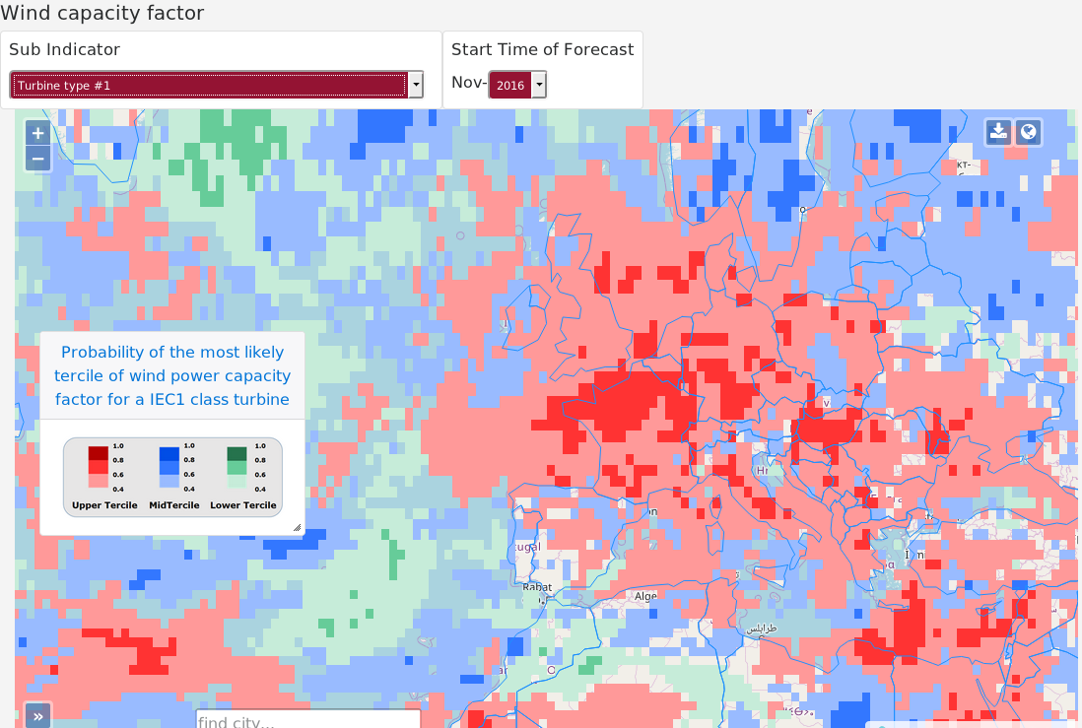
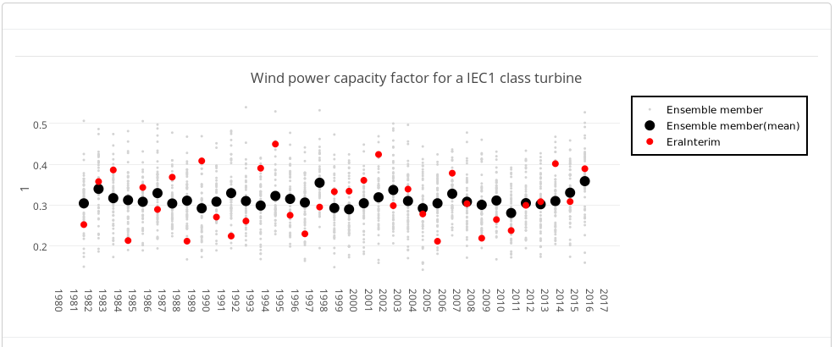
CLIM4ENERGY Prototype

Slide 16
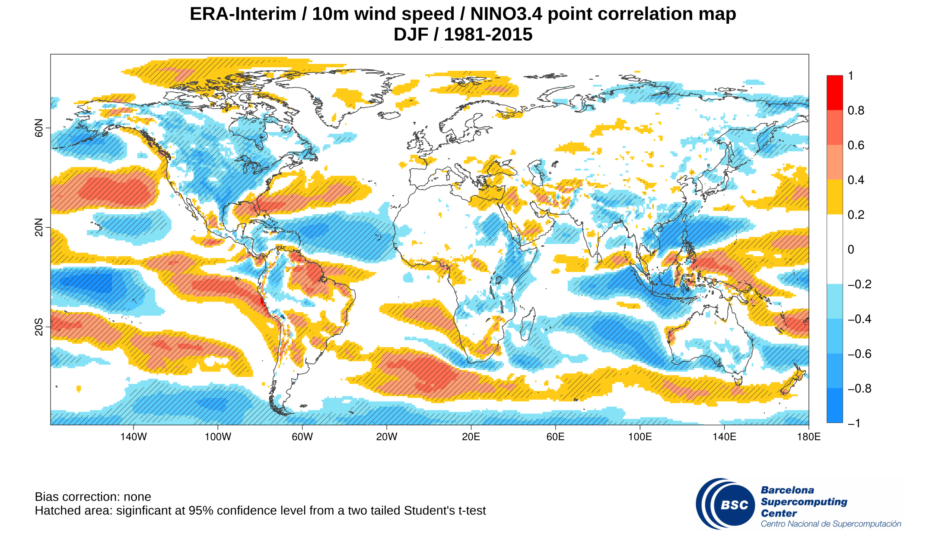
Impact of ENSO

Slide 17
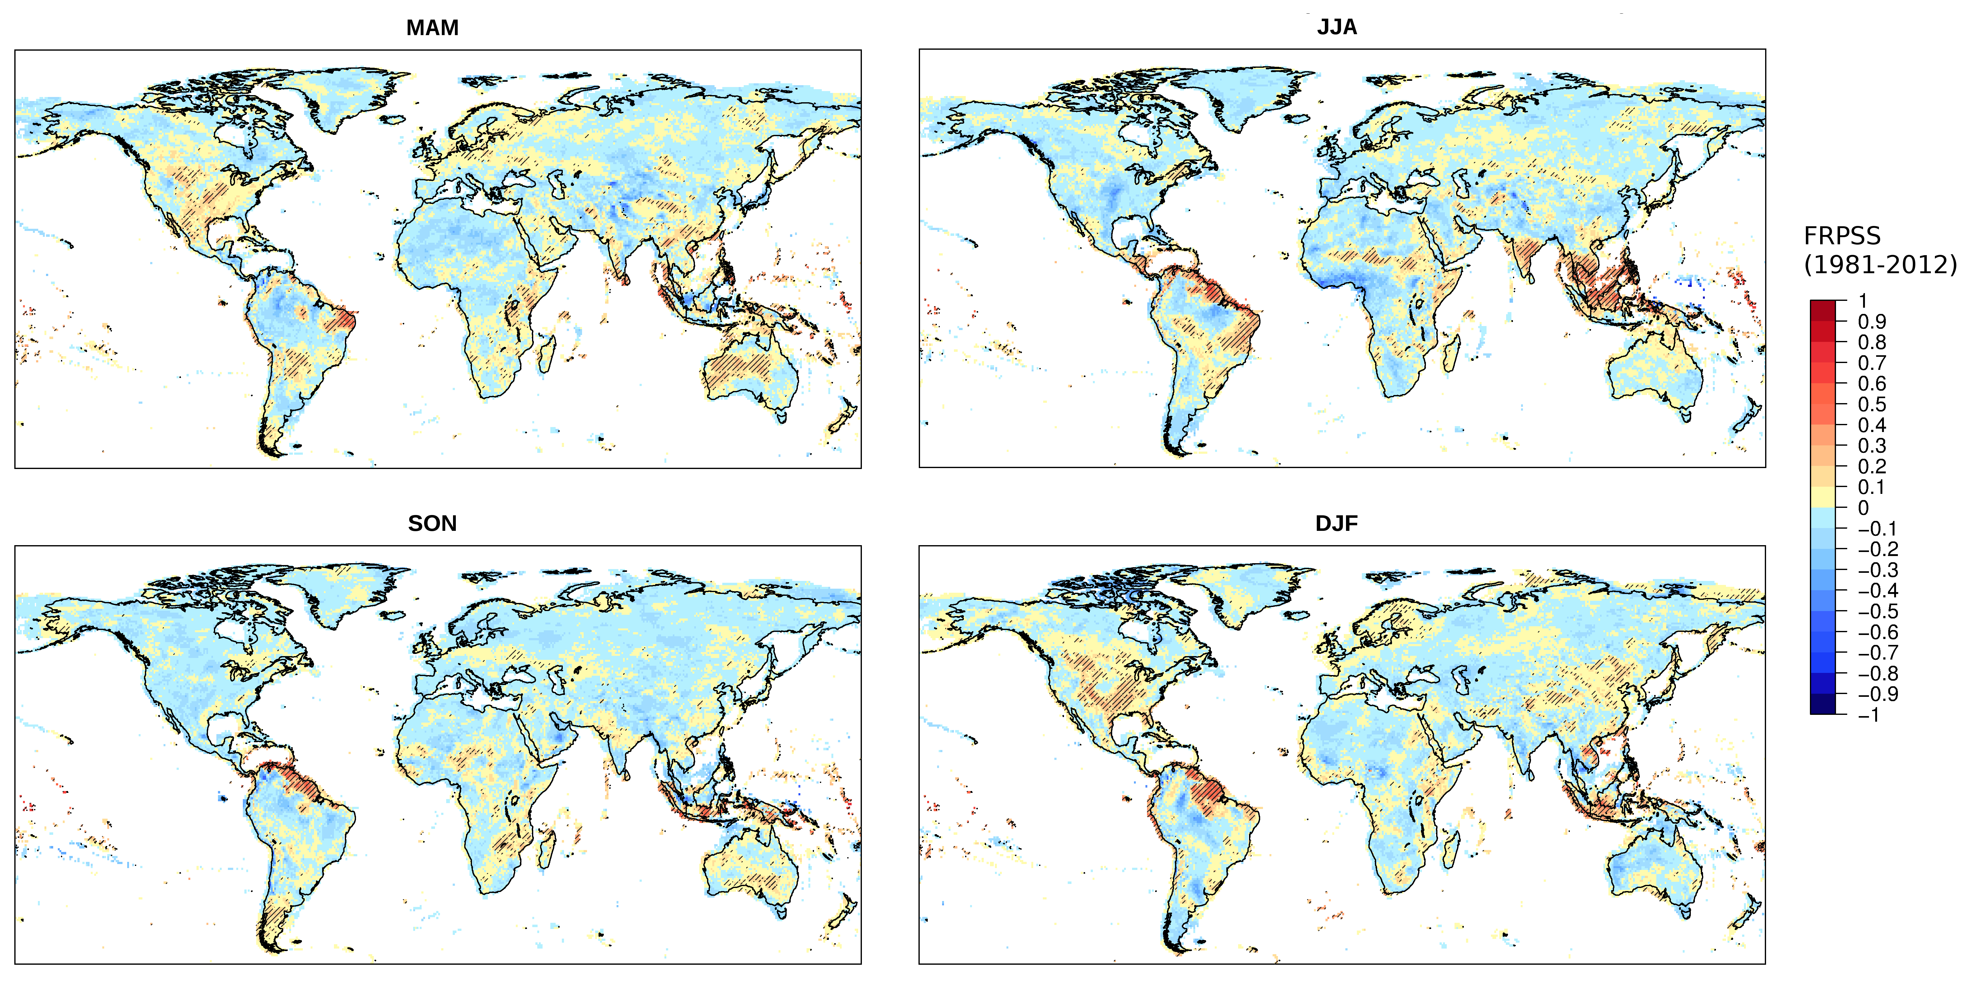
RPSS by season

Slide 18
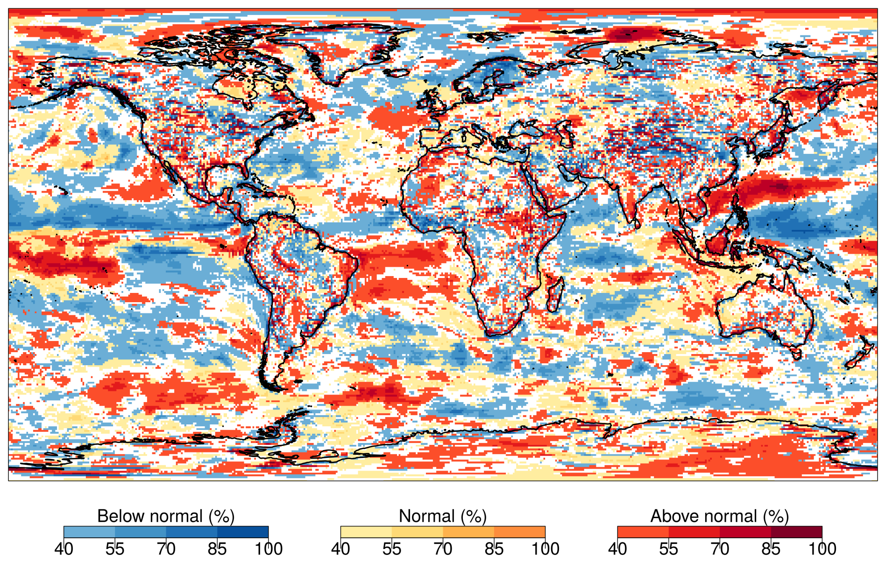
DJF 2017/18 - no mask

