Slide 1
WMO SDS-WAS: TOWARDS CONTINUOUS EVALUATION OF DUST MODELS IN NORTHERN AFRICA
S. Basart¹, G. García-Castrillo², E. Terradellas² and E. Cuevas³
¹Earth Sciences Department, BSC, Barcelona, Spain
²AEMET, Barcelona, Spain
³CIAI-AEMET, Tenerife, Spain
8th International Workshop on Sand/Duststorms and Associated Dustfall Lisbon, Portugal, 2-4 May, 2016
Notes:
I am going to present the developments undertaken at the Earth Sciences Department concerning the modelization of aerosol and chemistry processes inlined within a meteorological model and the latest SDS-WAS NAMEE RC activities.

Slide 2
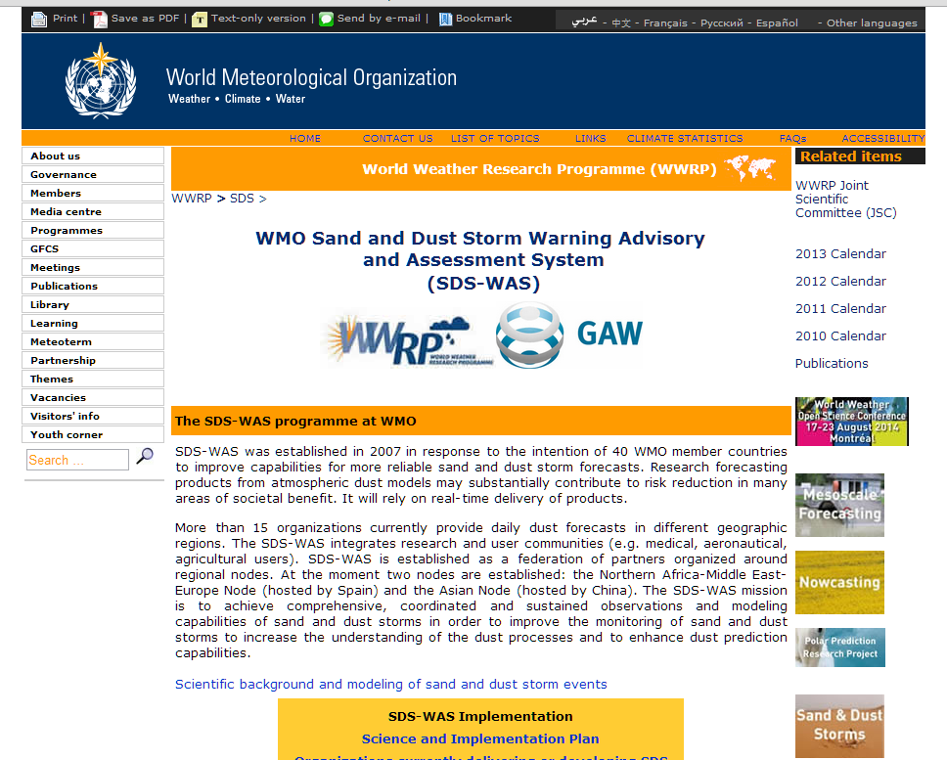
SDS-WAS (http://www.wmo.int/sdswas)
OBJECTIVES:
Identify and improve products to monitor and predict atmospheric dust by working with research and operational organizations, as well as with users
Facilitate user access to information
Strengthen the capacity of countries to use the observations, analysis and predictions provided by the WMO SDS-WAS project

Slide 3
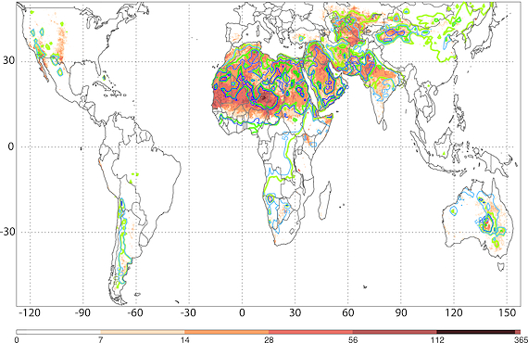
SDS-WAS Regional Centers
ASIAN
PAN AMERICAN
NA-ME-E
Regional Center in Barcelona (Spain)
Extracted from Ginoux et al. (2012, Rev. Geophys.)

Slide 4
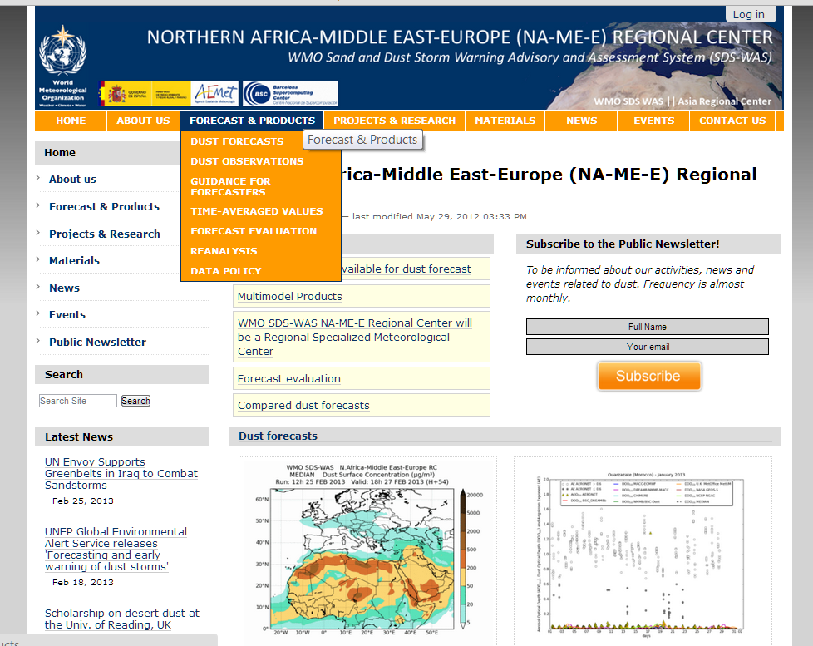
SDS-WAS NA-ME-E RC (http://sds-was.aemet.es)
FORECAST AND PRODUCTS
Data exchange
Joint visualization
Common forecast evaluation
Generation of multi-model products
Calculation of monthly evaluation metrics
New sources of data for model evaluation
Sharing model output data files
Time-averaged products
sdswas@aemet.es

Slide 5
Dust Forecasts
Dust prediction models provide 72 hours (at 3-hourly basis) of dust forecast (AOD at 550nm and surface concentration) covering the NAMEE region.

Slide 6
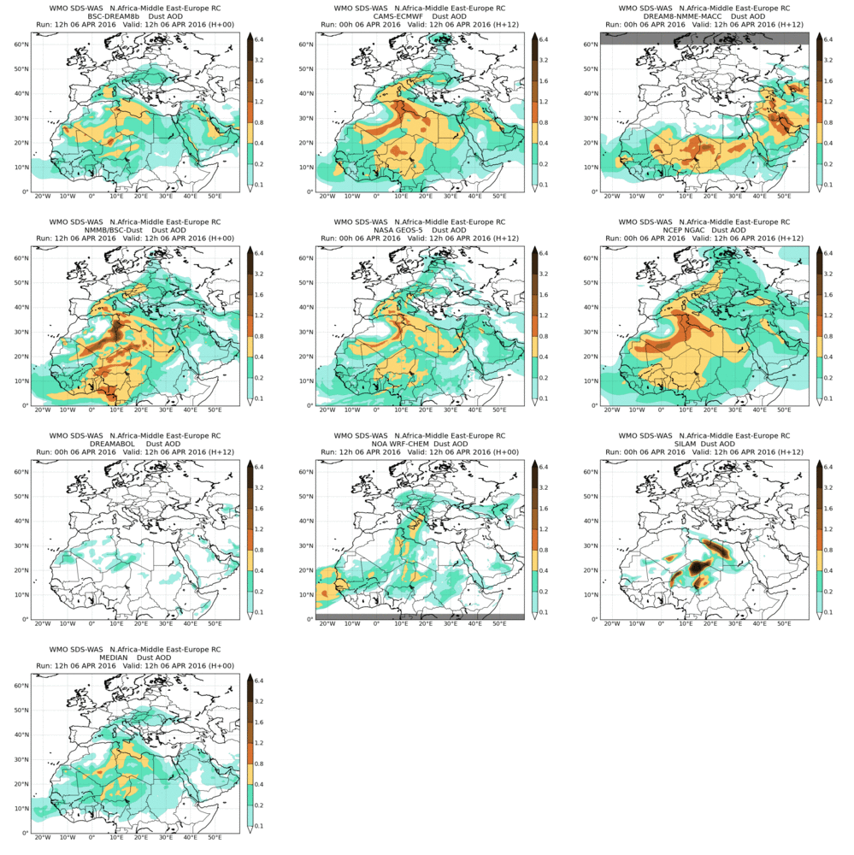
DOD joint visualization
AOD at 550nm
from 6-Apr-2016 12:00 to 9-Apr-2016 00:00

Slide 7
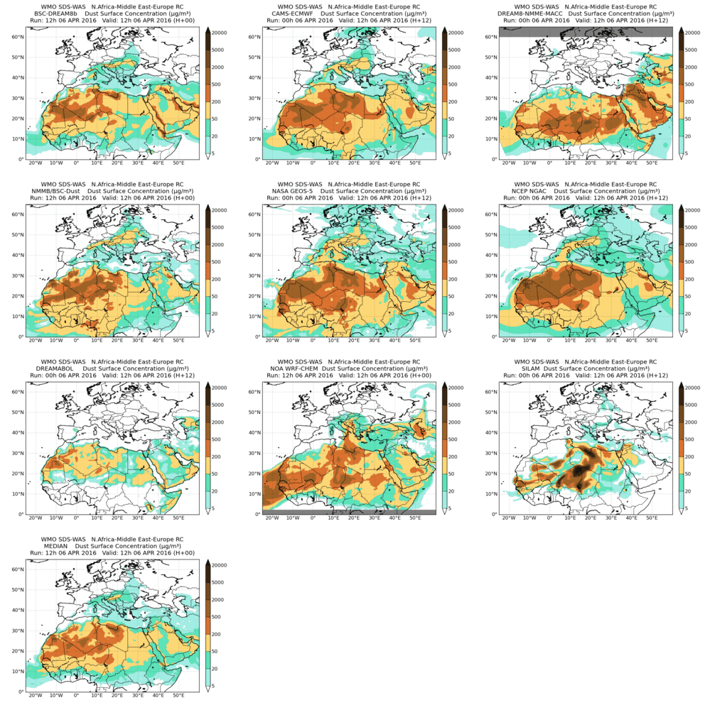
Surface concentration joint visualization
Surface concentration
from 6-Apr-2016 12:00 to 9-Apr-2016 00:00

Slide 8
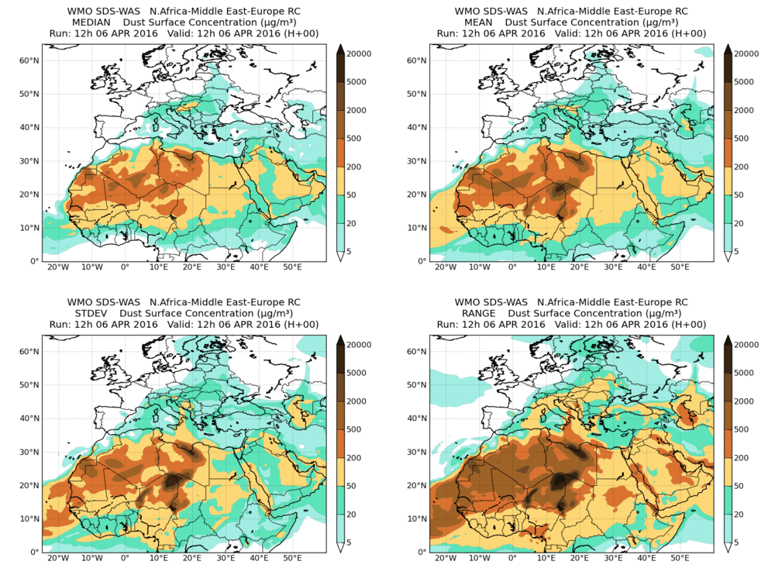
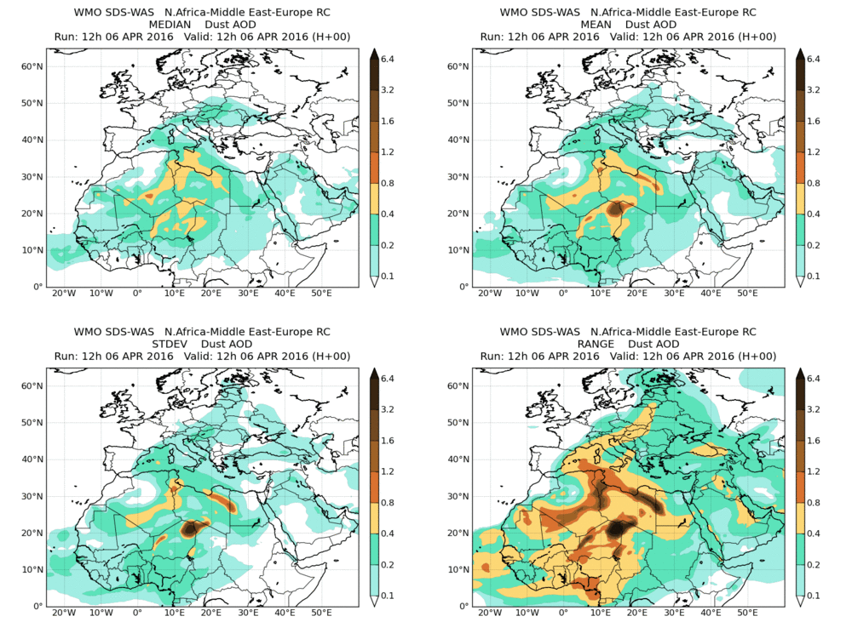
Generation of multi-model products
Surface concentration
DOD at 550nm
from 6-Apr-2016 12:00 to 9-Apr-2016 00:00
Model outputs are bi-linearly interpolated to a common 0.5ºx0.5º grid mesh. Then, different multi-model products are generated:
CENTRALITY: median - mean
SPREAD: standard deviation – range of variation

Slide 9
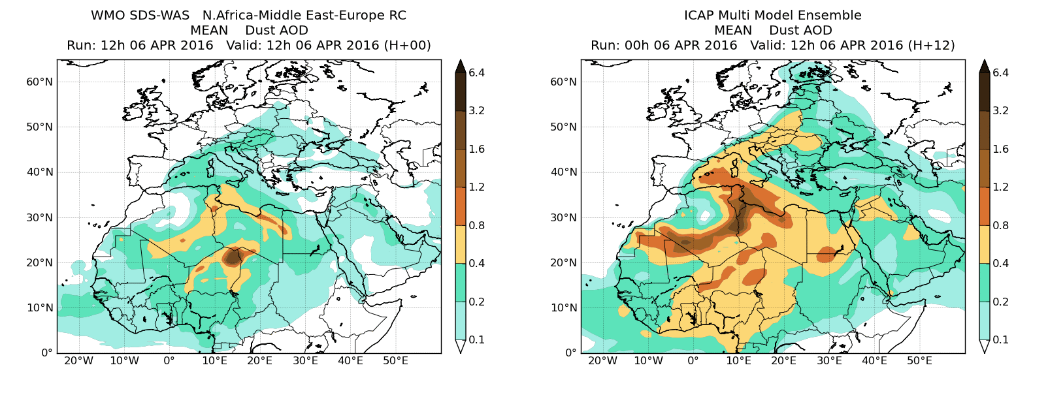
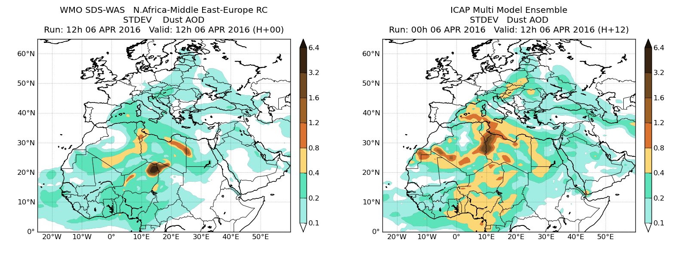
DOD comparison with ICAP-MME model
SDS-WAS
ICAP-MME (Only global models)
from 6-Apr-2016 12:00 to 9-Apr-2016 00:00
ICAP-MME (Sessions et al., 2014, ACP)

Slide 10
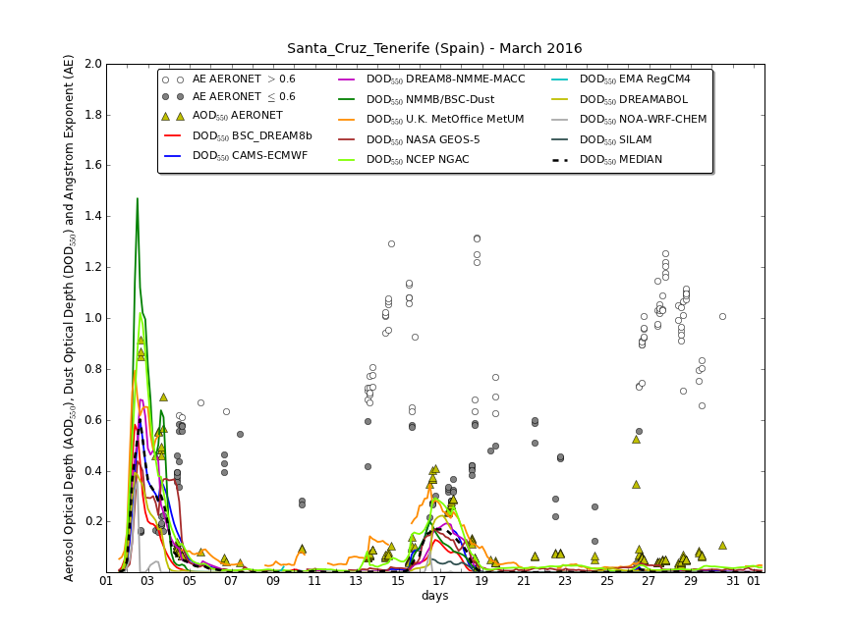
NRT Evaluation using AERONET

Slide 11
Evaluation using AERONET
A set of evaluation metrics are selected: Bias, RMSE, correlation coefficient and FGE
Calculations evaluation metrics are done for:
monthly/seasonal/annual
sites and regions
Notes:
Pel mes vinent s’inclouran 3 regions africa, orient mitjà i mediterrani

Slide 12
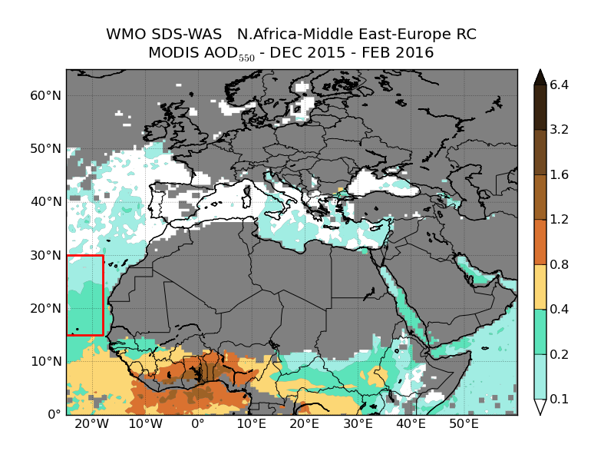
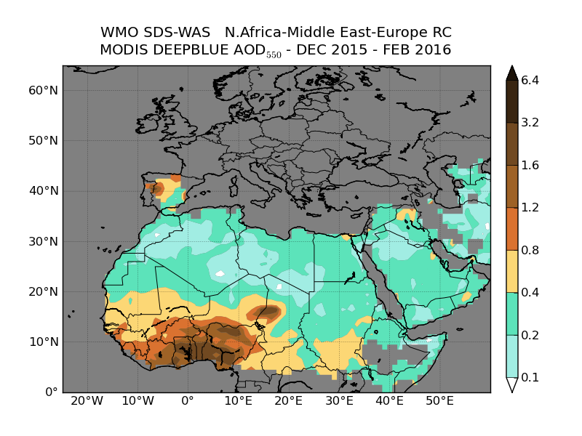
Evaluation using MODIS
Notes:
MODIS
Daily level 3 product
Collection 5.1 → Col. 6 (1 Dec 2014) 1 x 1 deg. Resolution
Angstrom exp. < 1.0

Slide 13
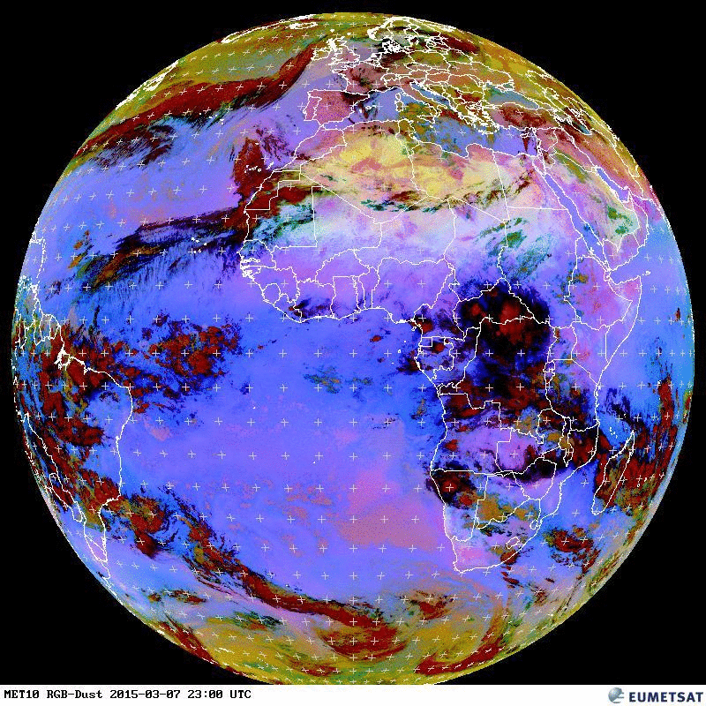
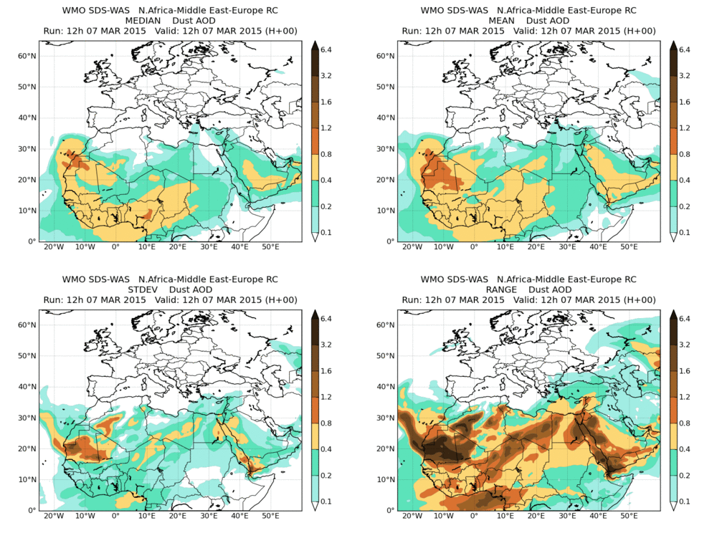
NRT Evaluation using satellite aerosol products
7 March 2015
New observational datasets for model evaluation in Northern Africa

Slide 14
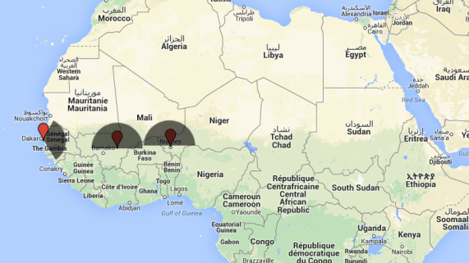
PM10 evaluation using AMMA sites: 2013
Not all PM10 is dust: Local and biomass burning from Savannah fires.
Dust filter: Considering the localizations of the desert dust sources the filter is based on wind direction.
AMMA (Marticorena et al., 2010)
Notes:
The SDS-WAS models are able to reproduce the seasonal dust cycle observed at ground levels with higher underestimations during summertime where haboobs are frequent.

Slide 15
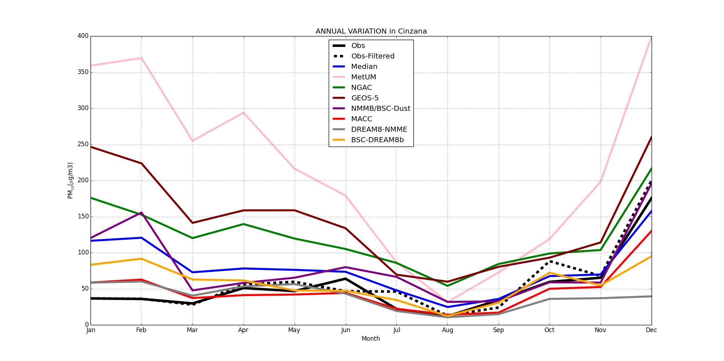
PM10 evaluation using AMMA sites: 2013
AMMA (Marticorena et al., 2010)
Notes:
The SDS-WAS models are able to reproduce the seasonal dust cycle observed at ground levels with higher underestimations during summertime where haboobs are frequent.

Slide 16
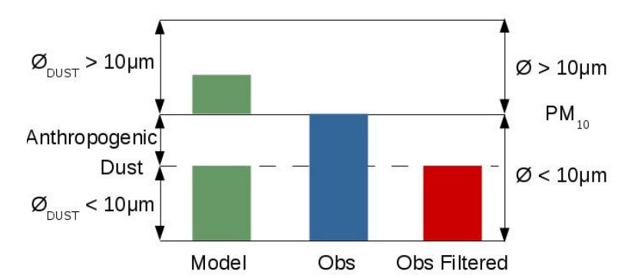
PM10 evaluation using AQ networks: Canary Islands
Not all PM10 is dust: Local sources
Dust filter: Moving 40th percentile of 30 days, 15 days before and 15 days after (Escudero at al. 2007).

Slide 17
PM10 evaluation using AQ networks: 2013-2014

Slide 18
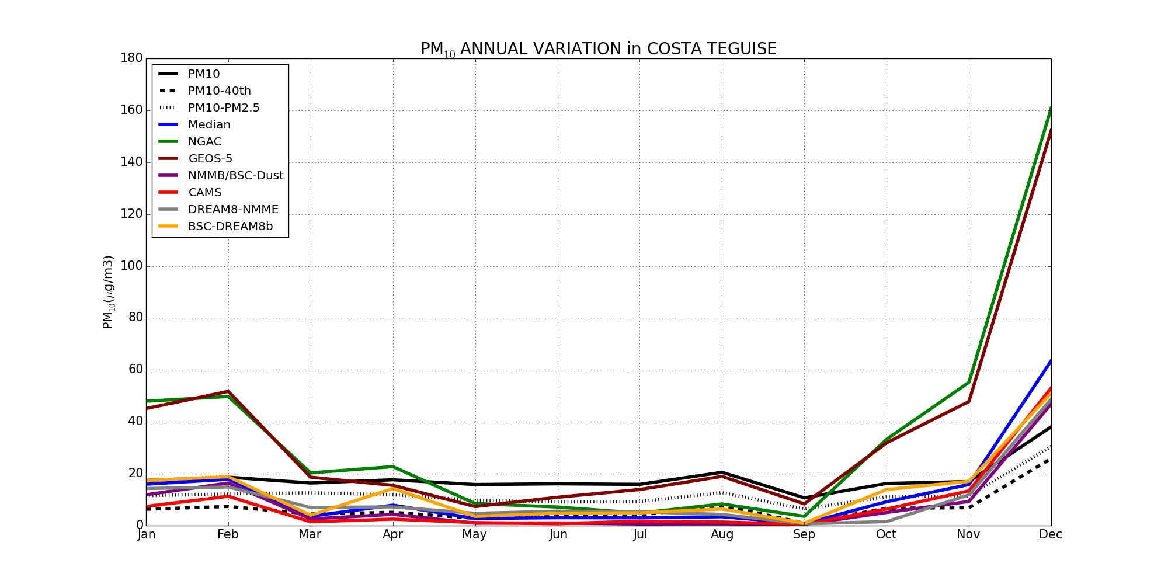
PM10 evaluation using AQ networks: 2013-2014

Slide 19
PM10 evaluation using AQ networks: 2013-2014

Slide 20
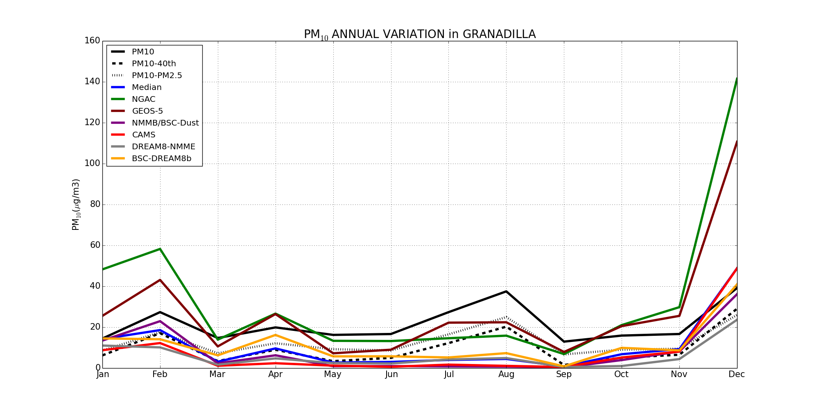
PM10 evaluation using AQ networks: 2013-2014

Slide 21
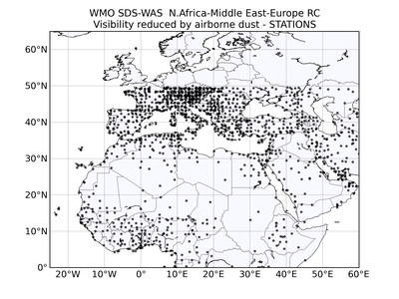
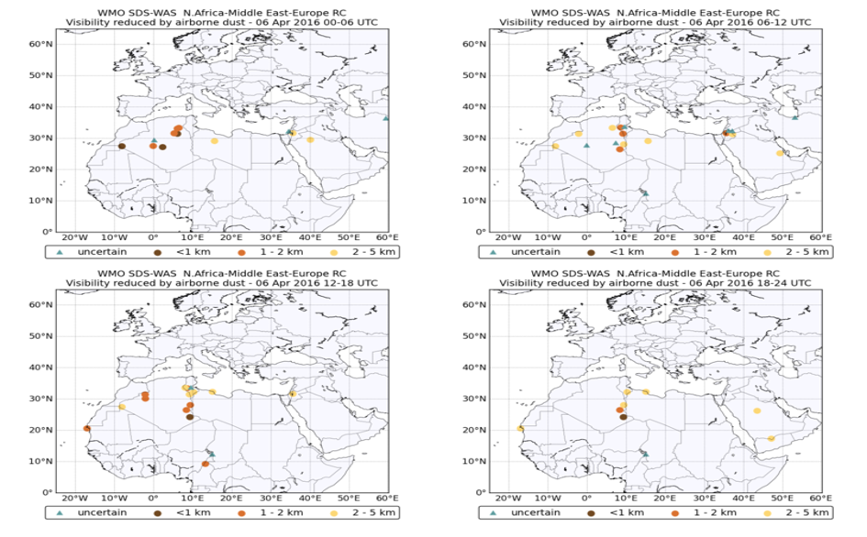
NRT visibility from METAR and SYNOP: 6-hourly reports

Slide 22
NRT visibility evaluation: 6th April 2016 0-12UTC

Slide 23
NRT Visibility evaluation: 6th April 2016 12-24UTC

Slide 24
NRT Vertical profiles: Tenerife and Dakar
Ceilometer
Santa Cruz de Tenerife (Spain)
Lidar
M’Bour (Senegal)
+ High density of stations
- Qualitatively products
- Low number of stations
+ Quantitative products

Slide 25
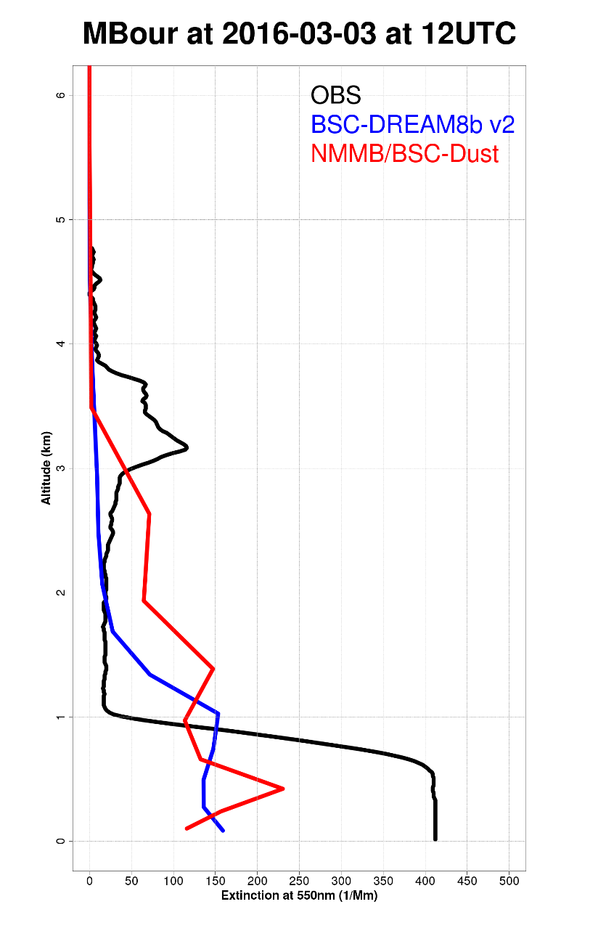
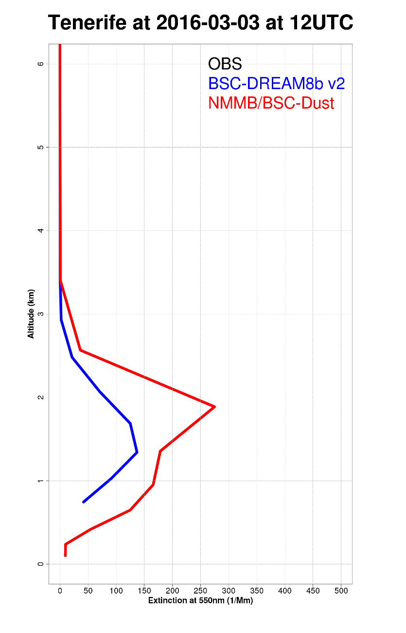
NRT Vertical profiles evaluation: at 12UTC
Notes:
Revise the vertical profiles!!
Incloure el mapes decl model corresponents!

Slide 26
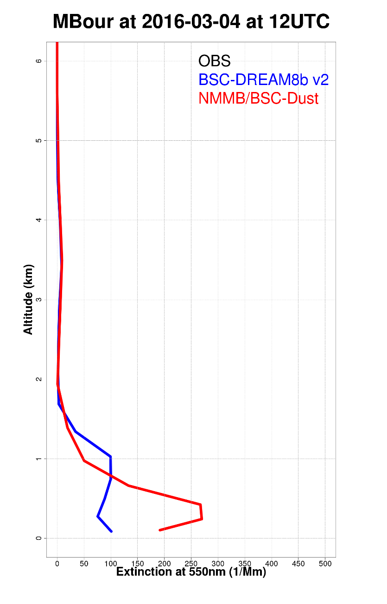
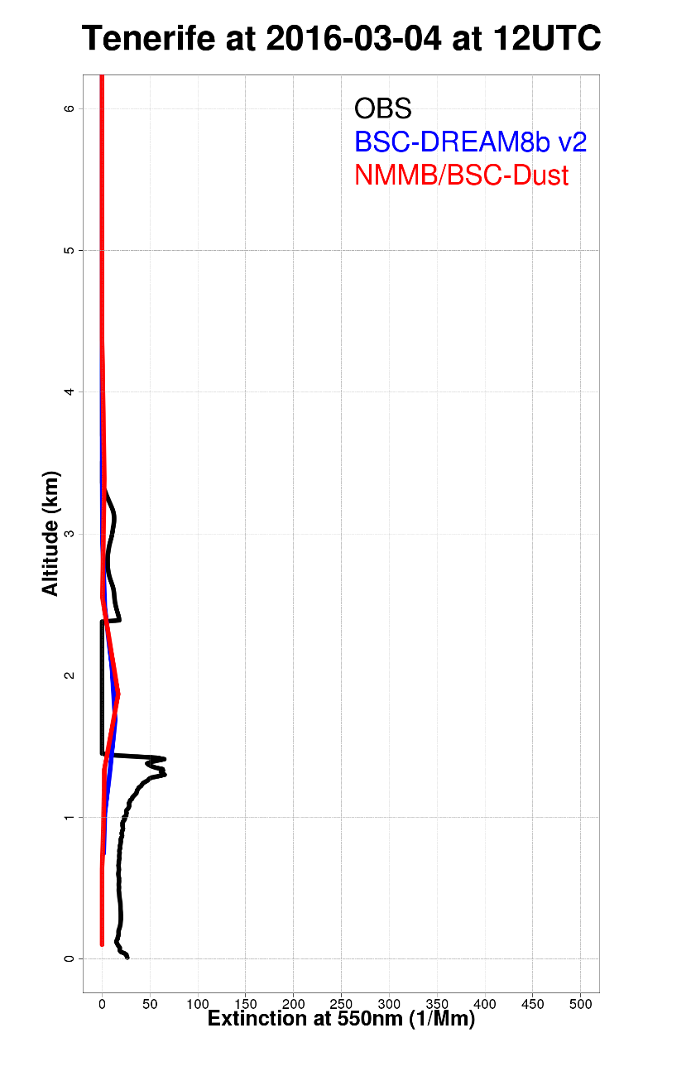
NRT Vertical profiles evaluation: at 12UTC
Notes:
Revise the vertical profiles!!
Incloure el mapes decl model corresponents!

Slide 27
Conclusions
Model evaluation activities (NRT and a posteriori) provide useful information for model developments
The comparison with multi-model products (as that from SDS-WAS NAMEE RC) provides additional information about the state-of-the-art of atmospheric models.
At present, there is a lack of ground-based mineral dust observations over North Africa for an accurate model evaluation:
PM10 from AQMS can be used for a preliminary evaluation of surface concentration in NRT
Visibility from METAR and SYNOP stations is a new operational product useful for operational prediction and model verification
Vertical aerosol products from lidar and ceilometers is starting to be deployed in the NRT evaluation

Slide 28
Barcelona Dust Forecasting Center (http://dust.aemet.es/)
In 2014, the First Specialized Center for Mineral Dust Prediction of WMO is created
NMMB/BSC-Dust selected to provide operational forecasts for NAMEE region
http://dust.aemet.es/
@Dust_Barcelona
Notes:
ECMWF petition: use MACC as initial conditions

Slide 29
Thank you!
Acknowledgements:
The authors thank Beartrice Marticorena, Philippe Goloub and Canary Government as well as
AERONET, MODIS, U.K. Met Office MSG, MSG Eumetsat and EOSDIS World Viewer principal investigators and scientists for establishing and maintaining data used in the present contribution.
Also special thank to all researchers, data providers and collaborators of the WMO SDS-WAS NA-ME-E Regional Node.
http://sds-was.aemet.es//
sdswas@aemet.es
Notes:
I would like to acknowledge all the people involved in the works done until now on the project, from BSC staff to external international research scientists.

Slide 30
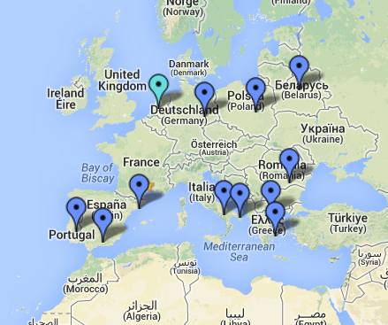
Vertical profiles evaluation: Next steps
BSC-DREAM8b v2
NMMB-BSC/Dust
DREAM8-NMME-MACC
69 dust cases between Jan 2011 – Jun 2013
BOLCHEM
(Binietoglou et al., 2015, ATM)
Notes:
Statistics!

Slide 31
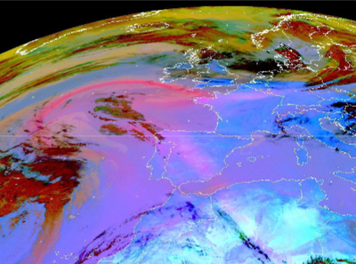
SDS-WAS: Dust outbreak April 2011
The selected dust event corresponds to the one which occurred between the 5th and 11th of April of 2011.
Participating models: BSC-DREAM8b, NMMB/BSC-Dust, ECMWF-MACC, UKMetOffice-UM and NMME-DREAM-MACC
Comparison of each forecast (at 24, 48 and 72h) output to in-situ measurements of AOD (from AERONET), surface concentration (PM) and satellite retrieved AOD (MODIS, CALIPSO) and meteorology.
MSG/SEVIRI RGB product 7 April
Courtesy of EUMETSAT
(Huneeus et al., ACP, 2016)
Notes:
As a contribution to the activities of the SDS-WAS NAMEE node we intend to complement its effort by conducting a case study where different dust forecast models are compared against observations for a given dust event, which occurred in April 2011. We are interested in exploring the differences between the models to simulate different datasets and identify whether this is due to vertical profile, optics, size distribution, removal fluxes, wind fields or other model characteristics or processes. Studying a specific dust event allows to also investigate on higher time frequency of a few hours the capacity of the models to predict the approach of a dust event.

Slide 32
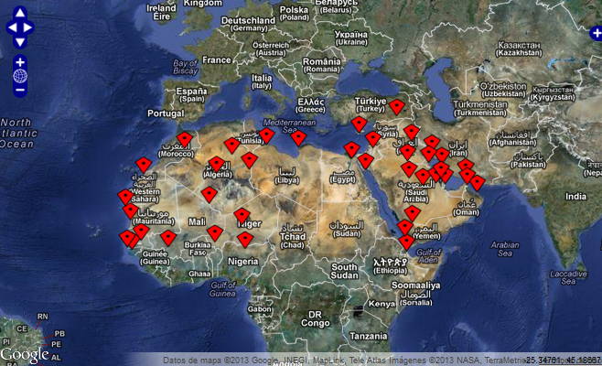
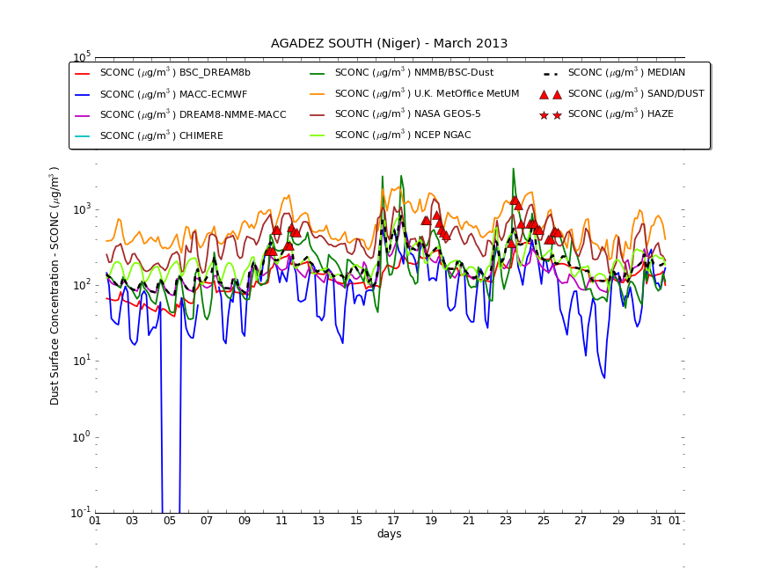
SDS-WAS: Evaluation using VISIBILITY data
AGADEZ SOUTH, Niger
March 2013
PM₁₀ = 1339.84 V^{-0.67}
Ben Mohamed et al. (1992)
PM₁₀ = 1772.24 V^{-1.1}
Camino et al. (2014, Aeolian Res.)

Slide 33
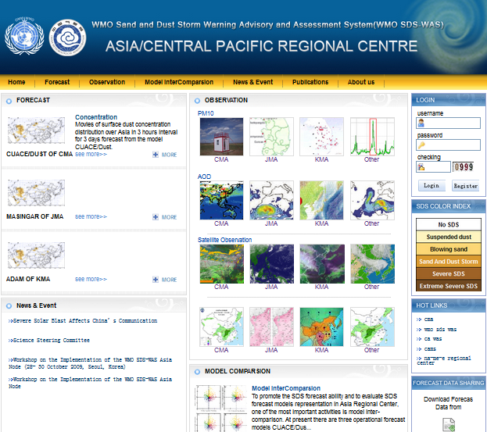
SDS-WAS: Asian RC (http://www.sds.cma.gov.cn)
Notes:
33
according to the WMO SDS-WAS for Asia Second Meeting of the Regional Steering Group
Next talk

Slide 34
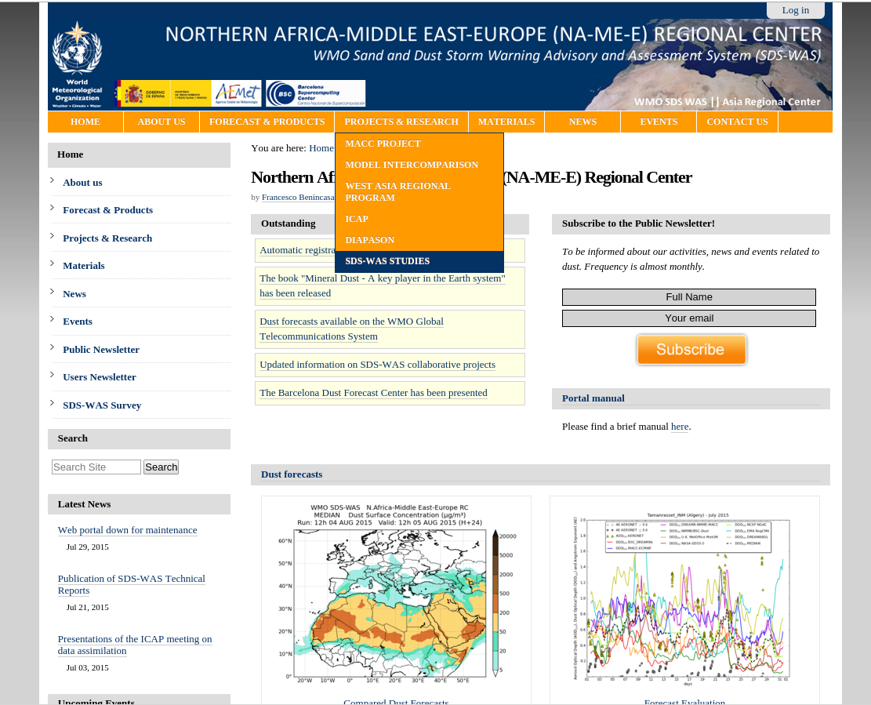
SDS-WAS: Model intercomparison
http://sds-was.aemet.es

Slide 35
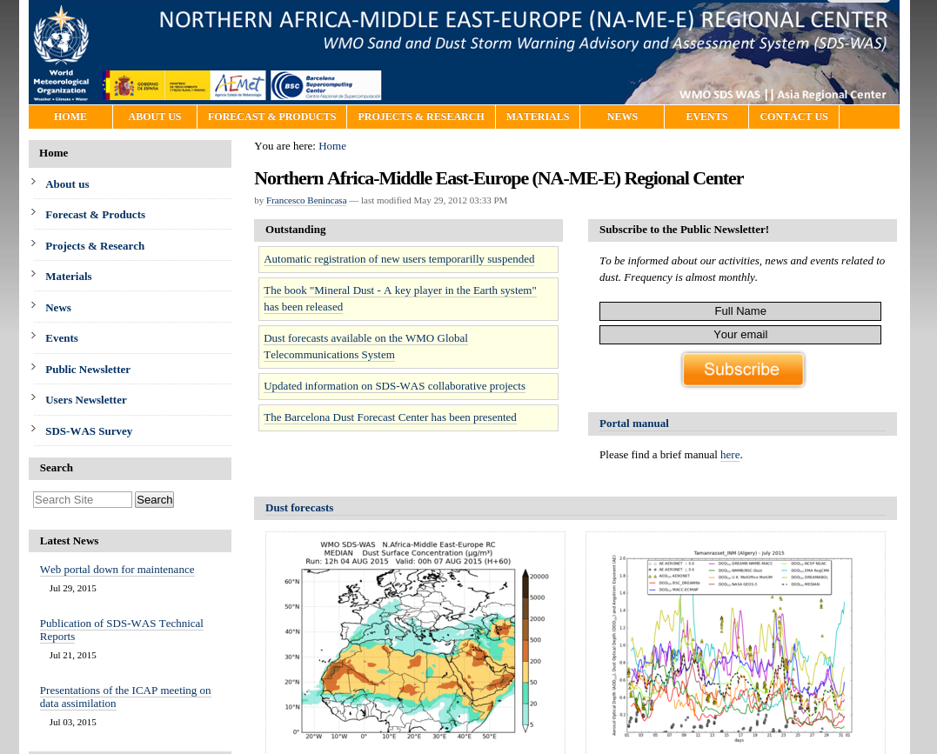
SDS-WAS: Forecast Evaluation
http://sds-was.aemet.es

Slide 36
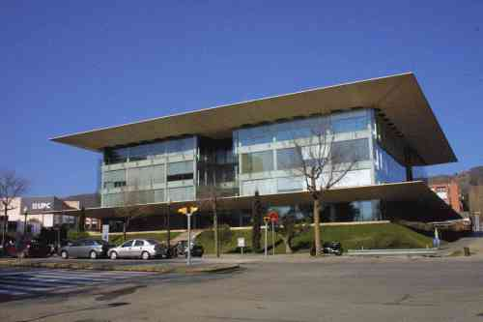
SDS-WAS: NA-ME-E RC (http://sds-was.aemet.es)
The Center is managed by a consortium of AEMET and the Barcelona Supercomputing Center (BSC-CNS)
Nexus II Building. Barcelona
MareNostrum supercomputer

Slide 37
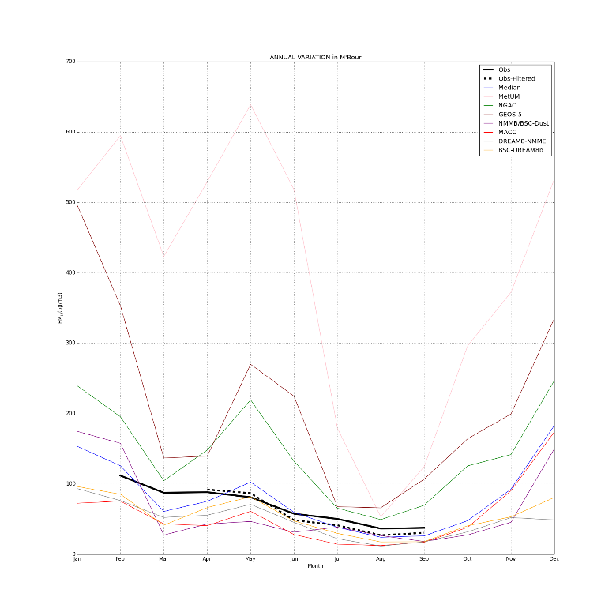
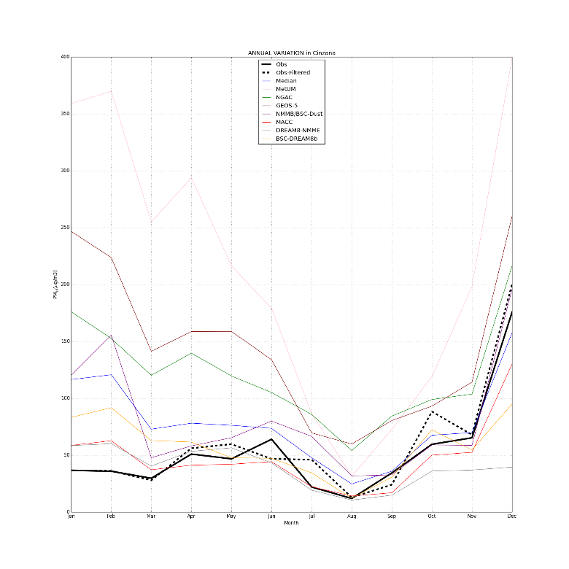
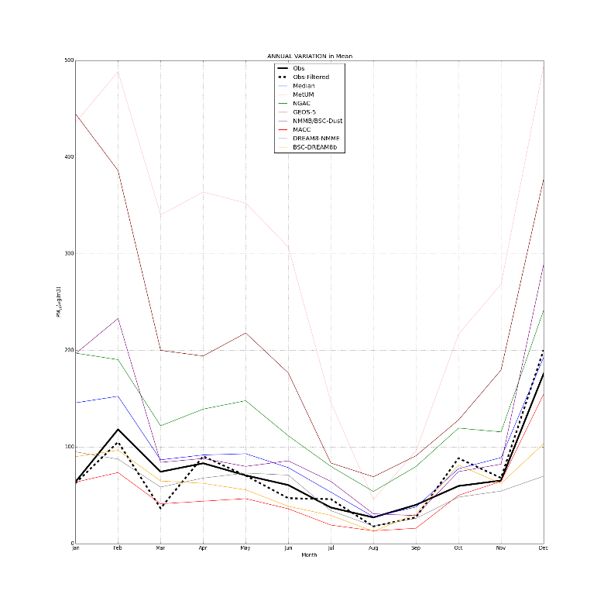
PM10 evaluation using AMMA sites: 2013
M’Bour-Senegal
Cinzana-Mali
Banizoumbou-Niger
AMMA sites (Marticorena et al., 2010)
Notes:
The SDS-WAS models are able to reproduce the seasonal dust cycle observed at ground levels with higher underestimations during summertime where haboobs are frequent.

