Slide 1
EC-Earth3-ESM
Earth System Model
Global Climate Model
Global Carbon Cycle Model
IFS (Atmospheric Model):
T255 (0.75º) ~80km
L91 (top 0.01hPa) ~mesosphere
IFS-HTESSEL (Land Model)
NEMO (Ocean Model):
Nominal 1° Resolution
L75 levels (thousands km deep)
LIM (Sea-ice Model):
Multiple (5) ice category
PISCESv2 (Ocean Biogeochemical Model):
Lower trophic levels of marine ecosystems
LPJ-GUESS (Dyn. Glob. Vegetation Model):
Process-based, plant functional types
TM5-CO2 (Atm. Chem. Transport Model):
34 layers, single-tracer version (CO2)
Model Components

Slide 2
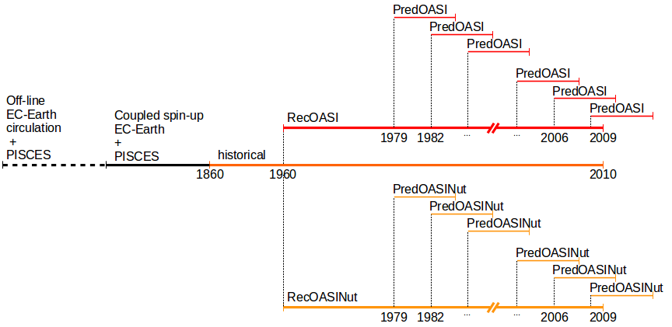
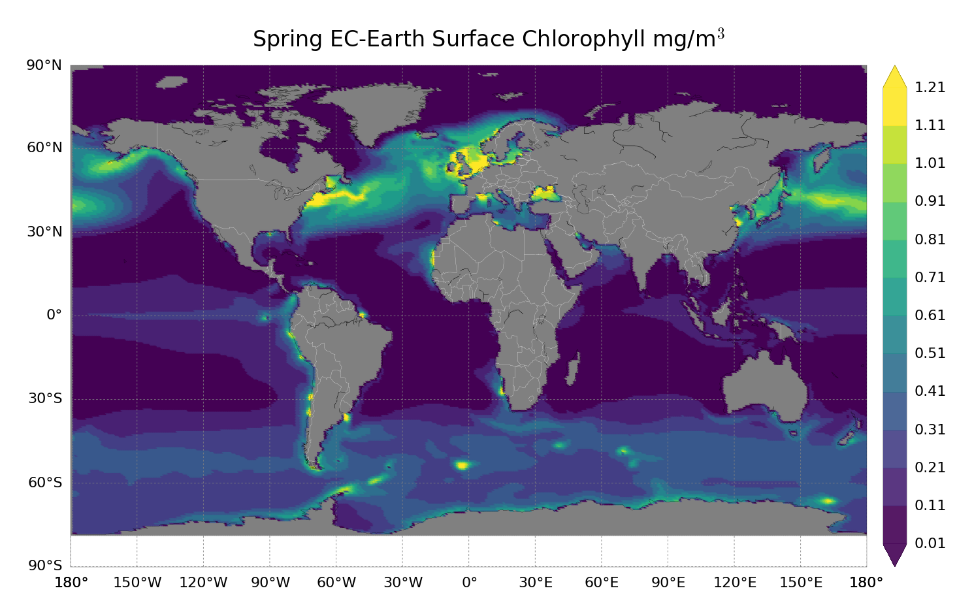
TRIATLAS
NeTNPPAO
Investigating mechanisms of predictability of ocean biogeochemical properties
Validation using satellite obs
Retrospective decadal predictions using different initializations

Slide 3
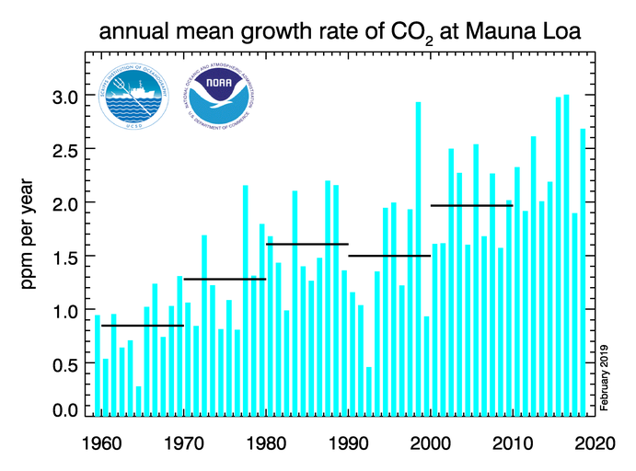
CCiCC
Towards a near-term prediction of the climate and carbon cycle interactions in response to Paris Agreement emission trajectories
Variability in atm CO2 growth rate is mostly due to natural variability
Testing different ocean biogeochemical reconstructions as initial conditions
Retrospective decadal predictions of ocean and land carbon uptake
Idealized perfect-model experiments to investigate mechanisms of C uptake predictability in the ocean.

Slide 4
C4MIP requirements
DECK (CO2-concentration-driven)
-piControl (500 years)
-historical (165 years, 1850 - 2014)
-1pctCO2 (141 years)
DECK (CO2 emission-driven)
-esm-piControl (500 years)
-ems-hist (165 years, 1850-2014)
Tier 1
-1pctCO2-bgc (141 years)
-esm-ssp585 (86 years, 2015-2100)
EC-Earth + PISCES + LPJ-GUESS
non-interactive mode (no TM5)
947 years
EC-Earth-CC : IFS+NEMO+PISCES+LPJ-GUESS+TM5
751 years

Slide 5
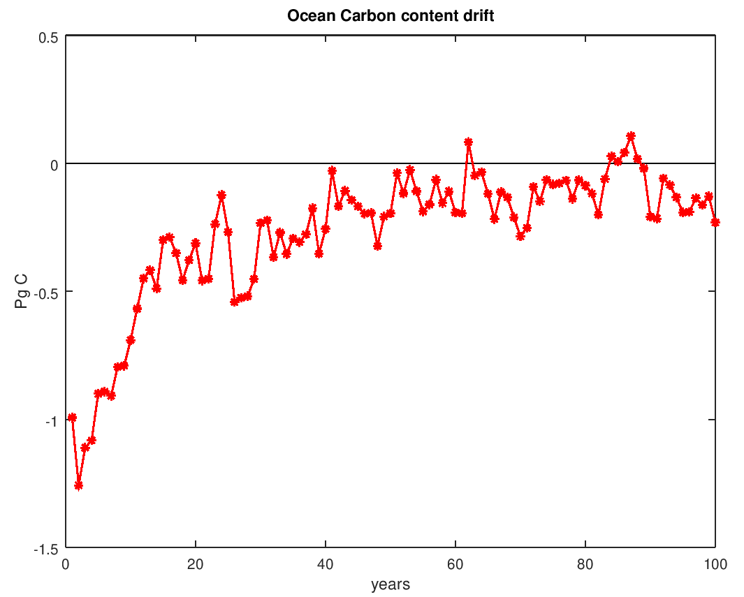
C4MIP status:
- spinup concentration-driven almost completed
- extension of spinup for emission-driven starting soon.
Actual C4MIP production to start in September with publication on ESGF early November

Slide 6
Ocean BGC reconstructions

Slide 7
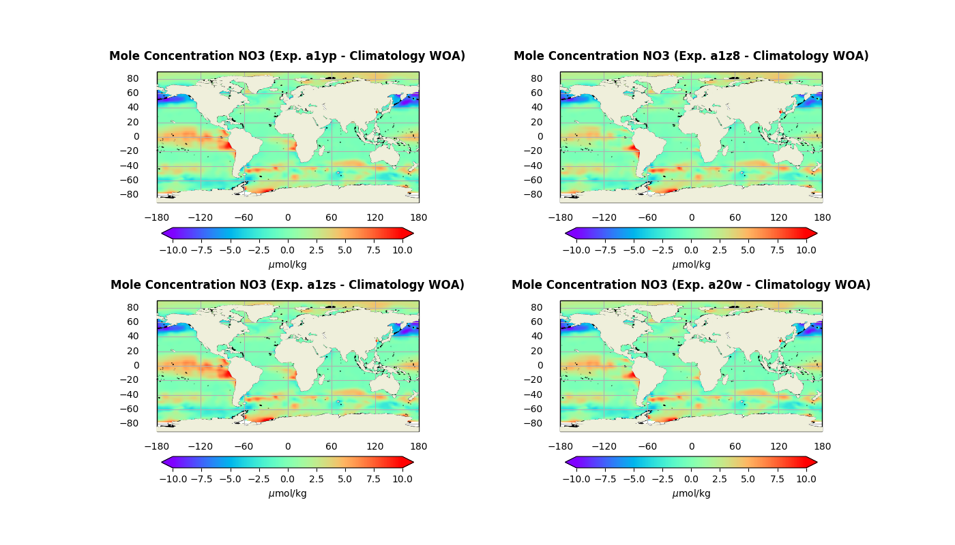

Slide 8
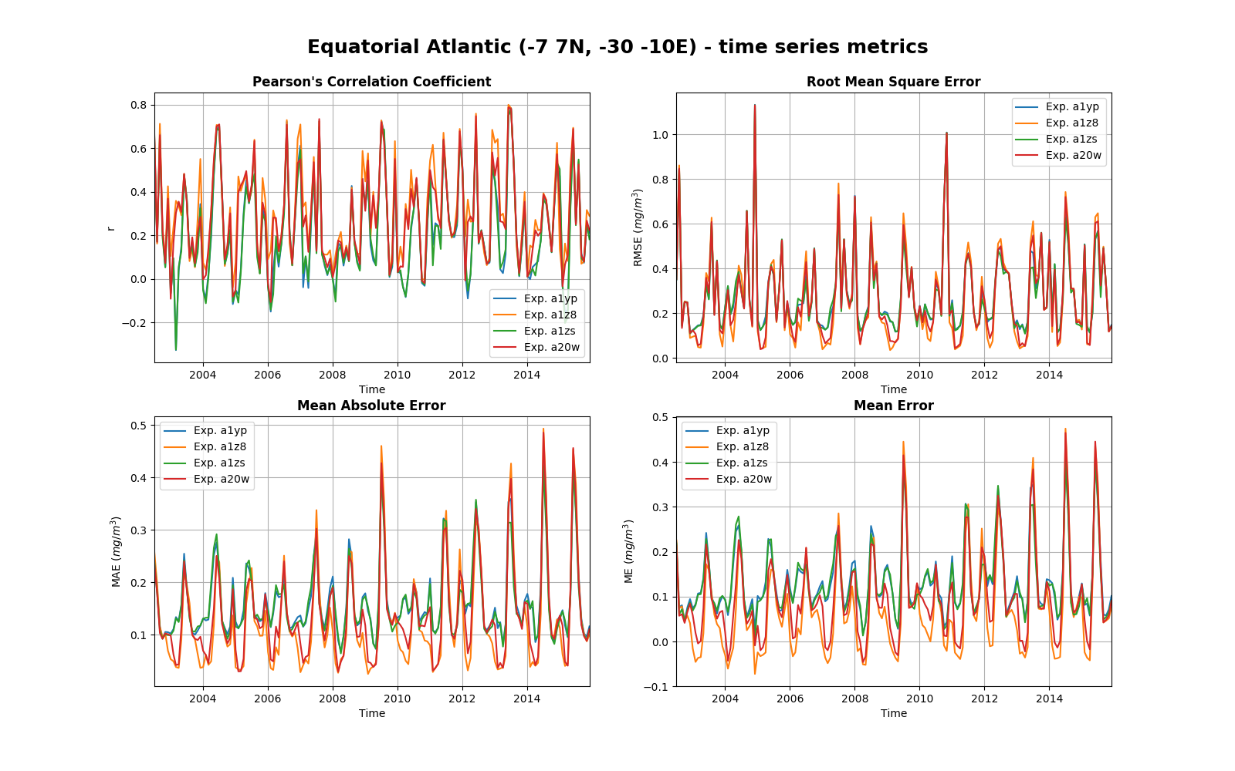

Slide 9
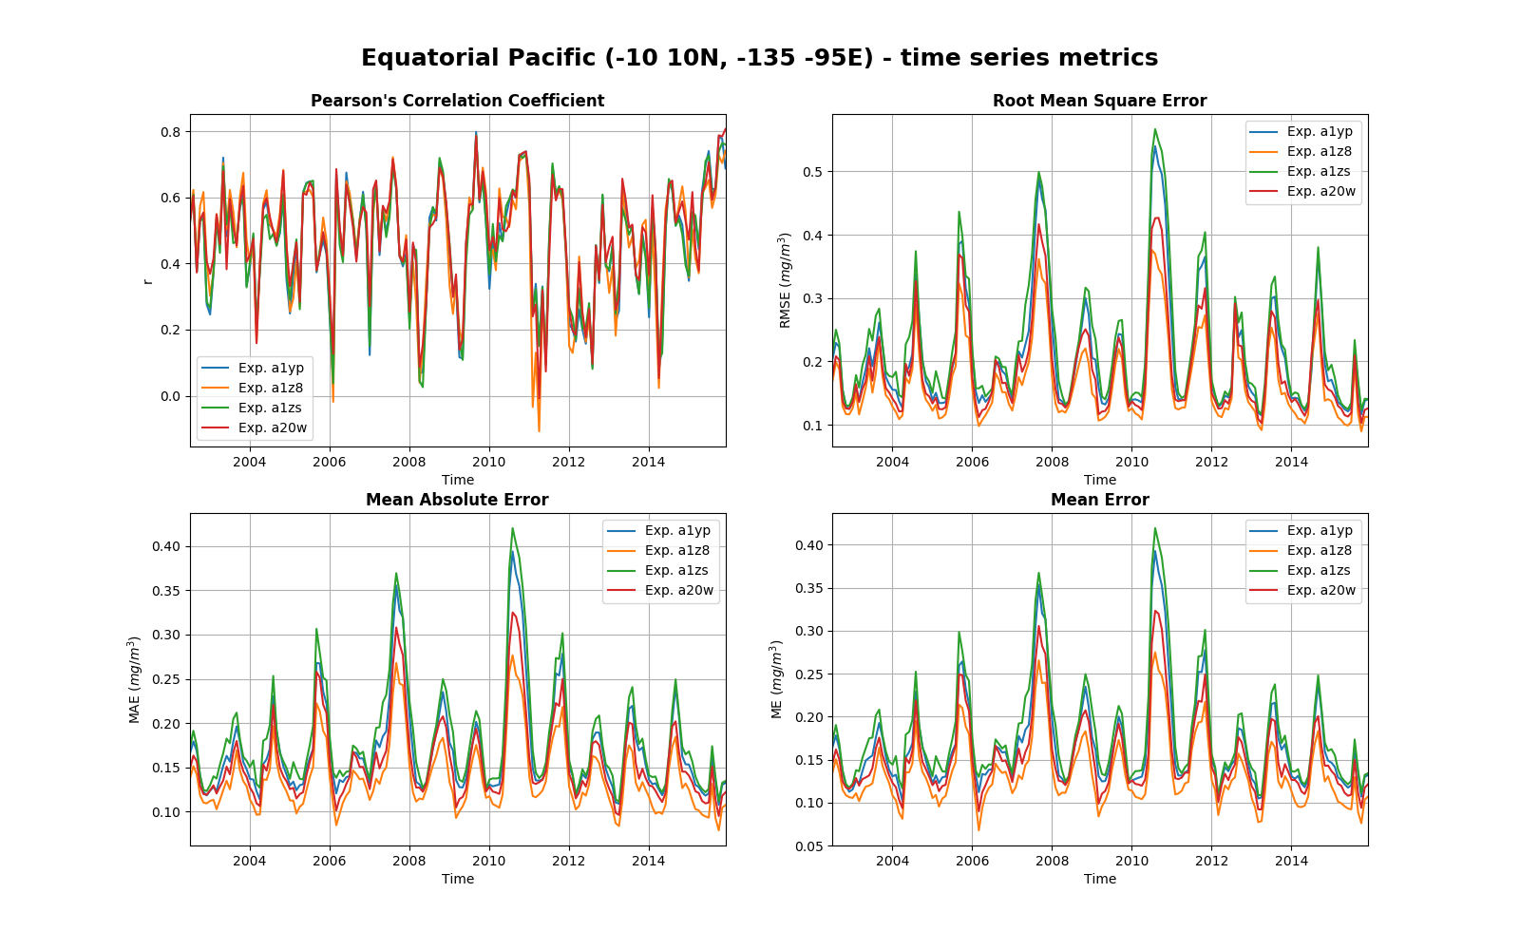

Slide 10
