Slide 1
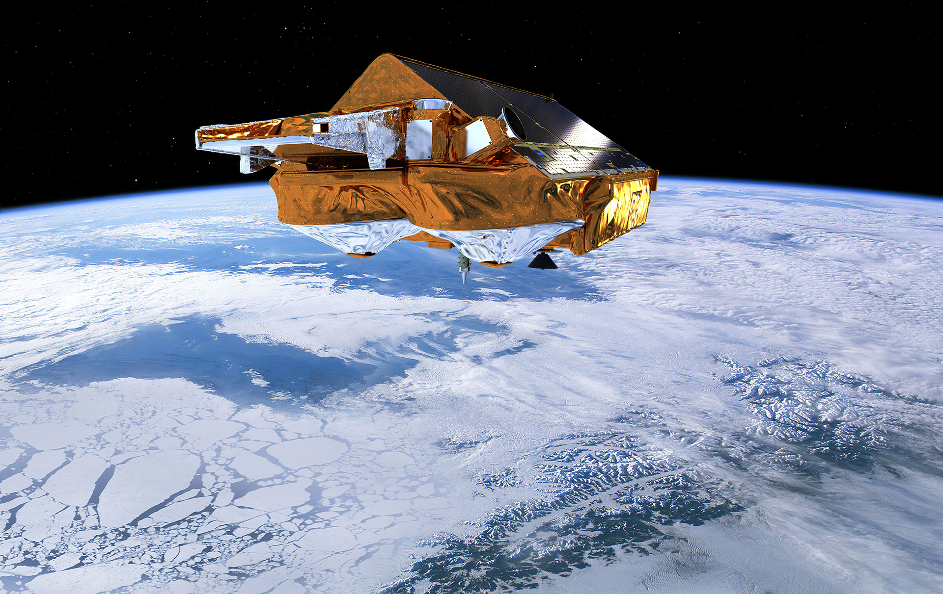
Exploiting observations to improve the predictive capacity in the Arctic, including its climate impacts
Dr. Pablo Ortega
Barcelona Supercomputing Center

Slide 2
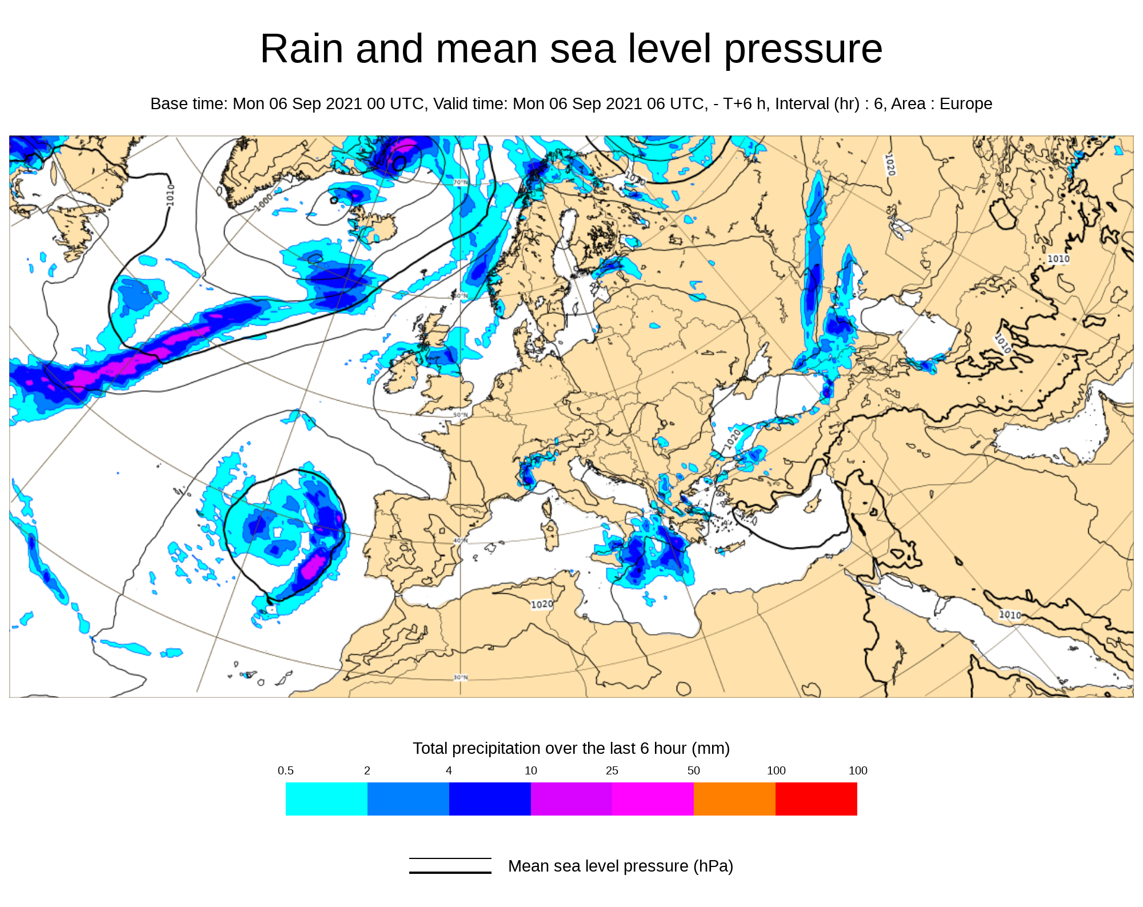
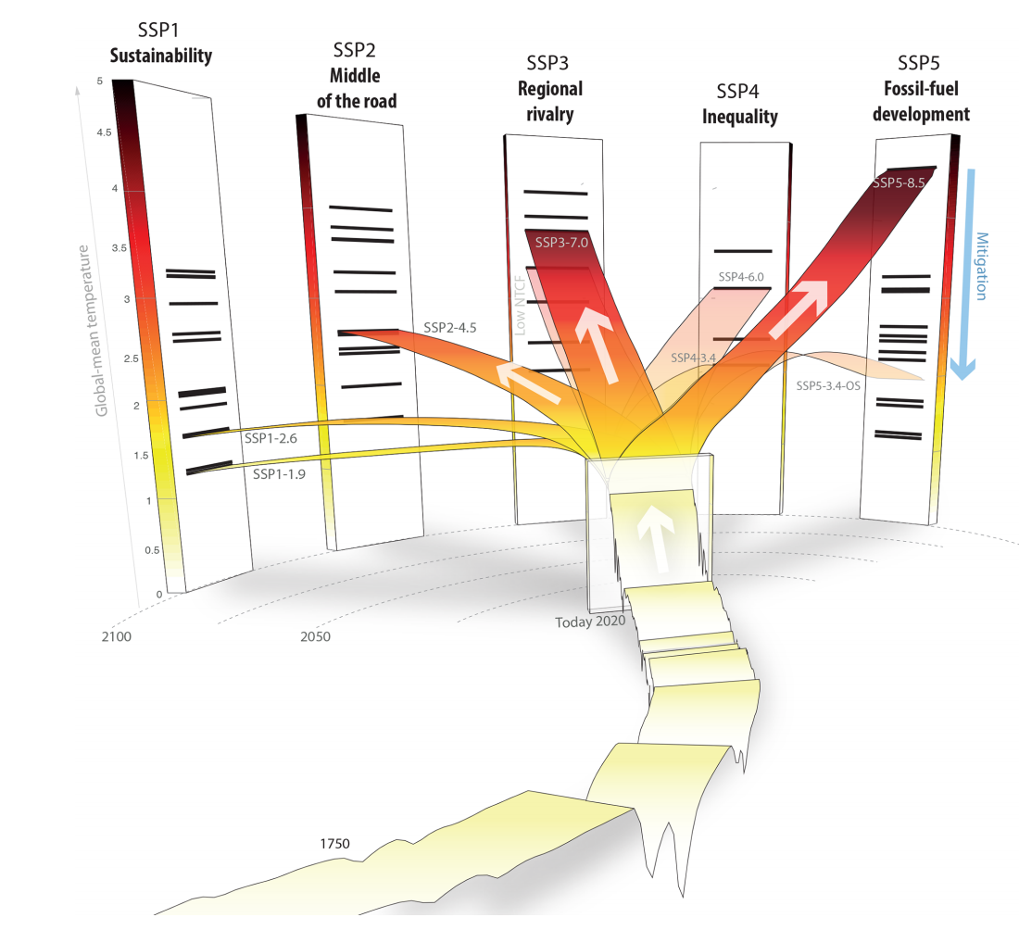
Fundamentals of Climate Prediction
Weather forecasts
Climate projections
Meinshausen et al. (2020)
Days
Weeks
Months
Seasons
Years
Decades
Centuries

Slide 3
Fundamentals of Climate Prediction
Weather forecasts
Climate projections
Meinshausen et al. (2020)
Days
Weeks
Months
Seasons
Years
Decades
Centuries
GHGs and Aerosols
Good guess of future changes in radiative forcing factors
©NASA/SDO
©European Environment Agency

Slide 4
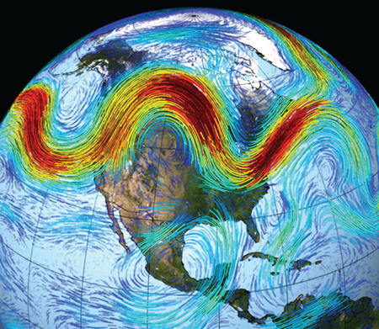
Fundamentals of Climate Prediction
Weather forecasts
Climate projections
Meinshausen et al. (2020)
Days
Weeks
Months
Seasons
Years
Decades
Centuries
Current Meteorological state
GHGs and Aerosols
Initialization of internal
sources of predictability
Good guess of future changes in radiative forcing factors
©National Research Council
©NASA/SDO
©European Environment Agency

Slide 5
Fundamentals of Climate Prediction
Weather forecasts
Climate projections
Meinshausen et al. (2020)
Days
Weeks
Months
Seasons
Years
Decades
Centuries
Current Meteorological state
GHGs and Aerosols
Initialization of internal
sources of predictability
Good guess of future changes in radiative forcing factors
©National Research Council

Slide 6
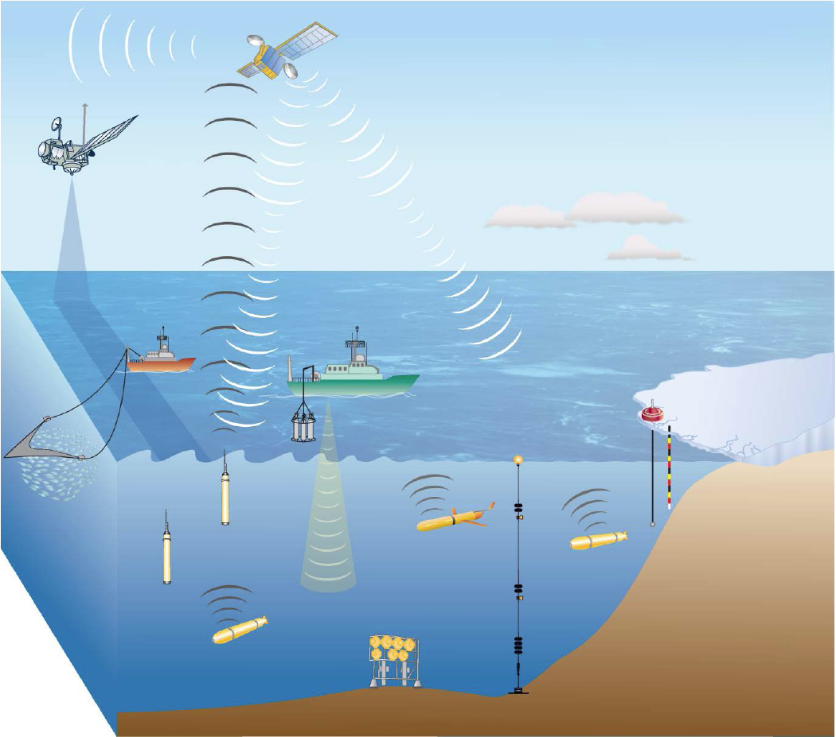
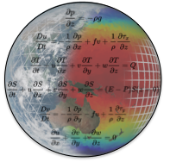
Fundamentals of Climate Prediction
Weather forecasts
Climate projections
Meinshausen et al. (2020)
Days
Weeks
Months
Seasons
Years
Decades
Centuries
Current Meteorological state
Observations
Global Earth System Model
Initialization of internal
sources of predictability
DATA ASSIMILATION
©National Research Council

Slide 7
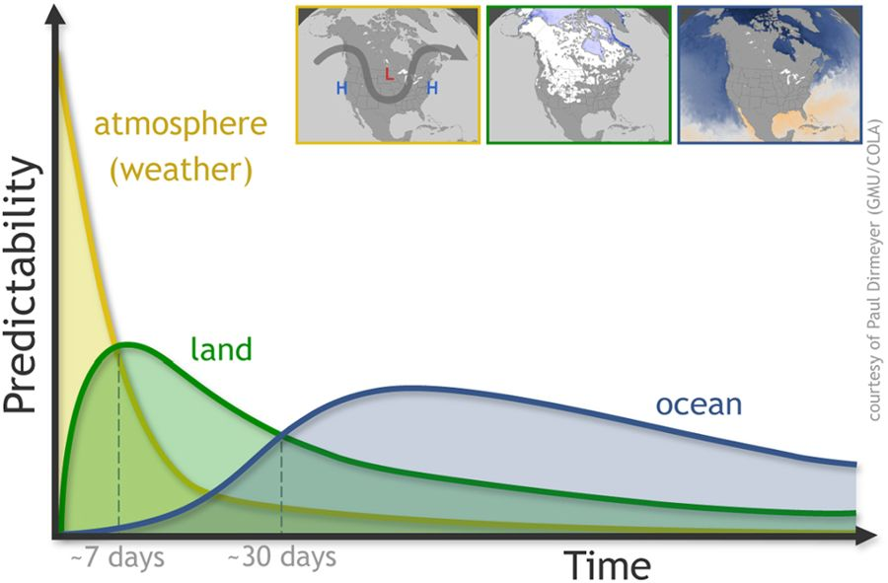
Fundamentals of Climate Prediction
Weather forecasts
Climate projections
Meinshausen et al. (2020)
Days
Weeks
Months
Seasons
Years
Decades
Centuries
Observations
Global Earth System Model
Mariotti et al. (2018)
atmosphere
©Paul Dirmeyer (GMU/COLA)
Predictability
Predictability from slowly varying components of the Earth system
land
ocean/sea ice
DATA ASSIMILATION
~7 days
~30 days
Time

Slide 8
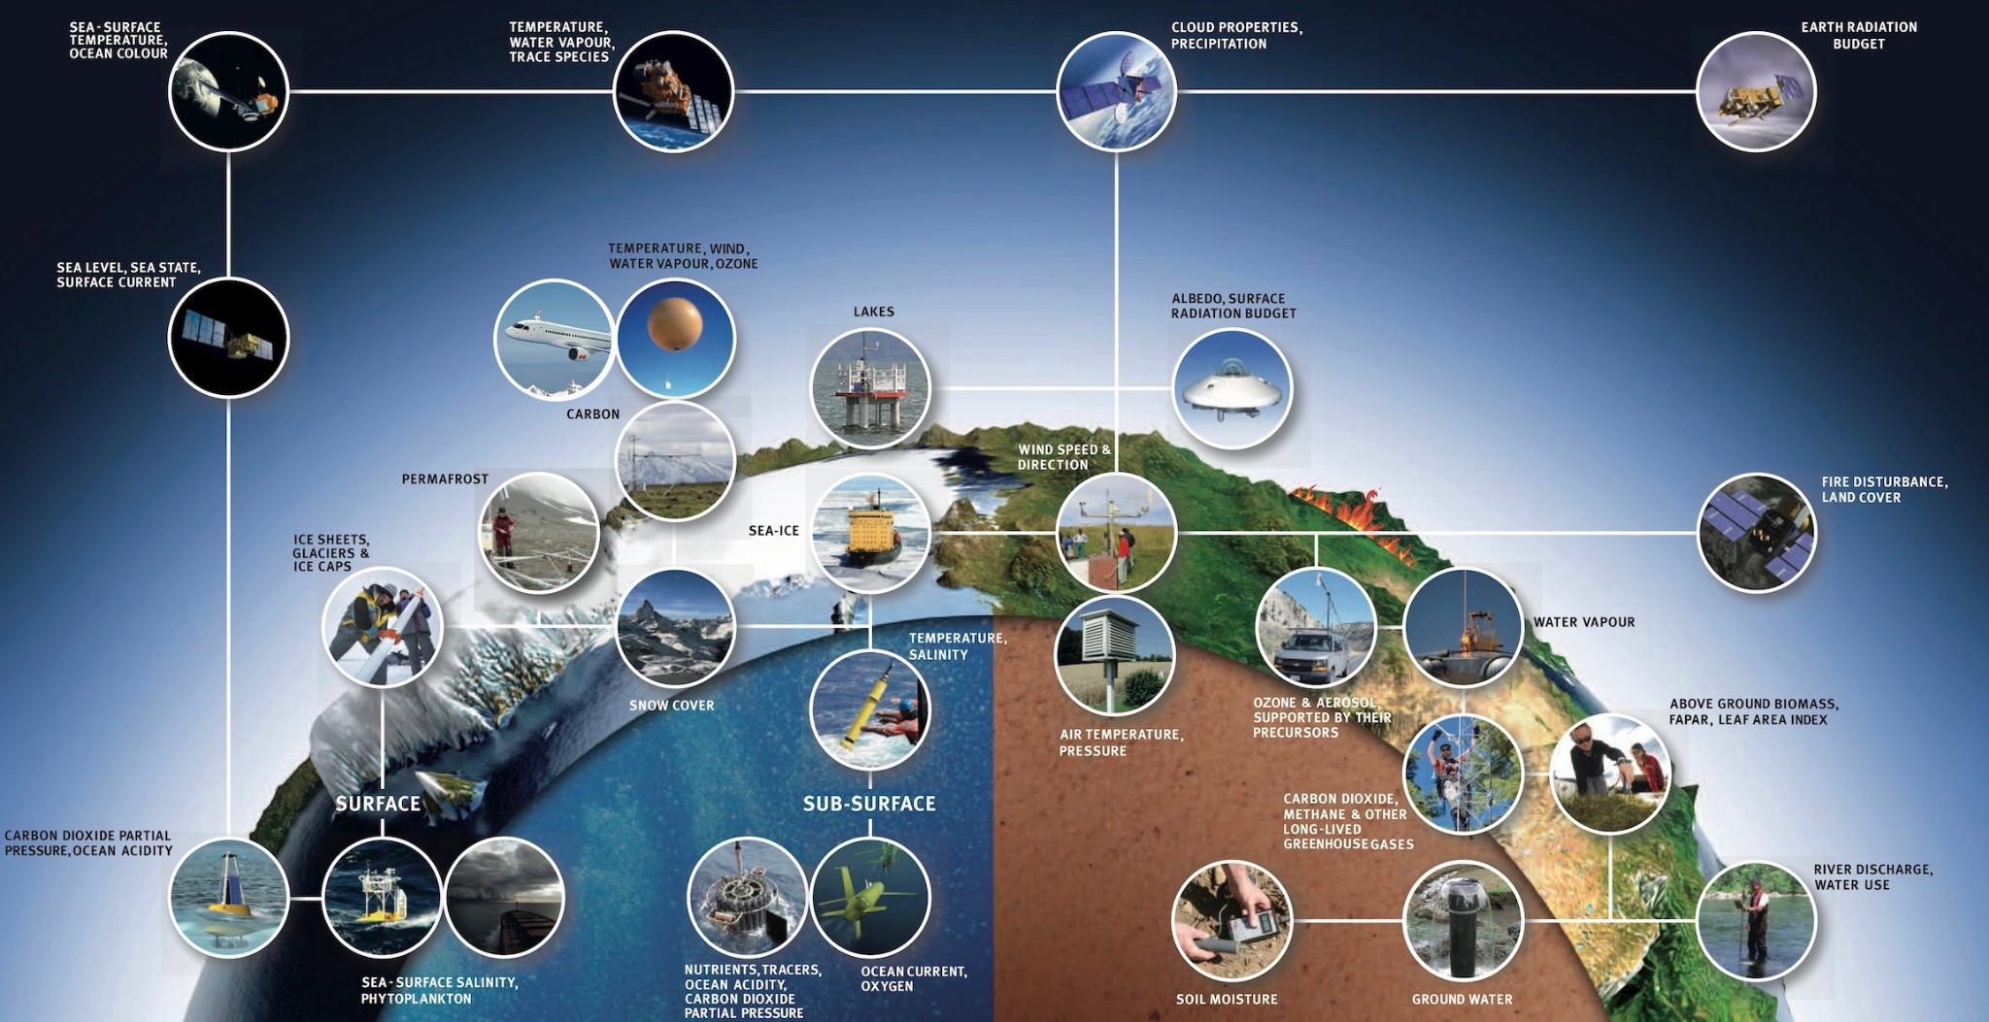
Fundamentals of Climate Prediction
Weather forecasts
Climate projections
Meinshausen et al. (2020)
Days
Weeks
Months
Seasons
Years
Decades
Centuries
Current Meteorological state
Observations
Global Earth System Model
Initialization of internal
sources of predictability
DATA ASSIMILATION
©National Research Council

Slide 9
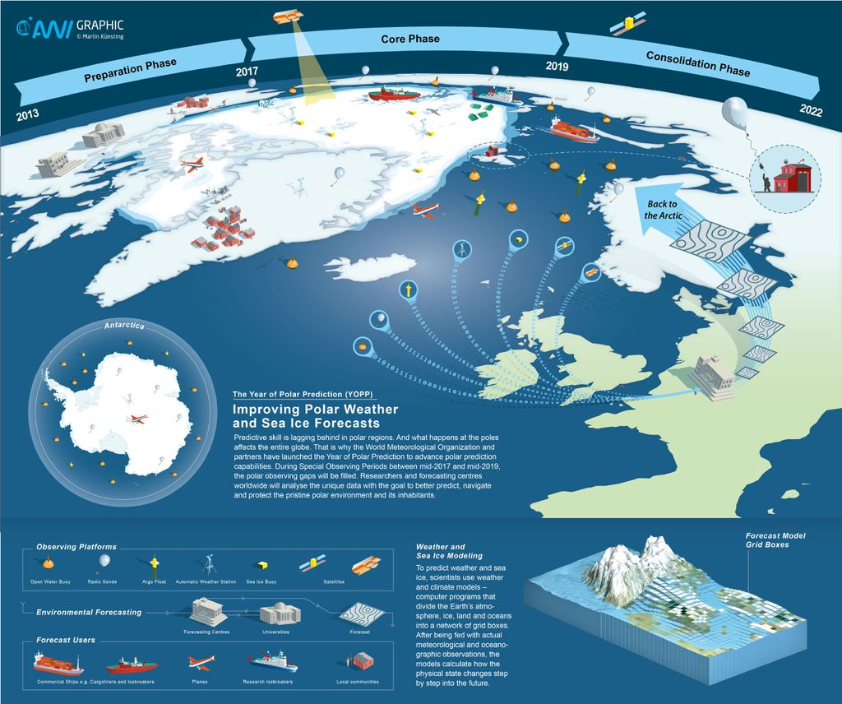
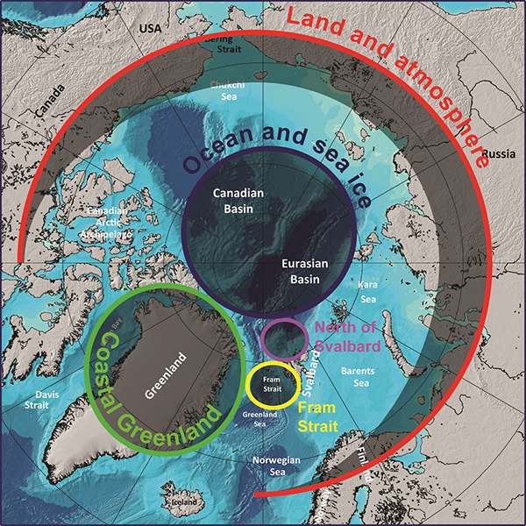
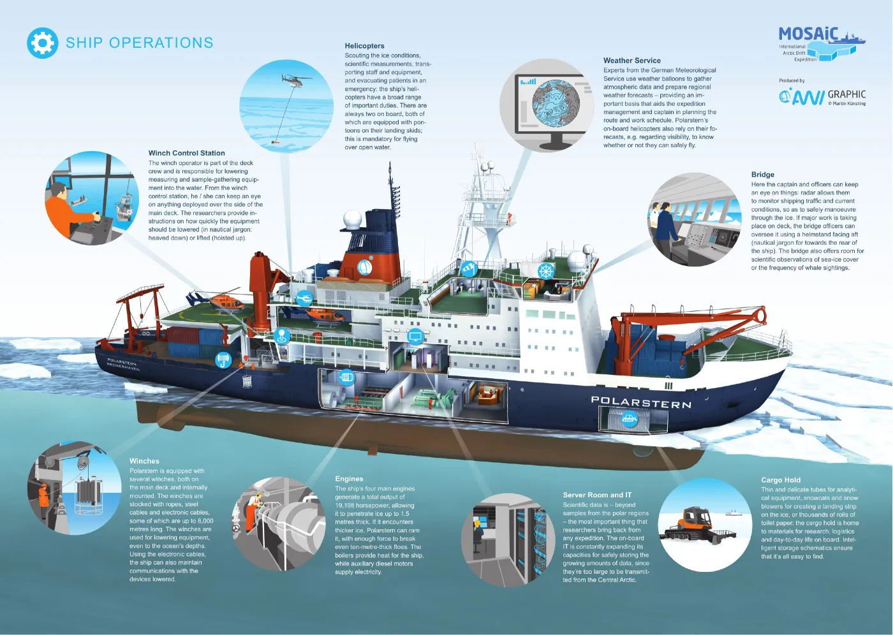
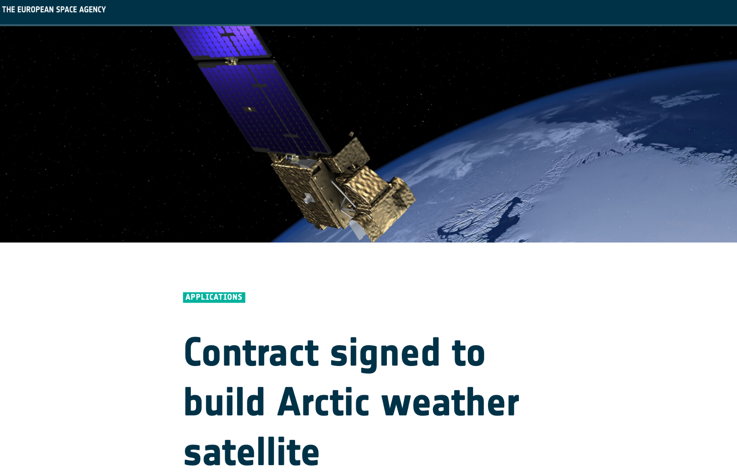
A growing network of Arctic observations
INTAROS Data Catalogue
Ocean moorings, Weather stations, Cruise Campaigns
Satellites, Supersites, Gliders, Floats,...

Slide 10
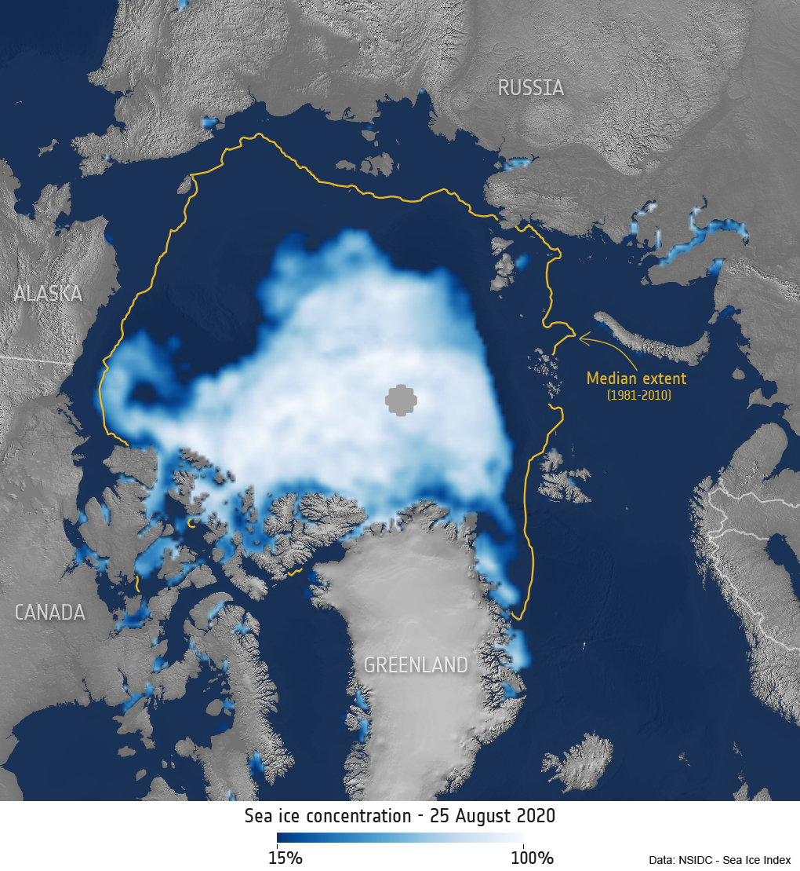
A growing network of Arctic observations
Satellite data are particularly useful for Arctic climate prediction
Several decades of uninterrupted spatially continuous fields are already available covering the whole Arctic region
This includes key variables for the Arctic such as:
Sea ice concentration (since 1979)
Sea ice thickness (since 2002)
Thanks to their homogeneity in time and space, satellite
data can be easily assimilated for forecast initialization
Sea ice concentration - 25 August 2020

Slide 11
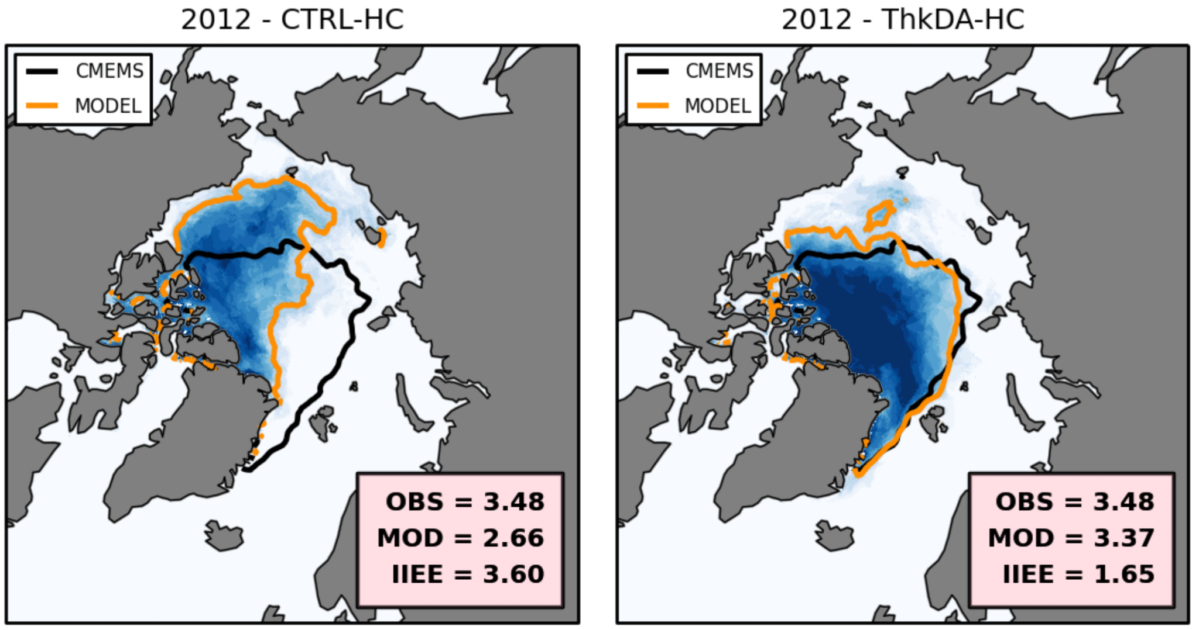
Benefits of assimilating sea ice data (on Arctic)
Improvements in prediction skill for september sea ice edge
1.0
0.8
0.6
Model: HadGEM
Start month: May
Period: 2012
Assimilating Sea Ice Thickness
Mean probability of sea ice
0.4
Blockley & Peterson (2018)
without
assimilation
with
assimilation
0.2
0.0

Slide 12
Benefits of assimilating sea ice data (on Arctic)
Improvements in prediction skill for summer sea ice concentrations
June (2nd month)
July-September (3rd-5th months)
Model: EC-Earth
Start month: May
Period: 1992-2018
Assimilating
Sea Ice Concentrations
Acosta-Navarro et al (in prep)
-0.5
-0.4
-0.3
-0.2
-0.1
0
0.1
0.2
0.3
0.4
0.5
Skill is worsened
Skill is improved

Slide 13
Benefits of assimilating sea ice data (beyond)
Improvements in prediction skill for summer atmospheric circulation
June (2nd month)
July-September (3rd-5th months)
Model: EC-Earth
Start month: May
Period: 1992-2018
Assimilating
Sea Ice Concentrations
Acosta-Navarro et al (in prep)
-0.5
-0.4
-0.3
-0.2
-0.1
0
0.1
0.2
0.3
0.4
0.5
Skill is worsened
Skill is improved

Slide 14
Take home messages
Arctic climate predictions are improving their accuracy (and usefulness), benefiting from the increased observational network in the region
Benefits in prediction skill are also tangible beyond the Arctic
Outside of the Arctic, ocean campaigns, targeting in particular the ocean subsurface, are also critical to improve our understanding of the processes that govern the ocean circulation, its impacts on decadal variability (including the North Atlantic Cold Blob), and their predictability.
Sustained observations are essential to maintain and further develop current climate prediction capabilities

Slide 15
Key take home messages
Arctic climate predictions are improving their accuracy (and usefulness), benefiting from the increased observational network in the region
Benefits in prediction skill are also tangible beyond the Arctic
Outside of the Arctic, ocean campaigns, targeting in particular the ocean subsurface, which have been traditionally undersampled, are also critical to improve our understanding of the processes that govern the ocean circulation, its impacts on decadal climate variability (including the North Atlantic Cold Blob), and their predictability.
Hence, sustained observational efforts are essential to maintain and further develop current climate prediction capabilities

Slide 16
Cornerstones of Climate Prediction
Weather forecasts
Climate projections
Meinshausen et al. (2020)
Days
Weeks
Months
Seasons
Years
Decades
Centuries
Current Meteorological state
atmosphere
©Paul Dirmeyer (GMU/COLA)
Initialization of internal
sources of predictability
Predictability
land
ocean/sea ice
©National Research Council
~7 days
~30 days
Time

