Slide 1
Computational aspects and performance evaluation of the IFS-XIOS integration
Xavier Yepes-Arbós, BSC
Mario C. Acosta, BSC
Gijs van den Oord, NLeSC
Glenn Carver, ECMWF
18th workshop on high performance computing in meteorology, ECMWF, UK
24/09/2018

Slide 2
Index
1. Introduction
2. Components description
3. IFS-XIOS integration
4. Performance analysis and optimization
5. Evaluation
6. Conclusions
2

Slide 3
1. Introduction

Slide 4
Introduction
Earth system models have benefited of the exponential growth of supercomputing power
This allows to use more complex computational models to find more accurate solutions
As a consequence, the generated amount of data has grown considerably
However, since the I/O was not significant enough in the past, not much attention was paid to improve it
4

Slide 5
Introduction
Due to this reason, some Earth system models output data using inefficient sequential I/O schemes
This type of scheme requires a serial process:
Gather all data in the master process of the model
Then, the master process sequentially writes all data
This is not scalable for higher grid resolutions, and even less, for future exascale machines
This is the case of one of the I/O schemes of IFS
5

Slide 6
Introduction
IFS is a global forecasting system developed by ECMWF
It has two different output schemes:
The Météo-France (MF) I/O server which is fast and efficient from a computational point of view. It is only used at ECMWF, such its operational forecasts
A sequential I/O scheme which is slow and inefficient from a computational point of view. It is used by non-ECMWF users, this is, in OpenIFS and in the IFS version of EC-Earth
IFS is also used as a component of the EC-Earth model
6

Slide 7
Introduction
EC-Earth is a global coupled climate model, which integrates a number of component models in order to simulate the Earth system
The two main components are IFS as the atmospheric model and NEMO as the ocean model
7

Slide 8
Introduction
In addition, Earth system models such as EC-Earth, run experiments that have other tasks in their workflow
Post-processing task can perform data format conversion, compression, diagnostics, etc.
8

Slide 9
Introduction
When IFS is used in EC-Earth for climate modeling, post-processing is needed to:
Convert GRIB files to netCDF files
Transform data to be CMIP-compliant (CMORization)
Compute diagnostics
Post-processing turns into an expensive process
9

Slide 10
Motivation
In particular, we are experiencing an I/O bottleneck in the IFS version of EC-Earth
EC-Earth has been recently used to run experiments using the T511L91-ORCA025L75 configuration under the H2020 PRIMAVERA project
Experiments require to output a lot of fields, causing a considerable slowdown in the EC-Earth execution time
I/O in IFS represents about 30% of the total execution time
10

Slide 11
Motivation
In order to address the I/O issue, we have to select a suitable tool that fulfills a series of needs:
It must be a parallel, efficient and scalable I/O tool
Data must be written using netCDF format (standard in climate modelling) and must follow the CMIP standard
It must perform online post-processing along with the simulation, such as interpolations or data compression
There is a tool designed to that end: XIOS
XIOS is an I/O server
11

Slide 12
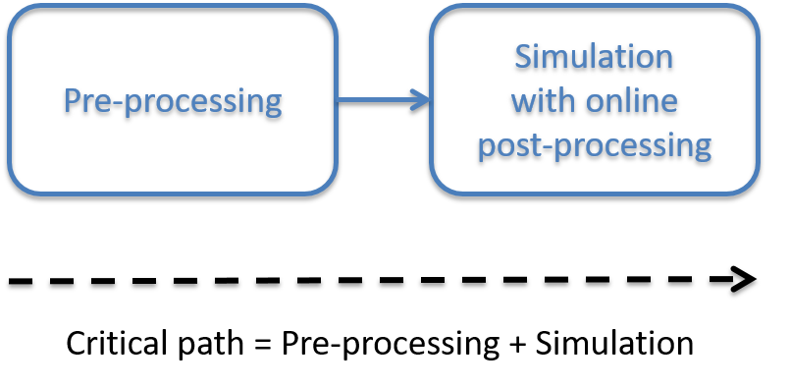
Motivation
The use of a tool such as XIOS has a twofold effect:
Improve the computational performance and efficiency of a model, and thus, reduce the execution time
Reduce the critical path of its workflow by avoiding the post-processing task
12

Slide 13
European collaboration
Netherlands eScience Center (NLeSC)/Koninklijk Nederlands Meteorologisch Instituut (KNMI)
European Centre for Medium-Range Weather Forecasts (ECMWF)
13

Slide 14
2. Components description

Slide 15
IFS
The Integrated Forecast System (IFS) is a global data assimilation and forecasting system developed by ECMWF
It writes using the GRIB format (standard in weather forecast)
It can use two different output schemes:
The MF I/O server
A sequential I/O scheme
15

Slide 16
XIOS
The XML Input/Output Server (XIOS) is an asynchronous MPI parallel I/O server developed by IPSL
It writes using the netCDF format
Written data is CMIP-compliant (CMORized)
It is able to post-process data online to generate diagnostics
16

Slide 17
3. IFS-XIOS integration

Slide 18
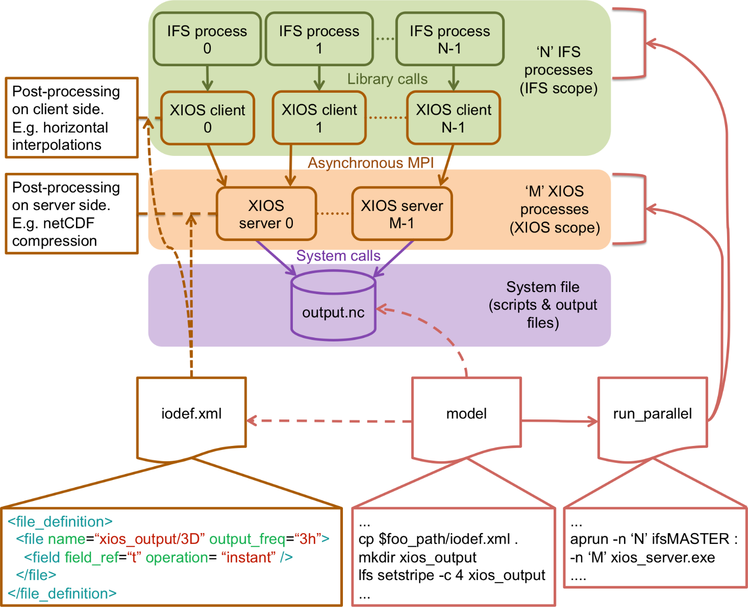
Scheme of the IFS-XIOS integration
18

Slide 19
Development steps
XIOS setup
Initialization
Finalization
Context: calendar and geometry (axis, domain and grid)
Iodef.xml file
Grid-point fields transfer
NPROMA blocks gather
Send fields
Environment setup
XIOS compilation
Include and link XIOS, netCDF and HDF5
Model script
Supporting MPMD mode
FullPos integration to support vertical post-processing: grid-point fields only
19

Slide 20
Development steps
XIOS setup
Initialization
Finalization
Context: calendar and geometry (axis, domain and grid)
Iodef.xml file
Grid-point fields transfer
NPROMA blocks gather
Send fields
Environment setup
XIOS compilation
Include and link XIOS, netCDF and HDF5
Model script
Supporting MPMD mode
FullPos integration to support vertical post-processing: grid-point fields only
20

Slide 21
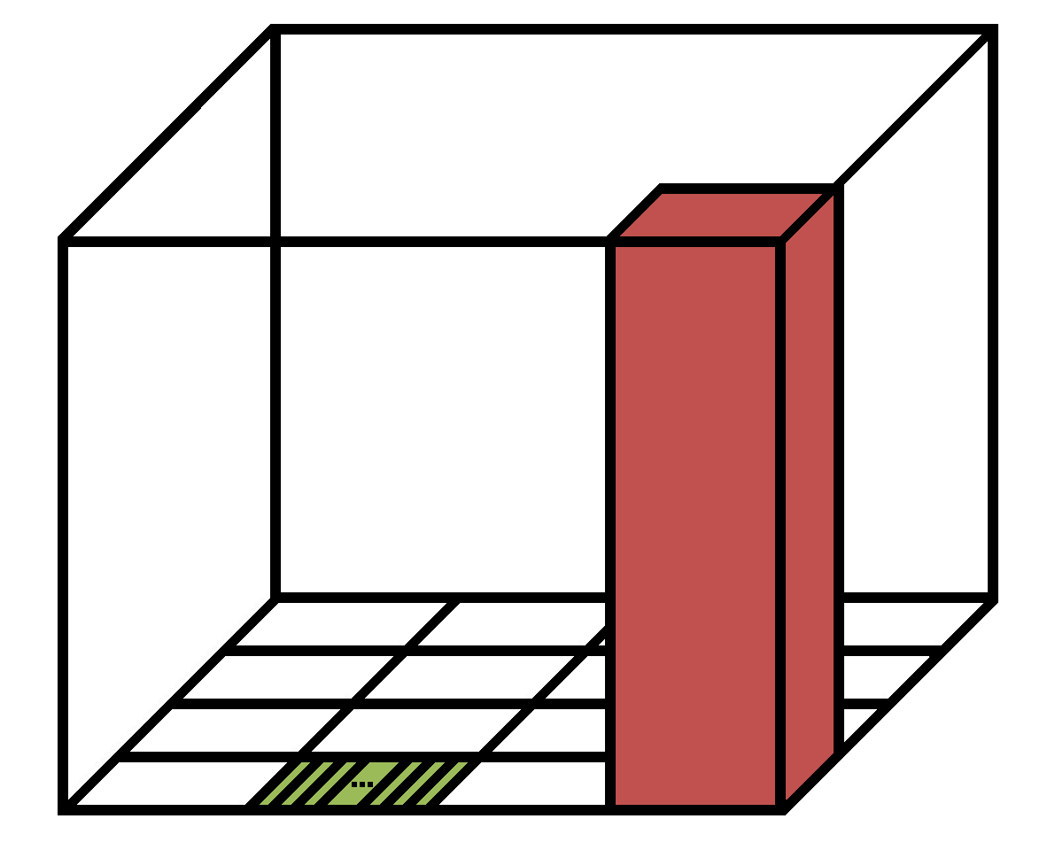
Subdomain decomposition in IFS
IFS uses a blocking strategy to efficiently parallelize the manipulation of data arrays using OpenMP
IFS_data_array(NPROMA, NFLEVG, NFIELDS, NGPBLKS)
NFLEVG
NGPBLKS block
One element
NPROMA
21

Slide 22
NPROMA blocks gather
The IFS data arrays do not match with the XIOS ones:
IFS_data_array(NPROMA, NFLEVG, NFIELDS, NGPBLKS)
XIOS_data_array(unidimensional 2D domain, NFLEVG)
We have to re-shuffle fields data before sending them
According to the blocking strategy used in IFS, we have to build an XIOS-style array by gathering NPROMA blocks
22

Slide 23
FullPos integration
FullPos is a post-processing package currently used by IFS
The use of FullPos is necessary to perform vertical interpolations not supported by XIOS
It is called as usual, and afterwards, data is sent to XIOS
For now, it is only possible to output grid-point fields
23

Slide 24
4. Performance analysis and optimization

Slide 25
Execution overview
Two different experiments according to if we use FullPos or not:
Pre-FullPos: it outputs both grid-point and spectral fields. NetCDF files size: 3.2 TB
Post-FullPos: it outputs only grid-point fields. NetCDF files size: 2.5 TB
For both experiments:
Octahedral reduced Gaussian grid. Horizontal resolution: T1279 (16 km)
702 MPI processes, each with 6 OpenMP threads
10 days of forecast with a time step of 600 seconds
Three optimizations applied:
Parallelization using OpenMP threads (both exp.) [XIOS v2]
Optimized compilation of XIOS with -O3 (both exp.) [XIOS v3]
Computation and communication overlap (only Pre-FullPos)
25

Slide 26
Execution overview
Execution times of this presentation correspond to Post-FullPos, except the third optimization
Execution times:
Sequential output: 9391 seconds
MF I/O server: 7453 seconds
IFS-XIOS integration: 7682 seconds [XIOS v1]
IFS with FullPos but no I/O: 7443 seconds
26

Slide 27
Threading with OpenMP
We used OpenMP to parallelize the NPROMA blocks gather
Although it does not have a big impact, it avoids the rest of threads to be idle while the master is working
The execution time is reduced 80 seconds, from 7682 seconds to 7602 seconds
27

Slide 28
Optimized compilation of XIOS
We had a lot of issues to optimally compile XIOS
For this reason, we used a conservative option: -O1
XIOS reports too much time for just outputting data:
Client
Server
28

Slide 29
Optimized compilation of XIOS
Someone previously reported a bug in the compilation of XIOS using -O2 and -O3 for Cray compilers
However, it was reported using older Cray compilers, so it might be solved in newer versions
Certainly, XIOS compiled and tests successfully passed
29

Slide 30
Optimized compilation of XIOS
The execution time in both client and server sides is reduced
The execution time is reduced 103 seconds, from 7602 seconds to 7499 seconds
Client
Server
30

Slide 31
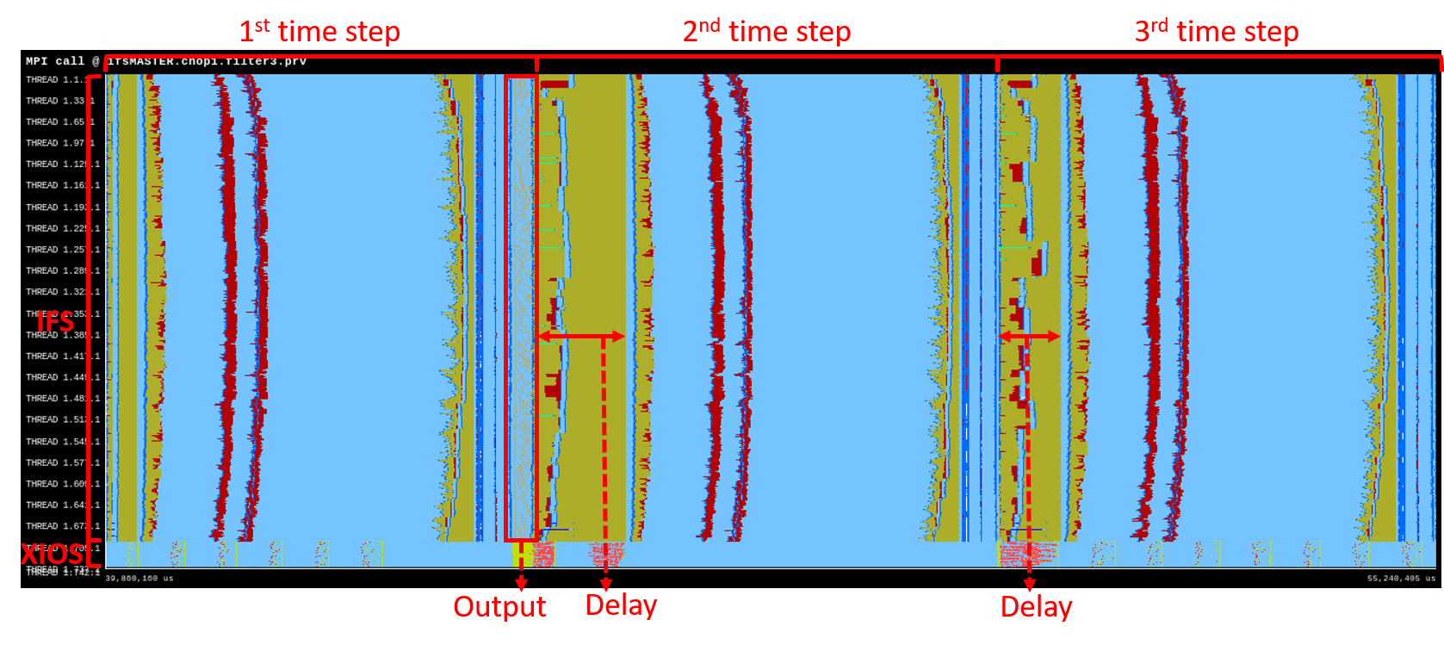
Overlapping computation and communication
The trace shows that after an output time step, there is a delay in the communications of the next two time steps (MPI_Waitany and MPI_Alltoallv)
There is a conflict between intra IFS communications and IFS to XIOS communications
31

Slide 32
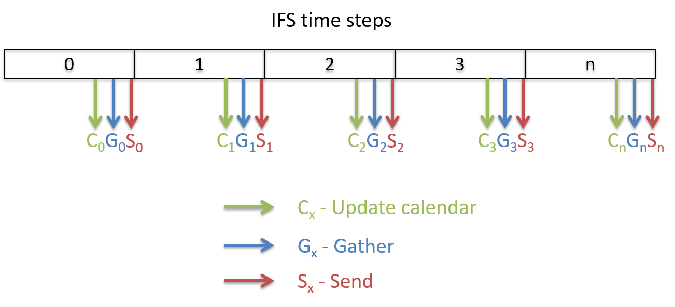
Overlapping computation and communication
Approach of the current output scheme:
If it is an output time step, at the end of it IFS sequentially executes three steps
Otherwise, IFS only executes the update calendar step
32

Slide 33
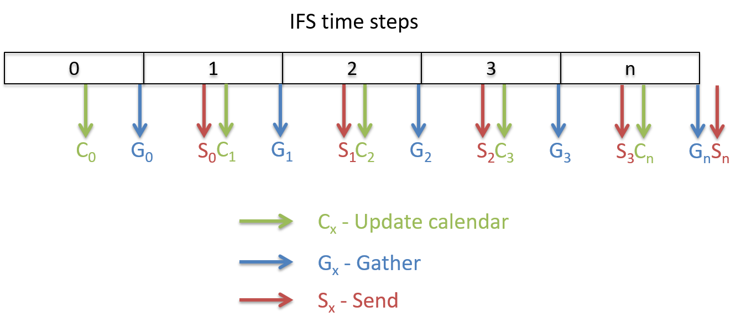
Overlapping computation and communication
We used a new output scheme to truly overlap XIOS communication with IFS computation
It splits the three needed steps to output data through XIOS:
33

Slide 34
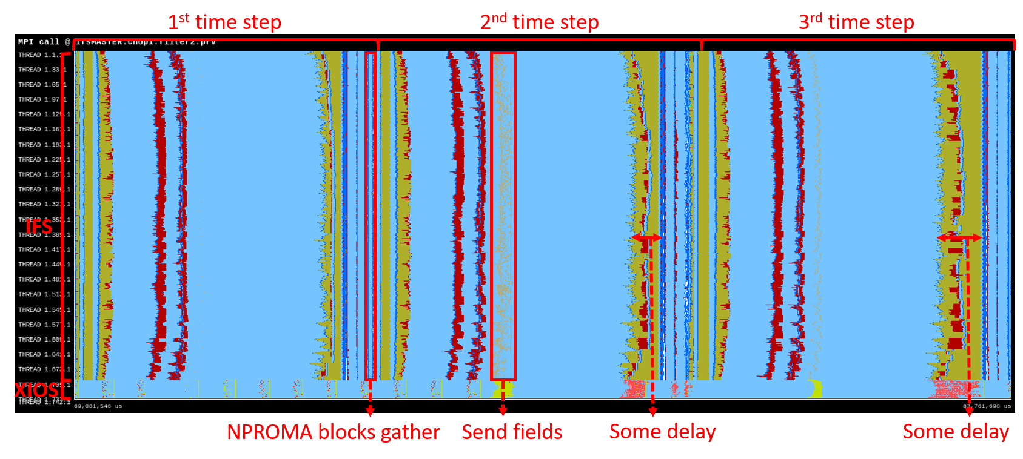
Overlapping computation and communication
The trace shows that there is no delay at the beginning of the 2nd and 3rd time steps. However, there is some delay at the end, but it is less significant
The execution time is reduced 122 seconds (Pre-FullPos)
34

Slide 35
5. Evaluation

Slide 36
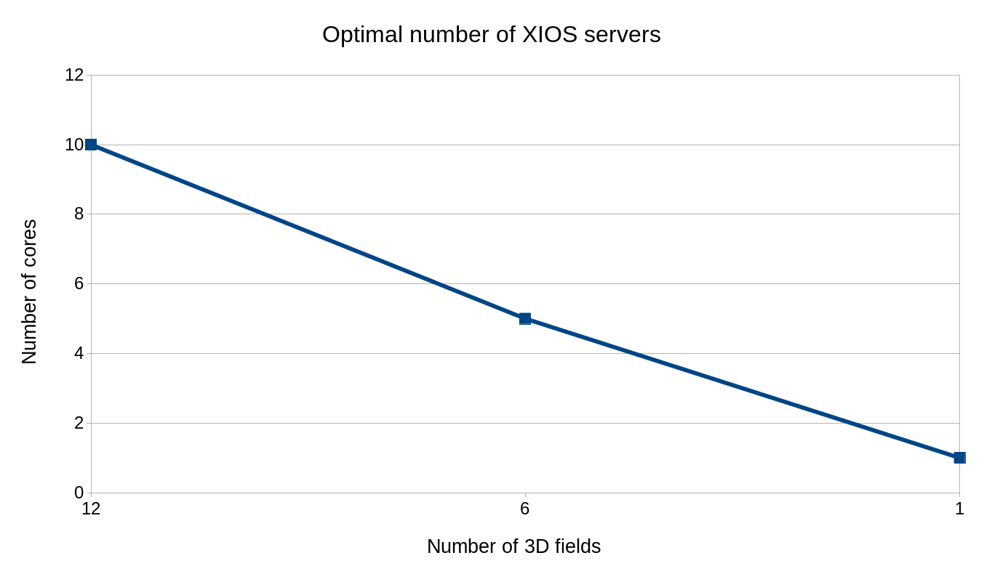
Optimal number of XIOS servers
36

Slide 37
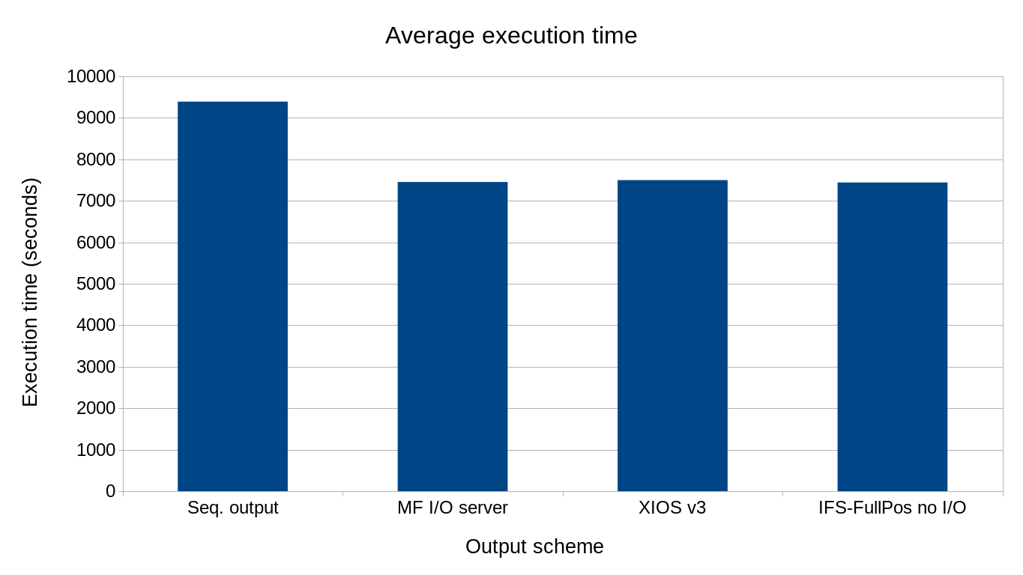
Comparison test
37

Slide 38
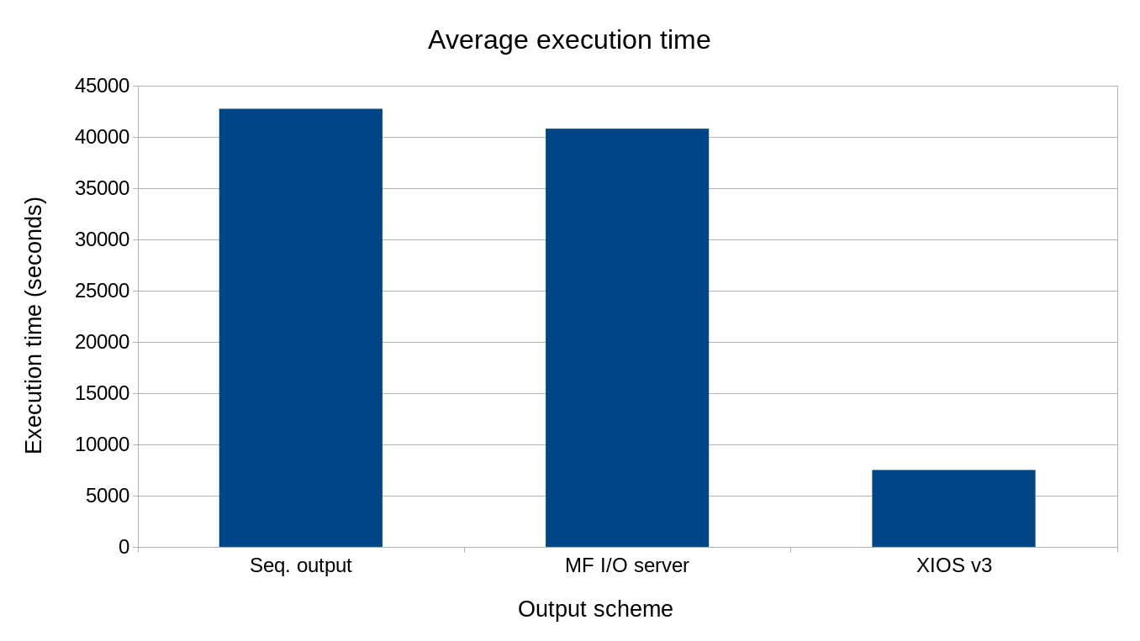
Comparison test adding GRIB to netCDF post-processing
38

Slide 39
6. Conclusions

Slide 40
Conclusions
We have presented an easy-to-use development
The integration with no optimization already improved the execution time:
Sequential output 9391 seconds (20.7% of overhead) → IFS-XIOS integration 7682 seconds (3.1% of overhead)
Using OpenMP to parallelize the NPROMA blocks gather, the execution time is reduced by 80 seconds
It is really important to make an scalable gather, because it could become a bottleneck for future higher grid resolutions
40

Slide 41
Conclusions
Using an optimized compilation of XIOS, the execution time is reduced by 103 seconds
This optimization proves that it is important to compile external libraries using the best optimization flags
Using a better overlapping between IFS computation and XIOS communication, the execution time is reduced by 122 seconds (Pre-FullPos experiment)
It is sometimes necessary to analyse in which places computation and communication can be effectively overlapped
41

Slide 42
Conclusions
Performance highlights of the most optimized version:
It only has a 0.7% of overhead
Within 56 seconds IFS outputs 2.5 TB of data
When post-processing to convert GRIB to netCDF files is taken into account:
The post-processing takes 9.2 hours (sequentially performed, as in EC-Earth)
Thus, the most optimized version is a 5.7x faster than the sequential output and a 5.4x faster than the MF I/O server
42

Slide 43
Conclusions
These numbers denote that we have implemented an scalable and efficient development that will address the I/O issue
In EC-Earth, this new I/O development will:
Increase the performance and efficiency of the whole model
Perform online post-processing operations
Save thousands of computing hours
Save storage space, because it will only store processed data ready to be used
43

Slide 44
Conclusions
These numbers denote that we have implemented an scalable and efficient development that will address the I/O issue
In EC-Earth, this new I/O development will:
Increase the performance and efficiency of the whole model
Perform online post-processing operations
Save thousands of computing hours
Save storage space, because it will only store processed data ready to be used
Save money!
44

Slide 45
Ongoing and future work
Use FullPos to transform fields from spectral space to grid-point space, post-process and send them to XIOS
The development done for IFS will be ported to OpenIFS
Adapt the EC-Earth model to generate online diagnostics from OpenIFS and NEMO components through XIOS
45

Slide 46
Thank you!
xavier.yepes@bsc.es

Slide 47
Computational aspects and performance evaluation of the IFS-XIOS integration
Xavier Yepes-Arbós, BSC
Mario C. Acosta, BSC
Gijs van den Oord, NLeSC
Glenn Carver, ECMWF
18th workshop on high performance computing in meteorology, ECMWF, UK
24/09/2018

