Slide 1
Bordeaux, April 10-13, 2016
Climate predictions for vineyard management
A.Soret¹, N.Gonzalez¹, V.Torralba¹, N.Cortesi¹, M. Turco, F. J.Doblas-Reyes^{1, 2}
¹Barcelona Supercomputing Center, Barcelona (BSC), Spain
²Institució Catalana de Recerca i Estudis Avançats (ICREA), Spain

Slide 2
Outline
Introduction to climate predictions and their application in key sectors of society.
Predictability of seasonal forecast simulations.
On-going development at BSC exploring the applicability of seasonal predictions to agriculture and viticulture.
Potential applications of climate predictions for vineyard management.
Preliminary results.
Conclusions

Slide 3
Introduction
Introduction to climate predictions
Weather forecasting: Initial-value problems
Climate projections: forced boundary condition problem.
Climate predictions (sub-seasonal, seasonal and decadal) in the middle.
Weather forecasts
Climate predictions
Climate-change projections
Sub-seasonal
Seasonal
Decadal
1-15 days
10-32 days
1-15 months
2-30 years
20-100 years
Time
Initial-value
driven
Boundary-condition
driven
Adapted from: Meehl et al. (2009)
Notes:
Schematic illustrating progression from initial value problems with daily weather forecasts at one end, and multidecadal to century projections as a forced boundary condition problem at the other, with seasonal and decadal prediction in between.
Progression from initial-value problems with weather forecasting at one end and multi-decadal to century projections as a forced boundary condition problem at the other, with climate prediction (sub-seasonal, seasonal and decadal) in the middle. Prediction involves initialization and systematic comparison with a simultaneous reference

Slide 4
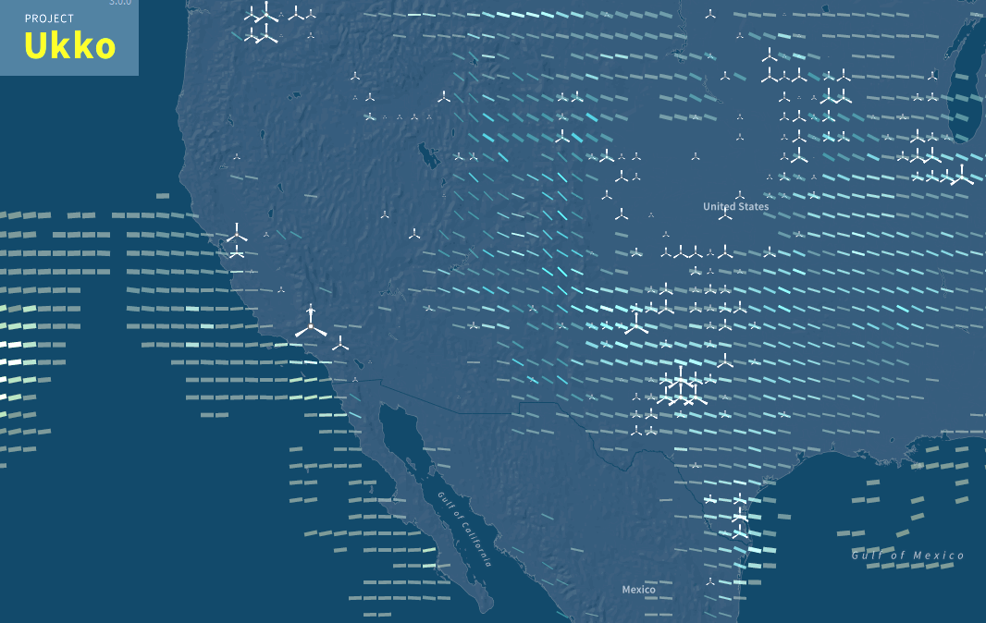
Introduction
Introduction to climate services
Viticulture sector routinely uses weather forecast up to 15 days. Beyond this time horizon, climatological data are used.
In other sectors, climate information on seasonal-to-interannual time scales have already been illustrated for management decisions.
http://project-ukko.net/
Notes:
While the energy sector has routinely been using weather forecast out up to 15 days (Dubus, 2010), beyond this time horizon, climatological data (typically 30-years averages) are used. A common assumption in this method is that future conditions will be similar to past conditions. This assumption entails two inherent shortcomings. The first one is that past conditions can be highly variable, which can make them of limited use when guessing the future. The second one is that climatology cannot predict events which have never happened before, i.e. extreme events, which can be particularly harmful and whose prediction is of special interest for stakeholders. Our knowledge of climatology is based on a finite sample of past events. This sample is limited in time, and doesn’t need to be fully representative of what can happen. Moreover, a climatological approach does not take into account changes in atmospheric dynamics, such as those caused by climate change. Climate change may render past conditions useless for predicting future events, as they may no longer hold true.

Slide 5
Seasonal forecast predictability
How can we predict climate for the coming season if we cannot predict the weather next week?
Weather forecasts
The forecasts are based in the initial conditions of the atmosphere, which is highly variable and develops a chaotic behaviour after a few days
Climate predictions
The predictions are based in the initial conditions of the sea surface temperature, snow cover or sea ice, which have a slow evolution that can range from few months to years.
Notes:
Climate predictions don’t have usable skill in forecasting on which day a locality will have temperature extremes, etc.
However, climate predictions have nonetheless some skill in predicting anomalies in the seasonal average of the weather i.e., anomalies of the climate. This skill is present regardless of the daily timing of the major weather events within the period. This level of skill for seasonal averages or totals may be useful for sectors impacted by climate variability, such as viticulture.

Slide 6
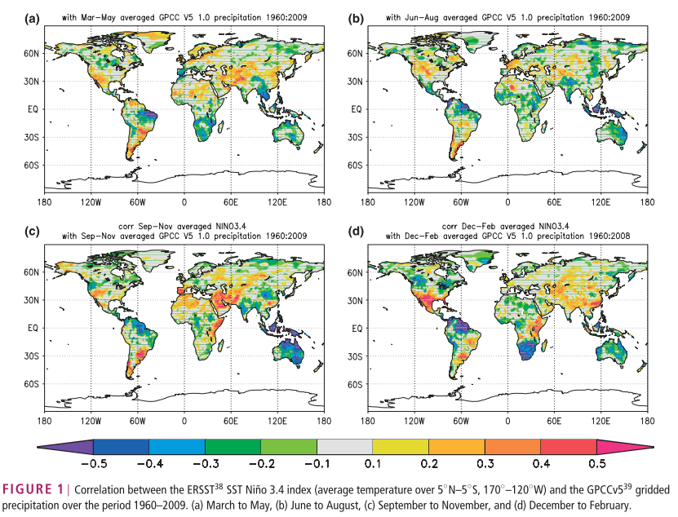
Sources of seasonal predictability
ENSO is the most important source of predictability at seasonal timescales (see e.g. Doblas-Reyes et al. 2013)
Notes:
The predictability of the Surface air temperatura and precipitation patterns, which are the varibles that play the most importatn role to agricluture is linked to our ability to predict the boundary conditions of the climate system such as the SST, especially in the tropics. ENSO is the most important source of predictability at seasonal time scales. The large spatial shifts in tropical Pacific rainfall associated with ENSO lead to large-scale changes in global circulation and precipitation, , which makes ENSO a primary source for predictabilty in remote regions. Figure shows that the linear association of an ENSO index with the local precipitation is high in many regions, even in the extratopics, although the relation has a strong seasonality.

Slide 7
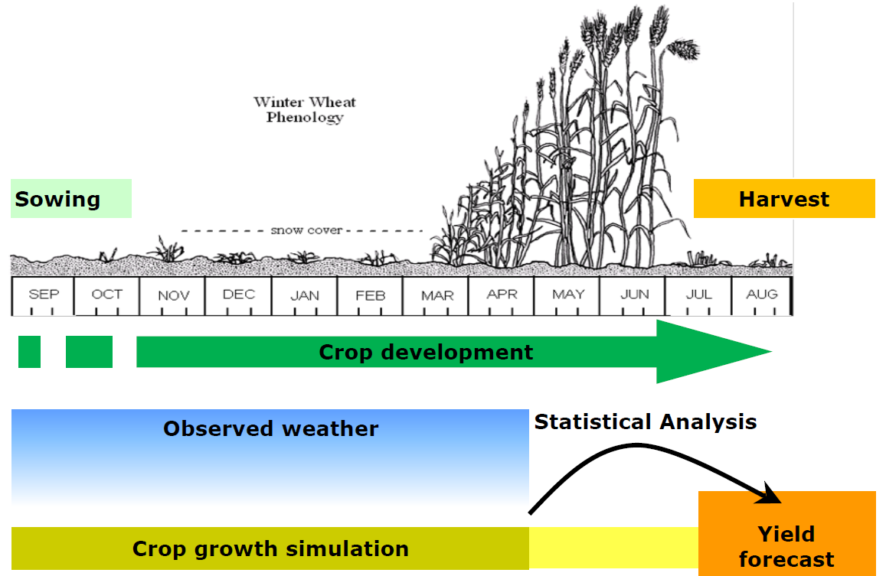
Seasonal forecast for agriculture: on-going developments
Testing seasonal forecast for MARS: BSC and JRC are exploring how the MARS Crop Yield Forecasting System (MCYFS) could ingest the seasonal forecast for a future operational use.
Current approach of MARS
Seasonal forecast
Source: Toreti, 2015.
EUPORIAS

Slide 8
Seasonal forecast for viticulture: on-going activities
SECTEUR PROJECT (negotiation process).
HIATUS (accepted).
Objective: develop a climate service for the wine sector to bridge this communications gap and to ensure that research reaches the industry and society in a timely and usable manner.
Notes:
Understand the specific needs of end users in the wine sector.
Produce comprehensive and reliable set of probabilistic climate information alongside their full verification.
Co-develop user-tailored decision-support materials and tools

Slide 9
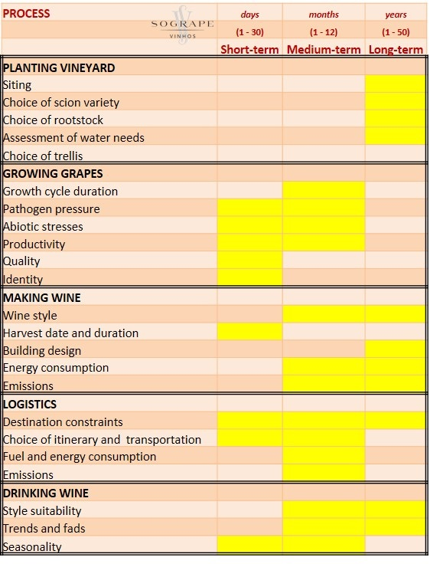
Seasonal forecast applications for vineyard management
Source: Antonio Graça, SOGRAPE VINHOS SA, 2014
Notes:
Wet-dry/Cold-warm
The objective is to provide valuable information for crop management (again, taking into account that the interest is global, not just over Europe). Predicting the climate on inter-annual time scales will be a valuable information for crop management (if a warm year is expected, it is important to maintain the maximum of leaves as possible to protect the plant, while if a humid year is expected, it is important to reduce leaf coverage in order to avoid diseases and fungus).

Slide 10
Seasonal forecast applications for vineyard management: model chain
Seasonal forecast
Tmax, Tmin, precipitation, humidity, radiation, wind speed
End-users empirical models
Phenological and irrigation models
Outcomes:
Critical phenological events
(Bloom, Berry et, veraison and harvest)
Wine alcoholic category
Water demand
Extreme events
Integrated assessment
Notes:
Empirical models. Analog periods

Slide 11
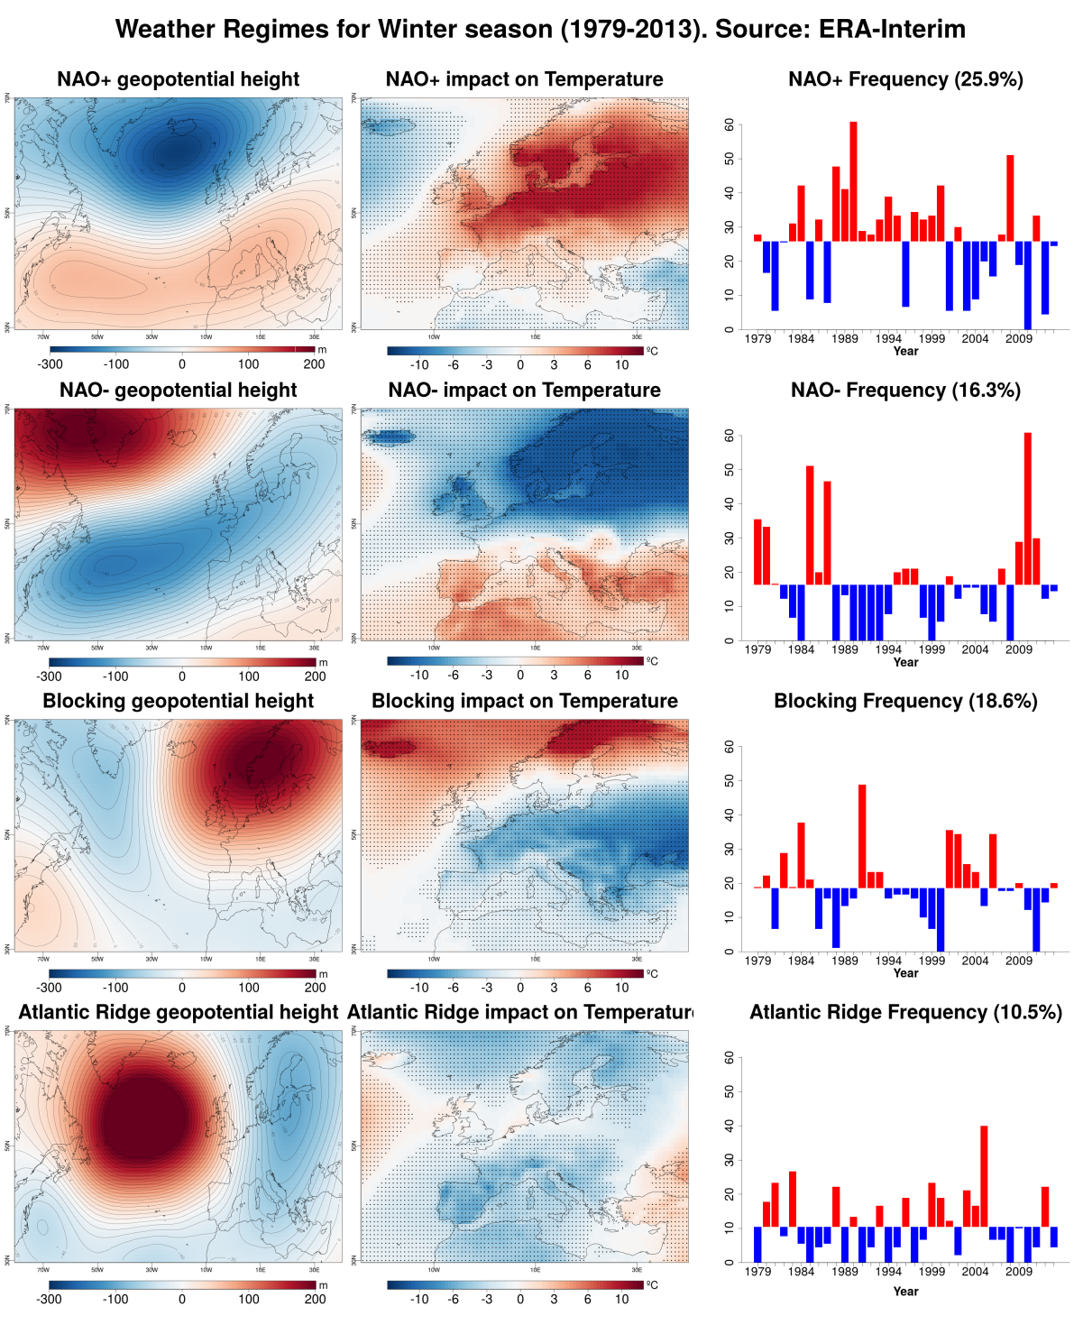
Preliminary results: Weather regimes. Winter
Notes:
Z500 geopotential

Slide 12
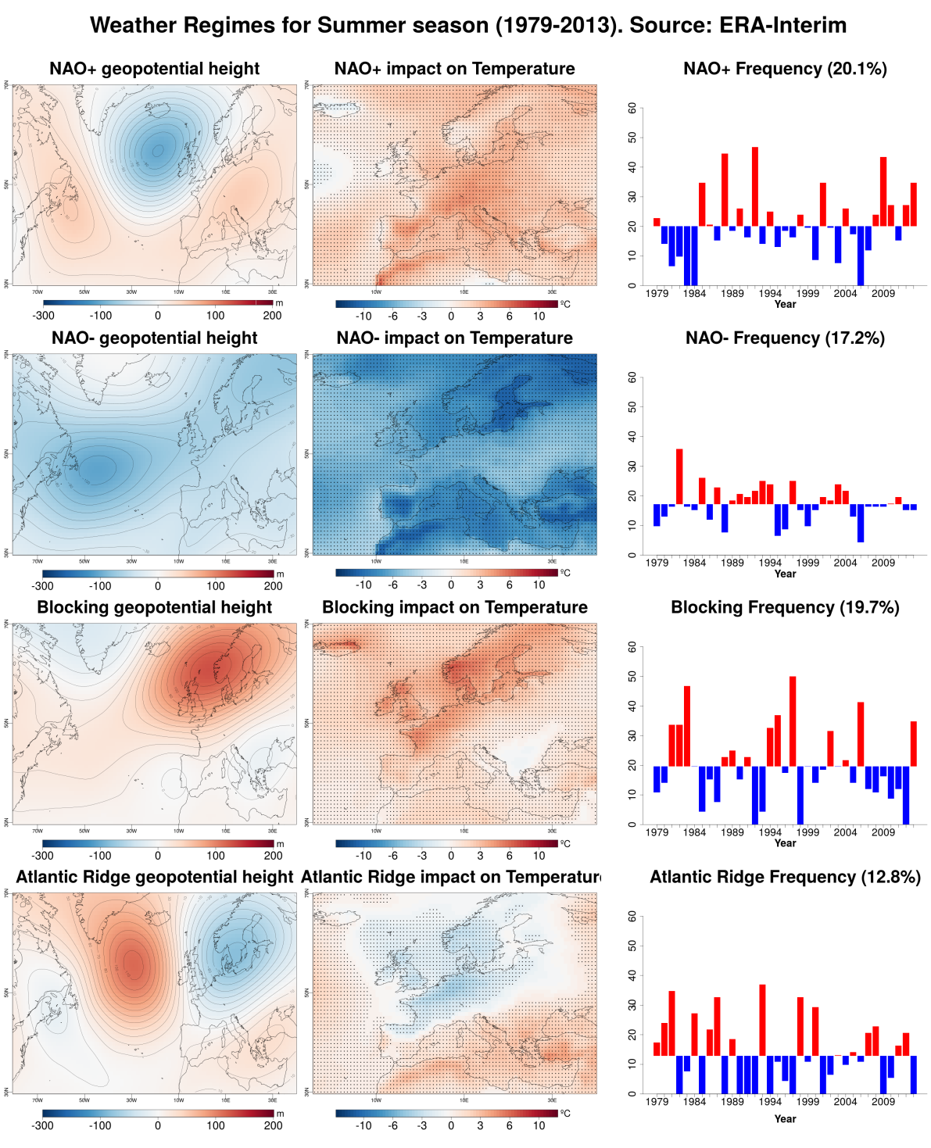
Preliminary results: Weather regimes. Summer
Notes:
Z500 geopotential

Slide 13
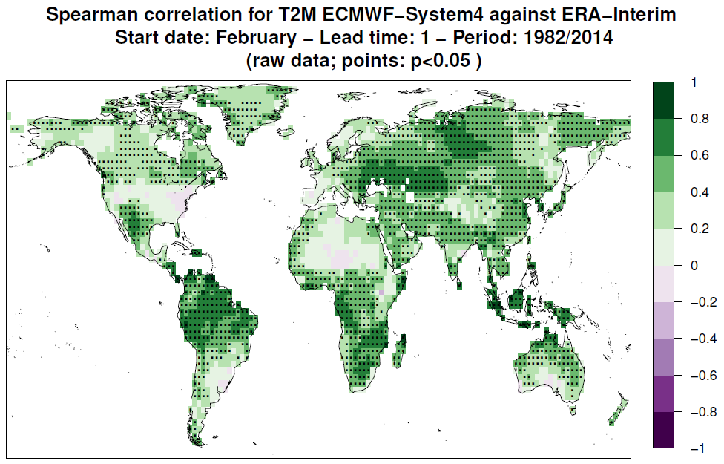
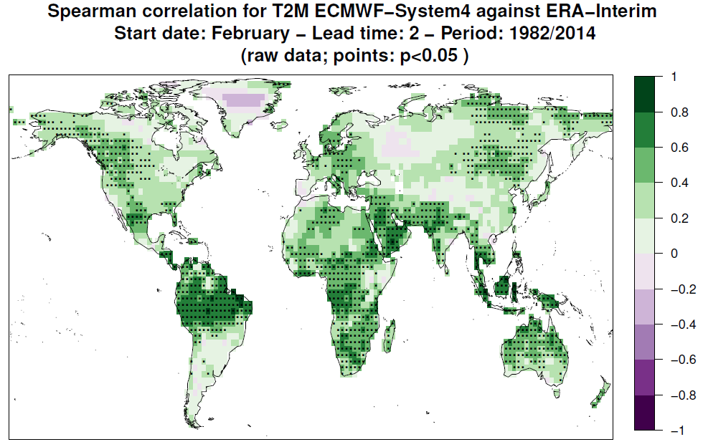
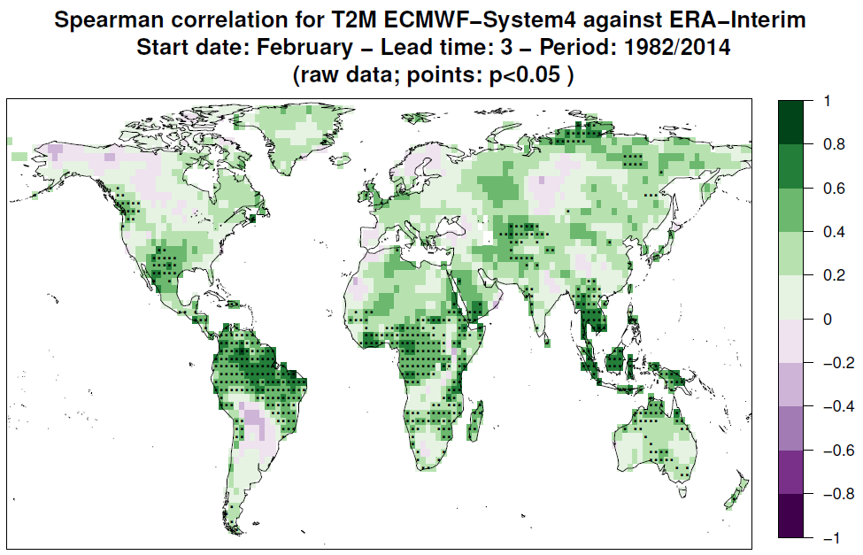
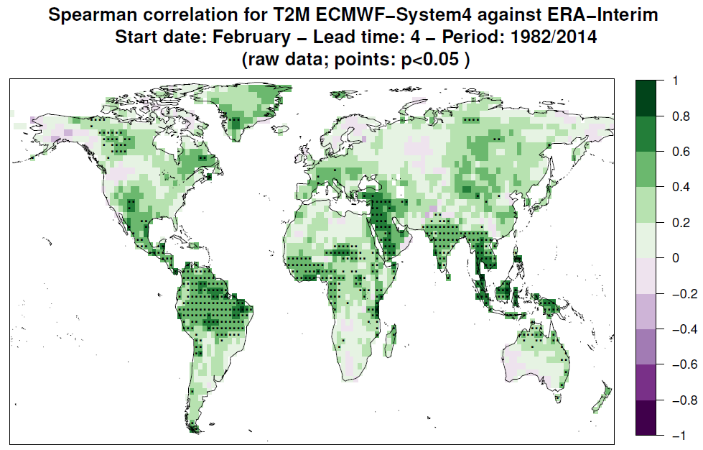
Preliminary results: Skill of seasonal temperature forecasts of ECMWF-System4
Evaluation of surface air temperature CFSv2 forecasts over land grids issued in February for 4 lead times from month-1 to month-5. Spearman correlation considering raw data

Slide 14
Conclusions
Climate predictions have nonetheless some skill in predicting anomalies in the seasonal average of the weather i.e., anomalies of the climate.
This skill is present regardless of the daily timing of the major weather events within the period.
This level of skill for seasonal averages or totals may be useful for sectors impacted by climate variability, such as viticulture.
Now is the time to develop climate services for agriculture based on seasonal forecast predictions. Bridging the gap to ensure that research reaches the industry and society in a timely and usable manner.

Slide 15
Thank you!
For further information please contact:
info-services-es@bsc.es
albert.soret@bsc.es

Slide 16
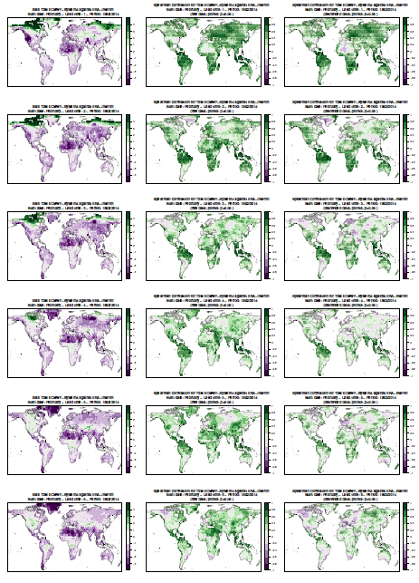
Temperature skill

Slide 17
Ensemble predictions
Ensemble forecast system
Nov 2000 Nov 2001 Nov 2002 Nov 2003 Nov 2004 Nov 2005 Nov 2006
Notes:
Simple diagram illustrating the initialization and production of the multi-model hindcasts.

Slide 18
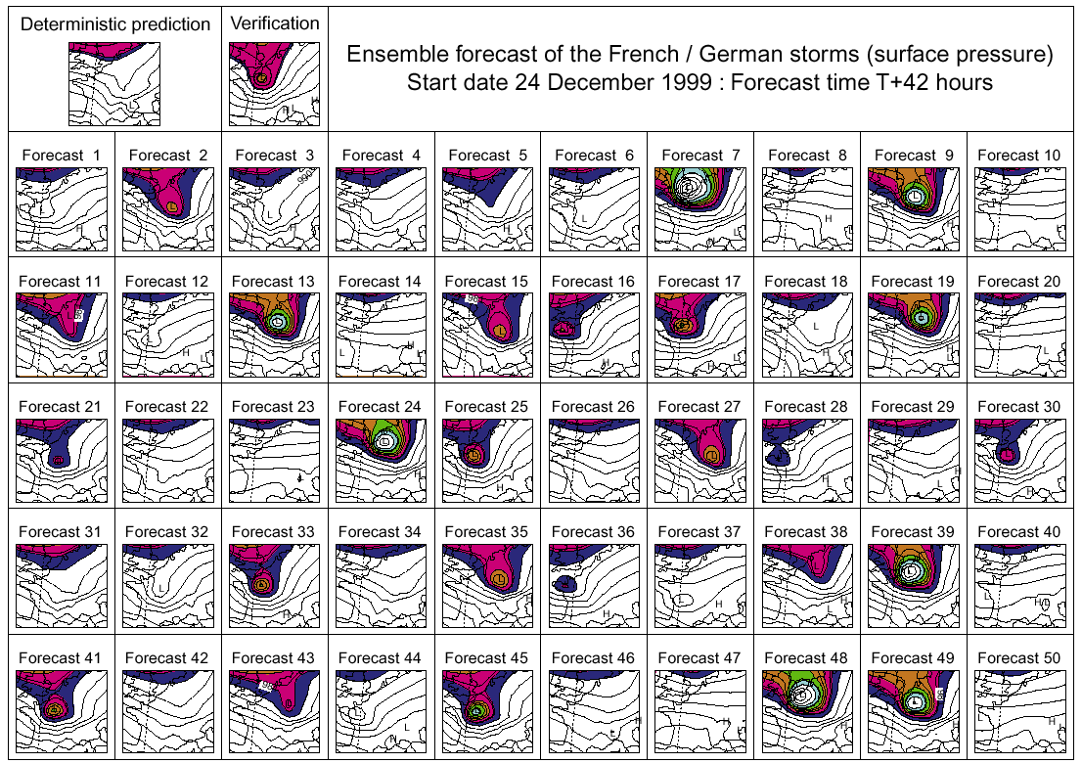
How many members: ensemble size
ECMWF forecasts (D+42) for the storm Lothar
Misses
Notes:
Simple diagram illustrating the initialization and production of the multi-model hindcasts.

Slide 19
How many members: ensemble size
ECMWF forecasts (D+42) for the storm Lothar
Misses
Notes:
Simple diagram illustrating the initialization and production of the multi-model hindcasts.

Slide 20
How many members: ensemble size
ECMWF forecasts (D+42) for the storm Lothar
With a large enough ensemble size, the very rare event can be forecast with a probability of 9/50, i.e. ~20%
Misses
Notes:
Simple diagram illustrating the initialization and production of the multi-model hindcasts.

Slide 21
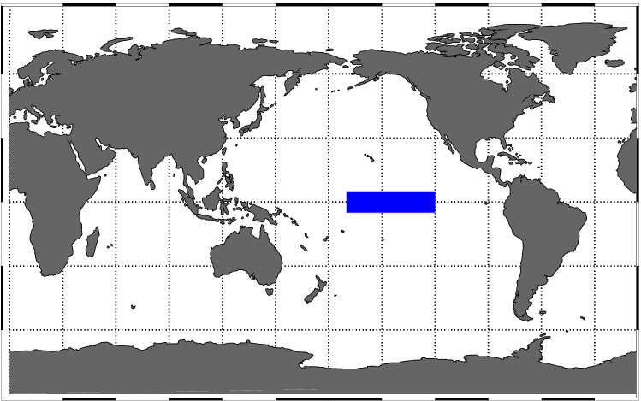
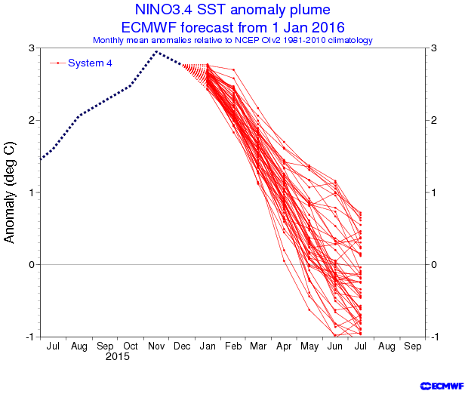
ENSO ensemble predictions

Slide 22
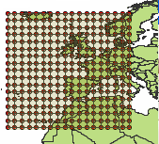
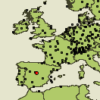
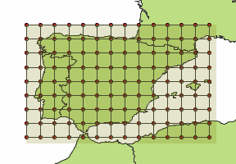
Bias correction/downscaling
Perfect prognosis approach:
In the training phase the statistical model is calibrated using observational data for both the predictands and predictors (e.g. reanalysis data)
Typical techniques: transfer functions, analogs, weather typing, weather generators, etc. (Maraun et al. 2010)
Predictors
Downscaling
Model
Predictands
(SLP, T(850 hPa);
T(700 hPa),..., Z(500 mb))
X_{n}
Precipitation Temperature
Regres, Analogs, …
Y_{n} = W^{T} X_{n}
Y_{n}
Global zone
Local zone
Source: José M. Gutiérrez, University of Cantabria

