Slide 1
Predicting wind power markets:
A new generation of climate risk
management tools
Isadora Ch. Jiménez ¹
Melanie Davis¹, Francisco Doblas-Reyes^{1,2,3}, Verónica Torralba Fernandez¹, Nube Gonzalez-Reviriego¹
¹ Climate Forecasting Unit, Catalan Institute of Climate Science (IC3)
² Institució Catalana de Recerca i Estudis Avançats (ICREA)
³ Barcelona Supercomputing Center (BSC)
International colloquium on “Large Wind-power plants: Interaction, control and integration”
8-10 July 2015, Leuven, Belgium
Notes:
Current site selection practices use the retrospective wind speed climatology, with an assumption that the past will also represent the future. Recent advances in climate predictions can provide a more informative view by modeling future wind over months to decades: they use both an analysis of the past climate system, as well as its current state at the specific time when the prediction is created to provide a probability of different future outcomes, with an indication as to which will be the most likely.
It has been demonstrated that climate predictions can improve upon using climatology at some spatial and temporal scales, so decision makers now have a new set of climate risk management tools that can strengthen their decision making, but are they ready to use them?

Slide 2
Past
Seasons
Years
Today
Hours
Days
Weeks
Months
Decades
Century
DIAGNOSTIC
FORECAST
PREDICTION
PROJECTION
Worldwide only & work in this timeframe
Partners in European projects (FP7 and H2020) in collaboration with private wind sector (EDPF, Vortex, EDPR…)

Slide 3
SPECS: Seasonal-to-decadal climate Prediction for the improvement of European Climate Services
http://www.specs-fp7.eu/
EUPORIAS: EUropean Provision Of Regional Impact Assessment on a Seasonal-to-decadal timescale
http://www.euporias.eu/
NEWA: New European Wind Atlas
http://euwindatlas.eu/
Notes:
Climate predictions come with a new set of challenges for end users: information is often un-tailored and hard to understand or apply in a decision-making context. A new generation of European projects, including NEWA, SPECS and EUPORIAS aim to address these challenges and support the development of a new realm of climate services and tools using climate predictions. Here we will present the state-of-the-art in wind speed and power prediction methodologies, to include: initialisation of ensemble simulations; post-processing using bias correction or calibration and validation to assess the prediction skill, as well as new climate prediction visualisation tools and interfaces tailored to the energy sector.
To assess these needs it is need to further tailor, validate, harmonise and improve the presentation and communication of climate information for all timescales in the past and in the future.

Slide 4
Wind power markets have traditionally used the retrospective wind speed climatology, assuming that the past would also represent the future.
Hydroelectric power management
Electricity demand
García-Morales & Dubus 2007
De Felice, Alessandri & Catalano 2015
Notes:
Wind resource is one of the fastest growing and most volatile forms of electric power generation, improved forecast beyond the first tow weeks of renewable power generation can improve the strategic and operational management of renewable power during the pre- and post-construction phase.

Slide 5
Pre-Construction Decisions: Annual to Decadal Timescales
Wind farm planners: Site selection
Wind farm investors: Evaluate return on investments
Policy makers: Understand changes to energy mix
Post-Construction Decisions: Monthly to Seasonal Timescales
Energy producers: Resource management strategies
Energy traders: Resource effects on markets
Wind farm operators: Planning for maintenance works
Wind farm investors: Optimize return on investments
Notes:
- For the pre-construction phase, forecasts (from annual to decadal timescales) support strategic decisions for these end-users: investors, planners, policy makers.
Information to answer questions such as: where should I locate my farm, what is the risk to my investment, how will the national energy mix change over time?

Slide 6
Climate predictions for wind power markets:
Wind speed
Capacity factor
NAO+ and NAO- seasons and correlation with wind and Capacity factor

Slide 7
Seasonal wind power predictions: probabilistic predictions
We don’t provide deterministic predictions
Data from ECMWF (European Centre for Medium-Range Weather Forecasts)
We run multiple models and assess the global behaviour providing a probabilistic predictions
Aggregated output in terciles:
Above normal
Normal
Below normal

Slide 8
Seasonal wind power predictions: probabilistic predictions

Slide 9
Aimed at the wind energy sector, RESILIENCE goal is to provide user-friendly tools to produce information of the future variability in wind speed and wind power resources based on probabilistic climate predictions
Notes:
Within RESIÇLIENCE we are working in a visualization tool called project UKKO

Slide 11
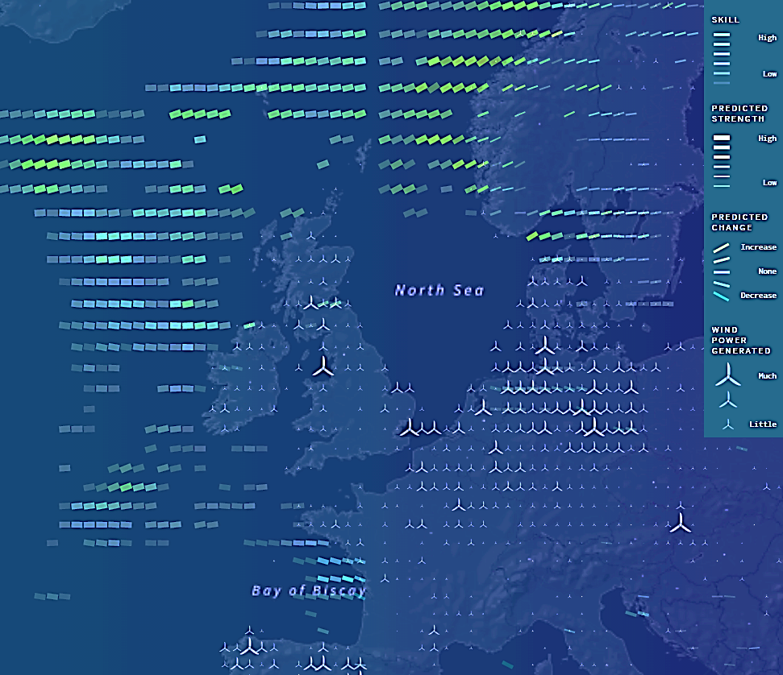

Slide 13
Transparency
SKILL
Slope
PREDICTED
CHANGE
Line width
WIND
STRENGTH

Slide 14
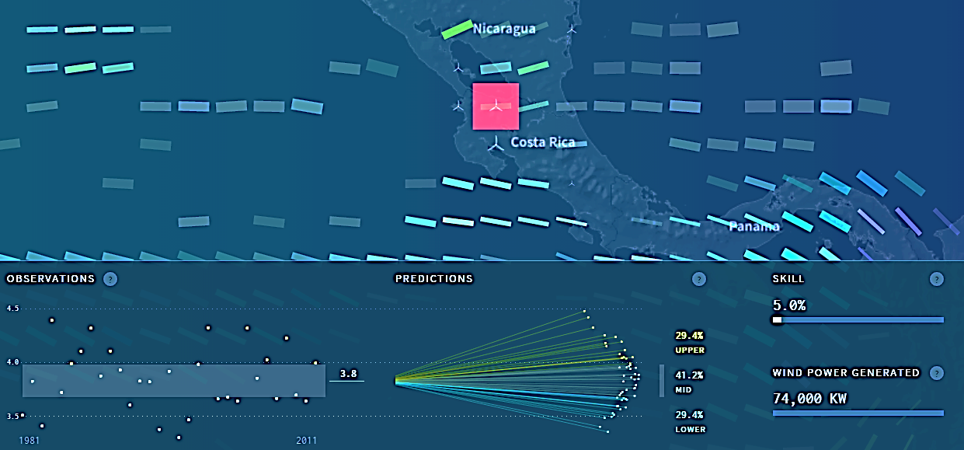
HISTORICAL
OBSERVATIONS
PROBABILISTIC
PREDICTIONS
SKILL
+
WIND POWER
GENERATED

Slide 15
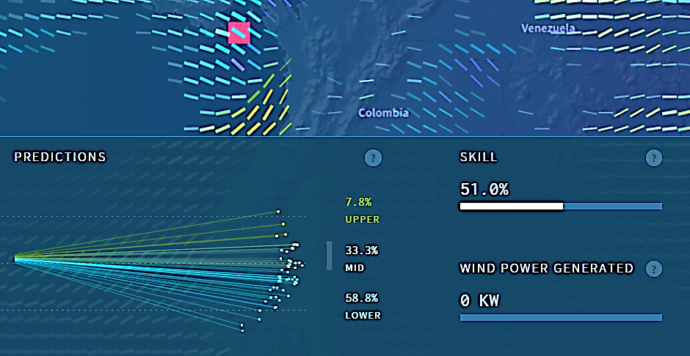
Lower tercile example

Slide 16
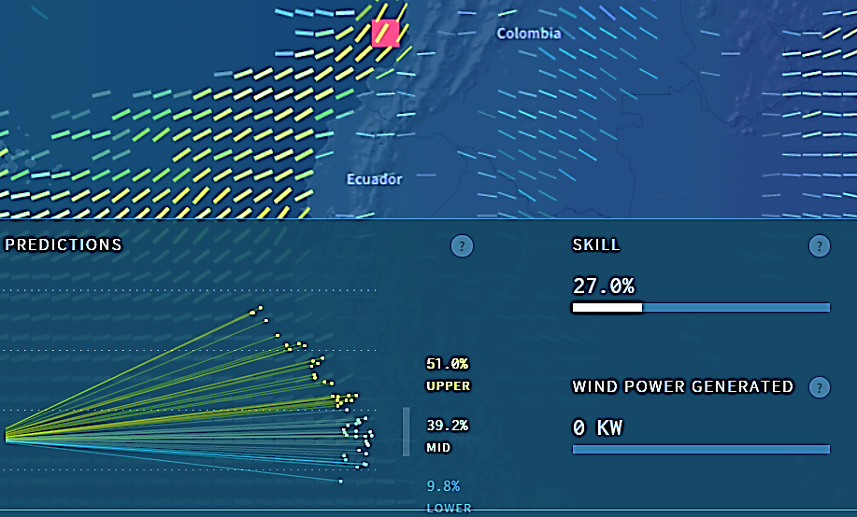
Higher tercile example

Slide 17
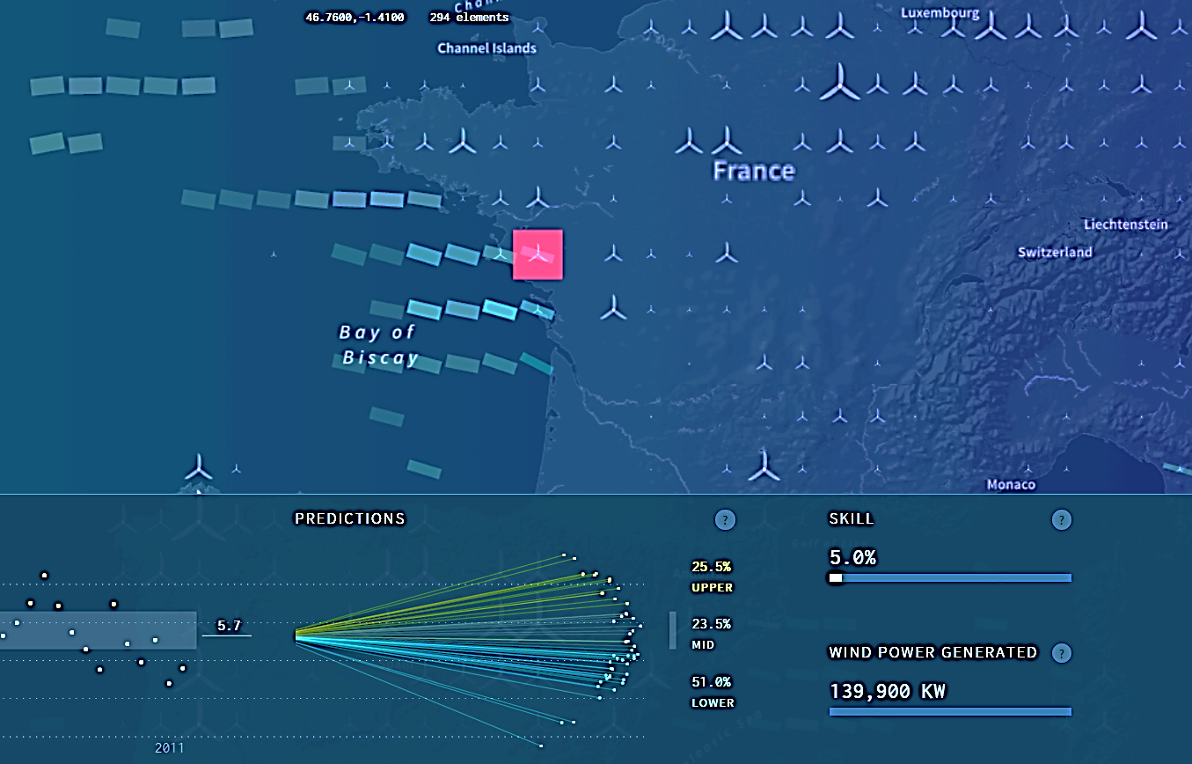
In Europe there are large areas without skill

Slide 18
If you are interested we will present an operative version at:
Contact us for further information
Info-services-es@bsc.es

Slide 19
Thank you!
For further information:
isadora.jimenez@bsc.es
info-services-es@bsc.es
International colloquium on “Large Wind-power plants: Interaction, control and integration”
8-10 July 2015, Leuven, Belgium

