Slide 1
Towards an optimal use of numerical precision in Earth Sciences models: the case of NEMO
Oriol Tintó Prims
PhD Candidate
18/04/2018
8th JLESC @ Barcelona

Slide 2
Outline
Motivation
Method
Proof of concept
Discussion and collaboration

Slide 3
Motivation

Slide 4
Motivation
“Mixed precision algorithms can easily provide substantial speedup for very little code effort. ”

Slide 5
Motivation
There are smart strategies to use less precision to solve problems that originally required higher precision.
Many times, that’s not even necessary because the higher precision is not required in the first place.

Slide 6
Motivation
We need a method to find which variables can effectively use less precision without compromising the quality of the outputs.

Slide 7
Method

Slide 8
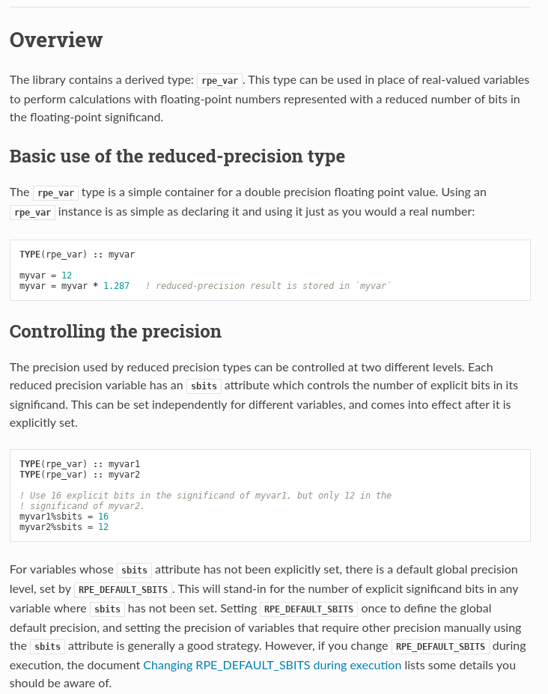
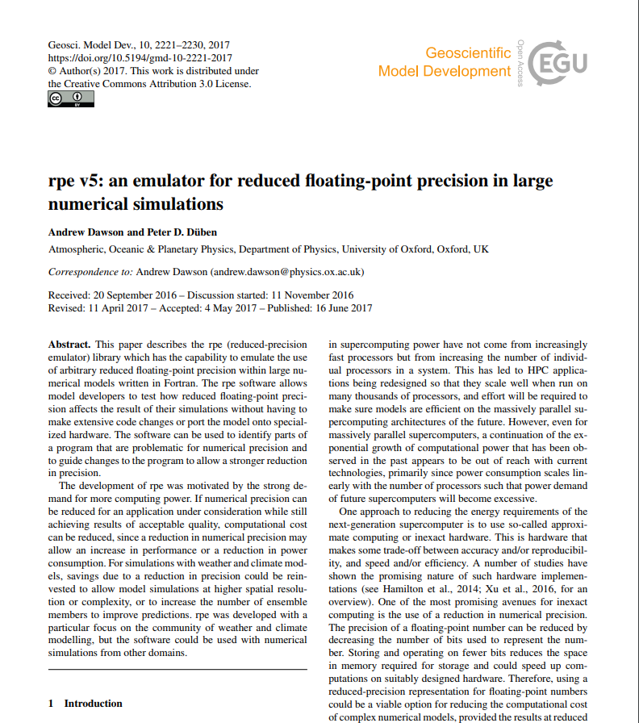
Reduced Precision Emulator
Fortran Library developed by the Atmospheric, Oceanic & Planetary Physics group, within the University of Oxford Department of Physics

Slide 9
Method
Implement the emulator
Design the tests
Launch the simulations

Slide 10
Proof of concept

Slide 11
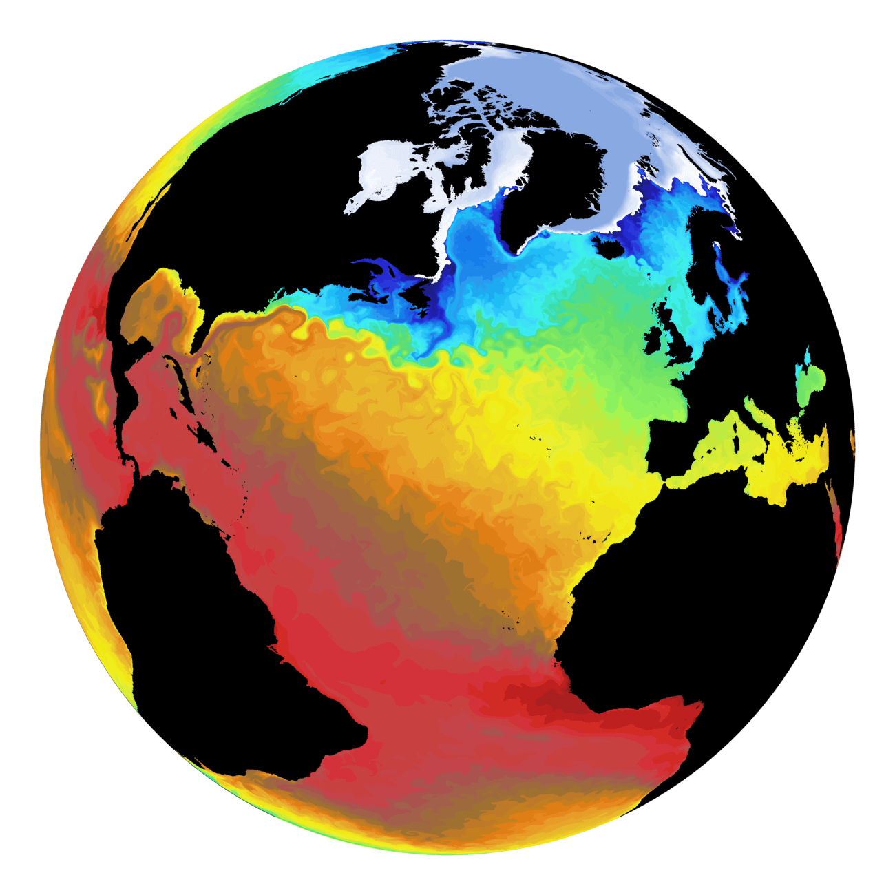
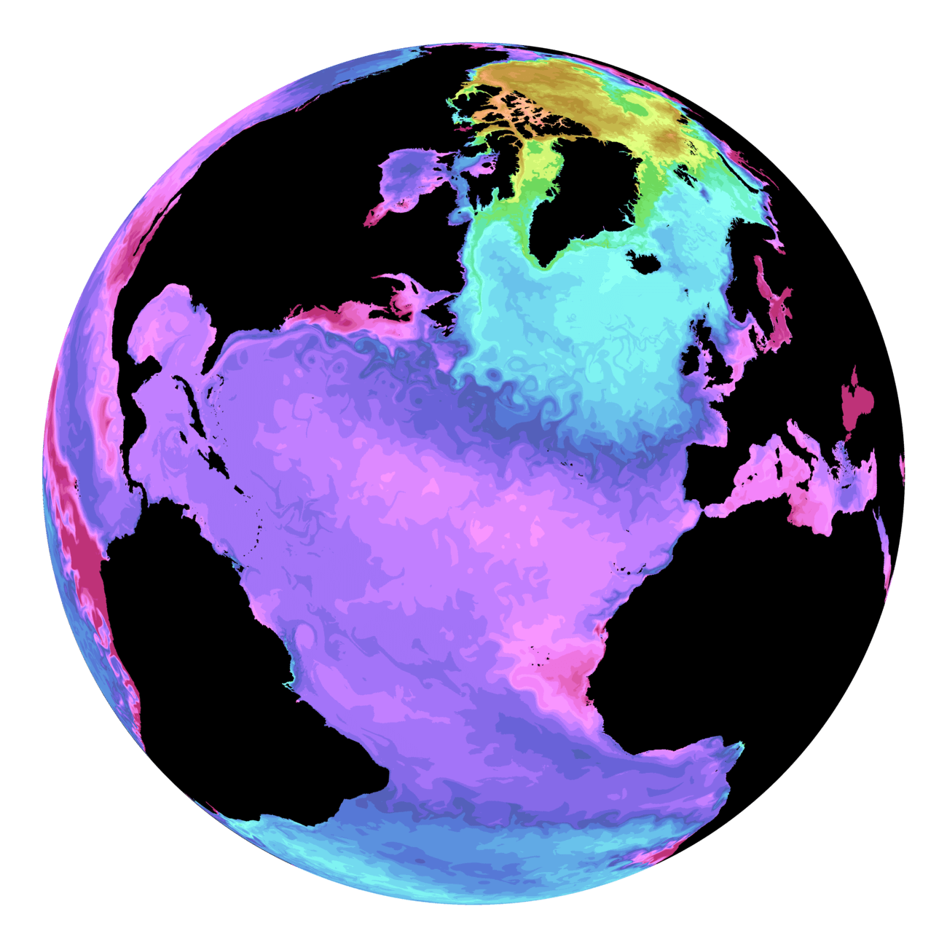
Proof of concept
v3.6
Current Velocity
Chlorophyll
Sea Surface Temperature
PH

Slide 12
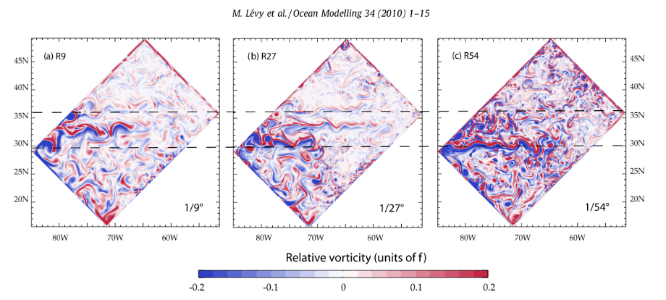
Proof of concept
v3.6
GYRE 1
This configuration uses 3509 real variables

Slide 13
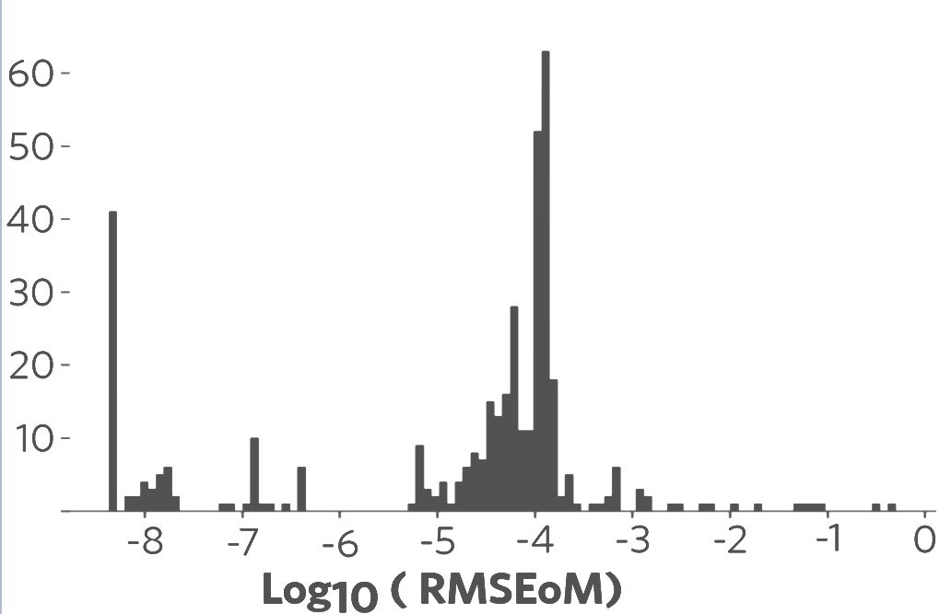
Proof of concept
392
3117
3509
89% of the variables can use 10 bit for the significand without adding significant error

Slide 14
Discussion

Slide 15
Possible points of collaboration
CONCLUSIONS:
There is a huge room for precision reduction in Earth Science models without affecting the accuracy of the results.
The proposed methodology proved to be useful.
POSSIBLE COLLABORATIONS AND OPEN ISSUES:
Bring the results to an actual mixed-precision implementation.
Anybody using (FORTRAN) models and willing to test the same approach.
Extrapolativity of the results:
Configuration, resolution, initial conditions, long term effects, ...
Identifying and correcting algorithms that have less precision-dependant alternatives.
Study further ways to exploit precision reduction (fixed-point representations, adaptive precision, ... ).
All the steps in the general workflow can be improved.

Slide 16
Thank you
oriol.tinto@bsc.es

