Slide 1
Preparados para el calor y para el frío extremos? / Are we ready for hot and cold extremes? (Part I)
Virginie Guemas
Climate Prediction Group
Earth Sciences Department
Barcelona, 8 October 2015

Slide 2
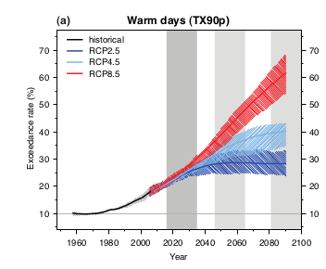
Hot extremes in the future
Warm days defined as the annual % of days when the maximum daily temperature (Tmax) exceeds Tmax of 90% of days over 1961-1990
Interquartile range
Median
Extracted from the 5th Assessment Report of the Intergovernmental expert Panel on Climate Change

Slide 3
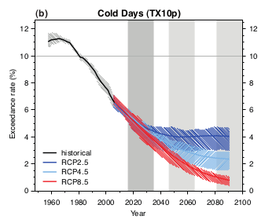
Cold extremes in the future
Cold days defined as the annual % of days when the minimum daily temperature (Tmin) is below Tmin of 90% of days over 1961-1990
Interquartile range
Extracted from the 5th Assessment Report of the Intergovernmental expert Panel on Climate Change
Median

Slide 4
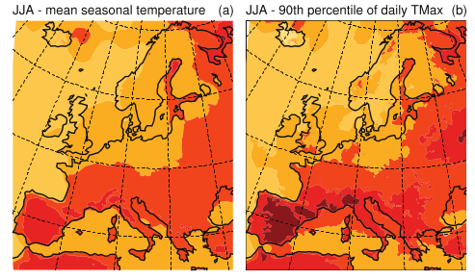
Hot summer extremes in the future
Changes in boreal summer (June to August) surface temperature for
2016-2035 relative to 1986-2005
a) Seasonal average b) Threshold 90% of Tmax
Extracted from the 5th Assessment Report of the Intergovernmental expert Panel on Climate Change

Slide 5
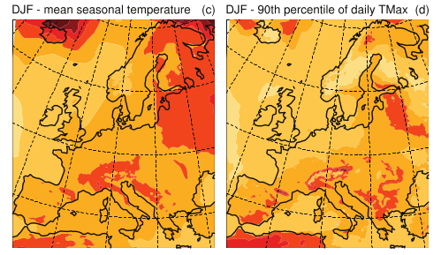
Hot winter extremes in the future
Changes in boreal winter (December to February) surface temperature for 2016-2035 relative to 1986-2005
a) Seasonal average b) Threshold 90% of Tmax
Extracted from the 5th Assessment Report of the Intergovernmental expert Panel on Climate Change

Slide 6
Conclusions
Doubling of the frequency of hot extremes and decrease by about half of the frequency of cold extremes in the coming decade whichever emission pathway society follows
Increase by 25% to 70% of the frequency of hot extremes and decrease down to nearly 0% of the frequency of cold extremes by the end of the century
Largest increase in the temperature of hot summer extremes than in the summer mean temperature over Europe
Weakest increase in the temperature of hot winter extremes than in the winter mean temperature over Europe

