Slide 1
Workshop on workflows Brussels, 13 September 2018
From Autosubmit to Cylc
A community standard for the EC-Earth consortium?
Domingo Manubens

Slide 2
EC-Earth use cases
We conducted a survey among the
EC-Earth community to know
about their use cases and asking
about their needs and expectations
from a workflow management system.
Participants: 34
( 12 countries / 18 institutions )
Country | Institution | # participants
Sweden | Lund (3), SU (2), SMHI (2) | 7
Spain | BSC | 6
Netherlands | KNMI (3), NSC (1), IMAU(1) | 5
Finland | FMI (3), CSC (1) | 4
Belgium | UCL | 3
Germany | AWI (1), KIT (1) | 2
Denmark | DMI | 2
Italy | ENEA | 1
Norway | UiB | 1
Portugal | UL | 1
United Kingdom | University of Oxford | 1
Ireland | ICHEC | 1

Slide 3
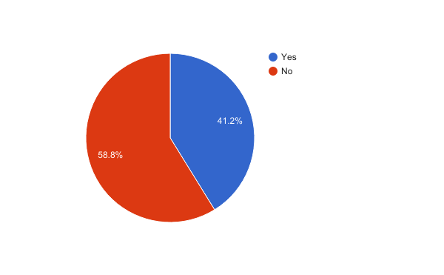
EC-Earth use cases
Have you used a workflow management system?

Slide 4
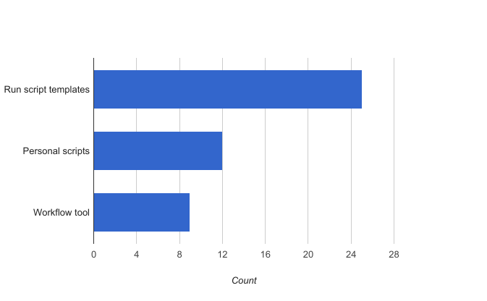
EC-Earth use cases
How do you run EC-Earth?

Slide 5
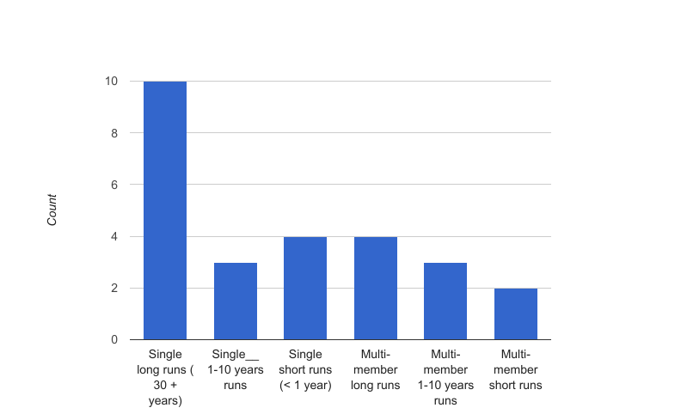
EC-Earth use cases
Model simulation production

Slide 6
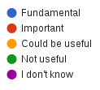
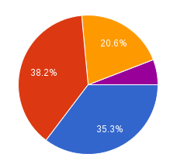
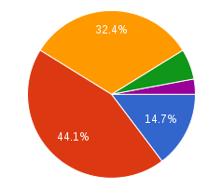
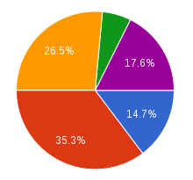
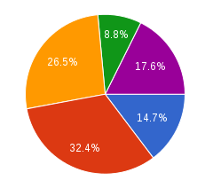
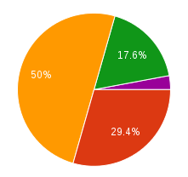
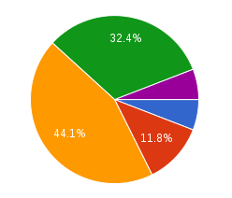
EC-Earth use cases
Database
E-mail notifications
Complex workflows
Jobs wrapper
GUI
Clock triggered jobs

Slide 7
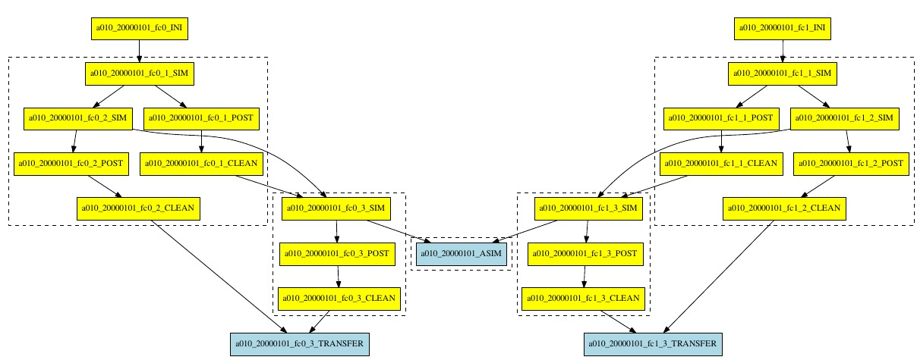
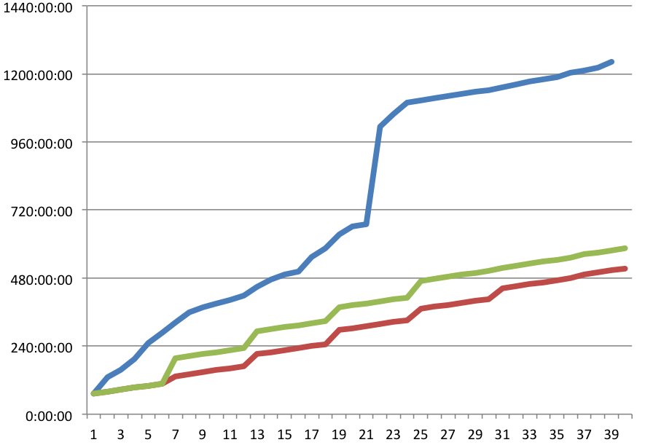
Autosubmit wrappers (job clustering)
Motivation: to improve the throughput by reducing queueing time by wrapping different jobs together.

Slide 8
Vertical wrapper
The status of each job is checked and updated
Failures are detected, also when a job is running for longer than its wallclock
In this case, the whole wrapper job is cancelled, and, if there are retrials, resubmitted from the point of failure
[wrapper] TYPE = vertical JOBS_IN_WRAPPER = SIM POST

Slide 9
Horizontal wrapper
Usage of machinefiles in mpirun identified by the job name
[wrapper] TYPE = horizontal JOBS_IN_WRAPPER = SIM POST

Slide 10
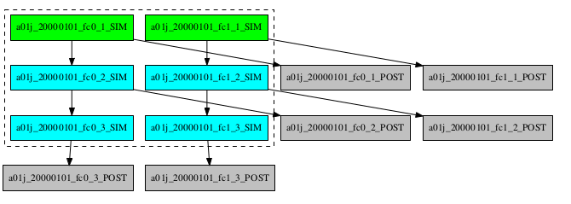
Hybrid wrapper
Mix of vertical and horizontal wrappers
Runs in parallel independent members, each one having a sequence of jobs that depend on one another
[wrapper] TYPE = hybrid JOBS_IN_WRAPPER = SIM

Slide 11
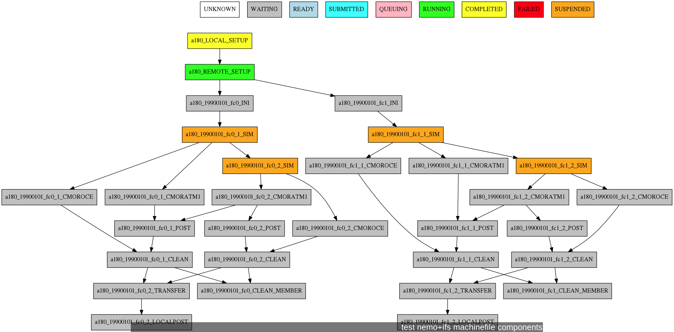
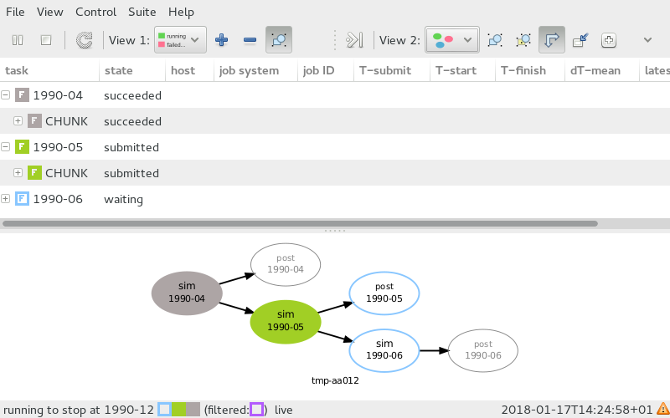
From Autosubmit to Cylc
Some people are interested in a workflow management system common for EC-Earth
Option Autosubmit is available and will be maintained
Option Cylc will be implemented in the next 1-2 years
Notes:
GR autosubmit to cylc

Slide 12
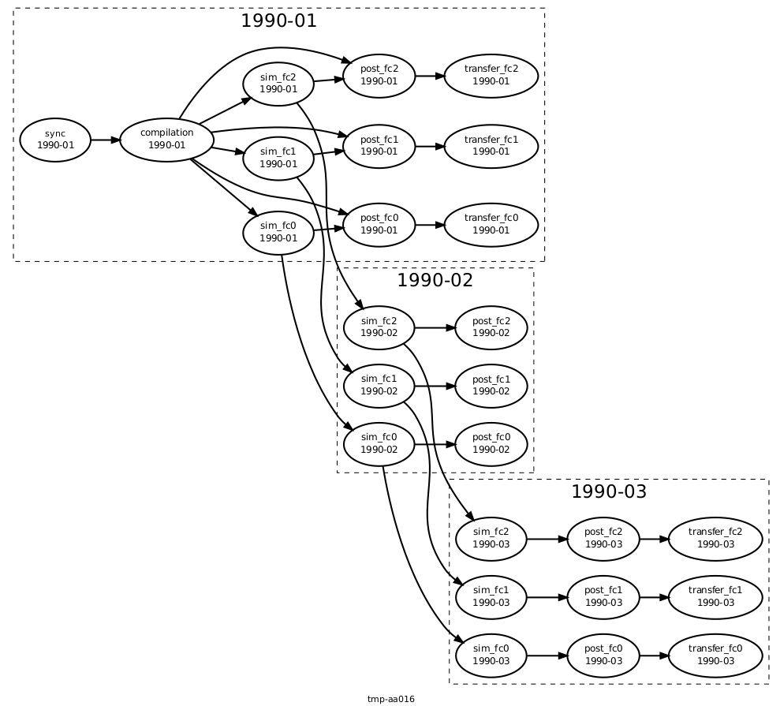
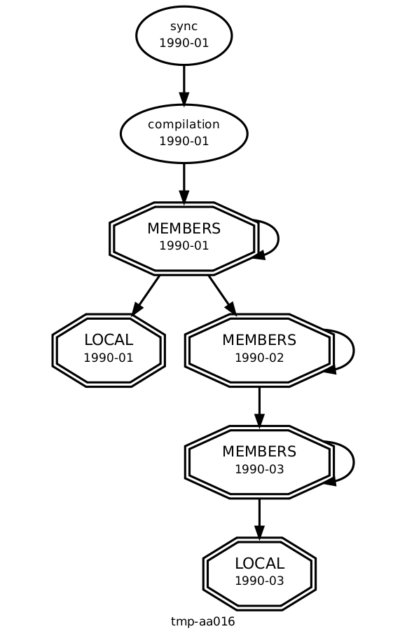
Cylc - workflow engine
Notes:
Cylc + Rosie + Rose description

Slide 13
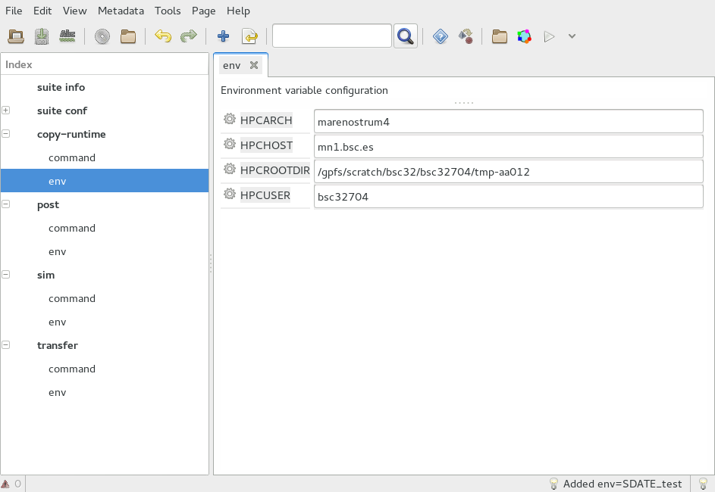
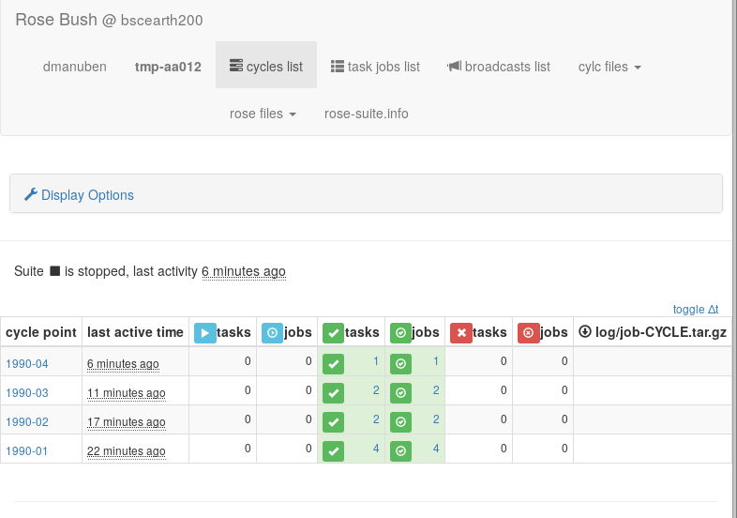
Rose - configuration management, GUI
Goal: to facilitate suite development, management and collaboration
Notes:
- Rose to facilitate suite development, management and collaboration.

Slide 14
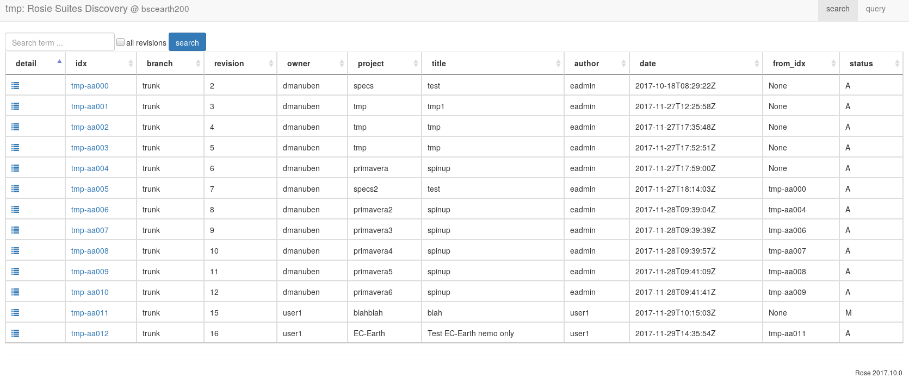
Rosie - experiment database
Goal: version controlling suites and suite discovery and management
Notes:
Rosie server, for version
controlling suites and suite discovery and management, which I find are
of special interest for a community (such as EC-Earth) to collaborate.

Slide 15
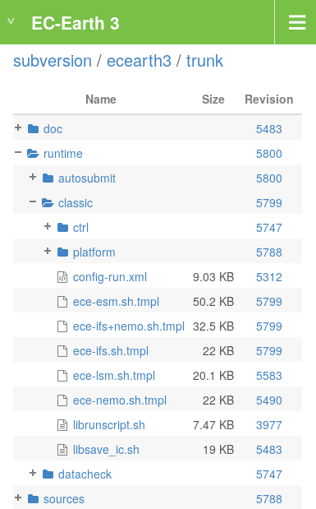
EC-Earth runtime
Basic set of portable runscript templates
Classic
Simulation template for 4 use cases (ESM, GCM, IFS only, NEMO only) single runs, multiple platforms supported
Variable definitions on templates can be overwritten with specific parameters from config-run.xml at runtime
Autosubmit
The same but support for taking parameters from Autosubmit config files

Slide 16
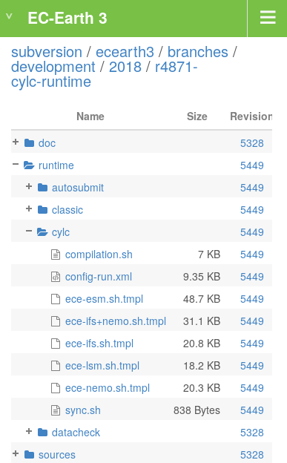
EC-Earth Cylc runtime
Same idea as for Autosubmit runtime
Config-run.xml parameters can be taken from a rose-app.conf

Slide 17
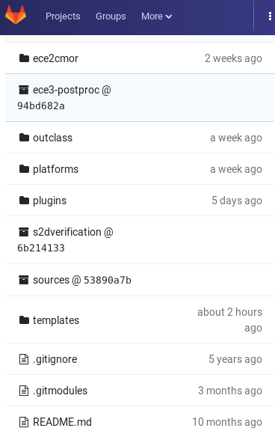
Auto-EC-Earth
Framework to run EC-Earth versions with Autosubmit smoothly
BSC-ES additional tasks templates (setup, compilation, transfer …), support for seasonal runs and more complex use cases (data assim, diagnostics, jobs wrapper…) are provided on a different repository (git)
It includes EC-Earth basic runtime as Git submodule
All BSC-ES production and development experiments start from an Auto-EC-Earth branch or tag

Slide 18
Auto-EC-Earth, MareNostrum4
/gpfs/scratch
>5 min
1 min
~10 min
0.25-1h
~10 min
Local Setup
Remote Setup
Initialize
Sim
Post
Clean
dtrsync automodel
copy inidata
link inidata
run ELPiN
run model
move output
move restarts
ece3-postproc
config-build.xml
dtrsync output
dtrsync restarts
autosubmit/config-run.xml
/gpfs/archive/esarchive
classic/config-run.xml
/gpfs/archive/esarchive
classic/platforms
classic/control

Slide 19
Auto-EC-Earth, set of tests
nord3 | CCA | MN4 | resolution | type | details
t02c | t00u | t00q | T255L91-ORCA1L75-LIM3 | coupled | start from restart
 |  | t00v | T255L91-ORCA1L75-LIM3 | coupled | ATM nudgin
 |  | t011 | T255L91-ORCA1L75-LIM3 | coupled | sppt
 | t00s | t00o | T255L91-ORCA1L75-LIM3 | coupled | cold start
 | t01d | t00z | ORCA1L75-LIM3 | nemo | cold start
 |  | t01j | ORCA1L75-LIM3 | nemo | cold start ocean nudging
 | t01e | t00r | T511L91-ORCA025L75-LIM3 | coupled | start from restart
 |  | t01o | ORCA025L75-LIM3 | nemo | cold start
 | t01b | t00y | T511L91 | ifs | cold start
 | t00t | t00p | T511L91-ORCA025L75-LIM3 | coupled | cold start

Slide 20
Cylc adoption at BSC (WIP)
Climate prediction
EC-Earth / NEMO / OpenIFS
Historical runs
Seasonal / decadal runs
Model development (stem?)
Air quality
MONARCH
Operational runs
Computational group
Automated tests on multiple platforms
Scalability analysis
Load balance analysis
Precision analysis
Data provisioning
Portable experiments including
Compilation
Initialization
Simulation
Post processing
Automated transfers
Data assimilation

Slide 21
Ongoing work
Portable suites for collaborative model development
EC-Earth Cylc runtime simplification
Rose metadata compliance
Rose stem, is it useful in the testing/development phase?
Rosie web services under EC-Earth Development portal
Capture more use cases @ BSC
Suite for ensemble climate prediction
Suite for ensemble MONARCH (operational air quality model)
System wide installation of Cylc and Rose
Cylc @ MN4
Communication back from tasks to suite host will be possible
Notes:
Make the slide nicer?

Slide 22
Ongoing work
Cylc @ ECMWF
Rose suite running at ECMWF, including tasks to archive data at BSC and compute diagnostics on Power9 cluster
Will Cylc web-based GUIs be available from ECMWF servers?
Could ECMWF HPC be used as remote resource, using the ecaccess web toolkit?
(later) Single batch job for multiple tasks #2754
Notes:
Make the slide nicer?

Slide 23
Summary
A strategy for adopting Cylc and Rose as the EC-Earth common workflow management system is being build
Needs of the community have been taken into account
A demonstrator has been created at BSC
Cylc, Rose and Rosie have been installed on a private virtual machine at BSC
Rose suites have been created for running EC-Earth historical and multi-member ensemble climate simulations
MareNostrum 4 (Slurm) and data-transfer nodes (background) are being used as remote resources, using polling
Notes:
Make the slide nicer?

Slide 24
Next steps
EC-Earth consortium collaboration
Develop more EC-Earth use cases
Close collaboration with the MetOffice
ESiWACE 2
IS-ENES 3
Training activities
Cylc + Rose from scratch, suite design, at BSC
Tutorials at EC-Earth meeting and PATC course
Notes:
Make the slide nicer?

Slide 25
Q & A

Slide 26
Thank you!
“The research leading to these results has received funding from the EU H2020 Framework Programme under grant agreement n° H2020 GA 675191”
For further information please contact
domingo.manubens@bsc.es

