Slide 2
Motivation
Tropical cyclones (TCs) are the costliest natural disasters (e.g. US hurricane season 2017 when Hurricanes Harvey, Irma & Maria accumulated ≈ 250 billion $US loss) [2-5]
Effect of climate change on TCs still relatively unknown (indications for increase in precipitation & lifetime max. intensity, decrease in global frequency) [6]
Standard measures of TC intensity do not correlate well with damages as they do not consider storm size, which has been shown to be beneficial to damage estimates [7-11]
Studies show that refined horizontal resolutions lead to more realistic representations of TCs in climate models [12]
This is what we are doing in this study in order to provide an estimate of the changes between present & future TC potential damages
Since CMIP6 HighResMIP simulations have resolutions that allow a more realistic representation of TCs, the PRIMAVERA project now provides a good opportunity to look at the wind fields of TCs between the present & future at different resolutions

Slide 3
Outline
Methodology
Experiment & model
BSC cyclone tracker
Integrated kinetic energy (IKE)
2. Results
Storm tracks & numbers
Effect of resolution on IKE probability
Cyclone structure
IKE in a future climate
3. Summary & conclusions
4. Questions
1
1
2
2
3
3
4
4

Slide 4
Methodology: Experiment & model
HighResMIP: Atmosphere-only run for tier 1 & tier 3
Historic run: 1950 – 2014 ("present")
Future projection: 2015 – 2050 ("future")
CNRM: Use as a test and expand to coupled version & other models
Fully coupled ocean-atmosphere GCM
Components other than atmosphere prescribed by HighResMIP protocol
Experiments performed at 2 different horizontal resolutions
Resolution | Truncation | Analysis grid | Vertical levels
Low ("LR") | Tl127 | 1.4° x 1.4° | 91
High ("HR") | Tl359 | 0.5° x 0.5° | 91
[13]

Slide 5
Methodology: BSC cyclone tracker
Modified version of the GFDL Vortex Tracker V3.5b ("tracker") in ESMValTool
Uses mean sea level pressure (MSLP) to provide estimates of location, intensity and structure of potential storm candidates at each 6-hour time step
Input variables:
Mean sea level pressure
Horizontal wind speed components evaluate storm candidates
at 850 & 700 hPa (or at 500 hPa)
-------------------------------------------
Surface horizontal wind speed components
Geopotential height at 850 & 700 hPa
400 hPa temperature field → distinguish from extra-tropical cyclones
mandatory
optional
correct storm centre

Slide 6
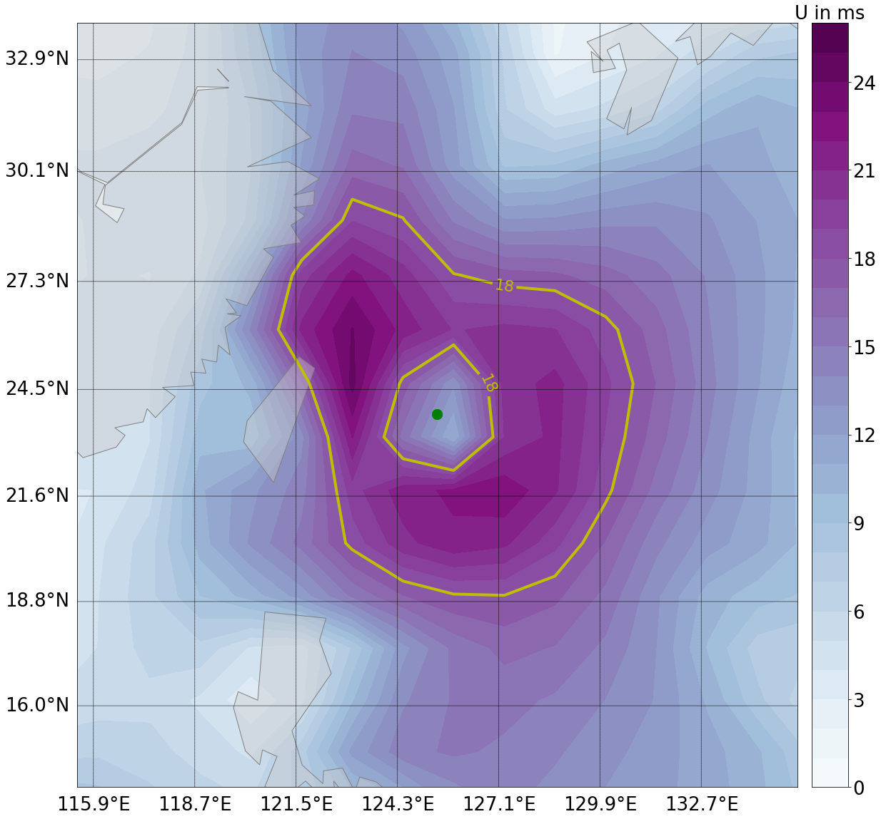
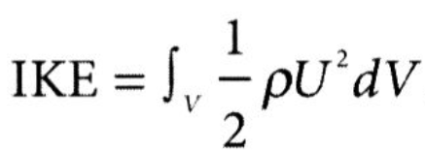
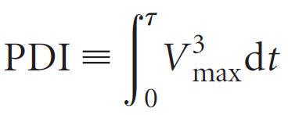
Methodology: Integrated kinetic energy (IKE)
Integrated measure to assess the level of energy of a storm at each time step
Unlike ACE or PDI, IKE does not only consider maximum wind speed, but also lower wind speeds by summing up the contribution of the entire wind field
Tracking criteria:
Wind speed ≥ 18 ms⁻¹ for at least 24 hrs
Northern hemisphere
Storm season: June - November
[14]
[7]
[6]
Wind speed field of an example TC in CNRM. 18 ms⁻¹ isoline and storm centre (green dot) are depicted.

Slide 7
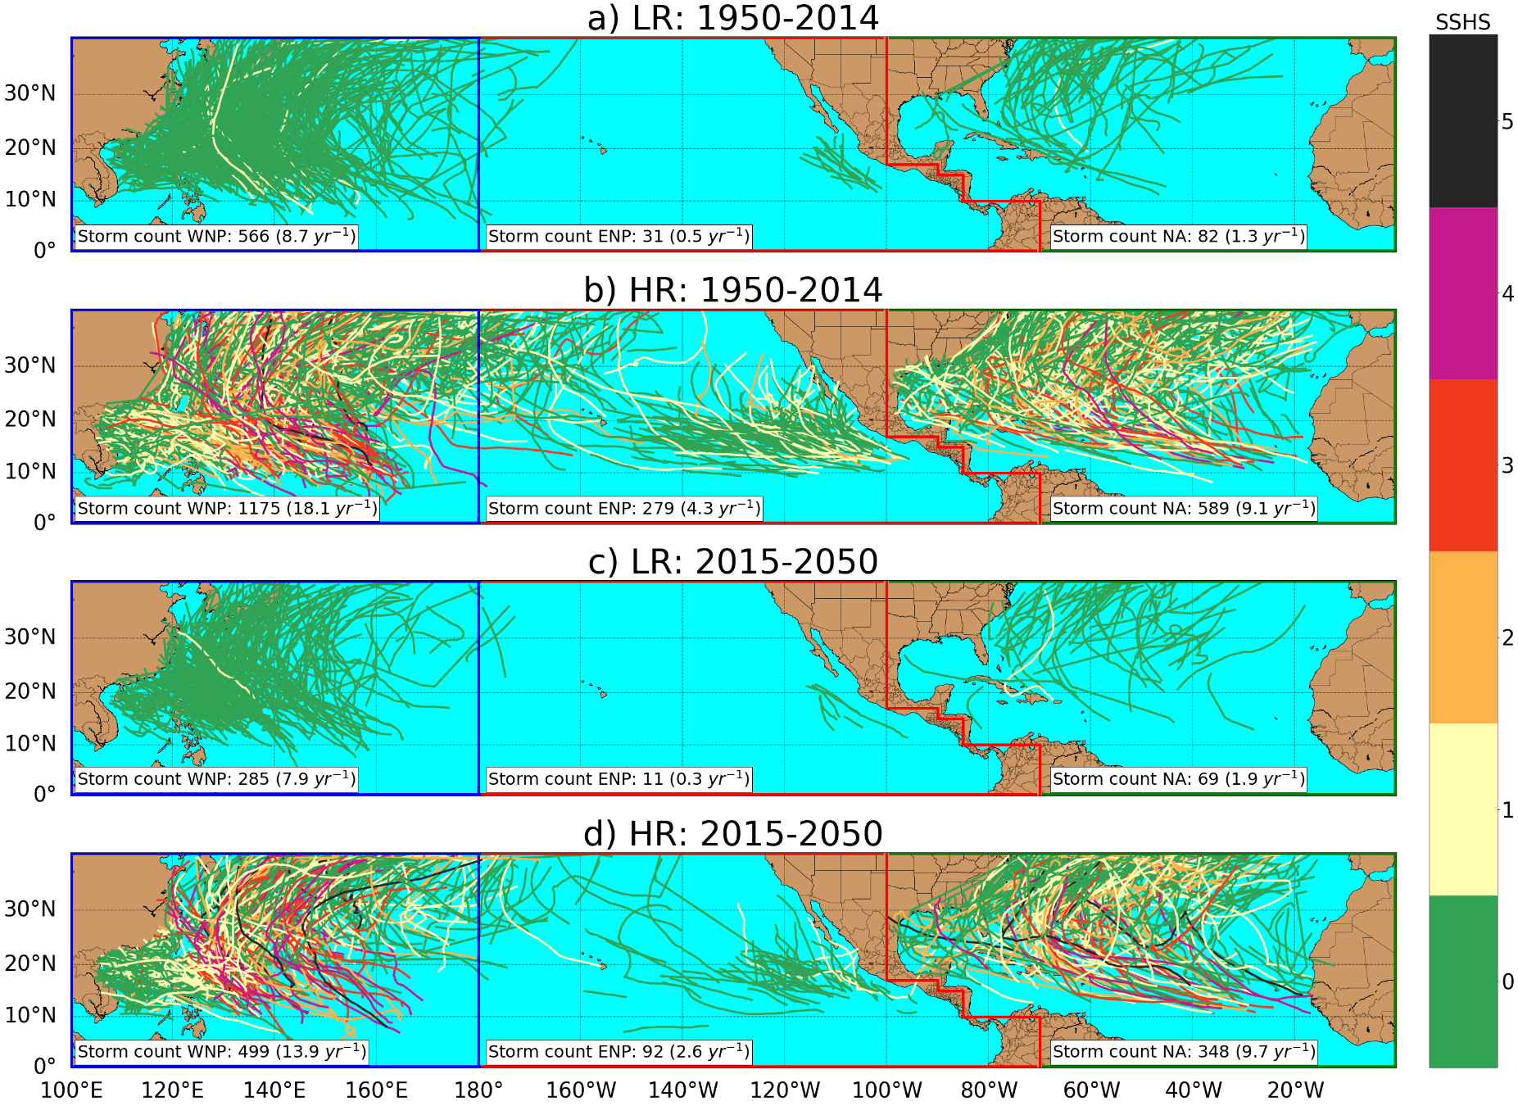
Results: Storm tracks & numbers
North Eastern Pacific under-represented
More storms resolved in HR
LR significant problems to produce TCs > Cat 1
Much better in HR
Decrease in overall frequency from present to future
Regional differences:
Decrease in Pacific
Increase in Atlantic
Cat
Storm tracks as recognised by the tracker and categorised after their lifetime max. intensity.

Slide 8
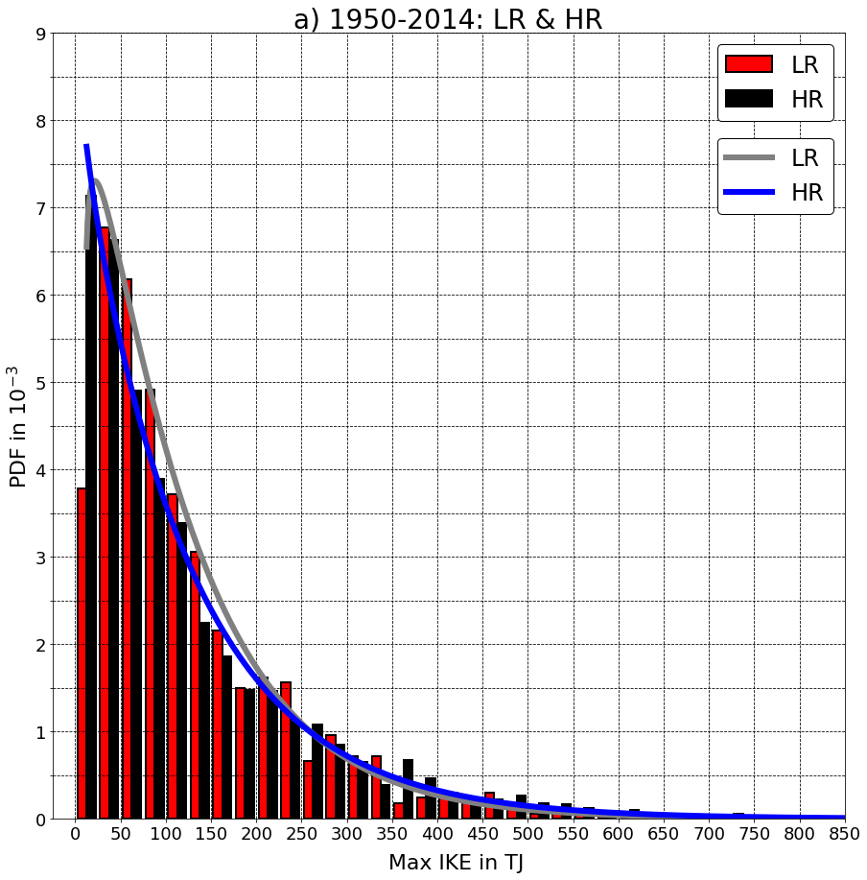
Results: Effect of resolution on IKE probability
HR: More intense storms
Is there a change in probability towards
more energetic storms?
PDFs, fitted Gamma distribution & Kolmogorov-Smirnov test:
Significant (5 %) difference
between IKE in LR & HR
But: Difference in high energetic storms
not pronounced
Effect of intensity compensated by smaller
storm sizes?
PDF for storms in the entire northern hemisphere, sorted after their lifetime max. IKE from 1950-2014. Gamma distribution is fitted.

Slide 9
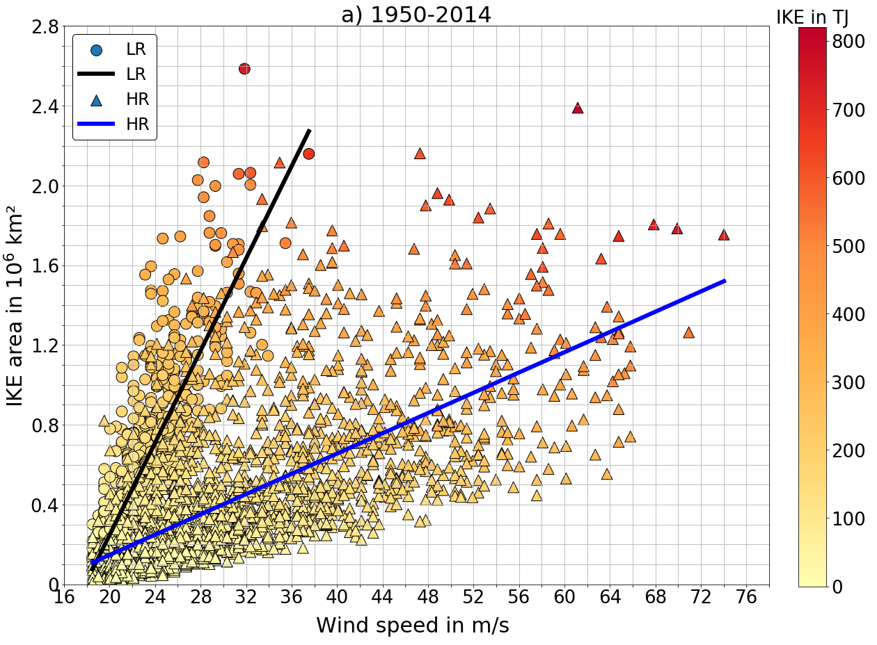
Results: Cyclone structure
Why is the IKE between the two resolutions similar?
Regressions suggest that storms in HR are more intense & smaller at similar IKE
Increasing effect of wind speed on IKE is weakened by decreasing effect of shrinking storm size
Scatter plot (IKE area against max. wind speed at time of max. lifetime IKE) for all storms in the entire northern hemisphere from 1950-2014. Colour coded with IKE value. Regression lines for LR & HR are added.

Slide 10
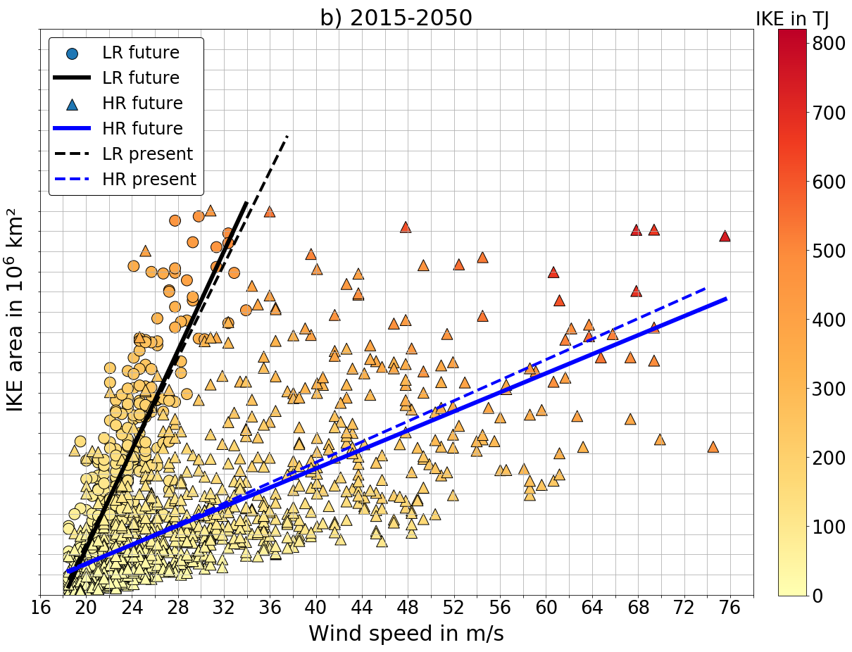
Results: IKE in a future climate
Difference between regressions for future period small
Scatter plot (IKE area against max. wind speed at time of max. lifetime IKE) for all storms in the entire northern hemisphere from 2015-2050. Colour coded with IKE value. Regression lines for LR & HR are added. (also for 1950-2014)

Slide 11
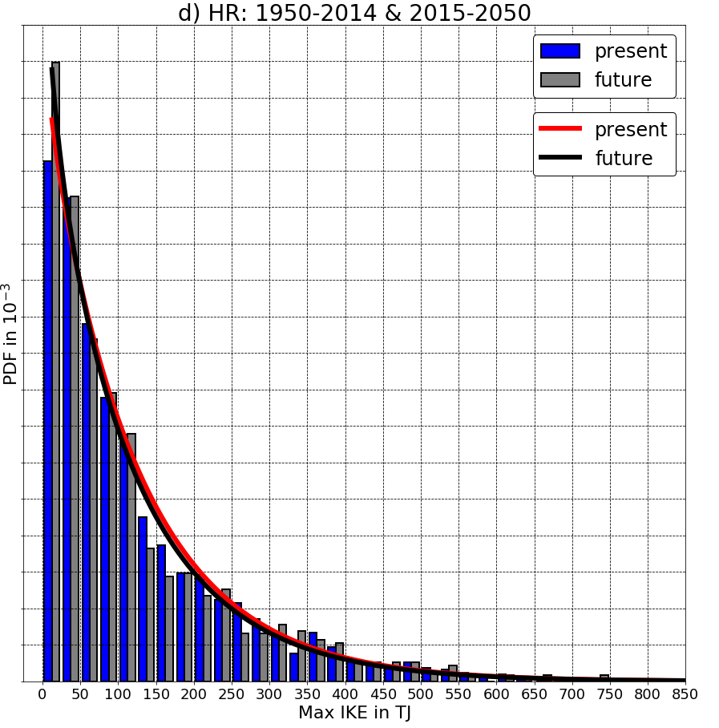
Results: IKE in a future climate
Difference between regressions for future period small
No significant change in IKE between present & future periods
Impact of climate change on TC intensity and size relatively small on global scale
Basin scale?
PDF for storms in the entire northern hemisphere, sorted after their lifetime max. IKE for HR. Gamma distribution is fitted.

Slide 12
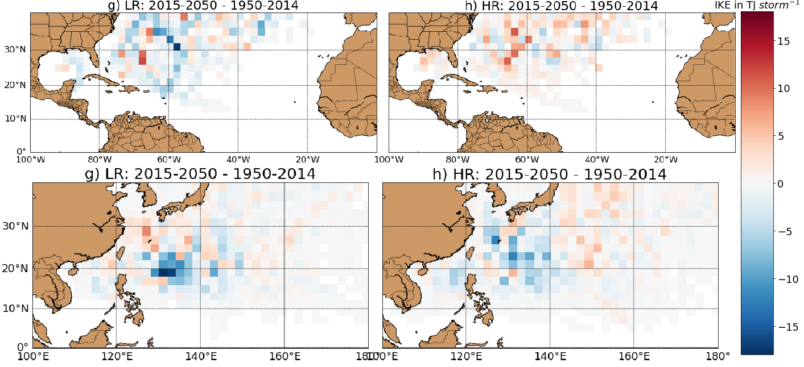
Results: IKE in a future climate
Different signals between LR & HR in Atlantic
Uncertain response
Negative signal in both resolutions in Pacific
Storms in Pacific could get less energetic
Similar results for coupled experiment & other models?
Difference in IKE per storm (storm number per respective basin) between future and present period in 2° x 2° grid boxes in the Atlantic (top) and the Western North Pacific (bottom). Results for both basins are shown for LR (left) and HR (right).

Slide 13
Summary & conclusions
Climatology:
Refinement in resolution increases number & intensity of generated storms
Overall decrease in frequency of storms in future (difference in individual basins)
Cyclone structure:
HR: Storms get more intense and smaller at similar IKE
Resolution plays a major role in representing these features
IKE probability:
HR: Increasing effect of wind speed outweighs decreasing effect of shrinking area
No significant change in global IKE content between future & present climate
Differences between & within the individual basins

Slide 14
Acknowledgements
Thank you very much!
Saskia Loosevelt from BSC for setting up the tracker and providing valuable help with technical issues!
Louis-Philippe Caron & Simon Wild from BSC for making it possible to write this thesis in cooperation with BSC, for their supervision and all the advice they have given to me during this project!
Katja Matthes from GEOMAR - Helmholtz Centre for Ocean Research Kiel / Christian-Albrechts-University of Kiel (Germany) for supervising me and allowing me to compose this thesis in cooperation with the BSC!
Questions?

Slide 15
References
[1] https://upload.wikimedia.org/wikipedia/commons/thumb/0/04/Hurricane_Isabel_from_ISS.jpg/1024px-Hurricane_Isabel_from_ISS.jpg
[2] Munich Re: Löw, P. (08.01.2019). The natural disasters of 2018 in figures. https://www.munichre.com/topics-online/en/climate-change-and-natural-disasters/naturaldisasters/the-natural-disasters-of-2018-in-figures.html.
[3] Emanuel, Kerry. "Increasing destructiveness of tropical cyclones over the past 30 years." Nature 436.7051 (2005): 686-688.[3] Bevere L, Seiler T, Zimmerli P, Feyen H and H 2013 Natural
[4] Catastrophes and Man-Made Disasters in 2012: A Year of Extreme Weather Events in the US (Zurich, Switzerland: SwissReinsur) p 40
[5] Costliest U.S. tropical cyclones tables update (PDF) (Report). United States National Hurricane Center. January 12, 2018. Archived (PDF) from the original on January 26, 2018. Retrieved January 12, 2018.
[6] Knutson, Thomas, et al. "Tropical cyclones and climate change assessment: Part II. Projected response to anthropogenic warming." Bulletin of the American Meteorological Society 2019 (2019).
[7] Mahendran, M. "Cyclone intensity categories." Weather and forecasting 13.3 (1998): 878-883.
[8] Kantha, Lakshmi. "Time to replace the Saffir‐Simpson hurricane scale?." Eos, Transactions American Geophysical Union 87.1 (2006): 3-6.
[9] Powell, Mark D., and Timothy A. Reinhold. "Tropical cyclone destructive potential by integrated kinetic energy." Bulletin of the American Meteorological Society 88.4 (2007): 513-526.
[10] Yu, Jia-Yuh, and Ping-Gin Chiu. "Contrasting Various Metrics for Measuring Tropical Cyclone Activity." Terrestrial, Atmospheric & Oceanic Sciences 23.3 (2012).
[11] Zhai, Alice R., and Jonathan H. Jiang. "Dependence of US hurricane economic loss on maximum wind speed and storm size." Environmental Research Letters 9.6 (2014): 064019.
[12] Camargo, Suzana J., and Allison A. Wing. "Tropical cyclones in climate models." Wiley Interdisciplinary Reviews: Climate Change 7.2 (2016): 211-237.
[13] Voldoire, A., et al. "Evaluation of CMIP6 DECK Experiments With CNRM‐CM6‐1." Journal of Advances in Modeling Earth Systems 11.7 (2019): 2177-2213.
[14] Bell, Gerald D., et al. "Climate assessment for 1999." Bulletin of the American Meteorological Society 81.6 (2000): S1-S50.

