Slide 1
Case studies as a tool to co-develop climate services
Marta Terrado
Dragana Bojovic
Sara Octenjak

Slide 2
In a nutshell
01
Develop enhanced predictive capacity for weather and climate in the Arctic and beyond and determine the influence of Arctic climate change on Northern Hemisphere mid-latitudes, for the benefit of policy makers, businesses and society.

Slide 3
Participatory framework for climate services
02
Engagement
Empowerment
CO-
DEVELOPMENT
AWARENESS
RAISING
Websites and web tools
Tailored knowledge
CASE STUDIES
CLIMATE SERVICES
CO-PRODUCTION
Adapted from Bojovic et al. (under review) and
WMO’s guidance for good practices for climate services user engagement (2018)
KNOWLEDGE
EXCHANGE
Involvement
Interactive group activities

Slide 4
Case studies
04
Increasingly used in the climate services field to provide descriptions of particular extreme weather and climate events of interest for stakeholders (e.g. affecting their businesses and activities) that occurred in the past over a specific location and time.
Notes:
We try to connect project outputs with this particular extreme events to see it APPLICATE results could have been useful.
Wildfires in summer 2018 (hot and dry summer). More than 60 hitting Sweden (worst affected country) and at least 11 in the Arctic Circle.
200 reindeer death from starvation in Svalbard in winter 2018-19 because of rain that falls on the snow and forms a layer of ice crust that covers vegetation and therefore reindeer can not feed

Slide 5
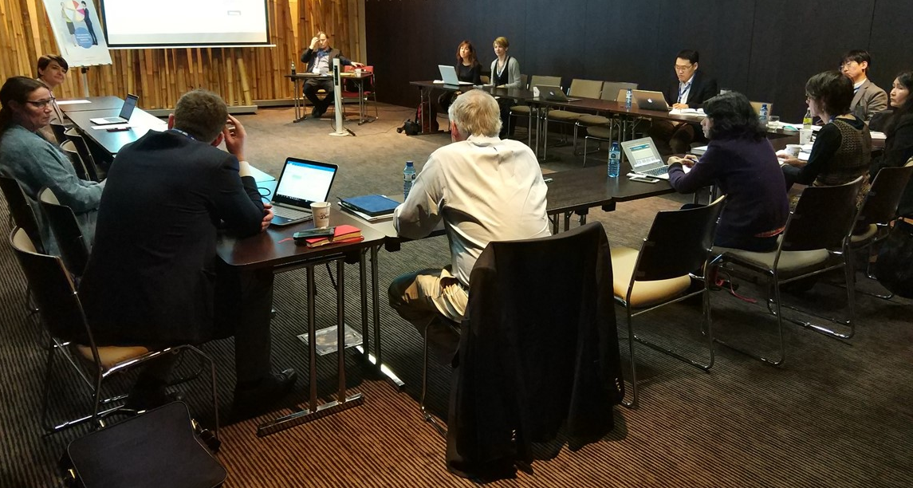
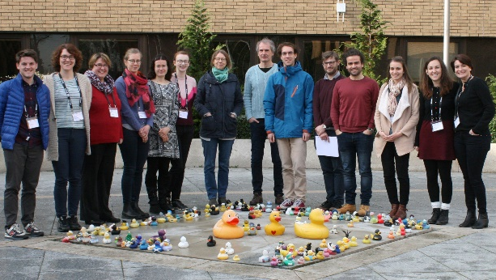
Case studies
04
BLOG POLAR PREDICTION MATTERS https://blogs.helmholtz.de/polarpredictionmatters/
USER GROUP
▼
CONFERENCES
OTHER PROJECTS
ECS
CASE STUDIES
Notes:
The user group: group of experts/representatives from the APPLICATE target groups that have the role to advice the project research to make it user-oriented
The PPM blog, containing articles written by stakeholders and highlighting main issues of Arctic climate change and identifying needs.
Attendance to workshops, conferences and other events to meet with stakeholders face-to-face and present our work.
EU Polar Cluster interactions (for polar regions) and other projects (beyond)
ECRs have also been providing ideas

Slide 6
Case studies
05
Energy case studies
Risk management case studies

Slide 7
Extreme events in the Arctic
06
Source: Alfred-Wegener Institute (AWI)
Notes:
Warm and moist air intrusions are associated with the undulation of the jet stream, which can lead to extreme events in the Arctic and in the northern hemisphere mid-latitudes. They are sometimes responsible of heat waves in the Arctic, and research is looking at the relationship between these heatwaves and extreme conditions, such as cold spells, occurring in Europe.

Slide 8
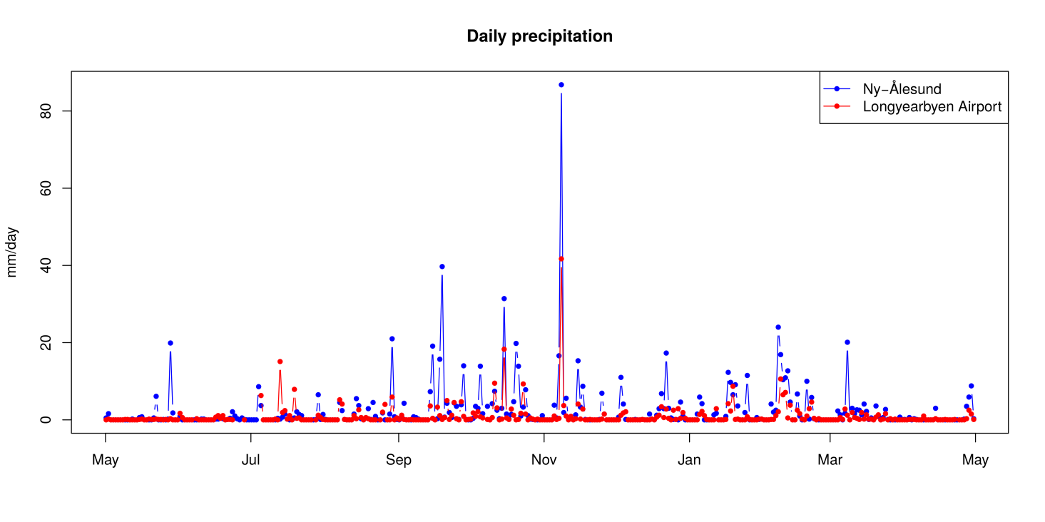
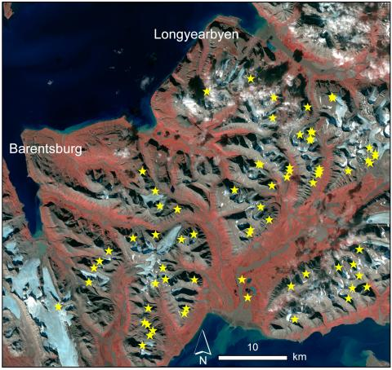
Case study: Extreme rainfall in Svalbard
07
Learning from the past
Extreme temperatures over the Arctic
Observed daily precipitation, 7 November 2016
Landslides and slush avalanches identified by satellite images
Notes:
Svalbard as hotspot of polar climate change. Nowhere in the planet is heating faster. In winter 2016 temperatures climbed above 0ºC for several days, triggering partial permafrost thawing. Recurrent rainy episodes associated with warm and moist air intrusions lead to hillslope destabilization and represent a threat for infrastructure

Slide 9
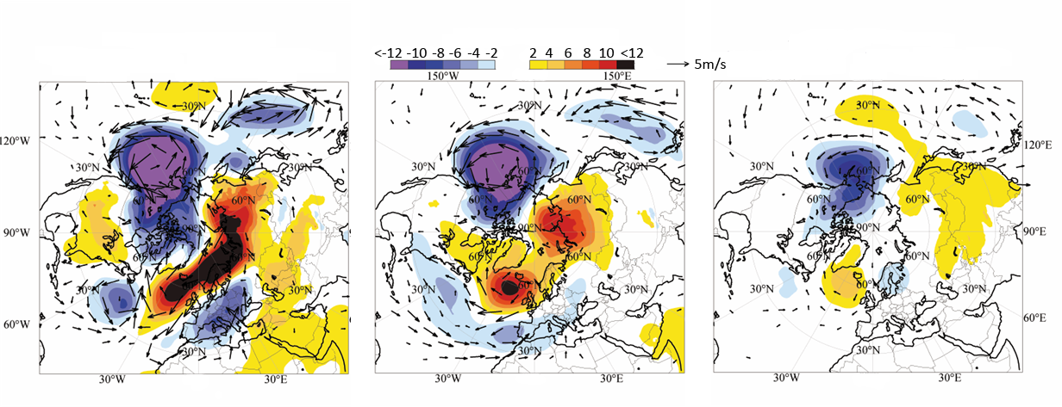
08
Case study: Extreme rainfall in Svalbard
Preparing for the future
Understand linkages between the Arctic and mid-latitudes
Enhanced weather and climate information can support preparedness of local populations to deal with events that can be catastrophic
Next: explore how these type of events will look like in the future.
Sub-seasonal predictions 1, 2 and 3 weeks in advance
(potential occurrence of rain-on-frozen ground)
Notes:
Image: Mean sea level pressure anomalies in hPa (shaded areas) and surface wind anomalies in m/s (arrows) for the week of the 3-7 November 2016 predicted one week (left), two weeks (middle) and three weeks (right) in advance. Red colours indicate higher pressures for the rainfall event in November 2016 as compared to the pe-riod 1996-2015. Source: ECMWF extended-range forecasts
Timely sub-seasonal predictions of the occurrence of large scale weather patterns provided by the project can be used as early-warning for the potential occurrence of rain-on-snow or rain-on-frozen ground events in Svalbard related to potential risks of landslide and avalanche. Warnings could be confirmed a few days prior to the event through EFI predictions of temperature and precipitation that, together with short-range high-resolution forecasts able to capture topography, can sup-port decision-making of civil protection and rescue and preparedness teams

Slide 10
Lessons learned
09
Learning from the past
Preparing for the future
Event identified by stakeholders. Ask stakeholders to provide feedback and help in the dissemination
Physical processes and underlying causes of the event
Impact on society and the economy
Explore event attribution
Identify research gaps
Assess the predictability of the event
Assess the added value of climate services for the affected/benefitted stakeholders
Build narratives of how the event will look like in the future

Slide 11
Thank You!
Marta Terrado
marta.terrado@bsc.es
You can find the APPLICATE projects case studies here: https://applicate.eu/outreach/case-studies
The project participating in this presentation has received funding from the European Union’s Horizon 2020 research and innovation programme under grant agreement nº 727862 (APPLICATE)

