Slide 1
Brussels, 23rd of May 2017
Joint uncertainty assessment of models and observations in verification of climate predictions.
Francois Massonnet, Omar Bellprat, Chloé Prodhomme, Virginie Guemas, Francisco Doblas-Reyes
VERITAS-CCI

Slide 2
A traditional verification question
Is model system B superior to model system A?
A
B
Low horizontal resolution
High horizontal resolution

Slide 3
Comparing climate forecasts
Compare hindcast skill with an observation
A
B
r(AO)
r(BO)
r(BO)
O
Anomaly Correlation
Correlation is symetric: How well correlates O with A or B?

Slide 4
Reversing the question
Which observation is better? A useful question?
A
r(AOB)
r(AOA)
O
O
B
A

Slide 5
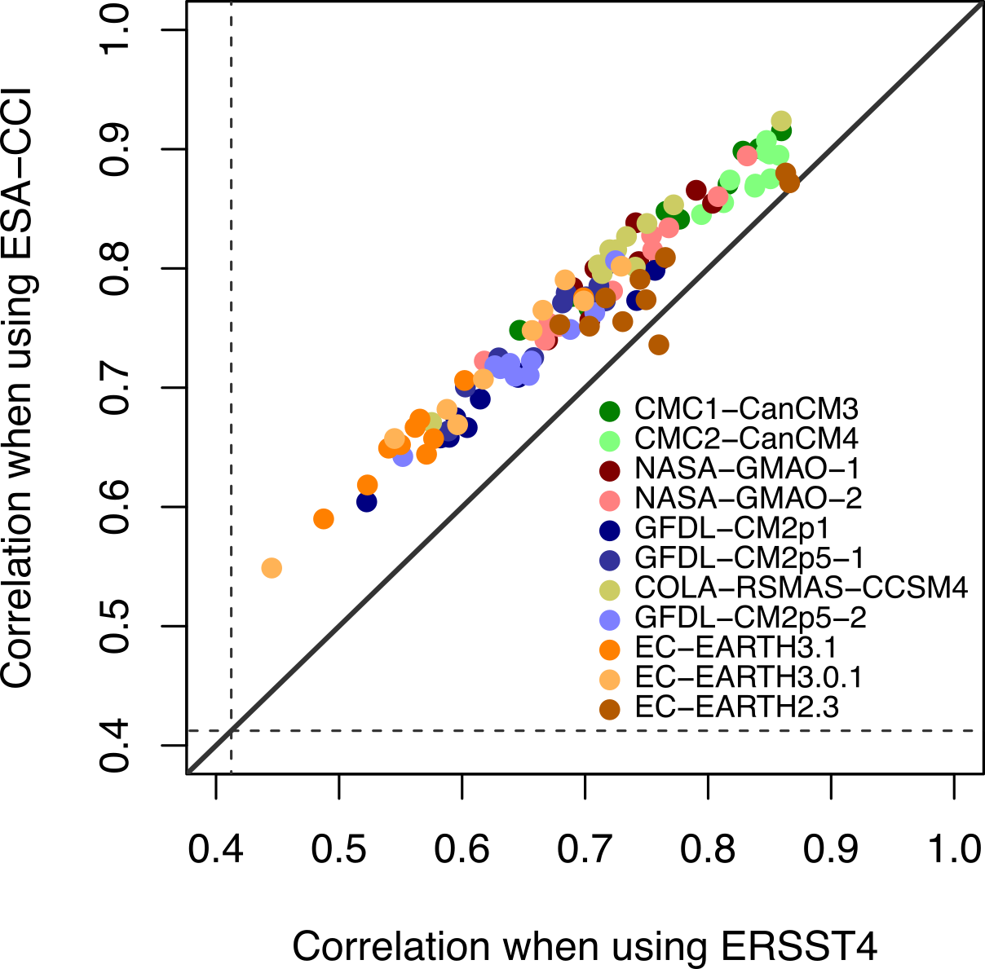
Reversing verification question
CCI SST yields systematic higher correlation skill across many models
Niño 3.4
Independent from the models
Fully
independent datasets
Massonnet et al. (2016) Science

Slide 6
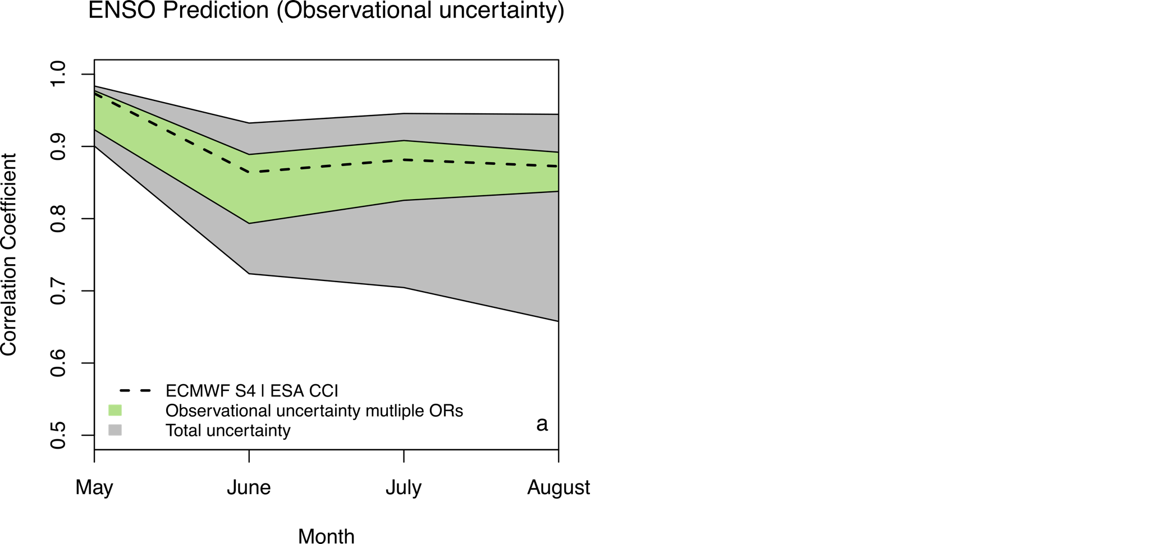
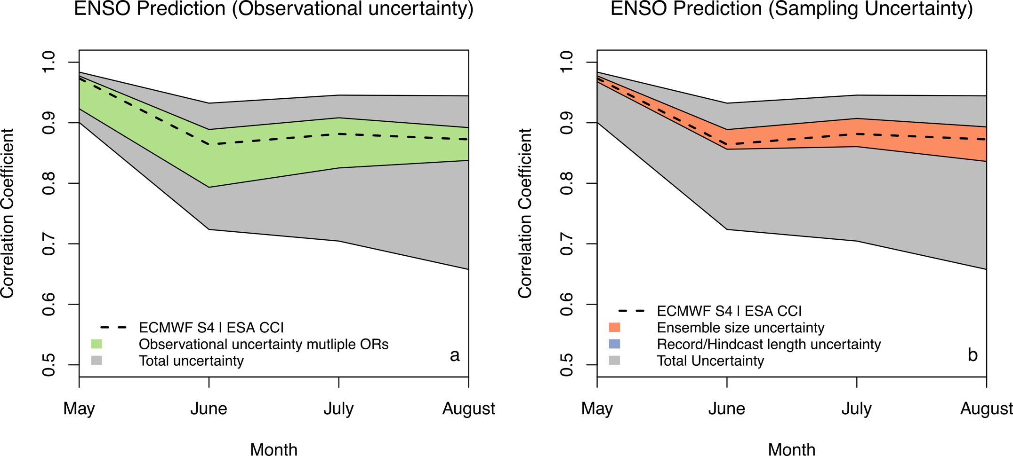
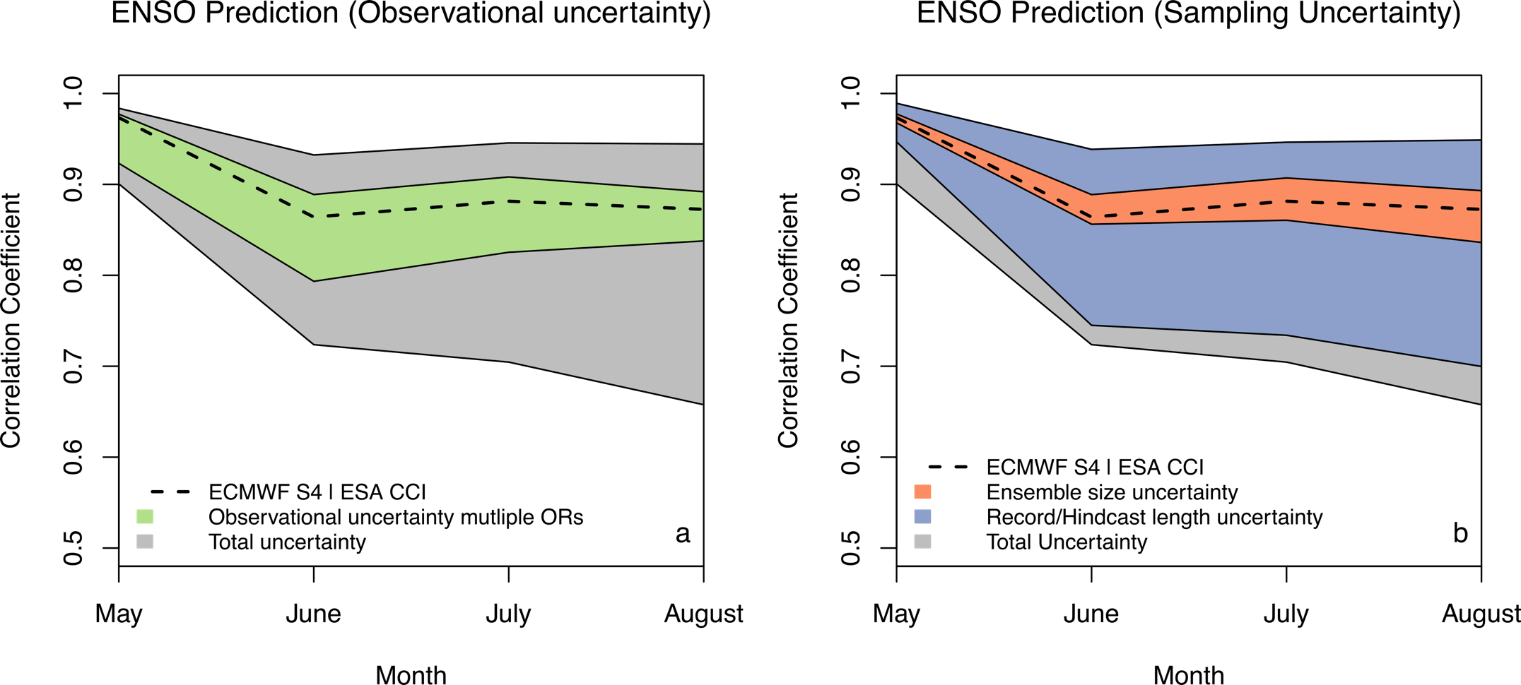
Decomposition of uncertainties
Comparison to sample uncertainties: observational uncertainty is an important source of verification uncertainty for ENSO
60%!
20%
Bellprat et al. (2017) Remote Sensing of the Environment

Slide 7
Thank you!
Massonnet, F., Bellprat, O., Guemas, V., Doblas-Reyes, F. J., (2016). Using climate models to estimate the quality of global observational data sets, Science (AAAS)
Bellprat, O., Massonnet, F., Siegert, S., Guemas, V., Doblas-Reyes, F. J. (2017). Exploring observational uncertainty in verification of climate model predictions, Remote Sensing of the Environment (RSE), in review

